Slide 1
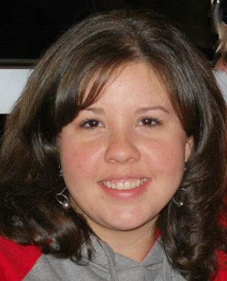
Informer for Financial Aid
Brandi J. Massey
Subject Matter Expert-Financial Aid
NC Community College System
masseyb@nccommunitycolleges.edu
Daniel Boyette
Subject Matter Expert-Technical
NC Community College System
boyetted@nccommunitycolleges.edu

Slide 2
Objectives
Understand file structure in relation to FA
Review commonly used fields in reporting
Write Informer query using FA data
Understand basic construction of a query

Slide 3
File Structure
FIN.AID
CS.ACYR
YS.ACYR
SA.ACYR
TA.ACYR

Slide 4
File Structure: CS.ACYR
Student budgets, attendance pattern code, general FAFSA information, pointers to FAFSA files, auto-packaging data, etc.
Commonly used items:
CS.FC
CS.FED.ISIR.ID (pointer)
CS.FED.ISIR.OR.CORRECTION (pointer)
CS.FED.DEPENDENCY
CS.ISIR.HOUSING CODES
CS.HAS.ISIR

Slide 5
File Structure: YS.ACYR
Contains Misc FA Fields and the FILE COMPLETE DATE
YS.FILE.COMPLETE.DT
YS.DECISION
YS.MISC 1-5

Slide 6
File Structure: SA.ACYR
Annual
Per Term
SA.ACYR
TA.ACYR

Slide 7
File Structure: SA.ACYR
SA.ACYR
Pell
Pell Fall
Pell Spring
SEOG
SEOG Fall
Annual
2 Awards
2 Terms
SEOG Spring

Slide 8
File Structure: TA.ACYR
TA.ACYR: term level award amount and status, registered credits

Slide 9
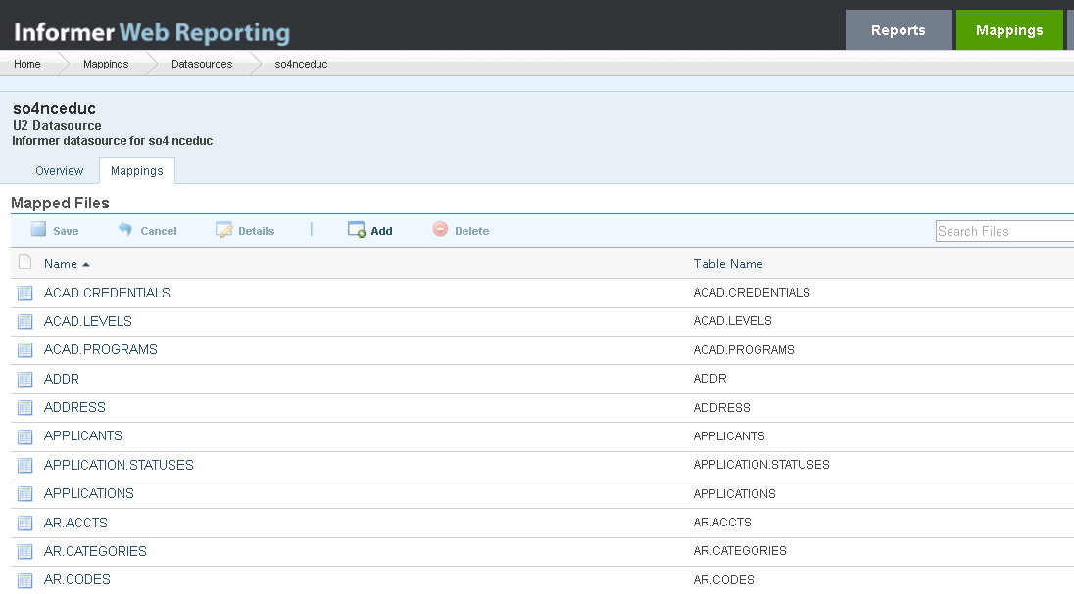
Informer Administrator's Role

Slide 10
Informer Mapping Suites

Slide 11
Questions?

