Slide 1
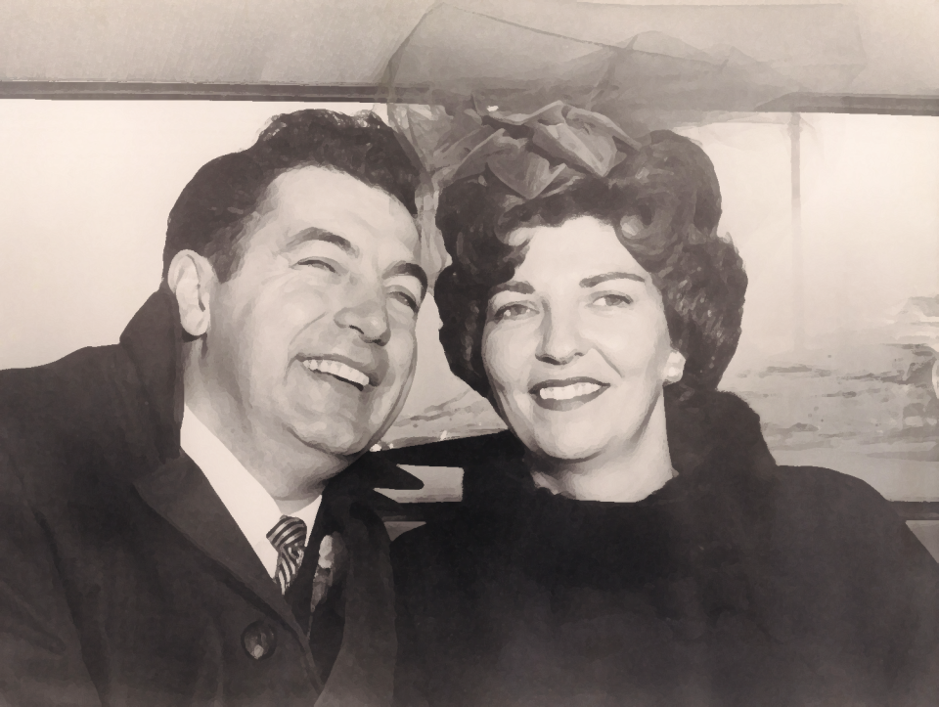
Celebrating Life with Clancy & Teri
With Love from Your Children & Families

Slide 2
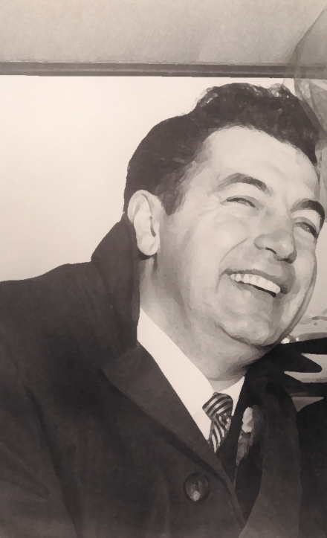
About Clancy (Our Amazing Dad!)

Slide 3
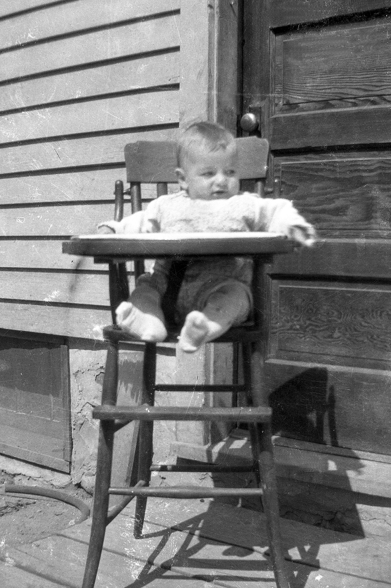
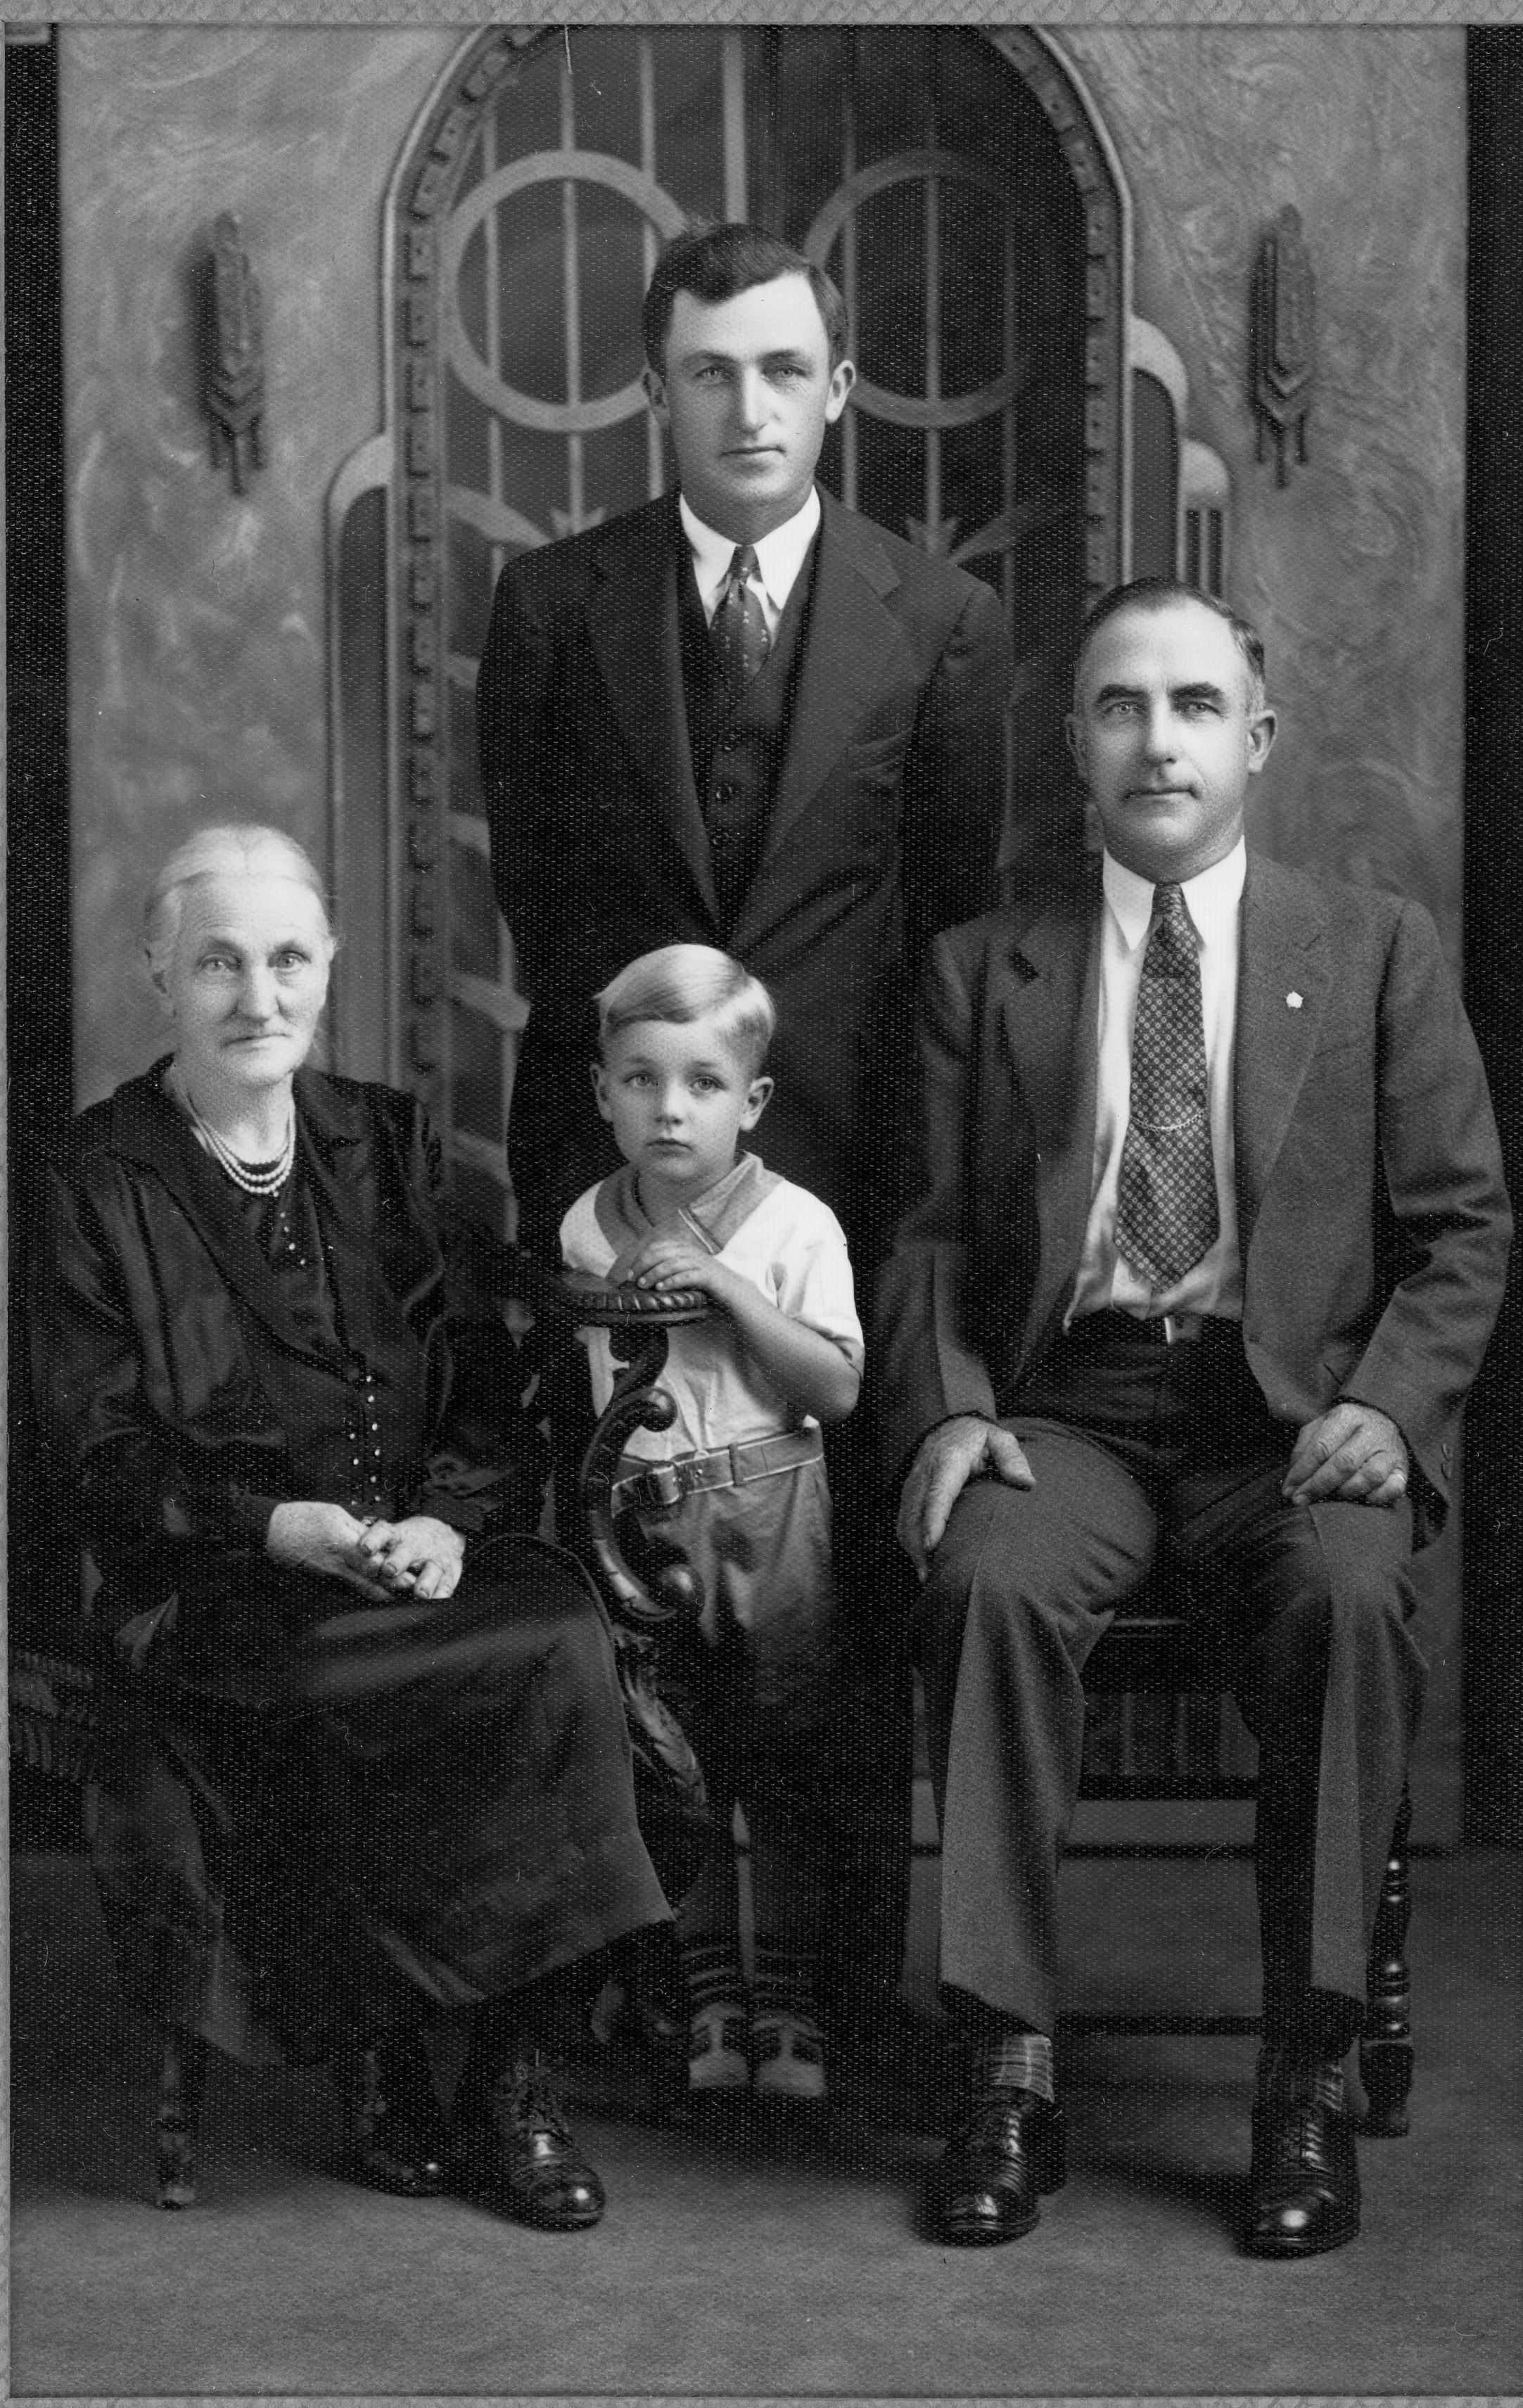
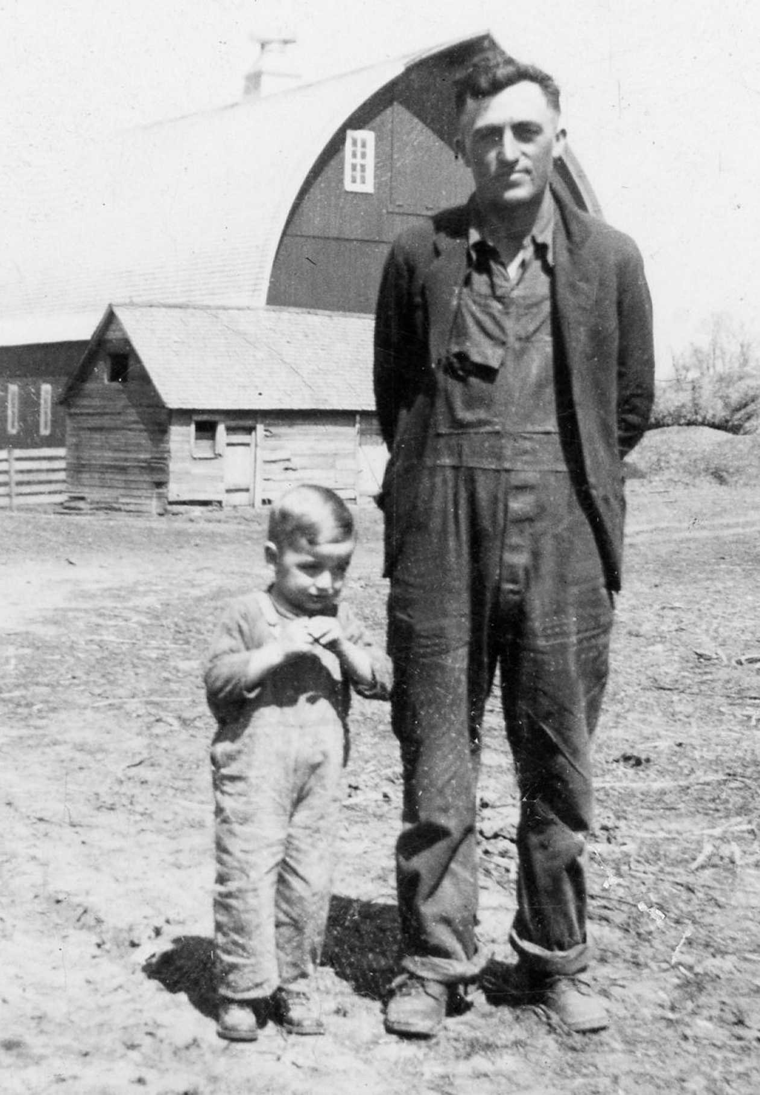
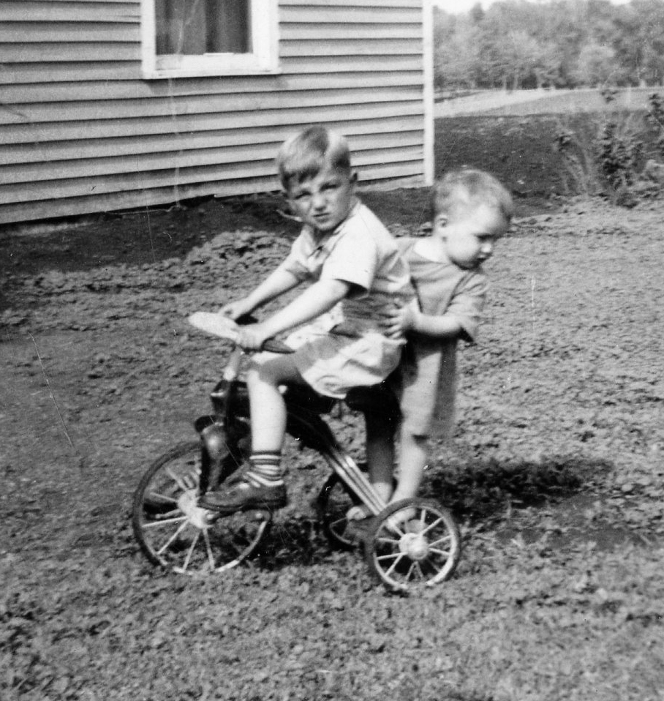
“When I was just a boy…”
…I never knew how many lives I would touch!
Dad Denis M. Campbell
Great Grandmother Campbell
Grandpa Denis E. Campbell
Clancy
4 Generations

Slide 4
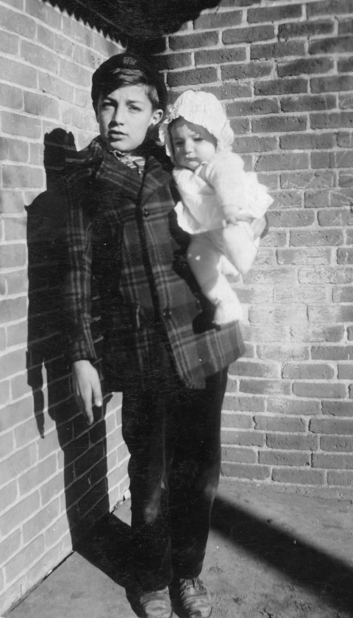
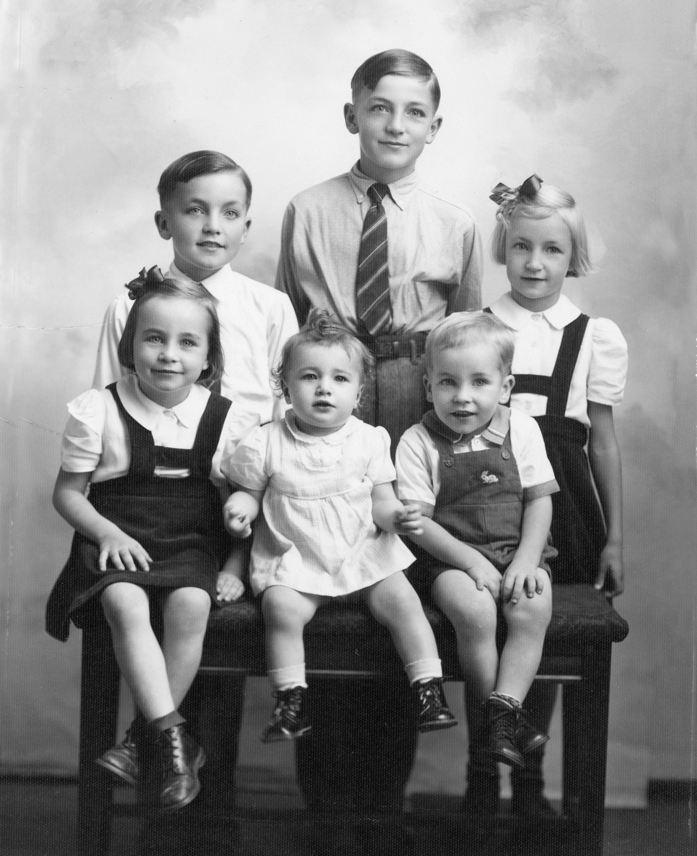
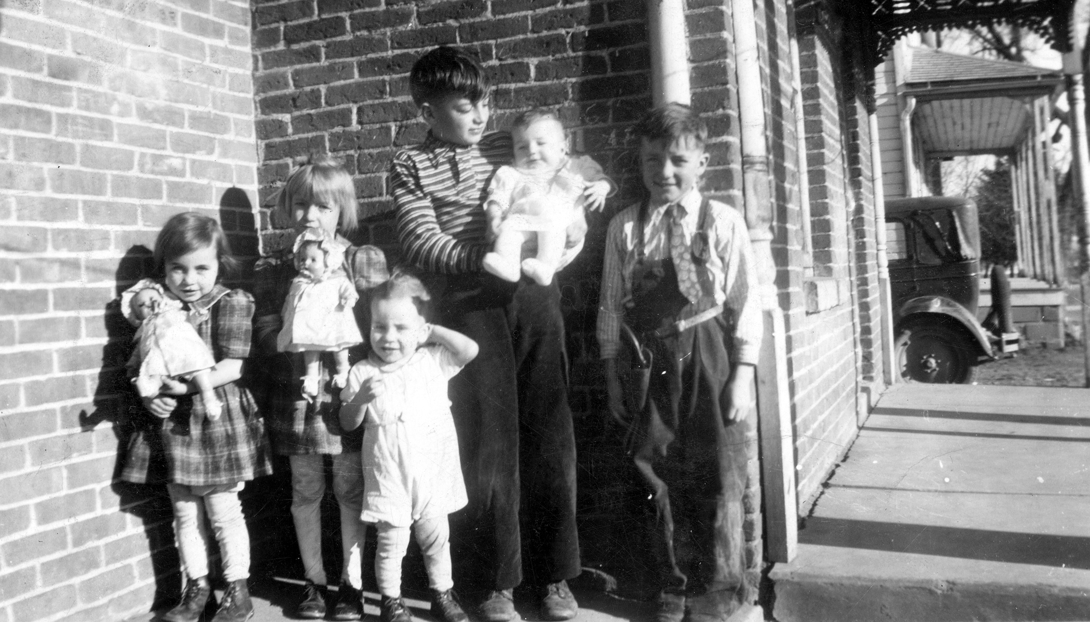
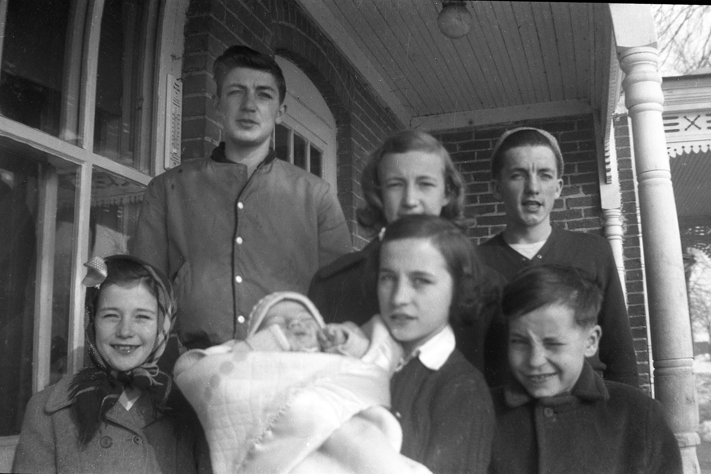
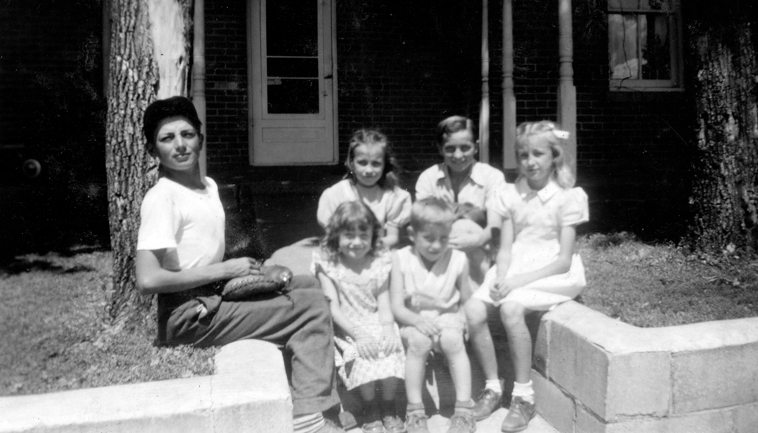
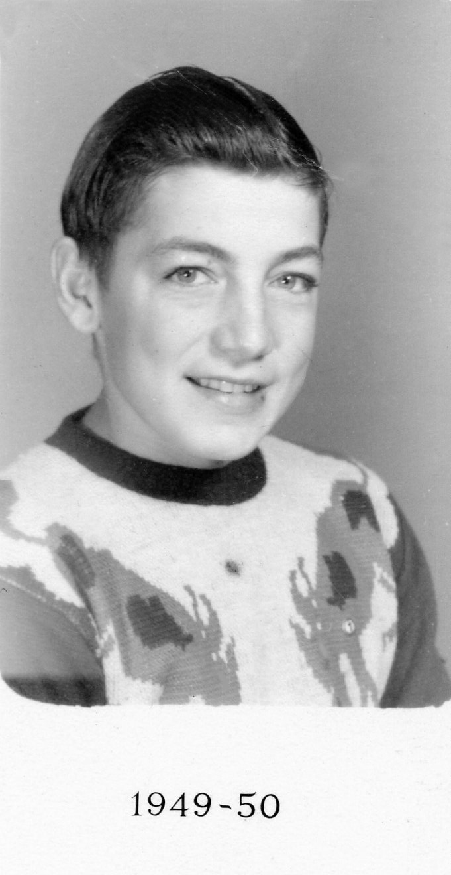
Growing up loving his family!
He saved ALL of the kids lives
when there was a fire in their home!
“He made sure we all got out. He himself was 10 or 11!”
That’s Pauline
…now 70!

Slide 5
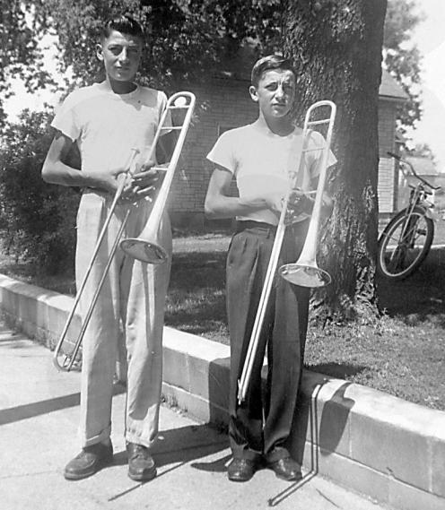
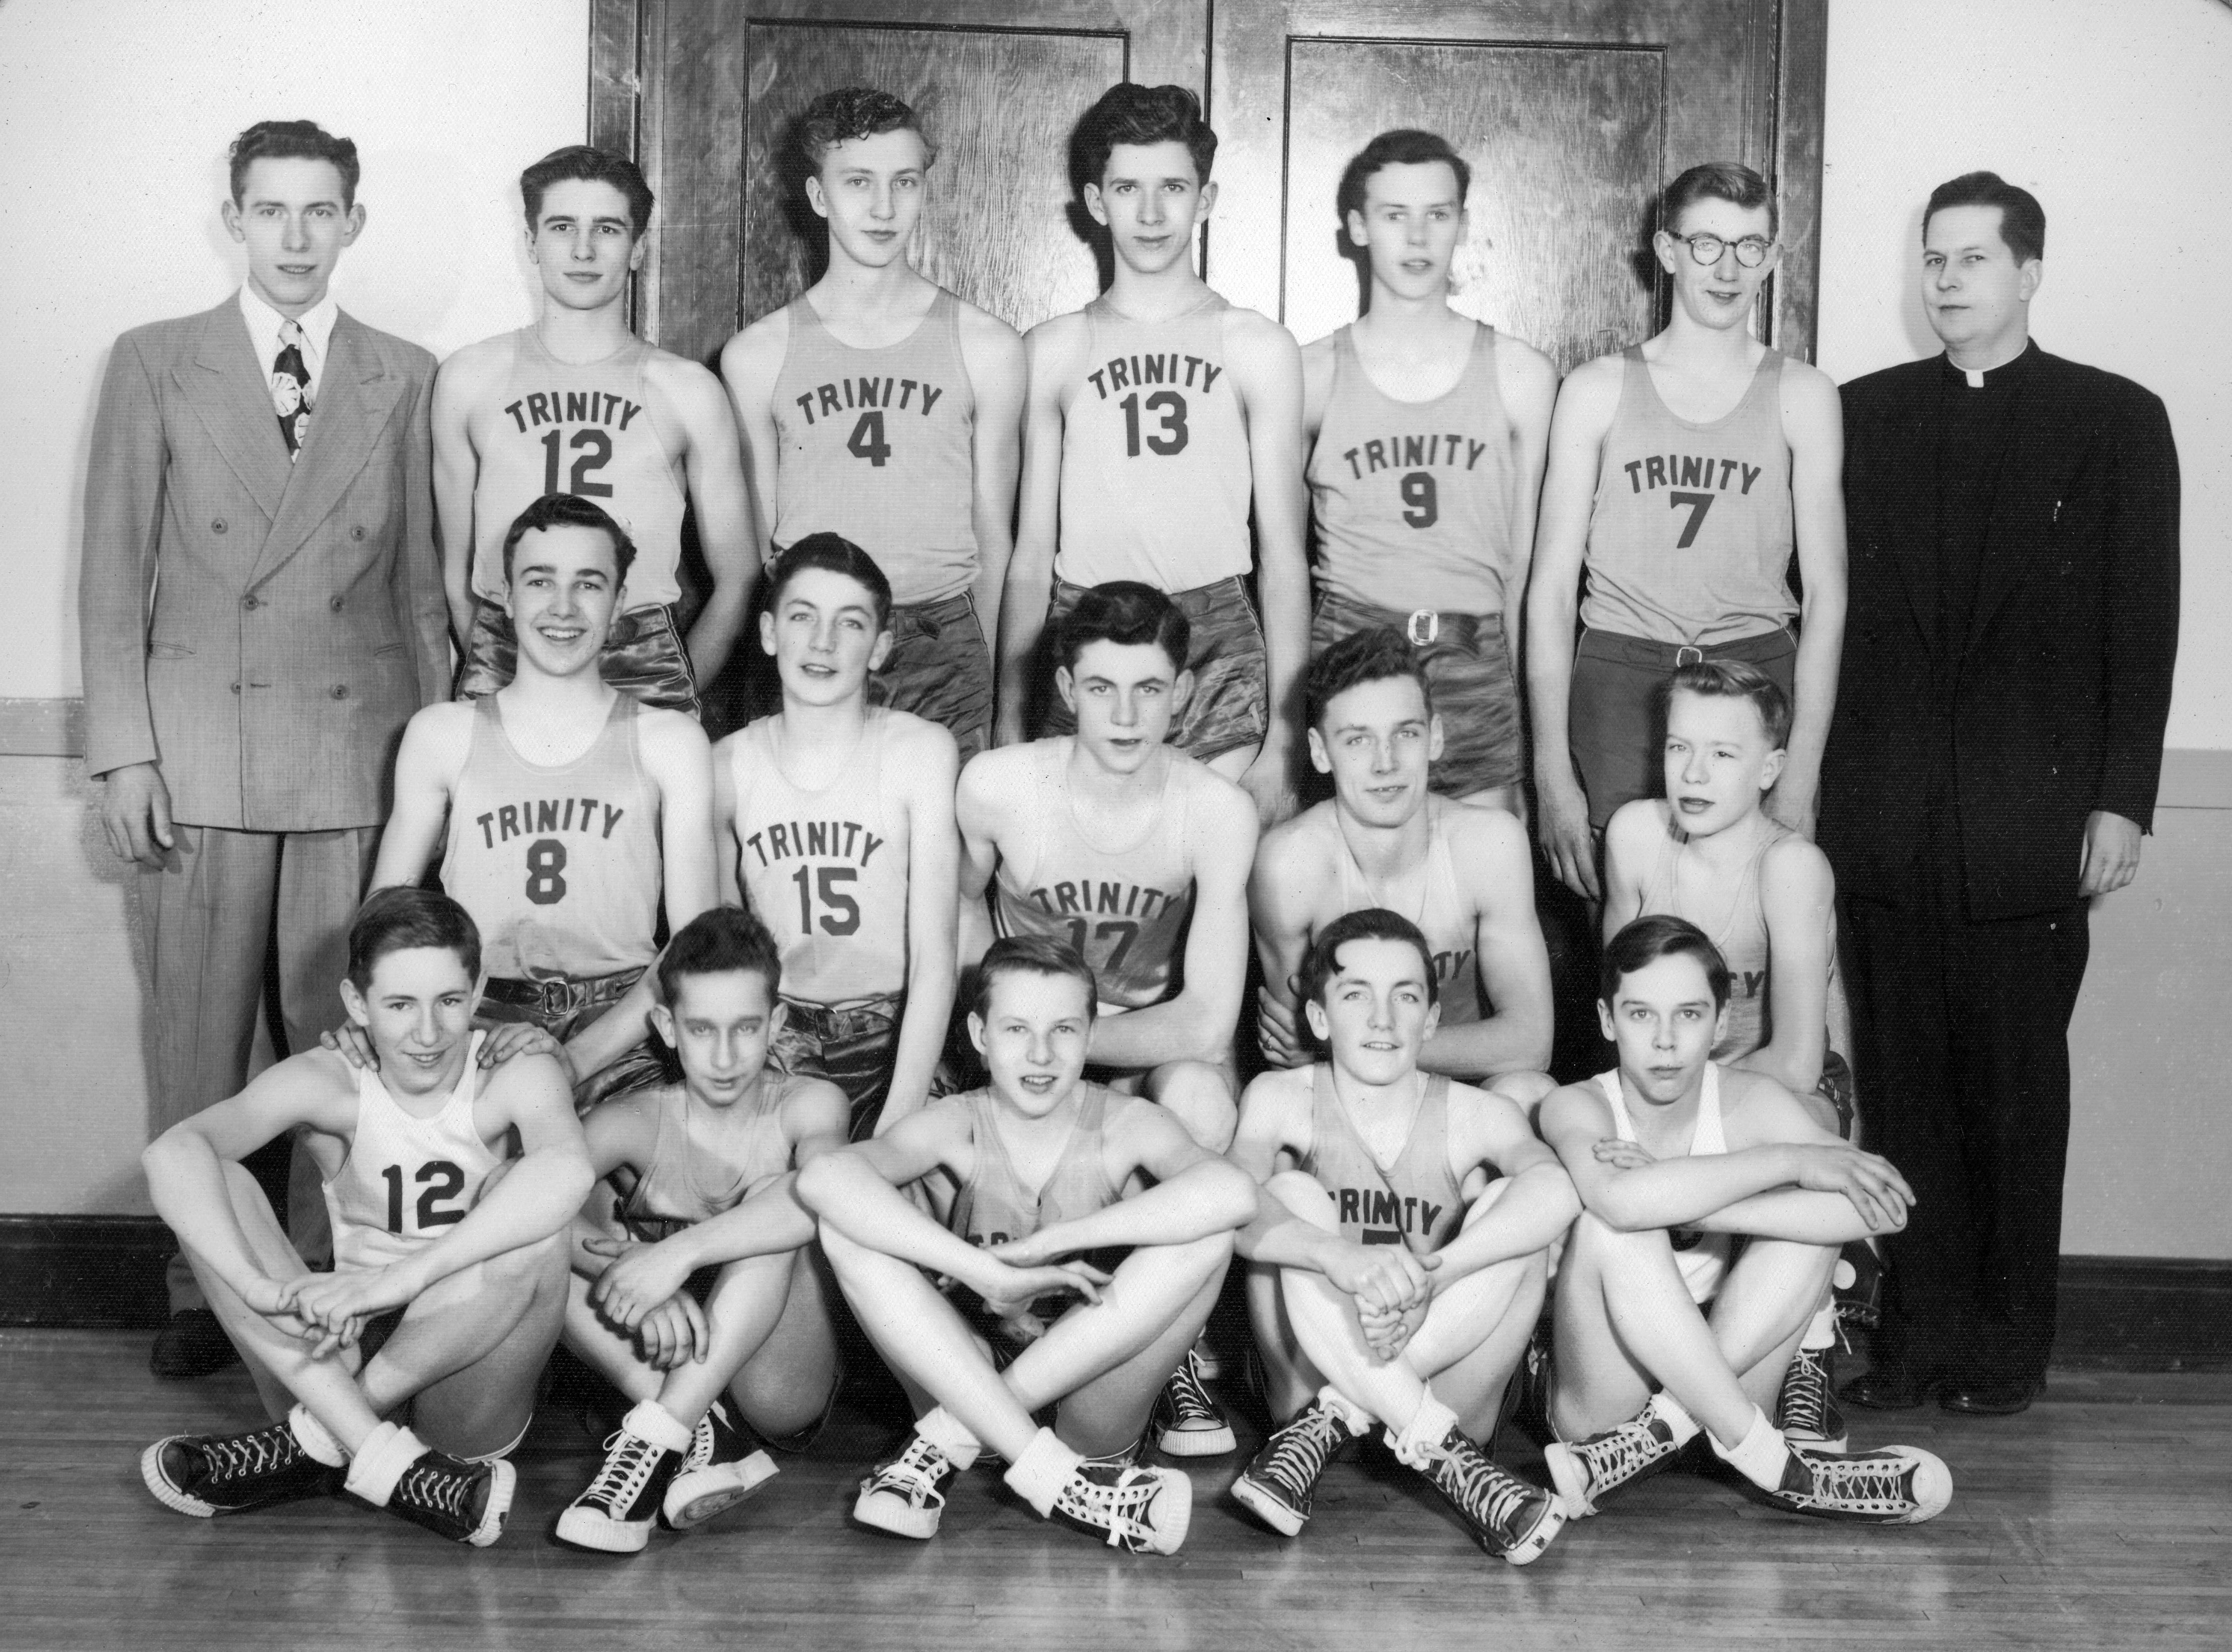
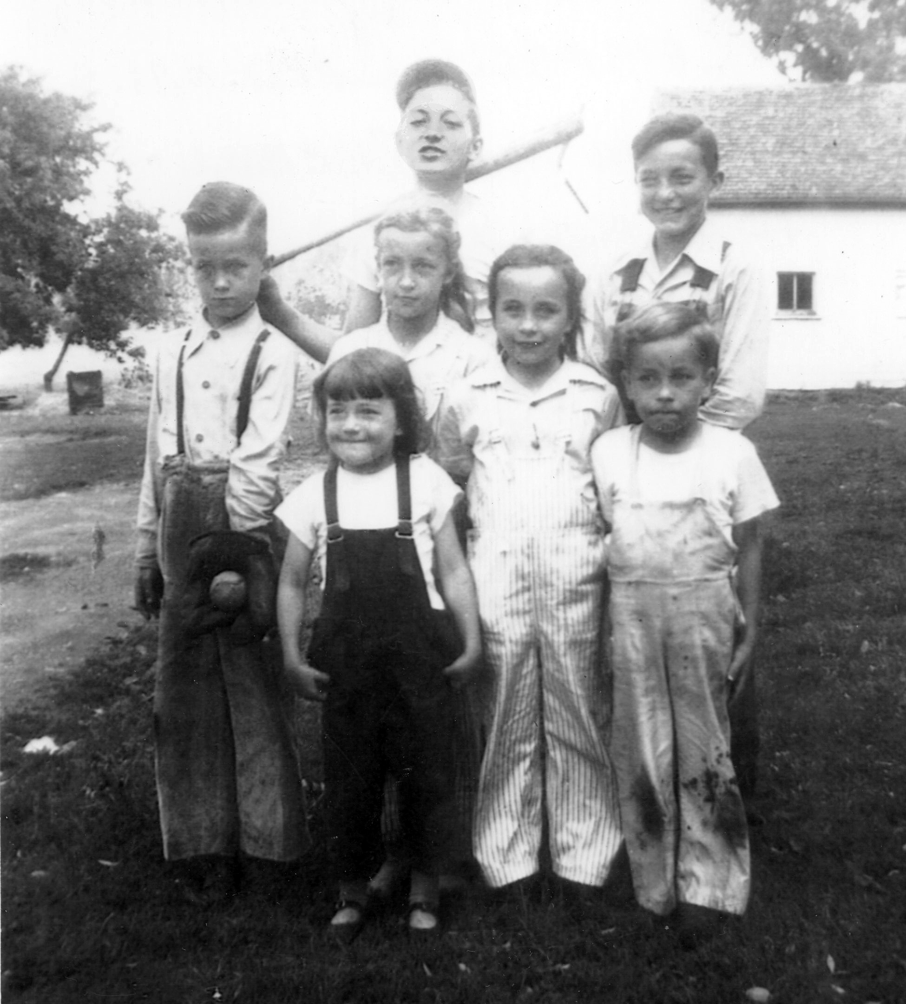
Baseball, Basketball & Band
Clancy
Kenny
76 Trombones? No, just 2 – Clancy & Ken

Slide 6
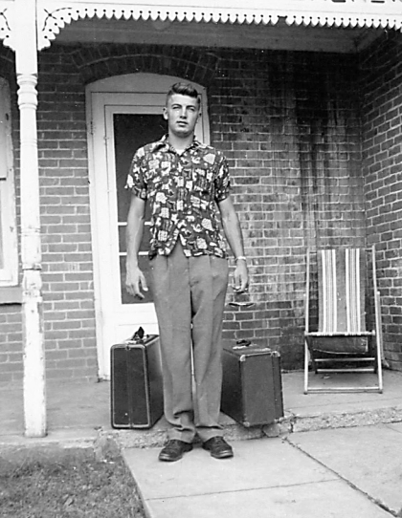
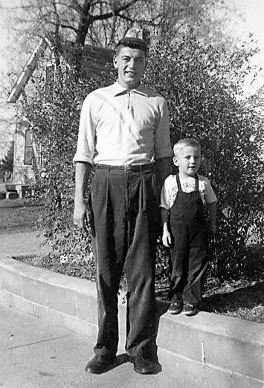
First to leave the Campbell nest…
“Just got my Marine haircut…”
“My bags are packed, I’m ready to go…”

Slide 7
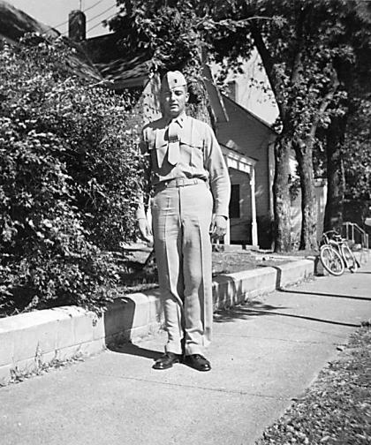
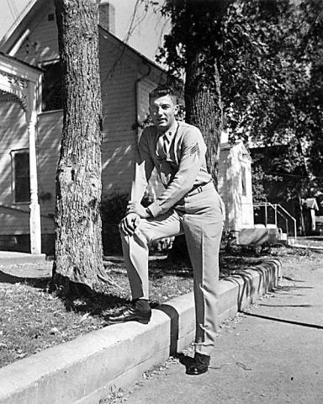
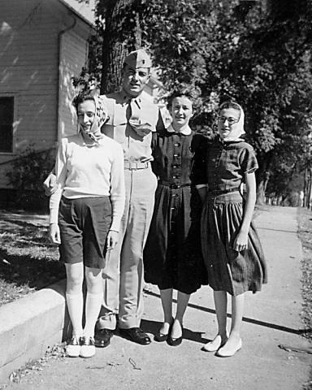
Back from basics – October 1956
First Sunday Clancy was home!
Clancy with Jane, Donna & Pauline

Slide 8
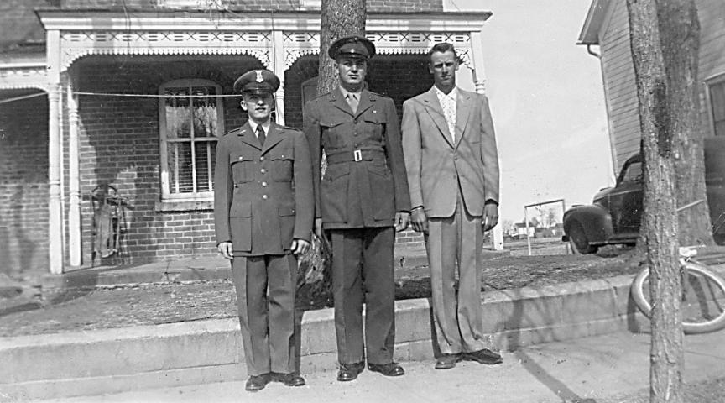
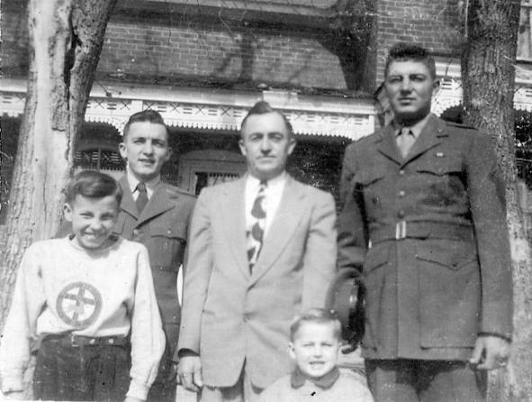
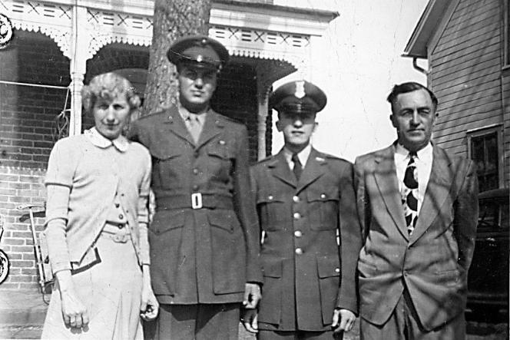
Proud to be a Marine!
The world was a safer place with men like these serving our country!
Clancy
Ken Knoop
Ken

Slide 9
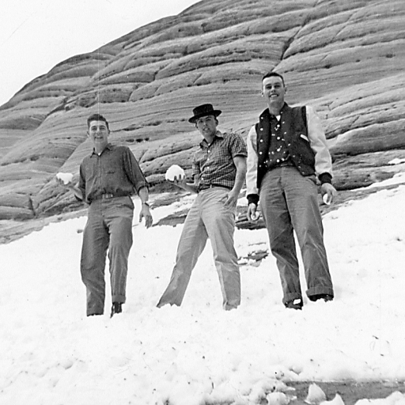
Stationed in Nevada and determined to find snow on Christmas Eve!
Clancy, with friends
Buddy and Dick,
ended up in Utah,
400 miles away!
Forgot their coats?
☺☺☺☺☺☺☺☺☺

Slide 10
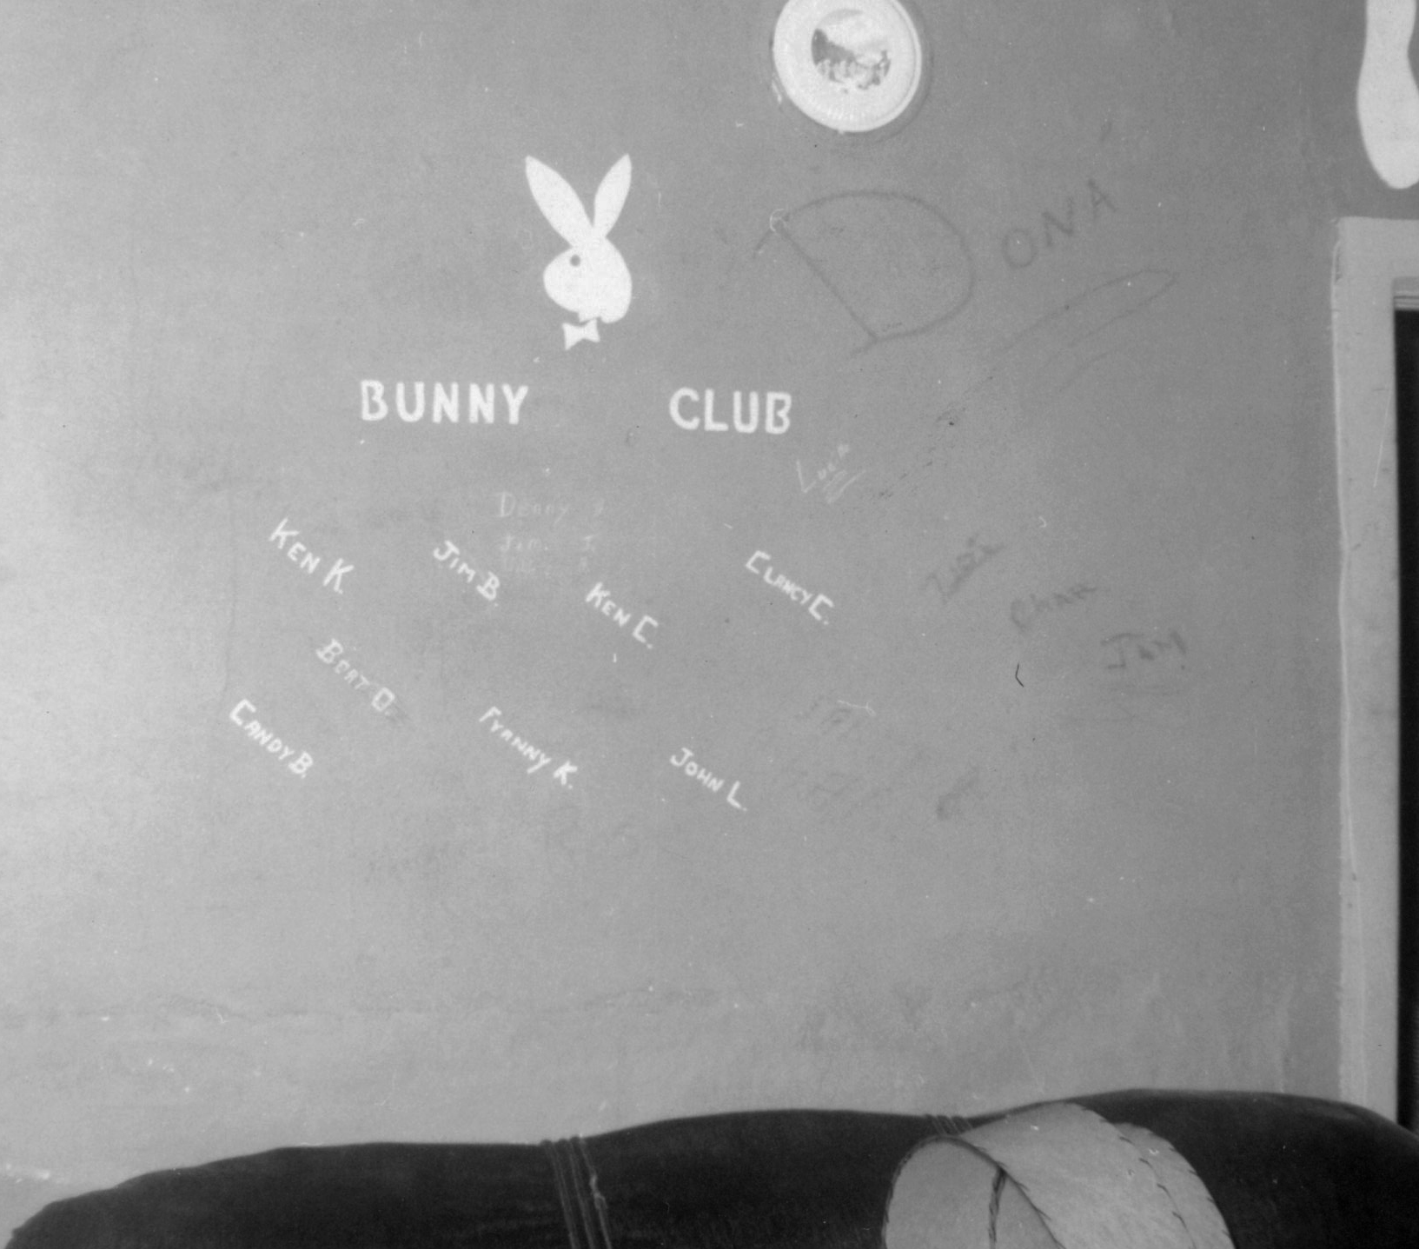
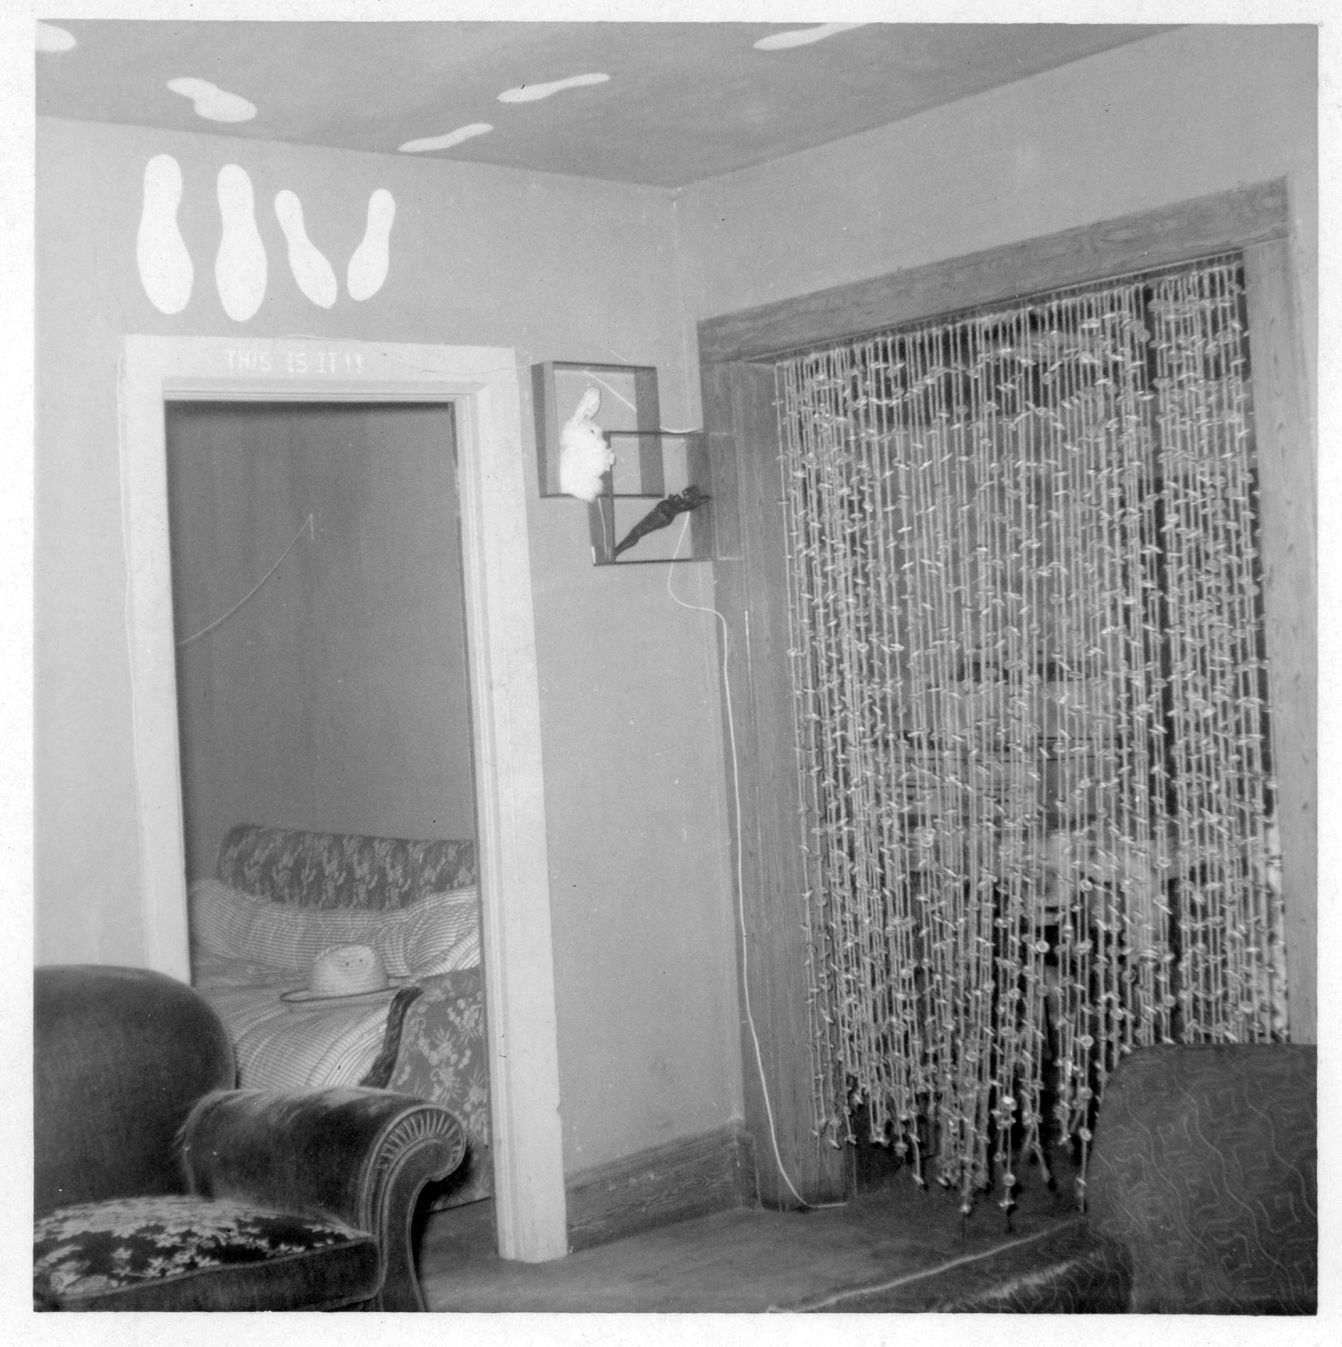
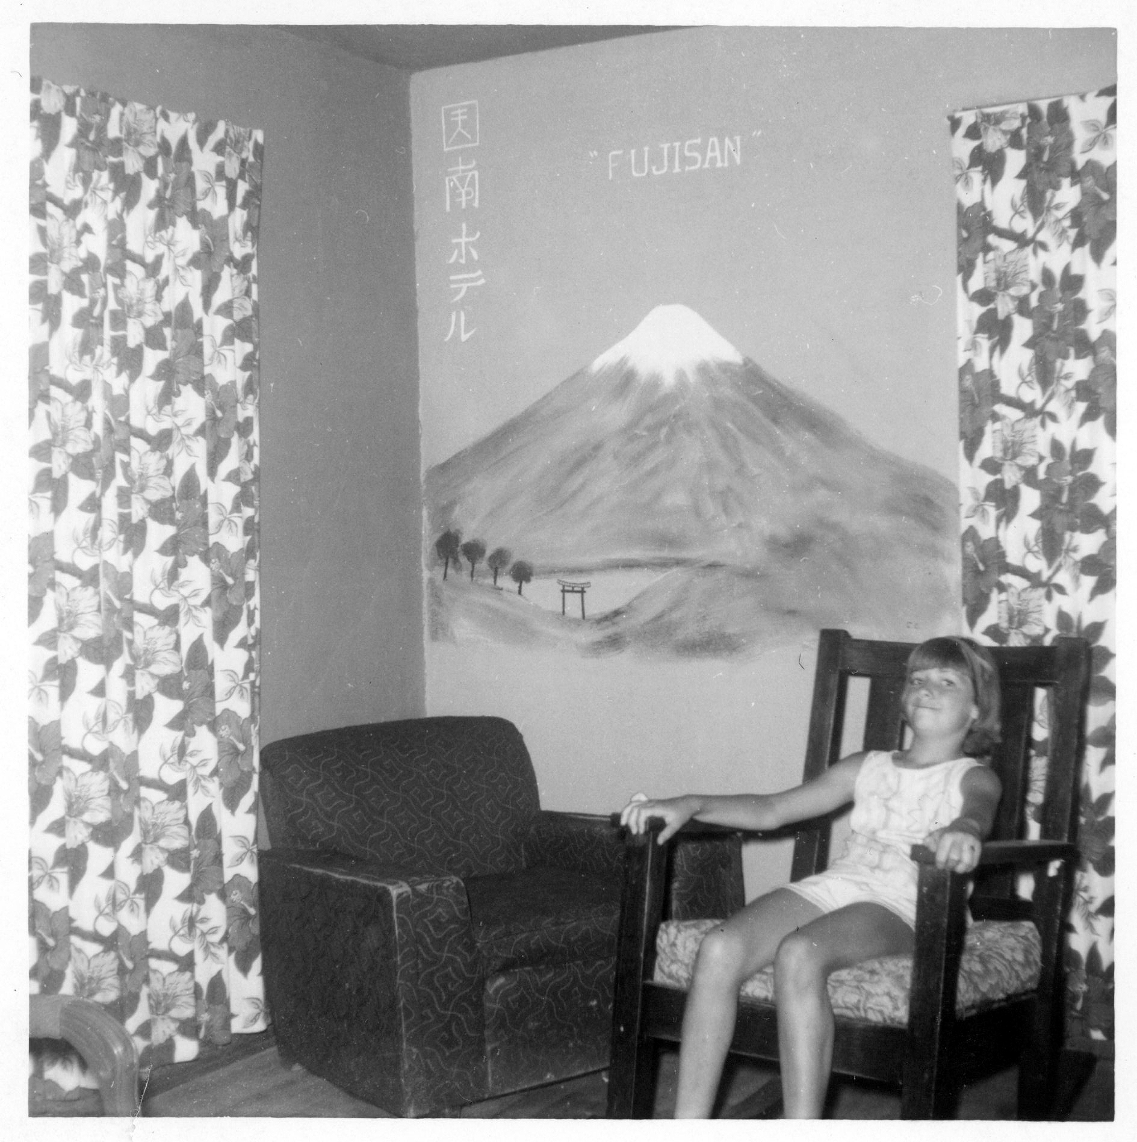
Bachelor’s Fun!
John
McCarthy
Cutie!!
Gary
Tony Radtke
OK, Who’s been walking on the ceiling? ☺
Isn’t that Mt. Fuji?
…and who is that
Mystery Bunny?
Bunny Club Members

Slide 11
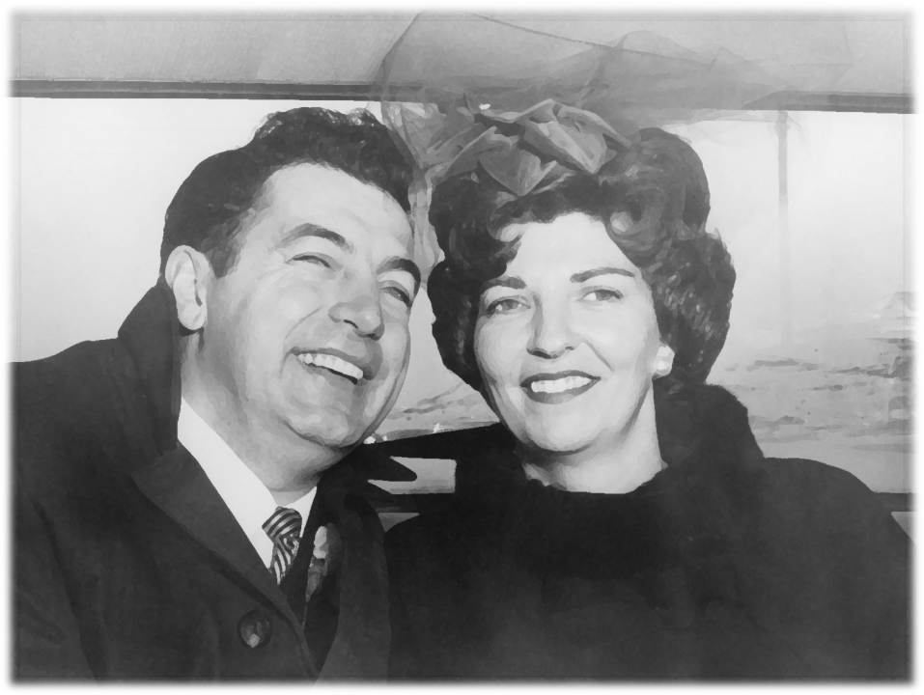
Clancy meets Teri

Slide 12
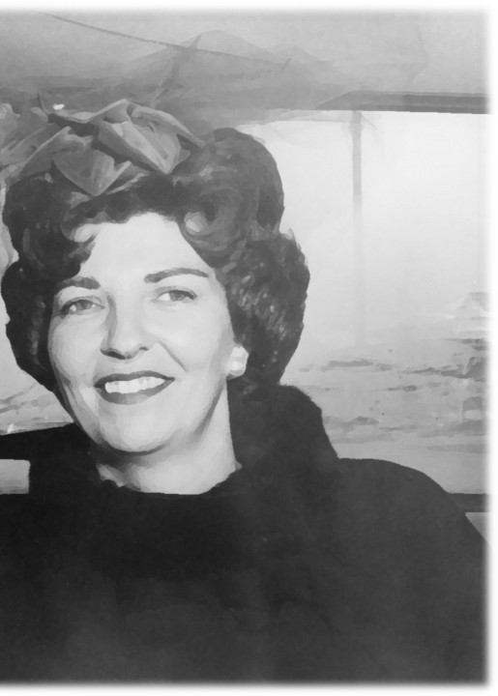
About Teri (Our Wonderful Mom!)

