Slide 1
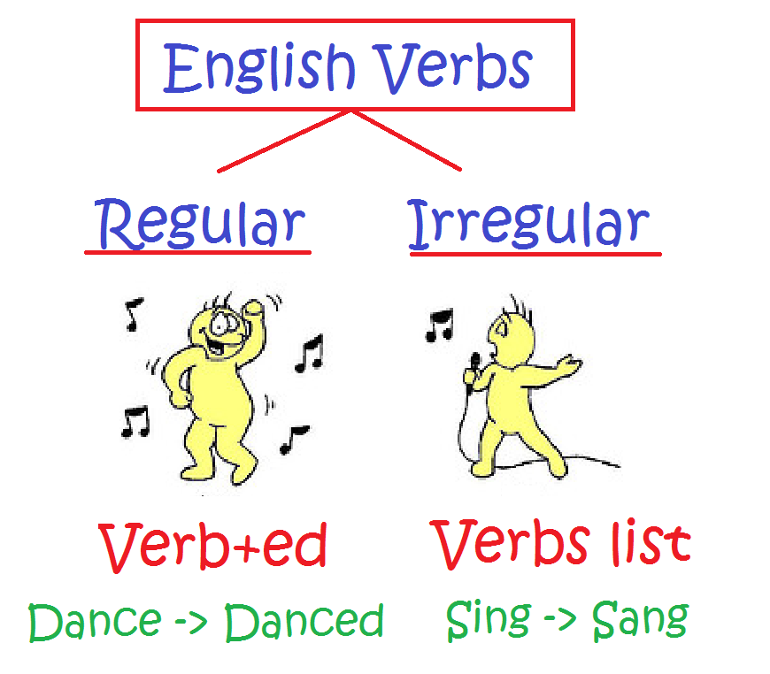
Irregular Verbs 50 Most Common Part 1
Copyright ©2015 Donna Barr All rights reserved by author www.ESLAmerica.us

Slide 2
say said
I usually say hello but yesterday I said hi.

Slide 3
make made
I made rice this morning but I won’t make rice tonight.

Slide 4
go went
He went to bed at 12:00 last night so he didn’t go to school today.

Slide 5
take took
The thief took my cell phone but didn’t take my laptop.

Slide 6
come came
They came home at 7:00 but they usually come home at 7:30.

Slide 7
see saw
I saw the mountains yesterday and I can see them today.

Slide 8
know knew
We know our neighbors because we knew them years ago.

Slide 9
get got
I got a lottery ticket and hope I get a winning ticket.

Slide 10
give gave
You gave me a present and I would like to give you one also.

Slide 11
find found
She found her keys but couldn’t find her wallet.

Slide 12
think thought
I thought English was too difficult to learn but now I think it’s easy.

Slide 13
tell told
His doctor told him to rest so I will tell him to listen to his doctor.

Slide 14
become became
She became a U.S. citizen and I hope to become one too.

Slide 15
show showed
I showed him my ID but I never show my Social Security number.

Slide 16
leave left
They left the party early because they will leave for vacation tomorrow morning.

Slide 17
feel felt
I feel sick today but yesterday I felt fine.

Slide 18
put put
I usually put my books on the table but yesterday I put them on the floor.

Slide 19
bring brought
I never bring a snack but I brought a snack today.

Slide 20
begin began
We usually begin class at 8:30 but yesterday we began at 9:00.

Slide 21
keep kept
He kept his book in his backpack but I think he should keep it on his desk.

Slide 22
hold held
I held my baby all day yesterday and today I will occasionally hold her.

Slide 23
write wrote
I wrote two letters yesterday and tomorrow I will write three more.

Slide 24
stand stood
I hope I won’t stand in line at the DMV for a long time because the last time, I stood for one hour.

Slide 25
hear heard
I can hear the birds singing but heard nothing last night.

Slide 26
let let
He let me borrow a pencil last week but I usually let him borrow mine.

Slide 27
