Slide 1
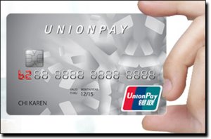
Using UnionPay Cards On Our Website 在本站使用银联卡
Secure method to pay or load your account
安全的支付或账户充值方法

Slide 2
Getting Started 现在开始

Slide 3
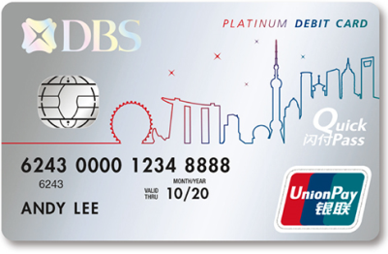
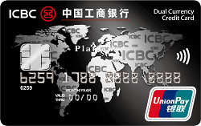
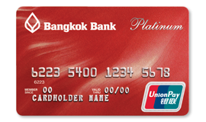
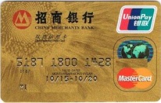
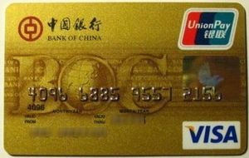
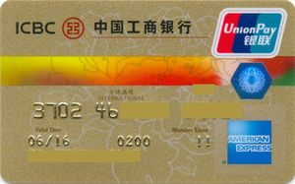
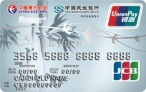
WHICH CARDS ARE ACCEPTED AT OUR SITE? 本网站可接受哪些卡？
Nearly All UnionPay cards are accepted
Our site accepts the majority of UnionPay cards for payment and account loading
UnionPay cards issued in China or internationally
All prepaid reloadable cards which carry the UnionPay logo
All debit/ATM cards linked to bank accounts which carry the UnionPay logo
All credit cards which carry the UnionPay logo
MasterCard, Visa, Amex and JCB cards issued in China which also carry the
UnionPay logo
UnionPay disposable prepaid cards and anonymous prepaid cards are
NOT accepted at our site
Some international cards may not be enabled for e-commerce transactions
Global and Chinese ATM/Debit Cards
基本上所有银联卡均可接受
本站接受大多数银联卡付款和帐户充值
在中国境内或境外发行的银联卡
所有带银联标识的预付充值卡
带银联标识的银行帐户关联的所有借记卡/ ATM卡
所有带银联标识的信用卡
在中国发行、且带银联标识的万事达卡、VISA卡、美国运通卡和JCB卡
本网站不接受银联一次性预付卡和匿名预付卡
某些境外银联卡可能未启用电子商务交易功能
Global and Chinese Credit Cards
Mastercard, Visa, Amex, JCB Co-Badged Cards

Slide 4
WHAT YOU NEED TO USE UNIONPAY CARDS AT OUR SITE 在本站使用银联卡的要求
Cardholder requirements
Depending on which bank issued your card and what type of card you hold, you will be required to have certain information, and may be requested to provide other information to complete payment at our site
Required Information
The card number embossed or printed on your card
Access to the mobile phone number linked to your bank account or credit card
Other Information – depending on card issuer and card type
For credit cards you will be required to provide the card expiry data and CVN
For some debit cards you may be required to provide the ID information used when opening the card account
For some debit cards you may be asked to enter your card PIN, this is properly secured and not stored
If your card PIN is requested, you will be required to download a ‘plug in’ which secures the entry of your PIN
持卡人要求
根据您的发卡行和所持卡类型，您将须填写某些特定信息、且或需提供其他信息以完成在本站的付款。
必填信息
您银行卡上压印或印刷的卡号
您银行帐户或信用卡关联的手机号码
其他信息–取决于发卡行和持卡类型
对于信用卡，您将需要提供信用卡到期信息和CVN码（安全码）
对于某些借记卡，您可能需要提供开设账户时使用的身份信息
对于某些借记卡，可能会要求您输入卡密码（PIN），此密码将得到妥善保护且不会被储存
如果要求输入卡密码（PIN），则需要下载“插件”以确保输入密码时的安全性

Slide 5
Performing a UnionPay Transaction on a Personal Computer 执行银联卡交易

Slide 6
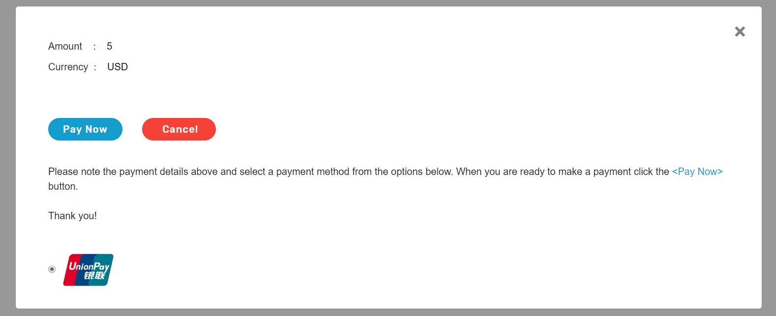
STEP 1 – CHOOSE UNIONPAY PAYMENT 第1步 –选择银联卡付款
Choose to pay with UnionPay at the merchant page
An example merchant screen is shown below
在商户页面上选择使用银联卡付款
商户页面示例如下所示

Slide 7
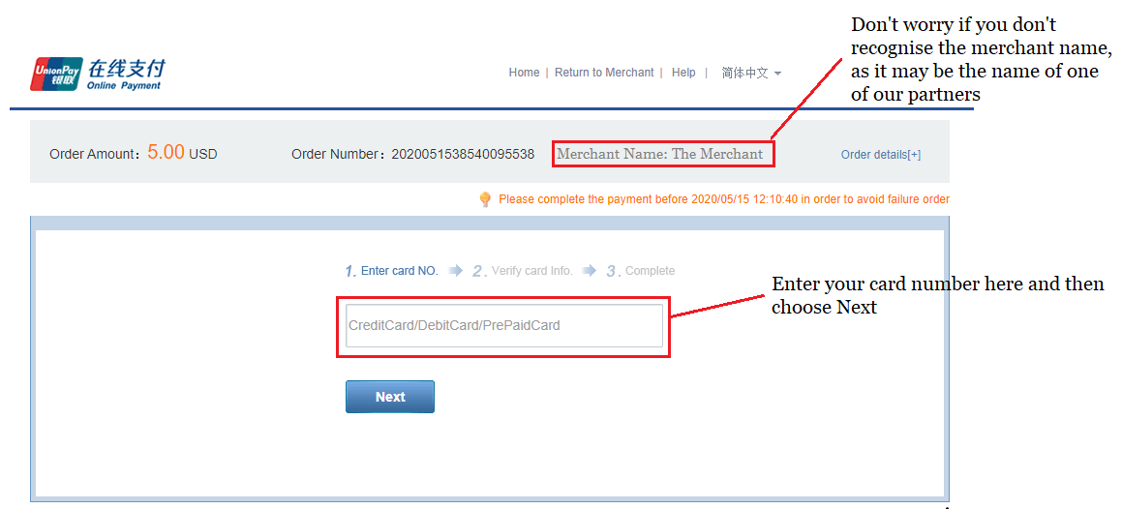
STEP 2 – ENTER YOUR UNIONPAY CARD NUMBER
第2步 –输入您的银联卡卡号
You will be directed to a page to enter your chosen UnionPay card number; the number embossed or printed on your card
您将被导向一个新的页面，请在此输入您选择的银联卡卡号；即卡上压印或印刷的数字
如果不认识商户名称 ，
您不必为此担忧，
它可能是我们的合作伙伴之一
请在此处输入您的卡号，然后点击下一步

Slide 8
Performing a UnionPay Transaction Using a Debit Card with PIN Entry 使用需要密码（PIN）的借记卡执行银联交易

Slide 9
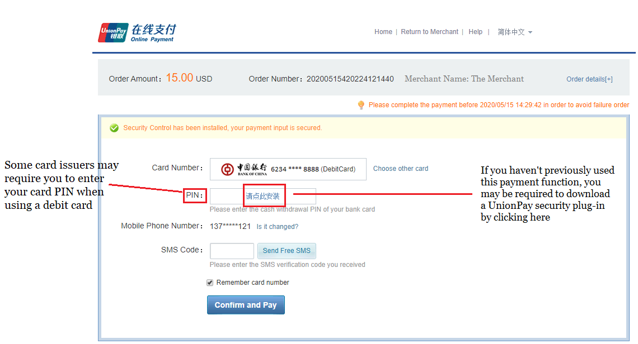
STEP 3a – USING A UNIONPAY DEBIT CARD WITH PIN 第3a步 – 使用需要密码（PIN）的银联借记卡
Should the issuer request your PIN for validation, if required download the UnionPay security plug-in by clicking on the link in the PIN field, shown below
如果发卡行需要您输入密码（PIN）进行验证，请在必要时点击密码（PIN）字段中的链接下载银联安全插件，如下所示。
部分发卡行可能要求
您使用借记卡时
输入卡密码（PIN
如果您此前从未使用过该支付功能，您可能需要点击此处下载银联安全插件

Slide 10
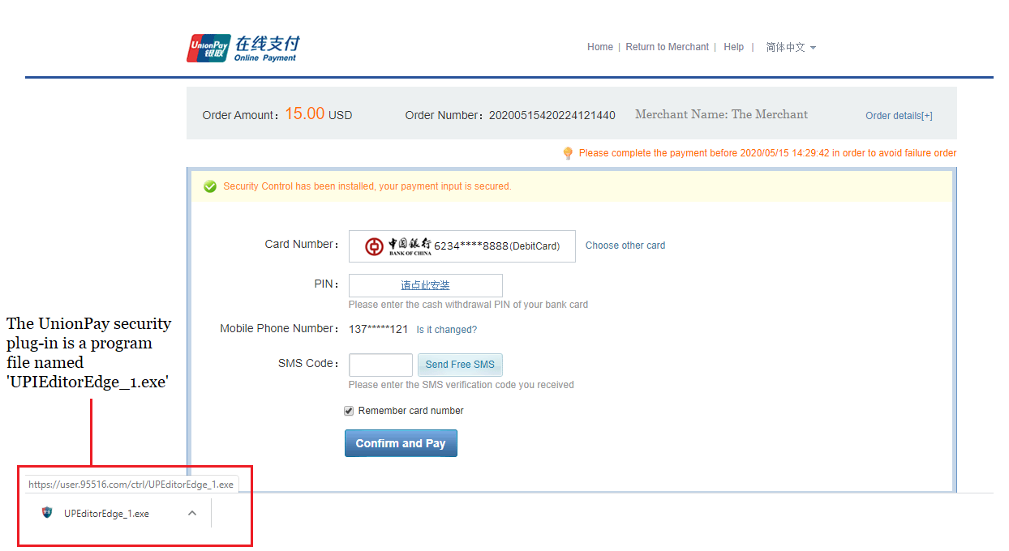
INSTALLING THE UNIONPAY SECURITY PLUG-IN 安装银联安全插件
Once the UnionPay security plug-in has been downloaded, choose the program and follow the instructions to complete
installation. Once downloaded it will not need to be installed for subsequent payments
下载银联安全插件后，选中该程序并按照指引完成安装。
下载后，后续付款无需再次安装。
银联安全插件程序
名称为
“UPIEditorEdge_1.exe”

Slide 11
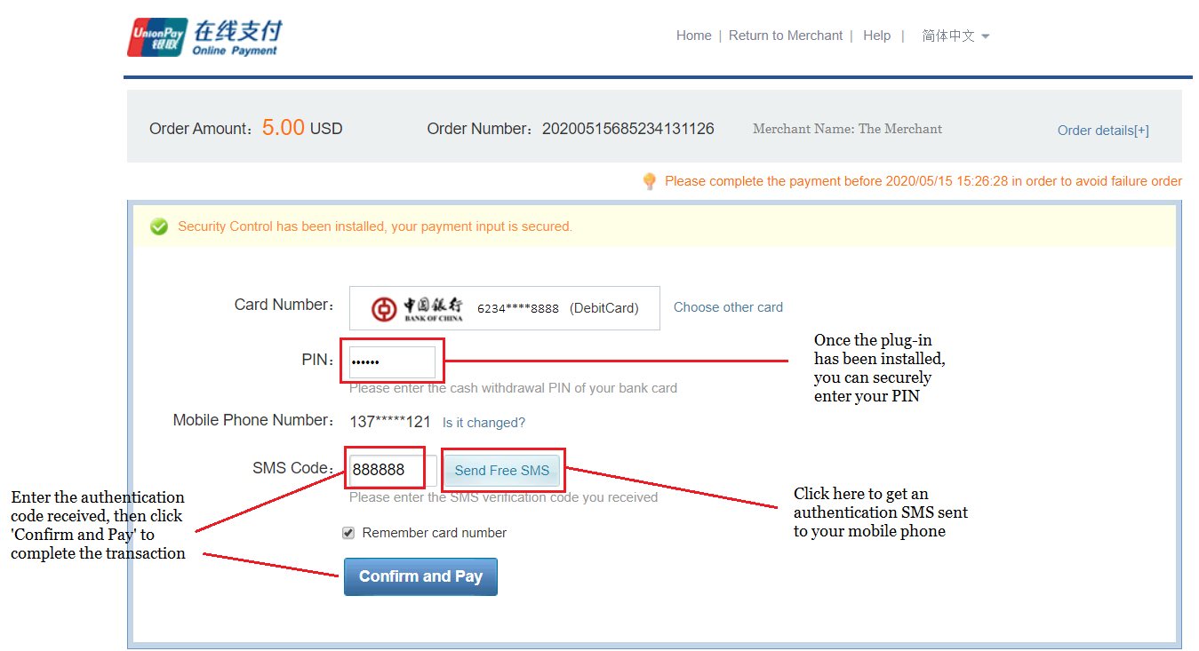
STEP 4a – COMPLETING THE PIN ENTRY DEBIT CARD TRANSACTION
第4a步 – 密码完成需要验证密码的借记卡交易
You can securely enter your PIN after the UnionPay security plug-in has been installed, then request an SMS code be sent to your mobile phone linked to the account. After the code has been entered, click ‘Confirm and Pay’, once the transaction has been approved by the card issuer you will be directed back to the merchant site
安装银联安全插件后，您可以安全地输入密码（PIN），然后请求将短信验证码发送到与该帐户关联的手机上。输入验证码后，点击“确认并付款”，一旦交易获得发卡行批准，您将返回至商户页面
安装银联安全插件后，
您可以安全地输入密码（PIN）
输入收到的验证码，
然后点击“确认并付款”完成交易
点击此处接收
发送至您手机的短信验证码

Slide 12
Performing a UnionPay Transaction Using a Debit Card Requiring ID 使用需要身份信息的借记卡执行银联交易

Slide 13
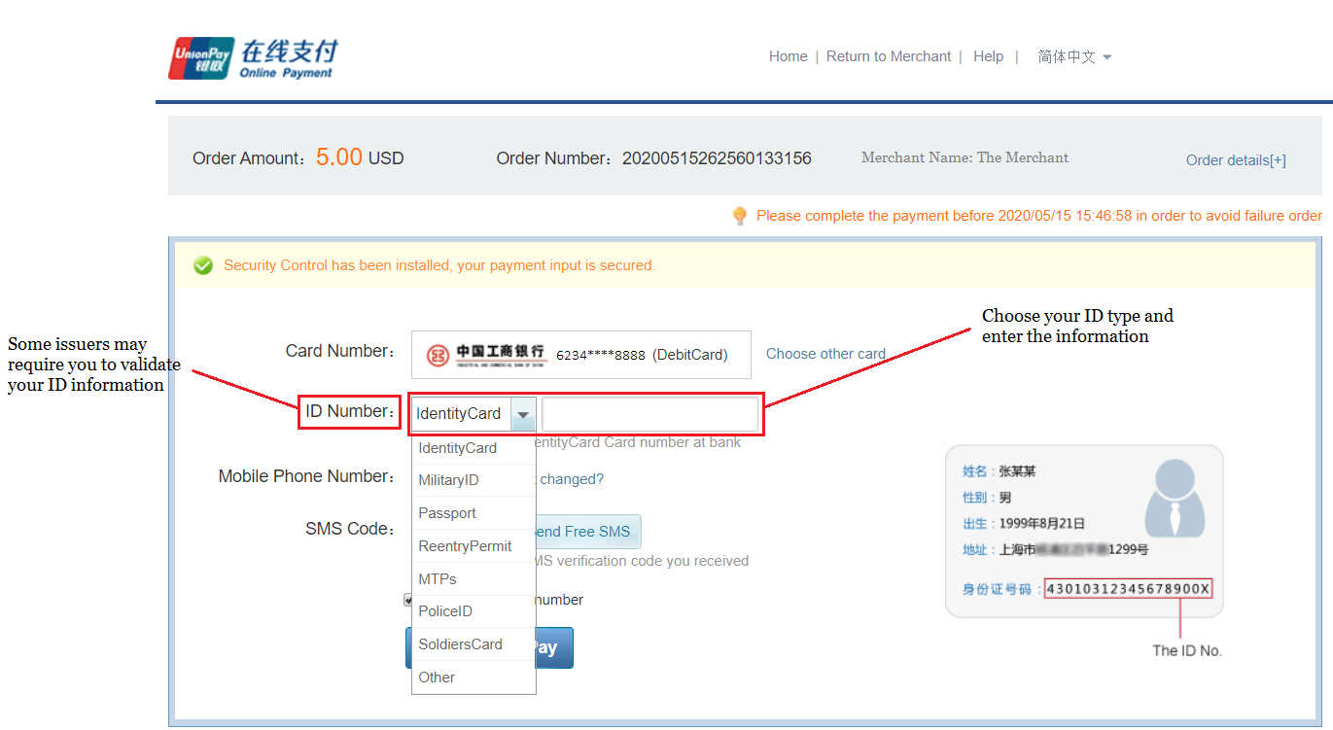
STEP 3b – USING A UNIONPAY DEBIT CARD REQUIRING ID CONFIRMATION
第3b步 – 使用需要确认身份信息的银联借记卡
Should the issuer request your ID for validation, choose the ID type and enter the information used when opening the account with the bank issuer, shown below
如果发卡行要求您进行身份验证，请选择证件类型并输入在发卡行开设帐户时使用的身份信息，
如下所示
选择证件类型并填写信息
部分发卡行可能
要求您进行身份验证
身份证号

Slide 14
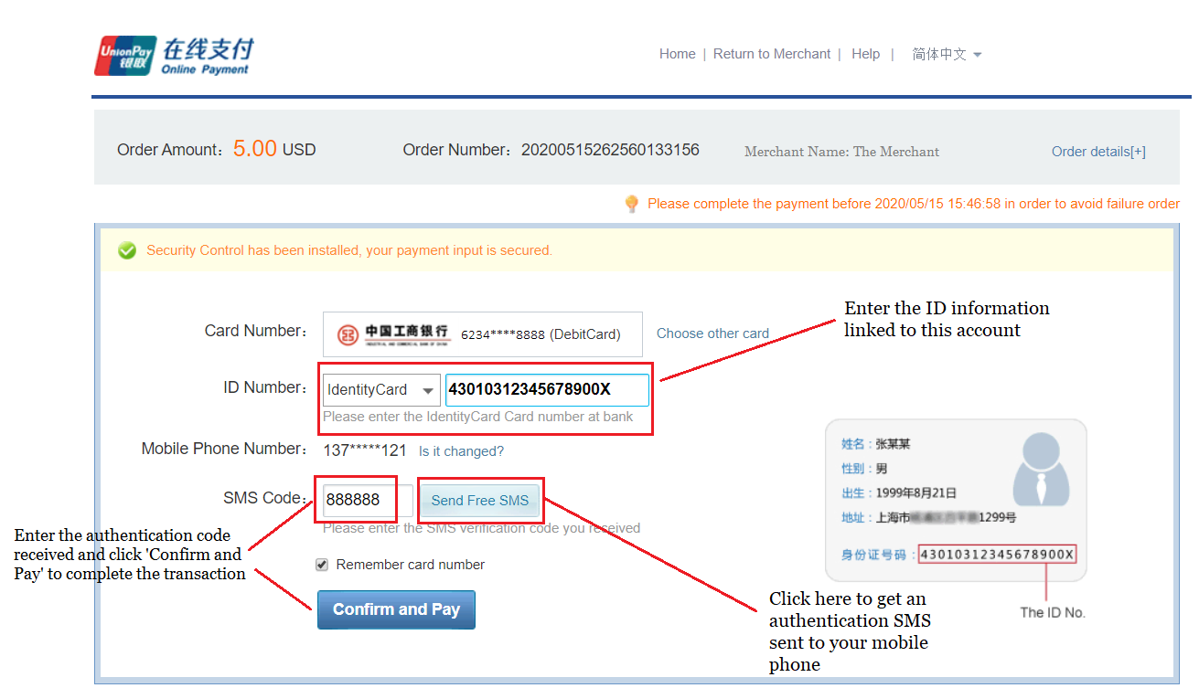
STEP 4b – COMPLETING THE ID VERIFIED DEBIT CARD TRANSACTION
第4b步 – 完成需要验证身份信息的银联卡交易
Once you have entered your ID information, you can request a SMS code be sent to your mobile phone linked to the account. After the code has been entered, click ‘Confirm and Pay’, once the transaction has been approved by the card issuer you will be directed back to the merchant site
输入身份信息后，您可以请求将短信验证码发送到与该帐户关联的手机上。输入验证码后，点击“确认并付款”，一旦交易获得发卡行批准，您将返回至商户页面
输入与该账户关联的身份信息
输入收到的验证码，
然后点击“确认并付款”完成交易
点击此处接收
发送至您手机的短信验证码

Slide 15
Performing a UnionPay Transaction Using an Authenticated Debit Card 使用需验证的借记卡执行银联交易

Slide 16
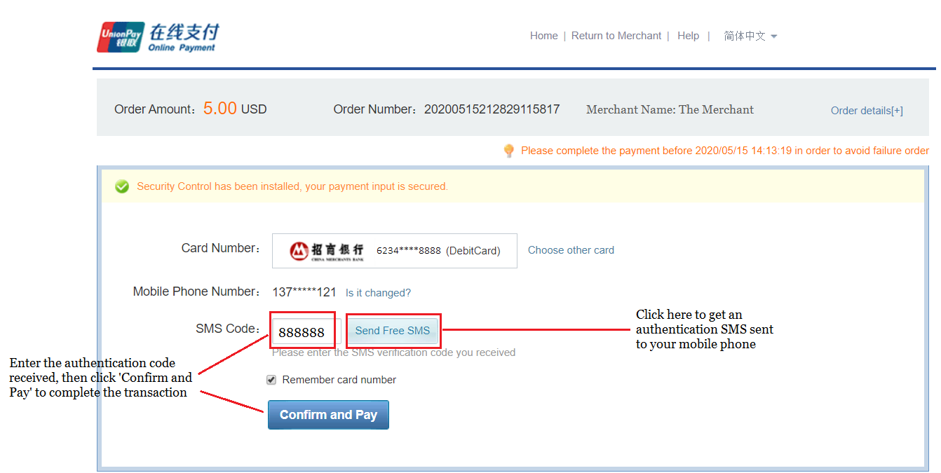
STEP 3c – USING AN AUTHENTICATED UNIONPAY DEBIT CARD
第3c步 – 使用需验证的银联借记卡
Many issuers only require you to enter an authentication code sent to your mobile phone for debit card transactions in addition to your card number. After the code has been entered, click ‘Confirm and Pay’, once the transaction has been approved by the card issuer you will be directed back to the merchant site
除了您的卡号信息外，许多发卡行只要求您输入发送至您手机的验证码以完成借记卡交易。输入验证码之后，
点击“确认并付款”，一旦交易获得发卡行批准，您将返回至商户页面
点击此处接收
发送至您手机的短信验证码
输入收到的验证码，
然后点击“确认并付款”完成交易

Slide 17
Performing a UnionPay Transaction Using an Authenticated UnionPay or Co-Badged Credit Card 使用需要身份验证的银联信用卡或联名信用卡执行银联交易

Slide 18
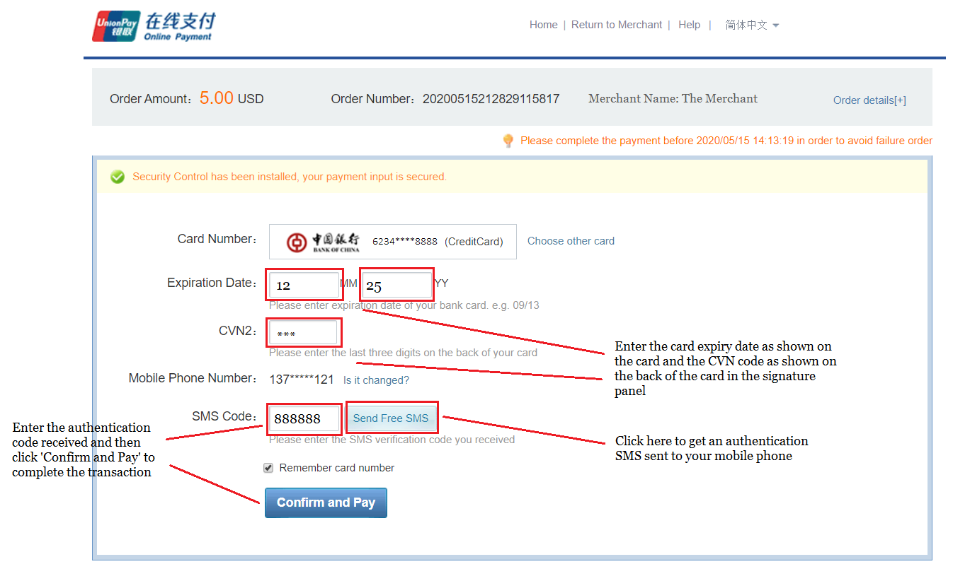
STEP 3d – USING AN AUTHENTICATED UNIONPAY OR CO-BADGED CREDIT CARD
第3d步 – 使用需要身份验证的银联信用卡或联名信用卡
UnionPay and Co-Badged Credit cards only require you to enter an authentication code sent to your mobile phone in addition to data embossed or printed on your card. After the information has been entered, click ‘Confirm and Pay’, once the transaction has been approved by the card issuer you will be directed back to the merchant site
除了卡上压印或印刷的卡号信息以外，银联信用卡和联名信用卡只要求您输入发送到手机的验证码。输入验证码后，点击“确认并付款”，一旦交易获得发卡行批准，您将返回至商户页面
输入信用卡显示的到期日以及卡背面签名栏的安全码（CVN）
点击此处接收
发送至您手机的短信验证码
输入收到的验证码，
然后点击“确认并付款”完成交易

Slide 19
Performing a UnionPay Transaction on a Mobile Device (Phone or Tablet) 在移动设备上（手机或平板电脑） 执行银联交易

Slide 20
PERFORMING A UNIONPAY TRANSACTION ON A MOBILE DEVICE
使用移动设备执行银联交易
The UnionPay Application 银联APP
Your experience when using a mobile device to perform a UnionPay transaction will depend on whether or not you have installed and enabled the UnionPay Application on your device
使用移动设备执行银联交易时的体验取决于您是否已在设备上安装和启用银联APP
The UnionPay Application
Can be installed from the Apple App Store or Google Play Store; search for UnionPay and choose the Cloud QuickPass (云闪付) App
Register and add your frequently used UnionPay payment cards – debit or credit
银联APP
可通过苹果应用商店或谷歌Play商店安装；搜索银联并选择云闪付APP
注册并添加您常用的银联卡 –借记卡或信用卡
If you have not installed the UnionPay Application
Your experience will be less efficient and will be similar to using a personal computer to perform a UnionPay transaction
如果您尚未安装银联APP
您的体验将与使用个人电脑执行银联交易类似，高效程度偏低。

Slide 21
Performing a UnionPay Transaction On a Mobile Device Using the UnionPay Application 在移动设备上利用银联APP执行银联交易

Slide 22
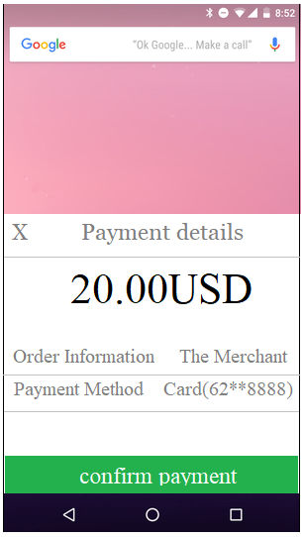
STEP 1a – USING A UNIONPAY CARD STORED IN THE UNIONPAY APPLICATION
第1a步 - 使用银联APP保存的银联卡
If you have installed the UnionPay Application; and registered and loaded your preferred UnionPay Credit and/or Debit card(s); the UnionPay Application will be automatically loaded; and you will be presented a screen similar to the one shown. Touch ‘confirm payment’, once the transaction has been approved by the card issuer you will be directed back to the merchant site
如果您已经安装银联APP，已注册并曾加载过您首选的银联信用卡及/或借记卡;银联APP将自动加载，页面显示与下图相似。点击"确认付款"，一旦交易获得发卡行批准，您将重新返回商户页面。
如果不认识商户名称 ，
您不必为此担忧，
它可能是我们的合作伙伴之一
Don’t worry if you don’t recognise the merchant name as it may be the name of one of our partners
Touch here to cancel the transaction
点击此处取消交易
Check the card number to be used; if you have enabled more than one card in the UnionPay Application you may be given the option to choose another card
点击"确认付款"完成交易
Touch ‘confirm payment’ to complete the transaction
检查即将使用的银行卡卡号，如果您此前曾在银联APP启用过不止一张银行卡，您可以使用选择另一张卡

Slide 23
Performing a UnionPay Transaction On a Mobile Device Without the UnionPay Application 在未安装银联APP的移动设备上执行银联交易

Slide 24
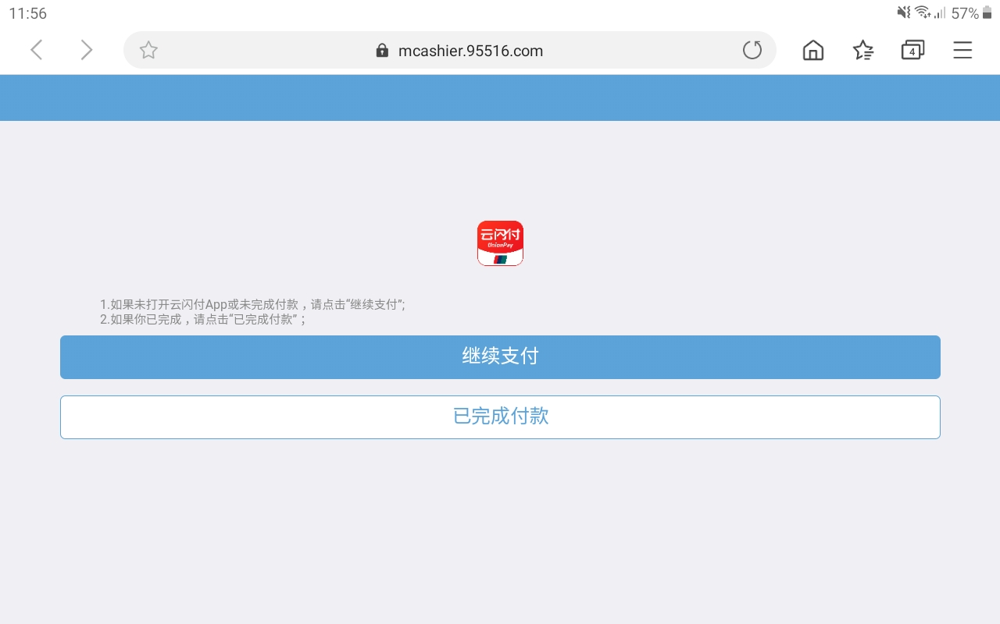
STEP 1b – USING A UNIONPAY CARD ON A MOBILE DEVICE
第1b步 - 在移动设备上使用银联卡
If you have not installed the UnionPay Application or it cannot be loaded; you will be directed to a page to confirm that you would like to continue. Touch ‘Continue to Payment’ to complete the payment by entering your card details
如果您尚未安装银联APP或无法加载，您将被导向一个新的页面以确认是否继续支付。点击"继续支付"并输入详细的银行卡信息以完成付款。
Touch here to continue to complete the transaction
点击此处继续完成交易

Slide 25
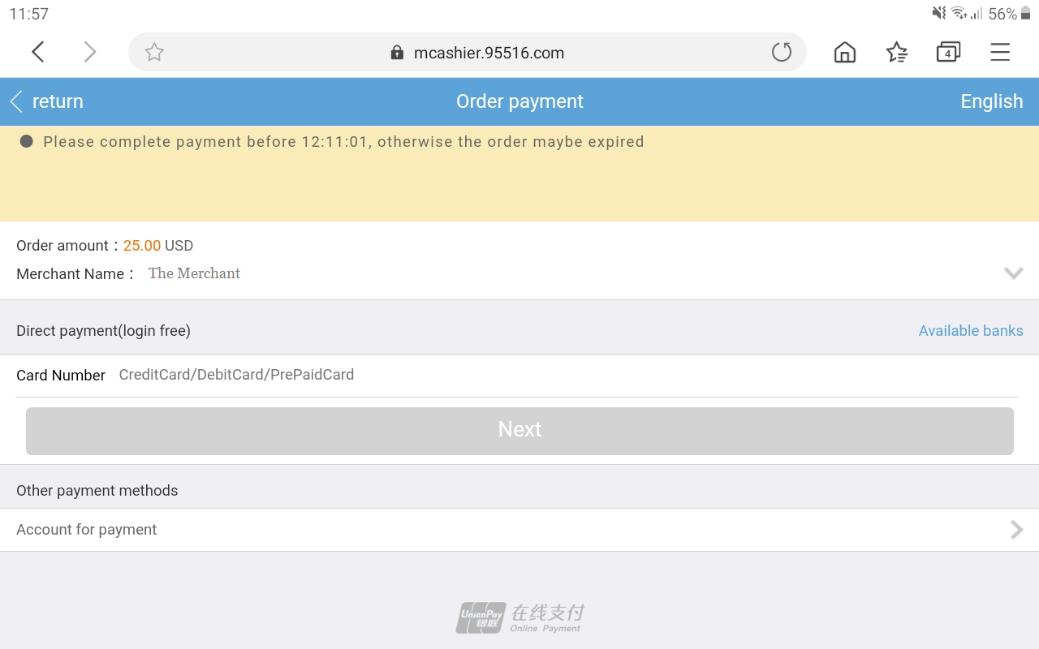
STEP 2b – USING A UNIONPAY CARD ON A MOBILE DEVICE
第2b步 - 在移动设备上使用银联卡
At the ‘Order Payment’ page you can enter your chosen UnionPay card number; the number embossed or printed on your card
在"订单支付"页面，您可以输入您选择的银联卡卡号;即卡上压印或印刷的数字
Enter your card number here and then choose ‘Next’
在此处输入您的卡号并选择“下一步”

Slide 26
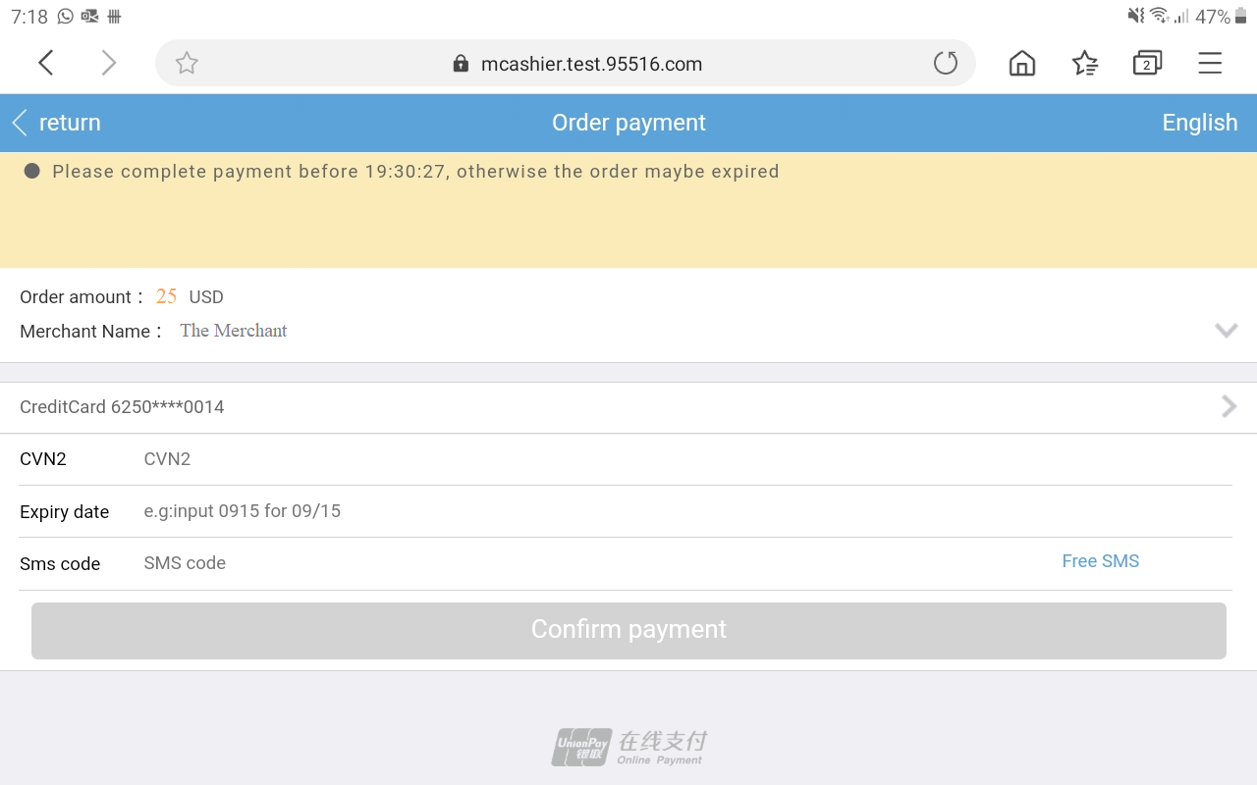
STEP 3b – COMPLETING A TRANSACTION ON A MOBILE DEVICE
第3b步 - 在移动设备上完成交易
Completing transactions on a mobile device without the UnionPay Application is similar to completing transactions on a personal computer as described above. Depending on the bank issuer and type of UnionPay card used, you may be required to enter ID or PIN information. You will be required to request and enter an SMS code for authentication. Shown below is an example of the screen you will be presented. Touch ‘Confirm payment’, once the transaction has been approved by the card issuer you will be directed back to the merchant site
在未安装银联APP的移动设备上完成交易，与此前介绍的在个人电脑上完成交易类似。根据发卡行和所持卡类型，您可能需要输入身份或 密码（PIN） 信息。您将须请求获取手机短信验证码并将其输入验证。您将看到的页面如下图所示。点击"确认付款"，一旦交易获得发卡行批准，将自动返回至商户页面。
输入信用卡显示的到期日以及卡背面签名栏的安全码（CVN）
Enter the expiry date shown on the card, and the CVN shown on the back of the card in the signature panel
输入收到的手机短信验证码，然后点击“确认并付款”完成交易
Touch here to get an authentication SMS sent to your mobile phone
Enter the SMS code received and touch ‘Confirm payment’ to complete the transaction
点击此处接收
发送给您的手机短信验证码

Slide 27
Unsuccessful Transactions 交易失败

Slide 28
WHY DO TRANSACTIONS FAIL?
为什么会交易失败？
Unsuccessful Transactions
Payment transactions on credit, debit and co-badged UnionPay cards may fail for a number of reasons
You entered information incorrectly at the payment screen; for example your card number, expiry date or authentication code
Your transaction may time-out should you take more than a certain amount of time to complete the transaction or enter your authentication code
The card issuer may decline the transaction for reasons including there being insufficient funds in your account, or a failure to properly authenticate your ID or PIN information
The card issuer’s risk management systems and processes may suspect your transaction is fraudulent due to the location the transaction was completed at, or due to the transaction amount being uncharacteristic of the way you normally transact
交易失败
银联信用卡、借记卡和联名卡的付款交易可能由于多种原因而失败
您在付款页面输入的信息不正确；例如您的卡号、有效期或验证码信息
如果您完成交易或输入验证码的时间超过一定界限，则交易可能超时
发卡行可能拒绝交易，其原因包括您的帐户资金不足或无法正确验证您的身份或密码（PIN）信息
发卡行的风险管理系统和流程可能怀疑您的交易为欺诈性质，原因是完成交易的地点或金额不符合您通常的交易特点

Slide 29
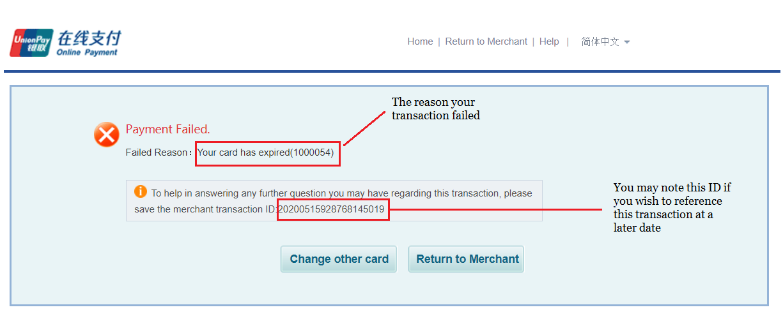
WHAT HAPPENS WHEN TRANSACTIONS FAIL? 交易失败时怎么办？
When a transaction fails you will be presented with the ‘Payment Failed’ screen. This screen will attempt to
provide a reason for why the transaction failed and offer you the opportunity to try again with a different card or return
to the merchant page, as shown
交易失败时，您将会看到“付款失败”的页面。该页面将尝试提供交易失败的原因，您可以选择使用其他银行
卡再次尝试或返回商户页面，如图所示
交易失败的原因
如果您希望在此后就
该次交易进行咨询，
请留意这一串号码

Slide 30
Other Options and Functions 其他选项和功能

Slide 31
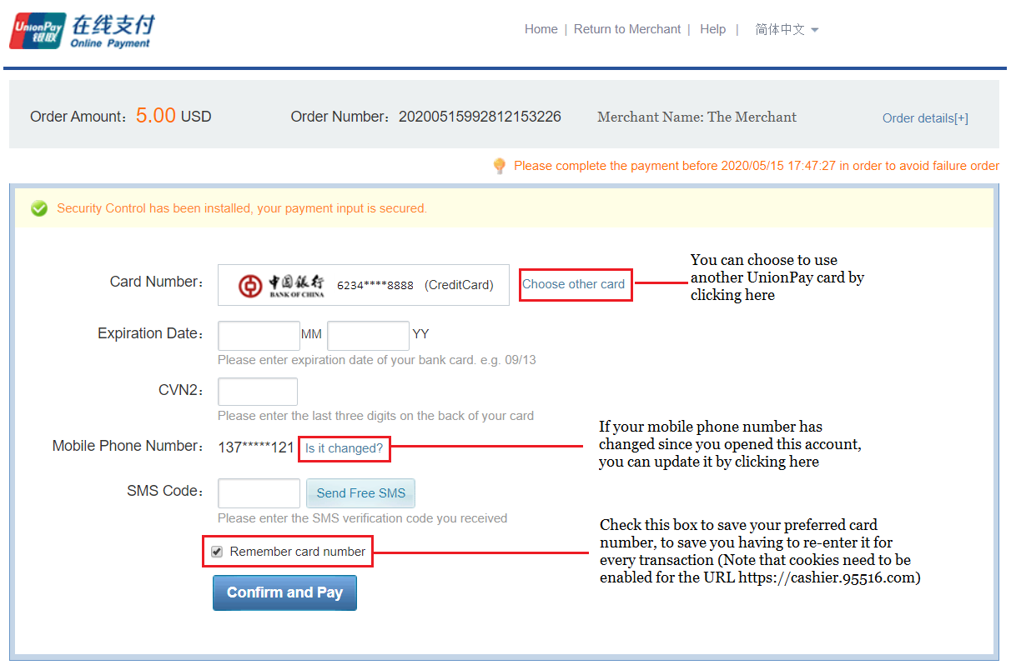
YOUR OPTIONS 您的选项
The payment application provides you various options and setting you may use to streamline your payments, shown below
付款程序为您提供了各种选项和设置，您可以使用它们来简化付款流程，如下所示
您可以点击此处选择另一张银联卡
如果您开户之后已更换手机号，
您可以点击此处更新信息
勾选此栏以保存您常用的银行卡卡号，
从而无需在每次交易时重复输入该信息
(请注意需要允许https://cashier.95516.com网站开启cookies）

Slide 32
CONTACT US
联系我们
Should you have any questions on how to pay or load your account please contact us at info@xxx.com or by phone at +xxx-xxxx-xxx
如果您对如何付款或帐户充值有任何疑问，请通过电子邮件info@xxx.com或电话号码+xxx-xxxx-xxx与我们联系

