Slide 1
Vijay Gollapudi
Chief Information Officer
9/15/2021

Slide 3
Topics
Reminders/Updates:
PA/TO for SIS packages
Enhanced Data Entry
Summer School Overview
District information Dashboard
Enrollment
Attendance
Attendance Coding – The ”D” code
TEDS Update

Slide 4
Reminders/Updates
Outstanding Participating Agreements/Task Orders are due to the Department
90% of Districts have turned in for this school year.
If you have questions, please contact Steven Sanders.
EIS Enhanced Data Entry tool
Released for the 2021-2022 school year.

Slide 5
Summer Program Overview
In 2021, started Summer Programs
Learning Loss Bridge Camp (Grades 6-8)
Summer Learning Camp (Grade K-5)
STREAM Camp (Grade K-5)
Over 100K kids enrolled across the state
Results will be shared with Superintendents during upcoming Summer Study.
We rolled out SPEAR to manage enrollments, attendance, and assessment scores
Between now and next year, will send out lessons learned and enhancements to that platform to make it easier for districts to manage the summer programs

Slide 6
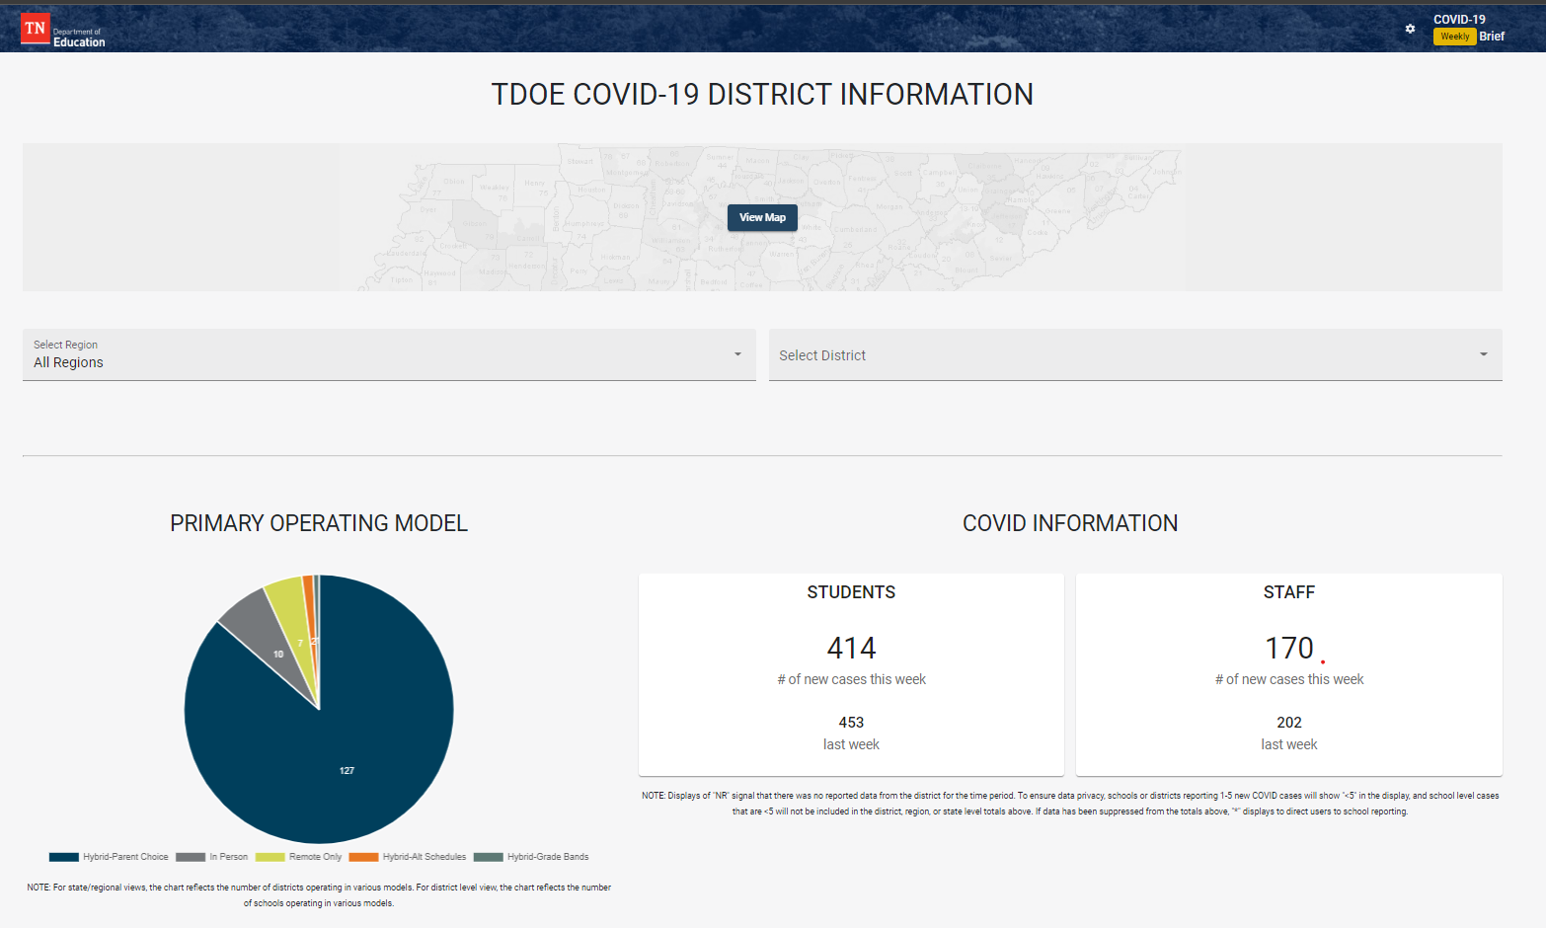
District Information Dashboard
Last school year, we rolled out the DID:
To support visibility across districts of the impact of the COVID pandemic
Capture # of new confirmed case counts week over week at school or district level.
Provides transparency for students and parents to keep them informed.
While not mandatory, average participation has been 65%-70% week over week (excluding holiday weeks) providing insightful data on impact on student and staff attendance

Slide 7
District Information Dashboard
Enhanced Dashboard to include federal reporting requirements, including:
Approved ESSER allocations (ESSER 1.0, 2.0, 3.0)
Enrollment by learning method
Also subdivided into federally required subgroups
Attendance by learning method
On the 16th of each month, will report Average Daily attendance for the previous period (Present, Absent, Remote, Virtual)
For August, enrollment and attendance will be reported on Sept 16th (today)
Critical to ensure that monthly data is attested to by the 15th of each month, so dashboard reflects the most accurate information.
Reporting this data is required for federal ESSER funds

Slide 8
Remote Instruction
Last school year, used the “D” code to track distance learning when schools were closed, in a hybrid learning model, etc when implementing a district’s CLP
This year, the “D” code will continue to be used to track students that are participating in remote instruction, if districts supports remote instruction during periods of quarantine
This does not apply to a district’s virtual school

Slide 9
When Do I Use The “D” Code?
There are 3 scenarios under which the “D” code shall be used for positive attendance reporting:
Individual student that are quarantining due to COVID
Classrooms that are utilizing remote learning with an approved Commissioner waiver.
Schools that are utilizing remote learning with an approved Commissioner waiver.
Districts that are not offering remote instruction for students who are quarantined due to COVID should be counted as absent (A).

Slide 10
What is TEDS?
Replacement for EIS
Statewide Reporting System Modernization
Utilizes EdFi Standard data model to simplify statewide reporting and enable future scalability and flexibility

Slide 11
TEDS
As we refine data reporting into data marts, our goals, in a virtual world:
Gathering data needed for reporting attendance appropriately
Understanding accountability with hybrid/virtual learning
Create a data governance model to ensure consistency in data points gathered that are aligned with State Board policy
The EdFi standard allows for the flexibility of improving data integrity and sharing (where appropriate) – how can we leverage the structure to improve system and statewide efficiency

Slide 12
TEDS – Are we there yet?
The pandemic, summer school and support for reactive work have slowed us down
By 10/31, 4 of the 5 vendors will be ready to send us data for their single “pilot” districts in parallel
Data and processing visibility will be released after data is verified by TDOE
Error and visibility portal part of launch with necessary reconciliation reporting.
Remainder of ramp up in 2021-2022 school year will depend on pilot districts’ success
Targeting early Q2 to parallel process all districts
Will convert EIS historical data into TEDS
BEP calculation will be done in parallel at the end of the school year.

Slide 13
Questions
?

