Slide 1
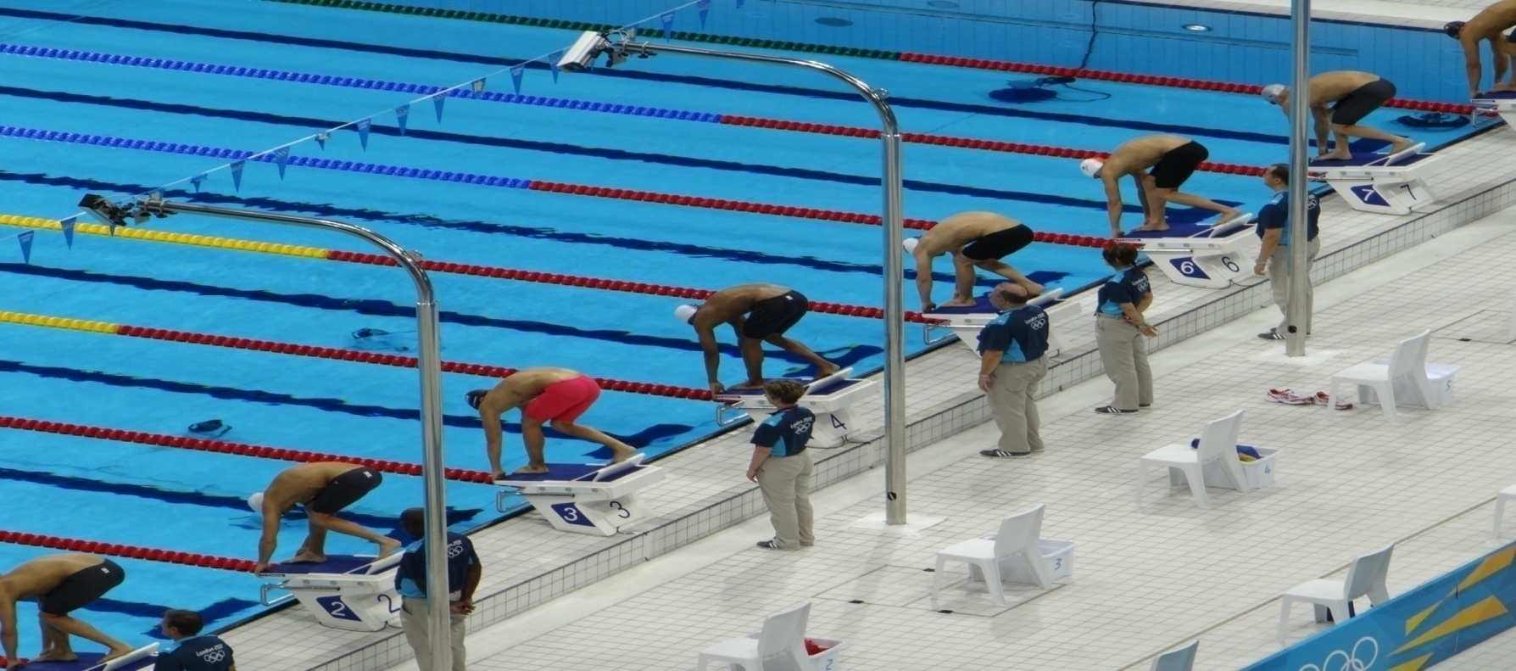
Welcome
Swimming Competitions
by Ericka Willis, Head Coach, Bircotes Swimming club – March 2019

Slide 2
What you will learn today
Understand Terminology, Pathway and Types
Disqualifications
Procedure on Race day
Info for swimmer for before, during and after race day
Advice to parents

Slide 3
Terminology - 1
FINA – Fédération internationale de natation (Administer international competition in water sports)
Swim England - English national governing body for aquatics
Gala/Meet – Unlicensed or licensed Swimming Competition
Open Meet - is a competition where swimmers enter as individuals, via the club, to compete against others of the same age band. These are open to all swimmers who meet the criteria set by the host club, known as the Promoter’s Conditions.

Slide 4
Terminology - 2
County Championships – this is a meet that is held once a year in each County across the UK. Swimmers must achieve certain times in order to compete at these events.
Regional Championships – this is a meet that is held once or twice a year in each region of the UK. Again swimmers must achieve certain times in order to compete at these events.
Swim England National Meet – this is a meet held in England where time achieved can mean you progress to the British Championships
British Championships - The Championships form part of a broader Performance Pathway Strategy aimed at increasing and supporting junior talent on the journey towards senior medal-winning performance.
NEXT STOP THE OLYMPICS!!!!!!!

Slide 5
Swimming Competition Pathway
Olympics
British Championships
Swim England Championships
Regional Championships
County Championships
Licensed Open Meet
Unlicensed Meet

Slide 6
There are 2 distinct forms of swimming competitions
Non Licensed Meets – these tend to be friendly competitions, often against competitors in your own club (eg time trials, club championships) or against local swimming clubs/schools. Whilst the general rules are followed they are not endorsed. Times achieved are recorded by the swimming club only.
Licensed Meets – these are organised and ran under Swim England and FINA rules. Times achieved at these events are recorded on the National database. Times can be used into entry into County, Regional and National Competitions.
Our Time Trials and Club Championships are currently Non Licensed
Most of our external swimming competitions we attend are Licensed

Slide 7
Guide to the 4 levels of licensed meets
All licensed meets are subject to ASA laws and regulations and the ASA Technical Rules of Racing. They are graded into four levels.
Level 1 Meets are long course (50m) only and cover National, Regional and County Championships. Their purpose is to enable athletes to achieve qualifying times for entry into National, Regional and County Championships.
Level 2 Meets are short course (25m) only and cover National, Regional and County Championships. Their purpose is to enable athletes to achieve qualifying times for entry into National, Regional and County Championships in short course.
Level 3 Meets are long and short course events. Their purpose is to enable athletes to achieve times for entry into Regional and County Championships and other Meets at Level 1 or Level 2.
Level 4 Meets are entry level events in pools 25m or greater. Borough Championships are an example. They are for inexperienced athletes and swimmers seeking to compete outside their club environment. If times are good athletes progress to Level 3 Meets.

Slide 8
What is LONG and SHORT Course?
Long Course – this is an Olympic sized pool (50 metres in length). We compete in these events at Ponds Forge (Sheffield) and Harvey Hadden (Nottingham) although there are several more around the country.
Short Course – this is 25 metres in length pool. This is the traditional sized pool found around towns in the UK. Sometimes though a short course event can be held in a 50 metre pool. Here they have the capacity to move the walls in order to divide the 50 metre pool into 2 – 25 metre pools. When this is done the other 25m section is often used a warm up and cool down pool and is available for swimmers to use in between their races.

Slide 9
HEATS – what are they?
Heats are the groups that the swimmers are placed in to race. This is decided by grouping those with similar previous race times together. Sometimes these are “spear headed” ie the fastest time will go in the middle lanes. Other times it will be done as fastest in lane 6 and slowest in lane 1.

Slide 10
Common questions asked about heats and times
Where has my child’s entered time come from?
Most times come from the national database and will be their latest personal best at the time of entry to the gala.
Why is the time on the programme different to what they actually can swim?
We have to enter galas several months in advance and supply a time. Between entering and racing they might have swam another event and set a faster time. Occasionally meets will adjust the times before publishing the programmes and heats but most do not.

Slide 11
Times entered into races
Where can I get my child’s time from?
For those that have raced before you can go on to the National Database and retrieve them from there. Visit Swimmingresults.org, Click on rankings and then best times, complete the prompts.
For those that have not raced before or their fastest times have been achieved at non licensed meets refer to your certificates from these events.
My child hasn’t swam this event before so where has the time come from?
Coaching team will have provided an estimated time. Some events we are able to submit an entry of No Time which will result in them swimming in the first heat. We might not feel that this is appropriate eg if they are an older swimmer or are of high ability and in this case we will submit an estimated time. What ever time the swimmer achieved in the race will be treated as a personal best on this occasion.

Slide 12
Please note
The Coaching team ensure that they have the child’s latest time with them on race day.
We would advise that you take note of your child’s up to date times and bring them with you on race day just in case.

Slide 13
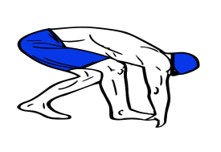
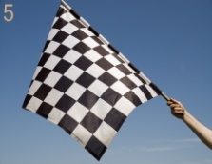
Reasons for Disqualifications
Starts
Stroke
Finish
Delays
Conduct

Slide 14
Reason for Disqualifications
False Start
At the start of a race, swimmers must take a stationary position atop the starting blocks. If a swimmer leaves the starting block before the starting signal or is moving as the signal sounds, he or she commits a false start violation and receives an automatic disqualification. If they don't immediately halt the race and recall the swimmers, officials may wait to disqualify the guilty part until the race's completion.
Delays
Officials may disqualify a swimmer who fails to report to the starting platform prepared to swim at the start of his scheduled heat. Any swimmer who intentionally delays the start of a race or who wilfully ignores or disobeys the orders of officials may also receive a disqualification.
Swimming Conduct
Swimmers may receive a disqualification for violating certain rules while in the act of swimming. Failing to touch the wall when executing a turn, grabbing the lane markers, using the lane markers for momentum or pushing off the bottom of the pool will all result in a disqualification. Swimmers also earn disqualifications for entering another swimmer's lane and for staying underwater longer than 15 meters at the start of a race.

Slide 15
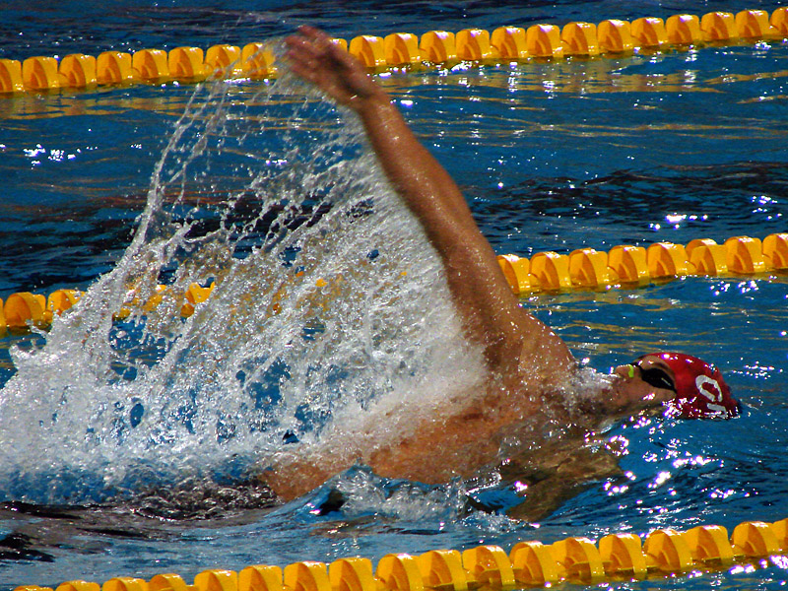
BACK STROKE Disqualifications
When competing in a backstroke race, a swimmer
must remain on his or her back and employ a proper double-armed backstroke or an elementary backstroke. Aside from stroke violations, the majority of backstroke disqualifications occur on turns,
with swimmers leaving their
backs too soon and gliding to
the wall on their stomachs or
failing to push off the wall
while on their backs.

Slide 16
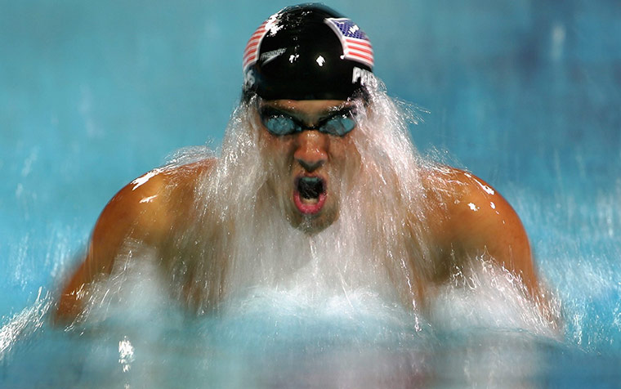
BREASTSTROKE Disqualifications
Most breaststroke disqualifications occur on turns as well. Swimmers must touch the wall with both hands simultaneously. Touching with only one hand or touching with one hand before the other results in a disqualification. Performing more than one dolphin kick before initiating a breaststroke kick when
pulling out of a turn, or taking
more than one arm pull
underwater can also earn a
disqualification.

Slide 17
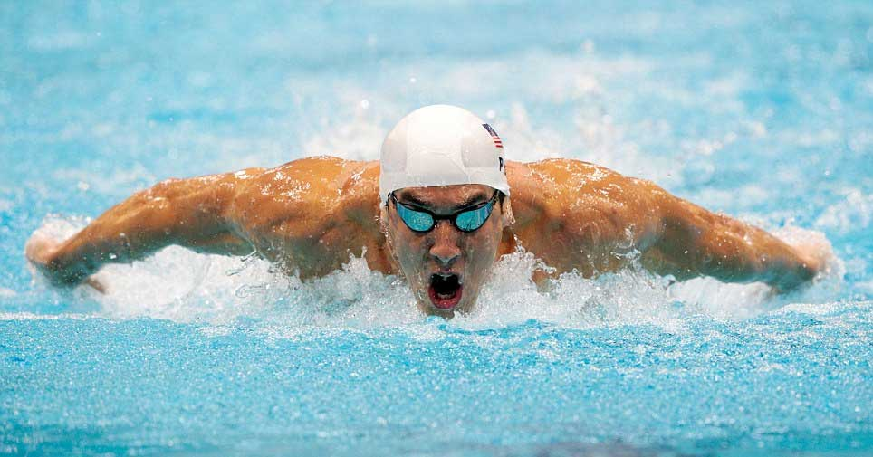
BUTTERFLY Disqualifications
As in the breaststroke, butterfly swimmers must also touch the wall on turns with both hands simultaneously to avoid disqualification. Employing an illegal kick, usually a flutter kick, will also earn a disqualification.

Slide 18
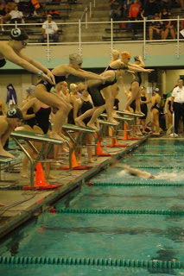
RELAY Disqualifications
In relay races, swimmers typically draw disqualifications for false starting, which occurs when one swimmer leaves the starting block before his or her teammate touches the wall. A relay team may also get disqualified for entering the pool to celebrate a victory before all other swimmers finish the race.

Slide 19
Want to know more about Disqualifications
There are many reasons for a swimmer to be disqualified during the race.
For further information visit
http://www.fina.org/content/disqualification-codes-2014-2017

Slide 20
Disqualifications Happen!!!
Remember: Disqualifications happen to the most experienced swimmers.
It is quite common for those new to racing to experience a disqualification.
Although this is not what we want it does help the swimmer focus on this more and perfect. We learn by our mistakes!!!

Slide 21
How Races Start
Series of short whistles 3-4
Buzzer or Horn
Swimmer leaves the block
Take your Marks
Long whistle (2 in back stroke)

Slide 22
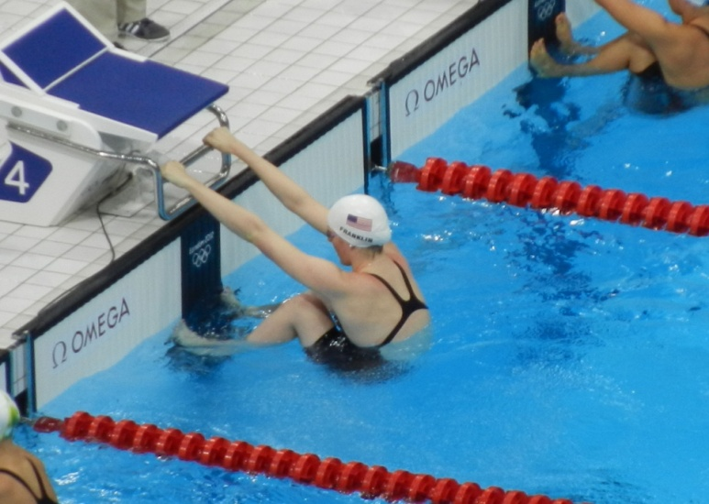
Start of the Race
The Referee will signal to the swimmers by a short series of whistles inviting them to set forward for their race. This will be followed by a long whistle indicating that they should take their positions on the block (or for backstroke and medley relays to immediately enter the water). When performing back stroke or medley relay there will be a second long whistle for them to take their position holding the blocks or wall.
The starter will say “Take your marks” which is the signal to get into your take off position.
At this point the swimmers should now be
concentrating on the start of their race and be still
(not fidgeting or adjusting goggles etc). Everyone
else should respect this by being quiet and still
until after the race has started
Then the starter will sound the buzzer or horn which is
the signal to start your racing start.
Once the race is underway then everyone can cheer
their swimmers on.
Some swimmers may not be ready for a full ‘Racing Dive’ start. In this case you may be allowed to start from in the water. Again, your coach or team manager will help you with this.

Slide 23
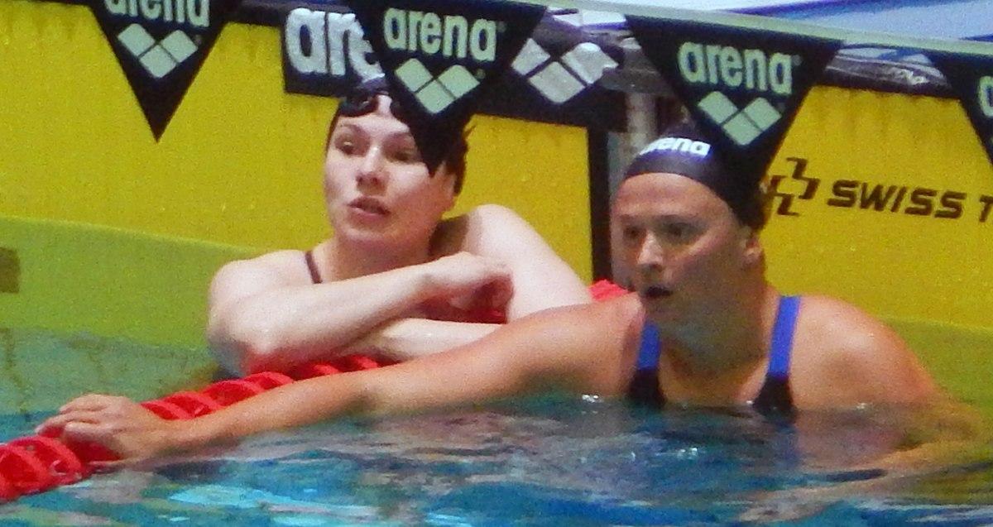
On completion of the race
Stay in the water holding onto the lane rope and wait for the signal from the referee to exit the pool. Exit by going under the lane ropes until you reach the nearest side of the pool to you.
Return to where you started to collect clothing etc. Only do this once the next race has started as there should be no
movement as the next race is
about to start.
Remember do not ask the officials for
your time or anything else as they need
to concentrate on the next race.

Slide 24
Pre Racing – the Night before
What to pack in a bag for the poolside:-
Spare towel
Goggles x 2
Swimming Club hat x 2
Drinks
Food in cool bag
Item for entertainment
Racing swimwear and spare
Make sure you layout your clothes for the morning to avoid pre race stress.
Clothing you will need to arrive on poolside are:-
Swimwear, Club shirt, jumper, jogging bottoms, flip flops or clean trainers
Get a good nights sleep!!

Slide 25
What the swimmer needs to do on Race Day
Please bring onto the poolside with you; a spare towel, healthy drinks and snacks, inhalers if required, club hat and goggles (plus spare goggles if possible). You should enter the poolside wearing your swimwear, club shirt and poolside flip flops/footwear, jogging bottoms/leggings. Please ensure you keep all your belongings together and following your warm up and races place your hat and goggles with your belongings to avoid losing items.
First thing you will need to do is your land warm up. Either a coach or club captain will be around to put you through this warm up.
Once the competition has started your Team Manager/Coach will tell you when you need to report to the officials to wait for your race. The team manager/coach will also remind you of your event and what you need to do in terms of start, turn and finish. Make sure just before you race you have been to the toilet, had a drink and have your hat and goggles with you.
Usually all swimmers must remain with the club on the poolside until your last race of the morning or afternoon session unless otherwise instructed by the Team Manager/Coach. You will only be allowed to leave for toilet breaks and following your final event of the morning/afternoon session. Please make sure that you inform your Team Manager when you are leaving for any of the above reasons.
Please remember following each race to report to the Head Coach or Acting Head Coach on the day immediately for feedback and then report back to our camp. Once you return make sure you drink, have a healthy snack and keep warm. Please check with your Team Manager/Coach if food is appropriate to have at that time and if the type of food is OK.

Slide 26
Behaviour at the Meet
Do not touch the officials equipment
Show respect to all officials and do not impede on them performing their duties
Be quiet at the start of race
Support and encourage all swimmers in the team
Show respect to other competing clubs.
Respect your coaches and team managers.

Slide 27
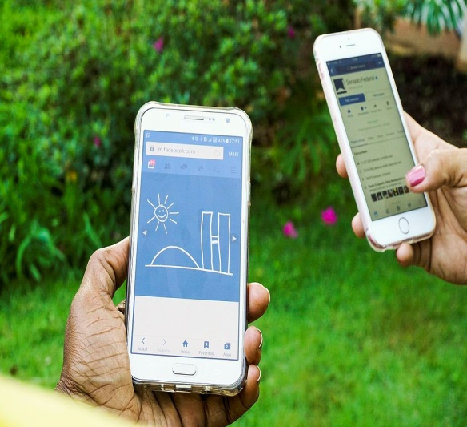
Use of media devices
Phones or tablets may be used on poolside to help occupy swimmers during races but avoid using social media.
Recommend just to be used for:-
Playing music
Playing games
Do not take any photographs on the poolside or in the changing rooms

Slide 28
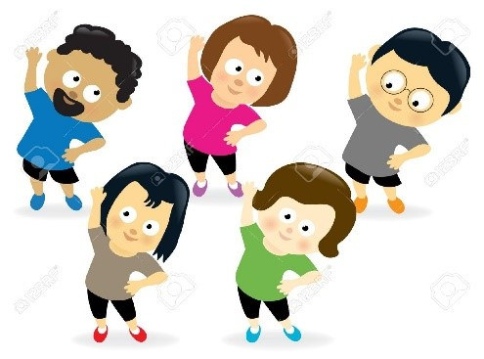
Warm Up
1) Raise body temperature
2) Stretch
3) Keep warm with clothing
4)Swimming warm up
5) Keep warm with clothing

Slide 29
Warm Up
Stretching cold muscles may relieve tension but will have very little effect on flexibility. Start by warming the body up by performing jogging or jumping to raise body temperature.
Stretch each body part in order. Hold stretches for 10 to 15 seconds. Run through this routine three times.
If water or air temperature is cold, it’s going to take longer to warm-up, so take that into account. Keep your t shirt, jumper and bottoms on.
Stretch after training. Try doing this in a warm shower, holding each stretch for 30 – 40 seconds to help clear waste products from the muscles, improve post-exercise flexibility and stimulate the muscle receptors that promote relaxation.
Swimming may be fantastic exercise for your joints in a weightless environment but bursting into ten lengths of butterfly isn’t going to do your shoulders any favours. Concentrate on relaxing your joints and gliding through the water as you warm-up.
Pulse rate. By warming-up you are avoiding any oxygen deficit or pre-training tiredness but don’t take it too easy! You need to be gradually raising your pulse to ensure the warm-up effects are maintained.
Unless you are breaking out in a sweat or feel uncomfortable – put clothing on.

Slide 30
Cool down following race
Cooling down following each race is important!!!
1. Regulate blood flow - doing some cool down exercises after your workout allows for a gradual recovery of blood pressure. This blood pooling that occurs when the body goes from a full scale swim session to resting can cause light headedness, dizziness, and fainting.
2. Flexibility - your cool down routine should also include some stretches that can improve your range of motion, joints, and flexibility. When your joints are able to move through their full range of motion, your swim technique improves, and of course, so does your overall performance. Stretch when your muscles are warm, once you've done a few cool down laps (if this facility is available). Improved flexibility will also reduce the occurrence of cramps and injuries, which can keep you from swimming in the next race/meet.
3. Lower heart rate - a proper cool down also helps lower a raised heart rate down to resting heart rate safely

Slide 31
Cool down following race
Multiple studies show improved performance for swimmers when cooling down between races, so don't skip this important step for optimal performance. To cool down after swimming, swim some leisure laps for five minutes (if facility available) and do any cool down exercises that your coach recommends.
In addition to this routine, don't forget to hydrate with water between events. Keep your recovery drink on the side of the pool and sip it during your cool down session.

Slide 32
NERVOUS?
Being nervous before a race is normal.
Evolution has primed your body to help you survive the coming challenge, and it doesn’t much care whether that’s winning a swimming race or bringing down a sabre-tooth tiger so your family of cave-people can eat tonight.
Look at it this way: when you’re in a nervous state you’re at least 10% more alive than normal.
Sure, you don’t feel as relaxed and carefree as you do watching a movie and eating pizza, but your senses are sharper, your brain is more alert and your instincts are tingling.
You’re ready to make something happen, and that’s a powerful place to be.

Slide 33
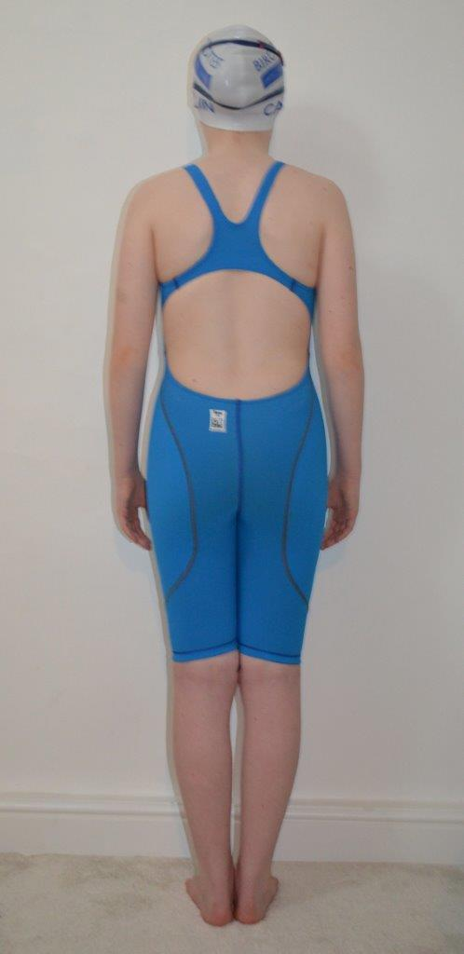
Competitive Swimwear

Slide 34
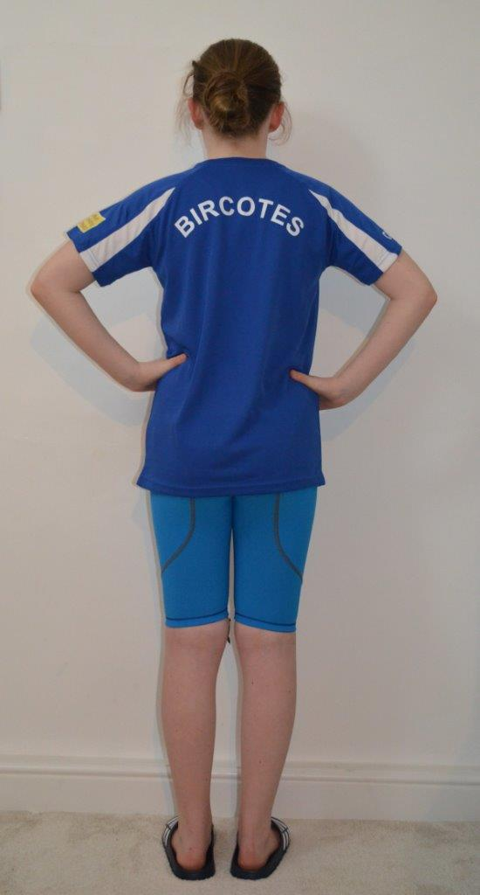
Club T Shirt to be worn on poolside

Slide 35
Entering poolside

Slide 36
Going to start race

Slide 37
Finishing a race

Slide 38
Between Races

Slide 39
End of day

Slide 40
NUTRITION
The day before
Drink fluids little and often to stay properly hydrated.
Eat little and often – every two to four hours to keep your blood sugar levels steady and fuel your muscles in preparation for your event.
Avoid big meals or over-eating in the evening – this will almost certainly make you feel uncomfortable and lethargic the next day.
Try to stick to familiar foods. Curries, spicy foods and baked beans (unless you are used to eating them) can cause gas and bloating, so avoid eating anything that may cause stomach discomfort the next day. It’s best to stick to foods that you are familiar and compatible with!

Slide 41
NUTRITION – Morning of Event
Don’t swim on empty. Even if you feel nervous, make breakfast happen. Stick to easily digested foods – cereal with milk, porridge, banana with yoghurt, some fruit or toast with jam.
If you’re really struggling, try liquid meals such as milkshakes, yoghurt drinks or a smoothie.
It’s a good idea to rehearse your competition meal routine in training so you know exactly what agrees with you.

Slide 42
NUTRITION – Snacks between heats
Try to eat as soon as possible after your swim to give yourself as long as possible to recover if you have to swim again.
High fat and simple sugar foods will do you no favours in competition. Instead search out complex carbohydrates eg bread, rice, pasta
If you can’t stomach anything solid try sports drinks, flavoured milk or diluted juice that will help replenish your energy supplies and assist the recovery of aching muscles.
The next slide shows great food options to be snacking on in and around training for a competition. Remember to keep eating healthy foods from your regular diet though, such as fresh vegetables, nuts and fruits.
Remember if you only have 1 hour or less between races then eat but keep to a small amount.

Slide 43
Great Nutrition Ideas
Water, diluted fruit juice with a pinch of salt or a sports drink
Pasta salad
Plain sandwiches e.g. chicken, tuna, cheese with salad, banana, peanut butter
Bananas, grapes, apples, plums, pears
Dried fruit e.g. raisins, apricots, mango
Smoothies
Crackers and rice cakes with bananas and/or honey
Cereal bars, fruit bars, sesame snaps
Yoghurt, yoghurt drinks and Muller Rice's
Small bags of nuts e.g. peanuts, cashews, almonds
Prepared vegetable crudités e.g. carrots, peppers, cucumber and celery

Slide 44
NUTRITION – Post Race
At the end of a long day of racing energy levels will be at a low, It is therefore important to eat and drink as soon as possible. Make sure you have packed a drink and snack for consuming after your last race.

Slide 45
Advice for Parents

Slide 46
How do we get to know about forthcoming competitions?
We produce a yearly gala planner that you can find located in our notice board in the viewing gallery and on our website.
When entries for an event are open a notification inviting you to attend will be published on the club’s closed Facebook page.
It is important that as soon as this notification of a gala is published that you reply as soon as possible to our events coordinator in order to secure a place. Meets get booked up quickly so it is imperative we send our entries in quickly.

Slide 47
How do I know what races to pick for my child to swim?
This depends on:-
the experience of attending galas
what races the swimmer has done before
the swimmers ability
whether they need to secure a time in a particular event eg entry to County Championships

Slide 48
What events to pick for the experienced/older swimmer
If you are experienced, aged 11 plus or have high ability:-
Enter as many of the 50 metre events as possible
Try the 100 metre and 200 metre events as well.
Try some distance events 400 metre plus.
Be sure to enter the events the swimmer is close to County Championship times for
Remember – ask the Head Coach or Assistant Head Coaches if you are unsure.
All entries will be checked by the Head Coach or Assistant Head Coaches

Slide 49
What events to pick if new to competition or are a young competitor
If you are new to competition or are aged 9-11:-
Enter the 50 metre events in as many strokes as possible.
Select the strokes that the swimmer can execute the entry and stroke.
If it is a short course event the swimmer will need to be able to perform a legal turn.
Remember – ask the Head Coach or Assistant Head Coaches if you are unsure.
All entries will be checked by the Head Coach or Assistant Head Coaches

Slide 50
How many races should a swimmer do in one day?
This comes down to ability and the amount of swimming training they perform.
Generally we would recommend for the new swimmer 1 - 2 events in the morning and 1- 2 in the afternoon session. For the experienced competitor we would recommend 3 events in the morning and 3 in the afternoon. This example is based on swimming 50m events and a couple of 100/200 events. The greater the distance you are competiting in then reduce the number of events you take part in. Those who train more eg at squad level will find they will be able to take part in more than 3 events per session.

Slide 51
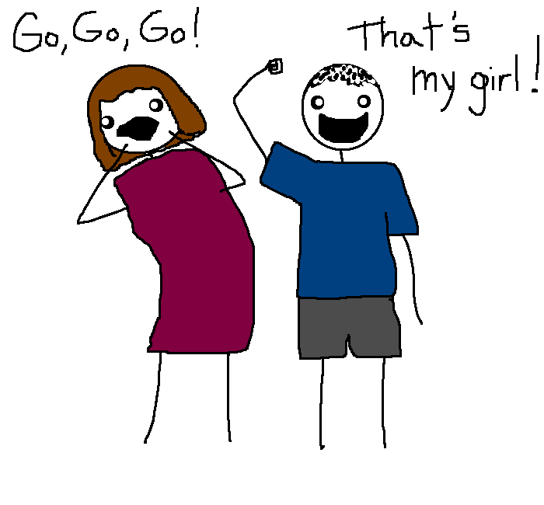
Advice to Parents for Race day
It’s completely normal to become emotional when supporting your child at swimming events. It shows you care, are involved in their life, and keen to share the pressure with them as they compete.
But when supporting your child at swimming events it’s important to be calm and supportive, rather than turning in to an overbearing “balcony ogre” once your child hits the water.
We know the pool balcony can be a stressful area.
Hundreds of parents all desperate to communicate
with their child mixed with the stifling sauna-like
atmosphere of the pool. It’s not easy to keep calm.
However, no matter what happens, or how tense
things get, it’s important that you maintain discipline,
poise, confidence and control. Your kids will thank
you for it and it’ll help them perform better.

Slide 52
Tips for supporting your child
Ask your child how they would like you to be. While few kids like a balcony ogre barking negative comments, they may want you in the front row of the balcony, whooping and cheering for them as they line up to race. On the other hand, they may find it a bit off-putting and anxiety inducing, and would rather you remained calm and quiet. So, tip one is ask first.
Try to remember that although you’re sat within a crowd, your actions and words will still be noticed, most of all by your child. Think before you shout, and keep your body language, actions and your words positive.
If you’re starting to feel any frustration, try taking slow, deep breaths to keep calm. If something’s gone particularly badly, try counting down from 100 in your head, to give you time to form a rational response.

Slide 53
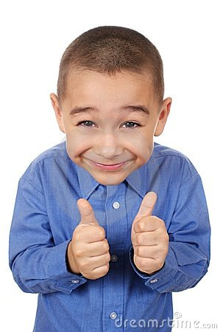
What should I expect from my child?
What should I expect in terms of results at Meets?
You should expect to see:
• Your child enjoying swimming with his / her friends;
• Your child learning to love challenging him / herself and taking pleasure in competition;
• Your child demonstrating all they have learnt in terms of swimming technique, dives, starts, turns, finishes, underwater kicking.
• Your child showing some self responsibility in their warm up, recovery, meet day nutrition and personal management.
• Your child showing a sense of “team” by cheering for team mates and supporting other members of the squad.

Slide 54
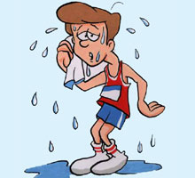
Parents – what you need to wear!!

Slide 55
Remember
Remember – ask the Head Coach or Assistant Head Coaches if you are unsure.

Slide 56
ANY QUESTIONS?

