Slide 1
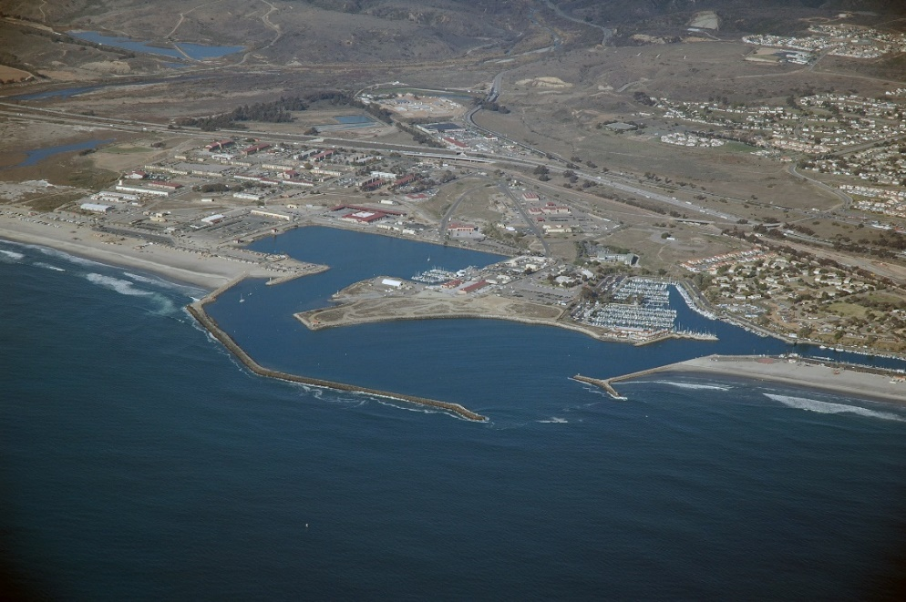

Beach Sand Update
Kiel Koger
Public Works Director
May 25, 2021

Slide 2
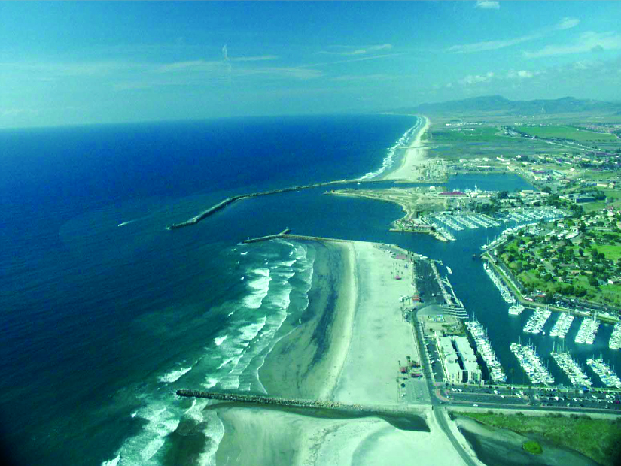
Harbor Dredging
Large breakwater jetty on north side of harbor entrance restricts sand transport north and south along the coastline
Sand becomes trapped at the harbor entrance

Slide 3
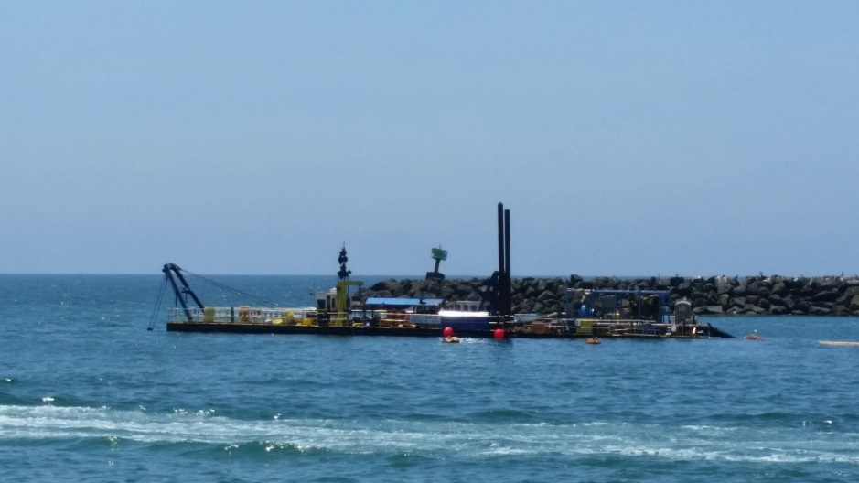
Harbor Dredging
Maintenance dredging performed annually prior to Memorial Day Weekend
Dredging done to ensure safe navigation for boaters
Project paid by Corps of Engineers and Navy
Approximately 225,000 cubic yards of sand dredged and placed on Oceanside beaches each year

Slide 4
Harbor Dredging
The 2021 dredging work started on April 13 and was completed on May 12
350,000 cubic yards of sand was dredged
Dredge to a depth of -30 feet
Sand primarily placed at North Coast Village, Surfrider Way and Pier
Grunion run starting in late April which limited the amount of sand that could be placed south of the pier

Slide 5
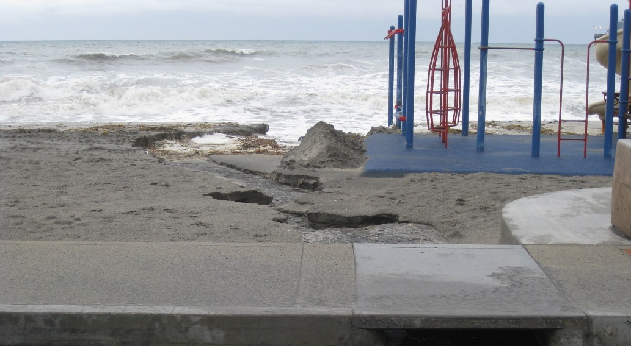
Contributed Funds Agreement
City signed agreement with the Corps to contribute $600,000 (55,000 cubic yards) to the project for additional sand to be placed on the beach
City last contributed to the project in 2016 when 440,000 cubic yards of sand total was dredged (City funded 80,000 cubic yards)

Slide 6
Sand Feasibility Study
City Council gave direction to staff in October 2019 to pursue beach sand replenishment and retention options
Due to the Corps of Engineers inability to complete the Shoreline Special Study originally authorized by Congress in 2000.
The Shoreline Special Study was to estimate the impacts of erosion on the shoreline caused after construction of Camp Pendleton Harbor and consider practices to ultimately restore sand to City beaches.

Slide 7
Sand Feasibility Study
City issued RFP for preliminary engineering evaluation and feasibility study in November 2019
Shortlisted firms were interviewed in January 2020
Negotiated contract with most qualified firm went to City Council to award on April 2020
Study will identify feasible options to protect the beach from long term erosion through either replenishment or retention devices or a combination of both.
Study will take approximately 1 year to complete and includes public and agency outreach (Sept 15, 2020 and June 30, 2021)

Slide 8
Going Forward
Complete Sand Feasibility Study and take to City Council for approval to move forward in August 2021
Next phase of project (design and permitting)
Request SANDAG to perform another regional beach nourishment project similar to 2001 and 2012 projects
Request Corps to finish Shoreline Special Study and move project forward. May be possible with earmarks
San Luis Rey Sediment Removal Project – Congress approved raising the project limit (WRDA 2020 bill) and push for funding to complete the project
Sand Compatibility Opportunistic Use Permit (SCOUP) – Look for potential sources of beach quality sand made available from development projects to deposit on local beaches

Slide 9
Questions?

