Slide 2
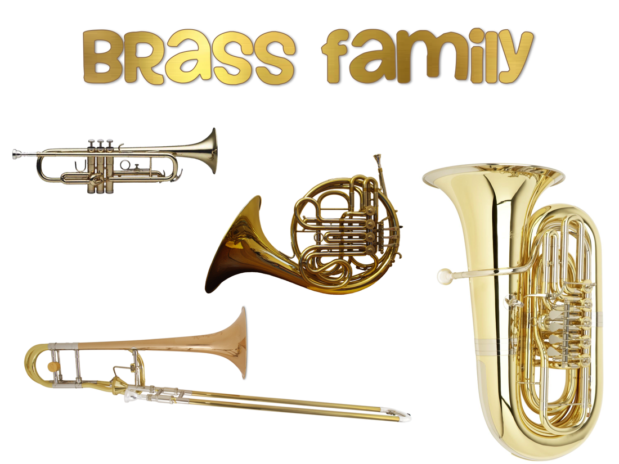
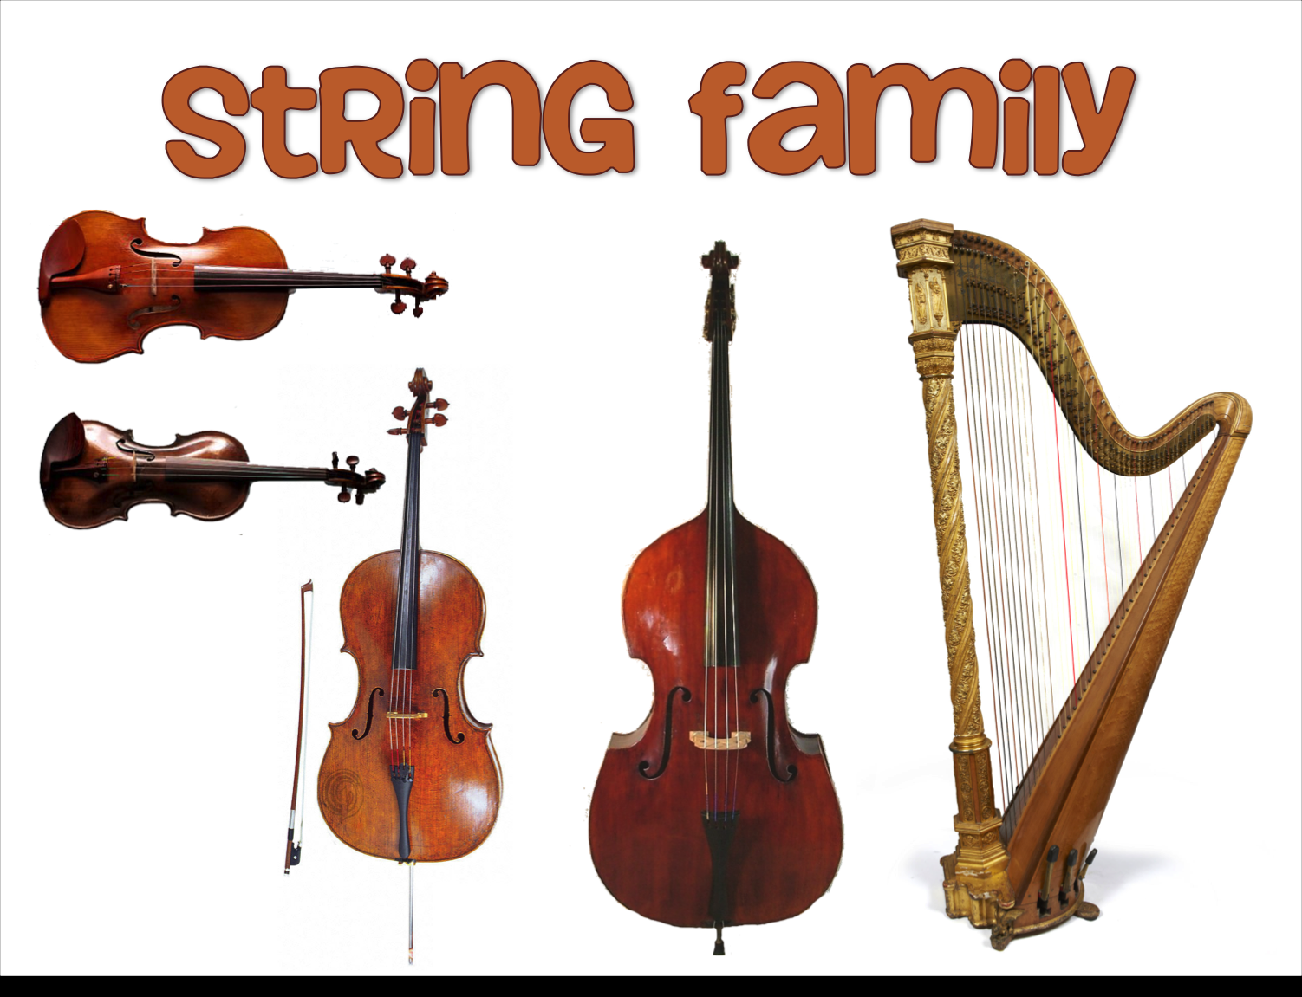
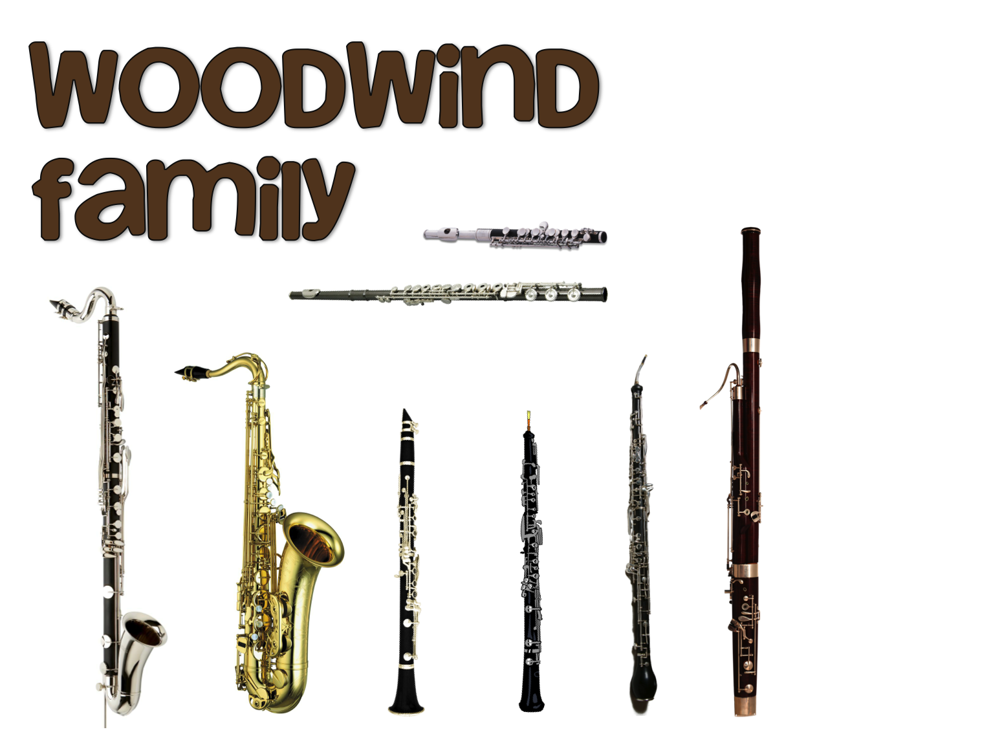

Slide 3
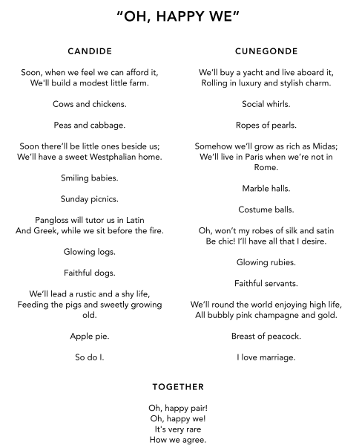

Slide 4
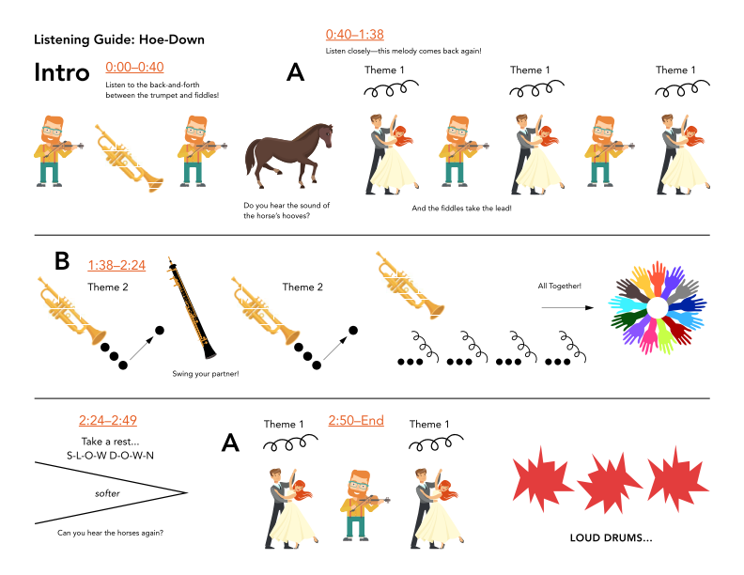

Slide 5
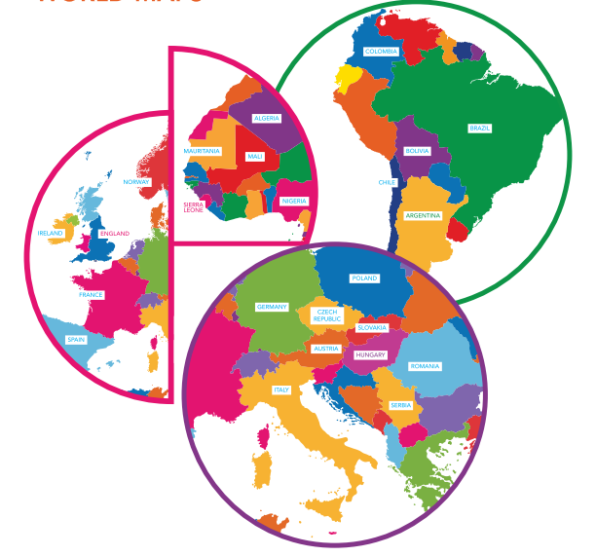
USA
Bernstein, Copland
FRANCE
Bizet
SIERRA LEONE and ENGLAND
Coleridge-Taylor
HUNGARY
Bartók
ARGENTINA
Ginastera

Slide 6
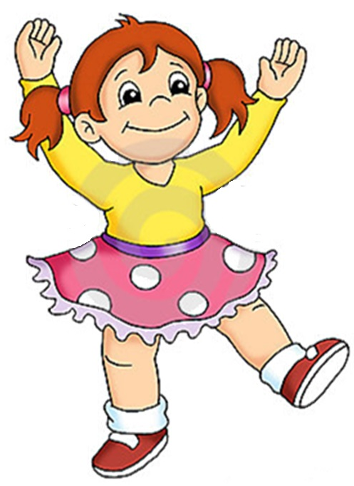

Slide 7
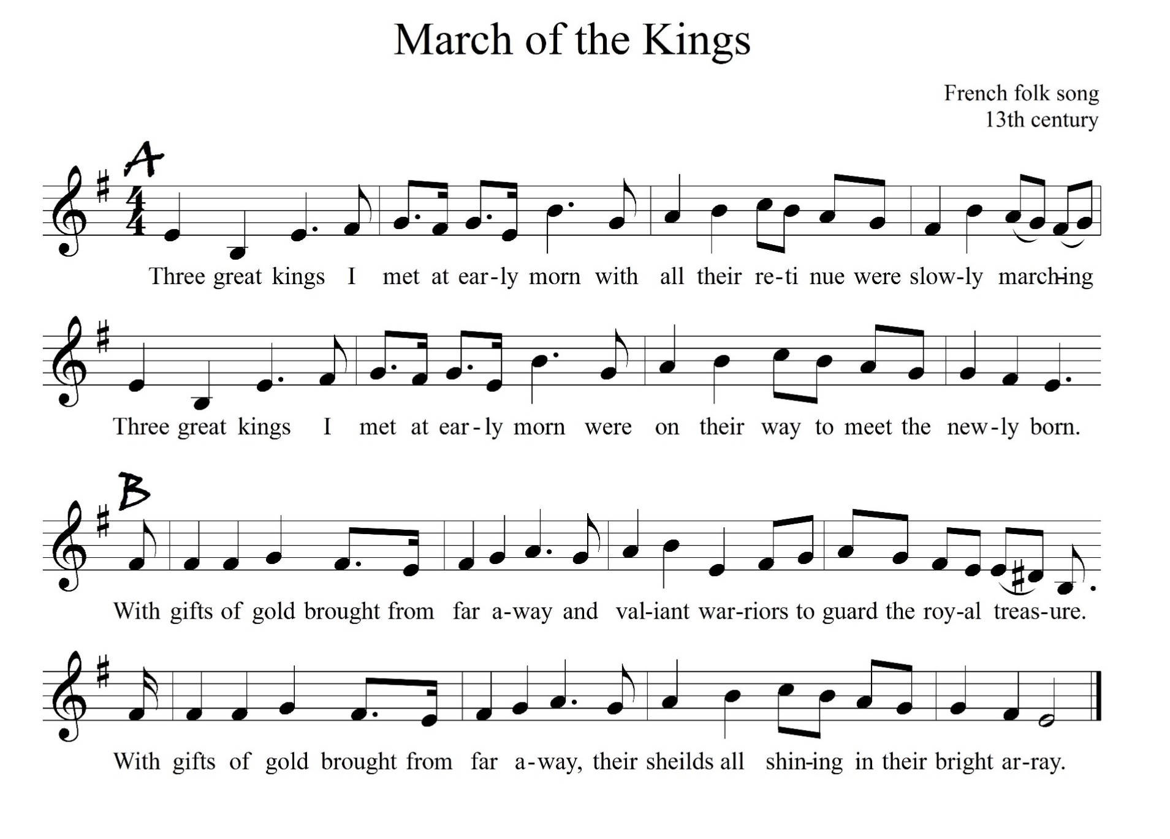

Slide 9
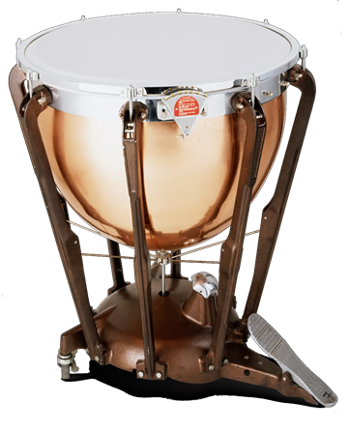
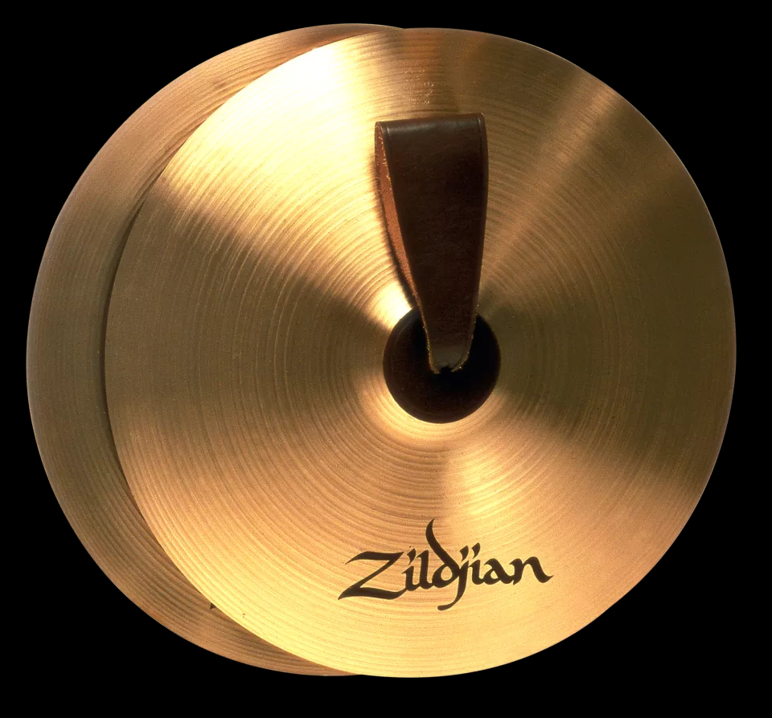
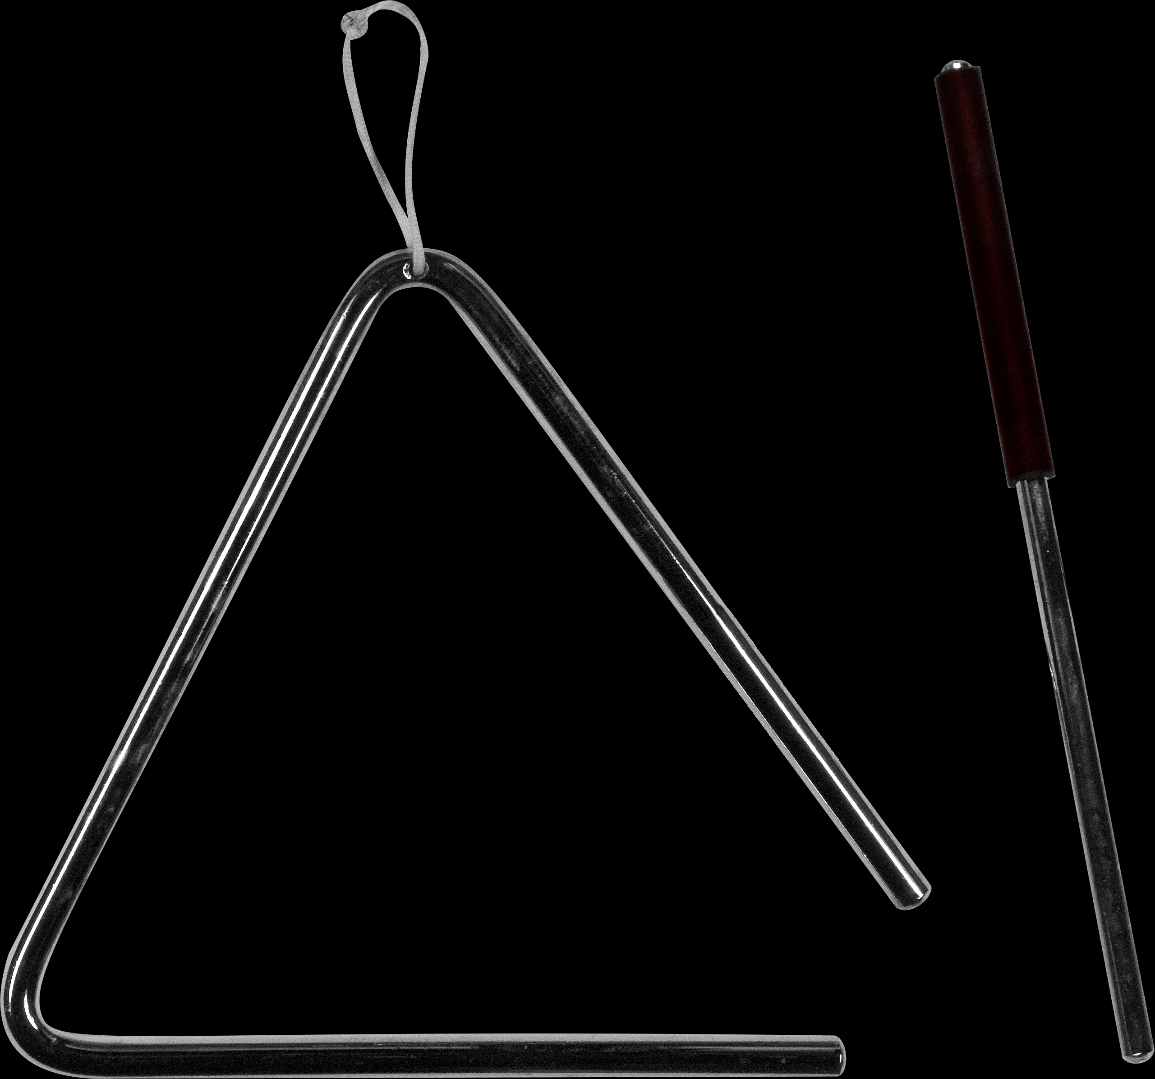
Danse Negre
cymbals
timpani
triangle

Slide 10
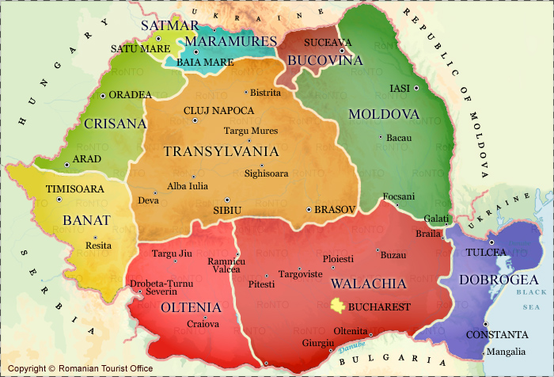
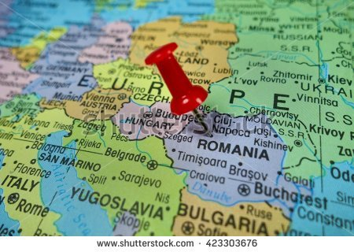
4
5
6
7
1
2
3

Slide 11
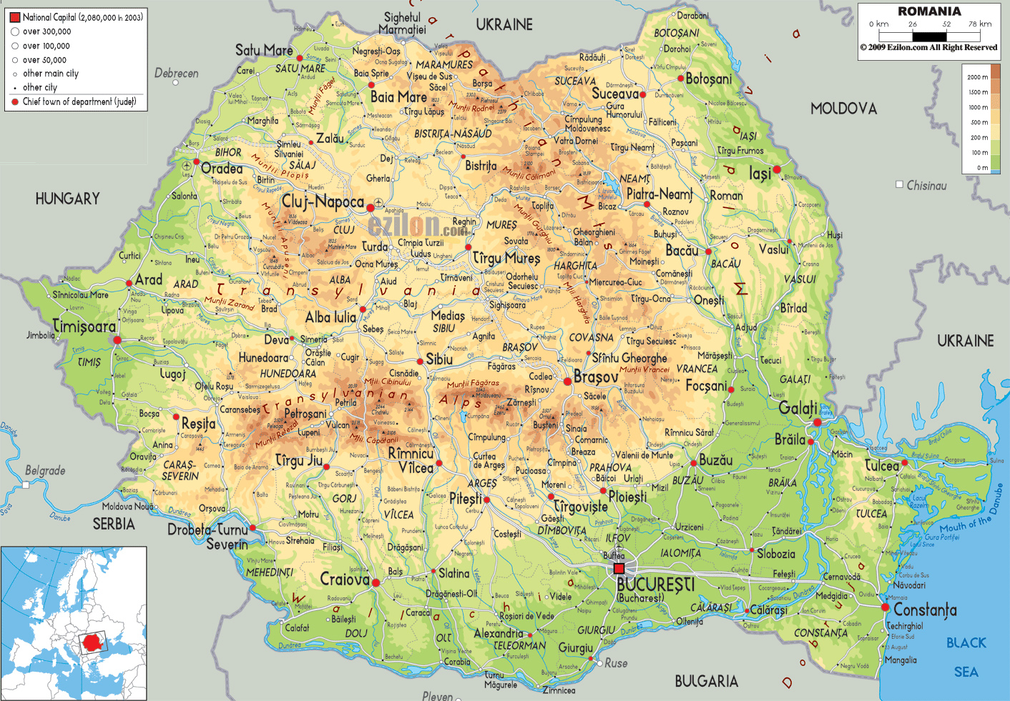
4
5
6
7
1
2
3

Slide 12
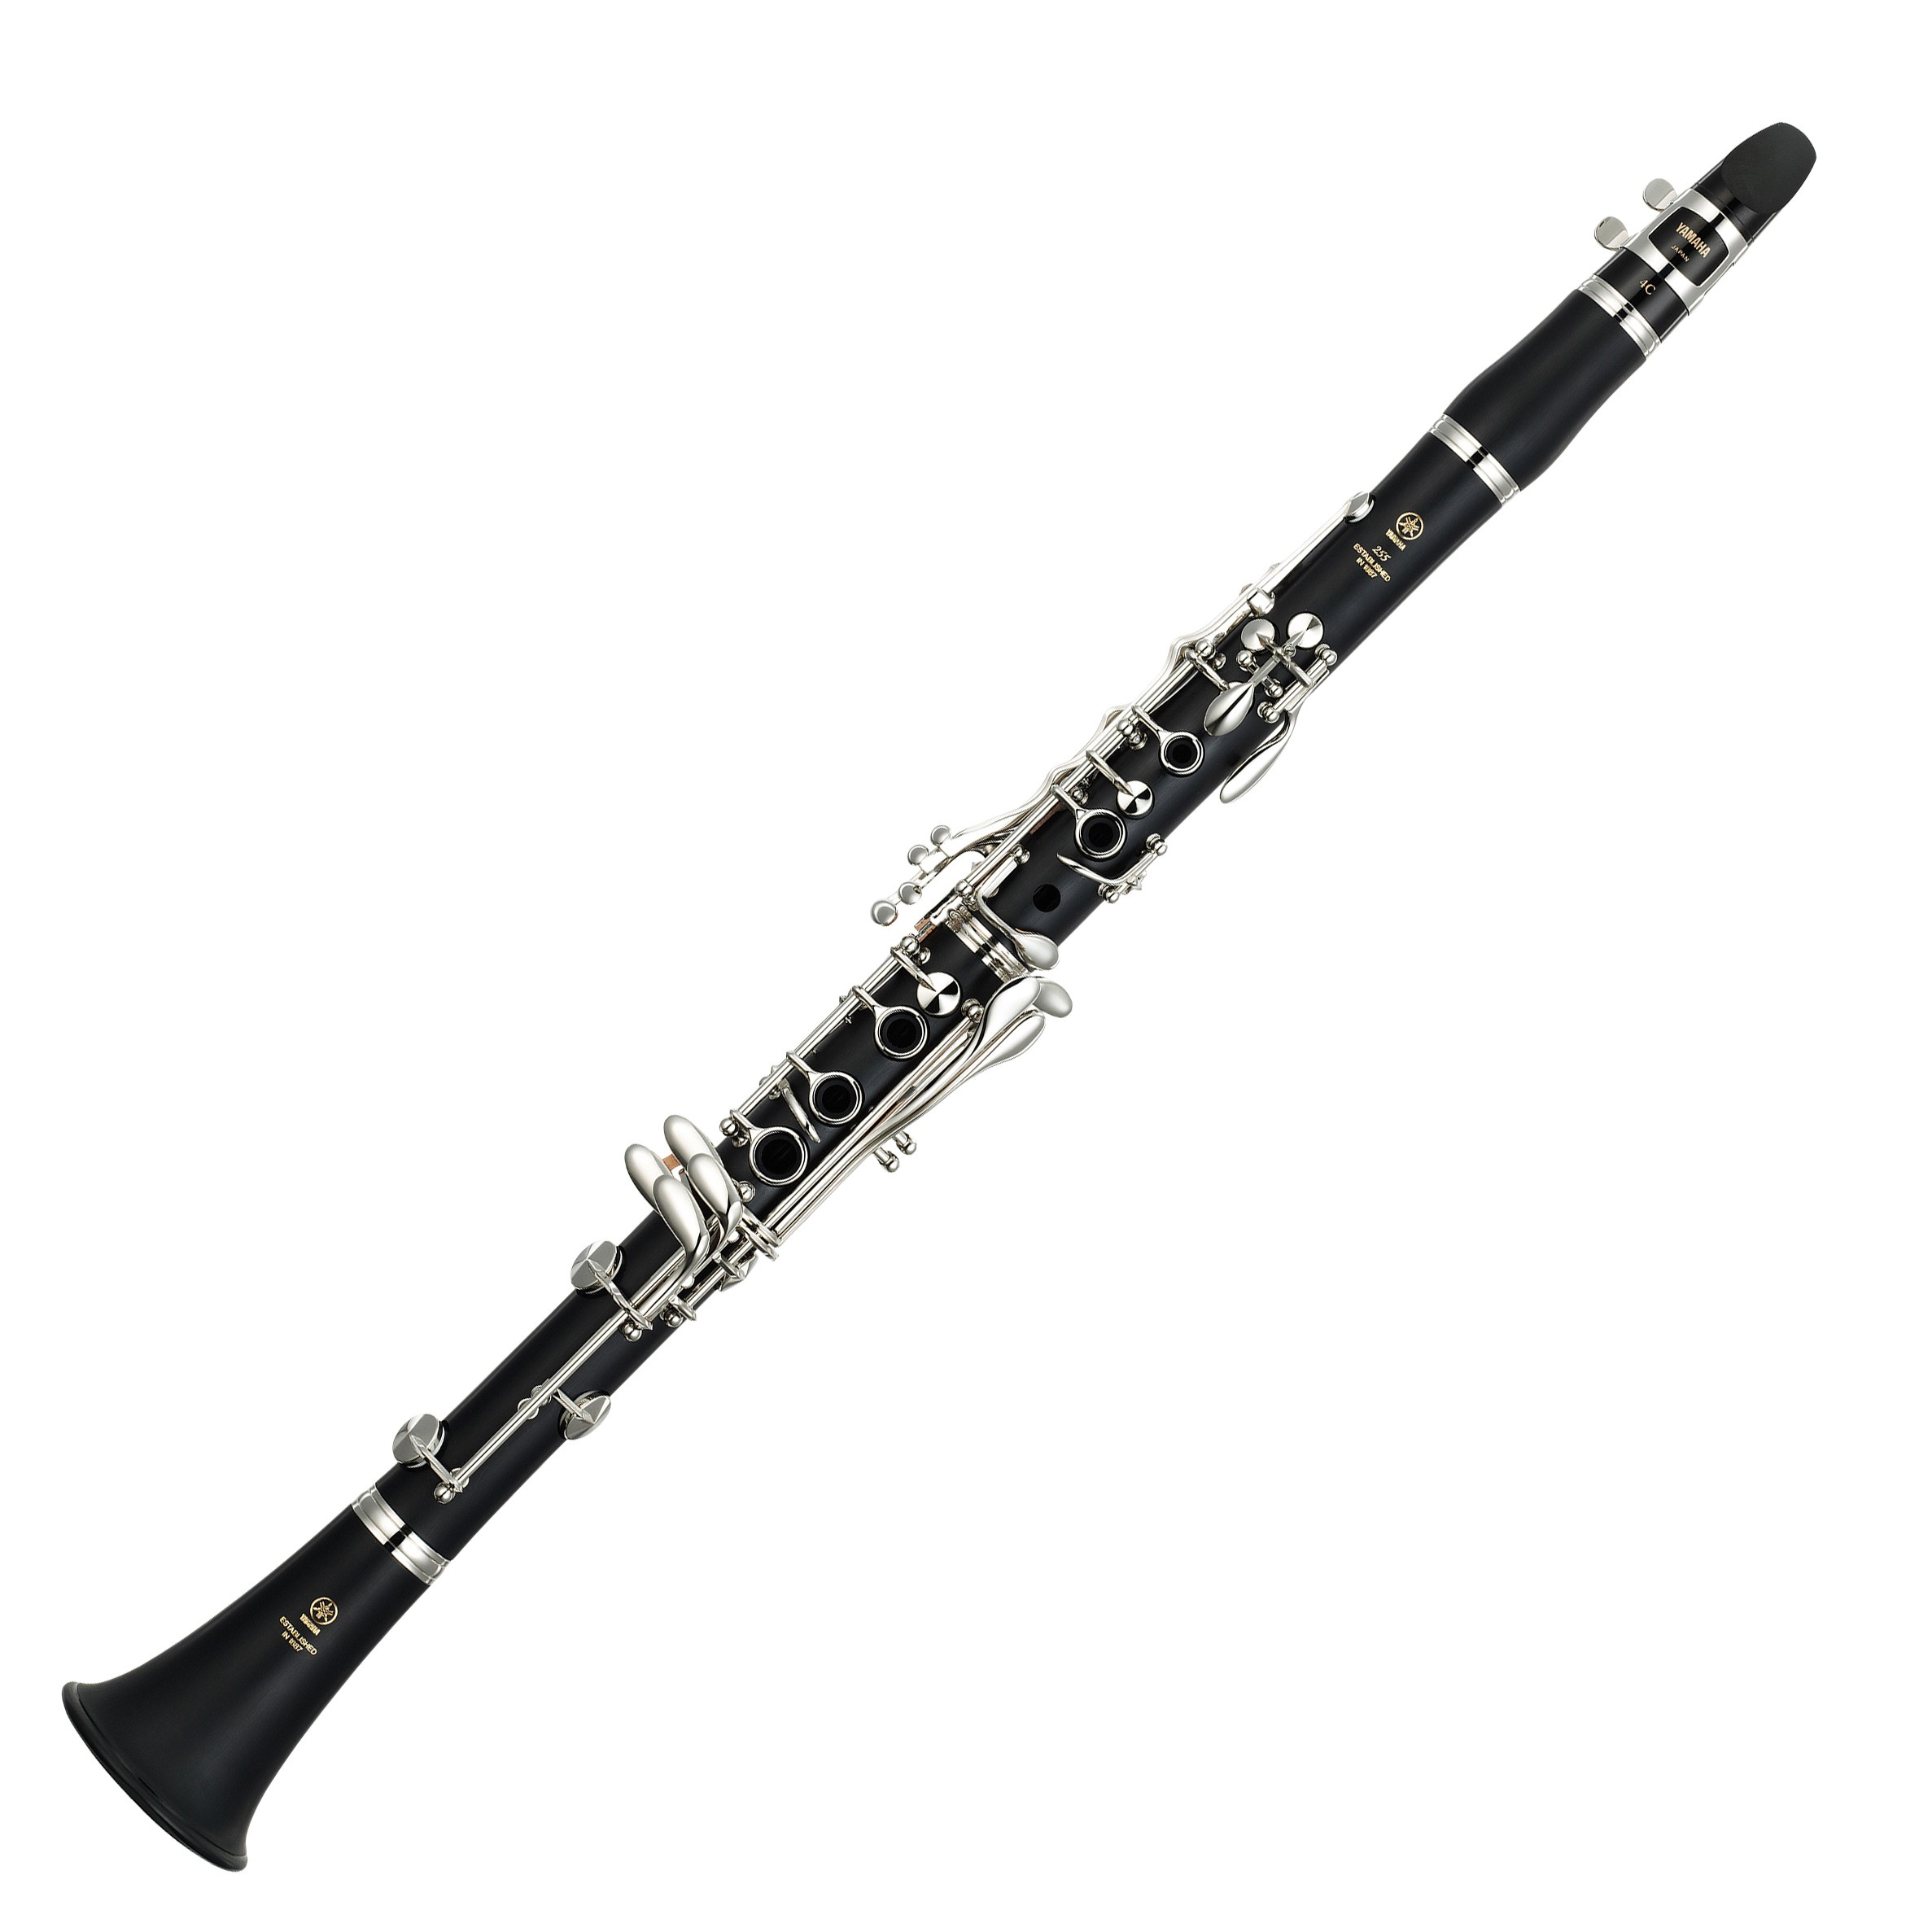
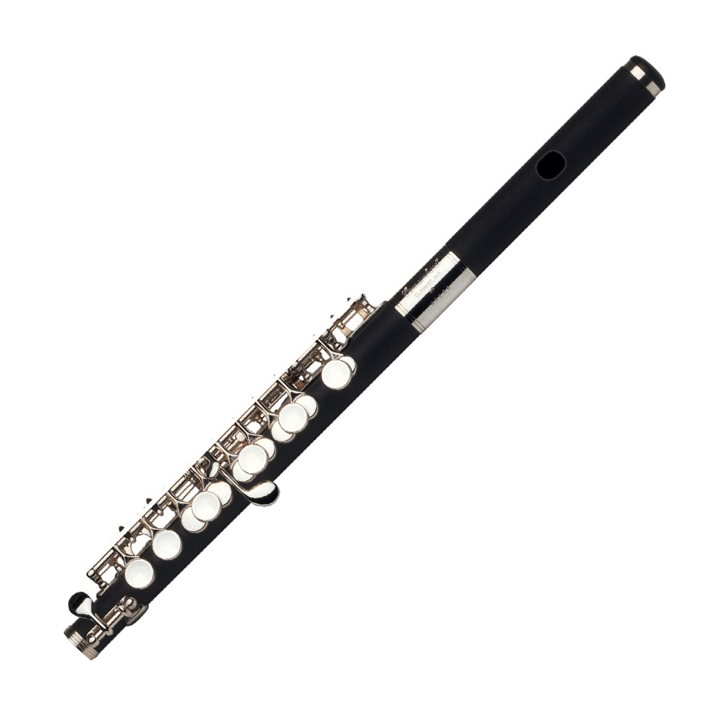
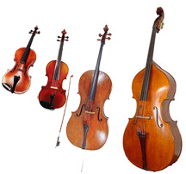
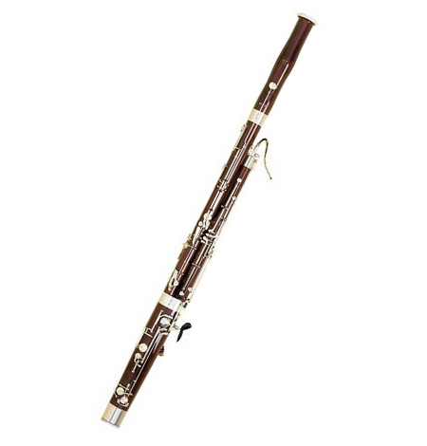
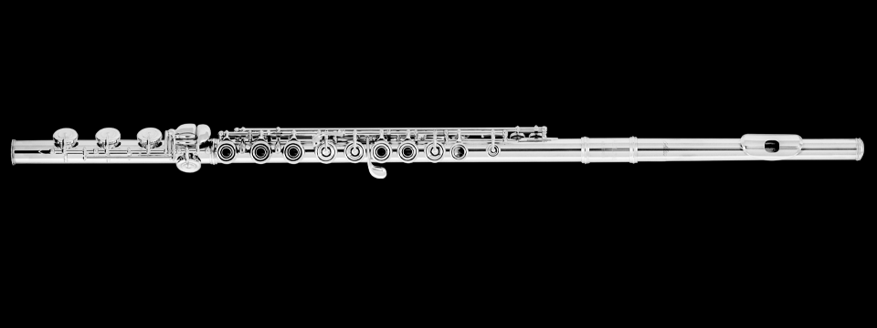
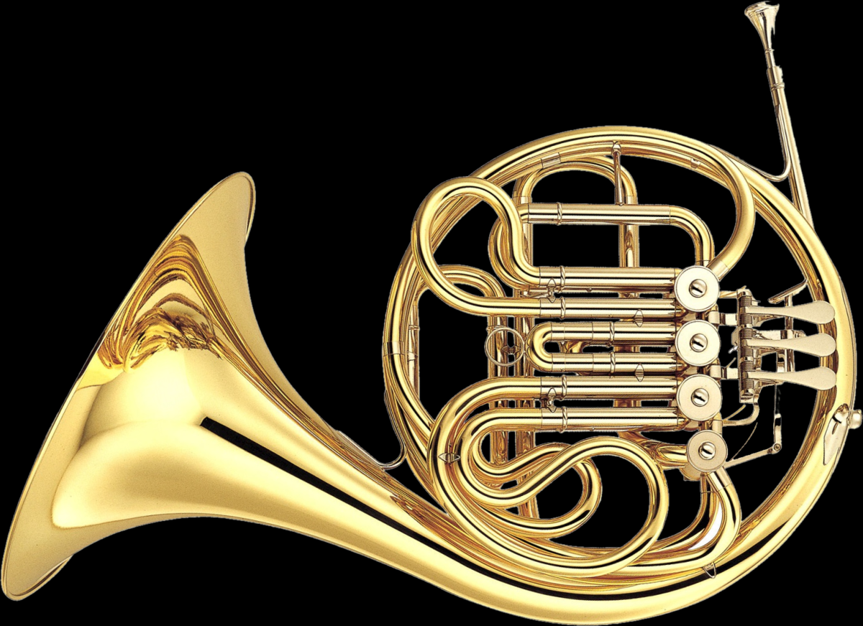
Bartok’s Romanian Dances
Who is the new “friend” in this dance?
Why is the clarinet easier to hear
in the second dance?
Which member of this family
is playing the solo?
Dances #1 & #2
Dance #3
Dance #4
Is the bassoon playing higher
or lower than the flute?
Which member of the Brass Family
has joined the group?
Dances #5
Dances #6 & #7

Slide 13
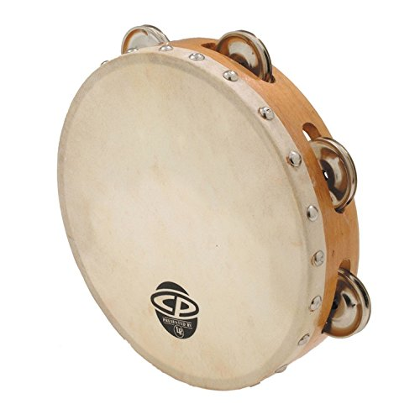
Ginastera’s Malambo

