Slide 1
Understanding Plagiarism
Robin James Mayes
Researcher and Author in the field of ETHICS.

Slide 2
My Research
Clarification of what plagiarism is.
Defining COA a strategy using Turnitin.
Measuring Plagiarism in both Student and Author works.

Slide 3
What is Plagiarism?
The Latin word plagiarius (kidnapper) used to denote stealing someone else's work was credited to the Roman poet Martial, who complained that another poet had "kidnapped his verses".
https://en.wikipedia.org/wiki/Plagiarism

Slide 4
Why The Concern?
Student-Cheating
Fairness
Fraud
Professional-Theft
Loss of Income
Loss of Recognition

Slide 5
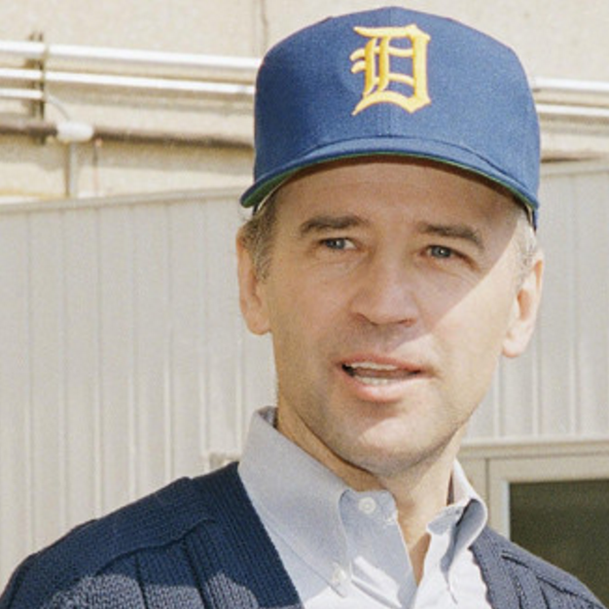
Joe Biden
The vice president was forced to withdraw from the 1988 presidential race over allegations of plagiarism. Many parts of Biden’s speeches on the trail, as Maureen Dowd of the New York Times reported, were lifted from the unsuccessful run of British politician Neil Kinnock of the Labor Party against Prime Minister Margaret Thatcher. Revelations followed that Biden took parts of his speeches from Robert Kennedy, JFK and Hubert Humphrey.
Read more: http://www.politico.com/gallery/2014/07/10-high-profile-plagiarism-cases-001770#ixzz4IkMoevOH Follow us: @politico on Twitter | Politico on Facebook

Slide 6
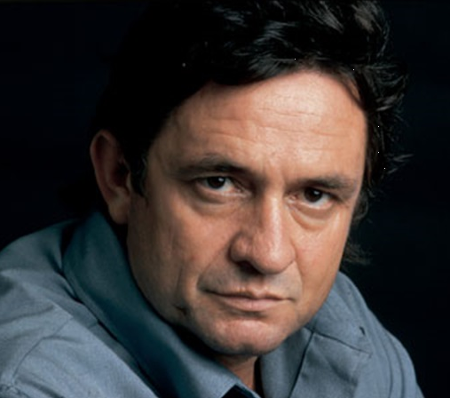
Johnny Cash
In 1955 Johnny Cash recorded the song “Folsom Prison Blues”, the tale of a convicted murder being tortured by the sound of a passing train while stuck in prison. It was released that year and rereleased again in 1968 after he performed the song at Folsom Prison.
However, Cash had lifted the melody and much of the lyrics from a 1953 song “Crescent City Blues” by Gordon Jenkins, about a narrator hoping to get out of a small midwest town. Though Cash had changed the song fairly drastically, turning it into a piece about regret and imprisonment, the similarities were still more than glaring.
The plagiarism resulted in a lawsuit, which was quickly settled with Cash paying $75,000 to put the issue to rest. That amount is worth about $660,000 today.
Read & Listen more:
https://www.plagiarismtoday.com/2015/02/10/5-great-people-who-plagiarized/
https://www.youtube.com/watch?v=jdCtc1WE3E0

Slide 7
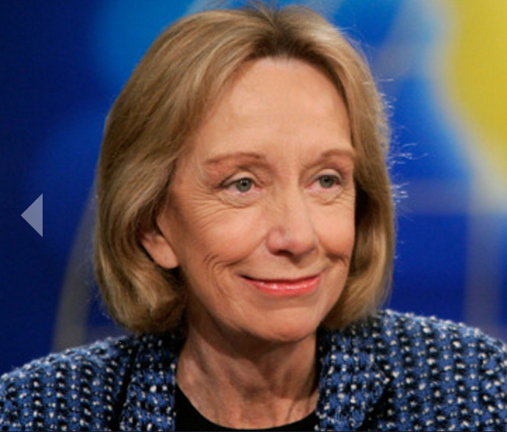
Doris Kearns Goodwin
a former Lyndon Johnson aide, was accused of using phrases from other books in her own, including the popular The Fitzgeralds and the Kennedys. Goodwin claimed it was accidental and withdrew unsold copies of the book to correct it.
Read more: http://www.politico.com/gallery/2014/07/10-high-profile-plagiarism-cases-001770#ixzz4IkPaXJ88 Follow us: @politico on Twitter | Politico on Facebook

Slide 8
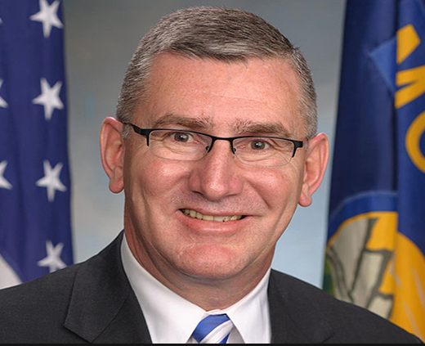
Sen. John Walsh
The Senator of Montana took most of a 2007 final paper required for his master’s degree from the United States Army War College from other sources without proper attribution. Mr. Walsh copies an entire page nearly word-for-word from a Harvard paper, and each of his six conclusions is copied from a document from the Carnegie Endowment for International Peace without attribution. the College revoked Walsh's degree.
Read more:
http://www.nytimes.com/interactive/2014/07/23/us/politics/john-walsh-final-paper-plagiarism.html?_r=0

Slide 9
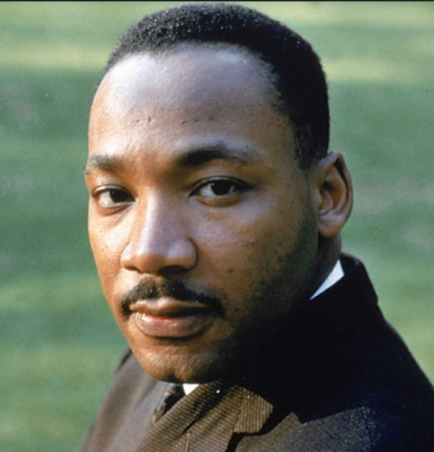
Martin Luther King Jr.
King’s most prominent run-in with plagiarism took place in 1955. In support of his doctorate at Boston University, King turned in a dissertation entitled, “A Comparison of the Conceptions of God in the Thinking of Paul Tillich and Henry Nelson Wieman.” He was able to successfully defend his dissertation and went on to receive his degree. Boston University did investigate the allegations of plagiarism and, in 1991, found that King’s dissertation did contain plagiarism. However, while the school appended a note to the dissertation, it declined to revoke his degree saying that the dissertation, despite its shortcomings, still contributed to the field.
Read more:
https://www.plagiarismtoday.com/2015/02/10/5-great-people-who-plagiarized/

Slide 10
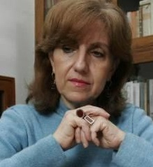
Prof. Luz Mary Giraldo
2010 Colombian Supreme Court of Justice decision that sentenced Professor Luz Mary Giraldo to two years in prison plus monetary and civil sanctions for plagiarizing a student's thesis, "The Poetic World of Giovanni Quessep."
Rubio, C. C. (2013). COLOMBIAS POETIC WORLD OF AUTHORS; MORAL RIGHTS: CONSIDERATIONS ON IMPRISONING A PROFESSOR FOR PLAGIARISM. Pacific Rim Law & Policy Journal, 22(1), 141-155.
David Cromwell. (2012). PUNISHING THE PEN WITH THE SWORD?: COLOMBIA'S NEW, EXTREME, AND INEFFECTIVE PUNISHMENT FOR PLAGIARISM. Pacific Rim Law & Policy Journal Association.

Slide 11
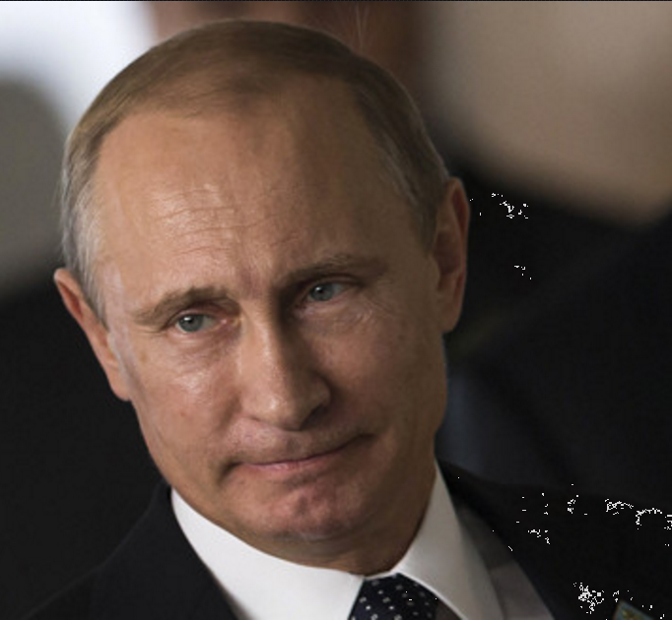
Vladimir Putin
The Russian leader and John Walsh now have something in common: Both have been accused of plagiarizing their theses. In 2005, researchers at the Brookings Institute managed to get their hands on a copy of Putin’s thesis, called “Strategic Planning of the Reproduction of the Mineral Resource Base of a Region under Conditions of the Formation of Market Relations.” The Brookings researchers said it lifted liberally from a 1978 textbook written by two University of Pittsburgh professors.
Read more: http://www.politico.com/gallery/2014/07/10-high-profile-plagiarism-cases-001770#ixzz4IkQEnuzD Follow us: @politico on Twitter | Politico on Facebook

Slide 12
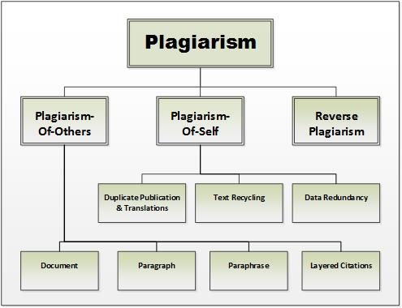
Types of Plagiarism?

Slide 13
Contributing Factors
Misconceptions
Mistakes & Errors
Fraud (Laziness/Procrastination)
Cultural Differences

Slide 14
Knowledge Consequences
Learning is writing, plagiarism is not.

Slide 15
Personal Consequences
Failing &/or Expulsion
Article Retraction
Academic/Publishing Career Jeopardy
Legal Entanglement

Slide 16
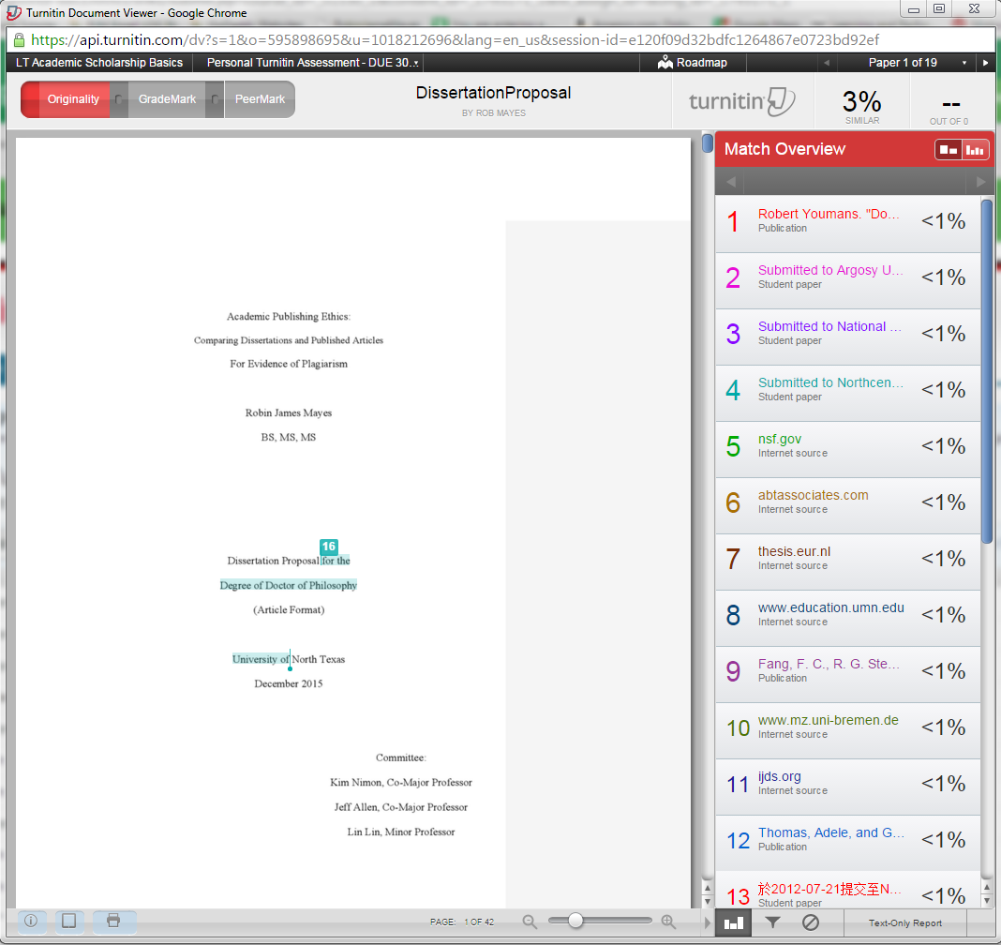
Turnitin Web

Slide 17
One of Many Similarity Standards
0-14% is acceptable.
15%-24 is high.
25% & more is Excessive.

Slide 18
Results
Detection is difficult in published works
Detection is easy in student course work.

Slide 19
Solutions
Clarifying the Science of Plagiarism to Students
Have Students Participate
Level the Playing Field.

Slide 20
Avoiding Plagiarism
How do you write without creating plagiarism issues? EASY.
Read all your sources that apply to your essay. Take notes.
Create your title and subheadings.
...Create the reference section in your paper (You will need to continually edit the list by adding to it and deleting unused ones.)
Now write your article in your own words with your understanding of the materials without directly looking at your sources. (DO NOT COPY, PASTE and EDIT)
Next cite any ideas you found in your sources that are not yours. You do not have to cite every sentence.
If you want to add some exact quotes, cite with a page number. Rob (2013) stated that "Small quotes are just placed within the text" (p.45).
Rob (2013) also added that:
Large quotes such as a whole paragraph need to be separated out and indented. Quote marks are not needed. However, do not go over board on quotes. You want the reader to know you are the author and not just copying a bunch of text (p.46).
If you used an image you should say where it came from and cite it.
Note: You can cite one reference several times.

Slide 21
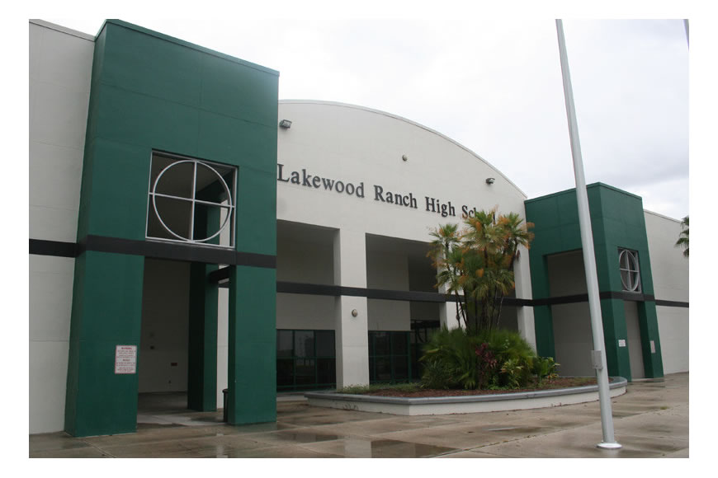
Plagiarism Events
Teachers at Lakewood Ranch High
School gave failing grades to a group
of honors-level English students who
were accused of plagiarizing work
from Internet sites, an administrator
and the school principal said.
Several students in the sophomore
honors-level English program received
"zero" grades on a summer assignment.
Some parents are worried that even the hint of plagiarism could tarnish the academic reputations, and collegiate or employment aspirations, of some of Manatee County's brightest students.
Parents are more concerned over the possible long-term ramifications of their children being labeled plagiarists.
Read more: http://www.heraldtribune.com/article/20060909/NEWS/609090372

Slide 22
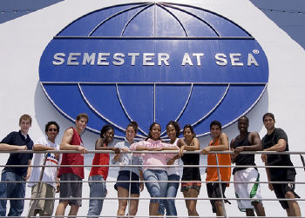
Plagiarism Events
An Ohio University student was kicked out of her Semester at Sea program and dropped off in Greece after being accused of plagiarism, according to the Post, the student-run newspaper at OU. Her expulsion, along with the dismissal of a student from California Baptist University, has put the spotlight on the strict, single-sanction honor code enforced by the University of Virginia, which sponsored the program.
OU senior says she was expelled
for taking three sentence
fragments verbatim from
Wikipedia and for paraphrasing
a movie Synopsis from the site...
The appeal she mounted was
also dismissed.
http://www.usnews.com/education/blogs/paper-trail/2008/08/14/two-students-kicked-off-semester-at-sea-for-plagiarism

Slide 23
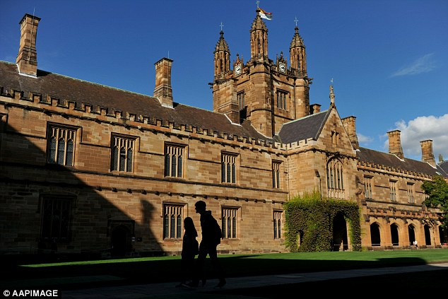
Plagiarism Events
Hiring imposters to sit exams and blatant copying: New report says students are going to extreme lengths to raise their grades as 16 universities are caught up in plagiarism scandal The report found that 'plagiarism, collusion, recycling and ghost writing' were problems seen within a number of take-home assignments but was also
seen extensively across
multiple choice
examinations.
Read more: http://www.dailymail.co.uk/news/article-3192473/New-University-Sydney-report-proves-students-going-extreme-lengths-pass-exams-16-universities-caught-plagiarism-scandals.html#ixzz4IkrfvPvE

Slide 24
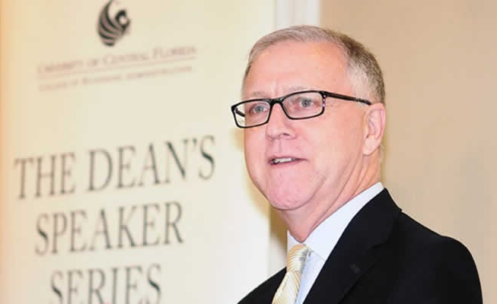
Plagiarism Events
Schminke and Ambrose (2014) authored an editorial explanation to the retraction of one of their previous editorials.
Schminke, M. & Ambrose, M. L. (2014). Retraction statement for 'Ethics and Integrity of the Publishing Process: Myths, Facts, and a Roadmap'. Management and Organization Review, 10:1, March 2014, 157–162

Slide 25
Donatus
“Perish those who said our good things before we did.”
Donatus. (2013). Columbia Electronic Encyclopedia, 6th Edition, 1 &
http://famous-quotes.com/author.php?aid=2084
Donatus (Aelius Donatus) (ē′lēəs dōnät′əs), fl. 353, Roman grammarian; teacher of St. Jerome. His only well-known work, the Ars grammatica [elements of grammar], was throughout the Middle Ages the standard elementary Latin grammar.

Slide 26
Thank You Audience Questions & Suggestions
Rob Mayes

