Slide 1
Linkage Institutions
What are they? What do they do?

Slide 2
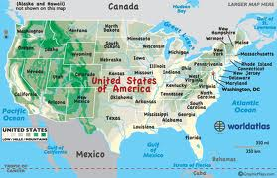
It's a big country out there. Not only does the United States have nearly 312 million CITIZENS, it has so much territory that most Americans live a long way from the White House.

Slide 3
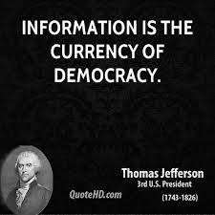
Democracy depends on meaningful contacts between the people and the government.
How does this happen in modern America?

Slide 4
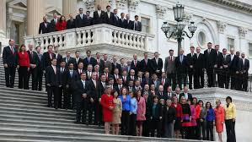
The Founders intended for members of Congress to provide the link between citizens and government.
Today, however, each House member represents almost 65,000 people, so we have to rely on other linkage institutions to connect the citizens (public) to the policy makers (government) as well.

Slide 5
What Are Linkage Institutions?
In the modern United States, four types of groups, known as LINKAGE INSTITUTIONS, play a vital role in connecting citizens to the government.
They are not officially a part of the government, but without them, a democracy would be difficult to maintain.
These groups in American politics include the following.

Slide 6
Political Parties
POLITICAL PARTIES represent broad points of view—or IDEOLOGIES—(party generalists) that present people with alternative approaches to how the government should be run.
Each party seeks political power by nominating and electing people to office so that its positions and philosophy become public policy.
For example, both the Republican and Democratic candidates for president present competing plans for solving a wide array of public issues.
People, then, link to their government by identifying themselves as "Democrats," "Republicans," or "Reform" party members, for example.

Slide 7
Campaigns and Elections
CAMPAIGNS and elections involve citizens by reminding them of their ultimate power: the vote.
Campaigns today are increasingly elaborate and long, cost millions of dollars, and attract the public's attention in any way they can.
For all the expense and glitz, the process of electing government officials provides citizens with vital information regarding issues and candidates' qualifications for office.

Slide 8
Interest Groups
INTEREST GROUPS organize people with common interests and attitudes to influence government to support their points of view.
They generally represent only one issue or a closely related set of concerns and give money to candidates who will support their cause. They are party specialists!
So, people can organize according to their profession, business, corporation, or hobby — yet another way to "link" to government.

Slide 9
Media
The MEDIA play an important role in connecting people to government.
Most of us find out about candidates for office, public officials' activities, and the burning issues of the day through television, newspapers, radio, and the Internet. States tend to hold primaries early to grab all the media attention—front-loading!
The media's power to shape the American mind has often been criticized, but it also allows people to give feedback to the government.

Slide 10
Importance of Linkage Institutions
Democracy still works though, partly because linkage institutions make important connections that allow the government to hear what its people are saying.

