Slide 1
Five Essential Components of Mathematics Intervention
CAMT
July 10, 2019

Slide 2
srpowell@austin.utexas.edu
@sarahpowellphd
119

Slide 3
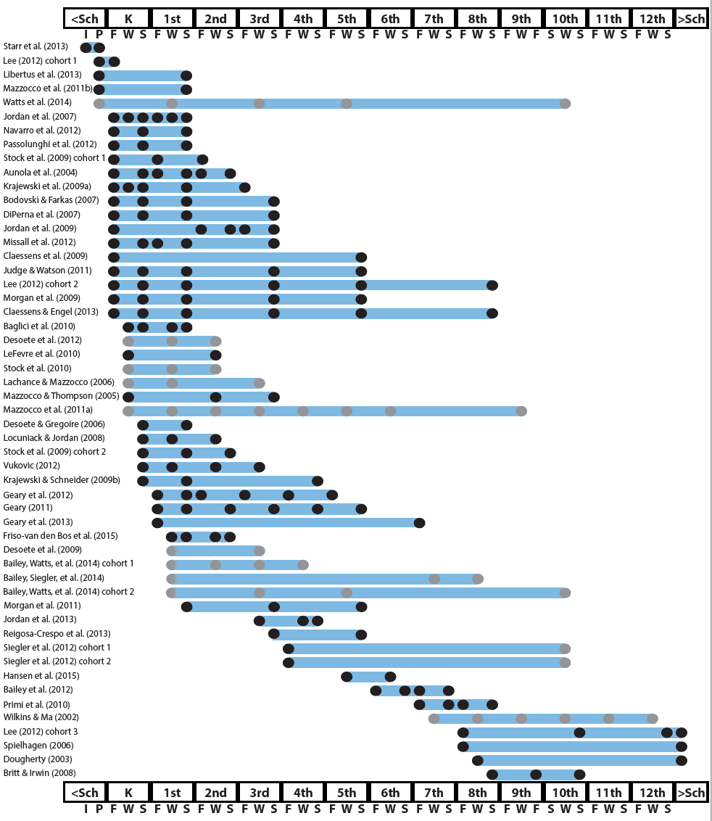
Mathematics in preschool predicts later mathematics
Mathematics in kindergarten predicts later mathematics
http://www.greatertexasfoundation.org/trajectories-of-mathematics-performance/
Mathematics in elementary school
predicts later mathematics
Mathematics in middle school
predicts later mathematics
Mathematics in
high school
predicts later outcomes

Slide 4
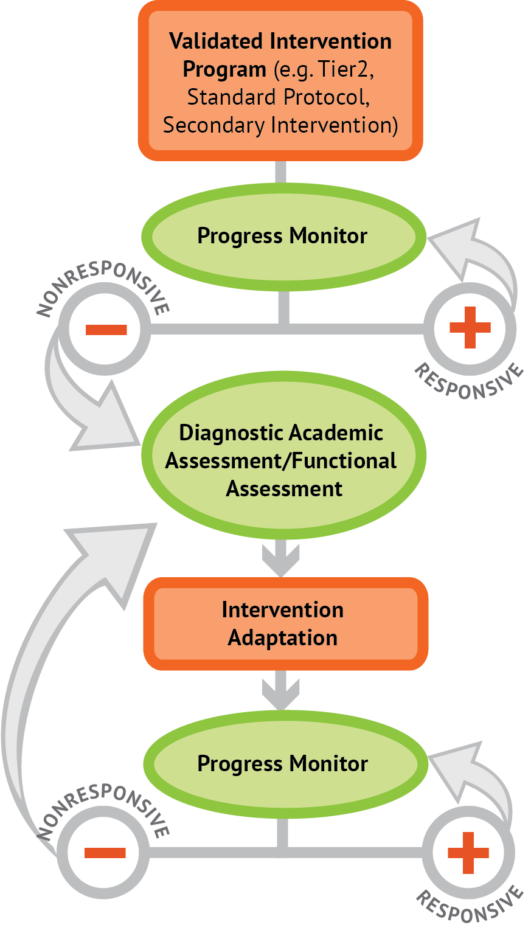
Intervention: Occurs frequently and with intensity
Assessment: Formative
Assessment: Diagnostic
Intervention adaptation: Content, dosage, explicit instruction, attention to transfer
Assessment: Formative

Slide 5
Instructional Platform
INSTRUCTIONAL DELIVERY
Explicit instruction
Concise language
Multiple representations
INSTRUCTIONAL STRATEGIES
Fluency building
Problem solving instruction

Slide 6
Modeling
Practice
Clear Explanation
Guided
Practice
Planned
Examples
Independent Practice
Supporting Practices
Asking the right questions
Eliciting frequent responses
Providing immediate specific feedback
Maintaining a brisk pace

Slide 7
Goal and importance
Modeling
Clear Explanation
“Today, we are learning about division. This is important because sometimes you have to share objects or things with your friends.”
Planned
Examples
“Let’s continue working with our three-dimensional shapes and volume. Understanding volume and calculating volume helps with measuring capacity.”

Slide 8
Goal and importance
Modeling
Clear Explanation
Model steps
Planned
Examples
“To solve 26 plus 79, I first decide about the operation. Do I add, subtract, multiply or divide?”
“The plus sign tells me to add. So, I’ll add 26 plus 79. I’ll use the partial sums strategy. First, I add 20 plus 70. What’s 20 plus 70?”
“20 plus 70 is 90. I write 90 right here.”
“Then I add 6 plus 9. What’s 6 plus 9?”
“6 plus 9 is 15. So, I write 15 here.”
“Finally, we add the partial sums. What do we add?”
”So, we add the partial sums of 90 and 15. 90 plus 15 is 105. So, 26 plus 79 equals 105.”

Slide 9
Goal and importance
Modeling
Clear Explanation
Model steps
Planned
Examples
Concise language
“To solve 26 plus 79, I first decide about the operation. Do I add, subtract, multiply, or divide?”
“The plus sign tells me to add. So, I’ll add 26 plus 79. I’ll use the partial sums strategy. First, I add 20 plus 70. What’s 20 plus 70?”
“20 plus 70 is 90. I write 90 right here.”
“Then I add 6 plus 9. What’s 6 plus 9?”
“6 plus 9 is 15. So, I write 15 here.”
“Finally, we add the partial sums. Why do we add the partial sums?”

Slide 10
Goal and importance
Modeling
Clear Explanation
Model steps
Planned
Examples
Concise language
Examples
“Today, we are learning about division. This is important because sometimes you have to share objects or things with your friends.”
24 / 6
28 $÷$ 7
35 $)$ 5

Slide 11
Goal and importance
Modeling
Clear Explanation
Model steps
Planned
Examples
Concise language
Examples
With non-examples
32 $÷$ 8
42 $÷$ 7
25 $−$ 5

Slide 12
Modeling
Practice
Clear Explanation
Guided
Practice
Planned
Examples
Independent Practice
Supporting Practices
Asking the right questions
Eliciting frequent responses
Providing immediate specific feedback
Maintaining a brisk pace

Slide 13
Practice
Teacher and student practice together
Guided
Practice
Independent Practice

Slide 14
Practice
Teacher and student practice together
Guided
Practice
Independent Practice
Student practices with teacher support

Slide 15
Modeling
Practice
Clear Explanation
Guided
Practice
Planned
Examples
Independent Practice
Supporting Practices
Asking the right questions
Eliciting frequent responses
Providing immediate specific feedback
Maintaining a brisk pace

Slide 16
Low-level and high-level
“What is 7 times 9?”
“Which shape has 6 sides?”
“What do you do when you see a word problem?”
Supporting Practices
“Why do you have to regroup?”
Asking the right questions
Eliciting frequent responses
Providing immediate specific feedback
Maintaining a brisk pace
“How would you solve this problem?”
“Why do you have to use zero pairs?”

Slide 17
Low-level and high-level
Classwide, individual, partner, write on paper, write on whiteboard, thumbs up, etc.
Supporting Practices
Asking the right questions
Eliciting frequent responses
Providing immediate specific feedback
Maintaining a brisk pace
“Turn and discuss the formula for perimeter with your partner.”
“Write the multiplication problem on your whiteboard.”
“In your math journal, draw a picture to help you remember to term parallelogram.”

Slide 18
Low-level and high-level
Classwide, individual, partner, write on paper, write on whiteboard, thumbs up, etc.
Supporting Practices
Asking the right questions
Eliciting frequent responses
Providing immediate specific feedback
Maintaining a brisk pace
Affirmative and corrective
“Good work using your word-problem attack strategy.”
“Let’s look at that again. Tell me how you added in the hundreds column.”

Slide 19
Low-level and high-level
Classwide, individual, partner, write on paper, write on whiteboard, thumbs up, etc.
Supporting Practices
Asking the right questions
Eliciting frequent responses
Providing immediate specific feedback
Maintaining a brisk pace
Affirmative and corrective
Planned and organized

Slide 20
Modeling
Practice
Supporting Practices
Introduction of material
Review of material
Modeling
Practice
Modeling
Practice
Supporting Practices
Supporting Practices

Slide 21
How do you use explicit instruction within intensive intervention?
Model steps
Provide guided practice
Provide independent practice
Use supporting practices during modeling and practice
Ask the right questions
Elicit frequent responses
Provide feedback
Be planned and organized

Slide 22
degree

Slide 23
Vocabulary Across Grades

Slide 24
Language of Mathematics
Technical terms
Subtechnical terms
Symbolic terms
General terms
trapezoid
rhombus
numerator
addend
subtract
base
degrees
cube
plane
arc
plus
zero
twelve
dollars
and
above
measure
answer
longest
outside

Slide 25
Instead of…
Say…
“And the last one is 10.”
“8, 9, 10. We’ll stop counting there but we could count more.”
“What number is in the tens place?”
“What digit is in the tens place?”
“Six hundred and forty-eight”
“Six hundred forty-eight”
“Bigger number and smaller number”
“Number that is greater and the number that is less”
Hughes et al. (2016)

Slide 26
Instead of…
Say…
“Numbers in the fraction”
“This fraction is one number.”
“Top number and bottom number”
“Numerator and denominator”
“Reduce”
“Find an equivalent fraction”
“One point two nine”
“One and twenty-nine hundredths”
Hughes et al. (2016)

Slide 27
Instead of…
Say…
“Corner”
“Angle”
“Flips, slides, and turns”
“Reflections, translations, and rotations”
“Box or ball”
“Cube or sphere”
“Long hand and short hand”
“Minute hand and hour hand”
Hughes et al. (2016)

Slide 28
precise
“The denominator is the number of equal parts that make the whole.”
“A difference problem is two amounts compared for the difference.”
“To show the fraction, look at the denominator. A denominator of 5 means I need to break the whole into 5 equal parts.”
concise
“To use partial sums, add the hundreds, then add the tens, then add the ones. Finally, add all the partial sums.”

Slide 29
How do you attend to language within intensive intervention?
Connect informal language to formal language
Plan for language to be precise
Plan for language to be concise

Slide 30
Multiple Representations
Abstract
Pictorial
Concrete

Slide 31
Abstract
Pictorial
Concrete
Three-dimensional objects

Slide 32
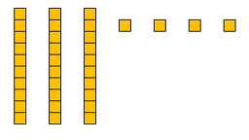
Abstract
Pictorial
Concrete
Two-dimensional images

Slide 33
Numerals, symbols, and words
Abstract
Pictorial
Concrete
34 = 3 tens and 4 ones
2 + 8 = 10
x – 6 = 8
4,179
+ 569

Slide 34
How should multiple representations be used within intensive intervention?
Use three-dimensional concrete materials
Use two-dimensional pictorial representations
Ensure students understand numbers and symbols and words (i.e., the abstract)

Slide 35
Fluency
Addition
Subtraction
Multiplication
Division

Slide 36
Addition
100 addition basic facts
Single-digit addends sum to a single- or double-digit number
5 (addend)
+ 4 (addend)
9 (sum)

Slide 37
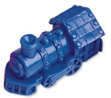
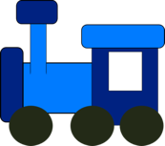
Addition: Part-Part-Whole (Total)
Count one set, count another set, put sets together, count sum
2 + 3 = 5

Slide 38
Addition: Join (Change Increase)
Start with a set, add the other set, count sum
2 + 3 = 5

Slide 39
Subtraction
100 subtraction basic facts
Subtrahend and difference are single-digit numbers and minuend is single- or double-digit number
16 (minuend)
– 8 (subtrahend)
8 (difference)

Slide 40
Subtraction: Separate (Change Decrease)
Start with a set, take away from that set, count difference
5 – 3 = 2

Slide 41
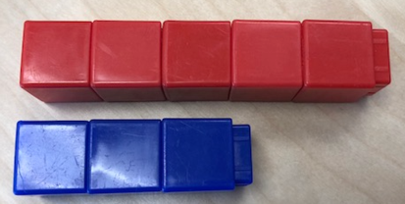
Subtraction: Compare (Difference)
Compare two sets, count difference
5 – 3 = 2

Slide 42
Multiplication
100 multiplication basic facts
Multiplication of single-digit factors results in a single- or double-digit product
2 (factor)
× 3 (factor)
6 (product)

Slide 43
Multiplication: Equal Groups
Show the groups, show the amount for each group, count product
3 × 2 = 6

Slide 44
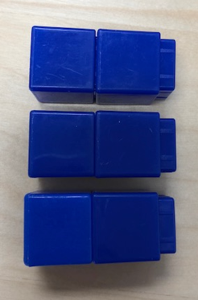
Multiplication: Array/Area
Make the array, count product
3 × 2 = 6

Slide 45
Multiplication: Comparison
Show a set, then multiply the set
3 × 2 = 6

Slide 46
Division
90 division basic facts
Divisor and quotient are single-digit numbers and dividend is single- or double-digit number
8 ÷ 4 = 2
(dividend) (divisor) (quotient)

Slide 47
Division: Equal Groups (Partitive Division)
Show the dividend, divide equally among divisor, count quotient
6 ÷ 3 = 2

Slide 48
Division: Equal Groups (Measurement Division)
Show the dividend, make groups of the divisor, count groups
6 ÷ 3 = 2

Slide 49
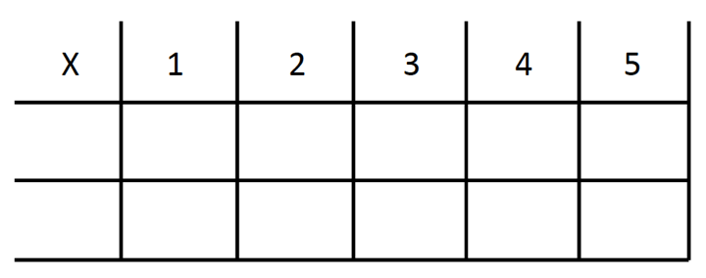
-3 + (-4) = ___ 5 – (-6) = ___

Slide 50
How to build fact fluency within intensive intervention?
Teach the concepts of the operations
Teach strategies to understand how facts fit together
Practice building fluency with a variety of activities and games

Slide 51
Problem Solving Difficulties
Reading problems
Understanding vocabulary
Identifying relevant information
Ignoring irrelevant information
Interpreting charts and graphs
Identifying appropriate operation(s)
Performing the computation(s)

Slide 52
Don’t tie key words to operations
Do have an attack strategy
Do teach word-problem schemas

Slide 53
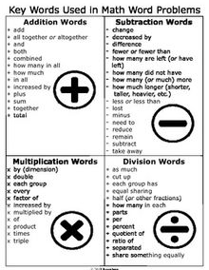
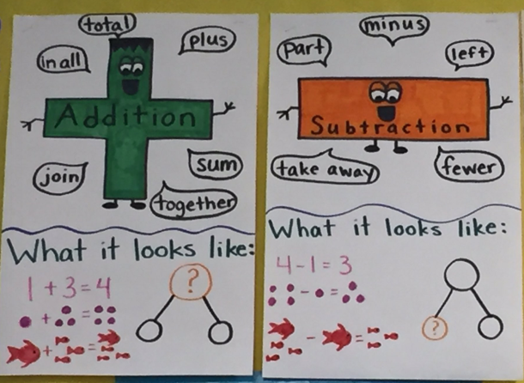

Slide 54
Problem Solving
SOLVE
Study the problem.
Organize the facts.
Line up the plan.
Verify the plan with computation.
Examine the answer.
SIGNS
Survey questions
Identify key words
Graphically draw problem
Note operations
Solve and check

Slide 55
Problem Solving
Total
When teaching about word problems, students should learn the schema of the word problem.
Difference
Change
Equal Groups
Comparison
Ratios/Proportions

Slide 56
How do you incorporate effective problem-solving strategies within intensive intervention?
Don’t use key words tied to operations
Do teach students an attack strategy
Do teach students schemas
Do explicitly teach problem solving
Do provide problem-solving instruction regularly (i.e., several times a week)
Do practice schemas that students will encounter regularly

Slide 57
Instructional Platform
INSTRUCTIONAL DELIVERY
Explicit instruction
Concise language
Multiple representations
INSTRUCTIONAL STRATEGIES
Fluency building
Problem solving instruction

Slide 58
https://intensiveintervention.org/intensive-intervention-math-course

Slide 59
srpowell@austin.utexas.edu
@sarahpowellphd
119

