Slide 1
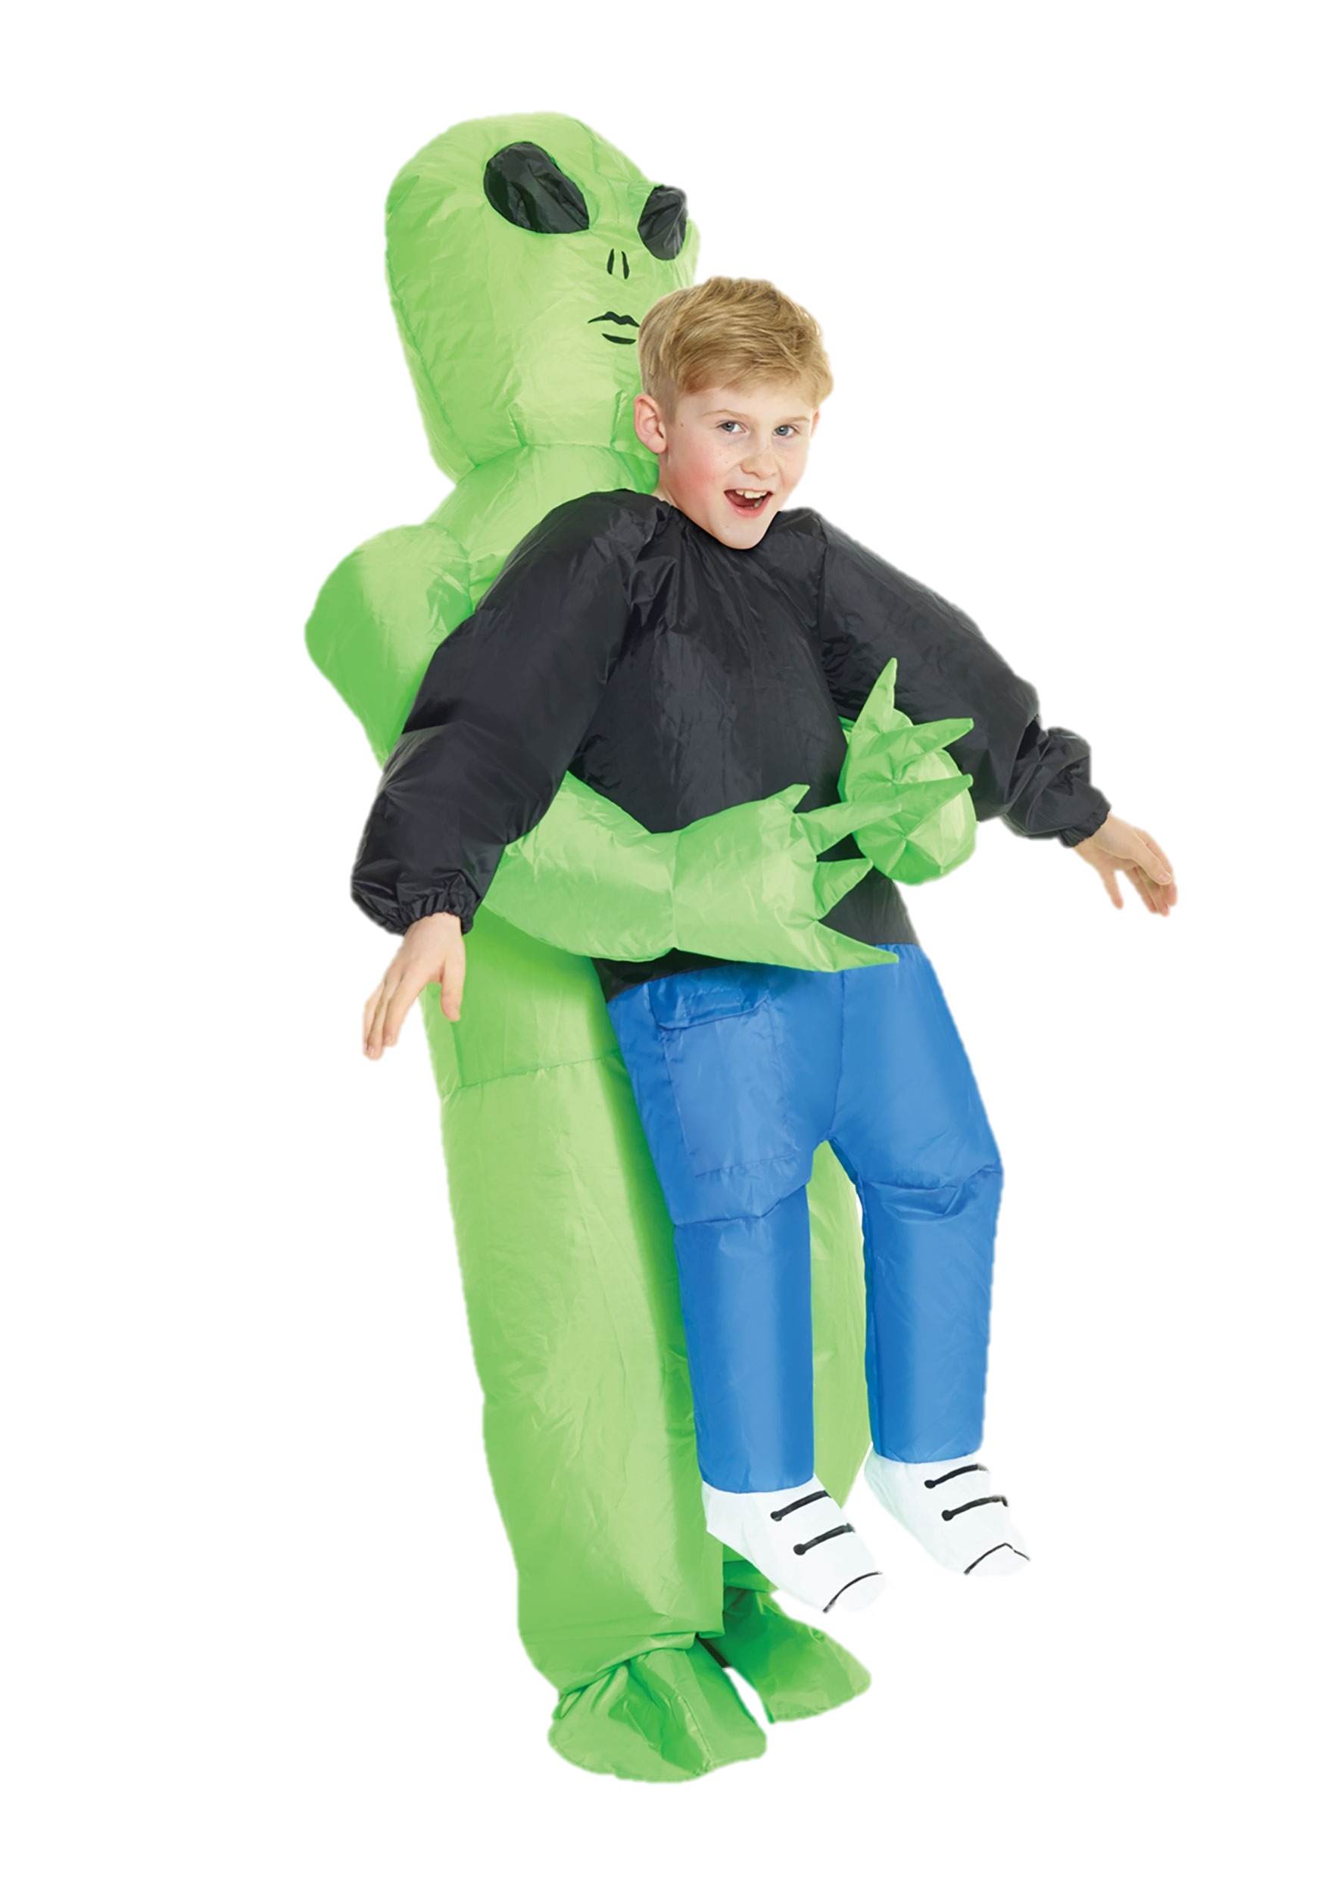
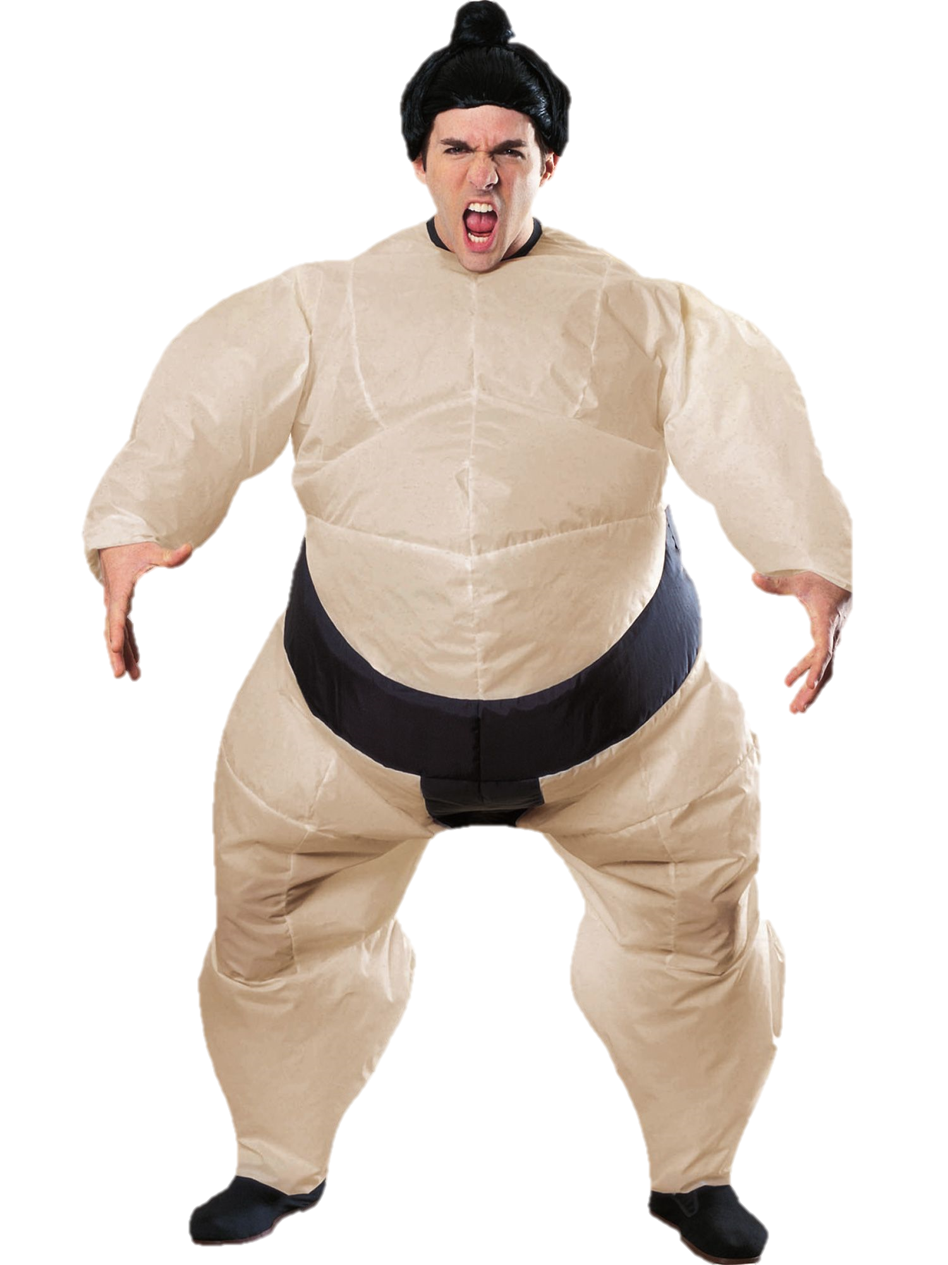
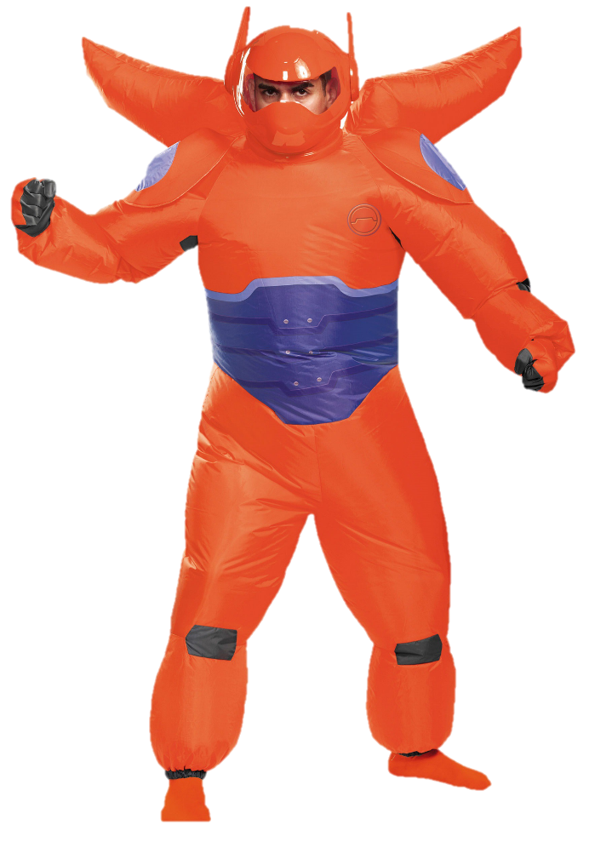
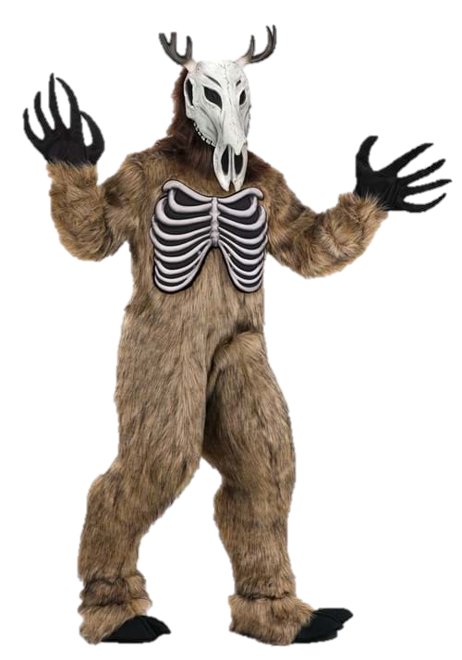
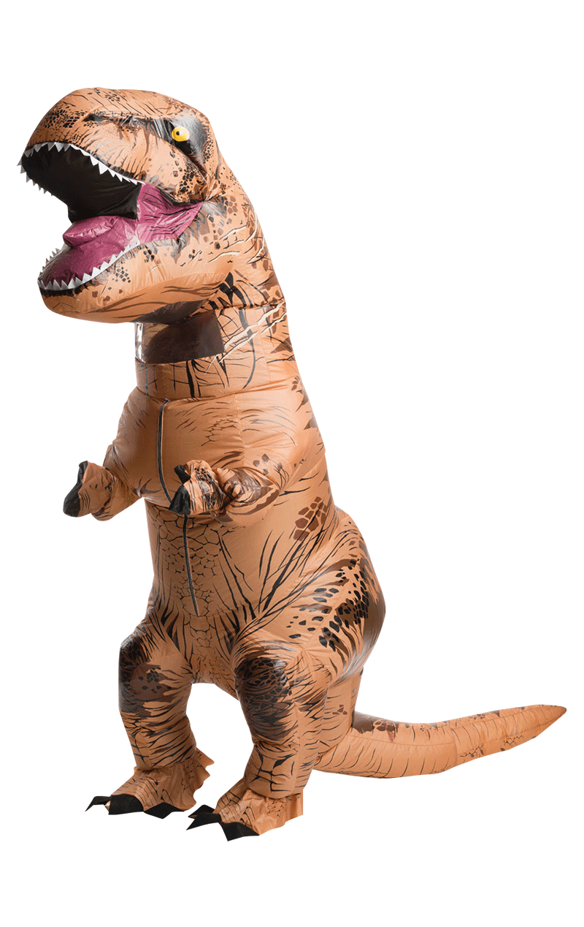
THE Hunters moon MAIN STREET
‘full moon’
Inflatable
costume
party
6’ DISTANCING between points
Awards for ’best of show’ – ANTLER head Gear & MORE
Lone oak lounge │ 701 s. cedar st │CALVERT, TX
ATTIRE: inflatable costumes
SATURDAY
OCT
19
Street
Party dance
Food trucks
Inflatable costumes
LONE OAK LOUNGE |701 S CEDAR ST.
7PM-10PM | FREE EVENT
&
2024
7:00PM
WINE ALE & SPIRIT STROLL $40-50/person oct. 19, 2024 2-6pm
Tickets
Pumpkin Patch
Oct. 1 thru Oct. 31
Sun-thurs. 10am–5pm
Fri. & sat. 10am-6pm
CLOSED MONDAYS
EVENT FINALE
TO THE MAIN STREET MOON-FEST AND THE
WINE ALE & SPIRIT STROLL. JOIN US FOR THE AFTER PARTY AT LONE OAK LOUNGE
COSTUME
BLOW-UP!
Boo crew
Haunted house
Sat., OCT. 16
7pm-midnight
Free entry w/vip ticket
Or $10 Cash/person
Sat. & Sun., Oct. 30 & 31
7pm-midnight
979.567.8910
CalvertTX.us

Slide 2
THE Hunters moon MAIN STREET
‘full moon’
Inflatable
costume
party
6’ DISTANCING between points
Awards for ’best of show’ – ANTLER head Gear & MORE
Lone oak lounge │ 701 s. cedar st │CALVERT, TX
SATURDAY
OCT
19
Street
Party dance
Food trucks
Inflatable costumes
LONE OAK LOUNGE |701 S CEDAR ST.
7PM-10PM | FREE EVENT
Street
Party
Street dance
Inflatable costumes
LONE OAK LOUNGE |701 S CEDAR ST.
7PM-10PM | FREE EVENT
2024
&
7:00PM
Farmers & Artisan market Saturday, 10am–3pm OR SOLD OUT
EVENT FINALE
TO THE MAIN STREET MOON-FEST AND THE
WINE ALE & SPIRIT STROLL. JOIN US FOR THE AFTER PARTY AT LONE OAK LOUNGE
COSTUME
BLOW-UP!
WINE ALE & SPIRIT STROLL $40-50/person oct. 19, 2024 2-6pm
Tickets
Pumpkin Patch
Oct. 1 thru Oct. 31
Sun-thurs. 10am–5pm
Fri. & sat. 10am-6pm
CLOSED MONDAYS
Boo crew
Haunted house
Sat., OCT. 16
7pm-midnight
Free entry w/vip ticket
Or $10 Cash/person
Sat. & Sun., Oct. 30 & 31
7pm-midnight
CalvertTX.us
979.567.8910
CalvertTX.us
ATTIRE: inflatable costumeS

Slide 3
THE Hunters moon MAIN STREET
‘full moon’
Inflatable
costume
party
6’ DISTANCING between points
Awards for ’best of show’ – ANTLER head Gear & MORE
Lone oak lounge │ 701 s. cedar st │CALVERT, TX
SATURDAY
OCT
19
Street
Party dance
Food trucks
Inflatable costumes
LONE OAK LOUNGE |701 S CEDAR ST.
7PM-10PM | FREE EVENT
Street
dance
Costume party
Inflatable costumes
LONE OAK LOUNGE |701 S CEDAR ST.
7PM-10PM | FREE EVENT
&
2024
WINE ALE & SPIRIT STROLL $40-50/person oct. 19, 2024 2-6pm
Tickets
7:00PM
Farmers & Artisan market Saturday, 10am–3pm OR SOLD OUT
EVENT FINALE
TO THE MAIN STREET MOON-FEST AND THE
WINE ALE & SPIRIT STROLL. JOIN US FOR THE AFTER PARTY AT LONE OAK LOUNGE
COSTUME
BLOW-UP!
Pumpkin Patch
Oct. 1 thru Oct. 31
Sun-thurs. 10am–5pm
Fri. & sat. 10am-6pm
CLOSED MONDAYS
Boo crew
Haunted house
Sat., OCT. 16
7pm-midnight
Free entry w/vip ticket
Or $10 Cash/person
979.567.8910
CalvertTX.us
Sat. & Sun., Oct. 30 & 31
7pm-midnight
CalvertTX.us
ATTIRE: inflatable costumes

