Slide 1
Training for the Primary Care Dental Team
Notes:
Welcome all members of your dental team to the presentation and explain the presentation has been acknowledged by the Consultant in Dental Public Health in consultation with experts in this field. All the information in the workshop is taken from the dementia friendly dentistry toolkit.
For an eCPD certificate to be presented every member of the dental team must sign the attendance register with their name and GDC number and be present for the full session.
Please send to Elaine Douglas elaine.douglas@hee.nhs.uk

Slide 2
Aim & Objectives
Increase awareness of and support people living with dementia visiting the dental practice
At the end of the workshop participants will be able to:
Describe ways they can support people with dementia who access the practice
Utilise and implement the Dementia Friendly toolkit and the Dental Practice Environment Audit
Become a Dementia Friend
Intended Learning Outcomes
Practice team can work together to ensure the provision of Dementia Friendly Dentistry
GDC Development Outcomes: A, C & D
Notes:
Discuss the aims and objectives:
If possible I would like a couple of members of the team to become dementia friends, I will explain this as we go through the presentation.

Slide 3
Why was the toolkit developed?
To meet the Prime Ministers challenge 2012:
Aim to improve the health and care of those living with dementia and their carers
Develop dementia friendly communities
Promote research
Supporting people living with dementia is a priority for NHS England, Local Authorities and Public Health England
Evidence locally that those with dementia and carers experience difficulties in accessing appropriate dental care
Notes:
In 2012 the Prime Minister pledged to improve the health and care of those living with dementia which included developing dementia friendly communities – our role in primary care dentistry is to improve our knowledge and awareness of the disease to ensure we can provide the best possible care for our patients living with dementia. To do this as a practice we will embed the guidance from the toolkit into our everyday practice.

Slide 4
Why was the toolkit developed?
People living with dementia visiting the dentist need to continue this as a routine part of their life
People living with dementia and their carer’s, experience difficulties in accessing appropriate dental care
To avoid complex dental problems developing later
Notes:
DF Toolkit should be accessible by all members of the dental team and it is recommended that each surgery has access to an electronic copy on their desktop. Please check your practice has a paper copy.

Slide 5
Key issues relating to dental care
Dental teams may not understand how dementia affects those who have it
Staff not aware that a patient has dementia, resulting in communication difficulties and misunderstanding
Potential difficulties in navigating the practice environment and practice systems such as appointments and reminders
People living with dementia may develop acute dental problems late in the disease progression.
Need for:
- Earlier intervention and more prevention would reduce the risk of this happening
Treatment planning in early stages crucial
Scope for sharing care across primary and specialist services
Notes:
This information came from a study conducted in Liverpool which highlighted several key issues, as a dental practice we want to make sure that we understand:
how dementia affects those who have it and make sure we improve our communication skills to ensure we understand our dementia patients and they understand us.
By completing an environment audit we have identified where there maybe potential difficulties in navigating the practice environment and we may need to look at practice systems such as appointments and reminders to ensure we have a method of providing reminders for our dementia patients.
We need to ensure we provide earlier intervention and more prevention with our patients so treatment planning in early stages is crucial and we need to collaborate with primary and specialist services

Slide 6
Greater Manchester, Cheshire & Merseyside, Lancashire & South Cumbria Chart only showing GM
Council | 2020 | 2030 | Increase
Bolton | 3296 | 4196 | 900
Bury | 2377 | 3062 | 685
Manchester | 3476 | 4199 | 723
Oldham | 2546 | 3236 | 690
Rochdale | 2452 | 3139 | 687
Salford | 2579 | 3142 | 563
Stockport | 4328 | 5384 | 1056
Tameside | 2676 | 3453 | 777
Trafford | 3130 | 3882 | 752
Wigan | 4068 | 5396 | 1328
Total | 30928 | 39089 | 8161
Notes:
Discuss our areas case numbers of patients in 2020 known to have dementia and what the projections could mean

Slide 7
Barbara’s story
https://www.youtube.com/watch?v=VFXirEnjfTI
Notes:
“Barbara’s story” discuss, thoughts and feelings which this video may have generated

Slide 8
WHAT DO WE NEED TO DO AS A TEAM?
Download and familiarise ourselves with the toolkit
Attend the Health Education England Dementia Friendly Dentistry training (minimum of 1 dentist but the whole team are invited)
Practice team will achieve dementia friends status (minimum of 50% of staff)
Practice will:
- complete the Dental Practice Environment audit
- identify at least three to four changes to improve the
practice experience for people living with dementia
- report on the implementation of any changes (within 2/12 of the workshop)
Notes:
We should have a Dementia Friends Champion to monitor all the work that is necessary, we must also ensure we register the dental practice environment audit with our local Dementia Action Alliance and complete the criteria for the award.
It would also be great to update the team during team meetings on the progress we are making to become and maintain our dementia friendly status.

Slide 9
Bookcase analogy
Notes:
If you are not using the video to explain this you can use the information below to provide an insight to what it may deal like for an individual experiencing dementia
This is not a scientific explanation but it should give you some insight into how dementia might affect someone. But, remember, dementia affects each person in different ways. First of all, I’d like you to imagine that I’m 80 years old and that beside me there’s a bookcase that’s as tall as I am and it’s filled with books. Each of those books represents a memory, a fact, something that I’ve learnt in the last 80 years. Right by my head would be my most recent memories, maybe what I had for breakfast this morning. By my shoulders I might have my 60s, maybe my retirement party. By my knees I’d probably have my 20s, so maybe when I met my partner. And then all the way down by my feet would be my childhood memories, maybe my first day of school. Dementia rocks my bookcase. So, as it rocks my bookcase, what do you think is likely to happen to those books? They’re going to fall out, aren’t they? And which ones do you think are likely to fall out first? The ones at the top. So, that might explain why my short term memory would be affected first. As my dementia progresses, I might find that my most recent memories, that’s to say, the books that are highest on my bookcase, being from further down from earlier in my life. Now, say I’ve got to the point where all of my top shelves are empty and I’m living in the 1950s. I want you to embrace my reality. I’m going to go into my kitchen today and try and make myself a cup of tea. But, remember, I think I’m living in the 1950s. So, what’s going to be different about my kitchen? You’re probably thinking the layout, the appliances. Now, remember, I want to make tea. The kettle, right? It’s likely to be electric rather than a whistling kettle that you put on the hob. You might see me when you come round one day filling up my electric kettle and doing what with it? Putting it on the hob. Now, say that you’re my loved one, my carer, my friend, and you see me doing this. You might be tempted to say, ‘You cannot make your own tea anymore. It’s just too dangerous.’ But how might that make me feel? I might feel sad, frustrated, like I’m losing my independence. Thirsty. Now, as I said, embrace my reality. What could you do differently to help me to make my own tea for longer? You could buy me a whistling kettle. Now, of course, I’m not saying that’s going to help everybody at different points in their dementia but at this point it would help me. So, this just goes to show how embracing my reality can really help me to live well with my dementia. From what you’ve heard so far you might think that someone with dementia loses everything but actually that’s because I’ve only told you about one part of the brain. I’ve told you about my factual bookcase. Now, this represents my hippocampus. That’s the part of my brain where I manage factual and biographical data, so things like names and faces and dates and numbers. And, unfortunately, it’s built with really flimsy wood and it’s not very resistant to dementia which is why it’s going to rock so much and I’m more likely to lose those books. However, there’s another part of my brain that manages my feelings and my emotions. That part of the brain is called the amygdala and it’s much more resistant to dementia. So I’d like you to picture that as a separate bookcase but that is made of solid oak. So, even though it will be rocked, the contents will be safer for longer. Now let me explain to you how the two bookcases work together. Say, when I was a child, I had a teacher. So, the fact of that teacher is going to go way down by my feet on my factual bookcase. But the way he made me feel, which was inspired and like I could do anything in my life, it’s going to go on the emotional bookcase. Let me give you some examples of how that might work today when I have dementia. So, say, think again, you’re my loved one, my carer, my friend and you come round and we have a blazing row. We have a really big argument because I’ve forgotten your name. Now, the fact of that argument is going to go on my factual bookcase. What feelings do you think are going to go onto my emotional bookcase? Sadness, anger, frustration. And as you go home you might think, ‘It doesn’t matter. She’s going to forget that we had the argument and that I shouted at her.’ And you’re right, I probably will. But what’s likely to stay with me are those feelings of sadness and anger and frustration with nothing to connect it to. I’m going to leave with a positive example. So, I’d like you to picture that you’ve come to visit me. We’ve gone out to the seaside, we had an ice-cream, we had a brilliant day and I feel safe and warm and loved. But on the way home I’ve forgotten the ice-cream and I’ve forgotten the day out and you might think it’s just not worth visiting anymore. But look! You’ve left me with these feelings of happiness and safety and love and that’s what really matters. At Dementia Friends we want to encourage everybody who knows somebody with dementia to continue to visit and spend time with people with dementia and help them to live well. And always remember there is more to the person than the dementia. Thank you.

Slide 10
Bookcase analogy https://youtu.be/WQ9uSR22qkI
Notes:
This video must be shown during the session to highlight the issues a person living with dementia may experience.

Slide 11
What is a Dementia Friend?
Notes:
A Dementia Friend is somebody that learns about dementia so they can help their community.
Dementia Friends help by raising awareness and understanding, so that people living with dementia can continue to live in the way they want.

Slide 12
What does a Dementia Friend do?
Dementia Friends help people living with dementia by taking actions - both big and small.
These actions don’t have to be time-consuming. From visiting someone you know with dementia to being more patient in a shop queue, every action counts!
Dementia Friends can also get involved with things like volunteering, campaigning or wearing a badge to raise awareness.
Everyone can become a Dementia Friend simply by doing some brief on-line training.
Dementia Friends help people living with dementia by taking actions - both big and small.
These actions don’t have to be time-consuming. From visiting someone you know with dementia to being more patient in a shop queue, every action counts!
Dementia Friends can also get involved with things like volunteering, campaigning or wearing a badge to raise awareness.
Everyone can become a Dementia Friend simply by doing some brief on-line training.
Notes:
Ask the dental team if any members of the team would like to become a dementia friend. ( HLD lead please encourage this)
2 ways to do the training either
Watch a short video about dementia to become a Dementia Friend
Quick and easy (5 minutes)
Hear from people living with dementia and learn how you can help or
attend a virtual Information Session run by one of our volunteer Champions.
More in-depth (45 minutes)
Attend a friendly and interactive Session from the comfort of your home or work.

Slide 13
Turning understanding into action
https://www.dementiafriends.org.uk/register-digital-friend
Notes:
https://www.dementiafriends.org.uk/register-digital-friend

Slide 14
Five Key Messages
1. Dementia is not a natural part of ageing
2. Dementia is caused by diseases of the brain
3. Dementia is not just about losing your memory
4. It is possible to live well with dementia
5. There is more to the person than the dementia
Notes:
These are the five key messages we need to know so we can be more supportive to our dementia patients

Slide 15
Completing the Dental Practice Environment audit
Notes:
This Audit must have been completed by the HLD lead.
We have a copy of this and I would like all staff to have a look at this and see where our practice scores well and where improvements need to be made to ensure our practice is a dementia friendly practice. Consider what improvement/actions need to be carried out, which will help us create our actions for our local Dementia Action Alliance

Slide 16
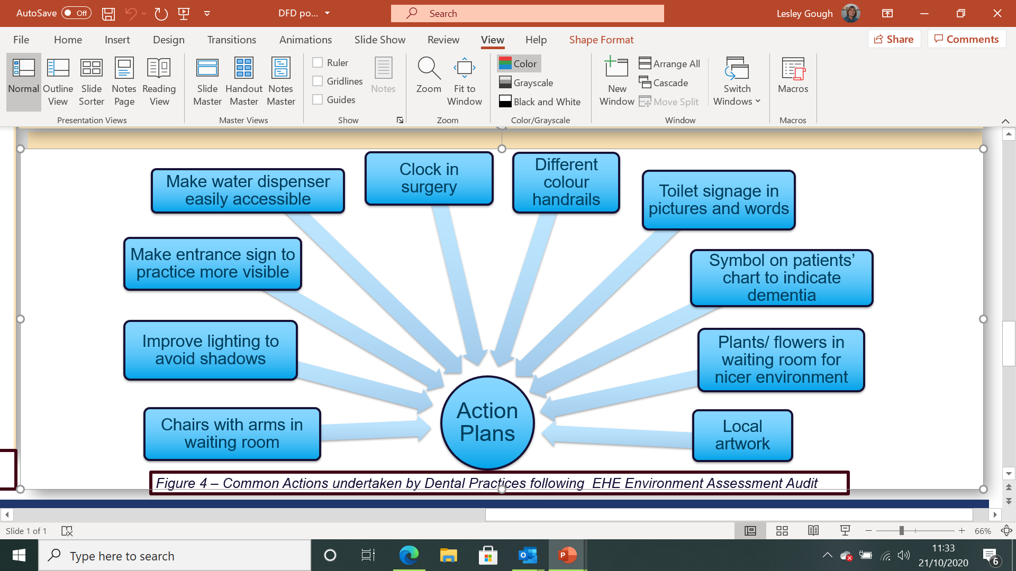
Examples from dental practices that have achieved Dementia Friendly status
Notes:
These are changes that have been made in other practices, look and see what our practice needs to do

Slide 17
Notes:
Encourage your team to become dementia friends by completing the online training
Complete the evaluations for this training

