Slide 1
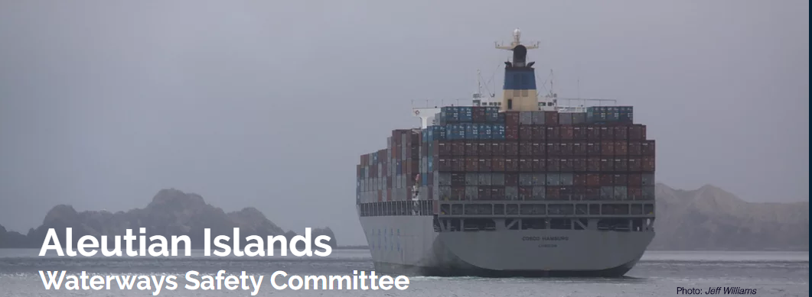
www.aleutianislandswsc.org

Slide 2
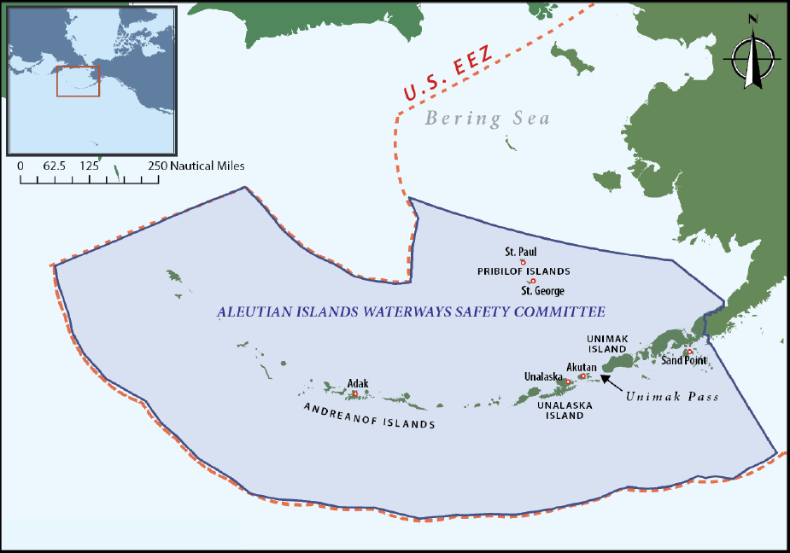

The Geographic Scope for the Aleutian Islands WSC

Slide 3
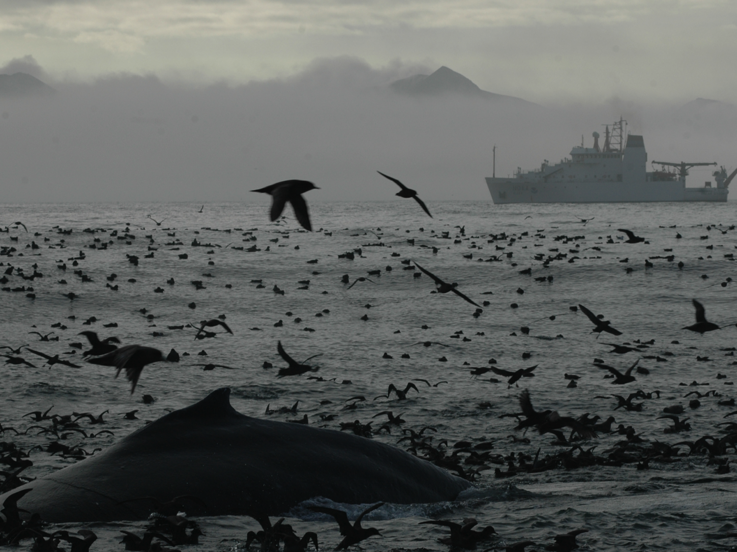
The Aleutians and southern Bering Sea
50% of U.S. seafood landings
Several Alaska Native Tribes in very remote communities
Home to a majority of the seabirds in Alaska and dozens of important marine mammal species
Part of the U.S. designated Arctic
A vital corridor for international vessel traffic…
Notes:
LCC

Slide 4
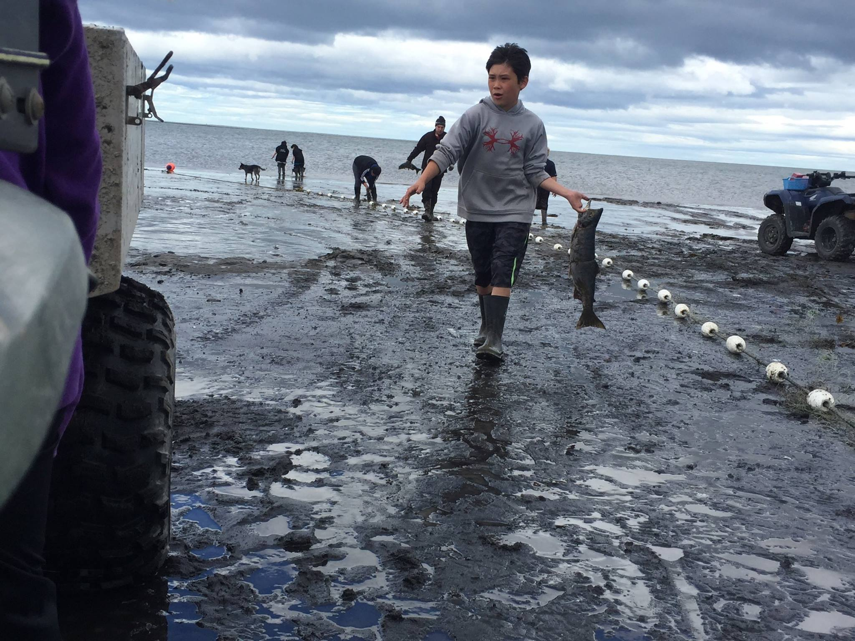
Community concerns of marine traffic
Oil spills and marine incidents
Contamination of the environment and food chain
Impacts to animal distributions and subsistence hunting
Risk to commercial fisheries
Introductions of invasive species
Notes:
Switching gears want to talk about another project that LCCs have launched (I’m joined by 3 other LCCs in alaska in these efforts) along with many partners that you see here

Slide 5
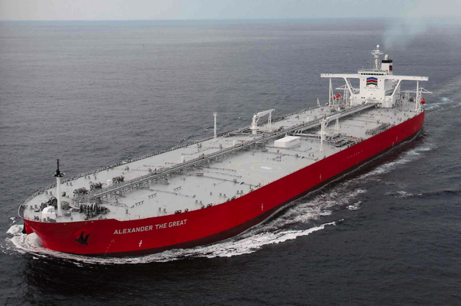
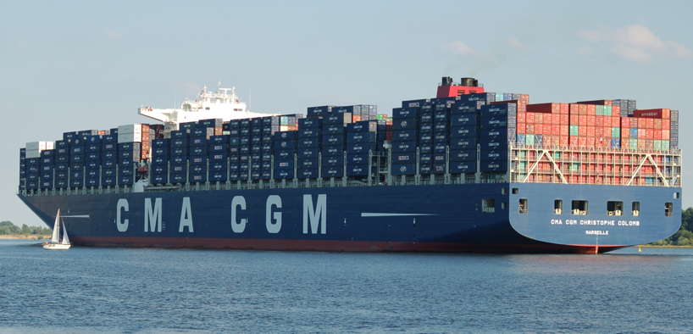
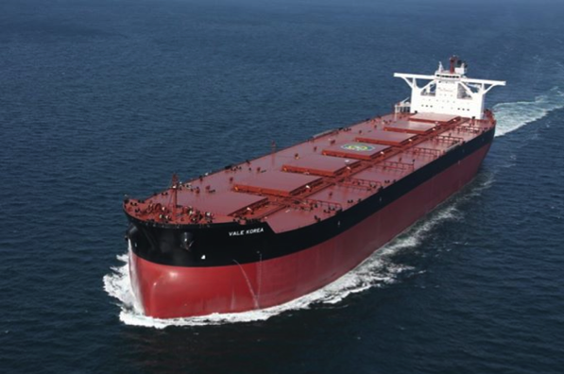
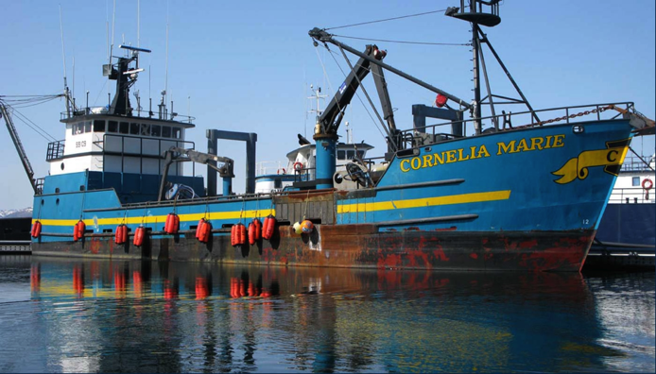
A focus on industrial traffic

Slide 6
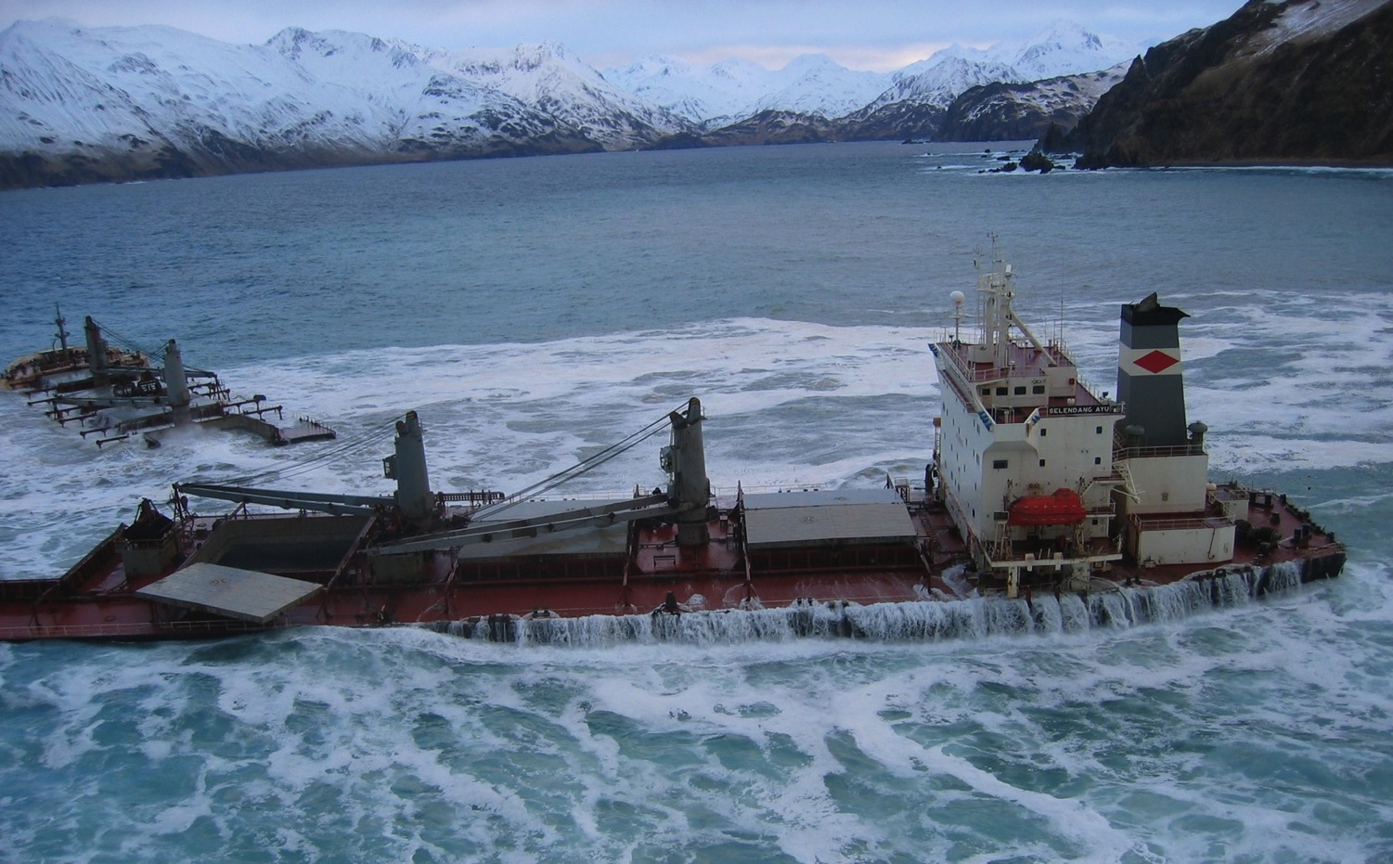
MV Selendang Ayu – December 8th 2004 Unalaska Island
Gallagher Marine

Slide 7
USCG & Alaska Dept. of Environmental Conservation
Structure:
  Management Team (USCG, NFWF, ADEC)
  Facilitation Team
  Advisory Panel
  Risk Analysis Team
  Technical Peer Review Panel
Process
  Phase A (scoping)
  Phase B (implementation & exploration/analysis)
Notes:
The TRB recommended that the risk assessment be organized and managed by a team consisting of the US Coast Guard, its designated fund management organization (the National Fish and Wildlife Foundation), and the State of Alaska.
The TRB recommended that the management team appoint an Advisory Panel with a facilitator and members consisting of experts and key parties with an interest in furthering the goals of the risk assessment.

Slide 8
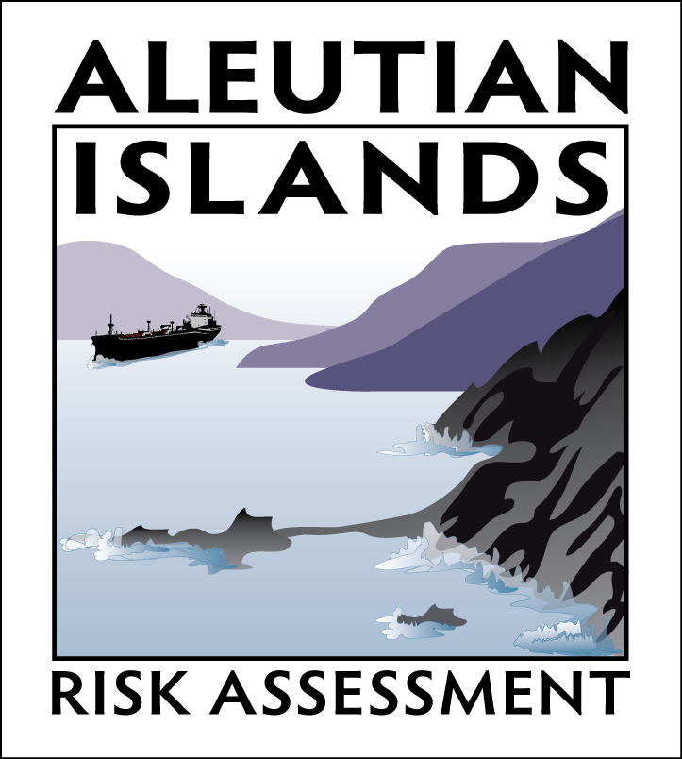
Grant funded by the National Fish and Wildlife Foundation from 2009-2015
Multi-stakeholder group focus on understanding and addressing vessel traffic risks
Released key findings and resources in 2011 and 2015
More at: AleutiansRiskAssessment.com

Slide 9
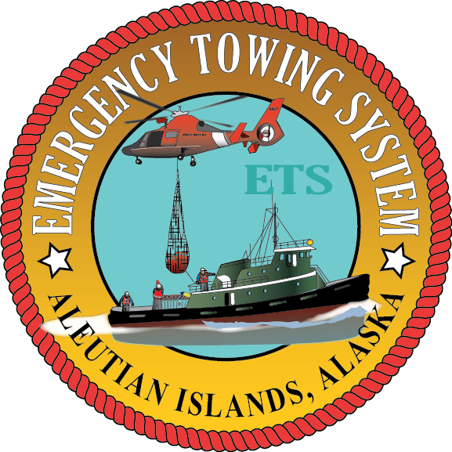
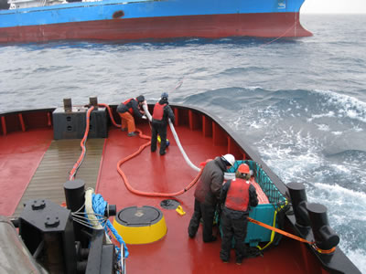
Emergency Towing System Exercise & Training Materials (Implementation)

Slide 10
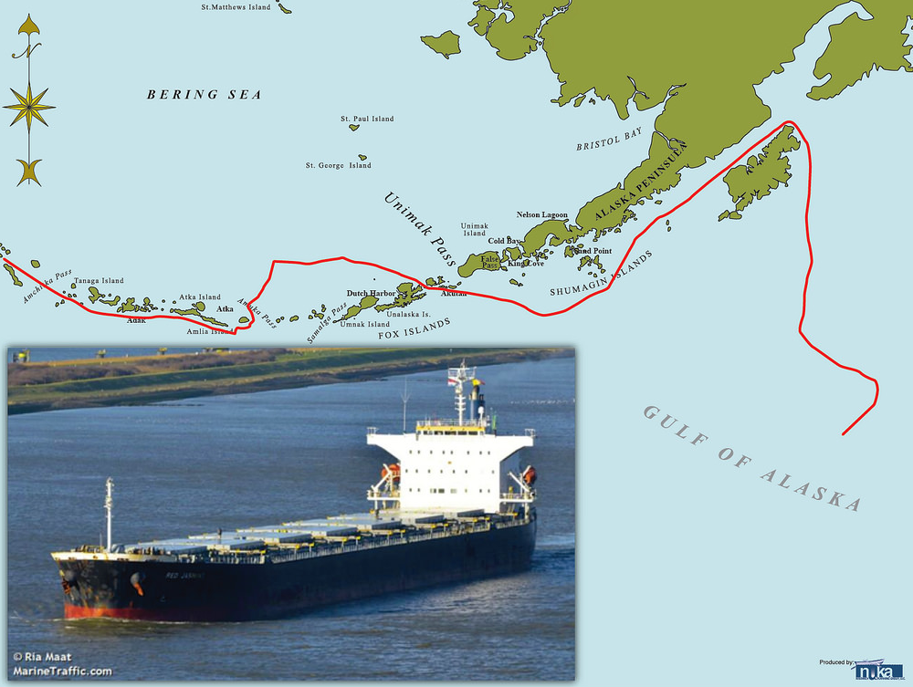
Routing Measures
(Exploration)
Some in place for tankers covered by U.S. regulations (part of Alternative Planning Criteria)
But what about other traffic?

Slide 11
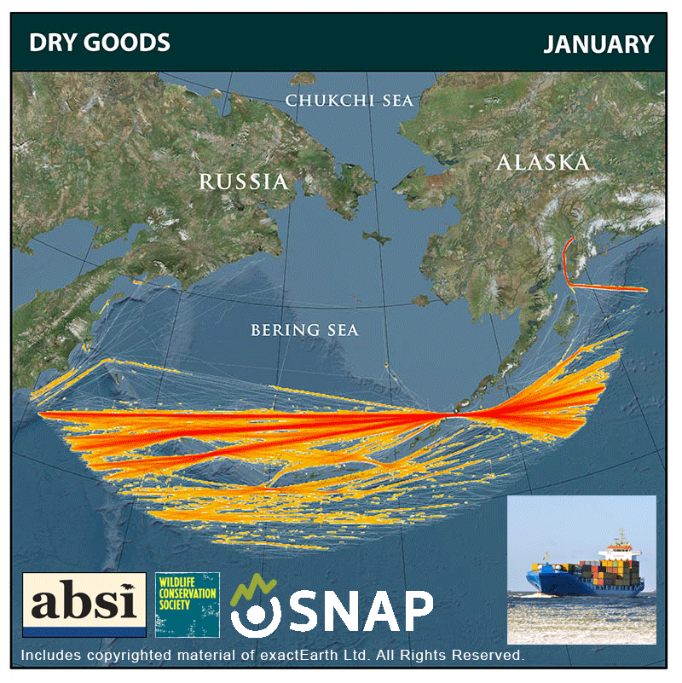

Slide 12
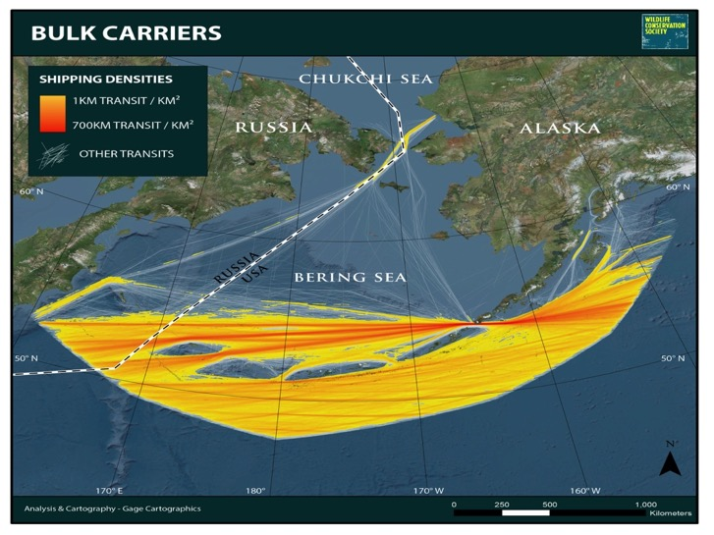
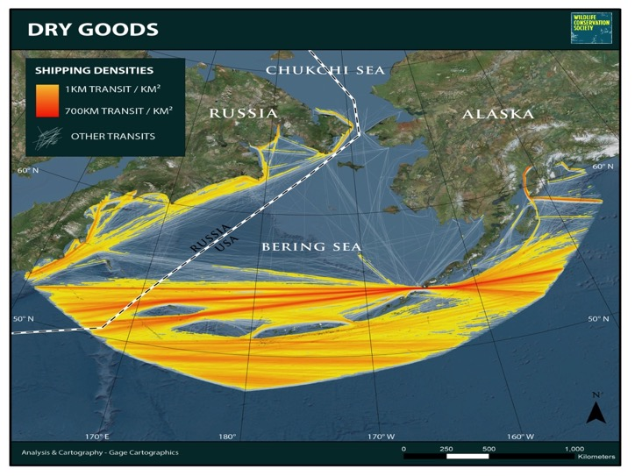
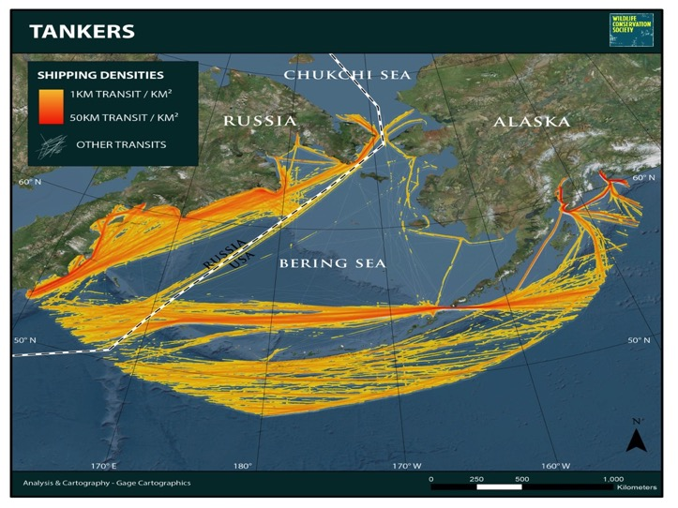
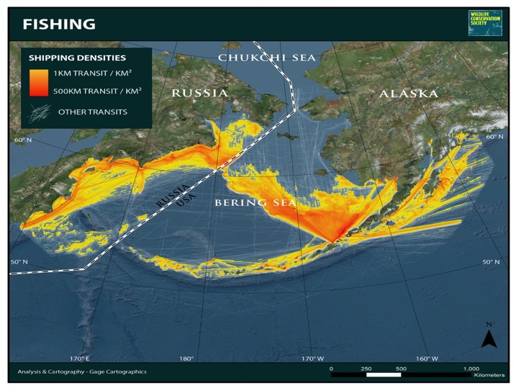
More Animations at: ABSILCC.org

Slide 13
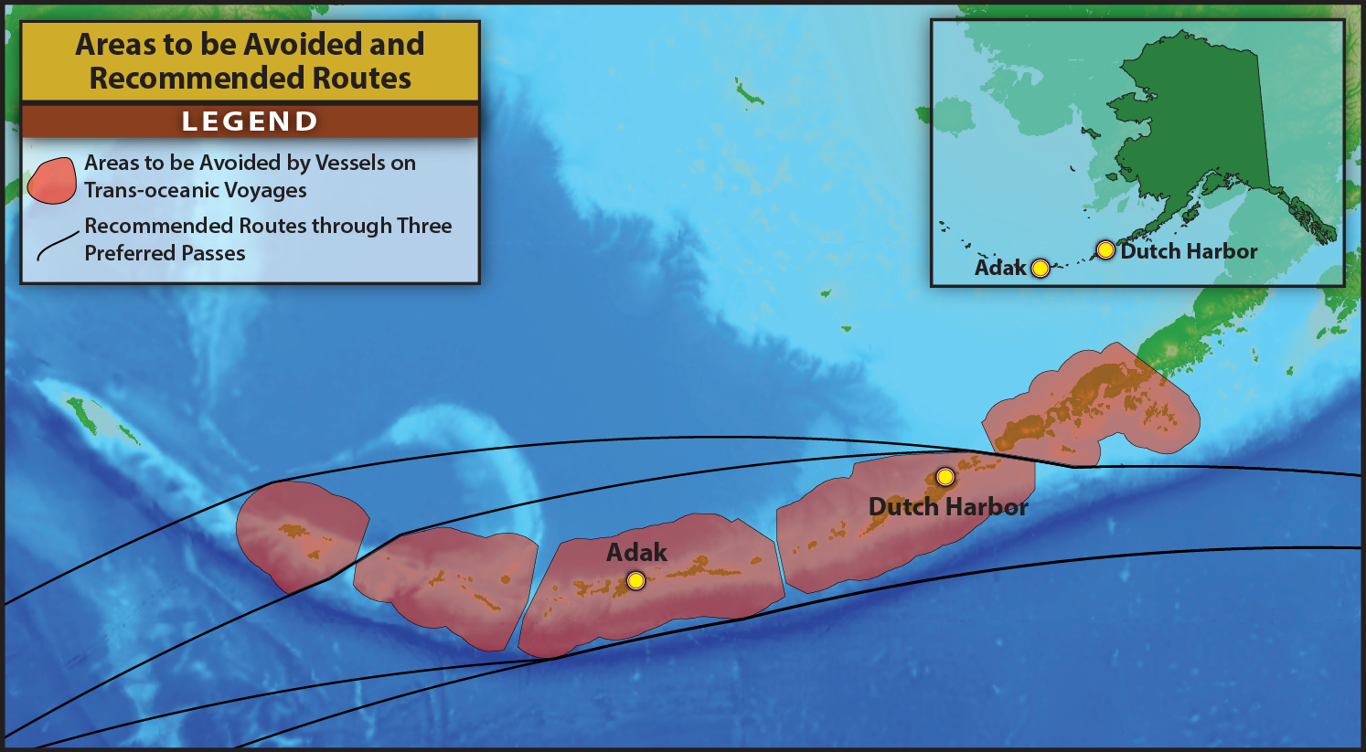
Routing Measures
(Exploration…led to Implementation)
IMO approval 2015
Effective Jan 1, 2016
Notes:
Mirrored what was already in place for tankers under APC (traveling to/from US port) and established recommended routes for all vessels passing through

Slide 14
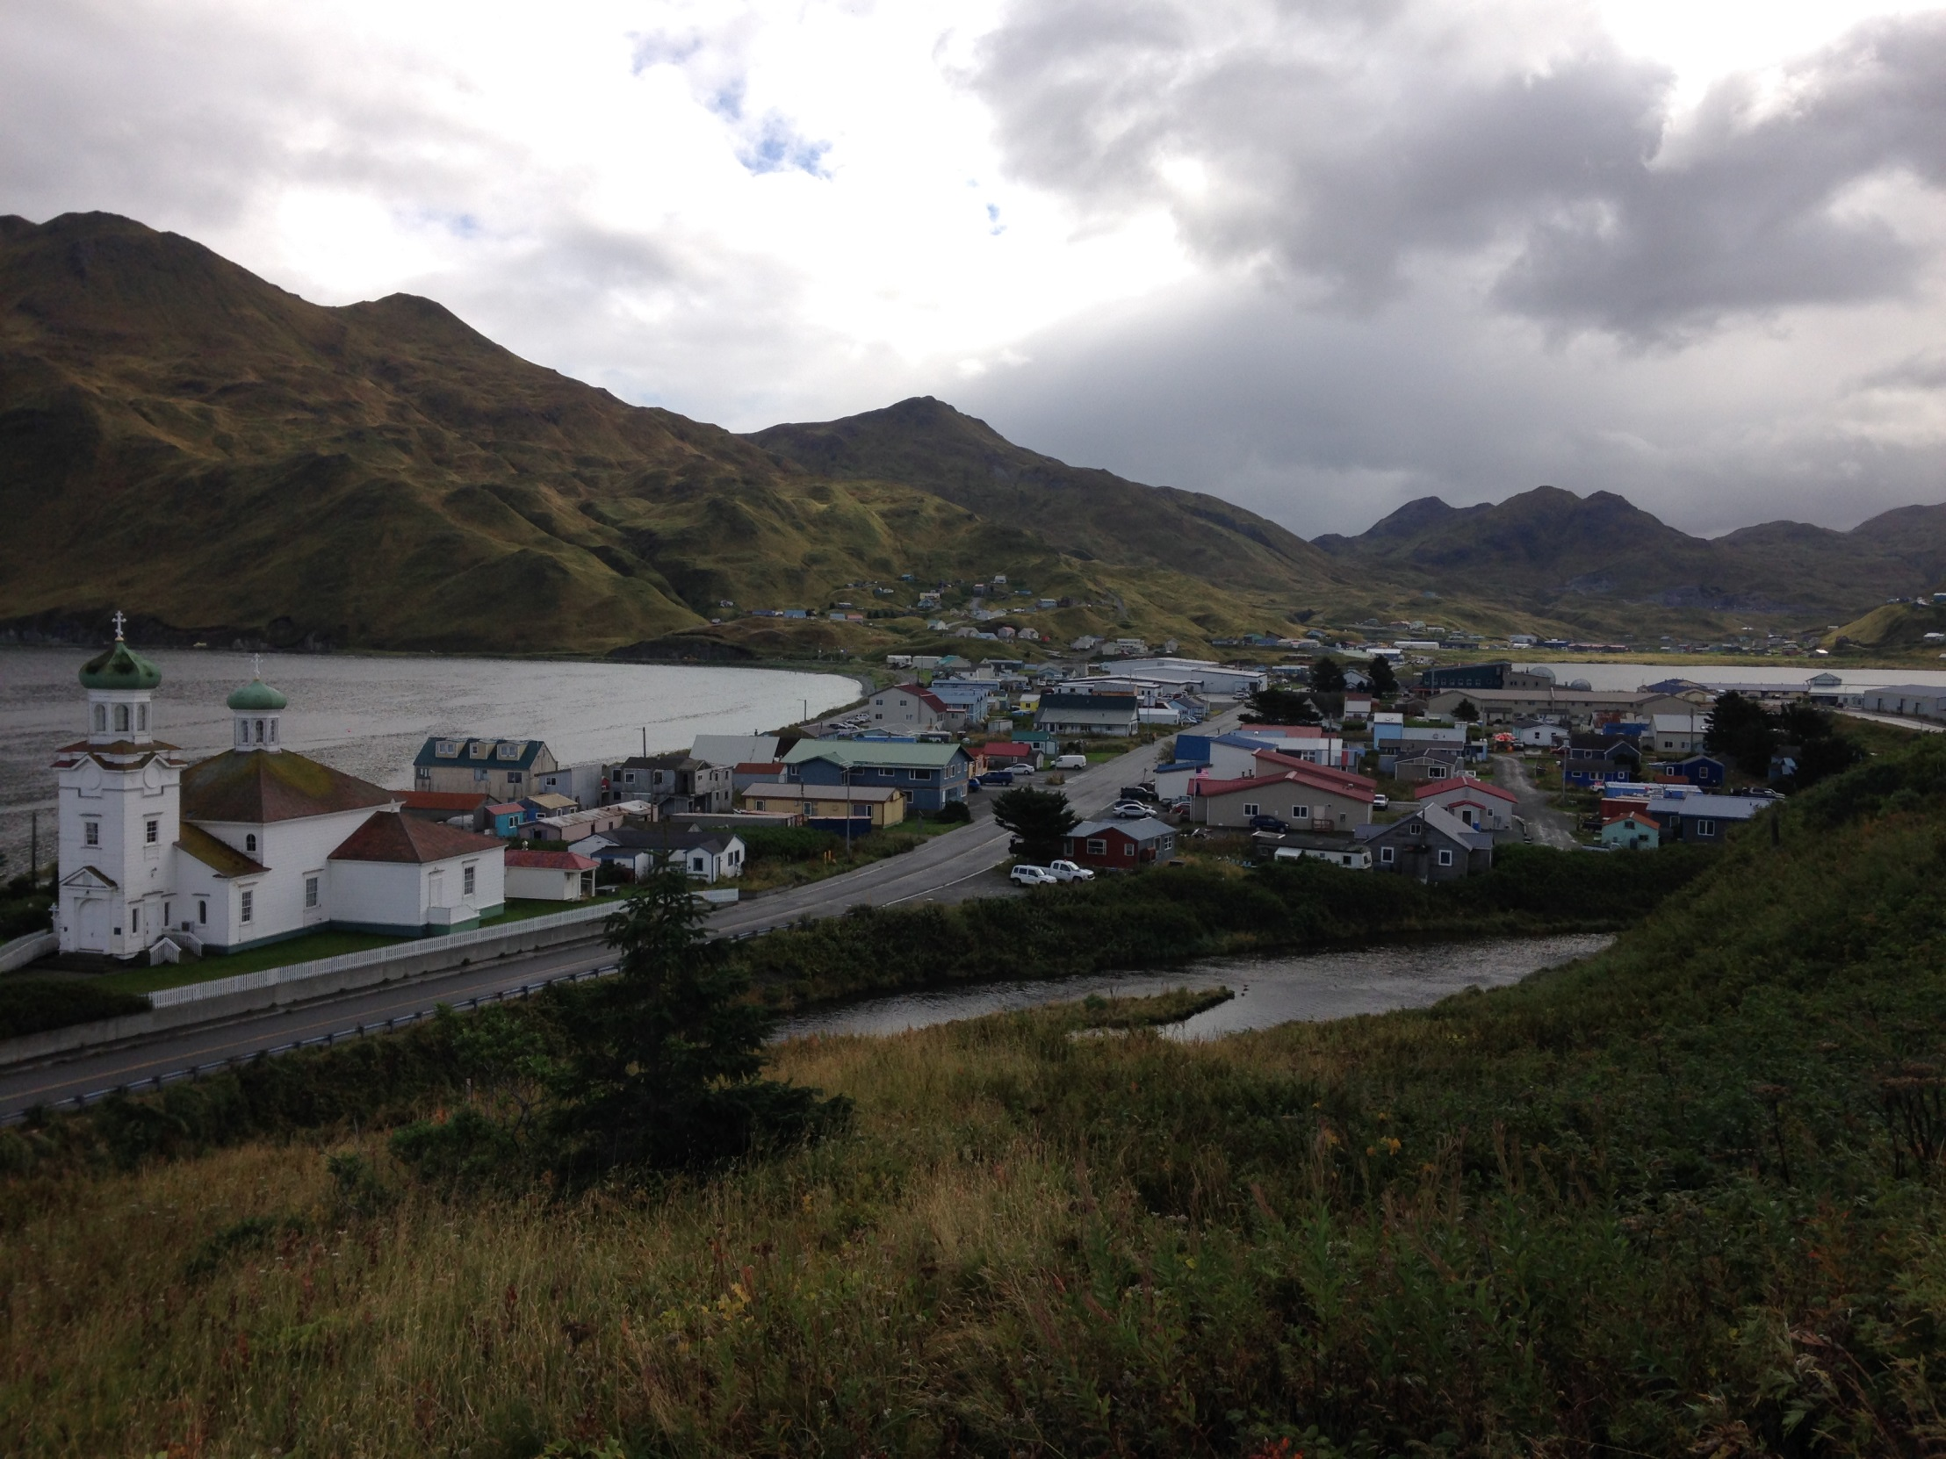
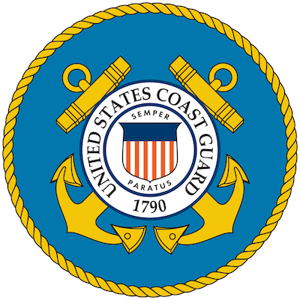

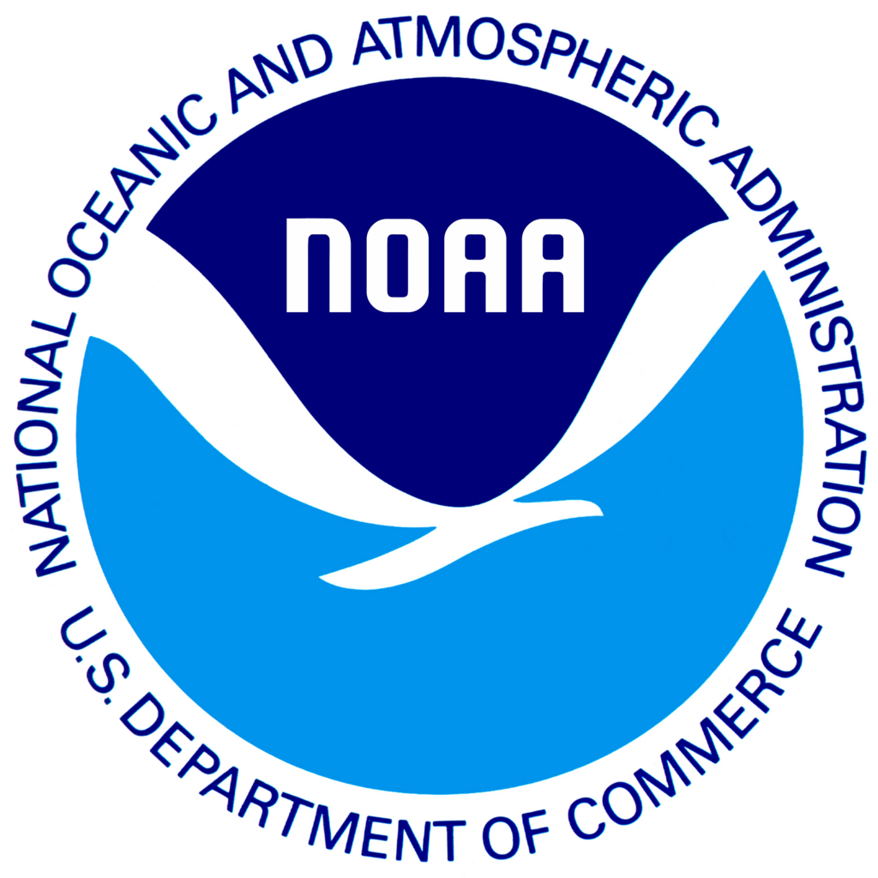

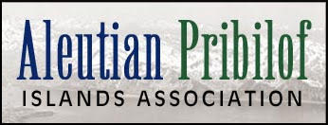
Scoping for a WSC in Unalaska in April, 2017
A grant from the National Fish and Wildlife Foundation
50 individuals from diverse stakeholder groups
Broad agreement on the need for a WSC

Slide 15
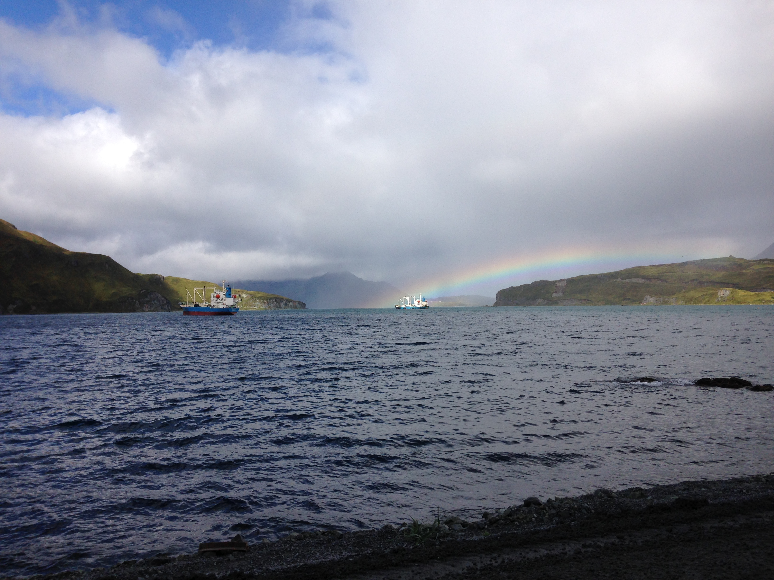
Standing up the Aleutian Islands WSC in 2017
Spring: A convening work group established
Summer: a charter, committee structure and bylaws for a 501c3 nonprofit drafted
Fall: board solicited & seated establishing the nonprofit
This week: committee solicitations go out for 20 seats
By December: the committee will be seated!
More at: www.aleutianislandswsc.org

