Slide 1
Data-Based Individualization in Secondary Mathematics

Slide 2
srpowell@austin.utexas.edu
@sarahpowellphd
119

Slide 3
How to help students with learning difficulties in mathematics?
DBI

Slide 4
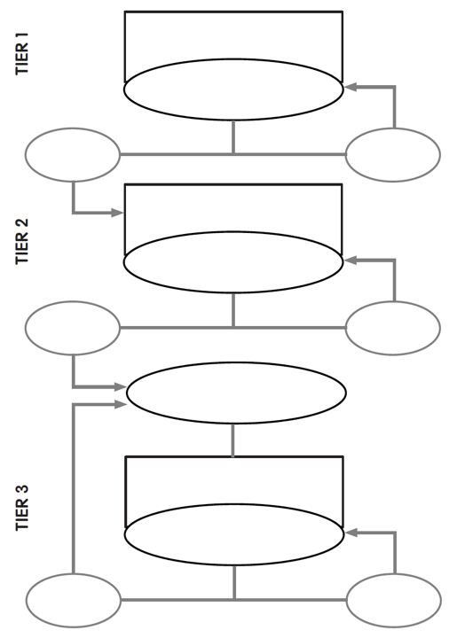
Universal
DBI

Slide 5
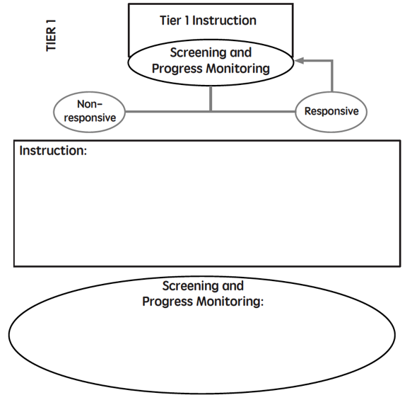

Slide 6
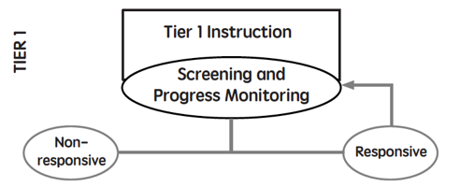
Core instruction utilizes evidence-based practices
All students screened (universal screener)
Students scoring below a cut-score are suspected at risk for math difficulties
Suspected at-risk students monitored for 6 to 10 weeks during primary prevention using progress monitoring

Slide 7
INSTRUCTION
Evidence-based interventions and strategies

Slide 8
evidence-based practice
evidence-based intervention
evidence-based strategy
promising practice
no or negative evidence

Slide 9
Assessment data to show results
evidence-based practice
Improvement from before intervention
Improvement compared to no treatment students
Replication
evidence-based intervention
Multiple researchers
evidence-based strategy
Multiple students
Multiple times
promising practice
Setting and students similar to your own

Slide 10
INSTRUCTION
Evidence-based interventions and strategies
SCREENING
Reliable measures with normative data
Usually administered fall, winter, spring

Slide 11
INSTRUCTION
Evidence-based interventions and strategies
SCREENING
Reliable measures with normative data
Usually administered fall, winter, spring
PROGRESS MONITORING
Reliable measures, administered regularly
After 6-10 weeks, student risk status is confirmed or disconfirmed

Slide 12
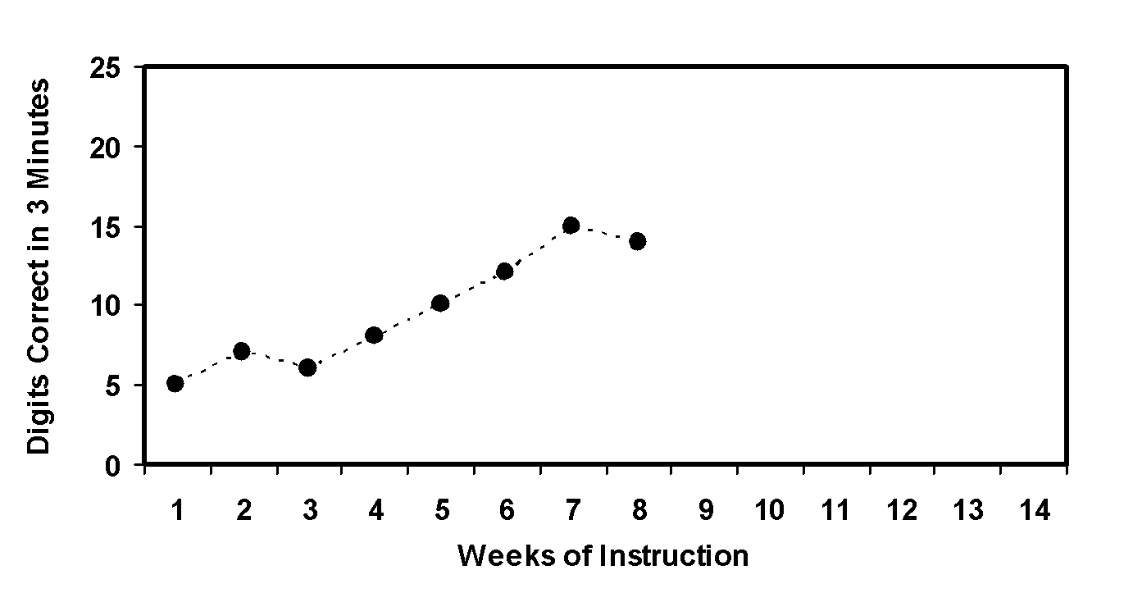
Student NOT at risk.
X
Slope = 1.0
13 – 6
7
X

Slide 13
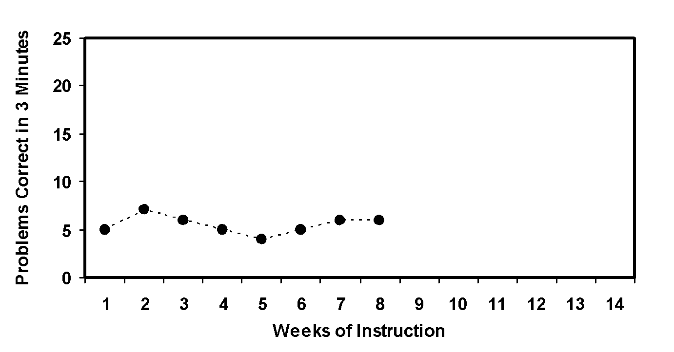
Student AT RISK.
Requires additional support!
Slope = 0.0
6 – 6
7
X
X

Slide 14
What are your school’s Tier 1 strengths and weaknesses?

Slide 15
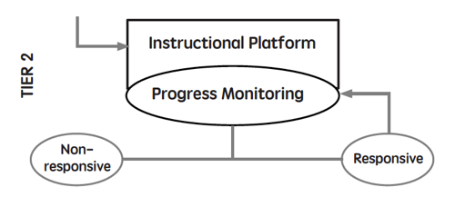
Students are tutored in small groups using evidence-based practices
Tutoring takes place three or four times a week
Each tutoring session lasts 30 to 60 minutes
Tutoring lasts 10 to 20 weeks
Progress monitoring continues weekly

Slide 16
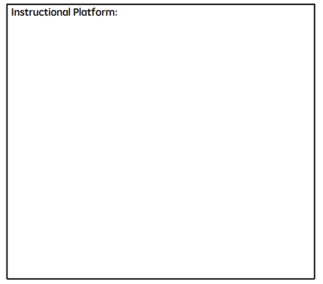
Instructional Platform
INSTRUCTIONAL DELIVERY
Explicit instruction
Precise language
Multiple representations
INSTRUCTIONAL STRATEGIES
Fluency building
Problem solving instruction
Motivation component

Slide 17
Goal and importance
“Today, we are learning about division. This is important because sometimes you have to share objects or things with your friends.”
Modeling
Practice
Clear Explanation
Guided
Practice
We Do
Planned
Examples
Independent Practice
“Let’s continue working with our three-dimensional shapes and volume. Understanding volume and calculating volume helps with measuring capacity.”
You Do
Supporting Practices
Asking the right questions
Eliciting frequent responses
Providing immediate specific feedback
Maintaining a brisk pace
Copyright 2018 Sarah R. Powell, Ph.D.

Slide 18
Goal and importance
Model steps
Modeling
Practice
Clear Explanation
Guided
Practice
“To solve 26 plus 79, I first decide about the operation. Do I add, subtract, multiply or divide?”
We Do
Planned
Examples
Independent Practice
“The plus sign tells me to add. So, I’ll add 26 plus 79. I’ll use the partial sums strategy. First, I add 20 plus 70. What’s 20 plus 70?”
You Do
Supporting Practices
“20 plus 70 is 90. I write 90 right here.”
Asking the right questions
Eliciting frequent responses
Providing immediate specific feedback
Maintaining a brisk pace
“Then I add 6 plus 9. What’s 6 plus 9?”
“6 plus 9 is 15. So, I write 15 here.”
“Finally, we add the partial sums: 90 and 15. 90 plus 15 is 105. So, 26 plus 79 equals 105.”
Copyright 2018 Sarah R. Powell, Ph.D.

Slide 19
Goal and importance
Model steps
Modeling
Practice
Clear Explanation
Concise language
Guided
Practice
We Do
Planned
Examples
Independent Practice
“To solve 26 plus 79, I first decide about the operation. Do I add, subtract, multiply, or divide?”
You Do
“The plus sign tells me to add. So, I’ll add 26 plus 79. I’ll use the partial sums strategy. First, I add 20 plus 70. What’s 20 plus 70?”
Supporting Practices
Asking the right questions
Eliciting frequent responses
Providing immediate specific feedback
Maintaining a brisk pace
“20 plus 70 is 90. I write 90 right here under the equal line.”
“Then I add 6 plus 9. What’s 6 plus 9?”
“6 plus 9 is 15. So, I write 15 here.”
“Finally, we add the partial sums: 90 and 15. 90 plus 15 is 105. So, 26 plus 79 equals 105.”
Copyright 2018 Sarah R. Powell, Ph.D.

Slide 20
Examples
“Today, we are learning about division. This is important because sometimes you have to share objects or things with your friends.”
Modeling
Practice
Clear Explanation
Guided
Practice
24 / 6
We Do
35 $)$ 5
28 $÷$ 7
Planned
Examples
Independent Practice
You Do
Supporting Practices
Asking the right questions
Eliciting frequent responses
Providing immediate specific feedback
Maintaining a brisk pace
Copyright 2018 Sarah R. Powell, Ph.D.

Slide 21
Examples
“Today, we are learning about division. This is important because sometimes you have to share objects or things with your friends.”
Modeling
Practice
Clear Explanation
Guided
Practice
24 / 6
We Do
35 $)$ 5
28 $÷$ 7
Planned
Examples
Independent Practice
You Do
With non-examples
Supporting Practices
Asking the right questions
Eliciting frequent responses
Providing immediate specific feedback
Maintaining a brisk pace
32 $÷$ 8
42 $÷$ 7
25 $−$ 5
Copyright 2018 Sarah R. Powell, Ph.D.

Slide 22
I Do
Modeling
Practice
Clear Explanation
Guided
Practice
Planned
Examples
Independent Practice
Supporting Practices
Asking the right questions
Eliciting frequent responses
Providing immediate specific feedback
Maintaining a brisk pace
Copyright 2018 Sarah R. Powell, Ph.D.

Slide 23
I Do
Modeling
Practice
Teacher and student practice together
Clear Explanation
Guided
Practice
Planned
Examples
Independent Practice
Supporting Practices
Asking the right questions
Eliciting frequent responses
Providing immediate specific feedback
Maintaining a brisk pace
Copyright 2018 Sarah R. Powell, Ph.D.

Slide 24
I Do
Modeling
Practice
Clear Explanation
Guided
Practice
Planned
Examples
Independent Practice
Student practices with teacher support
Supporting Practices
Asking the right questions
Eliciting frequent responses
Providing immediate specific feedback
Maintaining a brisk pace
Copyright 2018 Sarah R. Powell, Ph.D.

Slide 25
I Do
Modeling
Practice
Clear Explanation
Guided
Practice
Low-level and high-level
We Do
Planned
Examples
Independent Practice
You Do
“What is 7 times 9?”
“Which shape has 6 sides?”
“What do you do when you see a word problem?”
“Why do you have to regroup?”
“How would you solve this problem?”
“Why do you have to use zero pairs?”
Supporting Practices
Asking the right questions
Eliciting frequent responses
Providing immediate specific feedback
Maintaining a brisk pace
Copyright 2018 Sarah R. Powell, Ph.D.

Slide 26
I Do
Modeling
Practice
Clear Explanation
Guided
Practice
Low-level and high-level
We Do
Planned
Examples
Independent Practice
You Do
Classwide, individual, partner, write on paper, write on whiteboard, thumbs up, etc.
“Turn and discuss the formula for perimeter with your partner.”
“Write the multiplication problem on your whiteboard.”
Supporting Practices
Asking the right questions
Eliciting frequent responses
Providing immediate specific feedback
Maintaining a brisk pace
“In your math journal, draw a picture to help you remember to term parallelogram.”
Copyright 2018 Sarah R. Powell, Ph.D.

Slide 27
I Do
Modeling
Practice
Clear Explanation
Guided
Practice
Low-level and high-level
We Do
Planned
Examples
Independent Practice
You Do
Classwide, individual, partner, write on paper, write on whiteboard, thumbs up, etc.
Affirmative and corrective
Supporting Practices
“Good work using your word-problem attack strategy.”
Asking the right questions
Eliciting frequent responses
Providing immediate specific feedback
Maintaining a brisk pace
“Let’s look at that again. Tell me how you added in the hundreds column.”
Copyright 2018 Sarah R. Powell, Ph.D.

Slide 28
I Do
Modeling
Practice
Clear Explanation
Guided
Practice
Low-level and high-level
We Do
Planned
Examples
Independent Practice
You Do
Classwide, individual, partner, write on paper, write on whiteboard, thumbs up, etc.
Affirmative and corrective
Planned and organized
Supporting Practices
Asking the right questions
Eliciting frequent responses
Providing immediate specific feedback
Maintaining a brisk pace
Copyright 2018 Sarah R. Powell, Ph.D.

Slide 29
Modeling
Practice
Clear Explanation
Guided
Practice
Planned
Examples
Independent Practice
Supporting Practices
Asking the right questions
Eliciting frequent responses
Providing immediate specific feedback
Maintaining a brisk pace
Copyright 2018 Sarah R. Powell, Ph.D.

Slide 30
Modeling
Practice
Supporting Practices
Introduction of material
Review of material
Modeling
Practice
Modeling
Practice
Supporting Practices
Supporting Practices

Slide 31
How do you use explicit instruction?
Model steps using concise language
Provide guided practice opportunities
Provide independent practice opportunities
Use supporting practices during modeling and practice
Ask the right questions
Elicit frequent responses
Provide feedback
Be planned and organized

Slide 32
Instructional Platform
INSTRUCTIONAL DELIVERY
Explicit instruction
Precise language
Multiple representations
INSTRUCTIONAL STRATEGIES
Fluency building
Problem solving instruction
Motivation component

Slide 33
degree

Slide 34
Vocabulary Across Grades

Slide 35
Technical terms
Subtechnical terms
Symbolic terms
General terms
trapezoid
rhombus
numerator
addend
subtract
base
degrees
cube
plane
arc
plus
zero
twelve
dollars
and
above
measure
answer
longest
outside

Slide 36
Use formal math language
Use terms precisely

Slide 37
How do you attend to mathematical language?
Understand why formal mathematical language is important
Plan for mathematical language to be precise
Plan for mathematical definitions to be concise

Slide 38
Instructional Platform
INSTRUCTIONAL DELIVERY
Explicit instruction
Precise language
Multiple representations
INSTRUCTIONAL STRATEGIES
Fluency building
Problem solving instruction
Motivation component

Slide 39
Multiple Representations
Abstract
Pictorial
Concrete

Slide 40
Abstract
Pictorial
Concrete
Three-dimensional objects

Slide 41
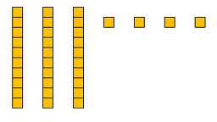
Abstract
Pictorial
Concrete
Two-dimensional images

Slide 42
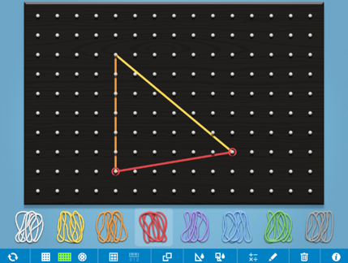
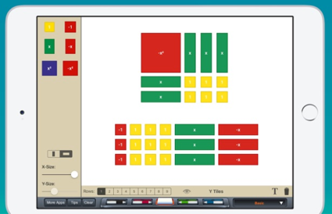
Abstract
Pictorial
Concrete
Two-dimensional images

Slide 43
Abstract
Pictorial
Concrete
Numerals and symbols
2 + 8 = 10
34 = 3 tens and 4 ones
x – 6 = 8
4,179
+ 569

Slide 44
How do you use multiple representations?
Use three-dimensional concrete materials to teach concepts and procedures
Use two-dimensional pictorial representations to teach concepts and procedures
Ensure students understand mathematics with numbers and symbols (i.e., the abstract)

Slide 45
Instructional Platform
INSTRUCTIONAL DELIVERY
Explicit instruction
Precise language
Multiple representations
INSTRUCTIONAL STRATEGIES
Fluency building
Problem solving instruction
Motivation component

Slide 46
Addition
Subtraction
Multiplication
Division

Slide 47
Addition
Subtraction
Multiplication
Division
BRIEF
(1-2 min)
DAILY
(everyday)

Slide 48
How to build fact fluency?
Teach the concepts of the operations
Teach strategies to understand how facts fit together
Practice building fluency with a variety of activities and games

Slide 49
Instructional Platform
INSTRUCTIONAL DELIVERY
Explicit instruction
Precise language
Multiple representations
INSTRUCTIONAL STRATEGIES
Fluency building
Problem solving instruction
Motivation component

Slide 50
Don’t tie key words to operations
Do have an attack strategy
Do teach word-problem schemas

Slide 51
Schemas
Total
Difference
Change
Equal Groups
Comparison
Ratios/Proportions

Slide 52
How do you teach problem solving?
Don’t use key words tied to operations
Do teach students an attack strategy
Do teach students schemas
Do explicitly teach problem solving
Do provide problem-solving instruction regularly (i.e., several times a week)
Do practice schemas that students will encounter regularly

Slide 53
Instructional Platform
INSTRUCTIONAL DELIVERY
Explicit instruction
Precise language
Multiple representations
INSTRUCTIONAL STRATEGIES
Fluency building
Problem solving instruction
Motivation component

Slide 54
Motivation Component
on task
keep attention
regulate behavior

Slide 55
How do you use a motivational component?
Utilize a motivational component, when necessary

Slide 56
Instructional Platform
INSTRUCTIONAL DELIVERY
Explicit instruction
Precise language
Multiple representations
INSTRUCTIONAL STRATEGIES
Fluency building
Problem solving instruction
Motivation component

Slide 57
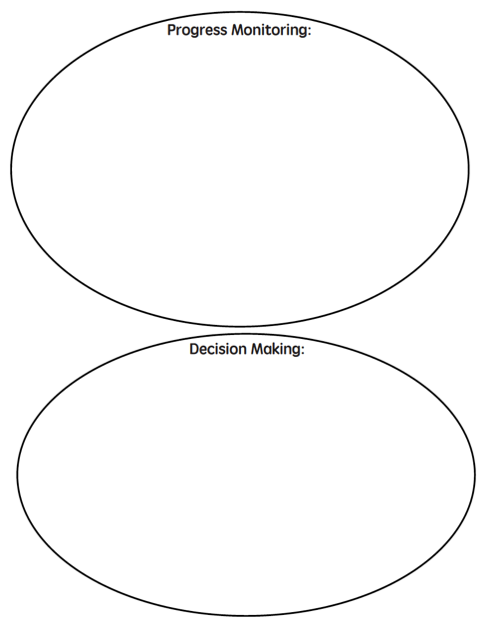
PROGRESS MONITORING
Reliable measures, administered regularly
After 10-20 weeks, student risk status is confirmed or disconfirmed

Slide 58
PROGRESS MONITORING
Reliable measures, administered regularly
DECISION MAKING
Set goal for students
Analyze data every 2-4 weeks to determine progress toward meeting goal

Slide 59
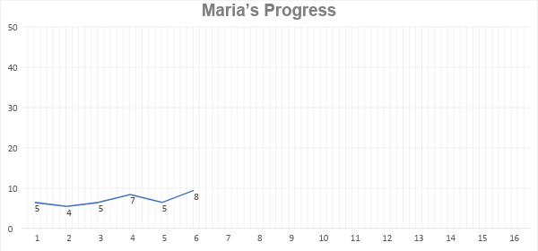
Is Maria making adequate progress?

Slide 60
Setting Goals
Benchmark
Slope (ROI)
Intra-individual

Slide 61
Determining Response
Four most recent, consecutive scores
Trendline

Slide 62
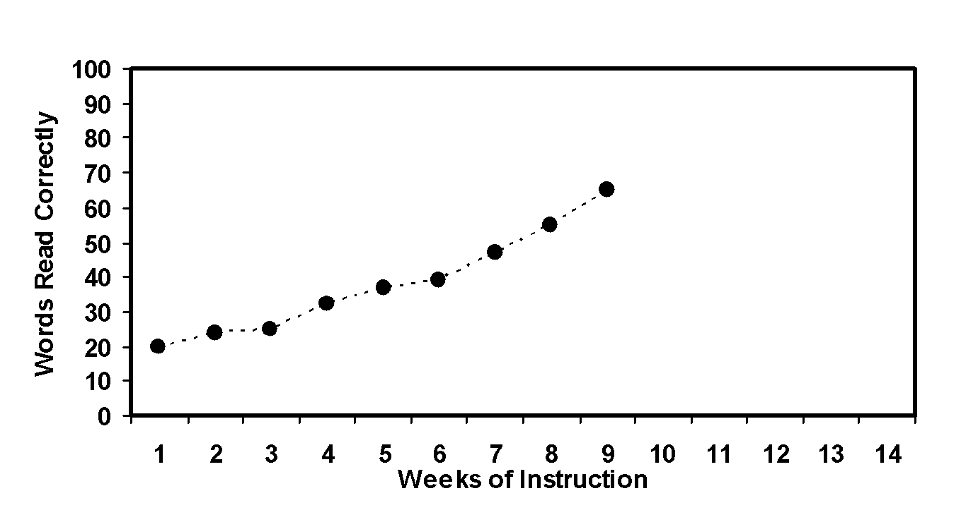
David’s slope:
(54 – 24) ÷ 8 = 3.75
X
X
Making adequate progress

Slide 63
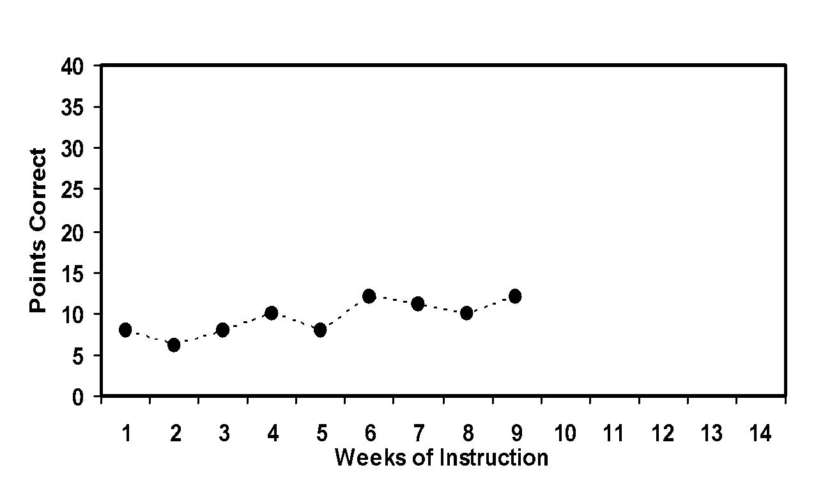
Martha’s slope:
(10 – 6) ÷ 8 = 0.5
X
X
Requires more
intensive support

Slide 64
What are your school’s Tier 2 strengths and weaknesses?

Slide 65
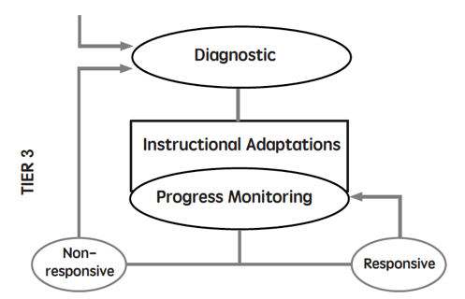
Diagnostics are conducted
Adaptations are made to the student’s intervention
Student progress is monitored weekly
With adequate slopes or end levels, students return to Tier 1 or 2

Slide 66
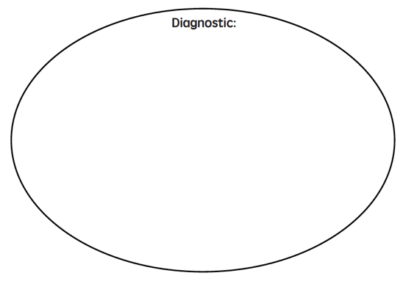
Diagnostic Online Mathematics Algebra Test (DOMA)
KeyMath3
Test of Early Mathematics Ability (TEMA3)
Test of Mathematical Mathematical Abilities (TOMA3)

Slide 67
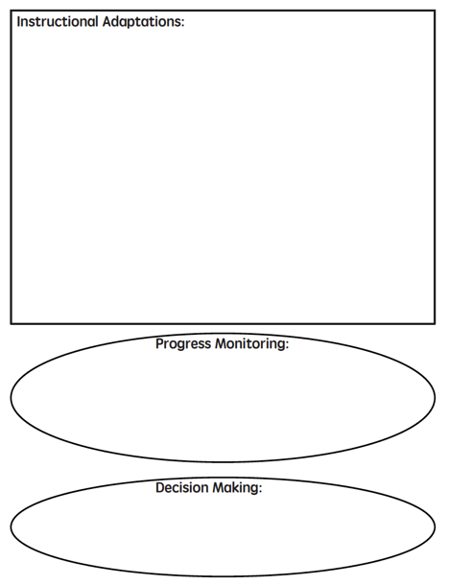

Slide 68
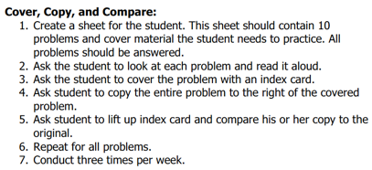
Implement with greater fidelity
Ensure that you are implementing the intervention or strategy with fidelity

Slide 69
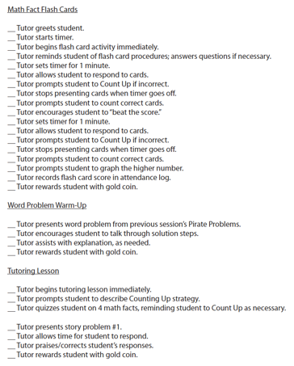
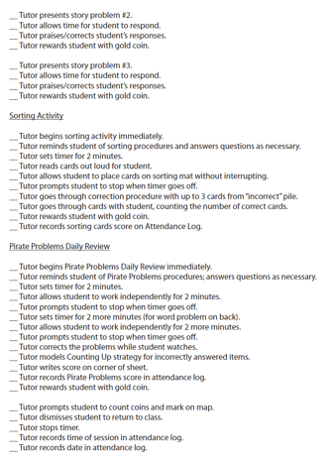
Implement with greater fidelity
Ensure that you are implementing the intervention or strategy with fidelity
Fuchs et al. (2008)

Slide 70
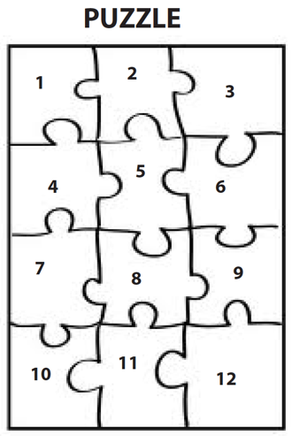
Implement with greater fidelity
Embed behavioral supports
May want to incorporate strategies to improve self-regulation and minimize nonproductive behavior
Powell, Driver, & Julian (2015)

Slide 71
Implement with greater fidelity
Embed behavioral supports
May want to incorporate strategies to improve self-regulation and minimize nonproductive behavior
UPSCheck
Understand
Plan
Solve
Check

Slide 72
Implement with greater fidelity
Embed behavioral supports
Increase dosage
Conduct longer sessions, more sessions per week, or more weeks within DBI

Slide 73
Implement with greater fidelity
Embed behavioral supports
Increase dosage
Conduct longer sessions, more sessions per week, or more weeks within DBI

Slide 74
Implement with greater fidelity
Embed behavioral supports
Increase dosage
Conduct longer sessions, more sessions per week, or more weeks within DBI
Number of weeks left in intervention

Slide 75
Implement with greater fidelity
Embed behavioral supports
Increase dosage
Adapt mathematics content

Slide 76
Implement with greater fidelity
Embed behavioral supports
Increase dosage
Adapt mathematics content
Alter the scope and sequence
Where student IS
Where student NEEDS TO BE
Explain why addition and subtraction strategies work, using place value and the properties of operations.
Use addition and subtraction within 100 to solve one- and two-step word problems…
Fluently add and subtract within 100 using strategies based on place value, properties of operations, and/or relationships.
Apply properties of operations as strategies to multiply and divide….
Fluently multiply and divide within 100, using strategies such as the relationship between multiplication and division…
Fluently add and subtract multi-digit whole numbers using the standard algorithm.
Find whole number quotients and remainders with up to four-digit dividends and one-digit divisors, using strategies based on place value, …
Solve multi-step word problems posed with whole numbers and having whole-number answers using the four operations…
Understand that the two digits of a two-digit number represent amounts of tens and ones.
Use multiplication and division within 100 to solve word problems…
Understand that the three digits of a three-digit number represent amounts of hundreds, tens, and ones.
Fluently multiply multi-digit whole numbers using the standard algorithm.

Slide 77
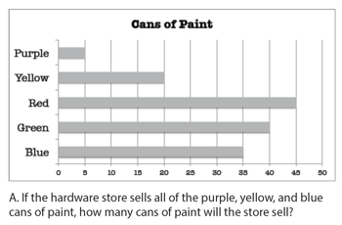
Implement with greater fidelity
Embed behavioral supports
Increase dosage
Solve
Adapt mathematics content
Write equation
Break down problems into smaller steps
Draw picture
Identify schema
Label graph
Underline labels
Read the problem

Slide 78
Implement with greater fidelity
Embed behavioral supports
Increase dosage
Adapt mathematics content
precise
Focus on the language of mathematics
concise

Slide 79
Implement with greater fidelity
Embed behavioral supports
Increase dosage
MATH JOURNAL
Adapt mathematics content
Focus on the language of mathematics
Define: | Characteristics:
Example: | Non-example:

Slide 80
Implement with greater fidelity
Embed behavioral supports
“Tell me how you solved this problem.”
Increase dosage
Adapt mathematics content
“What were you thinking about when you regrouped?”
Engage student in more discourse
“How would you teach this problem to another student?”
“Describe the word problem in 10 words or less.”

Slide 81
Implement with greater fidelity
Embed behavioral supports
Increase dosage
Adapt mathematics content
“Talk through this problem with me.”
Provide worked examples
405
+ 16
405
+ 16
411
421

Slide 82
Implement with greater fidelity
Abstract
Pictorial
Concrete
Embed behavioral supports
Increase dosage
Adapt mathematics content
Utilize more three-dimensional representations

Slide 83
Implement with greater fidelity
Abstract
Pictorial
Concrete
Embed behavioral supports
Increase dosage
Adapt mathematics content
Utilize more two-dimensional representations

Slide 84
Implement with greater fidelity
Abstract
Pictorial
Concrete
Embed behavioral supports
Increase dosage
Adapt mathematics content
Ensure students understand the abstract
34 = 3 tens and 4 ones
2 + 8 = 10
4,179
+ 569
x – 6 = 8

Slide 85
Implement with greater fidelity
Embed behavioral supports
Increase dosage
Adapt mathematics content
Focus on fact fluency
Addition
Subtraction
Multiplication
Division

Slide 86
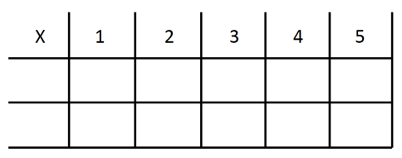
Implement with greater fidelity
Embed behavioral supports
Increase dosage
Adapt mathematics content
-3 + (-4) = ___ 5 – (-6) = ___

Slide 87
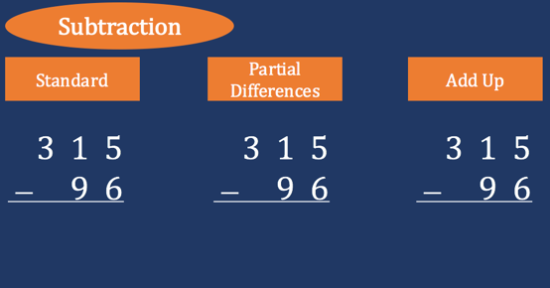
Implement with greater fidelity
Embed behavioral supports
Increase dosage
Adapt mathematics content
Teach alternate algorithms

Slide 88
Implement with greater fidelity
Embed behavioral supports
Increase dosage
Adapt mathematics content
405
+ 16
405
+ 16
Encourage alternate methods and solutions
400
10
11
421
421
+

Slide 89
Implement with greater fidelity
Embed behavioral supports
Don’t tie key words to operations
Teach word-problem schemas
Have an attack strategy
Increase dosage
Adapt mathematics content
Explicitly teach problem solving

Slide 90
Implement with greater fidelity
Embed behavioral supports
Increase dosage
Adapt mathematics content
Modeling
Practice
Utilize explicit instruction
Clear Explanation
Guided
Practice
Make sure you’re doing it! And do it well!
Planned
Examples
Independent Practice
Supporting Practices
Asking the right questions
Eliciting frequent responses
Providing immediate specific feedback
Maintaining a brisk pace

Slide 91
Implement with greater fidelity
Embed behavioral supports
405
+ 16
4305
+ 216
Increase dosage
Adapt mathematics content
Utilize explicit instruction
Explicitly teach transfer
Marney baked 89 cookies and sold 40 cookies at the bake sale. How many cookies does Marney have left?
Explicitly teach how current learning relates to other learning
Marney had $89 and spent $40 on shoes. How many much does Marney have left?
Marney had $89 and spent $40 on shoes. How much money will Marney have after buying the shoes?

Slide 92
Implement with greater fidelity
Embed behavioral supports
Increase dosage
Adapt mathematics content
Utilize explicit instruction
Explicitly teach transfer

Slide 93
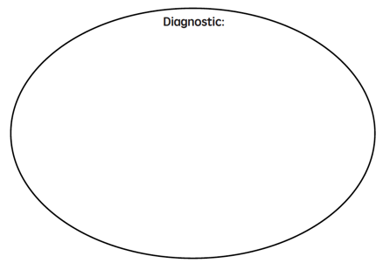
What are your school’s Tier 3 strengths and weaknesses?

Slide 94
https://intensiveintervention.org/intensive-intervention-math-course

Slide 95
srpowell@austin.utexas.edu
@sarahpowellphd
119

