Slide 1
O
U
R
W
E
E
K
!

Slide 2
D
A
Y
1
!
1
I can describe the power of the Executive Branch
I can describe the role the President has on the government.
Book reading
Notes (foldable)
Brain Pop video
Activity

Slide 3
Vocabulary…
Government Officials- any officer or employee of a Governmental Authority.
Nation- its a territory where all the people are led by the same government.

Slide 4
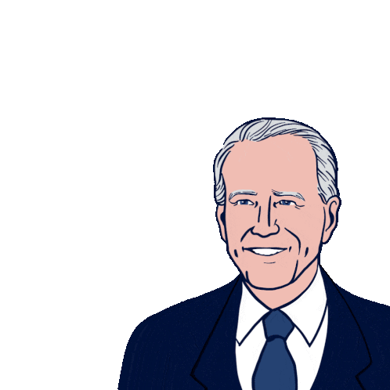
What is the Executive Branch?
The Executive Branch carries out and enforces the law.
This is where the President and the Vice President work.

Slide 5
What is a President?
A president is someone who is in charge.
A president is elected every 4 years.
A president can only serve 2 terms.
A president is elected by the people!

Slide 6
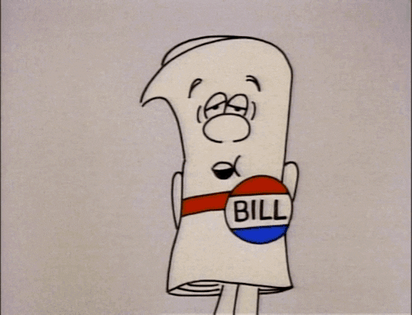
What Does the President Do?
The President is in charge of enforcing laws
The President can sign bills passed by Congress.
He/she can also veto a bill.

Slide 7
What Does the Vice President do?
The vice president supports the president.

Slide 8
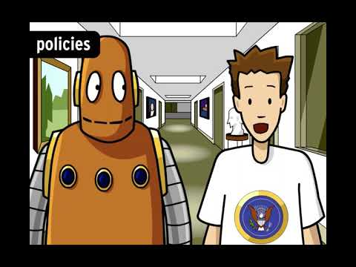

Slide 9
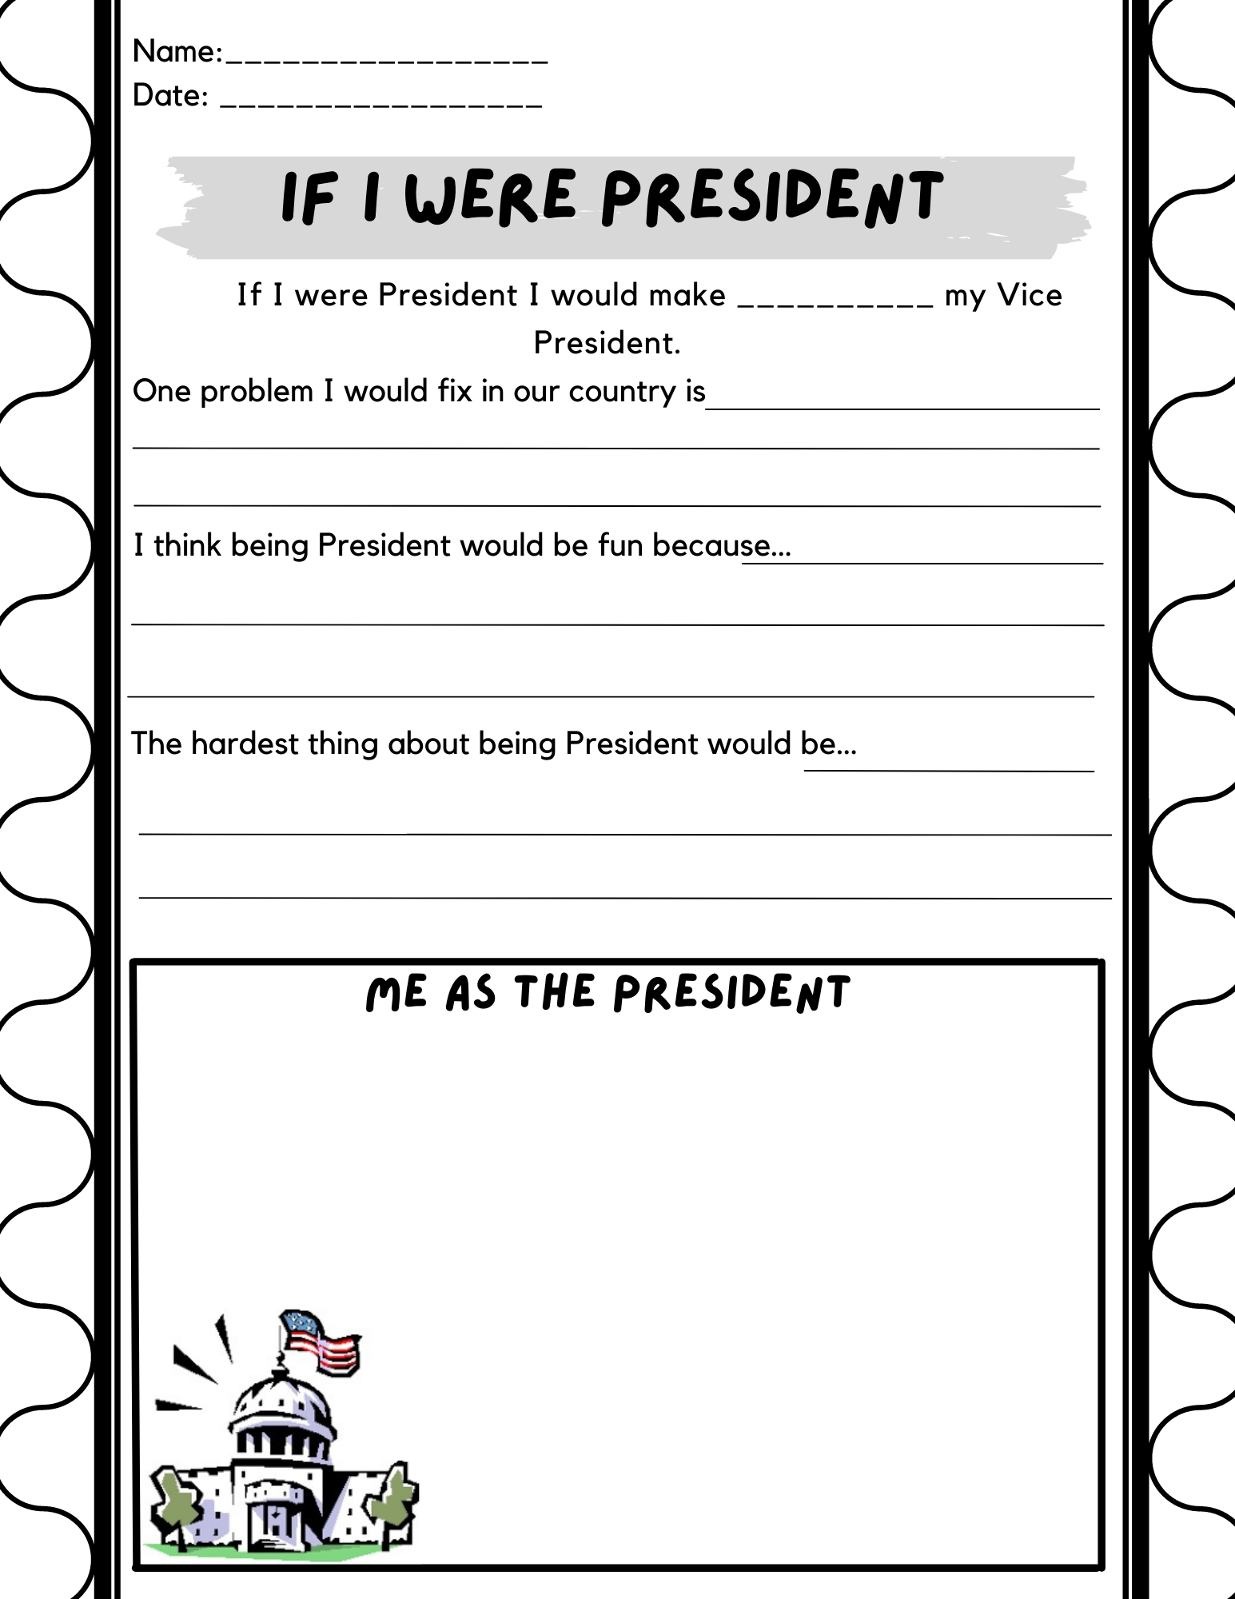
Activity Time!!
Notes:
Plan at least 15 minutes for this activity!!

Slide 10
3-2-1…
3 things you learned today
2 things you don’t understand
1 thing you still have questions about

Slide 11
D
A
Y
2
!
2
I can describe the power of the Legislative Branch.
I can describe the role the House has on passing a bill.
I can describe the role senate has on passing a bill.
Perfect Recipe
Foldable
Activity

Slide 12
The Perfect Pizza Recipe…
What would be the perfect recipe for Pizza?!
Notes:
Lead students in a class discussion to decide on the recipe for a perfect pizza (or chocolate chip cookie, or some other treat to share). Should it be thin or thick crust? Have cheese or not? Lots of toppings or few? Encourage students to speak up about their preferences and try to persuade their classmates, and then vote on each item. Afterwards, explain that this is very similar to how legislators have to negotiate and make compromise decisions about issues affecting the whole state.

Slide 13
What is the Legislative Branch?
Contains the House of Representatives and the Senate which makes up the congress.
Their job is to make make laws.

Slide 14
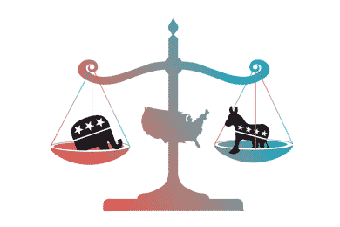
What is the power of Congress?
Creates bills
Overrides the president’s vetoes with a two-thirds vote
Declares war
Impeaches the president

Slide 15
What is the Senate?
The Senate is made of 100 people. That two senators per state!
A senate member serves six years.
They create money, taxes, and bills.

Slide 16
What is the House of Representatives?
There are 435 people in the House.
Representatives serve for 2 years
They can impeach the President.

Slide 17
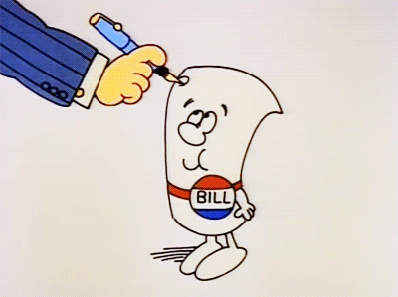
How does a Bill become a Law?
The bill is introduced to the House
the bill is introduced to the senate
the bill is sent the president to sign or veto!
Notes:
Explain to them how the pizza activity is exactly how they debate laws in the legislative.

Slide 18
Make your own law!
Notes:
Make your own law…
Group work!! Each table will be given a giant sticky note and will have to create a new classroom rule and present it to the classroom and then they all could vote to see which one we add to the classroom for the week or for the rest of the semester.

Slide 19
20 word summary…
On a piece of paper write a 20 word summary of what you learned about the legislative branch.

Slide 20
D
A
Y
3
!
3
I can describe the power of the Judicial Branch.
I can describe how the Supreme Court judges are placed in office
I can describe the three branches of government
Book
Foldable (notes)
Stations
Closure
Notes:
The past two days we have been talking about the executive and the legislative branches can anybody tell me what we learned about the executive branch?
The executive branch enforces the law and can veto laws made by the legislative.
The legislative branch creates the laws and approves of treaties. congress is divided into two parts the house and the senate.
Today we're going to talk about the judicial branch.

Slide 21
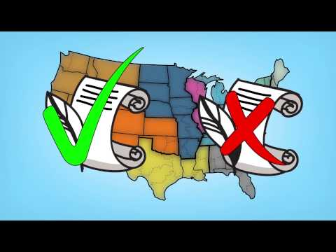

Slide 22
What is the Judicial Branch?
The Judicial branch contains the Supreme Court.
The Judicial branch interprets the meaning of laws.
They decide if laws are constitutional.
Notes:
What does it mean when i say if laws are constitutional?

Slide 23
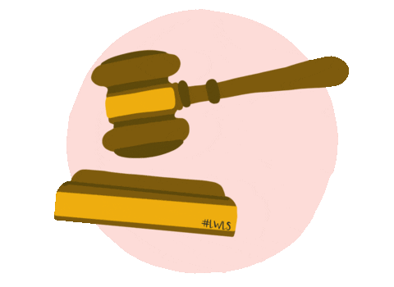
What is the Supreme Court?
The Supreme Court is the highest ruling court
They are appointed by the president and approved by the senate
They serve for life
There are 9 Justices
Notes:
The president appoints the justices in the Supreme Court. They are then approved by the Senate.
This whole thing is called checks and balances.
The president vetoes from the legislative, The legislative must approve of any presidential appointments, and the judicial decides if laws are constitutional on both branches. The legislative checks the executive branch by being able to override any veto by the president.

Slide 24
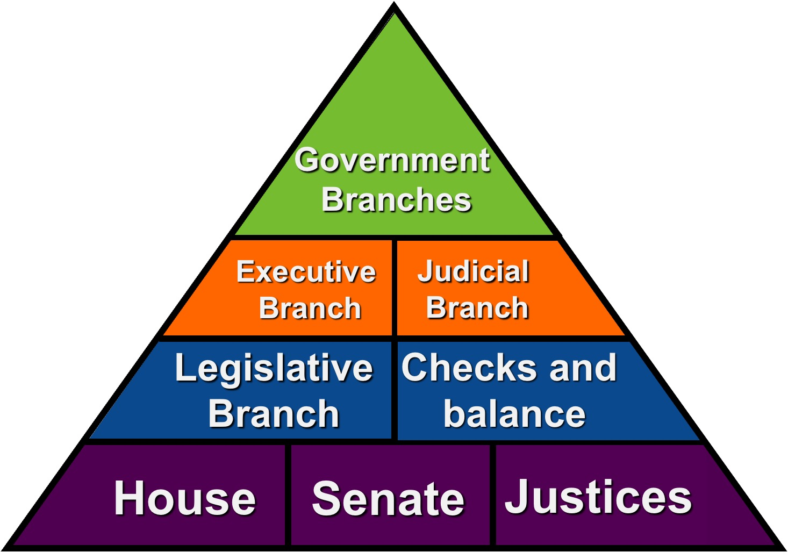
https://lead4ward.com/docs/instructional_strategies/vocabulary_pyramid_template_19-20.pptx

