Slide 1
Global brand value chain
Organizational structure
Global Brand
Enabling Structures and Processes
Global brand management
Shareholder value
Corporate social responsibility
Dimensions of value creation
Customer proposition
Marketing mix program
Digital strategy
Global Brand Building
Global brand equity
Performance

Slide 2

Sources of global brand value –
The COMET Framework
Customer preference for global brands
Organizational benefits
Marketing benefits
Economies of scale
Transnational innovation

Slide 3
COMET framework
Enhanced Customer Preference
Quality
Global culture
Country of origin
Dimensions of Value Creation by Global Brand

Slide 4


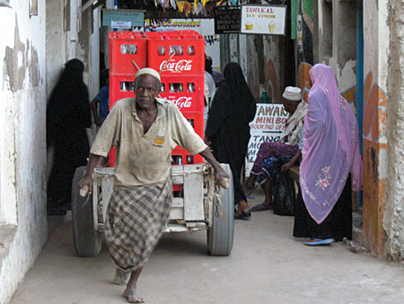

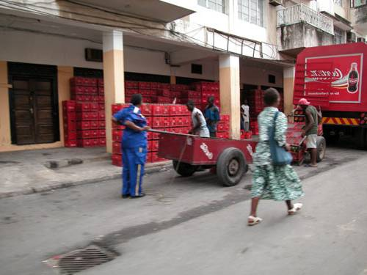

Global brands benefit from globalness per se
We are using something great which is available all over the world.
                - India
Global brands make you feel part of something bigger, and give a sense of belonging.
                - New Zealand
Local brands show what we are, global brands show what we want to be…
                - Costa Rica
Global brands make us feel citizens of the world, and we fear their leaving because they somehow give us an identity.
                - Argentina
Source: Baker et al. (2004)

Slide 5
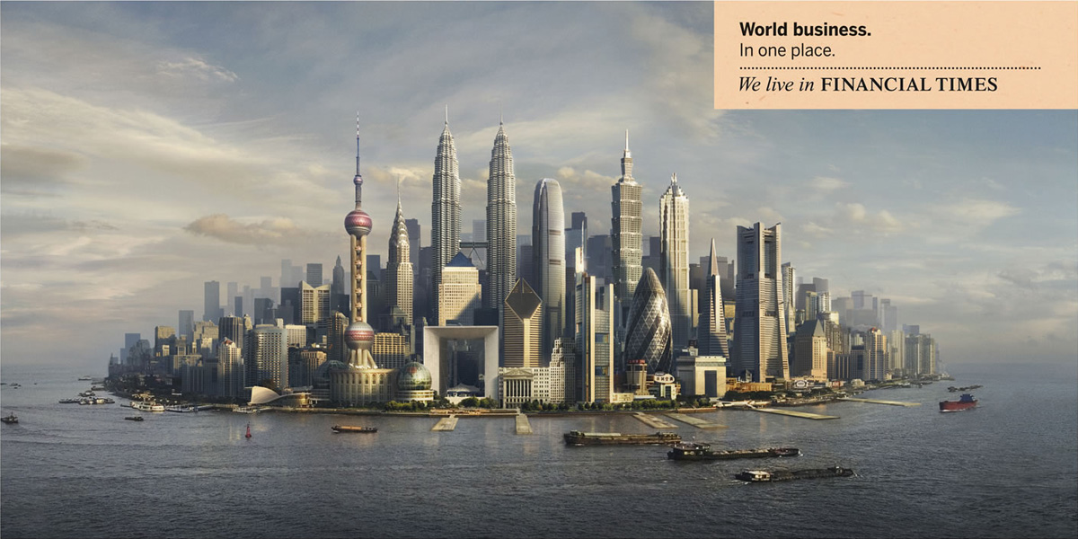
Creating customer preference through global symbols

Slide 6
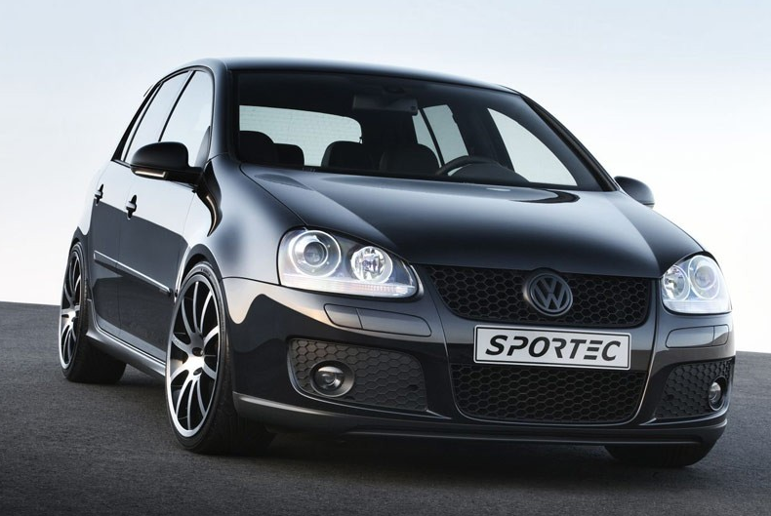
Does country of origin still matter? –
A test
Made in Germany
Made in Mexico
Which one would you buy?
© Prof. J-B.E.M. Steenkamp
Not to be used or reproduced without permission

Slide 7
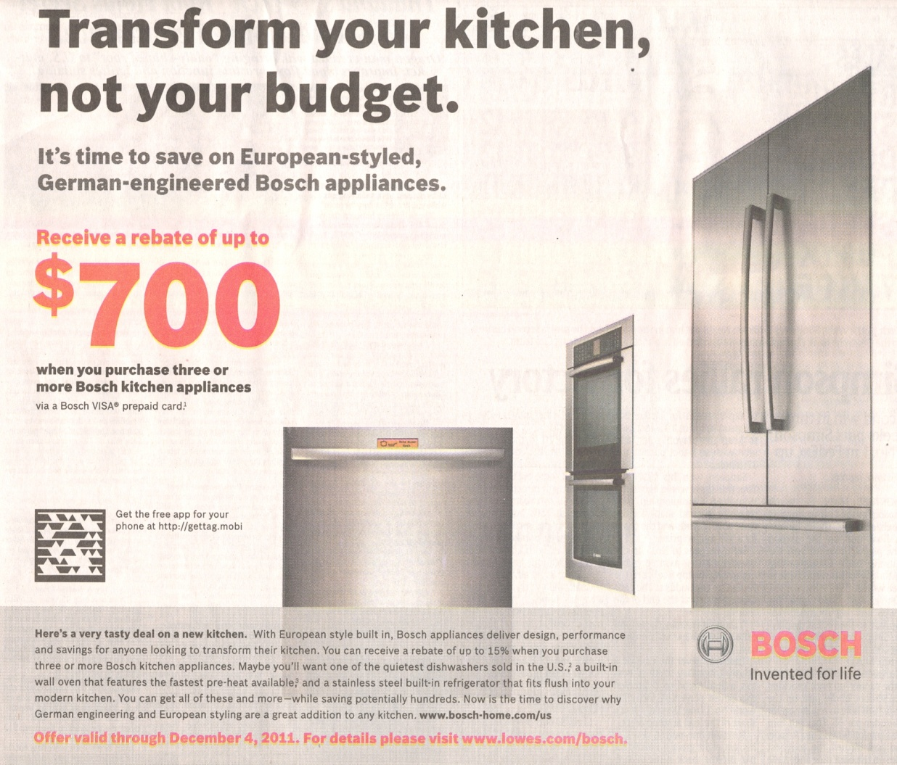
Bosch emphasizes German engineering

Slide 8
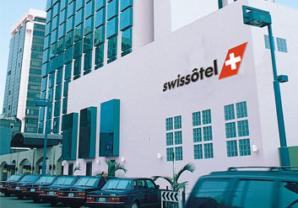
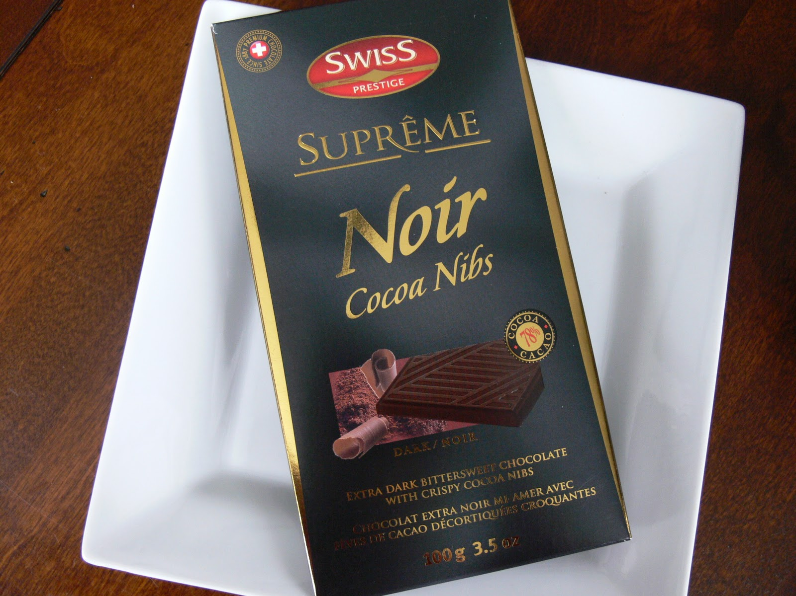
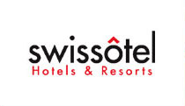
Deriving strength from Switzerland as COO

Slide 9

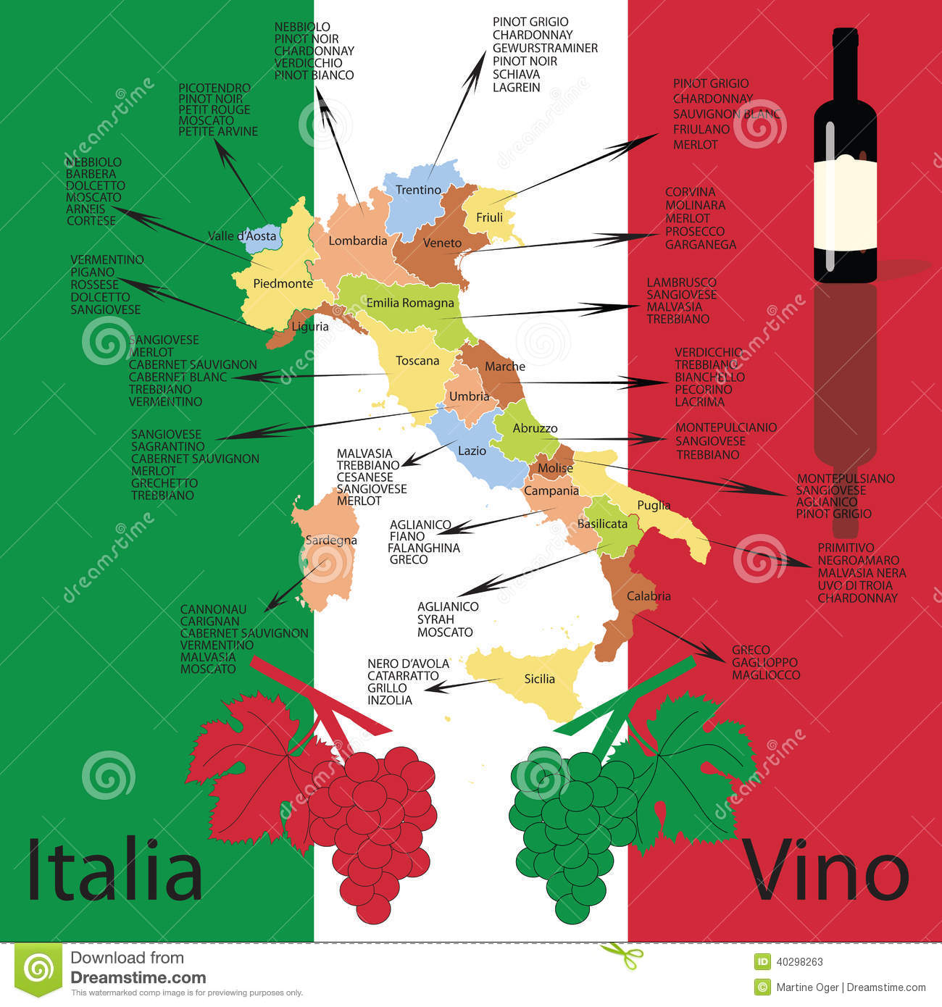
COO branding pays!
Price/liter
2015: € 1.17
Price/liter
2015: € 2.50
“That’s why I bang my head. We have the best olive oil in the world and it’s sent to Italy and sold as Italian. We send our wine to France and it’s sold as French. Why aren’t we able to do that?” María Urrutia, the marketing director of CVNE

Slide 10


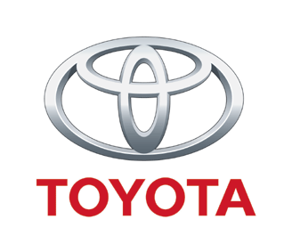

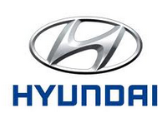


Strategies to cope with unfavorable COO
Select a brand name that disguises the COO or even invokes a favorable COO
Sell the product at a lower price and gradually move up the value chain
Use highly respected distribution channels – or alternatively, value channels
Offer extra guarantees
Invest heavily in promotion

Slide 11
Invest heavily in marketing communications and promotion
https://www.youtube.com/watch?v=jhFqSlvbKAM

Slide 12

Marca España
https://www.youtube.com/watch?v=3L7vLzVOAsY
https://www.youtube.com/watch?v=p3ZczKgStuM
https://www.youtube.com/watch?v=QYFSJytjvyQ

Slide 13
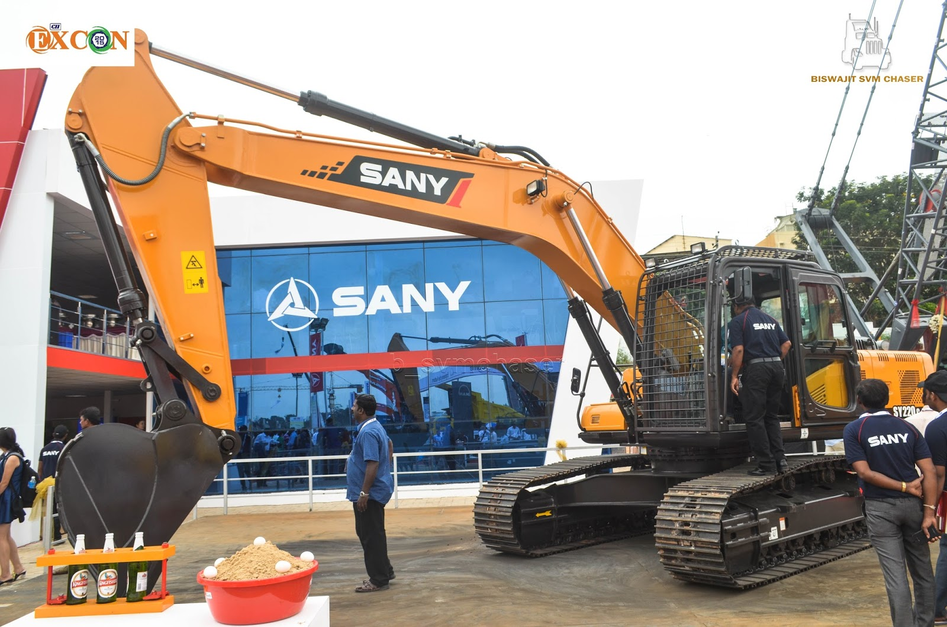
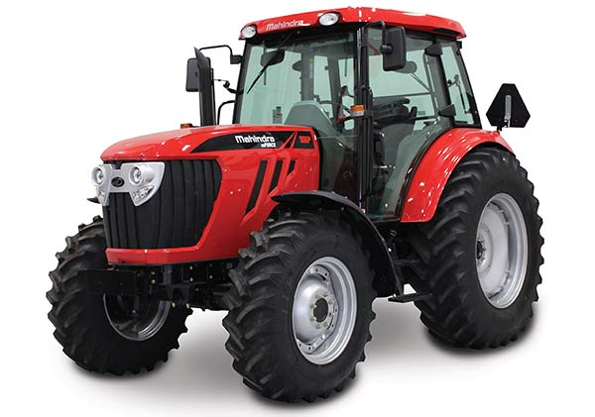
COO effects in B2B industries
Which countries have the most positive country-of-origin image?
For what type of industrial products does country-of-origin image play a larger role?
How can a B2B firm from a country with an unfavorable country-of-origin image mitigate the negative country-of-origin effect?

Slide 14
Source of global brand value
Enhanced customer preference
Quality
Global culture
Country of origin
Organizational benefits
Rapid NP roll-out
Global competitive moves
Creates corporate identity
Dimensions of Value Creation by Global Brand

Slide 15
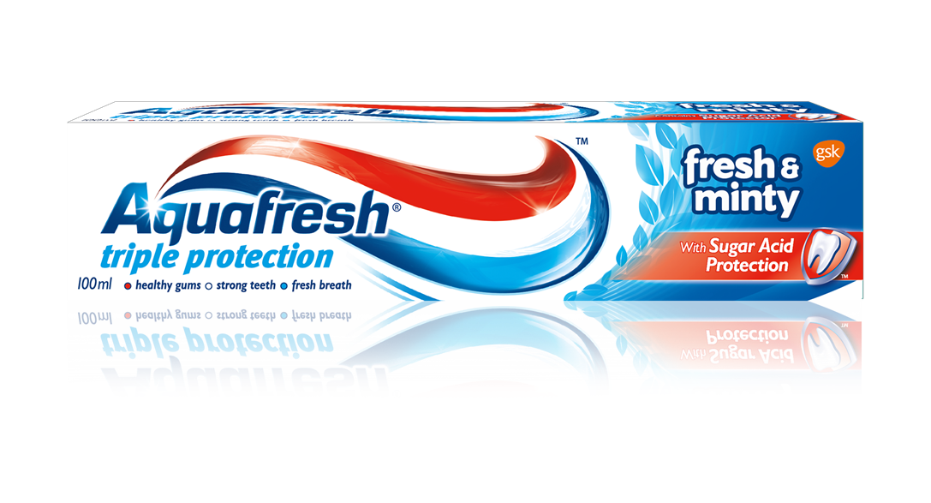

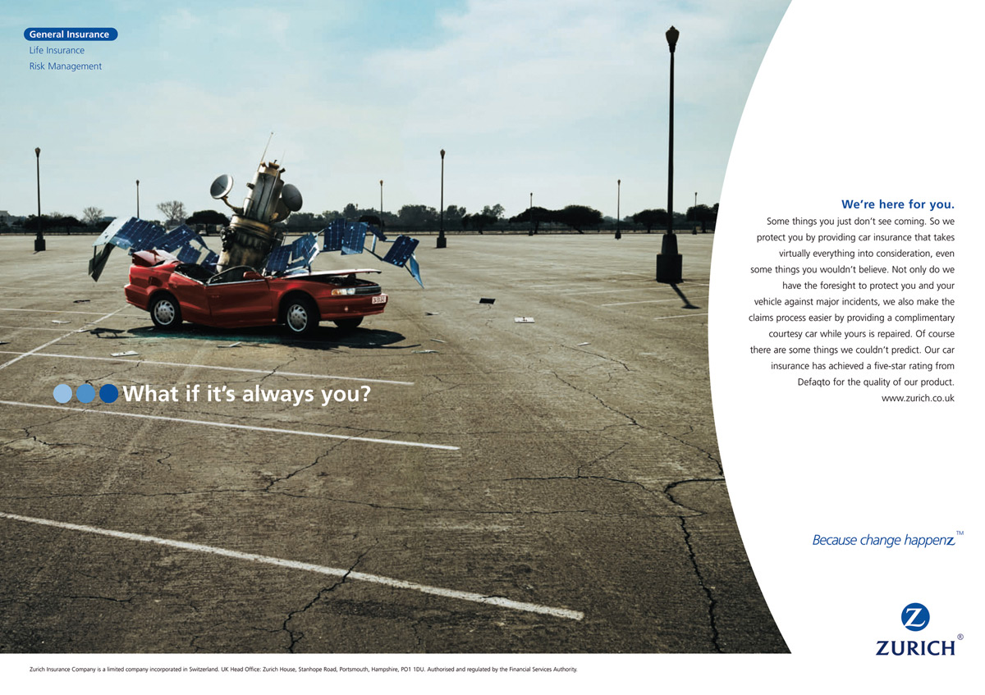
Global brands give the firm an identity

Slide 16
Source of global brand value
Enhanced customer preference
Quality
Global culture
COO image
Organizational benefits
Rapid NP roll-out
Globally competitive moves
Creates corporate identity
Dimensions of Value Creation by Global Brand
Marketing benefits
Media spillover
Pooling of resources
Leveraging best ideas

Slide 17
Media spillover
https://www.youtube.com/watch?v=OmBt-JVIc30

Slide 18

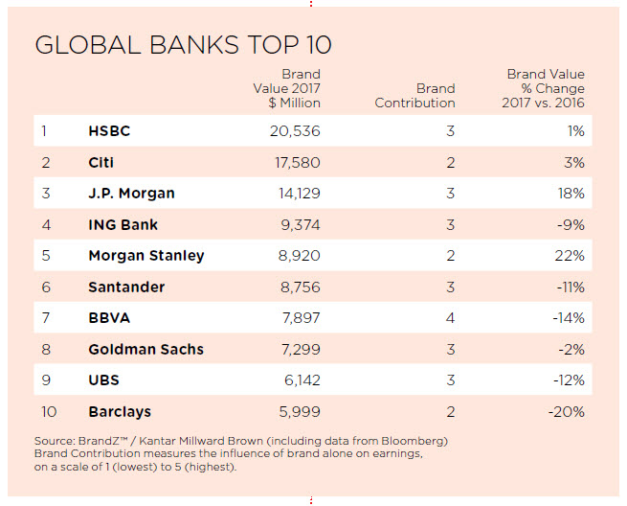
The result?
Source: Millward Brown BrandZ (2017)

Slide 19
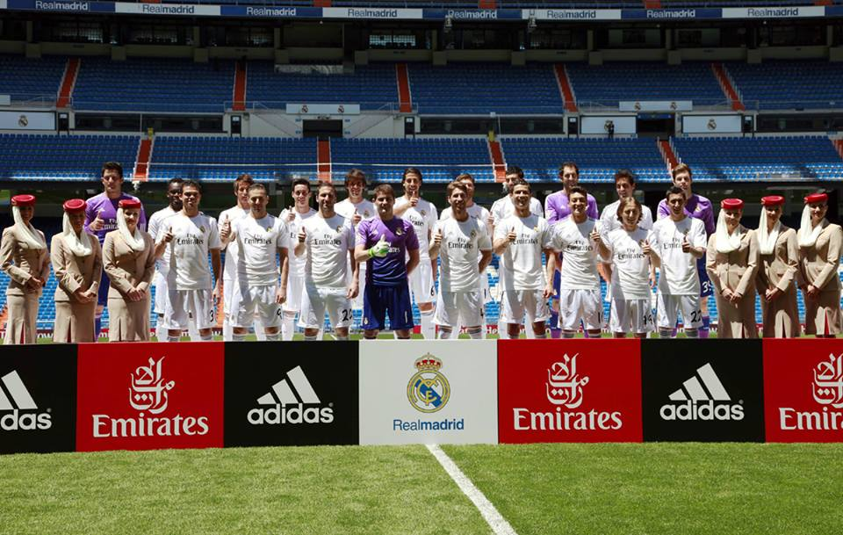
Pooling of resources to sponsor the greatest teams in the world

Slide 20
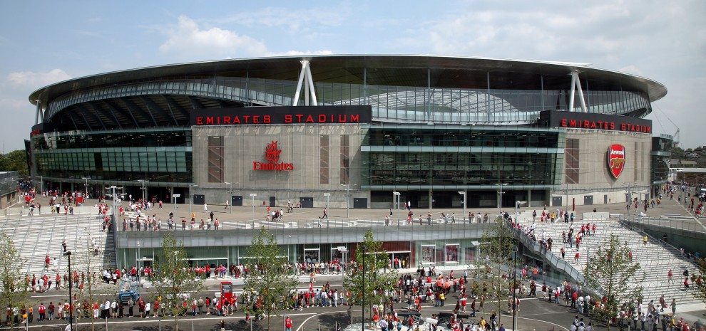
Arsenal Football Club’s stadium

Slide 21
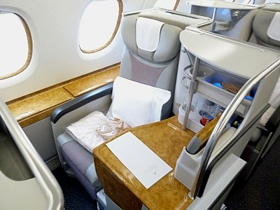
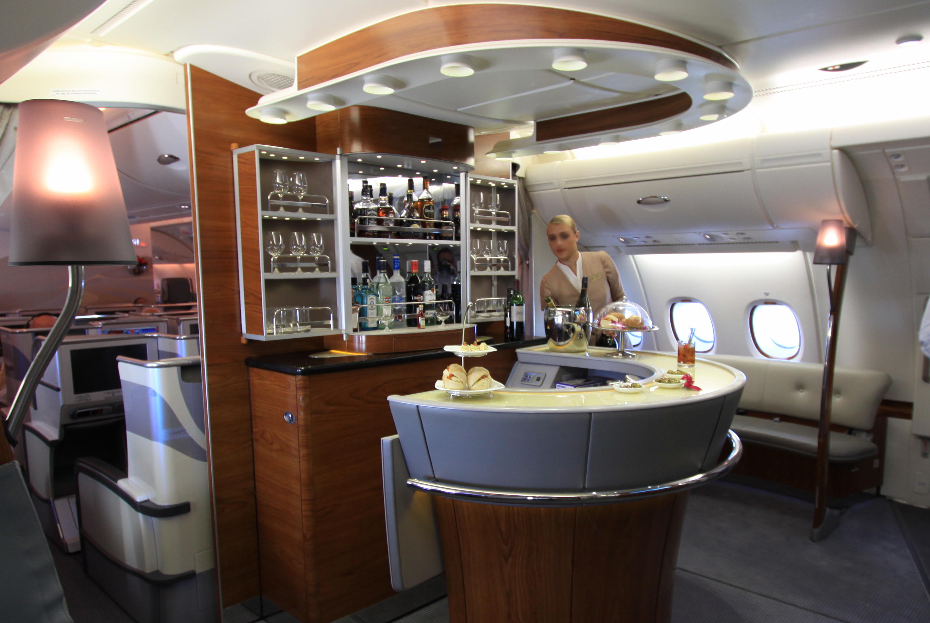
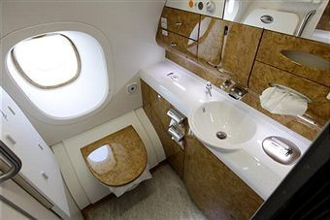
In-flight experience adds to the luster

Slide 22

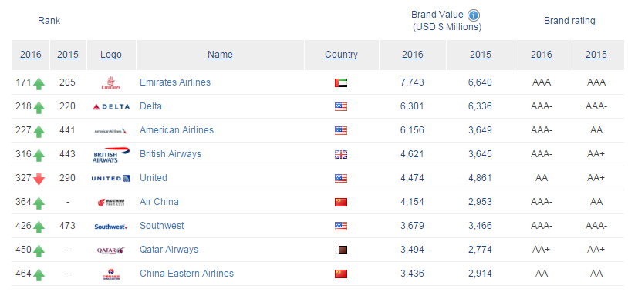
The result?
Source: Brand Finance (2016)

Slide 23
Leveraging creative ideas
https://www.youtube.com/watch?v=XAf37y4Wjh4

Slide 24
Source of global brand value
Enhanced customer preference
Quality
Global culture
COO
Organizational benefits
Rapid NP roll-out
Globally competitive moves
Creates corporate identity
Dimensions of Value Creation by Global Brand
Economies of scale and scope
Supply-chain/procurement
Production
Marketing benefits
Media spillover
Pooling of resources
Leveraging creative ideas

Slide 25
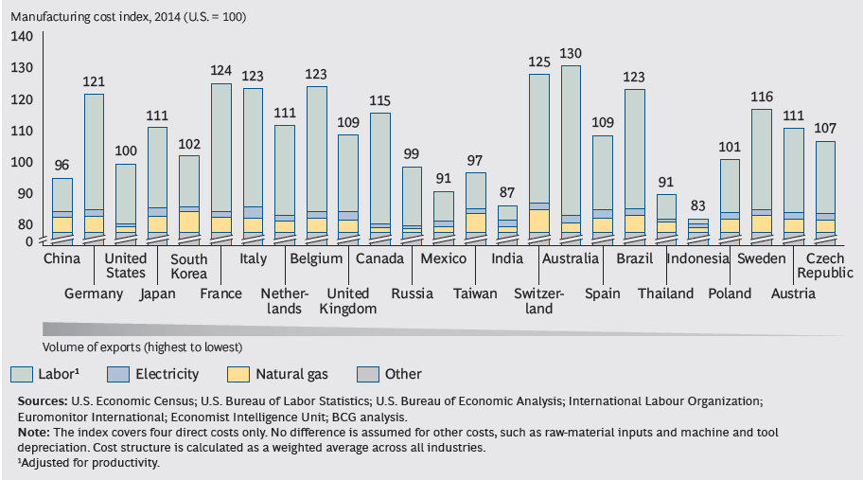
Manufacturing costs around the world
Source: Boston Consulting Group (2014)
© Prof. J-B.E.M. Steenkamp
Not to be reproduced without permission

Slide 26
Source of global brand value
Enhanced customer preference
Quality
Global culture
Country of origin
Transnational innovation
Pooling of R&D
Bottom-up innovation to overcome scarcity of great ideas
Frugal innovation to redefine the value proposition
Organizational benefits
Rapid NP roll-out
Globally competitive moves
Creates corporate identity
Dimensions of Value Creation by Global Brand
Economies of scale and scope
Supply-chain/procurement
Production
Marketing benefits
Media spillover
Pooling of resources
Leveraging creative ideas

Slide 27
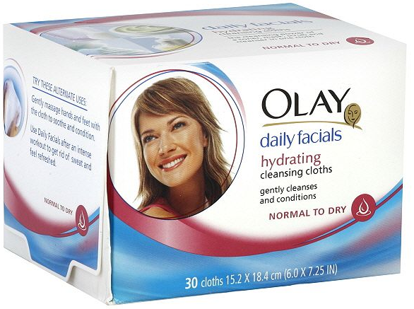
Pooling of R&D

Slide 28
P&G’s Global Product Development w/ Application to Facial Cleaning Cloth
Uncovering unmet consumer need worldwide with consumer research – going beyond observed cross-national differences in behavior
Soft, moisturized, clean-feeling skin
R&D facility in Cincinnati, drawing from P&G’s paper business: 10-micron mesh-woven fiber traps and absorbs dirt & impurities
Lead research center develops technical solution – “chassis”
Marketing expertise from lead markets brought in to expand “chassis” to a holistic new-product concept
Dispensable cleansing cloth impregnated w/ dry-sprayed formula of cleaners & moisturizers activated at different stages
U.S team develops Olay facial cloth ($7), one step routine “just like a daily facial”; Japan develops SK-II variant, positioned as “foaming massage cloth” ($50) as part of 6-step routine, supported by scientific data and beauty magazines
Technologists and marketers work on variations to holistic product concept for local markets

Slide 29
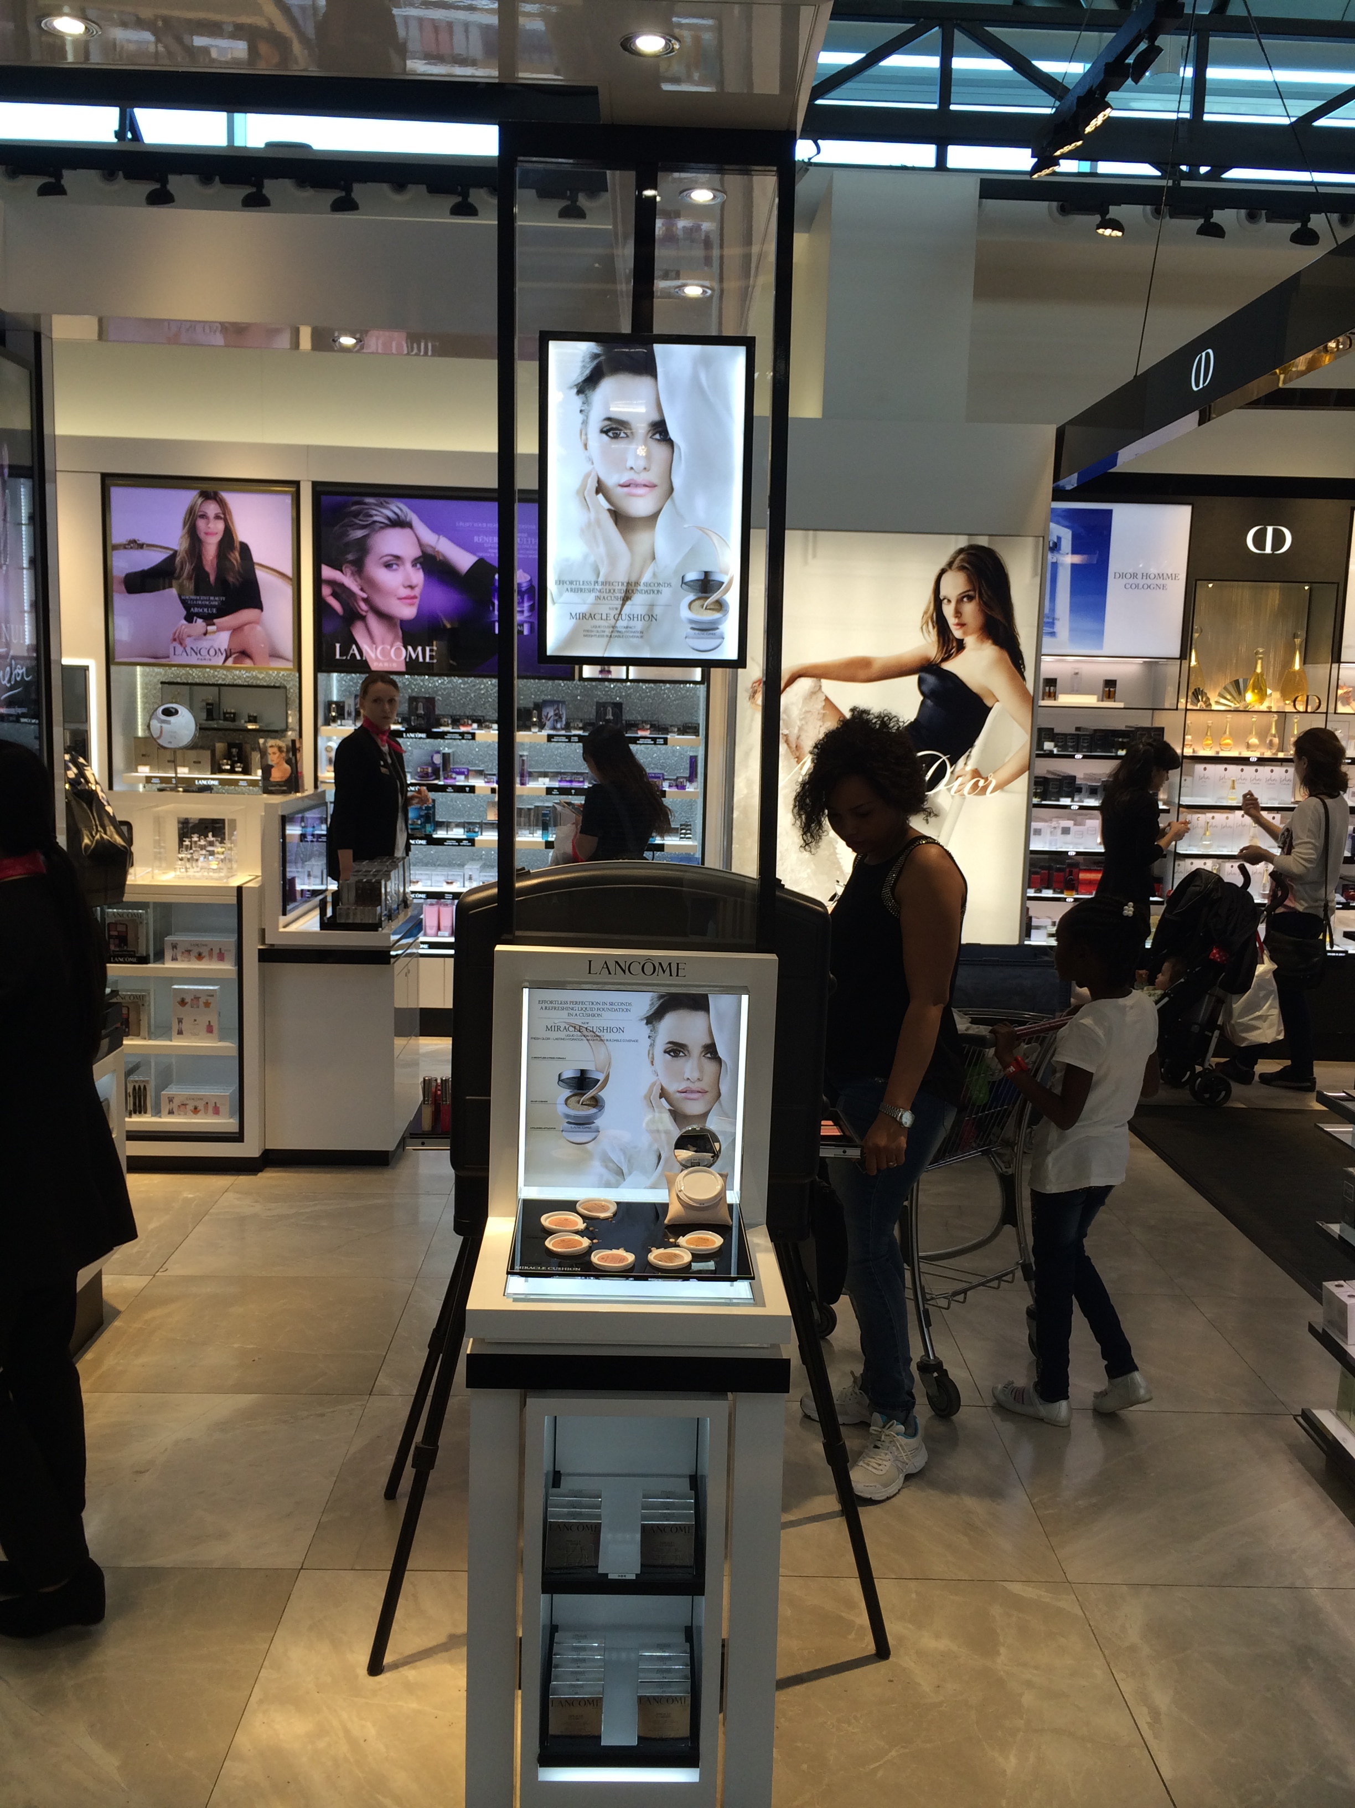
Bottom-up innovation
Miracle cushion – a sponge infused with liquid foundation to even out skin tones

Slide 30
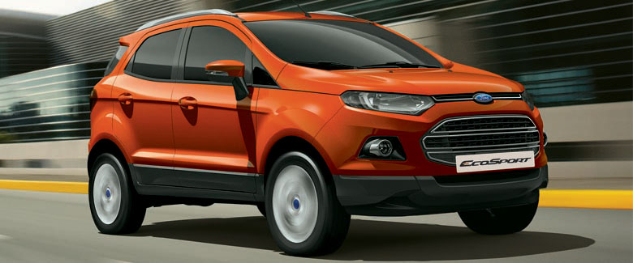

Frugal innovation to redefine the value proposition

