Slide 1
Topic one
ANNOUNCEMENTS
Subtitle

Slide 2
EVENTS THIS EASTER SEASON

Slide 3
Ways to connect

Slide 4
Ways to connect

Slide 5
Ways to connect

Slide 6
WHAT DOES THE BIBLE SAY ABOUT HEAVEN?

Slide 7
The Passion of the Christ Friday, April 7, 2023 2 pm – 4:15 pm Complimentary popcorn ; soft drinks Please bring a concession item to share (candy, chips, etc.) $7 suggested contribution

Slide 8
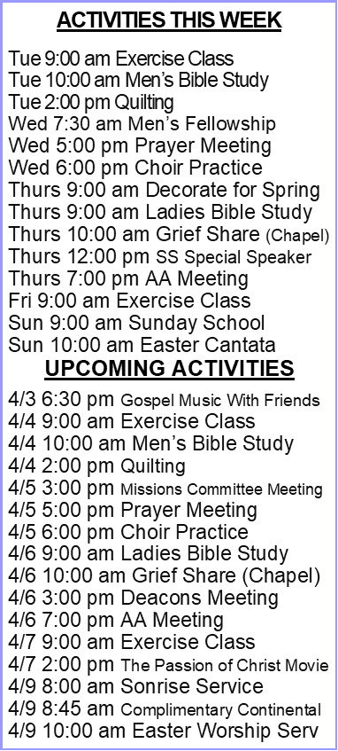
JOIN US
APRIL 9
MARCH 30

Slide 9
For information and details go to: http://ibctv.org

