Slide 1


Slide 2
HOLY SPIRIT PRAYER
Come, Holy Spirit, fill the hearts of your faithful.
And kindle in them the fire of your love.
Send forth your Spirit and they shall be created.
And you will renew the face of the earth.
Lord,
by the light of the Holy Spirit
you have taught the hearts of your faithful.
In the same Spirit
help us to relish what is right
and always rejoice in your consolation.
We ask this through Christ our Lord.
Amen.

Slide 3
The Eucharist

Slide 4
testimony
Don Conklin: “How the Eucharist transformed my life”

Slide 5
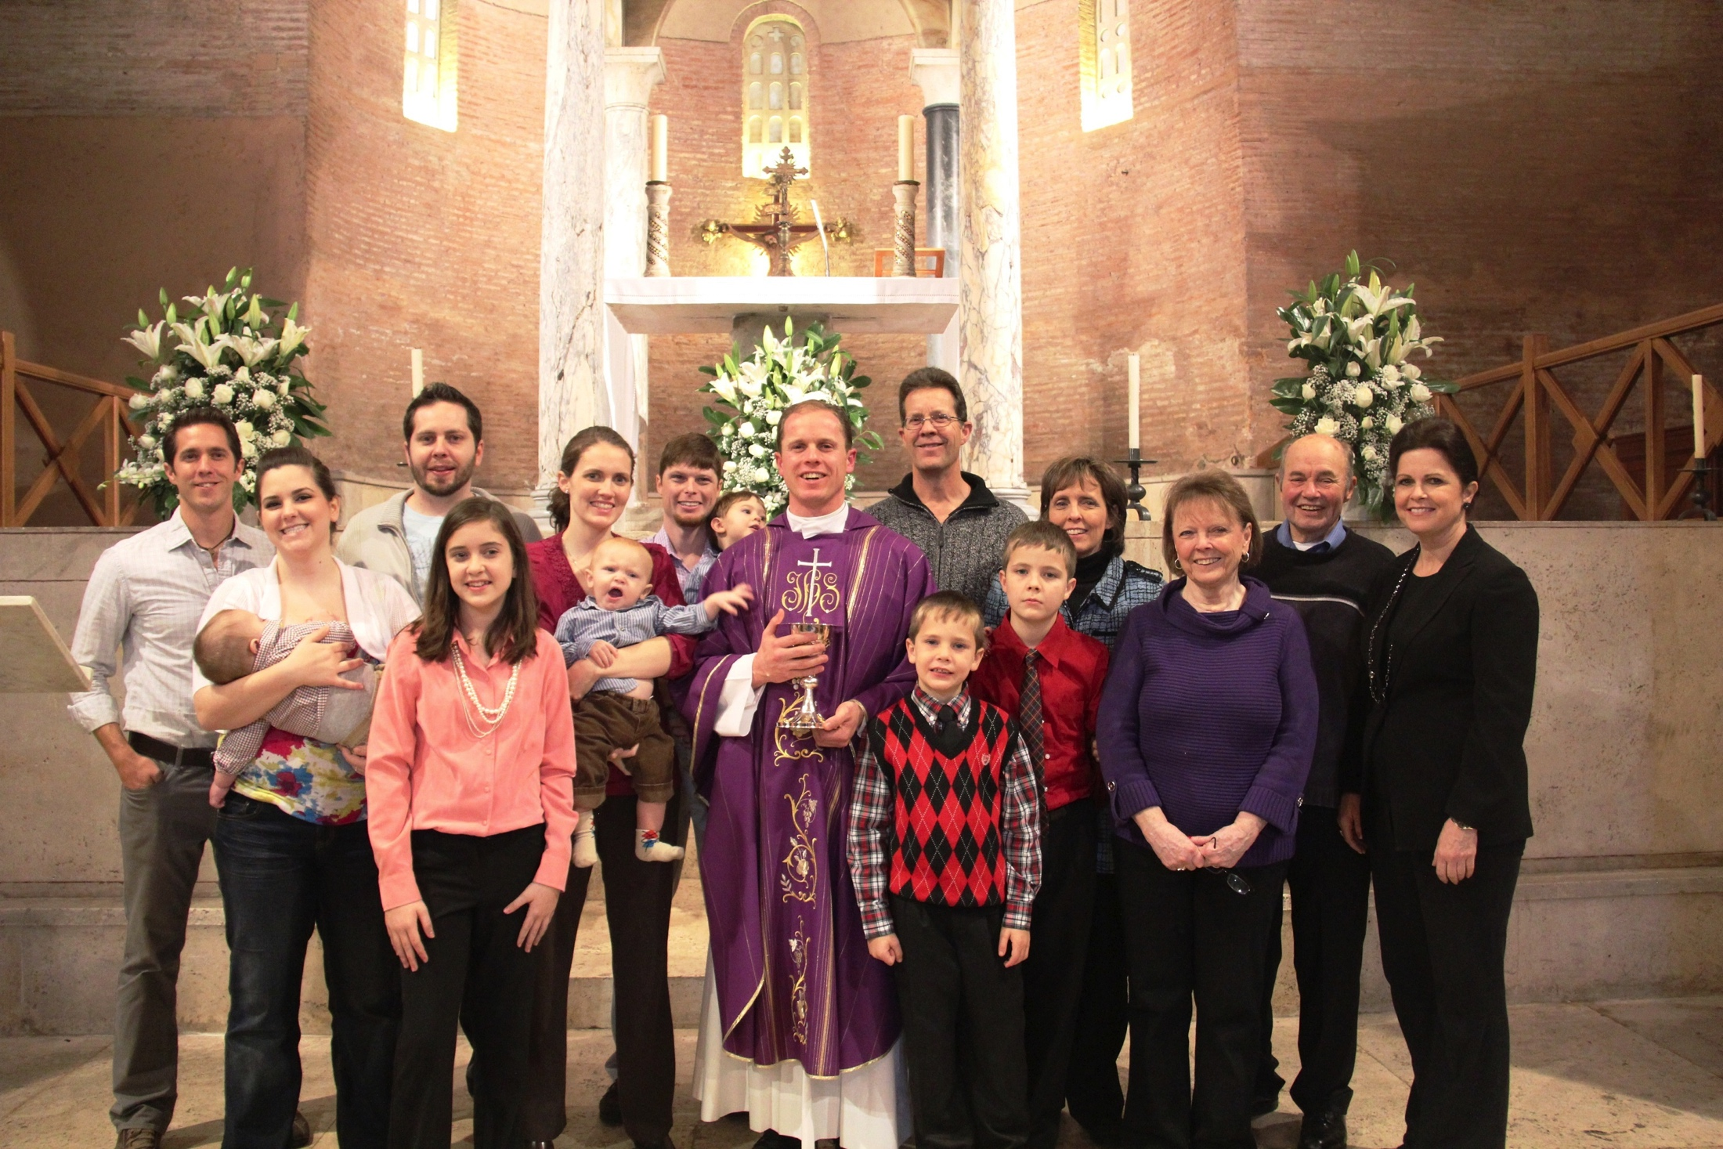
testimony

Slide 6
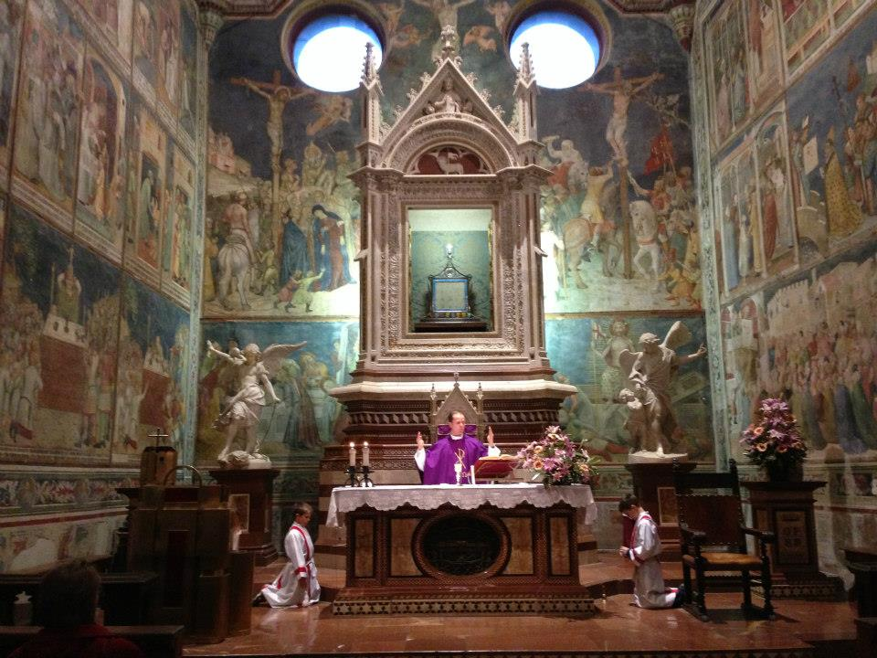
testimony

Slide 7
Why do you believe that Jesus Christ is really present in the Eucharist?

Slide 8
FIRST OBJECTION
In John 6:60-70, doesn’t Jesus explain He was only speaking symbolically in the previous verses? Notice verse 63: “It is the spirit that gives life, the flesh is of no avail; the words that I have spoken to you are spirit of life.”

Slide 9
ANSWER
No, verse 63 doesn’t prove Jesus was speaking symbolically about the Eucharist for the following reasons:
Jesus’ Eucharist discourse ends with verse 58 (see verse 59). The dialogue of verses 60-70 occurs later and deals with faith, not the Eucharist.
The Word “spirit” is nowhere used in the bible to mean “symbolic.” The spiritual is every bit as real as the material.
In verse 63, Jesus is contrasting the natural or carnal man (‘the flesh”) with the spiritual or faith-filled man. 1 Corinthians 2:14-3:4 offers a good explanation of what Jesus means by “the flesh”. Romans 8:1-13, especially verses 5-9, clearly contrast the flesh (human thoughts and desires) and the spirit (human thoughts and desires elevated by grace)

Slide 10
ANSWER
Notice that Jesus says “my flesh” when discussing the Eucharist. He says “the flesh” when referring to the carnal man who will not believe anything beyond his senses and reason. No Christian believes that Jesus’ flesh is “of no vail,” for His flesh was the means of our redemption.
The unbelieving disciples leave Jesus after verse 63. They would not have left at this point if Jesus had assured them that He was only speaking symbolically. This is the only time in the New Testament that any of Jesus’ disciples abandon Him because they find a doctrine of His too hard to accept.

Slide 11
SECOND OBJECTION
If the Apostles consumed Jesus’ real body and blood, wouldn’t they be committing cannibalism? Furthermore, wouldn’t this violate the biblical prohibition against drinking blood?

Slide 12
ANSWER
No. It was precisely this misunderstanding that led the unbelieving Jews and disciples in John 6 to reject Jesus when He said they must eat His body and drink His blood. They thought Jesus was commanding them to consume Him in a bloody, cannibalistic way. However, the believing disciples were rewarded for their faith at the Last Supper. Jesus revealed that they would receive His true body and blood sacramentally (present in a hidden way).
In the sacrament of the Eucharist, Christ's body and blood are truly present, but not with their normal physical properties. Jesus’ body isn’t spread out in space; its normal conditions hidden under the appearance of bread and wine.

Slide 13
ANSWER
While the Apostles truly consumed Christ’s real body and blood, it wasn’t cannibalism, because Christ wasn’t in His natural condition. They didn’t bite off pieces of Christ’s arm, for example, or swallow quantities of His blood; instead they received Christ whole and entire – body, blood, soul, and divinity – under the appearance of bread and wine.
Receiving Christ’s real, but sacramental presence in the Eucharist has nothing to do with cannibalism or drinking blood.

Slide 14
third OBJECTION
Why the Catholic Church teach that the Eucharist is truly a sacrifice? After all, in Hebrews 10:9-18, the sacred author talks about the “once for all” sacrifice of Christ, never to be repeated.

Slide 15
ANSWER
In the Old Testament, in Malachi 1:10-11, the prophet tells of a pure sacrifice being offered everywhere, from the rising of the sun to its setting. The council of Trent says that this anticipates the “pure offering to be sacrificed in messianic times…” the universal Sacrifice of the Mass.
The Catechism number 1366 says that the Eucharist is a sacrifice because it makes present the sacrifice of the cross. You see, the Mass is not just a representation but a re-presentation, of Christ’s sacrifice on Calvary. We truly participate in that once-for-all sacrifice.

Slide 16
ANSWER
So, Christ is not killed again and again on Catholic altars, as some has said. The Cathechism, number 1368, says it best… “Christ’s sacrifice present on the altar makes it possible for all generations of Christians to be united with His offering.”

Slide 17
Thank you!

