Slide 1
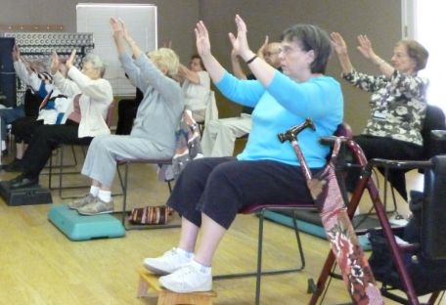
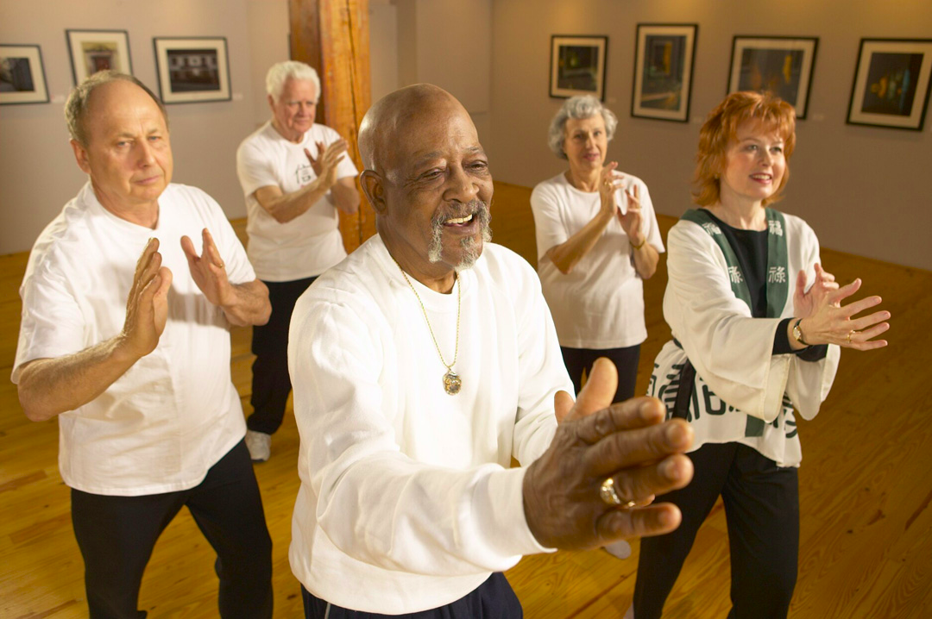
Tai Chi and Qi Gong for Older Adults
Linda Gabriel, PhD, OTR/L

Slide 2
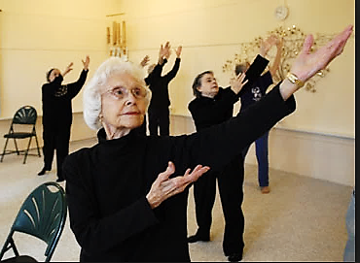
Tai Chi and Qi Gong
“Tai chi and qi gong are centuries-old, related mind and body practices. They involve certain postures and gentle movements with mental focus, breathing, and relaxation. In contrast to qi gong, tai chi movements, if practiced quickly, can be a form of combat or self-defense.” NCCIM, 2016

Slide 3
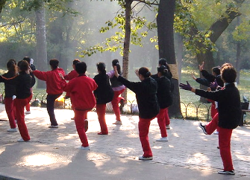
Tai Chi: evolved from martial art for the elite to exercise for all.
Initially, tai chi was a closely guarded secret within each family who developed its style. Family names are still used, such as Yang style tai chi. Now it is a common practice for all members of society for promotion of health and wellness. The most common is the Beijing 24 form “routine”.

Slide 4
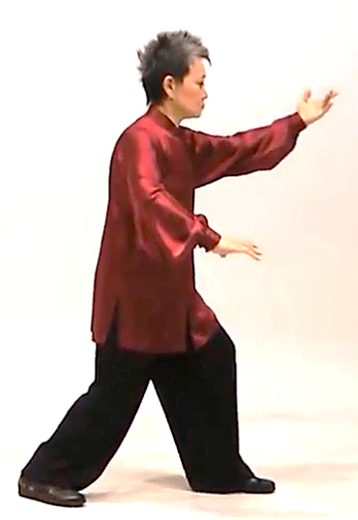
A “choreographed” series of movements/postures is known as a “form”.
The “simplified” 24 forms is still too complex for many beginners, especially those who are older or have chronic health conditions. Therefore forms have been further simplified.
https://www.youtube.com/watch?v=IEJLM29ITMw&nohtml5=False (if interested in viewing the 24 forms)
Other movements help with skill development,
practice components of forms, or to warm up or
cool down. Tai Chi is usually done standing, but
can also be done sitting in a chair. Qi Gong can
be done lying down, sitting, and standing.

Slide 5
The aging process can affect
Visual system
Auditory system
Cardiovascular system
Bone density
Muscle conditioning
Reaction time
ROM and joint health
Posture
Immune system and stress
Social interaction opportunities
Leading to ---------

Slide 6
Movement is Medicine
Tai Chi and Qi Gong are ideal for older adults because
they can be done sitting or standing and adapted to any level of ability. .
movements are slow, gentle and not complicated .
they addresses all 10 of the systems and function listed on the previous slide. .
A large body of evidence has been (and is being) created.

Slide 7
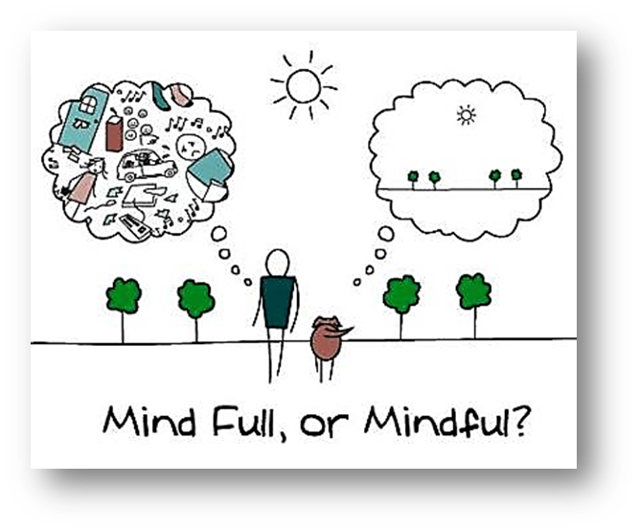
Basic Principles
Slow movements help increase mental focus and slow “monkey brain”.
Balance in body systems and between body and mind.
Power of expectation, intention, and mindfulness.
Be in the present.
Tune in to your body.

Slide 8
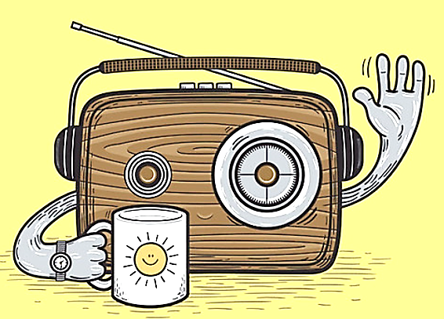
Tune In
Consider radio waves. You can’t hear them unless you know how to tune in to the station that you want. They are always present, even though you can’t see them.
Your body and mind have wisdom to impart and music to share that you will only hear when you tune in.

Slide 9
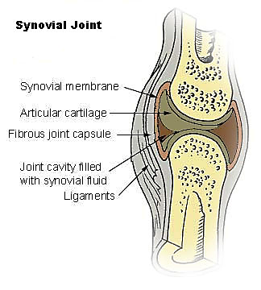
Tune In Bones and Muscles
Weight bearing (benefits bones) and shifting weight on legs with soft knees and active ankles improves strength.
Slow dynamic elongation of muscles, especially in torso, neck, and arms decreases tightness in muscles.
Improves flexibility of joints.

Slide 10
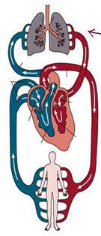
Tune in to respiration and circulation
Freer and focused breathing improves gas exchange and contributes to a decrease in stress hormones.
The body is about 60% water and fluids.
CSF
Lymphatic system
Blood
Connective tissues
Synovial fluid

Slide 11
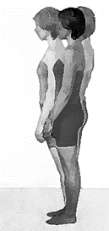
Tune in to gravity and balance
To keep our center of gravity over our base of support, we use vision, information from joints and muscles (tension, pressure), and information from the vestibular system.
The vestibular system acts as a gravity receptor and accelerometer.
The pull of gravity is a constant, although we are typically not aware of it.

Slide 12
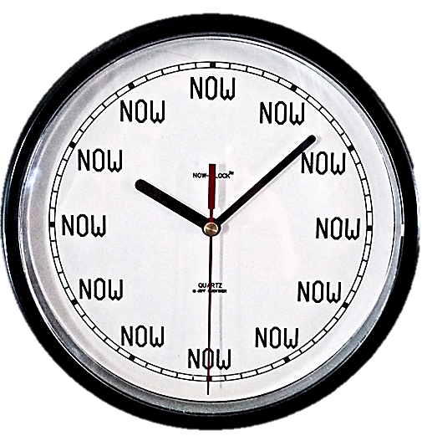
Tuning in mentally
Mindfulness, enhanced by visual imagery
Learn to suspend judgment of your thoughts and invite your mind to focus on the present, moment by moment, during the practice of Tai Chi, Qi Gong, or Yoga.
“Today is a gift. That’s why it’s called the Present.”

Slide 13
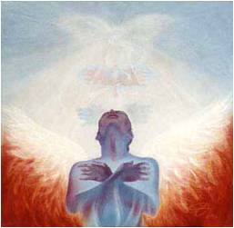
Tuning in spiritually
Provides an opportunity
to connect with yourself
with others (if in a group)
with the transcendent (in your own way).

Slide 14
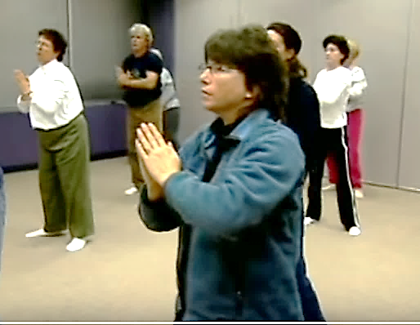
Qi Gong
https://www.youtube.com/watch?feature=player_embedded&v=utpK1YR19Pg

Slide 15
Basic Posture
Maintain vertical alignment of skeleton
Feet hip or shoulder width apart .
center of gravity (or mass) over your base of support. Base of support needs to be wide enough to the stable, but not so wide it prevents you from moving easily.
Soft knees and relaxed shoulders

Slide 16
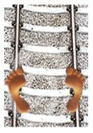
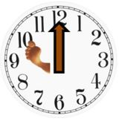
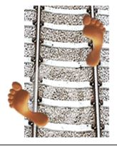
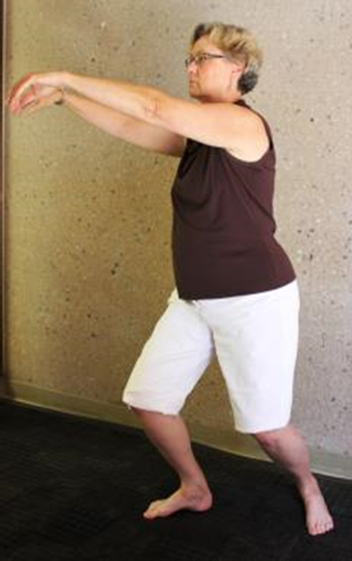
Bow Stance
Sift weight to left. Lift toes on left and pivot in heel so that foot is about 30° (or 10:00).
Slide right foot forward a few inches. Width between feet stays the same.
Sink downward slightly, keeping upper body and head in the same position.

Slide 17
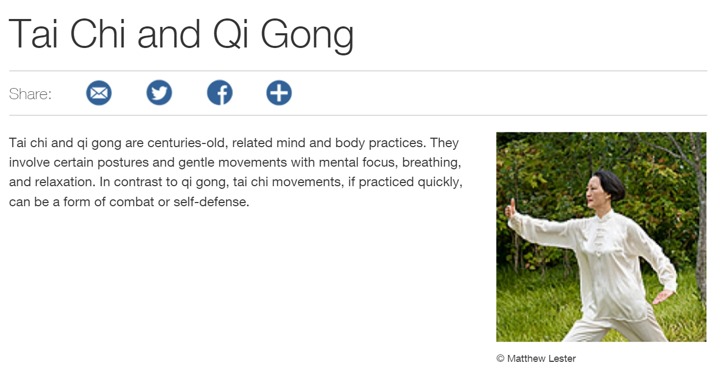
National Institute for Complimentary and Integrative Health https://nccih.nih.gov/health/taichi

Slide 18
NCCIH selected links for Health Professionals
Lecture: “Minding” Our Bodies: Research on the Impact of Tai Chi on Cognitive-neuromuscular Interactions in Older Adults (09/12/16)
Clinical Digest: Complementary Health Approaches for Chronic Pain
Clinical Digest: Mind and Body Approaches for Stress
Clinical Digest: Spotlight on a Modality: Tai Chi
Clinical Digest: Complementary and Integrative Health for Older Adults

Slide 19
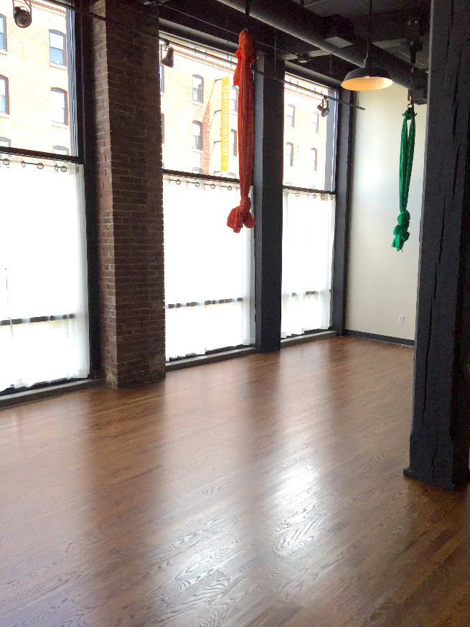
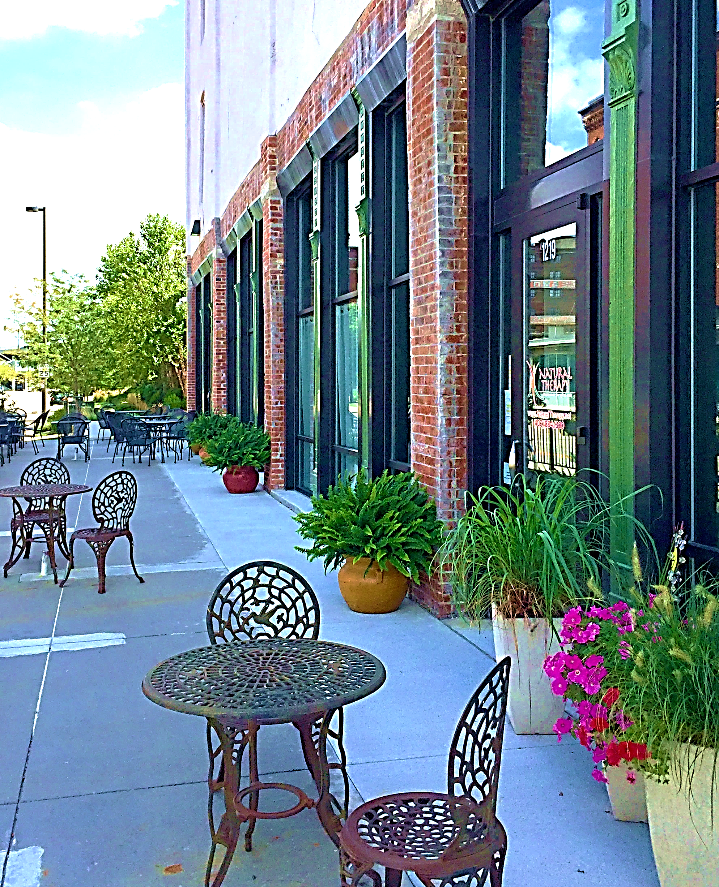
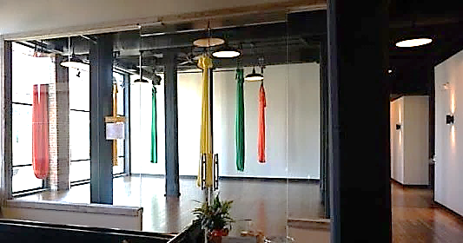
Natural Therapy 13th and Leavenworth
www.NaturalTherapy.com

Slide 20
Useful Websites:
The Eight Active Ingredients of Tai Chi developed by Peter Wayne. http://www.treeoflifetaichi.com/ .
Tai Chi Fundamentals developed by Tricia Yu. http://taichihealth.com/ .
Tai Chi for Balance http://taichibalance.org/
Additional references and resources available at www.TailoredTaiChi.com (webpage for Linda Gabriel, PhD, OTR/L

