Slide 1
Limiting Factors, Carrying Capacity and Biotic Potential
Chapter 1 Part 3 Populations

Slide 2
Goals
Understand how limiting factors affect populations
Explain how limiting factors are related to carrying capacity
Identify different biotic potential in living things

Slide 3
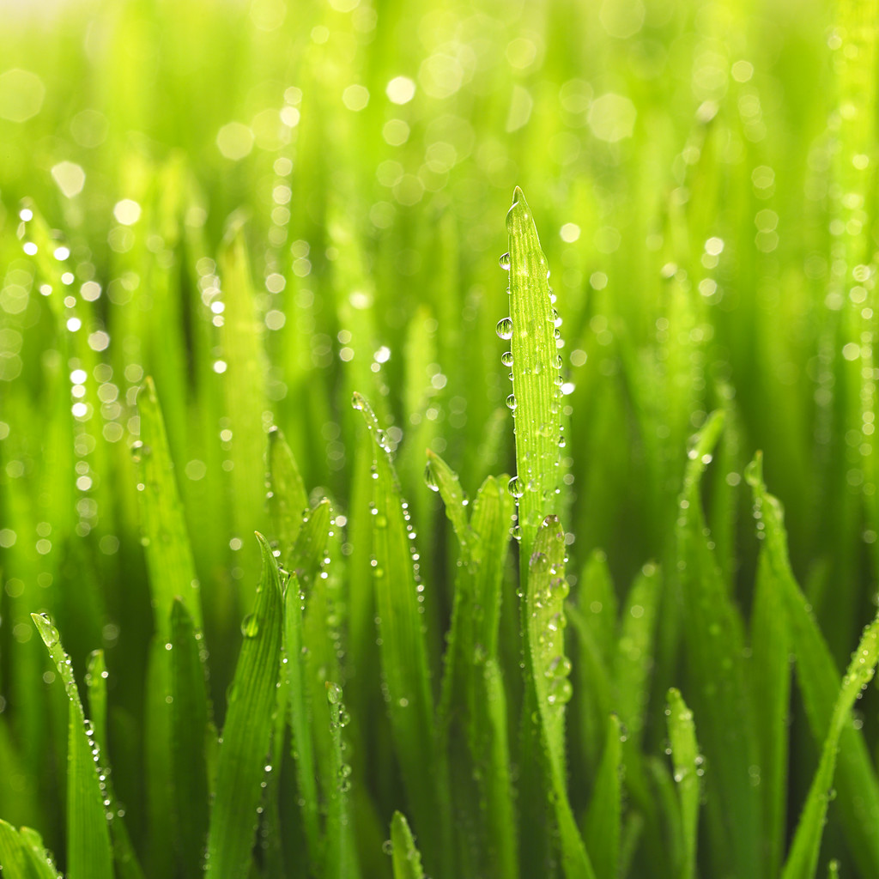
Limiting Factors
One grass plant can produce hundreds of seeds

Slide 4
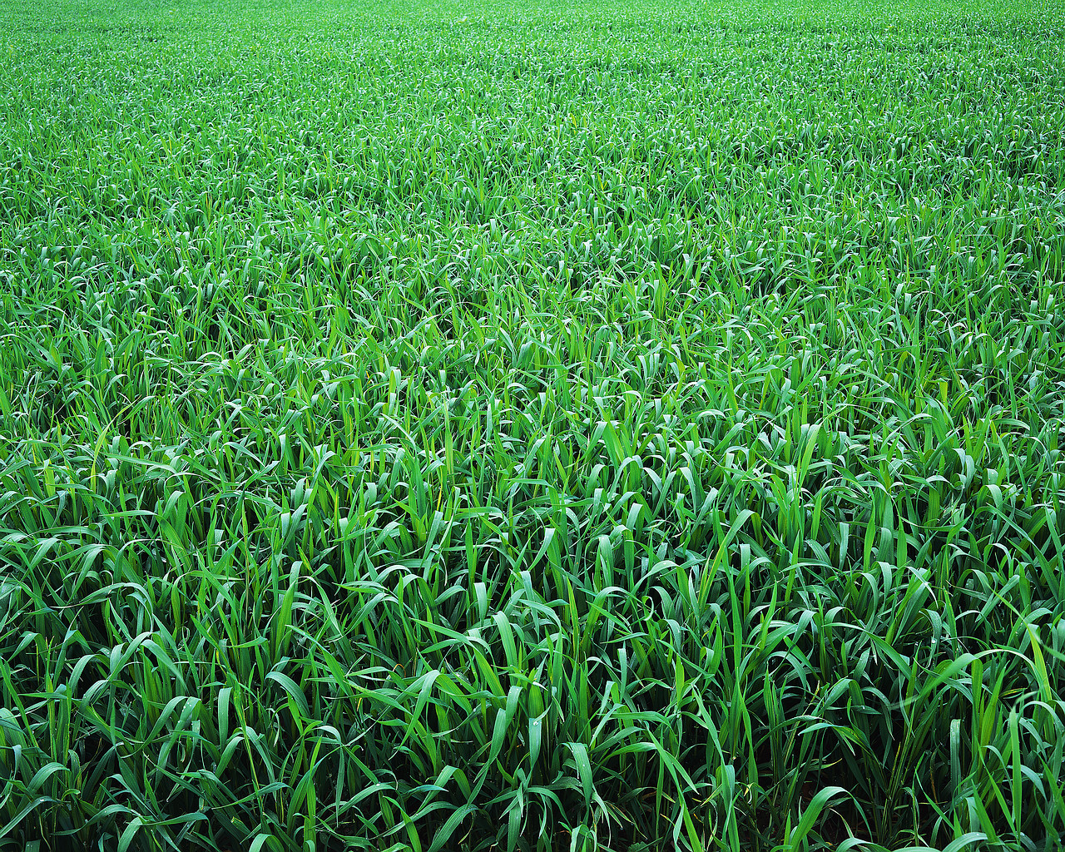
Limiting Factors
Can this grass population keep growing forever?

Slide 5
Limiting Factors
Suppose the seeds of wild flowers and trees drifted into that field.
If these seeds sprouted they would compete with the grass.
What would they be competing for?

Slide 6
Limiting factors
What if the grass was not competing for light, soil, and water?
What would happen if they were not competing with other plants and just kept growing?
They might just use up all the living space in the field.

Slide 7
Limiting Factor
In an ecosystem, certain resources are limited.
What resources are limited in an ecosystem?
Think….
Brainstorm a list of resources that are limited in an ecosystem.

Slide 8
Limiting Factor
A limiting factor is anything that restricts the number of individuals in a population
Limiting factors include living and non-living features in an ecosystem

Slide 9
Limiting Factors
Limiting factors can affect more than one population in a community

Slide 10
Limiting Factors
Let’s think….
Suppose rain limits the growth of grass or other plants in a meadow.
What could happen? What would happen if it did not rain?
What would be the limiting factors?

Slide 11
Limiting Factors
Fewer plants would produce fewer seeds
Fewer seeds provide less food for seed eating organisms, like mice
This reduction in food supply is a limiting factor
What would happen to the mice if there were a reduction in the production of seeds?

Slide 12
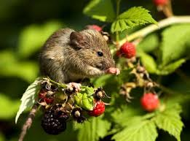
Limiting Factor
How would a reduction in the mice population affect other organisms in the ecosystem?

Slide 13
Carrying Capacity
What is happening to the fish in this ecosystem?
What is the limiting factor?

Slide 14
Carrying Capacity
This ecosystem has reached its carrying capacity for goldfish

Slide 15
Carrying Capacity
What do you think carrying capacity means?
Guess and Check:
GUESS: Write down what you think carrying capacity means
CHECK: Check your definition against the others at your table
Let’s see if we were correct

Slide 16
Carrying Capacity
Carrying capacity is the largest number of individuals of one species that an ecosystem can support over time

Slide 17
Carrying Capcity
What would happen if one population begins to exceed the environment’s carrying capacity?

Slide 18
Carrying Capacity

Slide 19
Carrying Capacity

Slide 20
Carrying Capacity and Limiting Factors
How are limiting factors related to carrying capacity?
Write down a guess

Slide 21
Carrying Capacity and Limiting Factors
Carrying capacity exists because of limiting factors.
A shortage of one or more things limits population size

Slide 22
Biotic Potential
What would happen if no limiting factors restricted the growth of a population?

Slide 23
Biotic Potential
Think about a population that has an unlimited supply of food, water, and living space.
The climate is favorable.
Population growth is not limited by disease, predators, or competition with other species
What would happen?

Slide 24
Biotic Potential
The highest rate of reproduction under ideal conditions is a population’s biotic potential
The higher the number of offspring produced, the higher the biotic potential of the population

Slide 25
Biotic Potential
Let’s look about the biotic potential of fruit bearing trees and plants

Slide 26
Biotic Potential
Brainstorm the names of fruit with different types of seeds?
Think about the fruit that has one seed and the fruit that have many seeds

Slide 27
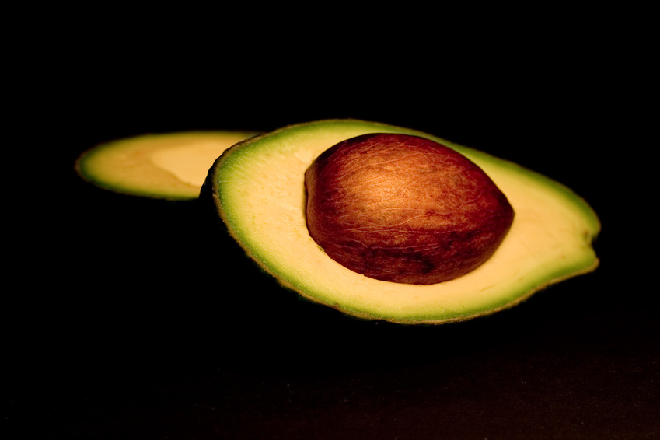
Biotic Potential

Slide 28
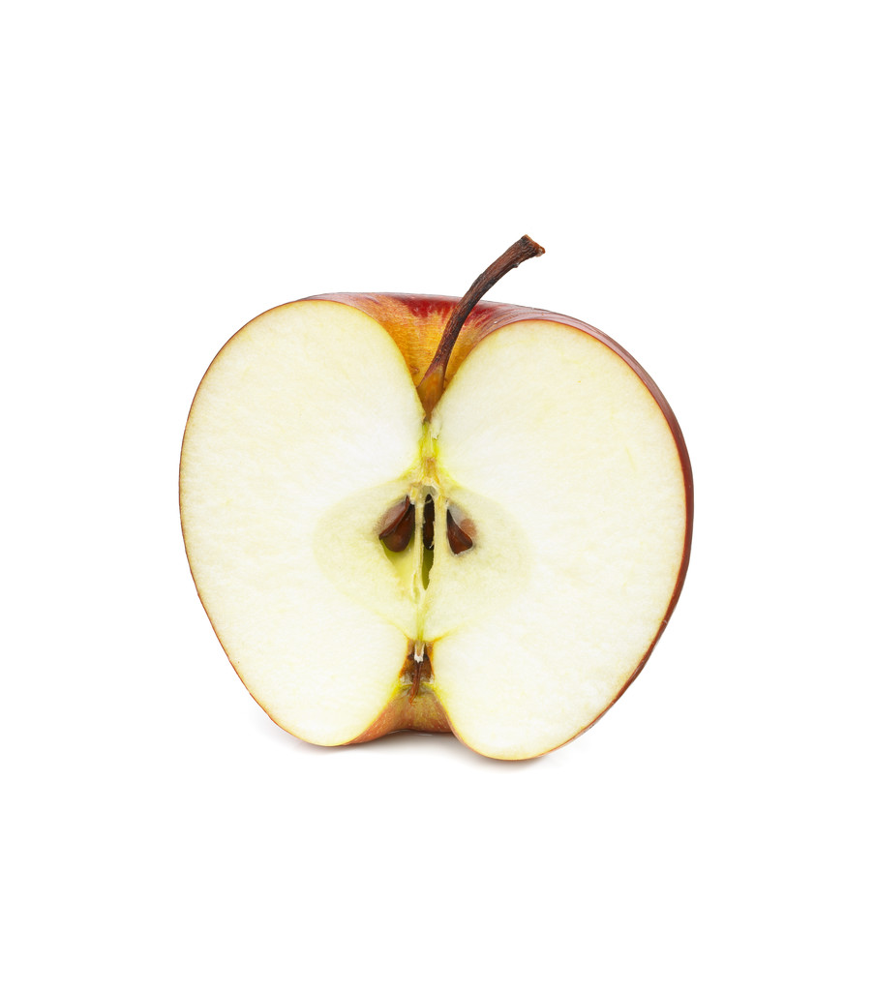
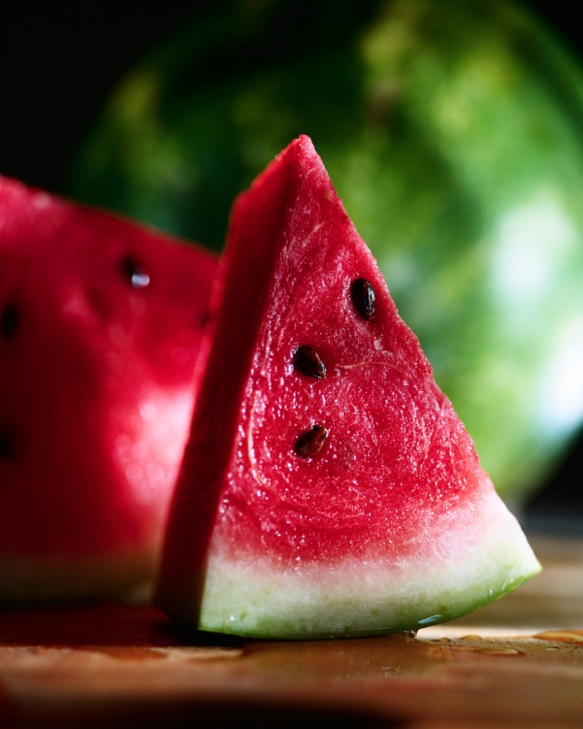
Biotic Potential

Slide 29
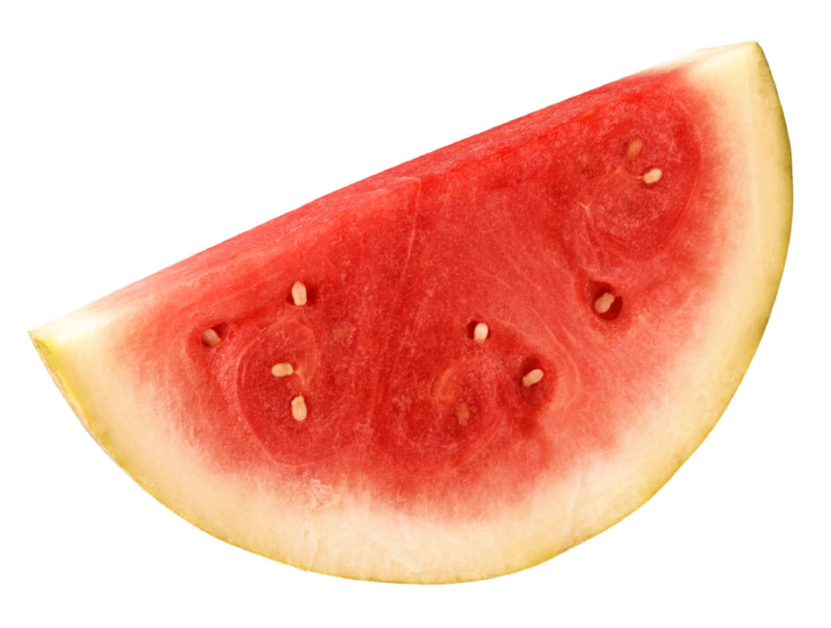
Biotic Poteial

Slide 30
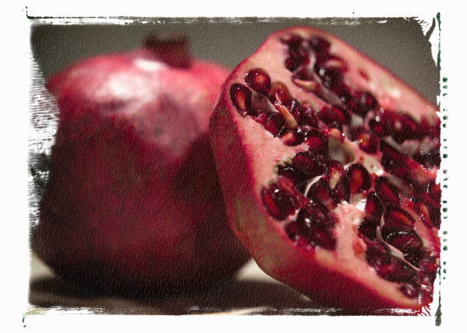
Biotic Potenial

Slide 31
Biotic Potenial
The fruit that has the highest number of seeds has the higher biotic potential

