Slide 1
EIS Updates
Melissa Teat; Customer Product Manager; Information Systems; April 21, 2017

Slide 2
Ticket Information
The Product Support Help Desk staff has resolved over 3,200 tickets in Freshservice since the fall conference.
Freshservice has over 2,000 user accounts.
Beginning July 1, 2017, the Help Desk will transition to a new ticket system.

Slide 3
Updates & Reminders
Review and update district EIS contact information when a staff change is made by sending the request to EIS.Help@tn.gov. Don’t forget to include requests for staff removal and addition of department listservs.
The EIS website contains important information: http://www.tn.gov/education/topic/education-information-system-eis.
EIS Extracts Layout document: http://www.tn.gov/assets/entities/education/attachments/eis_extracts_layout.pdf.

Slide 4
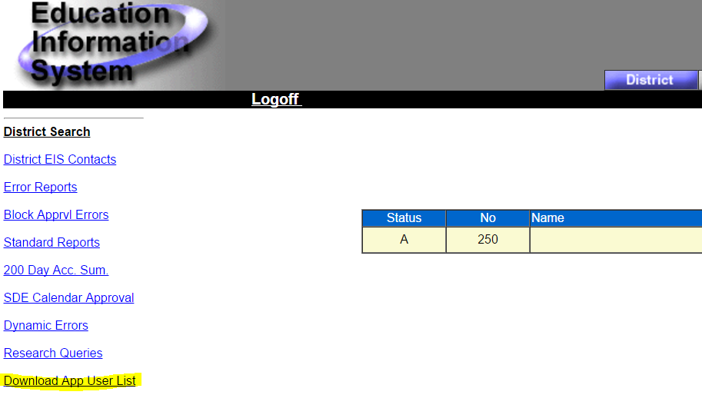
Updates & Reminders
District supervisors with DST_AA EIS Production access should periodically review the App User List in EIS Production, and make changes as needed. Please make sure all active users have an email address.

Slide 5
Updates & Reminders
Correlation of course codes: http://www.tn.gov/education/topic/correlations-of-course- and-endorsment-codes.
The Consolidated Planning and Monitoring (CPM) Data Manual was updated on April 11. This document can be obtained by contacting Trish.Kelly@tn.gov.

Slide 6
Updates & Reminders
2017-18 district calendars are due no later than May 15, 2017. The calendars must be approved by the district and by Paul Rainwater.
All districts must submit the student end-of-service extract and the student final grade extract. The extract numbers are 51 and 80, respectively.

Slide 7
2017-2018 EIS Changes
Title | Extract Number
District Calendar Number | 10
Increase Length Of Bus Number Field | 15 & 45
Date First Enrolled In A U.S. School | 40
Native Language | 40
Date First Enrolled In ESL | 40
Stop Collecting Enrollment Reasons EC & TC | 41
Stop Collecting Supplemental Educational Services (SES) Applied & (SES) Receiving | 41
Stop Collecting English Language Background Classification Type G | 41

Slide 8
2017-2018 EIS Changes
Title | Extract Number
Student Classification Type Increase In Field Length | 44
Stop Collecting Student Classification Types 3, X, Y, and Z | 44
Foster Care Student Classification Type | 44
Dyslexia Intervention Student Classification Type | 44
Voluntary Pre-K Grant (VPK) Student Classification Type | 44
Preschool Development Grant (PDG) Student Classification Type | 44

Slide 9
2017-2018 EIS Changes
Title | Extract Number
Bus Transportation Begin & End Dates | 45
Stop Collecting Withdrawal Reason 14, Withdrawn Under Public School Choice | 50
Completion Document Code 8, Alternate Academic Diploma | 51
Fine Arts & Foreign Language Waiver Completion Document Types | 51
Stop Collecting Completion Document Type 4, High School Certificate | 51
Staff Work Email Address | 60
Stop Collecting Public School Choice (PSC) Applied | 83

Slide 10
Melissa Teat Customer Product Manager Melissa.Teat@tn.gov (800) 495-4154

