Slide 1
Please come to the front and take all 3 handouts.

Slide 2
An Update on Chronic Absenteeism
Jonathon Attridge/Mike Herrmann
Tennessee Department of Education

Slide 3
Agenda
ESSA review
Data and planning resources
Chronic absenteeism and high school success
Self-assessment tool and discussion
Exit ticket

Slide 4
Our Vision
Districts and schools in Tennessee will exemplify excellence and equity such that all students are equipped with the knowledge and skills to successfully embark upon their chosen path in life.
Notes:
As a reminder, our vision is that all students are equipped with the knowledge and skills needed to successfully embark upon their chosen path in life. Our focus on chronic absenteeism and use of the Chronically Out of School Indicator is directly tied to this vision and to the All Means All strategy area of our strategic plan. School attendance is more than a legal mandate. It is an opportunity to learn.

Slide 5
The Chronically Out-of-School Indicator in District and School Accountability

Slide 6
The Chronically Out of School Indicator: A Measure of School Quality and Student Success
A new measure adopted by Tennessee as part of our accountability framework under the Every Student Succeeds Act (ESSA).
The percentage of students who have missed 10 percent or more instructional days for any reason including excused or unexcused absences as well as out-of-school suspensions.
The indicator recognizes excessive absences as lost instructional opportunities and a data point that is actionable throughout the school year.
Notes:
The indicator is based on a significant body of research around chronic absenteeism which identifies an absence rate of 10% as the threshold at which significant academic and social impacts begin to become evident.

Slide 7
District Accountability Areas
Six Areas
3–5 Success Rate* | 6–8 Success Rate* | 9–12 Success Rate*
Chronically Out of School | Graduation Rate + Ready Graduate | K–12 English Language Proficiency Assessment (ELPA)
*Success rate includes science, ELA, math and ACT/SAT composite. It may also include social studies in future years.
Notes:
Content areas aren’t the same as indicators. Pathways are similar to indicators.

Slide 8
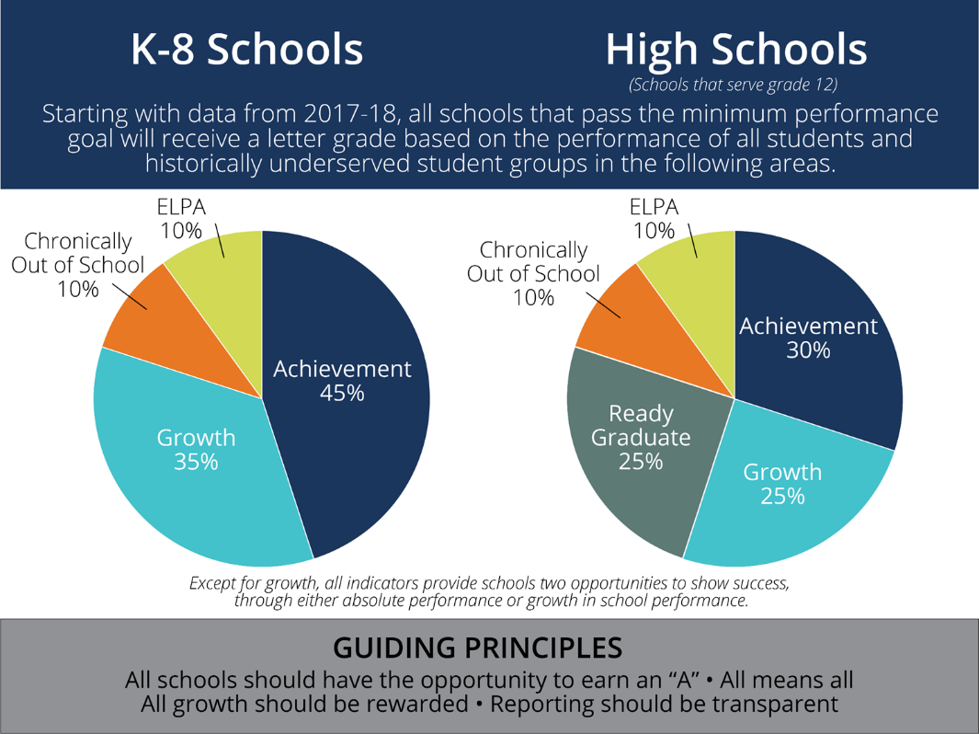

Slide 9
Guiding Beliefs about Attendance
All students should have the opportunity to learn.
Student attendance is linked with academic outcomes.
All absences—excused and unexcused, sporadic and consecutive—represent lost instructional time.
Attendance matters for students in all grades. In fact, the harmful effects of poor attendance are cumulative.
Chronically missing school is reflective of conditions that can be successfully addressed. Districts and schools have access to rich attendance data that can be monitored throughout the school year in order to minimize attendance barriers and maximize learning time.
Notes:
All students should have the opportunity to learn.
Student attendance is linked with academic outcomes. In fact, multiple research studies link poor attendance with reduced academic outcomes.
Harmful effects of poor attendance are cumulative and only looking at overall average daily attendance rates tend to mask attendance problems, particularly within subgroups.
Economically disadvantaged students are 3x more likely to be chronically absent than non-economically disadvantaged students. Similar trends exist with other historically underserved student groups including students with disabilities.

Slide 10
Defining Chronically Absent
The percentage of students who have missed 10 percent or more of instructional days for any reason including excused or unexcused absences as well as out-of-school suspensions.
Notes:
All students should have the opportunity to learn.
Student attendance is linked with academic outcomes. In fact, multiple research studies link poor attendance with reduced academic outcomes.
Harmful effects of poor attendance are cumulative and only looking at overall average daily attendance rates tend to mask attendance problems, particularly within subgroups.
Economically disadvantaged students are 3x more likely to be chronically absent than non-economically disadvantaged students. Similar trends exist with other historically underserved student groups including students with disabilities.

Slide 11
Questions to Consider
What barriers might be present that keep a child from attending school?
Why might a child avoid coming to school?
Why might a child be disengaged at school?
Notes:
To achieve our goal, we need to shift our thinking from compliance to support. Here are some questions to consider.

Slide 12
Sources of data
Quantitative data:
Attendance – Absent Student Research query
By subgroup
By grade level
By rate
Discipline data – Student Discipline Action query
Annual School Health Survey – Coordinated School Health
Qualitative data:
Student surveys
Feedback from student and family support services
Feedback from student and parent focus groups
Feedback from non-traditional sources

Slide 13
Examples of Student Surveys
Florida recently surveyed ~4,000 chronically absent students about perceptions of absences, reasons for absences, and ideas for improving absences.
Top Reasons
Health (92%)
Transportation (55%)
Personal Stress (41%)
Preferred activity outside of school (41%)
Value of school (39%)
Source: http://floridarti.usf.edu/resources/format/pdf/FloridaAggregateRCAReportFinal.pdf

Slide 14
Together, we must shift the focus from compliance to support.
Compliance
Support
Only includes unexcused absences (which may differ by LEA)
Emphasizes compliance with school rules
Focus on punitive and legal solutions, like truancy courts.
Includes ALL absences (excused and unexcused)
Emphasizes academic and social impact of missed days
Uses preventative strategies and positive messaging
Notes:
When we shift our attendance focus from compliance to support we set the stage for cooperation with students and families. How can we work together to help you/your child take full advantage of this opportunity to learn?

Slide 15
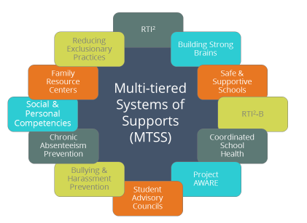
Step 4: Use available district and school supports
Notes:
On the screen, you’ll see what we call Tennessee’s multi-tiered systems of supports (MTSS), which is simply a framework for seeing how all the practices, programs, and interventions fit together in order to meet students’ needs both within an individual classroom and across the school building.
Many programs and initiatives you already utilize fall under the MTSS framework – some are instructional in nature, others are supports for well-rounded students. This list is not exhaustive – every school and district will prioritize different programs based on the unique needs of the school community. The most important point is to intentionally use data about your students’ needs to tailor your suite of programs over time and use data and evidence to refine your practices. For example, you may review your existing programs and determine you have several character and leadership building programs in Tier I but lack critical tiered interventions for students who are chronically out of school. Perhaps you could limit your focus to the most effective Tier I programming and turn further attention to your tiered attendance supports.
Note that this is not a new requirement; rather, it is a way to think about our existing strategies to support all students in a holistic fashion.

Slide 16
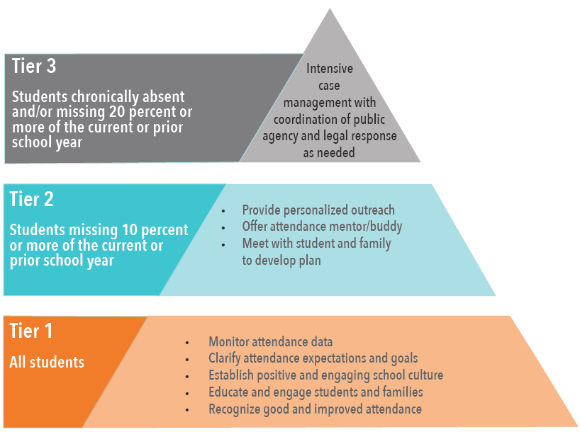
To create a multi-tiered system of support
Notes:
Public Chapter 379 –Progressive truancy interventions

Slide 17
Resources
Overview of Student Supports in Tennessee
Webpage that brings the many state-developed supports into one place including Back-to-School Attendance Toolkit.
Chronic Absenteeism in Tennessee’s Early Grades
TDOE policy brief
Attendance Works
National and State initiative

Slide 18
Chronic absenteeism and high school success

Slide 19
Each week of school missed per semester in ninth grade reduces the likelihood of graduation by about 10%

Slide 20
Chronic absence in ninth grade is a significant predictor of high school graduation.
Notes:
Just over 15 percent of ninth grade students are chronically absent. Chronic absence, along with grades in ninth grade, according to many researchers are the biggest predictors of ninth grade success. In Tennessee, the patterns are clear. The patterns of disengagement that lead to drop out tend to be present in ninth grade. Over half of the dropouts in the 2012 cohort were chronically absent in ninth grade. With a graduation rate of 88 percent (89 this year), we are able to identify most students who did not graduate on time simply by whether

Slide 21
Even those students who do graduate are significantly less likely to enroll in a postsecondary institution
Notes:
Just over 15 percent of ninth grade students are chronically absent. Chronic absence, along with grades in ninth grade, according to many researchers are the biggest predictors of ninth grade success. In Tennessee, the patterns are clear. The patterns of disengagement that lead to drop out tend to be present in ninth grade. Over half of the dropouts in the 2011 cohort were chronically absent in ninth grade.

Slide 22
Role of attendance in student success
Quotes from the Chicago Consortium:
“Test scores are much weaker indicators of high school grades [and postsecondary success] than middle school grades and attendance.”
“Strategies aimed at attendance improvement could likely have as much or more of a pay-off for high school and college graduation as efforts aimed at improving test scores.”
“Each week of absence per semester in 9th grade is associated with a
more than 20% decline in the probability of graduating from high school.”
What kind of state-level support is most likely to make a difference to student success?
What kind of district-level support is most likely to make a difference to student success?

Slide 23
Self-Assessment tool from Attendance Works

Slide 24
Select one: Strength, OK for now, Could be better, Urgent Gap, Don’t Know
Attendance data is entered accurately on a daily basis for each student into an electronic database.
How do you know? Who is responsible for ensuring accuracy? How has this problem been resolved?

Slide 25
Select one: Strength, OK for now, Could be better, Urgent Gap, Don’t Know
Data on levels of chronic absence are calculated (ideally at least monthly) for our district as a whole as well as by grade, school, student sub-population and, if possible, by zip code.
Who is responsible for this? Does the Student Absence Report provide enough information? What other tools do you use?

Slide 26
Select one: Strength, OK for now, Could be better, Urgent Gap, Don’t Know
At least once a month, school site teams & a district team receive & use data on the current level of chronic absence overall, by school, and by grade. School teams also receive a list of the students by grade who have missed 10% or more of school.
Who is responsible for this?

Slide 27
Select one: Strength, OK for now, Could be better, Urgent Gap, Don’t Know
We have identified a lead and team from the district whose responsibility it is to develop and ensure implementation of a systemic, tiered approach to reducing chronic absence.
What are the challenges to implementing this system?

Slide 28
Table discussion
In your groups, discuss the following::
How you use your role to improve attendance in your district;
Promising strategies or practices you'd like to highlight; and,
Practices that you are interested in learning more about.

Slide 29
Please take a few minutes to fill out the exit ticket.
For more information on resources, please contact Mike Herrmann, Mike.Herrmann@tn.gov
For questions on the chronically out of school indicator, please contact TNEd.Accountability@tn.gov.

