Slide 1
Peer Recovery Specialist (PRS)
Sharing Their Story
Of Hope and Recovery
Office of Recovery Services
Department of Behavioral Health and Developmental Services

Slide 2
A Peer Recovery Specialist…
…is a specifically trained professional who has practice guidelines, abides by a code of ethics and utilizes core skills . . .
. . . just as every professional does.

Slide 3
It’s an important role!
“A trained peer practitioner is described as a natural ally, and someone who has walked ‘in the same shoes’ as the individual seeking help.”
http://www.pillarsofpeersupport.org/

Slide 4
It’s an important role!
“Peer perspectives can provide momentum to an individual toward his/her self-management and health activation.” http://www.pillarsofpeersupport.org/

Slide 5
It’s an important role!
“Sharing lived experiences and a strengths-based approach can foster support and motivate an individual towards health, wellness, and resiliency.”
http://www.pillarsofpeersupport.org/

Slide 6
Why do we need PRS?
“Peer Recovery Specialists focus on increasing an individual’s resiliency and coping mechanisms while enhancing communication with providers so that care can be customized to meet an individuals' needs.”
Workforce Development Committee of the Access Task Force
Supreme Court Commission on Mental Health Law Reform January 13, 2010
Notes:
Question: Is developing “resiliency” a result of an individual working with a PRS
Answer: Yes, resiliency is adaptability and necessary for recovery

Slide 7
Why do we need PRS?
A PRS will encourage and coach those they support to help them decide what they want in life and how to achieve it. The PRS does this without judgement.
PRS help others find and use their own voice.
Notes:
Q: Does the PRS help the individual with goals and needs
A: Yes and how to appropriately achieve them and the most important goal is the path of recovery

Slide 8
Why do we need PRS?
Peer supporters demonstrate that recovery is REAL!
By authentically living recovery, peer supporters inspire real hope that recovery is possible for others!

Slide 9
How do they do what they do?
The following guidelines were created and are practiced by Peer Recovery Specialists

Slide 10
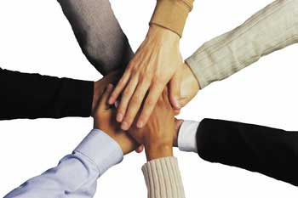
Peer Support is Voluntary
People choose freely to give or receive support; being pressured or forced is against the nature of genuine peer support.

Slide 11
Peer Support is Voluntary.
Peer Recovery Specialists:
Respect the rights of those they support
Have the right to choose not to work with individuals if they know they cannot provide effective support for that person
Do not force
Advocate for choice when they observe coercion

Slide 12
Peer Support is Hopeful
A Peer Recovery Specialist is a living example of recovery in action.
Hope in recovery is inspired by knowing that another person, the Peer Recovery Specialist, is having a regular and satisfying life.

Slide 13
Peer Support is Hopeful
Peer Recovery Specialists:
Tell strategic stories of their own personal recovery
Model recovery behaviors at work
Help others reframe life challenges as opportunities for personal growth

Slide 14
Peer Support is Open-Minded
Being judged can be emotionally distressing and harmful.
Peer supporters are non-judgmental and hold individuals in unconditional positive regard, with an open mind, a compassionate heart and full acceptance of each person as a unique individual.

Slide 15
Peer Support is Open-Minded.
Peer Recovery Specialists:
Embrace differences
Respect individual’s right to choose
Connect with others where they are
Do not evaluate or assess

Slide 16
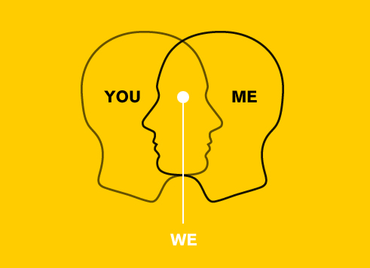
Peer Support is Empathetic
Peer Supporters do not assume that they know exactly what the other person is feeling even if they have experienced similar challenges.

Slide 17
Peer Support is Empathetic.
Peer Recovery Specialists:
Ask thoughtful questions and listen with sensitivity
Respond to what the other person is feeling
Openly and personally relate that recovery is a day to day involvement with life
Demonstrate that recovery affects decisions but does not limit goals or needs

Slide 18
Peer Support is Respectful
Each person is valued and seen as having something important and unique to contribute to the world.

Slide 19
Peer Support is Respectful
Peer Recovery Specialists:
Treat people with warmth, kindness and dignity
Accept and are open to differences
Encourage people to share strengths and gifts

Slide 20
Peer Support is Respectful
Peer Recovery Specialists:
Honor everyone’s ideas and opinions and truly believe every person is equally capable of contributing to the whole.
Talk openly about themselves and their recovery. Their interactions are guided by respect and what is comfortable to talk about.

Slide 21
Peer Support Facilitates Change
Peer supporters treat people as human beings and remain alert to any practice that is dehumanizing, demoralizing or degrading.
PRS will use their personal story and/or advocacy to be an agent for positive change.

Slide 22
Peer Support Facilitates Change
Peer Recovery Specialists:
Recognize injustices peers face in all contexts and act as advocates and facilitate change where appropriate.
Help those they support explore areas in need of change for themselves and others.
Encourage, coach and inspire those they support to challenge and overcome injustice.

Slide 23
Peer Support is Honest
Clear and thoughtful communication is fundamental to effective peer support. Difficult issues are addressed with those who are directly involved. Privacy and confidentiality are the cornerstones of trust.

Slide 24
Peer Support is Honest and Direct
Peer Recovery Specialists:
Engage in candid, honest discussions about stigma, abuse, oppression, crisis or safety when desired by those they serve.
Do not make false promises, misrepresent themselves, others or circumstances.
Strive to build peer relationships based on integrity, honesty, respect and trust.

Slide 25
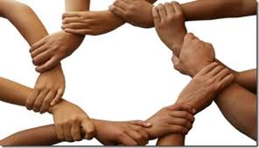
Peer Support is Reciprocal
“Peer support is a system of giving and receiving help founded on key principles of respect, shared responsibility, and mutual agreement of what is helpful.” Center of Excellence in Peer Support
All parties give
and share equally.

Slide 26
Peer Support is Mutual and Reciprocal
Peer Recovery Specialists:
Learn from those they support and those supported learn from the PRS
Encourage peers to fulfill a fundamental human need – to be able to give as well as receive
Facilitate respect and honor a relationship with peers that evokes power-sharing and mutuality wherever possible

Slide 27
Peer Support Shares Power
PRS speak as an equal to all about the experience of living in the community with a serious disability.

Slide 28
Peer Support Equally Shares Power
Peer Recovery Specialists:
Use language that reflects a mutual relationship with those they support
Behave in ways that reflect respect and mutuality with those they support
Do not exercise power over those they support

Slide 29
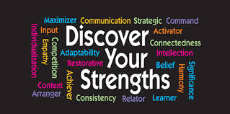
Peer Support is Strengths-Focused
Peer support focuses on what’s strong, not what’s wrong in another’s life.
Peer supporters share their own experiences to encourage people to see the “silver lining” or positive things they have gained through adversity.

Slide 30
Peer Support is Strengths-Focused
Peer Recovery Specialists:
Realize and help show those they support that individual talents, cultivated skills and relationships are strengths
Encourage others to identify their strengths and use them to improve their lives
Focus on the strengths of those they support
Openly share the story of their experiences as a tool of recovery that helps people discover their unique strengths and goals

Slide 31
Peer Support is Transparent
Peer supporters are
experientially qualified
to assist others
in this self-help process of recovery.
They set expectations with each person about what can and cannot be offered in a peer support relationship and communicate with everyone in plain language so that everyone can understand. There is no hidden agenda.

Slide 32
Peer Support is Transparent
Peer Recovery Specialists:
Provide support in a professional yet humanistic manner
Have roles that are distinct from the roles of other behavioral health service professionals
Make only promises they can keep and use accurate statements

Slide 33
Peer Support is Person-Driven
Peer supporters inform people about options, provide information about choices and respect their decisions.
Peer supporters encourage people to move beyond their comfort zones, learn from their mistakes and grow from dependence on the system toward their chosen level of freedom and inclusion in the community of their choice.

Slide 34
Peer Support is Person-Driven
Peer Recovery Specialists:
Do not offer solutions but encourage the development of unique strengths and goals that help a person shape an individual path of recovery
Do not tell others what to do
Encourage resilience and personal growth
Help others learn from their mistakes
Encourage and coach those they support to decide what they want in life and how they will achieve it

Slide 35
Good Medicine
Peer Support
is widely recognized
as effective treatment for many disabilities and is an
Evidence-Based Practice

Slide 36
For Information about
Certification, Supervision and Training
please contact:
Mary McQuown, MA, CPRS
Peer Recovery Specialist Liaison
Mary.McQuown@DBHDS.Virginia.Gov
757-403-3007

