Slide 1
Essential Components of Mathematics Intervention
TASSP Assistant Principal Workshop
March 4, 2019

Slide 2
Contact Information
Sarah Powell, Ph.D
The University of Texas at Austin
srpowell@austin.utexas.edu
@sarahpowellphd
119

Slide 3
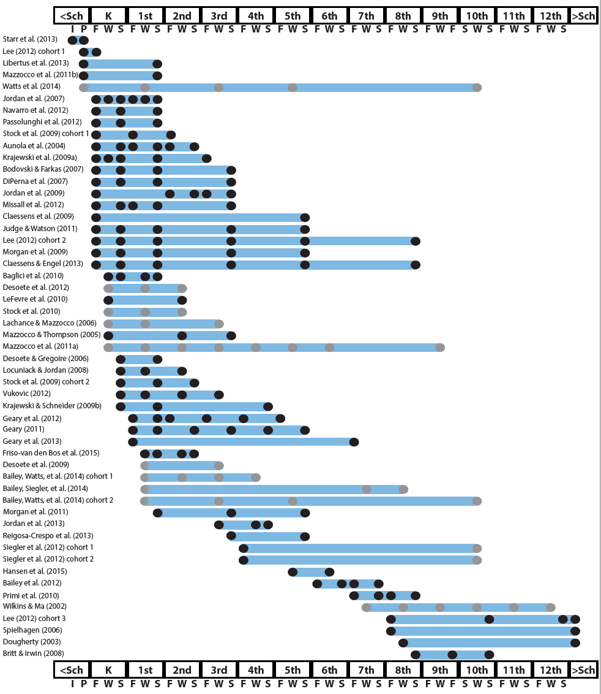
http://www.greatertexasfoundation.org/trajectories-of-mathematics-performance/

Slide 4
Broad math in preK predicted K broad math
Mathematics in preschool predicts later mathematics
http://www.greatertexasfoundation.org/trajectories-of-mathematics-performance/
Broad math in preK predicted grade 10 broad math

Slide 5
Counting in K predicted grade 1 broad math
Mathematics in kindergarten predicts later mathematics
http://www.greatertexasfoundation.org/trajectories-of-mathematics-performance/
Broad math in K predicted grade 8 broad math
K math accurately predicted math performance below 10th percentile in grades 2 and 3 with 84% correct classification

Slide 6
Mathematics in elementary school
predicts later mathematics
Addition influenced arithmetic with increasing importance from grades 1 to 5
http://www.greatertexasfoundation.org/trajectories-of-mathematics-performance/
Grade 1 arithmetic predicted arithmetic at grades 2, 3, and 4
Grade 1 broad math predicted broad math at grades 3, 5, and 10

Slide 7
Mathematics in middle school
predicts later mathematics
Counting and comparison in grades 2 or 4 predicted broad math 1 year later
http://www.greatertexasfoundation.org/trajectories-of-mathematics-performance/
Fractions at 10-12 years old predicted broad math 5 years later
Broad math in grade 7 predicted broad math in grade 8

Slide 8
Broad math in grade 8 predicted completion of 4-year college degree
Mathematics in
high school
predicts later outcomes
http://www.greatertexasfoundation.org/trajectories-of-mathematics-performance/
Students who took algebra in grades 8 took more advanced math courses and enrolled in 4-year colleges more often than students who took algebra in grade 9
Numeracy measured in adolescence impacted hourly earnings 7 to 15 years later

Slide 9
Mathematics in preschool predicts later mathematics
Mathematics in kindergarten predicts later mathematics
http://www.greatertexasfoundation.org/trajectories-of-mathematics-performance/
Mathematics in elementary school
predicts later mathematics
Mathematics in middle school
predicts later mathematics
Mathematics in
high school
predicts later outcomes

Slide 10
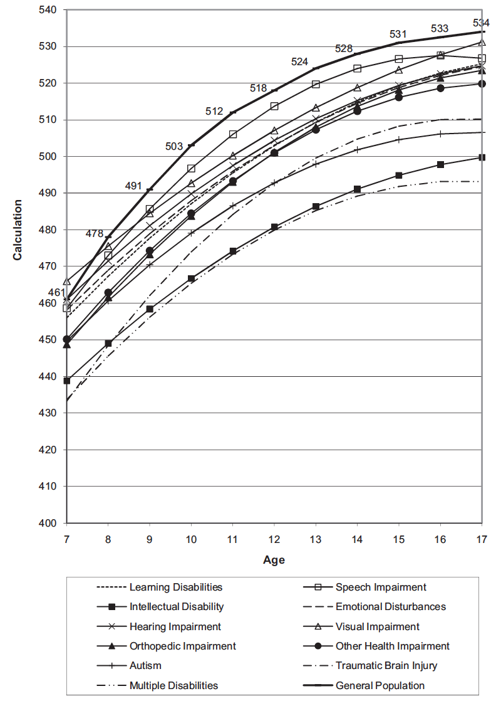
Wei, Lenz, & Blackorby (2013)

Slide 11
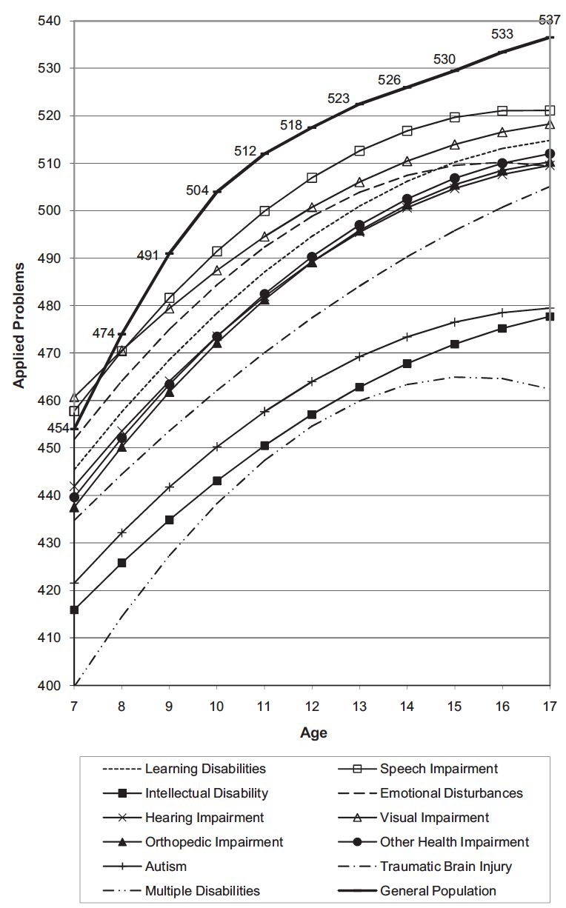
Wei, Lenz, & Blackorby (2013)

Slide 12
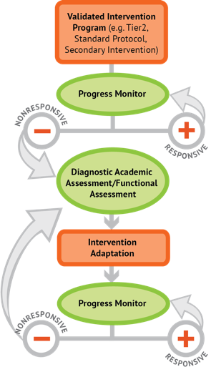
Intervention: Occurs frequently and with intensity
Assessment: Formative
Assessment: Diagnostic
Intervention adaptation: Content, dosage, explicit instruction, attention to transfer
Assessment: Formative

Slide 13
Instructional Platform
INSTRUCTIONAL DELIVERY
Explicit instruction
Concise language
Multiple representations
INSTRUCTIONAL STRATEGIES
Fluency building
Problem solving instruction
Motivation component

Slide 14
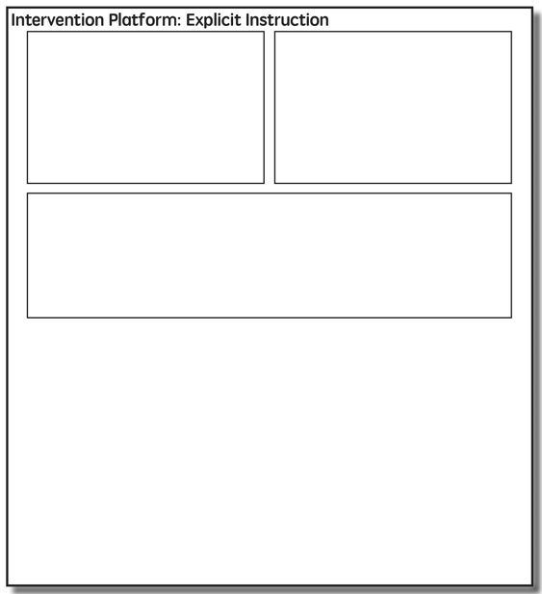

Slide 15
Modeling
Practice
Clear Explanation
Guided
Practice
Planned
Examples
Independent Practice
Supporting Practices
Asking the right questions
Eliciting frequent responses
Providing immediate specific feedback
Maintaining a brisk pace

Slide 16
Goal and importance
Modeling
Clear Explanation
“Today, we are learning about division. This is important because sometimes you have to share objects or things with your friends.”
Planned
Examples
“Let’s continue working with our three-dimensional shapes and volume. Understanding volume and calculating volume helps with measuring capacity.”

Slide 17
Goal and importance
Modeling
Clear Explanation
Model steps
Planned
Examples
“To solve 26 plus 79, I first decide about the operation. Do I add, subtract, multiply or divide?”
“The plus sign tells me to add. So, I’ll add 26 plus 79. I’ll use the partial sums strategy. First, I add 20 plus 70. What’s 20 plus 70?”
“20 plus 70 is 90. I write 90 right here.”
“Then I add 6 plus 9. What’s 6 plus 9?”
“6 plus 9 is 15. So, I write 15 here.”
“Finally, we add the partial sums. What do we add?”
”So, we add the partial sums of 90 and 15. 90 plus 15 is 105. So, 26 plus 79 equals 105.”

Slide 18
Goal and importance
Modeling
Clear Explanation
Model steps
Planned
Examples
Concise language
“To solve 26 plus 79, I first decide about the operation. Do I add, subtract, multiply, or divide?”
“The plus sign tells me to add. So, I’ll add 26 plus 79. I’ll use the partial sums strategy. First, I add 20 plus 70. What’s 20 plus 70?”
“20 plus 70 is 90. I write 90 right here.”
“Then I add 6 plus 9. What’s 6 plus 9?”
“6 plus 9 is 15. So, I write 15 here.”
“Finally, we add the partial sums. Why do we add the partial sums?”

Slide 19
Goal and importance
Modeling
Clear Explanation
Model steps
Planned
Examples
Concise language
Examples
“Today, we are learning about division. This is important because sometimes you have to share objects or things with your friends.”
24 / 6
28 $÷$ 7
35 $)$ 5

Slide 20
Goal and importance
Modeling
Clear Explanation
Model steps
Planned
Examples
Concise language
Examples
With non-examples
32 $÷$ 8
42 $÷$ 7
25 $−$ 5

Slide 21
Modeling
Practice
Clear Explanation
Guided
Practice
Planned
Examples
Independent Practice
Supporting Practices
Asking the right questions
Eliciting frequent responses
Providing immediate specific feedback
Maintaining a brisk pace

Slide 22
Practice
Teacher and student practice together
Guided
Practice
Independent Practice

Slide 23
Practice
Teacher and student practice together
Guided
Practice
Independent Practice
Student practices with teacher support

Slide 24
Modeling
Practice
Clear Explanation
Guided
Practice
Planned
Examples
Independent Practice
Supporting Practices
Asking the right questions
Eliciting frequent responses
Providing immediate specific feedback
Maintaining a brisk pace

Slide 25
Low-level and high-level
“What is 7 times 9?”
“Which shape has 6 sides?”
“What do you do when you see a word problem?”
Supporting Practices
“Why do you have to regroup?”
Asking the right questions
Eliciting frequent responses
Providing immediate specific feedback
Maintaining a brisk pace
“How would you solve this problem?”
“Why do you have to use zero pairs?”

Slide 26
Low-level and high-level
Classwide, individual, partner, write on paper, write on whiteboard, thumbs up, etc.
Supporting Practices
Asking the right questions
Eliciting frequent responses
Providing immediate specific feedback
Maintaining a brisk pace
“Turn and discuss the formula for perimeter with your partner.”
“Write the multiplication problem on your whiteboard.”
“In your math journal, draw a picture to help you remember to term parallelogram.”

Slide 27
Low-level and high-level
Classwide, individual, partner, write on paper, write on whiteboard, thumbs up, etc.
Supporting Practices
Asking the right questions
Eliciting frequent responses
Providing immediate specific feedback
Maintaining a brisk pace
Affirmative and corrective
“Good work using your word-problem attack strategy.”
“Let’s look at that again. Tell me how you added in the hundreds column.”

Slide 28
Low-level and high-level
Classwide, individual, partner, write on paper, write on whiteboard, thumbs up, etc.
Supporting Practices
Asking the right questions
Eliciting frequent responses
Providing immediate specific feedback
Maintaining a brisk pace
Affirmative and corrective
Planned and organized

Slide 29
Modeling
Practice
Supporting Practices
Introduction of material
Review of material
Modeling
Practice
Modeling
Practice
Supporting Practices
Supporting Practices

Slide 30
How do you use explicit instruction within intensive intervention?
Model steps using concise language
Provide guided practice opportunities
Provide independent practice opportunities
Use supporting practices during modeling and practice
Ask the right questions
Elicit frequent responses
Provide feedback
Be planned and organized

Slide 32
Vocabulary Across Grades

Slide 33
degree

Slide 34
Use formal math language
Use terms precisely

Slide 35
Language of Mathematics
Technical terms
Subtechnical terms
Symbolic terms
General terms
trapezoid
rhombus
numerator
addend
subtract
base
degrees
cube
plane
arc
plus
zero
twelve
dollars
and
above
measure
answer
longest
outside

Slide 36
Instead of…
Say…
“And the last one is 10.”
“8, 9, 10. We’ll stop counting there but we could count more.”
“What number is in the tens place?”
“What digit is in the tens place?”
“Six hundred and forty-eight”
“Six hundred forty-eight”
“Bigger number and smaller number”
“Number that is greater and the number that is less”
Hughes et al. (2016)

Slide 37
Instead of…
Say…
“Numbers in the fraction”
“This fraction is one number.”
“Top number and bottom number”
“Numerator and denominator”
“Reduce”
“Find an equivalent fraction”
“One point two nine”
“One and twenty-nine hundredths”
Hughes et al. (2016)

Slide 38
Instead of…
Say…
“Corner”
“Angle”
“Flips, slides, and turns”
“Reflections, translations, and rotations”
“Box or ball”
“Cube or sphere”
“Long hand and short hand”
“Minute hand and hour hand”
Hughes et al. (2016)

Slide 39
How do you attend to language within intensive intervention?
Understand why formal mathematical language is important
Plan for mathematical language to be precise
Plan for mathematical language to be concise

Slide 40
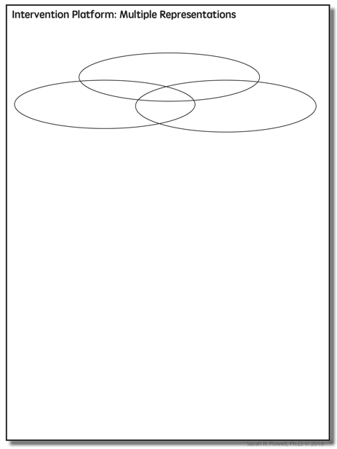

Slide 41
Multiple Representations
Abstract
Pictorial
Concrete

Slide 42
Abstract
Pictorial
Concrete
Three-dimensional objects

Slide 43
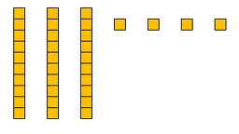
Abstract
Pictorial
Concrete
Two-dimensional images

Slide 44
Numerals, symbols, and words
Abstract
Pictorial
Concrete
34 = 3 tens and 4 ones
2 + 8 = 10
x – 6 = 8
4,179
+ 569

Slide 45
How should multiple representations be used within intensive intervention?
Use three-dimensional concrete materials to teach concepts and procedures
Use two-dimensional representations to teach concepts and procedures
Ensure students understand mathematics with numbers and symbols (i.e., the abstract)

Slide 46
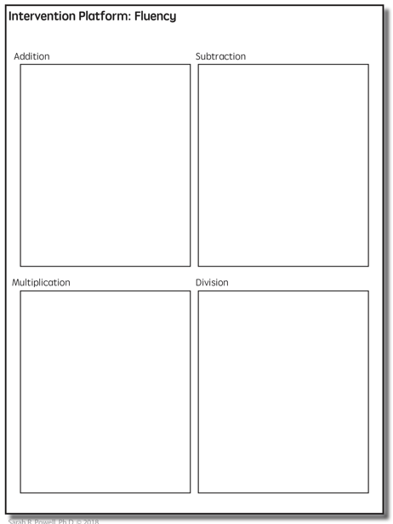

Slide 47
Fluency
Addition
Subtraction
Multiplication
Division

Slide 48
Addition
100 addition basic facts
Single-digit addends sum to a single- or double-digit number
5 (addend)
+ 4 (addend)
9 (sum)

Slide 49
Addition: Part-Part-Whole (Total)
Count one set, count another set, put sets together, count sum
2 + 3 = 5

Slide 50
Addition: Join (Change Increase)
Start with a set, add the other set, count sum
2 + 3 = 5

Slide 51
Subtraction
100 subtraction basic facts
Subtrahend and difference are single-digit numbers and minuend is single- or double-digit number
16 (minuend)
– 8 (subtrahend)
8 (difference)

Slide 52
Subtraction: Separate (Change Decrease)
Start with a set, take away from that set, count difference
5 – 3 = 2

Slide 53
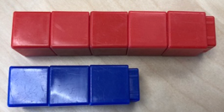
Subtraction: Compare (Difference)
Compare two sets, count difference
5 – 3 = 2

Slide 54
Multiplication
100 multiplication basic facts
Multiplication of single-digit factors results in a single- or double-digit product
2 (factor)
× 3 (factor)
6 (product)

Slide 55
Multiplication: Equal Groups
Show the groups, show the amount for each group, count product
3 × 2 = 6

Slide 56
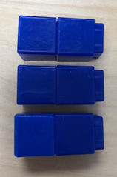
Multiplication: Array/Area
Make the array, count product
3 × 2 = 6

Slide 57
Multiplication: Comparison
Show a set, then multiply the set
3 × 2 = 6

Slide 58
Division
90 division basic facts
Divisor and quotient are single-digit numbers and dividend is single- or double-digit number
8 ÷ 4 = 2
(dividend) (divisor) (quotient)

Slide 59
Division: Equal Groups (Partitive Division)
Show the dividend, divide equally among divisor, count quotient
6 ÷ 3 = 2

Slide 60
Division: Equal Groups (Measurement Division)
Show the dividend, make groups of the divisor, count groups
6 ÷ 3 = 2

Slide 61
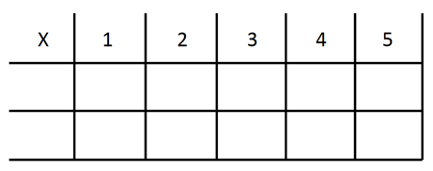
-3 + (-4) = ___ 5 – (-6) = ___

Slide 62
How to build fact fluency within intensive intervention?
Teach the concepts of the operations
Teach strategies to understand how facts fit together
Practice building fluency with a variety of activities and games

Slide 64
Problem Solving Difficulties
Reading problems
Understanding vocabulary
Identifying relevant information
Ignoring irrelevant information
Interpreting charts and graphs
Identifying appropriate operation(s)
Performing the computation(s)

Slide 65
Don’t tie key words to operations
Teach word-problem schemas
Have an attack strategy

Slide 66
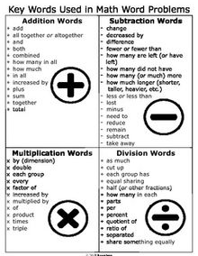
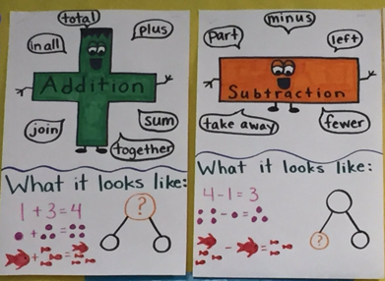

Slide 67
Problem Solving
SOLVE
Study the problem.
Organize the facts.
Line up the plan.
Verify the plan with computation.
Examine the answer.
SIGNS
Survey questions
Identify key words
Graphically draw problem
Note operations
Solve and check

Slide 68
Problem Solving
Total
When teaching about word problems, students should learn the schema of the word problem.
Difference
Change
Equal Groups
Comparison
Ratios/Proportions

Slide 69
How do you incorporate effective problem-solving strategies within intensive intervention?
Don’t use key words tied to operations
Do teach students an attack strategy
Do teach students schemas
Do explicitly teach problem solving
Do provide problem-solving instruction regularly (i.e., several times a week)
Do practice schemas that students will encounter regularly

Slide 70
Instructional Platform
INSTRUCTIONAL DELIVERY
Explicit instruction
Concise language
Multiple representations
INSTRUCTIONAL STRATEGIES
Fluency building
Problem solving instruction
Motivation component

Slide 71
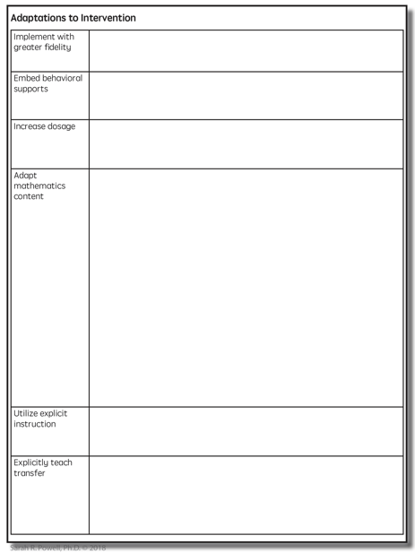

Slide 72
Instructional Platform
Adaptations

Slide 73
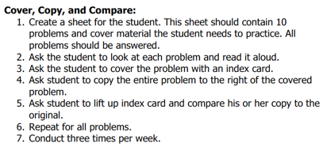
Implement with greater fidelity
Ensure that you are implementing the intervention or strategy with fidelity

Slide 74
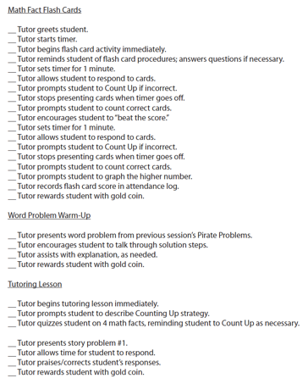
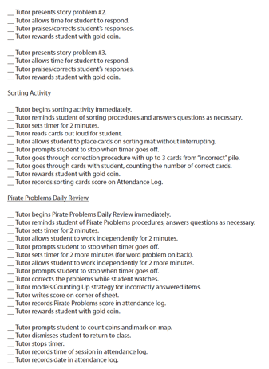
Implement with greater fidelity
Ensure that you are implementing the intervention or strategy with fidelity
Fuchs et al. (2008)

Slide 75
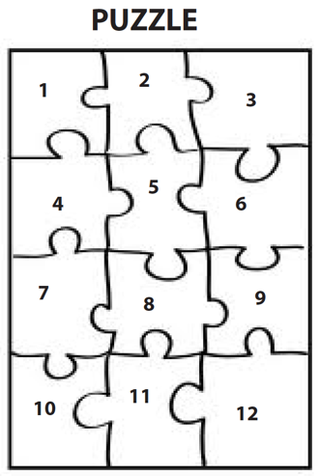
Implement with greater fidelity
Embed behavioral supports
May want to incorporate strategies to improve self-regulation and minimize nonproductive behavior
Powell, Driver, & Julian (2015)

Slide 76
Implement with greater fidelity
Embed behavioral supports
May want to incorporate strategies to improve self-regulation and minimize nonproductive behavior
UPSCheck
Understand
Plan
Solve
Check

Slide 77
Implement with greater fidelity
Embed behavioral supports
Increase dosage
Conduct longer sessions, more sessions per week, or more weeks within DBI

Slide 78
Implement with greater fidelity
Embed behavioral supports
Increase dosage
Conduct longer sessions, more sessions per week, or more weeks within DBI

Slide 79
Implement with greater fidelity
Embed behavioral supports
Increase dosage
Conduct longer sessions, more sessions per week, or more weeks within DBI
Number of weeks left in intervention

Slide 80
Implement with greater fidelity
Embed behavioral supports
Increase dosage
Adapt mathematics content

Slide 81
Implement with greater fidelity
Embed behavioral supports
Increase dosage
Adapt mathematics content
Alter the scope and sequence
Where student IS
Where student NEEDS TO BE
Explain why addition and subtraction strategies work, using place value and the properties of operations.
Use addition and subtraction within 100 to solve one- and two-step word problems…
Fluently add and subtract within 100 using strategies based on place value, properties of operations, and/or relationships.
Apply properties of operations as strategies to multiply and divide….
Fluently multiply and divide within 100, using strategies such as the relationship between multiplication and division…
Fluently add and subtract multi-digit whole numbers using the standard algorithm.
Find whole number quotients and remainders with up to four-digit dividends and one-digit divisors, using strategies based on place value, …
Solve multi-step word problems posed with whole numbers and having whole-number answers using the four operations…
Understand that the two digits of a two-digit number represent amounts of tens and ones.
Use multiplication and division within 100 to solve word problems…
Understand that the three digits of a three-digit number represent amounts of hundreds, tens, and ones.
Fluently multiply multi-digit whole numbers using the standard algorithm.

Slide 82
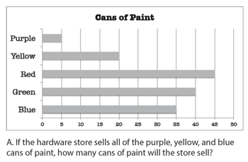
Implement with greater fidelity
Embed behavioral supports
Increase dosage
Solve
Adapt mathematics content
Write equation
Break down problems into smaller steps
Draw picture
Identify schema
Label graph
Underline labels
Read the problem

Slide 83
Implement with greater fidelity
Embed behavioral supports
Increase dosage
Adapt mathematics content
precise
Focus on the language of mathematics
concise

Slide 84
Implement with greater fidelity
Embed behavioral supports
Increase dosage
MATH JOURNAL
Adapt mathematics content
Focus on the language of mathematics
Define: | Characteristics:
Example: | Non-example:

Slide 85
Implement with greater fidelity
Embed behavioral supports
“Tell me how you solved this problem.”
Increase dosage
Adapt mathematics content
“What were you thinking about when you regrouped?”
Engage student in more discourse
“How would you teach this problem to another student?”
“Describe the word problem in 10 words or less.”

Slide 86
Implement with greater fidelity
Embed behavioral supports
Increase dosage
Adapt mathematics content
“Talk through this problem with me.”
Provide worked examples
405
+ 16
405
+ 16
411
421

Slide 87
Implement with greater fidelity
Abstract
Pictorial
Concrete
Embed behavioral supports
Increase dosage
Adapt mathematics content
Utilize more three-dimensional representations

Slide 88
Implement with greater fidelity
Abstract
Pictorial
Concrete
Embed behavioral supports
Increase dosage
Adapt mathematics content
Utilize more two-dimensional representations

Slide 89
Implement with greater fidelity
Abstract
Pictorial
Concrete
Embed behavioral supports
Increase dosage
Adapt mathematics content
Ensure students understand the abstract
34 = 3 tens and 4 ones
2 + 8 = 10
4,179
+ 569
x – 6 = 8

Slide 90
Implement with greater fidelity
Embed behavioral supports
Increase dosage
Adapt mathematics content
Focus on fact fluency
Addition
Subtraction
Multiplication
Division

Slide 91
Implement with greater fidelity
Embed behavioral supports
Increase dosage
Adapt mathematics content
-3 + (-4) = ___ 5 – (-6) = ___

Slide 92
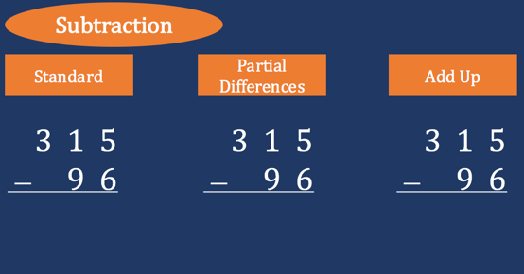
Implement with greater fidelity
Embed behavioral supports
Increase dosage
Adapt mathematics content
Teach alternate algorithms

Slide 93
Implement with greater fidelity
Embed behavioral supports
Increase dosage
Adapt mathematics content
405
+ 16
405
+ 16
Encourage alternate methods and solutions
400
10
11
421
421
+

Slide 94
Implement with greater fidelity
Embed behavioral supports
Don’t tie key words to operations
Teach word-problem schemas
Have an attack strategy
Increase dosage
Adapt mathematics content
Explicitly teach problem solving

Slide 95
Implement with greater fidelity
Additive
Embed behavioral supports
Total
Increase dosage
Adapt mathematics content
Difference
Explicitly teach problem solving
Change
Multiplicative
Equal Groups
Comparison
Ratios/
Proportions

Slide 96
Implement with greater fidelity
Embed behavioral supports
Increase dosage
Adapt mathematics content
Modeling
Practice
Utilize explicit instruction
Clear Explanation
Guided
Practice
Make sure you’re doing it! And do it well!
Planned
Examples
Independent Practice
Supporting Practices
Asking the right questions
Eliciting frequent responses
Providing immediate specific feedback
Maintaining a brisk pace

Slide 97
Implement with greater fidelity
Embed behavioral supports
405
+ 16
4305
+ 216
Increase dosage
Adapt mathematics content
Utilize explicit instruction
Explicitly teach transfer
Marney baked 89 cookies and sold 40 cookies at the bake sale. How many cookies does Marney have left?
Explicitly teach how current learning relates to other learning
Marney had $89 and spent $40 on shoes. How many much does Marney have left?
Marney had $89 and spent $40 on shoes. How much money will Marney have after buying the shoes?

Slide 98
Implement with greater fidelity
Embed behavioral supports
Increase dosage
Adapt mathematics content
Utilize explicit instruction
Explicitly teach transfer

Slide 99
Implement with greater fidelity
Embed behavioral supports
Increase dosage
Adapt mathematics content
Utilize explicit instruction
Explicitly teach transfer

Slide 100
Intervention: Occurs frequently and with intensity
Assessment: Formative
Assessment: Diagnostic
Intervention adaptation: Content, dosage, explicit instruction, attention to transfer
Assessment: Formative

Slide 101
Contact Information
Sarah Powell, Ph.D.
The University of Texas at Austin
srpowell@austin.utexas.edu
@sarahpowellphd
119

