Slide 1
Advances in the Treatment of Pancreatic Cancer: Nursing Education to Optimize Clinical Practice
This activity is provided by Clinical Care Options, LLC
September 12, 2020, 4:00 PM Los Angeles, California
This program is supported by an educational grant from Celgene Corporation.

Slide 2
Co-Chairs
Elizabeth B. McGrath, DNP, APRN, AGACNP-BC, AOCNP, ACHPN Nurse Practitioner Medical Oncology-Gastrointestinal Program Assistant Professor in Medicine Geisel School of Medicine at Dartmouth Dartmouth-Hitchcock Medical Center Lebanon, New Hampshire
Gayle Jameson, MSN, ACNP-BC, AOCN Associate Investigator, Nurse Practitioner Oncology Clinical Trials HonorHealth Research Institute Scottsdale, Arizona Adjunct Faculty Associate Investigator, Nurse Practitioner Translational Genomics Research Institute Phoenix, Arizona
Notes:
This slide lists the faculty who were involved in the production of these slides.

Slide 3
Disclosure of Conflicts of Interest
Clinical Care Options, LLC (CCO) requires instructors, planners, managers, and other individuals who are in a position to control the content of this activity to disclose any relevant conflict of interest (COI) they may have as related to the content of this activity. All identified COI are thoroughly vetted and resolved according to CCO policy. CCO is committed to providing its learners with high-quality CME/CE activities and related materials that promote improvements or quality in healthcare and not a specific proprietary business interest of a commercial interest.
Notes:
This slide lists the disclosure requirements for both faculty and staff.

Slide 4
Faculty Disclosures
The faculty reported the following financial relationships or relationships to products or devices they or their spouse/life partner have with commercial interests related to the content of this CME/CE activity:
Elizabeth B. McGrath, DNP, APRN, AGACNP-BC, AOCNP, ACHPN, has no relevant conflicts of interest to report.
Gayle Jameson, MSN, ACNP-BC, AOCN, has disclosed that she has received consulting fees and fees for non-CME/CE services from Celgene.
Notes:
This slide lists the disclosure information of the faculty and staff involved in the development of these slides.

Slide 5
Staff Disclosures
The planners/managers reported the following relationships:
Ryan P. Topping, PhD; Timothy A. Quill, PhD; Petra Cravens, PhD; June Wasserstrom; Jason Everly, PharmD; and Kevin Obholz, PhD, have no relevant financial relationships to disclose.
Notes:
This slide lists the disclosure information of the staff involved in the development of these slides.

Slide 6
Disclosure of Unlabeled Use
This educational activity may contain discussion of published and/or investigational uses of agents that are not indicated by the FDA. The planners of this activity do not recommend the use of any agent outside of the labeled indications. The opinions expressed in the educational activity are those of the faculty and do not necessarily represent the views of the planners. Please refer to the official prescribing information for each product for discussion of approved indications, contraindications, and warnings.
Disclaimer
Participants have an implied responsibility to use the newly acquired information to enhance patient outcomes and their own professional development. The information presented in this activity is not meant to serve as a guideline for patient management. Any procedures, medications, or other courses of diagnosis or treatment discussed or suggested in this activity should not be used by clinicians without evaluation of their patient’s conditions and possible contraindications and/or dangers in use, review of any applicable manufacturer’s product information, and comparison with recommendations of other authorities.
Notes:
This educational activity may contain discussion of published and/or investigational uses of agents that are not indicated by the US Food and Drug Administration and the Postgraduate Institute of Medicine and Clinical Care Options do not recommend the use of any agents outside of the labeled indications and the opinions expressed in this educational activity are those of the faculty.

Slide 7
Goal The goal of this activity is to improve nurses’ ability to optimize patient outcomes through live workshops and an online activity that support a shared decision-making approach between clinicians and patients and that accelerate the awareness and integration of evidence-based therapeutic approaches for the treatment of pancreatic cancer.
Target Audience This program is intended for oncology nurses and other healthcare providers who care for patients with pancreatic cancer.
Notes:
This slide summarizes the target audience, goal, and learning objectives for this CME activity.

Slide 8
Learning Objectives
At the conclusion of this activity, participants should be able to:
Support patient engagement and decision-making through education and communication
Explain to patients the current guidelines and clinical findings on individualized therapies for newly diagnosed advanced pancreatic cancer
Evaluate treatment strategies for patients with advanced pancreatic cancer after progression on first-line systemic therapy based on available data and treatment guidelines
Discuss the available data and ongoing trials investigating FOLFIRINOX or nab-paclitaxel as neoadjuvant and adjuvant therapy
Evaluate the available clinical evidence for the use of PARP inhibitors to treat pancreatic ductal adenocarcinoma harboring BRCA1/2 or other DNA damage response mutations
Manage disease-related and treatment-related symptoms for patients with advanced pancreatic cancer

Slide 9
Accreditation Information
In support of improving patient care, Clinical Care Options, LLC (CCO) is jointly accredited by the Accreditation Council for Continuing Medical Education (ACCME), the Accreditation Council for Pharmacy Education (ACPE), and the American Nurses Credentialing Center (ANCC) to provide continuing education for the healthcare team.
Notes:
This slide describes the accreditation of this program for physicians by the Postgraduate Institute of Medicine.

Slide 10
Designation of Credit
Nursing Continuing Education
The maximum number of hours awarded for this activity is 1.0 contact hour.

Slide 11
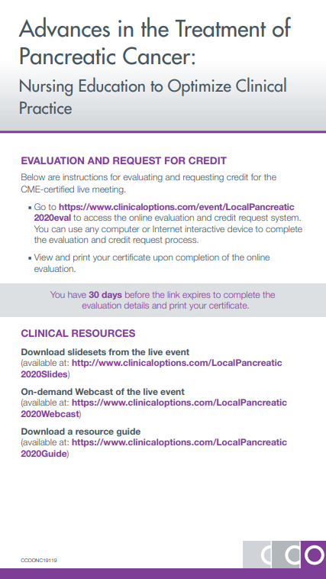
Please refer to your handout card for instructions to receive CE credit and for additional resources

Slide 12
Go Online for More CCO Coverage of Pancreatic Cancer
Downloadable slides with all the key data from this presentation (available now)
CE-certified Webcast of this presentation (coming soon)
Interactive Decision Support Tool for Advanced Pancreatic Cancer into which you can enter your own patient’s specific characteristics and see expert management recommendations
clinicaloptions.com/oncology
clinicaloptions.com/PancreaticTool

