Slide 1
OSHA Region II
Stand-Down for Amputation Awareness and Prevention
Finding and Using Your Data
What typically causes new data-gathering?
Your company’s Safety, QA/QC, insurer, OSHA, or other group identifies hazards.
Your company or other entity produces Pre-Task Plans, Job Hazard Analyses, and other risk studies.
Your employees, unions, clients, and/or insurance agent is concerned.
What kinds of questions do you want answered?
Which employees in which demographics are at greater risk?
What incidents are your company’s employees experiencing?
How do they compare with competitors or other employees in your industry?
Where do you need to spend your time and effort to increase safety in your company?
Where do you want to spend employees’ time and effort to increase safety in your company?
Note that this slide show was created in May of 2021. Query selections will change in time, and the BLS website may evolve.

Slide 2
OSHA Region II
Stand-Down for Amputation Awareness and Prevention
Finding and Using Your Data
There are many resources for data, guidance, and information (e.g. manufacturers’ specification, ANSI, OSHA, Industry regulations and standards, NIOSH, NFPA).
You will find answers to some of the questions via the U.S. Bureau of Labor Statistics site and can begin using that data to help develop safety programs for your organization.
This slideshow is a brief introduction to finding data at BLS.org.
Note that this slide show was created in May of 2021. Query selections will change in time, and the BLS website may evolve.

Slide 3
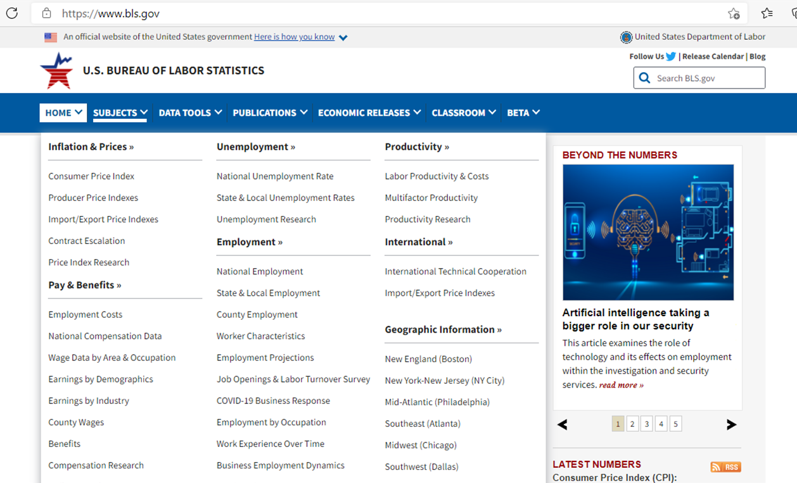
OSHA Region II
Stand-Down for Amputation Awareness and Prevention
Finding and Using Your Data
1) Open this link
2) Click here
For help, hold the Ctrl key and click the “Help” link. (https://www.bls.gov/help/)
Help

Slide 4
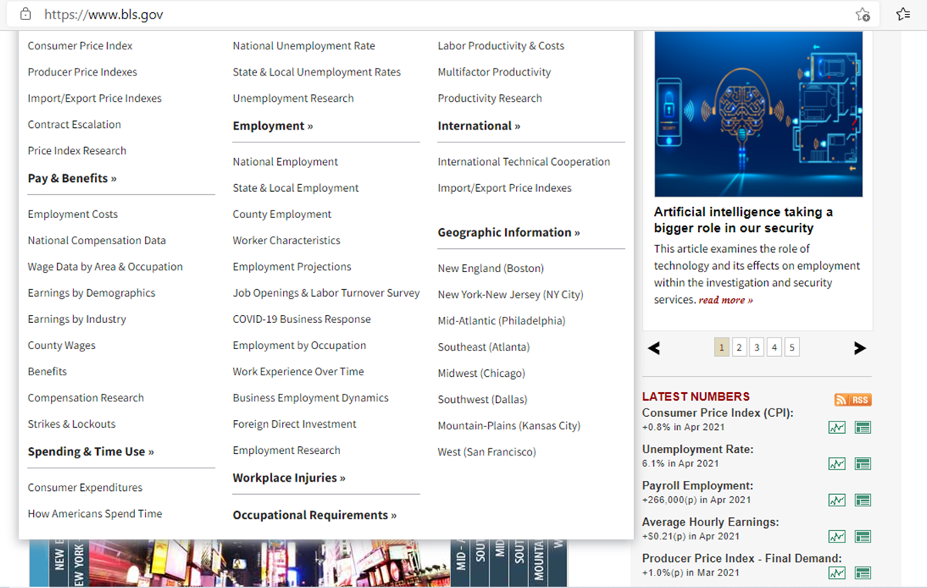
OSHA Region II
Stand-Down for Amputation Awareness and Prevention
Finding and Using Your Data
3) Scroll down and click here
Help

Slide 5
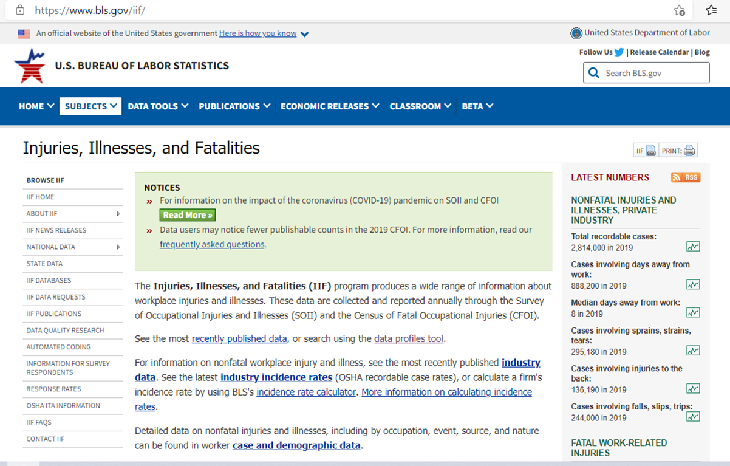
OSHA Region II
Stand-Down for Amputation Awareness and Prevention
Finding and Using Your Data
4) Click on “IIF Databases”
Help

Slide 6
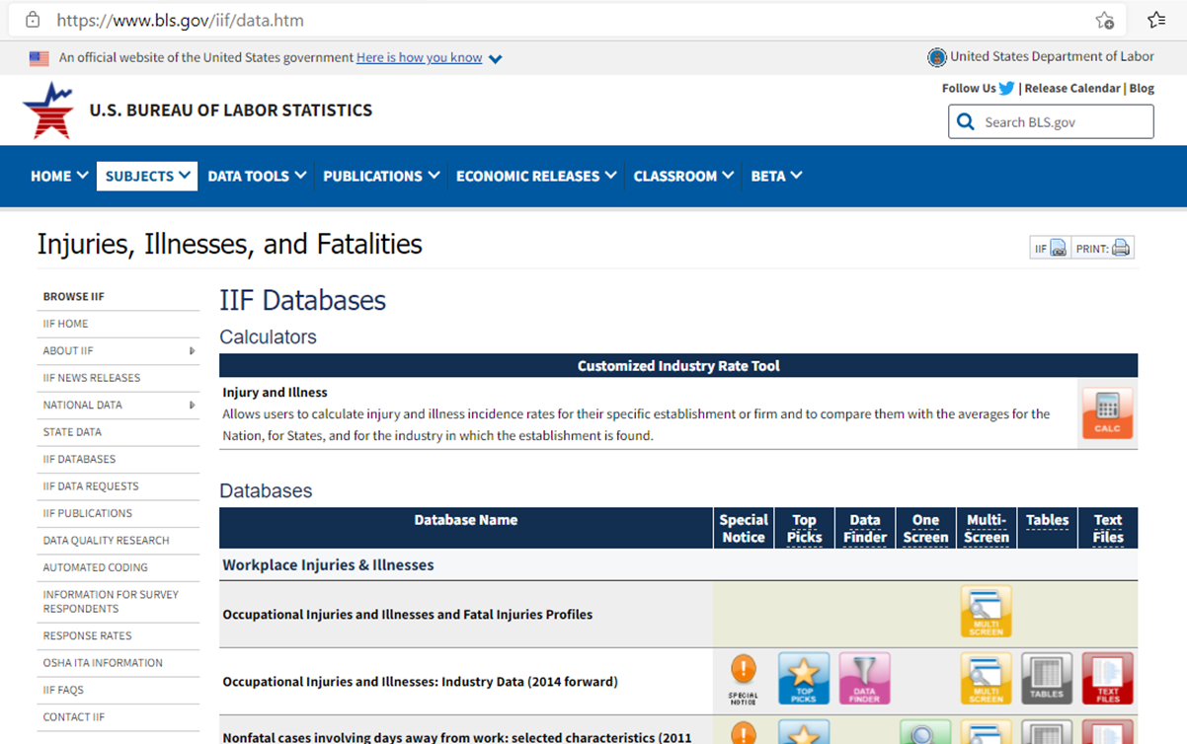
OSHA Region II
Stand-Down for Amputation Awareness and Prevention
Finding and Using Your Data
5) Click here
Help

Slide 7
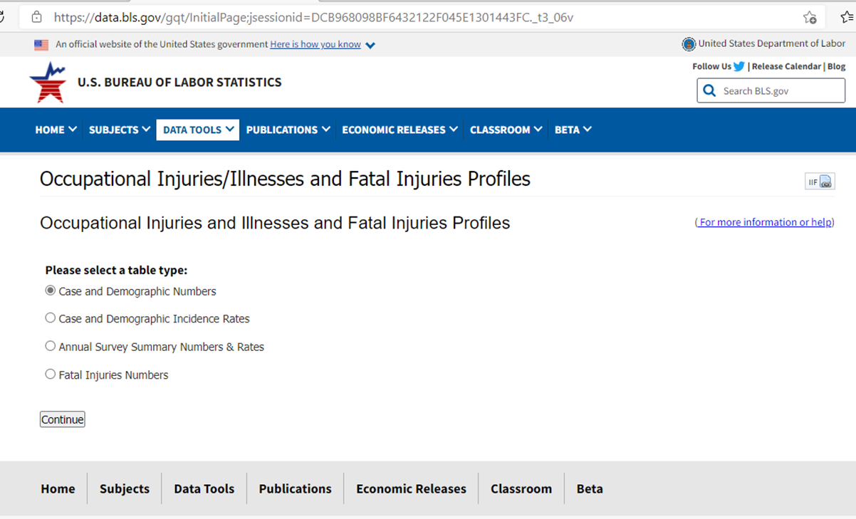
OSHA Region II
Stand-Down for Amputation Awareness and Prevention
Finding and Using Your Data
Numbers of injuries by age, gender, ethnicity, etc.
Incidence Rates by age, gender, ethnicity, etc.
Annual Summary of Numbers of Injuries and Incidence Rates
Numbers of Fatalities
Help

Slide 8
OSHA Region II
Stand-Down for Amputation Awareness and Prevention
Finding and Using Your Data
6) For this exercise, let’s select Numbers of Injuries by Age, Gender, Ethnicity, etc.
7) Click “Continue”
Help

Slide 9
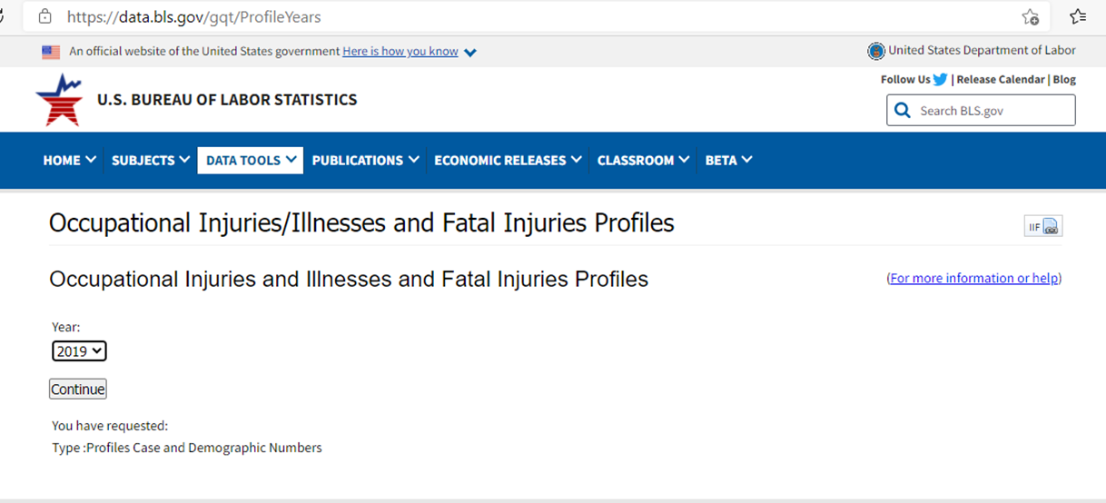
OSHA Region II
Stand-Down for Amputation Awareness and Prevention
Finding and Using Your Data
8) Click on the “Year Selection Arrow” and then a “Period-Ending” year for your inquiry - For this exercise, let’s select 2019
9) Click “Continue”
Help

Slide 10
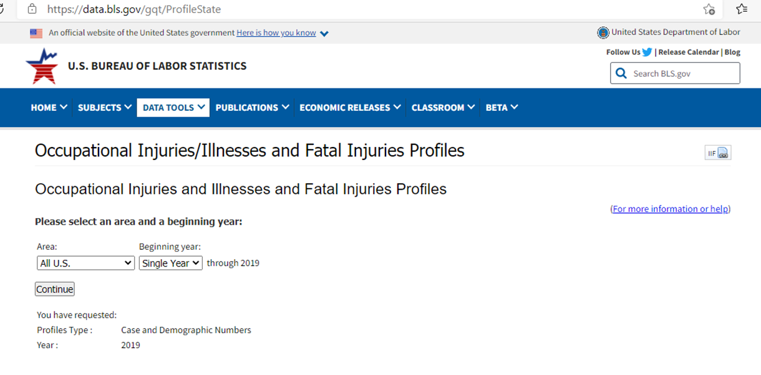
OSHA Region II
Stand-Down for Amputation Awareness and Prevention
Finding and Using Your Data
11) Click on the “Start Year Selection Arrow” and then “Single-Year” or another beginning year for your inquiry - For this exercise, let’s select 2016
10) Click on the “Area Selection Arrow” and then “All U.S.” or a State or Territory for your inquiry - For this exercise, let’s select N.J.
12) Click “Continue”
Help

Slide 11
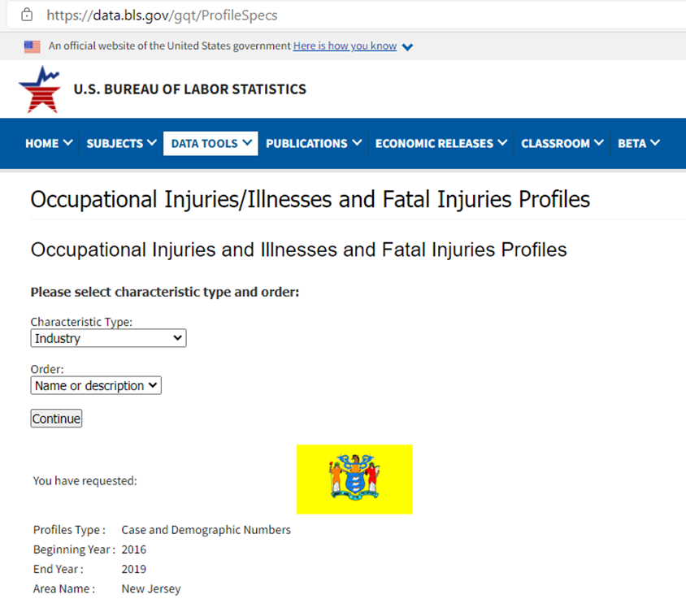
OSHA Region II
Stand-Down for Amputation Awareness and Prevention
Finding and Using Your Data
13) “Characteristic Type” gives a wealth of choices to select, depending on your inquiry. For this exercise, let’s select “Occupation”
14) Select sort by “Name or Description” or “Number”. For this exercise, let’s select “Name or Description”
Help
15) Click “Continue”

Slide 12
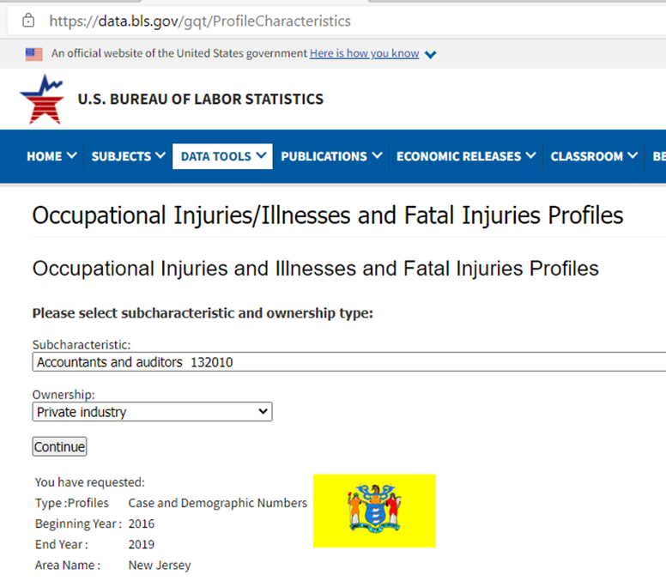
OSHA Region II
Stand-Down for Amputation Awareness and Prevention
Finding and Using Your Data
16) “Subcharacteristic” lets one focus on their work type. For this exercise, let’s select “Bus and truck mechanics and diesel engine specialists”
17) Select “Ownership Type”. For this exercise, let’s select “Private Industry”
18) Click “Continue”
Help

Slide 13
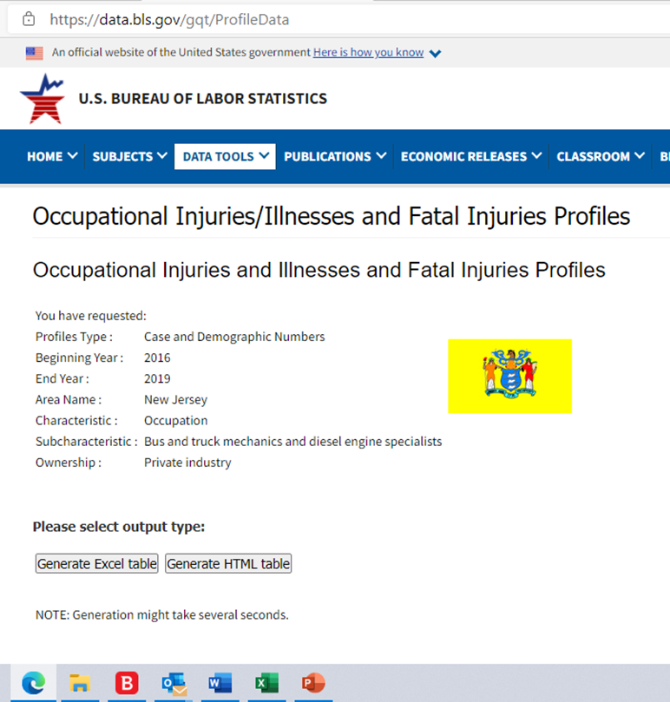
OSHA Region II
Stand-Down for Amputation Awareness and Prevention
Finding and Using Your Data
19) Note the parameters of your query
20) Click “Generate Excel Table”
Help

Slide 14
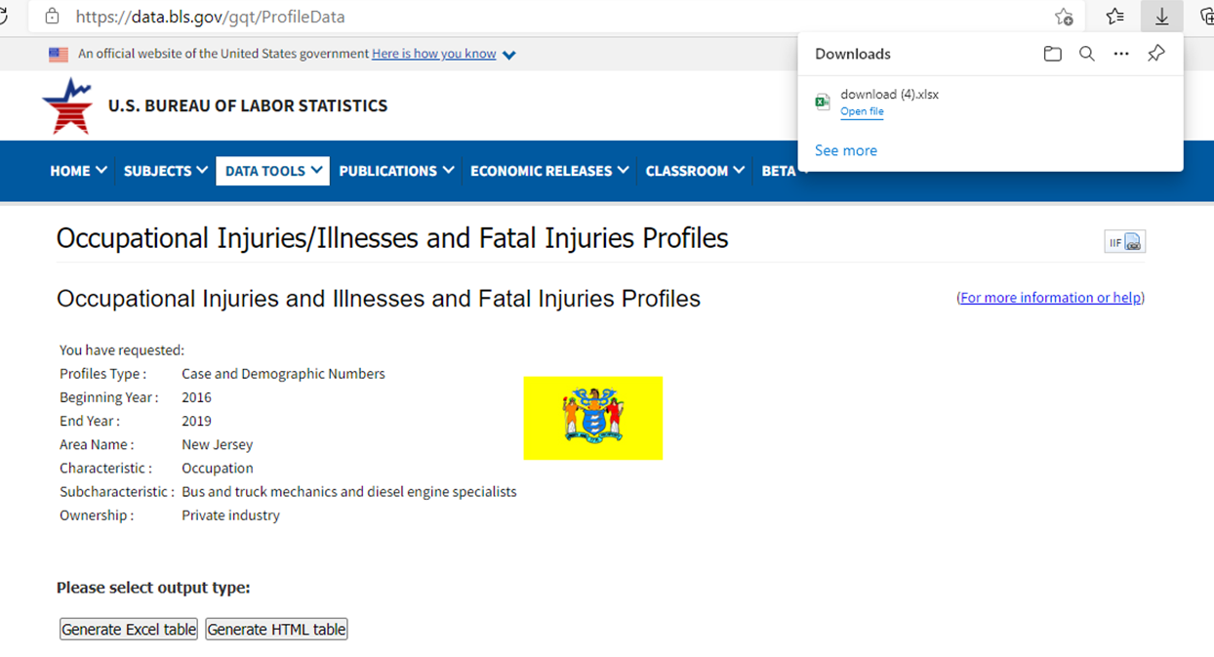
OSHA Region II
Stand-Down for Amputation Awareness and Prevention
Finding and Using Your Data
21) Click on “Open File”

Slide 15
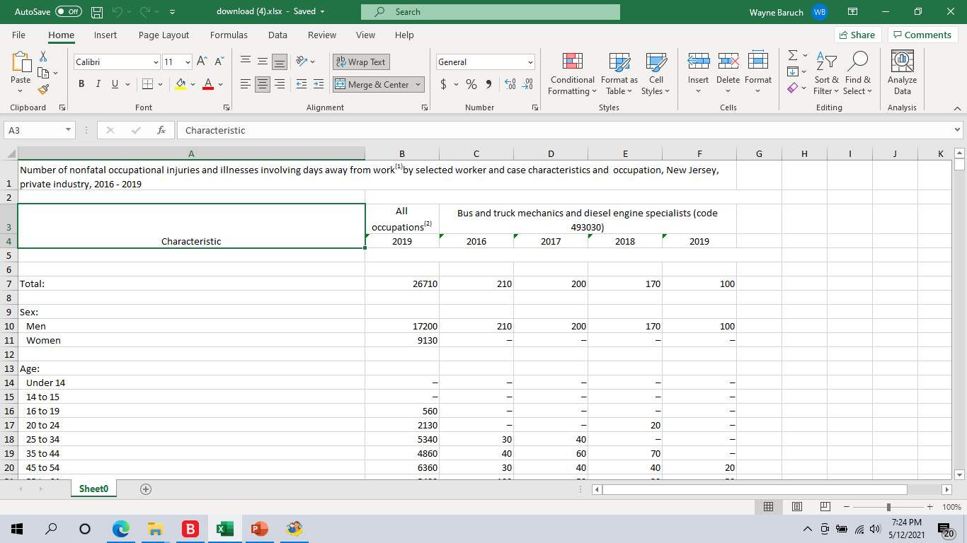
OSHA Region II
Stand-Down for Amputation Awareness and Prevention
Finding and Using Your Data
Here’s Your Data!

Slide 16
OSHA Region II
Stand-Down for Amputation Awareness and Prevention
Finding and Using Your Data
Characteristic
Total (in this case) Number of Incidents
Gender
Age
Length of service with employer
Race or ethnic origin
Number of days away from work and "Median days away from work(3)"
Median days away from work⁽³⁾
Industry sector⁽⁴⁾
Musculoskeletal disorders⁽⁸⁾
Event or exposure⁽⁹⁾
Nature of injury, illness⁽⁹⁾
Part of body affected⁽⁹⁾
Source of injury, illness⁽⁹⁾
Secondary source of injury, illness⁽⁹⁾
Day of Week
Time of Day or "Not Reported"
Hours Worked, "Before the Workshift", or "Not Reported"

Slide 17
OSHA Region II
Stand-Down for Amputation Awareness and Prevention
Exercise II
Let’s suppose that you are a manufacturer of construction machinery in NY State and your Q/A-Q/C team has observed amputation hazards due to missing machine guards.
After investigation, you learn that:
there have been five near-misses over the past quarter and
your personnel are scoffing at missing guards.
There will obviously be many components of your updated Machine Guarding program, but one will include data on related injuries and fatalities.
This will require two separate passes from the “Occupational Injuries/Illnesses and Fatal Injuries Profiles” page. See the next slides.
Help

Slide 18
OSHA Region II
Stand-Down for Amputation Awareness and Prevention
Exercise II – First Pass (Injuries & Illnesses)
1) Select “Case and Demographic Numbers”
2) Click “Continue”
Help

Slide 19
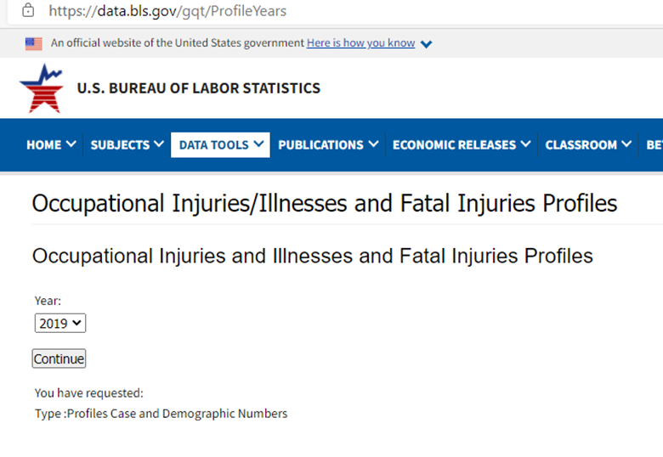
OSHA Region II
Stand-Down for Amputation Awareness and Prevention
Exercise II – First Pass (Injuries & Illnesses)
3) Select the most recent “period-ended” year.
4) Click “Continue”
Help

Slide 20
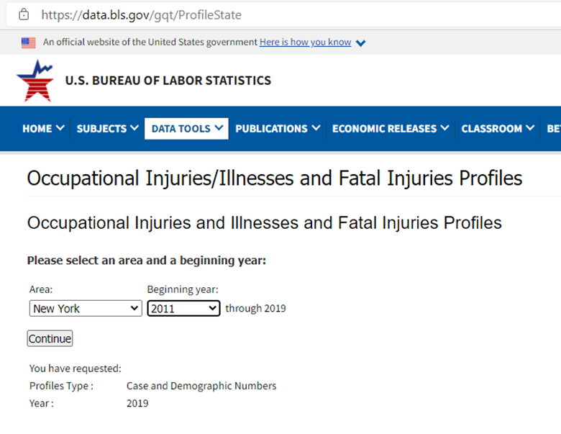
OSHA Region II
Stand-Down for Amputation Awareness and Prevention
Exercise II – First Pass (Injuries & Illnesses)
5) Select “NY” and “period-beginning” year = “2011”.
6) Click “Continue”
Help

Slide 21
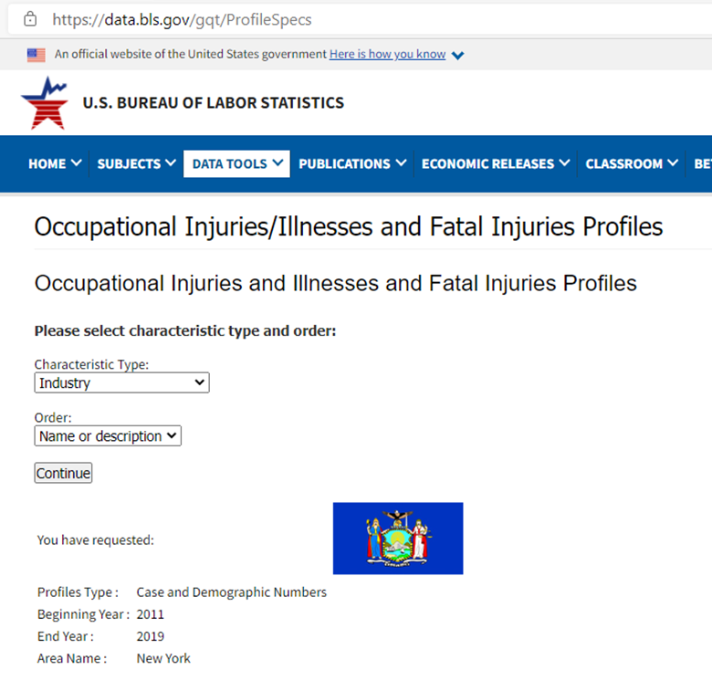
OSHA Region II
Stand-Down for Amputation Awareness and Prevention
Exercise II – First Pass (Injuries & Illnesses)
7) Select “Characteristic Type” = “Industry” and “Order” = “Name or Description”
8) Click “Continue”
Help

Slide 22
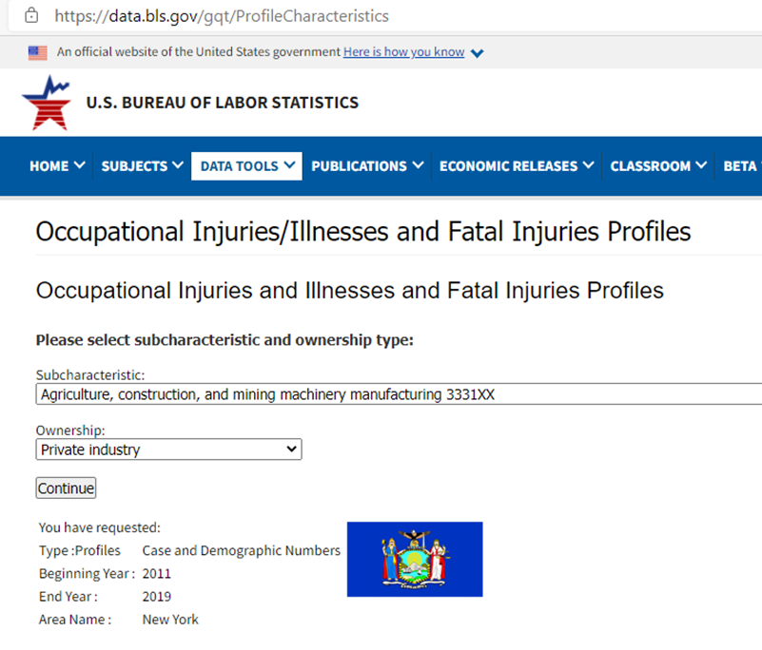
OSHA Region II
Stand-Down for Amputation Awareness and Prevention
Exercise II – First Pass (Injuries & Illnesses)
9) Select “Subcharacteristic” = “Agricultural, construction, and mining machinery manufacturing”
10) Select “Ownership” = “Private Industry”
11) Click “Continue”
Help

Slide 23
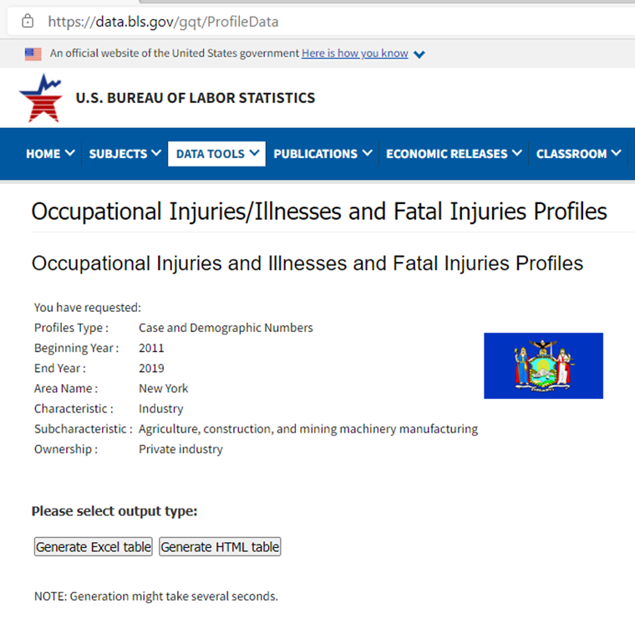
OSHA Region II
Stand-Down for Amputation Awareness and Prevention
Exercise II – First Pass (Injuries & Illnesses)
12) Note your selections
13) Click “Generate Excel”
Help

Slide 24
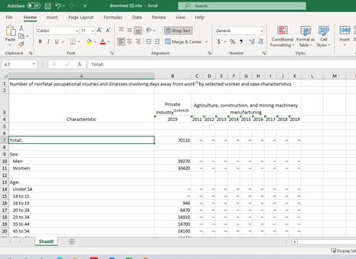
OSHA Region II
Stand-Down for Amputation Awareness and Prevention
Exercise II – First Pass (Injuries & Illnesses for Agriculture, construction, and mining machinery manufacturing)
Here’s Your Data!
Help

Slide 25
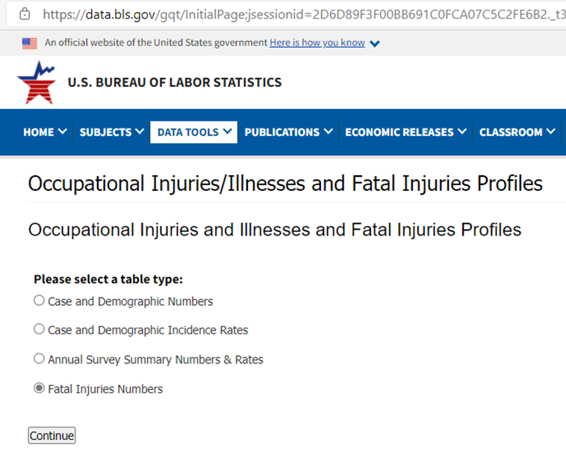
OSHA Region II
Stand-Down for Amputation Awareness and Prevention
Exercise II – Second Pass (Fatalities)
14) Select “Fatalities”
15) Click “Continue”
Help

Slide 26
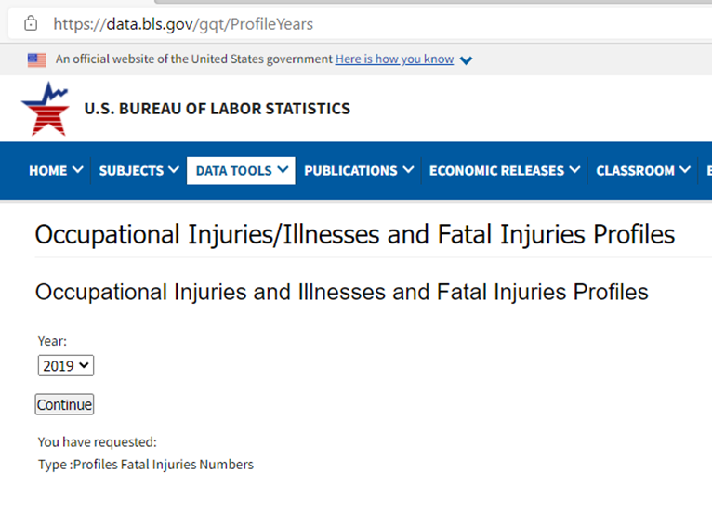
OSHA Region II
Stand-Down for Amputation Awareness and Prevention
Exercise II – Second Pass (Fatalities)
16) Select the most recent “period-ended” date
17) Click “Continue”
Help

Slide 27
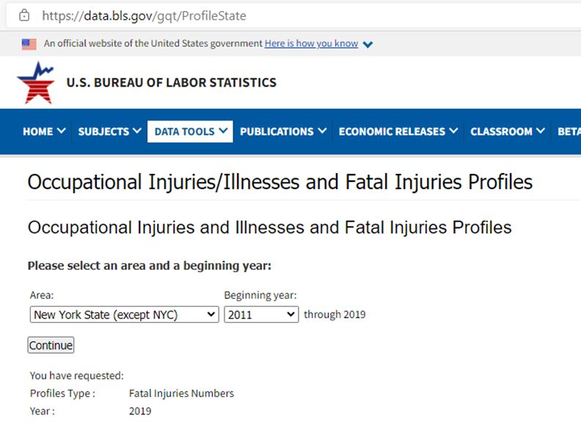
OSHA Region II
Stand-Down for Amputation Awareness and Prevention
Exercise II – Second Pass (Fatalities)
18) Select “Area” = “NY” (except NYC) and “period-beginning year” = 2011
19) Click “Continue”
Help

Slide 28
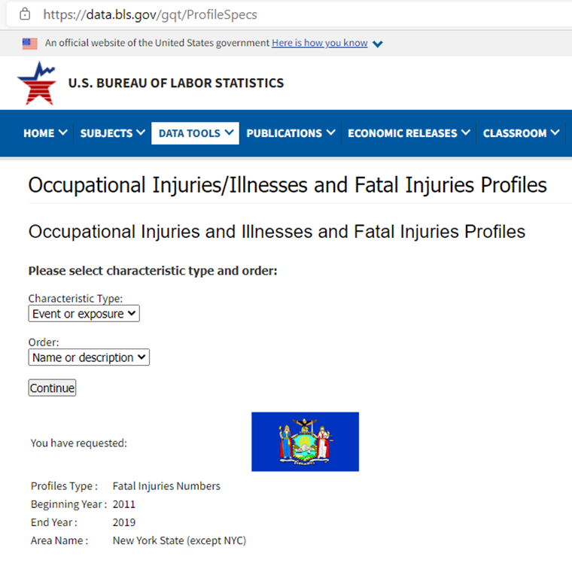
OSHA Region II
Stand-Down for Amputation Awareness and Prevention
Exercise II – Second Pass (Fatalities – Event or Exposure)
20) Select “Characteristic Type” = “Event or Exposure” and “Order” = “Name or Description”
21) Click “Continue”
Help

Slide 29
OSHA Region II
Stand-Down for Amputation Awareness and Prevention
Exercise II – Second Pass (Fatalities – Event or Exposure)
22) Select “Subcharacteristic” = “Caught in running equipment or machinery”
23) Select “Ownerships” = “Private”
24) Click “Continue”
Help

Slide 30
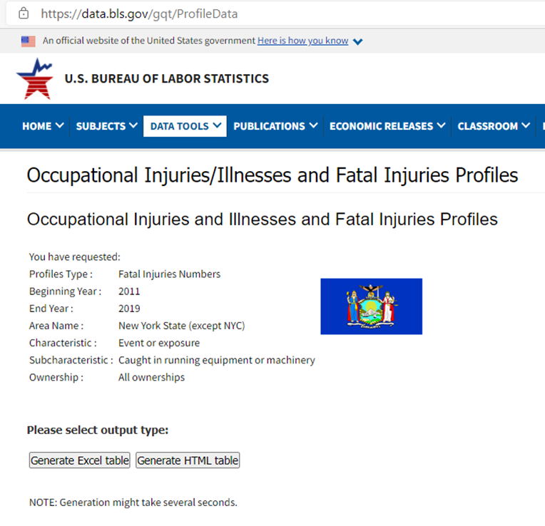
OSHA Region II
Stand-Down for Amputation Awareness and Prevention
Exercise II – Second Pass (Fatalities – Event or Exposure)
25) Note your selections
26) Click “Generate Excel”
Help

Slide 31
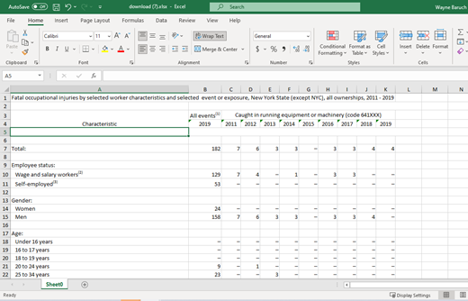
OSHA Region II
Stand-Down for Amputation Awareness and Prevention
Exercise II – Second Pass (Fatalities – Event or Exposure, Caught in running equipment or machinery)
Here’s Your Data!
Help

Slide 32
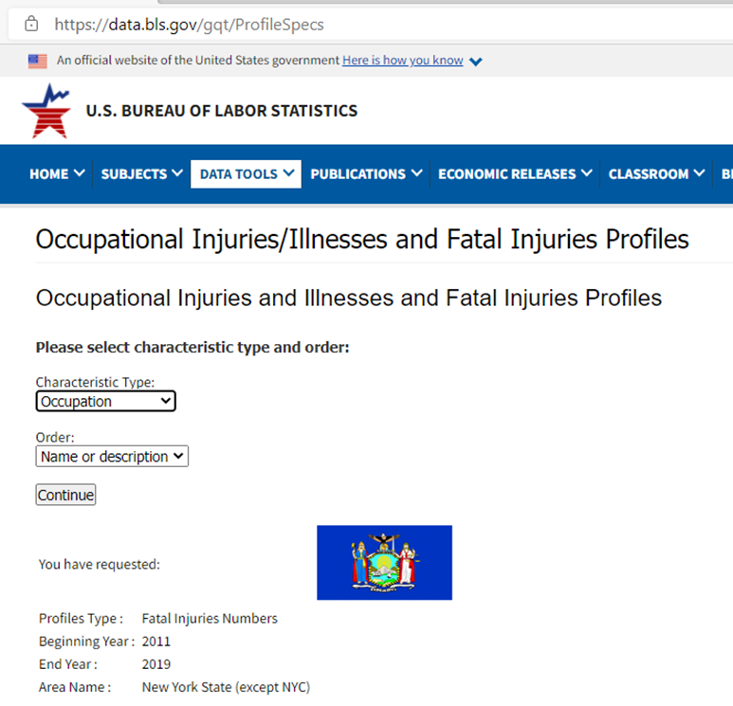
OSHA Region II
Stand-Down for Amputation Awareness and Prevention
Exercise II – Third Pass (Fatalities – Occupation)
As you learned, “Characteristic Type” offers a wealth of selections. Return to this field and click on “Occupation”
27) Select “Characteristic Type” = “Occupation” and “Order” = “Name or Description”
28) Click “Continue”
Help

Slide 33
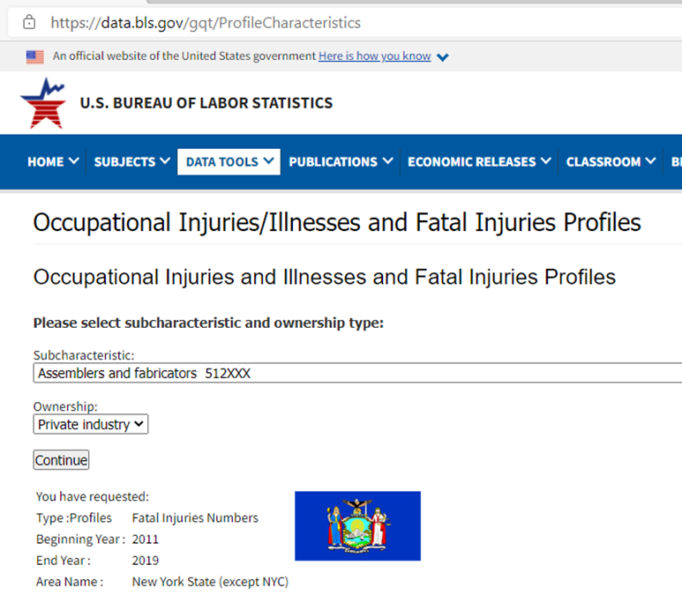
OSHA Region II
Stand-Down for Amputation Awareness and Prevention
Exercise II – Third Pass (Fatalities – Occupation)
29) Select “Subcharacteristic Type” = “Assemblers and fabricators”
30) Please select “Ownership” = “Private”
31) Click “Continue”
Help

Slide 34
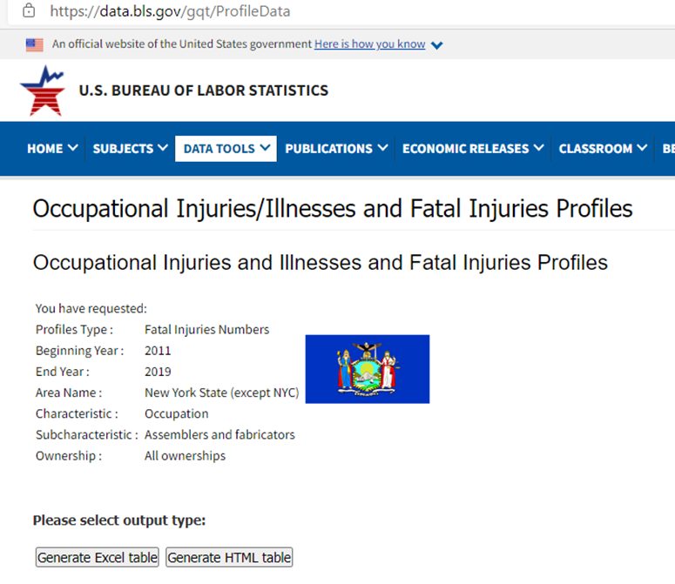
OSHA Region II
Stand-Down for Amputation Awareness and Prevention
Exercise II – Third Pass (Fatalities – Occupation)
32) Note your selections
33) Click “Generate Excel”
Help

Slide 35
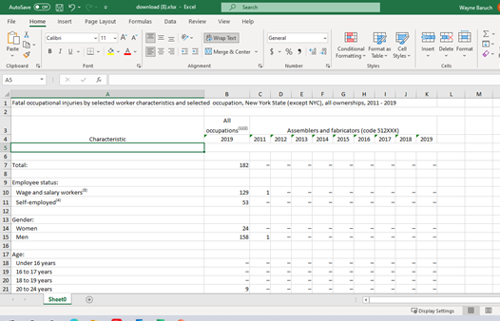
OSHA Region II
Stand-Down for Amputation Awareness and Prevention
Exercise II – Third Pass (Fatalities – Occupation, Assemblers and fabricators)
Here’s Your Data!
Help

Slide 36
OSHA Region II
Stand-Down for Amputation Awareness and Prevention
Summary
Now that you know how to get the data, it is up to the employer to start the ball rolling.
Data is obviously only as good as the information that it is used to create!
Classes in “Introduction to Working with MS Excel” and an “Introduction to Data Analysis” will also help a manager to be more skilled at converting the data to useful information.
Employers should welcome OSHA to consult on safety conditions and there are many commercial safety consulting firms that can assist employers with improving safety conditions.
It is also wise to encourage supervisors to earn an OSHA 30, and Safety Professionals should hold more advanced credentials.
A dollar invested in safety returns $4-6 in reduced risk and cost.

