Slide 1
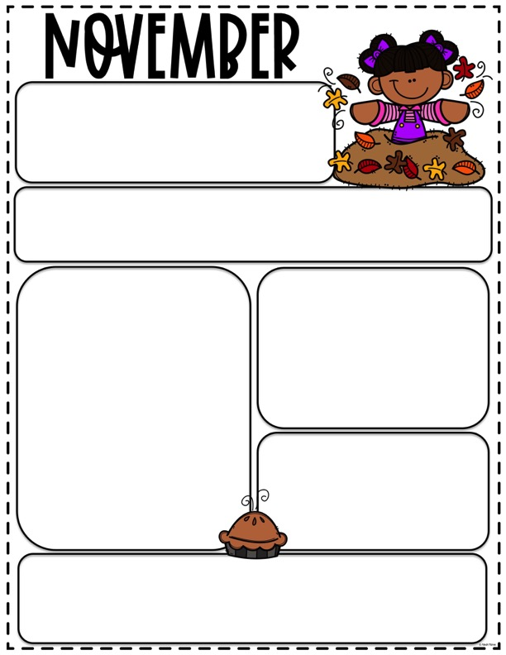
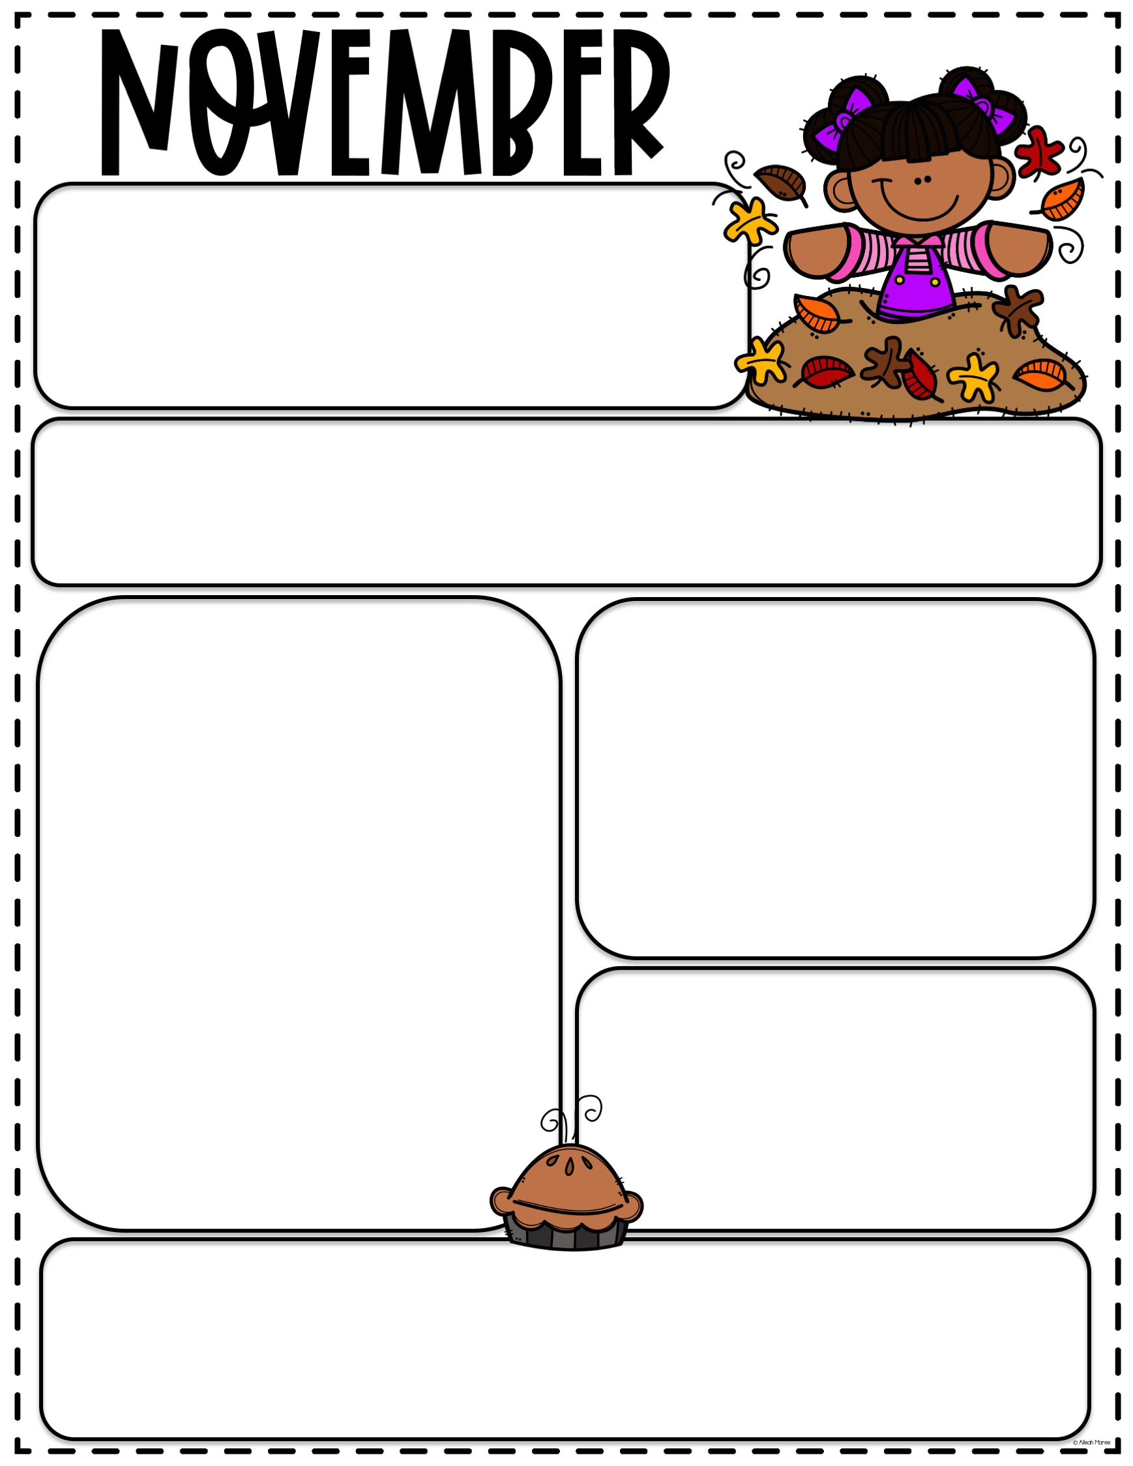
SCHOOL CLOSED
Friday November 10th closed for Veteran’s Day
and
Wednesday November 23nd through
Friday November 24th for Thanksgiving
BOOK ORDERS
Book orders are due Friday November 17th. To order
scan the QR code on the flyer and follow the prompts.
What we are Learning
BIG SCHOOL
LEAVES
HARVEST TIME
THANKSGIVING
LITTLE SCHOOL
Fall
WOODLAND ANIMALS
Christmas Around the World
LETTERS
S, D, J
PLEASE
Remember to write your child’s name on jackets, sweatshirts and sweaters. Also please check the extra clothes in their cubby to make sure they still fit and are weather appropriate.
Lunch Box Reminders
Please pack a nutritious lunch for your child. Remembering to include a form of protein, a fruit, vegetable and dairy product.
Also please remember to provide utensils in your child’s lunch.
Fun Reading Goal
If you read 2 books a day to your child starting on their 3rd birthday, when they turn 5 they will have had almost 1500 books read to them.
LETS GET READING!

