Slide 1
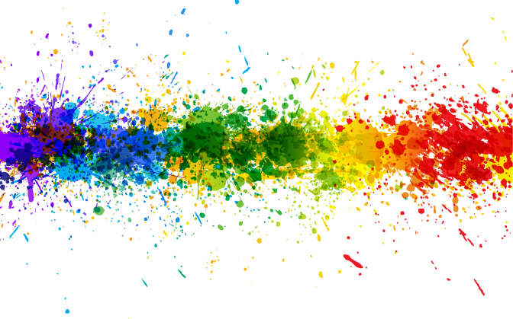
“Something About Color” a.k.a. Color In Composition
Mike Schaffner
Composition – The fine art of Seeing SIG
February 13, 2022
Mikeschaffnerphotography.com

Slide 2
Color Can Be A Very Strong Compositional Element
What colors look good together?
How does color affect our feelings or our sense of mood?
The cultural & religious interpretations of color

Slide 3
Color Combinations
Complementary
Two colors that are on opposite sides of the color wheel. This combination provides a high contrast and high impact color combination – together, these colors will appear brighter and more prominent.
Source: https://www.canva.com/colors/color-wheel/

Slide 4
Complementary Colors
Mesquite Dunes Sunset -DVNP

Slide 5
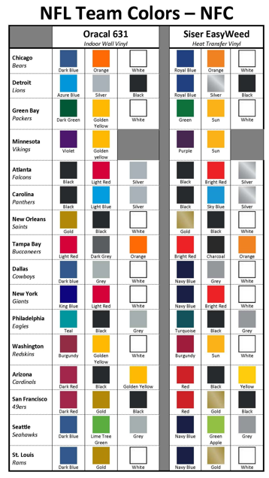
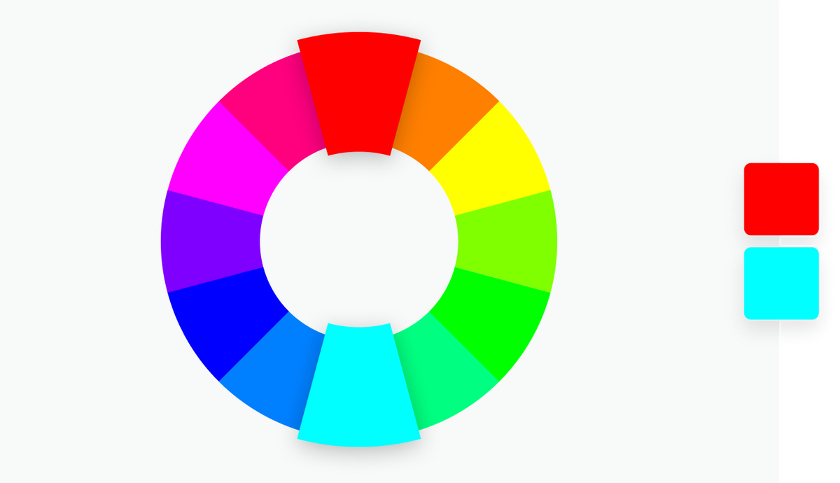
Complementary Color

Slide 6
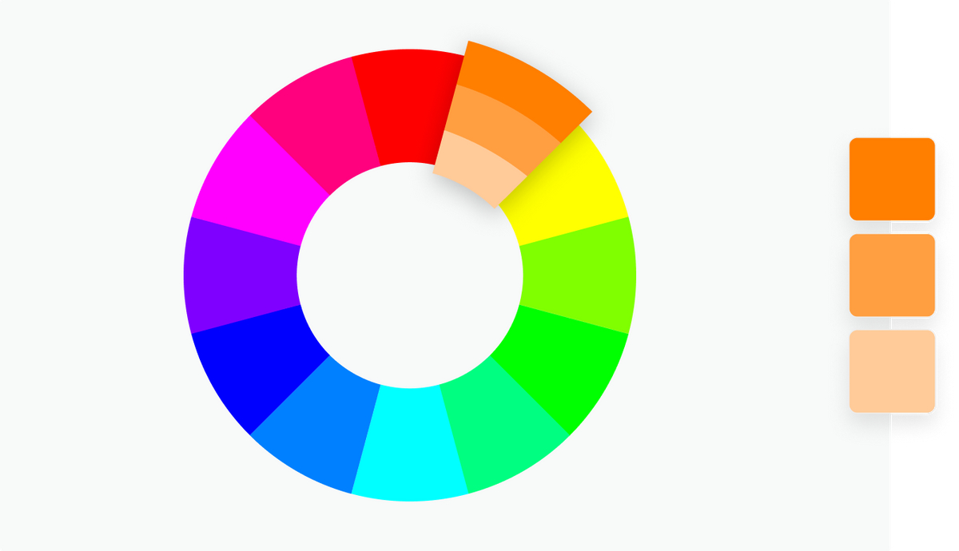
Color Combinations
Monochromatic
Three shades, tones and tints of one base color. Provides a subtle and conservative color combination. This is a versatile color combination that is easy to apply to design projects for a harmonious look.
Source: https://www.canva.com/colors/color-wheel/

Slide 7
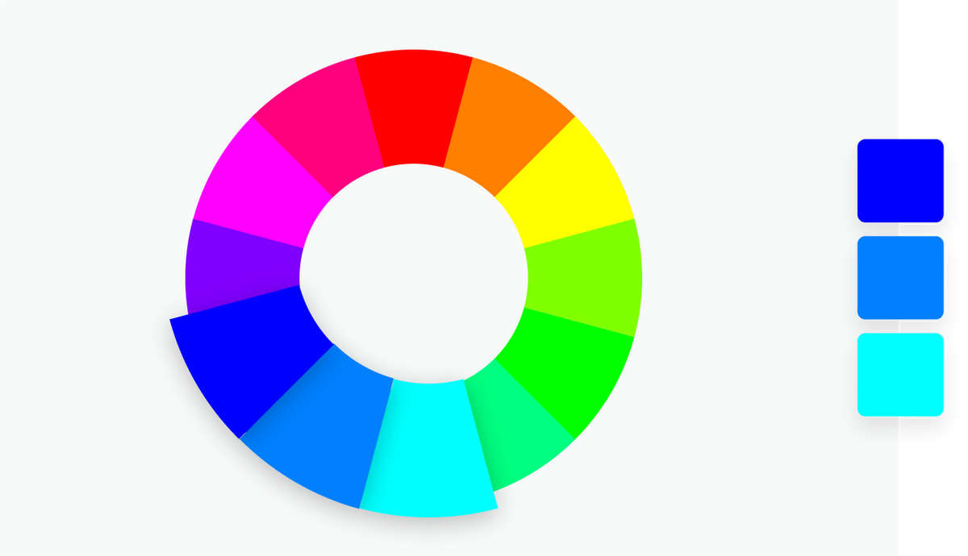
Color Combinations
Analogous
Three colors that are side by side on the color wheel. This color combination is versatile, but can be overwhelming. To balance an analogous color scheme, choose one dominant color, and use the others as accents.
Source: https://www.canva.com/colors/color-wheel/

Slide 8
Monochromatic Colors
Badwater Blue Hour - DVNP

Slide 9
Monochromatic Colors
Golden Canyon - DVNP

Slide 10
Analogous Colors
Mirrored Roses – Joan Tilton

Slide 11
Analogous Colors
Blue Chihuly

Slide 12
Analogous Colors
Tomball Sunrise

Slide 13
Shades, Tints and Tones
Shade
A shade is created by adding black to a base hue, darkening the color. This creates a deeper, richer color. Shades can be quite dramatic and can be overpowering.
Tint
A tint is created by adding white to a base hue, lightening the color. This can make a color less intense, and is useful when balancing more vivid color combinations.
Tones
A tone is created by combining black and white—or grey—with a base hue. Like tints, tones are subtler versions of the original color. Tones are less likely to look pastel, and can reveal complexities not apparent in the base color.
Source: https://www.canva.com/colors/color-wheel/

Slide 14
Hue, Saturation and Luminance
A hue is basically any color on the color wheel. When you are using a color wheel or a color picker, you can adjust the saturation and luminance of a hue.
Saturation is the intensity or purity of the color.
Luminance is the amount of brightness or light in a color.
Source: https://www.canva.com/colors/color-wheel/

Slide 15
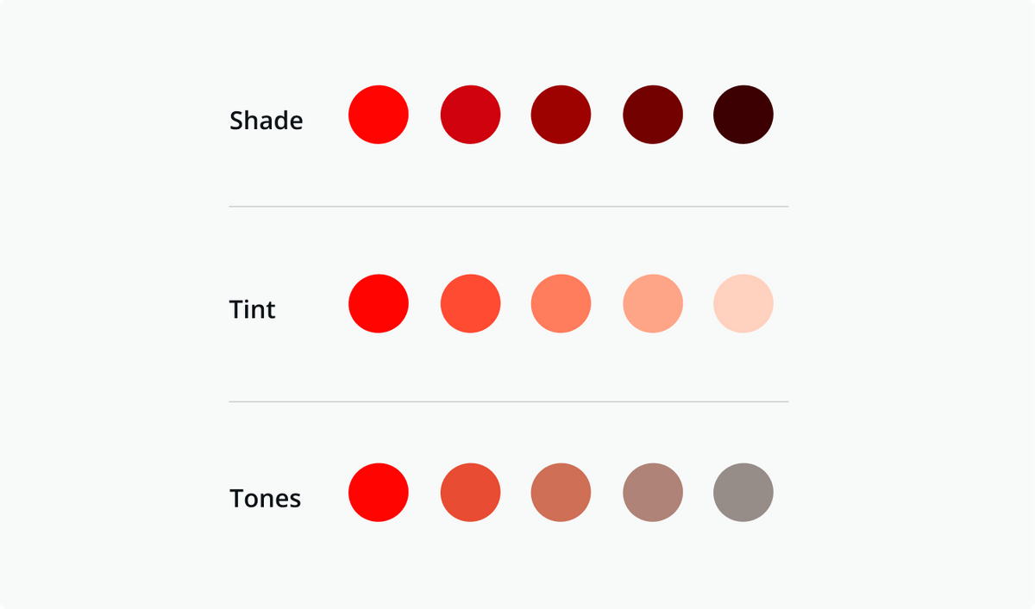
Hue, Saturation and Luminance
Saturation is the intensity or purity of the color.
Shade is created by adding black to a base hue, darkening the color. This creates a deeper, richer color. Shades can be quite dramatic and can be overpowering.
Luminance is the amount of brightness or light in a color.
Tint is created by adding white to a base hue, lightening the color. This can make a color less intense, and is useful when balancing more vivid color combinations.
White - fully reflects and scatters all the visible wavelengths of light – the opposite of black
Black - the very darkest color owing to the absence of or complete absorption of light – the opposite of white
Shade?
Tint?
Source: https://www.canva.com/colors/color-wheel/

Slide 16
White Balance

Slide 17
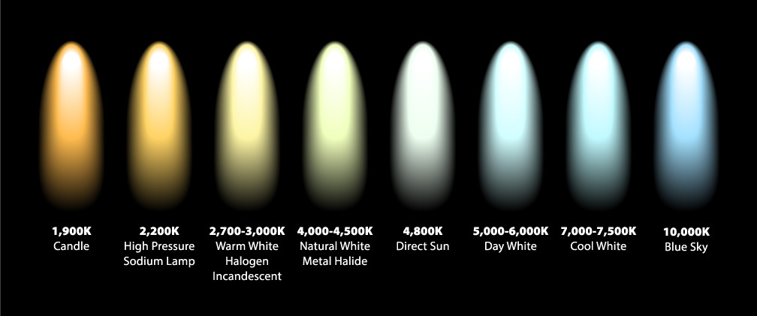
White Balance & Color Temperature
White balance (WB) is the process of removing unrealistic color casts, so that objects which appear white in person are rendered white in your photo.
Since we see reflected light the color temperature of the light affects the color we see.

Slide 18
White Balance & Imaging Software
Imaging software seems “backwards” to what I just said
“… the reason the adjustment seems backwards is that you are choosing a color temperature to compensate for, not choosing what color temperature the overall color in the image should look like.” - Tim Grey

Slide 19
Video
Color Temperature & Emotion | Film Lighting Techniques
LINK- https://youtu.be/A_aymULfI1Y?t=56

Slide 20
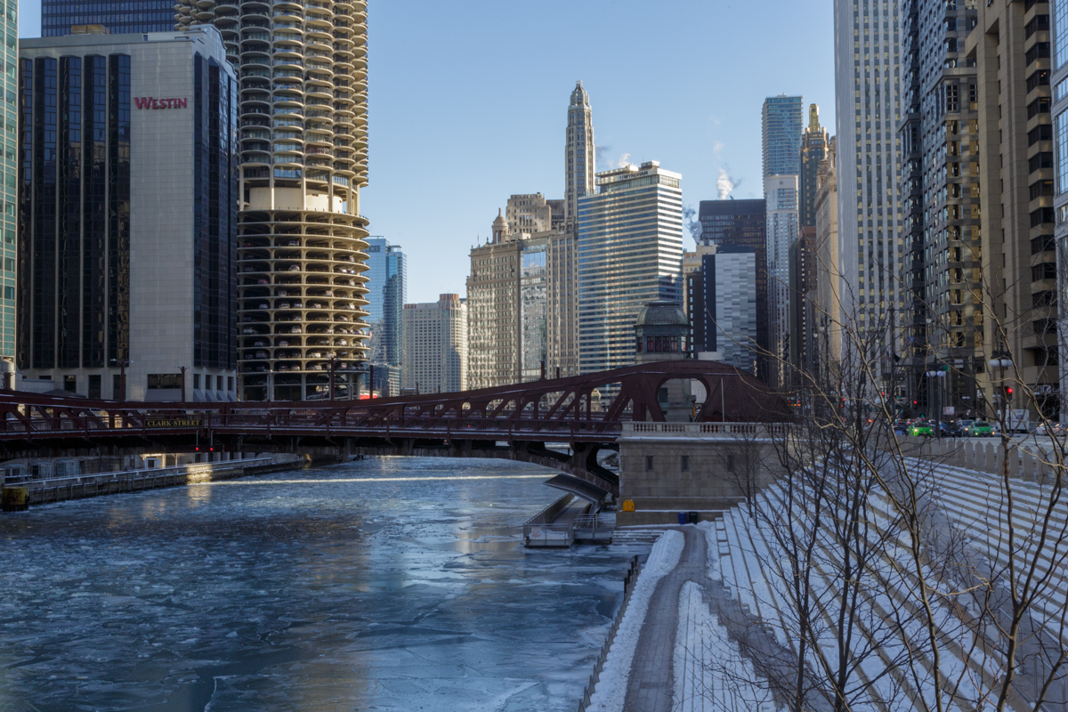
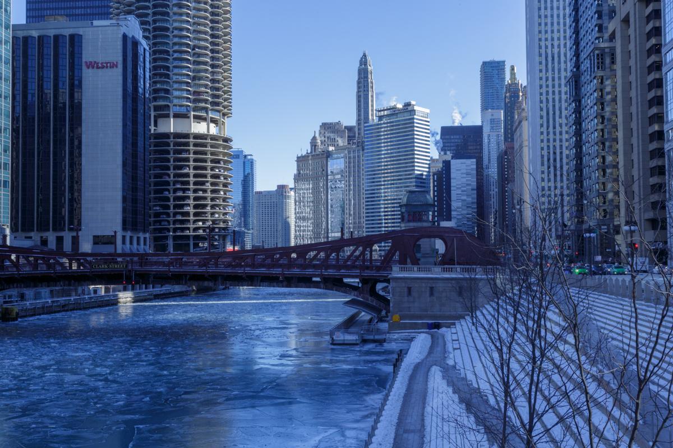

Slide 21
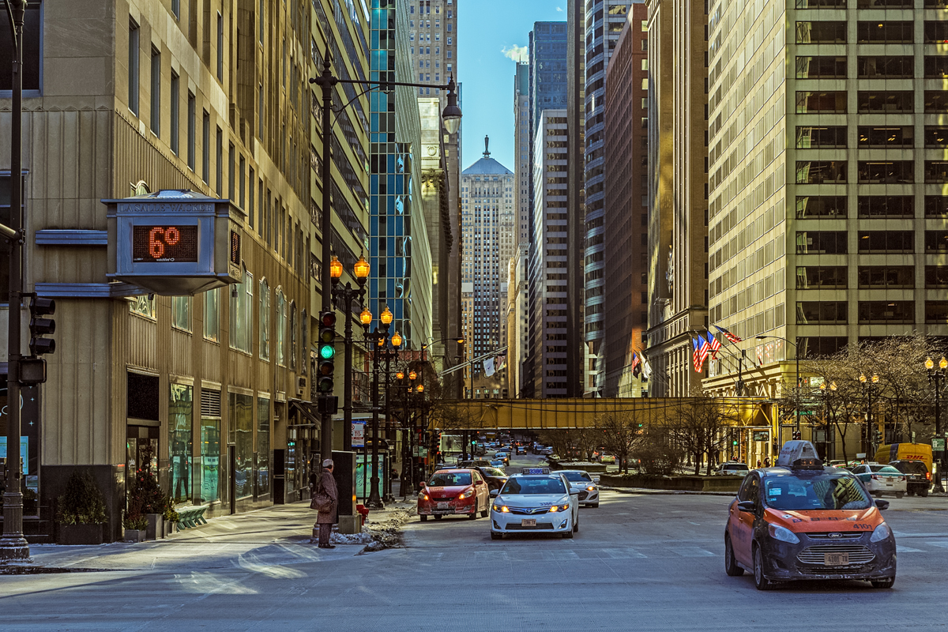
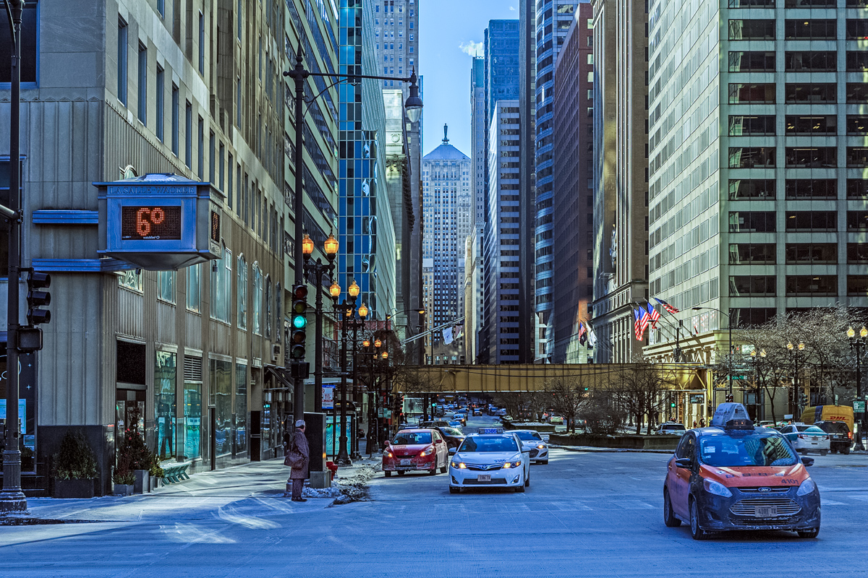

Slide 22
Importance Of Tone To B&W Photos
If the colors in scene are close to the same tonal value the B&W conversion seems “flat”. For good B&W we may need to adjust the tonal contrast by adjusting the underlying saturation and/or luminance of individual colors.
Source: https://www.vickinormanstudio.com/blog-articles/2018/1/9/a-lesson-about-matching-the-tonal-values-of-colours

Slide 23
Importance Of Tone To B&W Photos - Real World Example
If the colors in scene are close to the same tonal value the B&W conversion seems “flat”. For good B&W we may need to adjust the tonal contrast by adjusting the underlying saturation and/or luminance of individual colors.
Source: https://www.vickinormanstudio.com/blog-articles/2018/1/9/a-lesson-about-matching-the-tonal-values-of-colours

Slide 24
Demo In Lightroom

Slide 25
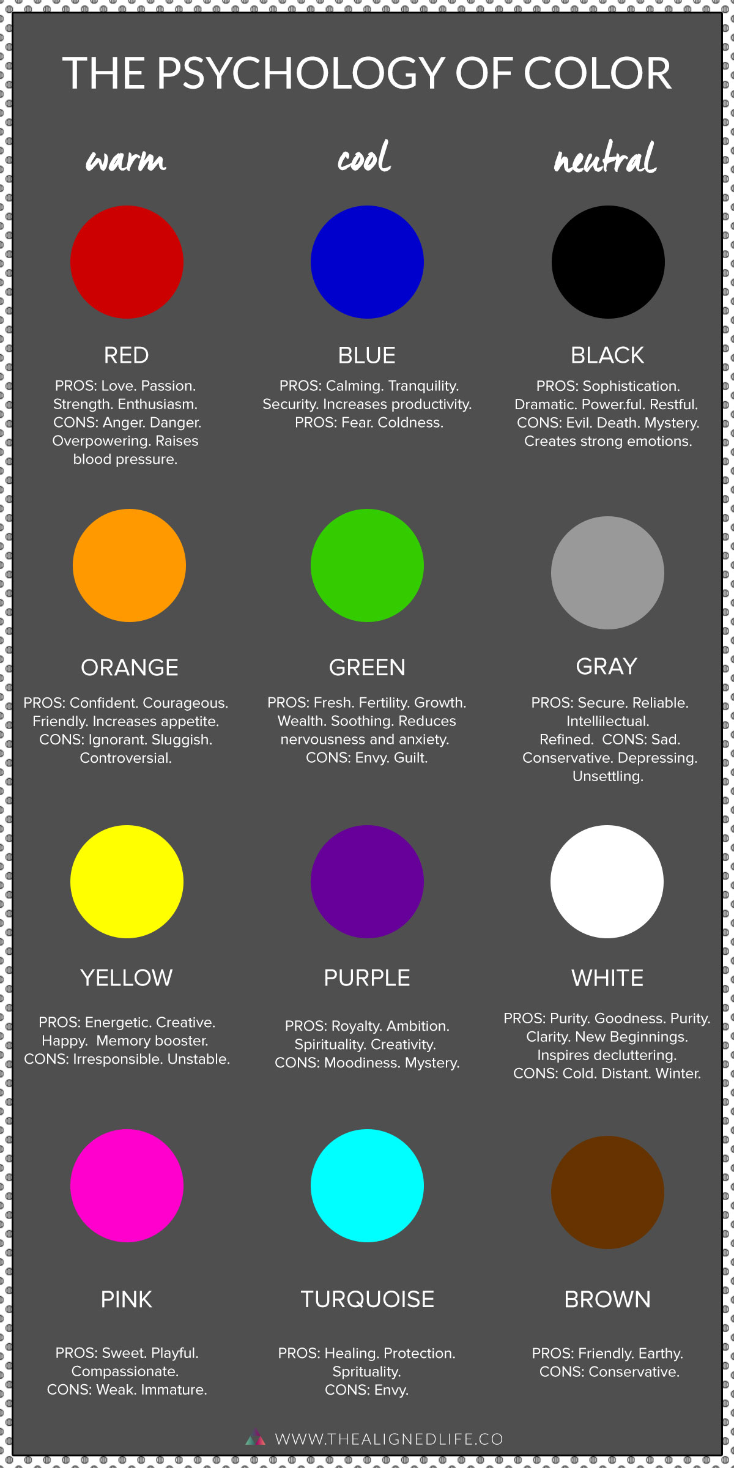
The Psychology of Color

Slide 26
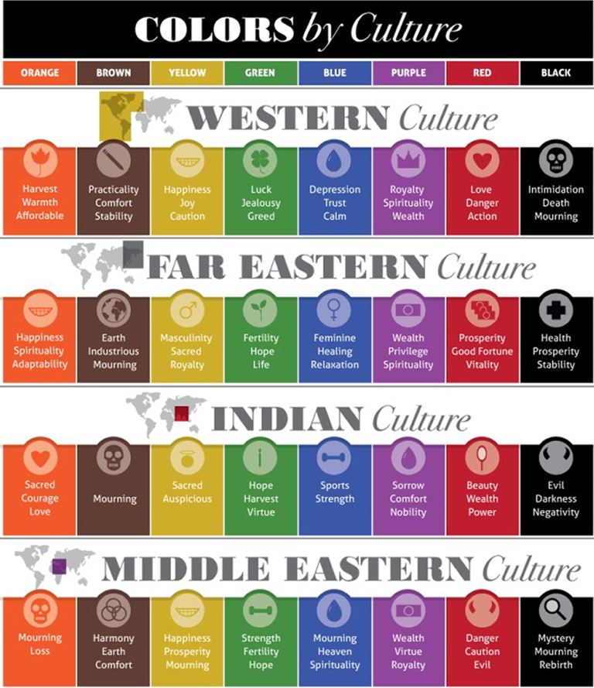
Color & Culture

Slide 27
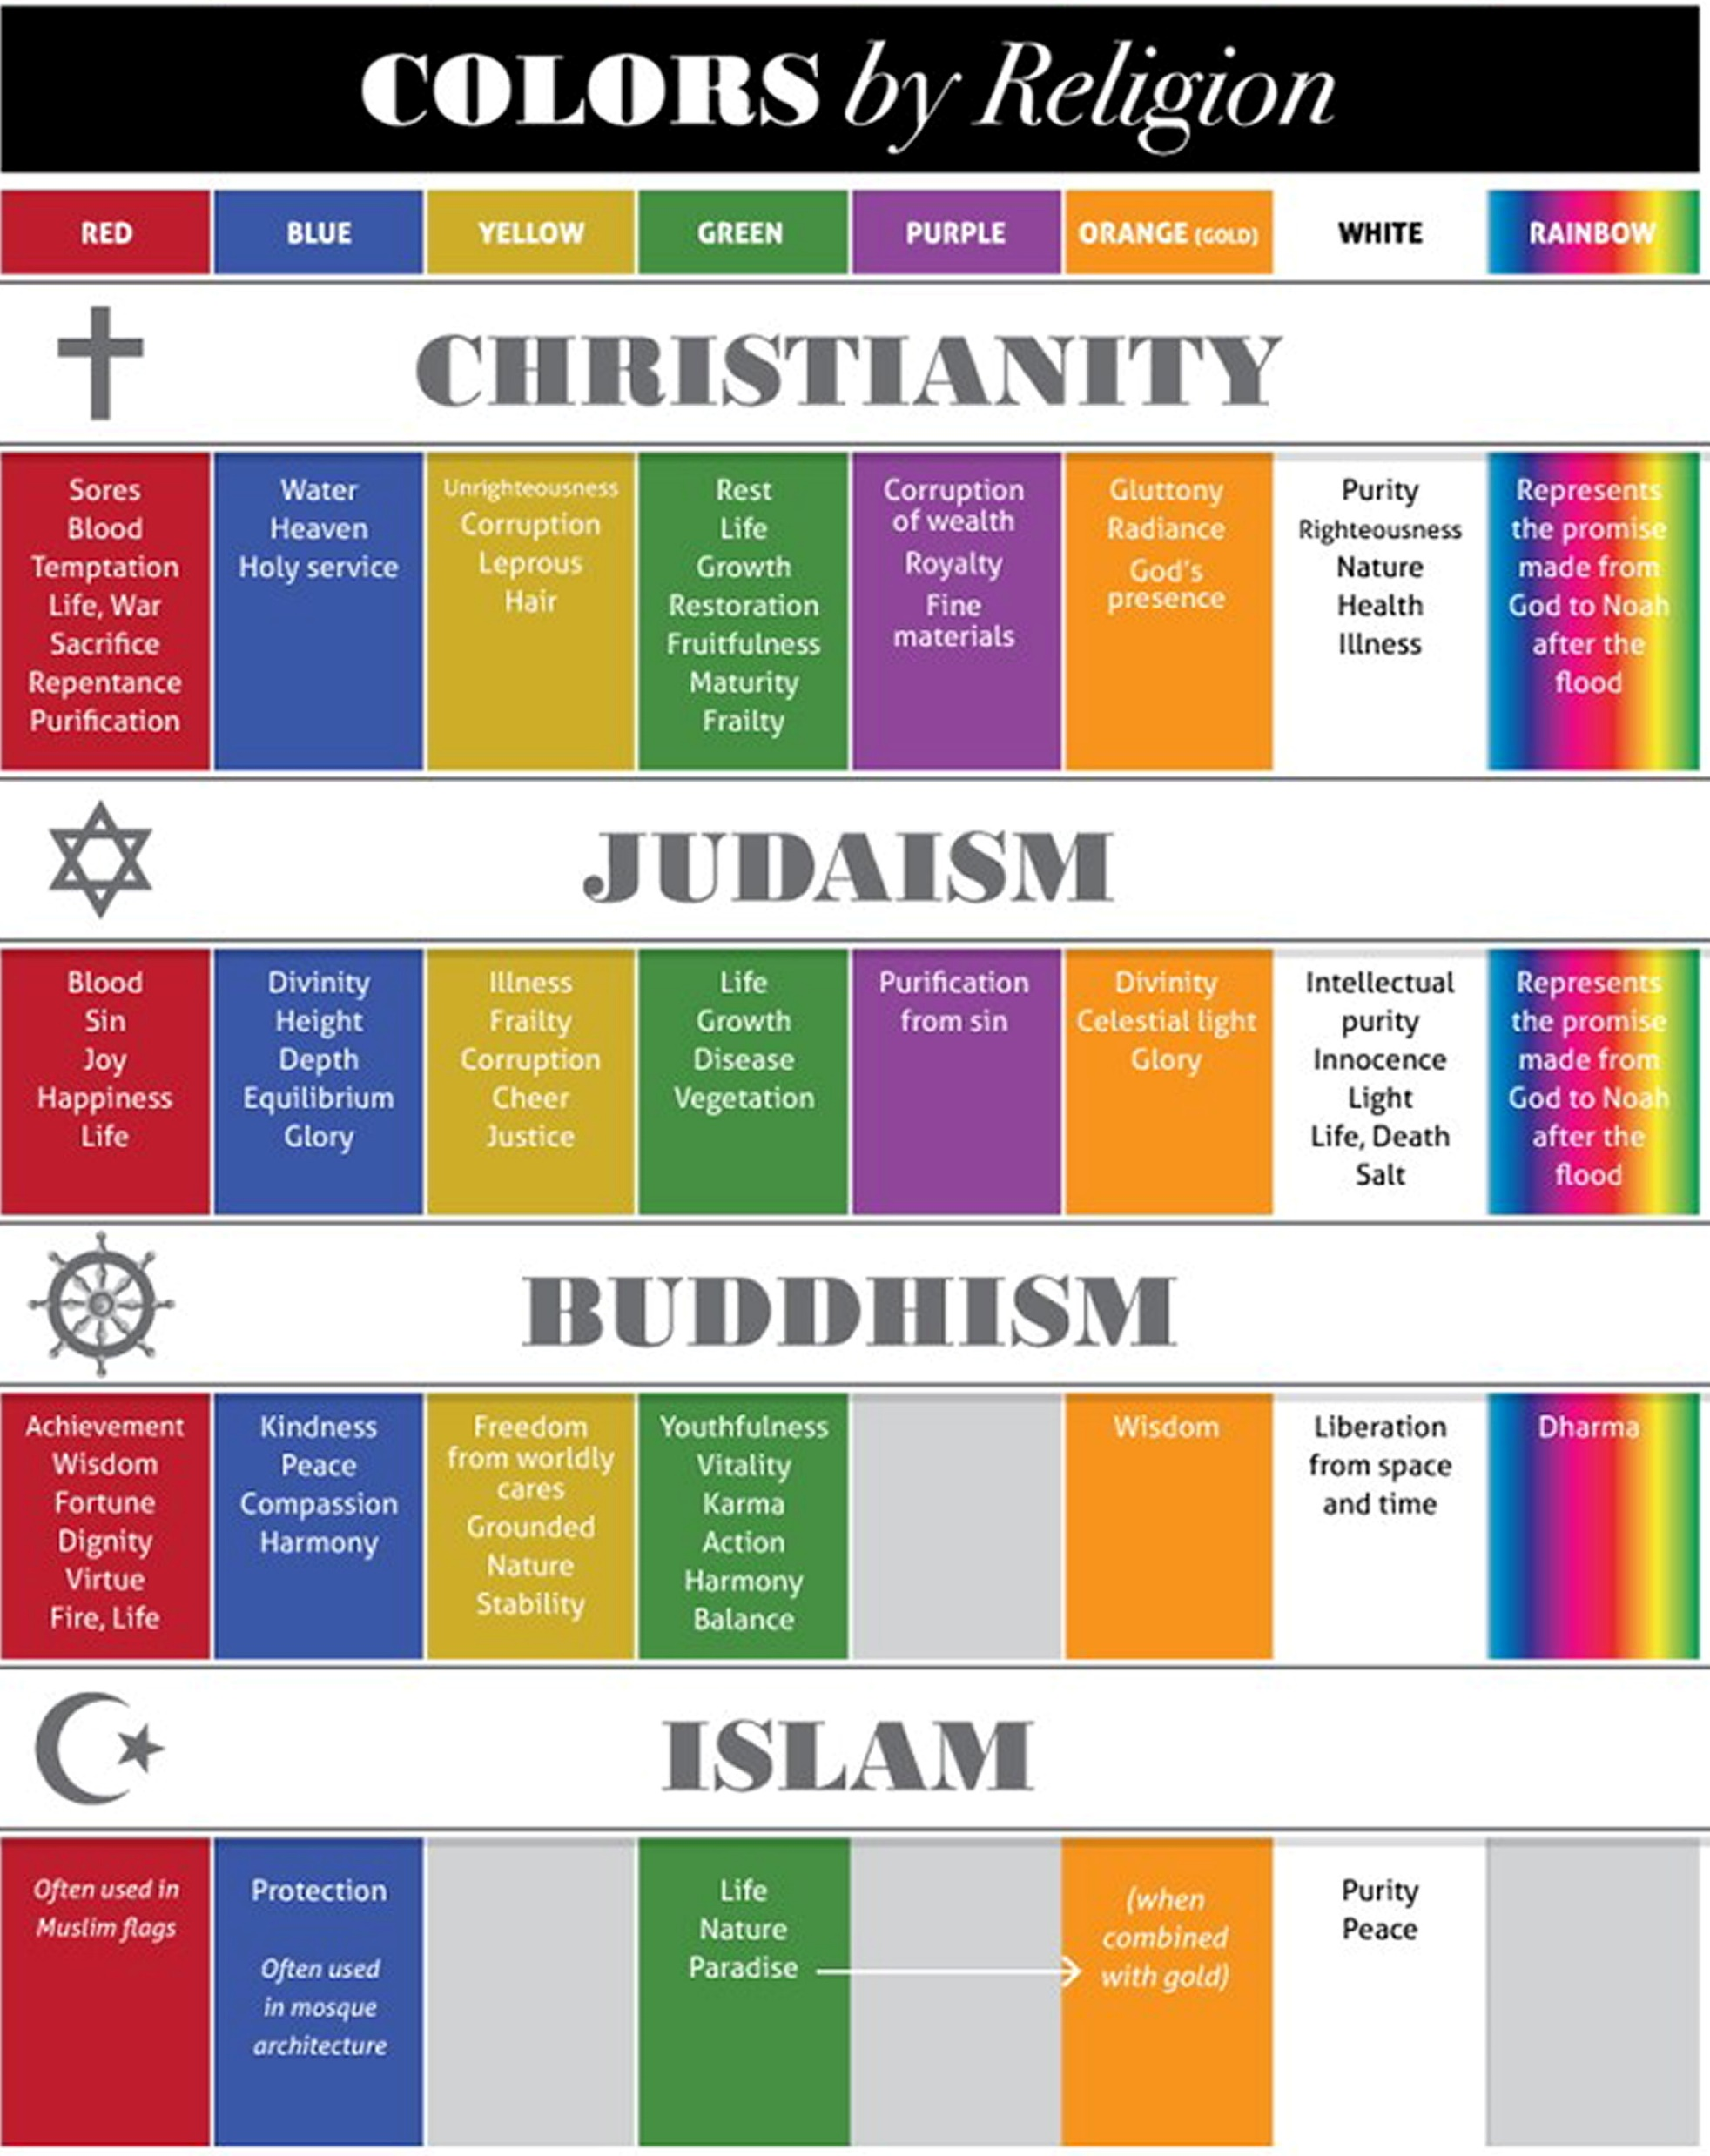
Color & Religion

Slide 28
Color In Composition
Compose around the color combinations
Adjust color (shade, tints, saturation, luminance, temperature) to establish a mood or meaning
Tailor your image for a particular religious or cultural audience

Slide 29
Homework & Next Meeting
Homework
Bring up to 4 color photos and discuss how you consciously; used color in your composition; used color to convey a meaning or mood; or used color to tailor you image to a particular audience.
Next Meeting
Sunday, March 13th
2 - 4PM
Joan Tilton – Creative Travel Photos
In-Person or Zoom TBD

