Slide 1
Future Flood Event
2019 Mega Flood CA Central Valley
Atmospheric River leads to flood of record on multiple tributaries
Levee failures equal widespread flooding of rural areas, small communities, and urban areas in the California Central Valley
2017 CVFPP identifies 1.3 million people at risk in floodplains protected by SPFC faclitites*
$80 billion in damageable property at risk*
*CVFPP 2017 Update

Slide 2
Potential External Review Panel Categories for Findings
Land Use
Operation and Maintenance
Delays in implementation of improvements
Evacuation

Slide 3
Land Use
Initial engineering studies identify levees protecting urban areas did not meet FEMA requirements in the 2003-2006 time frame
FEMA remaps rural areas, but largely delays the mapping of urban areas
Land use agencies continued with development in areas with known flood risk without notifying property owners or requiring flood insurance
What could have been done
Yuba County/CVFPB required disclosure to the homebuyer prior to sale and required the developer to purchase flood insurance
Land Use agency could have adopted the “Local Flood Hazard Area” designation until levee improvements were completed

Slide 4
Operations and Maintenance
The CVFPP identifies that approximately $60 million is needed annually in order to maintain Water Code 8361 facilities - $30 million is the amount that has been appropriated in the recent past
ESA and CEQA exacerbate the deferred maintenance
GGS concerns are preventing grouting burrowing rodent holes
Vegetation management in the Bypass system
Multiple LMAs for some hydraulic basins
Encroachments

Slide 5
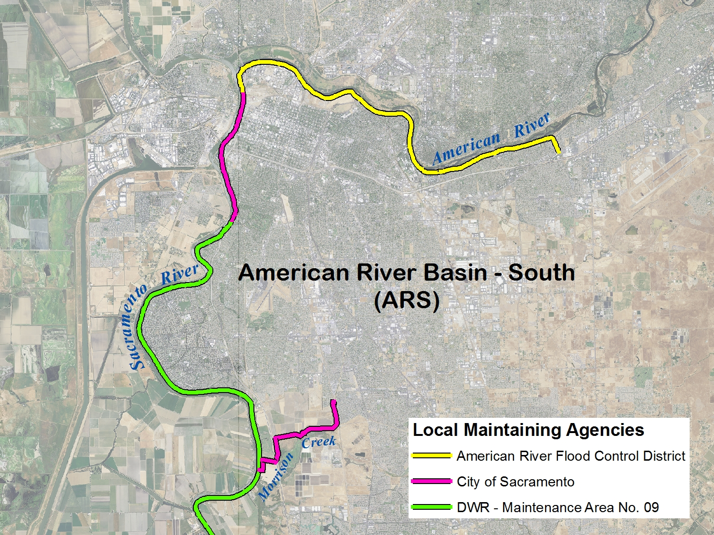

Slide 7
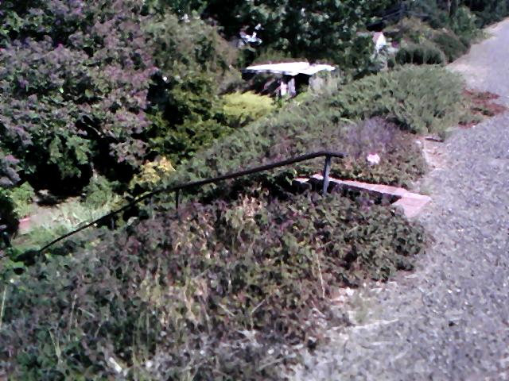

Slide 8
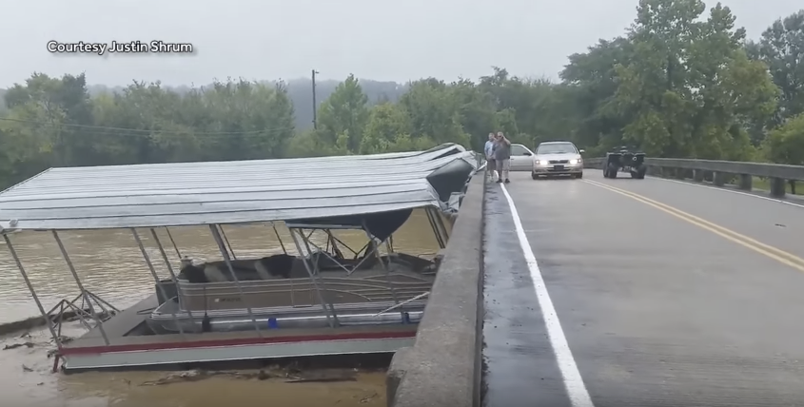

Slide 9
Delayed Project Implementation
1997 Arboga Levee Failure
Marysville
Natomas
ULOP Adequate Progress Findings
Requires urban projects to be completed by 2025
Urban Areas are relying on $4.5 - $5 billion in Federal Appropriations
Recent Federal appropriations have been $85 - $100 million annually – an appropriation of $500 million - $1 billion annually is needed to meet 2025 deadline

Slide 10
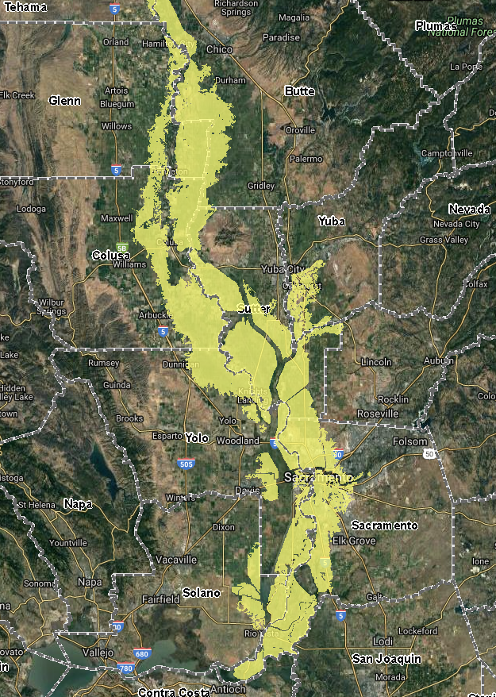
Evacuation

Slide 11
Discussion

Slide 12
Oroville Dam
“The Oroville Dam Spillway incident was caused by a tong-term systemic failure of the California Department of Water Resources (DWR), regulatory, and general industry practices to recognize and address inherent spillway design and construction weaknesses, poor bedrock quality, and deteriorated service spillway chute conditions”.
“The seriousness of the weak as-constructed conditions and lack of repair durability was not recognized during numerous inspections and review processes over the almost 50-year history of the project”.
“Although the poor foundation conditions at both spillways were well documented in geology reports, these conditions were not properly addressed... and all subsequent reviews mischaracterized the foundation as good quality rock”.
“Decisions were made with the best of intentions, but against the advice of civil engineering and geological personnel, who had by then recognized the poor bedrock conditions and the potential for unsatisfactory performance of the previously untested emergency spillway”.
“There were many opportunities to intervene and prevent the incident, but the overall system of interconnected factors operated in a way that these opportunities were missed”.
Independent Forensic Team Report, Oroville Dam Spillway Incident, January 5, 2018

Slide 13
Hurricane Katrina
“...the decades leading up to the Katrina disaster bore witness to a pattern of decisions in which compromises in the safety and reliability of the New Orleans levee system were made for reasons having to do with cost, scheduling, or political pressure”.
“Additional problems brought to light in [post-disaster] assessments of the hurricane protection system include failures of coordination on the part of federal, state, and local agencies; the absence of a central authority with responsibility for the system; a poor funding mechanism and pressures from government to lower design standards to increase affordability; and the failure of city disaster planners to mitigate the risk with more effective evacuation procedures”.
The Lessons of Katrina, ASCE, July 1,2015
“...two direct causes of the levee breaches [were] collapse of several levees with concrete floodwalls ... because of the way they were designed, and overtopping, where water poured over the tops of the levees and floodwalls and eroded the structures away. Furthermore, the many existing pump stations that could have helped remove floodwaters were inoperable...”
“With the beneﬁt of hindsight, we now see that questionable engineering decisions and management choices, and inadequate interfaces within and between organizations, all contributed to the problem”.
“...the levees were not armored or protected against erosion – an engineering choice of catastrophic consequences...”
“One of the most glaring results of not taking risk into account in the design and construction of the hurricane protection system is this: the consequence of failure — catastrophic loss of life— did not seem to be acknowledged”.
The New Orleans Hurricane Protection System: What Went Wrong and Why, ASCE, 2007

