Slide 2
Eagle Project Guide Red Bear ( David Bowery ) BsaEagleProject@Cox.net 918-857-3561 Cell 918-838-4238 Land BsaEagleProject.ORG

Slide 4
2021 Indian Nations Council SCOUTS BSA LIFE TO EAGLE SEMINAR
THE EAGLE SCOUT SERVICE PROJECT

Slide 5
PURPOSE
OF AN
EAGLE PROJECT?
WHAT IS THE
5

Slide 6
Purpose:
Help a Deserving Organization
Gain Useful Skills
Accomplish Something Important
DEMONSTRATE LEADERSHIP
6

Slide 7
Requirement #5
A Scout Must:
Plan, Develop, and Give Leadership to others in a Service Project.
The Project Must be Helpful for a:
Religious Institution,
School, or
Community Organization
7

Slide 8
Requirement #5
Scouts must use the BSA Eagle Scout Service Project Workbook.
The Project Proposal must be approved before any work is started.
8

Slide 9
How to start?
Project Ideas:
Build, Improve or Install something.
Organize a Drive or Community Effort.
The CBD Life to Eagle Guide (on-line) has many project ideas.
Benefiting Organizations:
Find Organizations that have sponsored Eagle Projects.
Ask what they need done.
9

Slide 10
Looking for a Project?
Think about your interests and passions.
Is there a skill you want to learn?
Consider your school, your church, your community, local parks …
Talk to your Eagle Advisor and Scoutmaster.
Ask other Eagles!
10

Slide 11
Acceptable Projects:
Require planning, development, demonstration of leadership.
Are feasible – Not too small, not too big.
Are safe for workers and the public.
Are beneficial and have a Project Beneficiary (religious, educational or community organization).
11

Slide 12
Unacceptable Projects:
Pre-planned by the beneficiary, organized or lead by others.
Routine labor or maintenance.
Benefit BSA organizations or for- profit businesses.
Primarily fundraisers.
Lack required approvals.
12

Slide 13
Obstacles to Success
Procrastination
Pessimism/Optimism
Confusion
Distractions
No schedule or timeline
No follow through
Failure to communicate
10

Slide 14
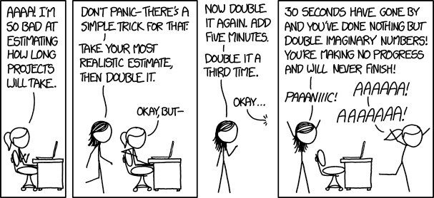
Don’t Panic!
11

Slide 15
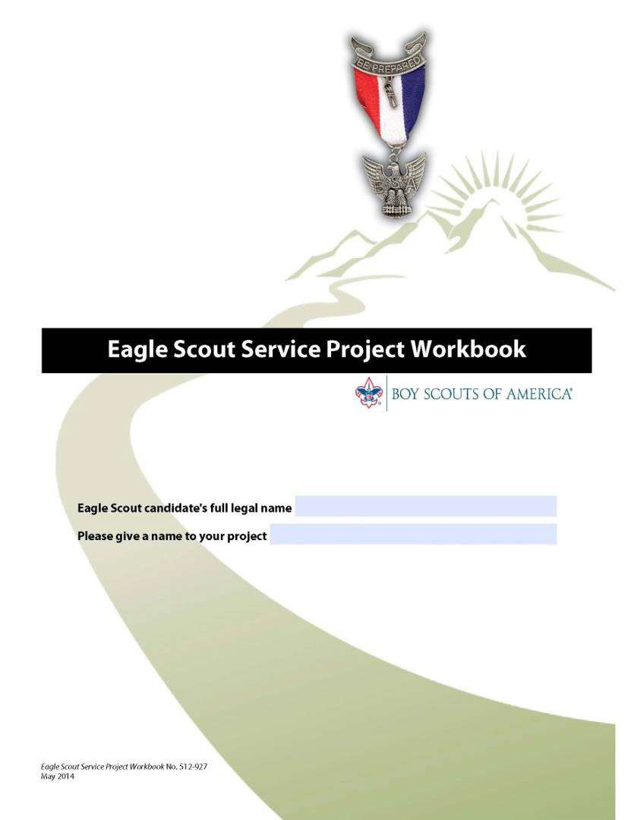
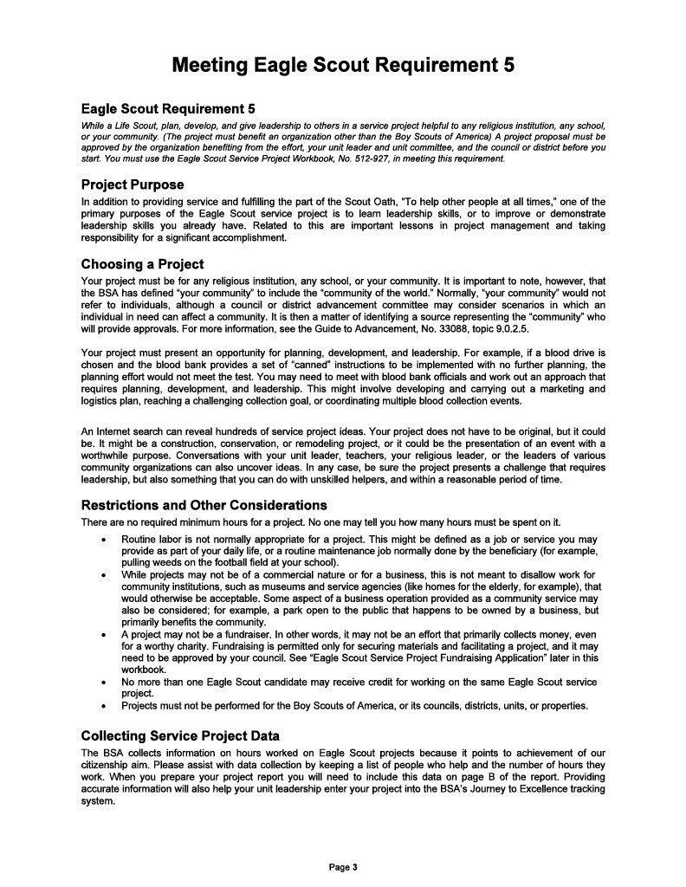
The Project Workbook
Publication No. 512-927 Jan. 2021

Slide 16
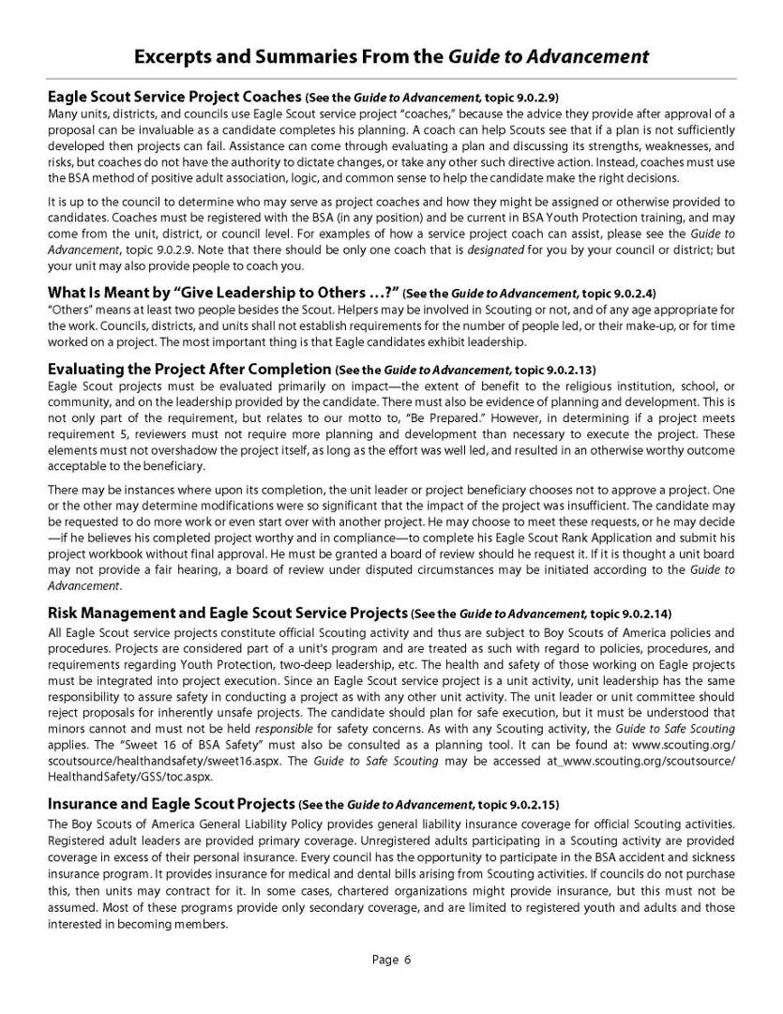
The Workbook
Publication No. 512-927 Jan. 2021
Fillable and Expandable PDF
Available online: BsaEagleProject.orgwww.scouting.org
Must read and use entire workbook

Slide 17
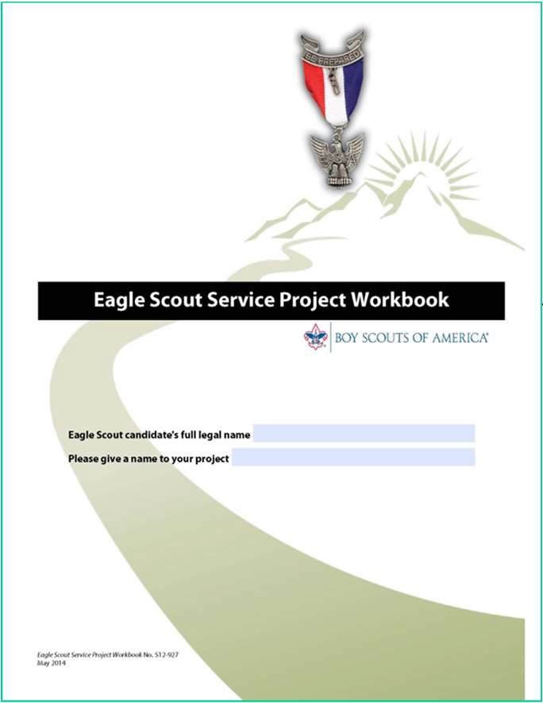
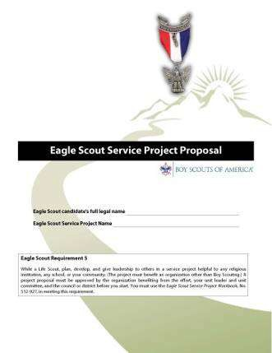
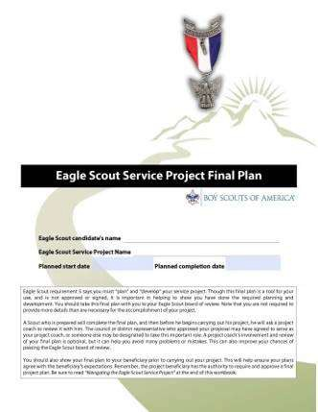
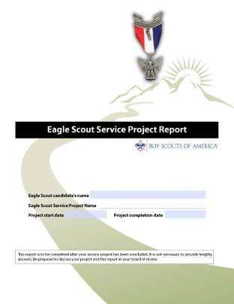
Service Project Process
Propose
Plan
Report
Do it
14

Slide 18
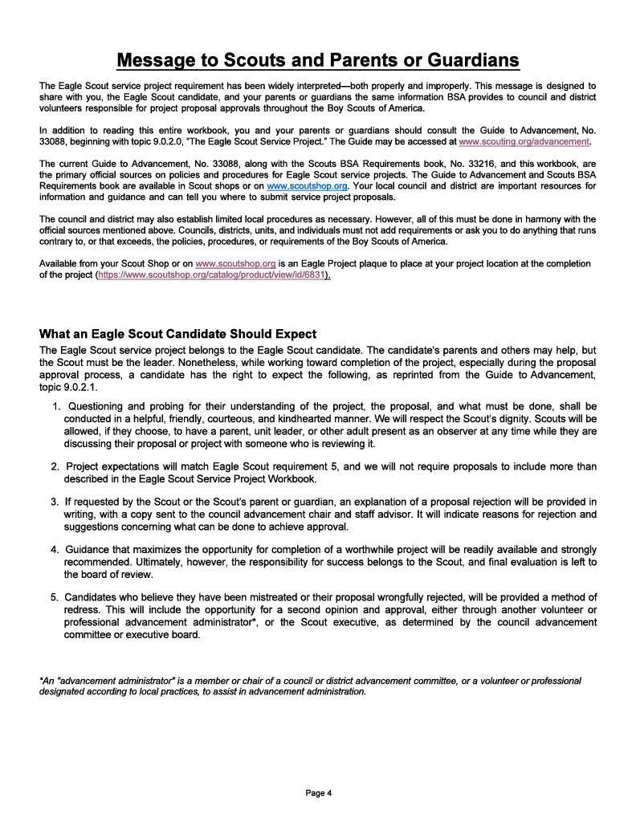
Clarifying Expectations
Important “Message to Scouts and Parents or Guardians”
Clarifies what Scouts are expected to do & what Scouts should expect from Adult Leaders
Page 4

Slide 19
Notes on Risk Management
(Page 5)
Eagle Projects are Scout activities subject to normal BSA policies and procedures.
Units must assure that projects are conducted safely and standard practices for Youth Protection and Two-Deep Leadership are followed.
The “Guide to Safe Scouting” applies.

Slide 20
Track Your Time!
All time spent on your project should be tracked and reported!
Use a notebook or computer spreadsheet as a project diary. Record:
Date, start and stop time, elapsed time and describe what you did.
Include:
Time spent on research, discussions, phone calls, Workbook entries.
Time spent preparing for and conducting the project.
Time of others who are helping you.
It all counts as project time.

Slide 21
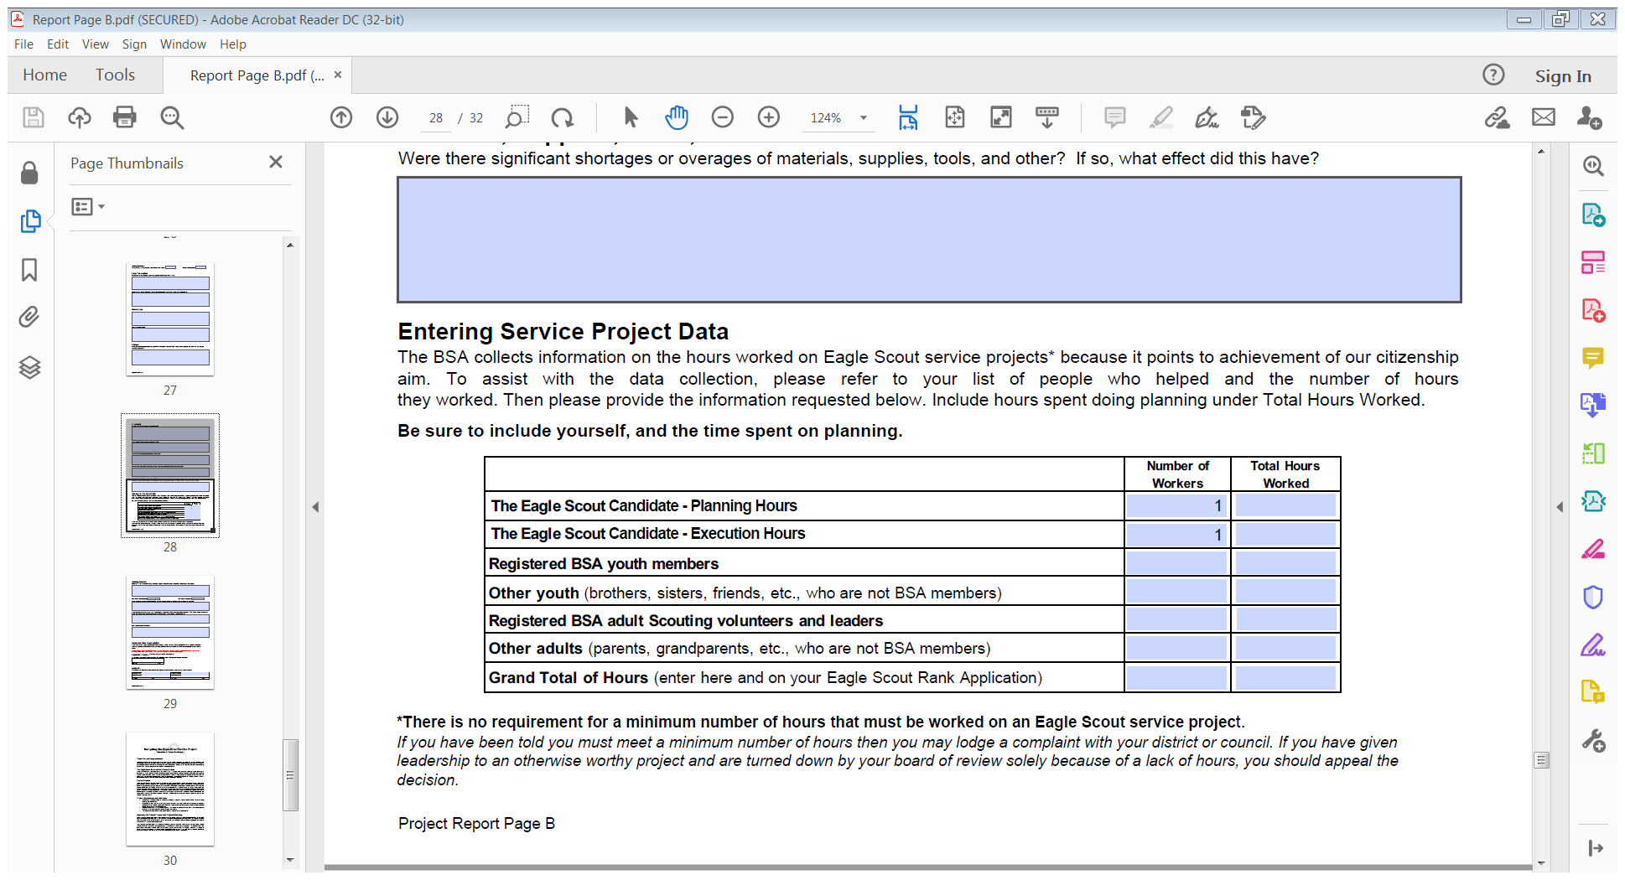
Track Your Time!

Slide 22
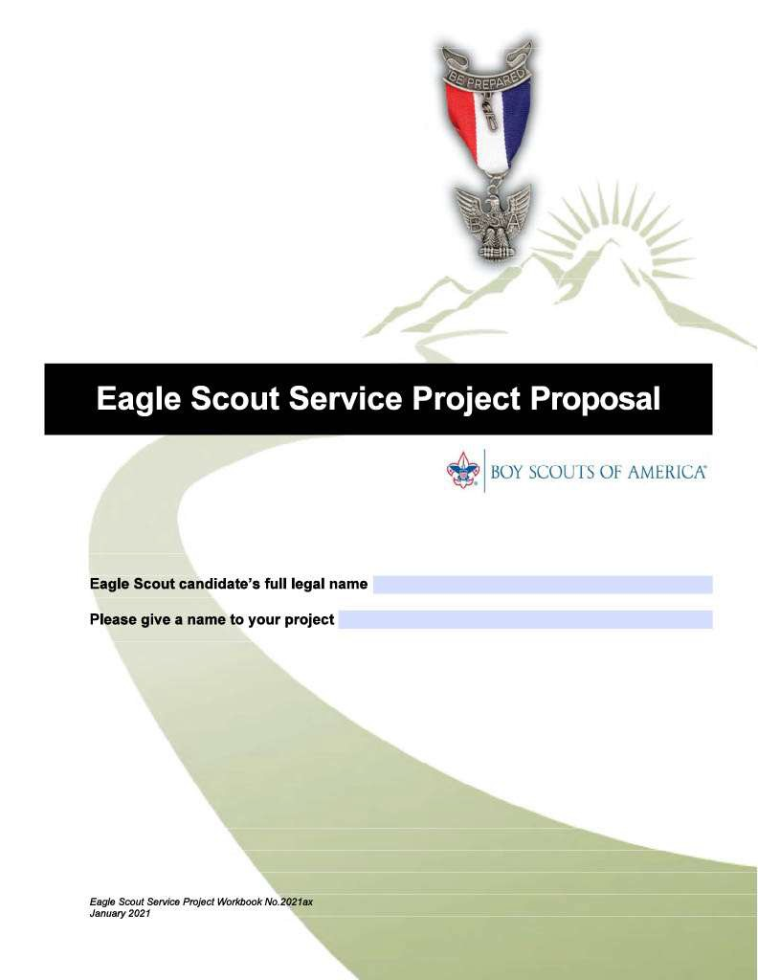
PROJECT PROPOSAL

Slide 23
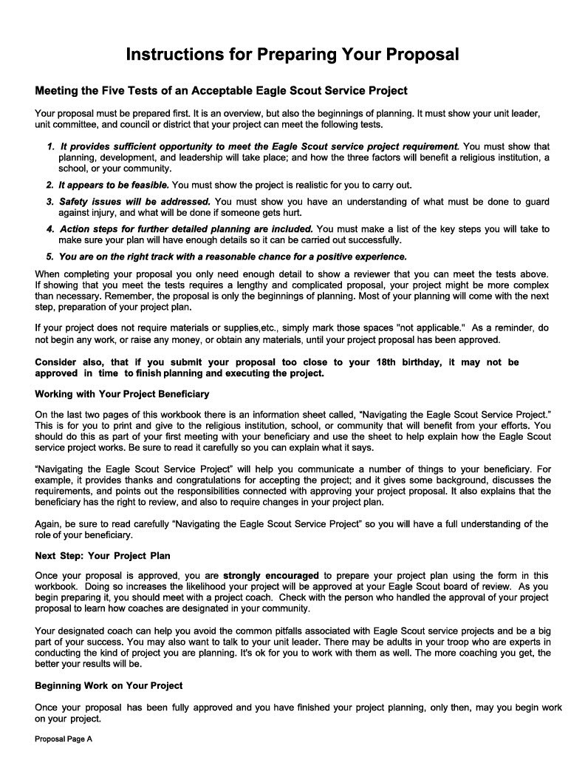
Proposal Page A
Instructions for Completing Proposal
Must Read Carefully
Note the Five Tests of an Acceptable Project
Understand how to work with your Project Beneficiary
The Proposal is a First Step. The Project Plan is the Next Step
No project work until Proposal and Planning are complete

Slide 24
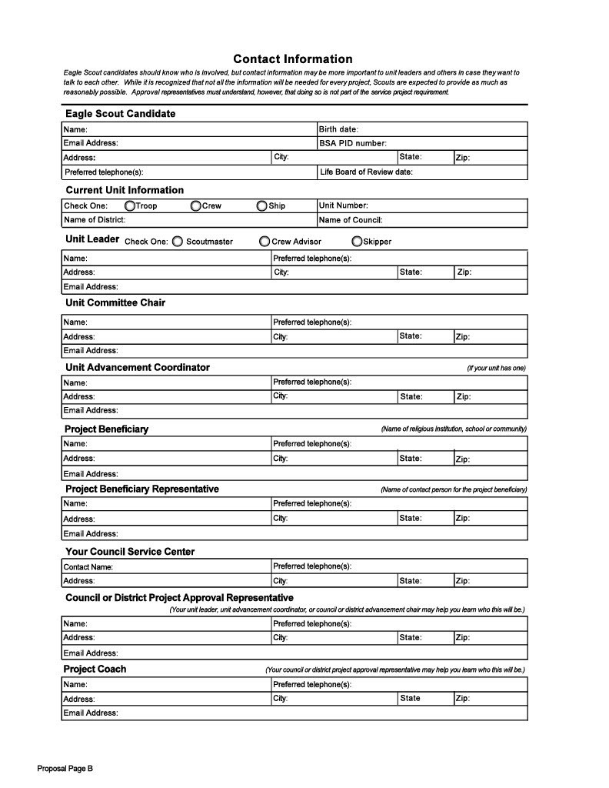
Proposal Page B
Contact Information
Your Info
Unit Info
Unit Leader
Committee Chair
Advancement Coordinator
Project Beneficiary
Beneficiary Rep.
Council Service Center
District Eagle Rep.
Project Coach
Information you will need as you develop your project.
20

Slide 25
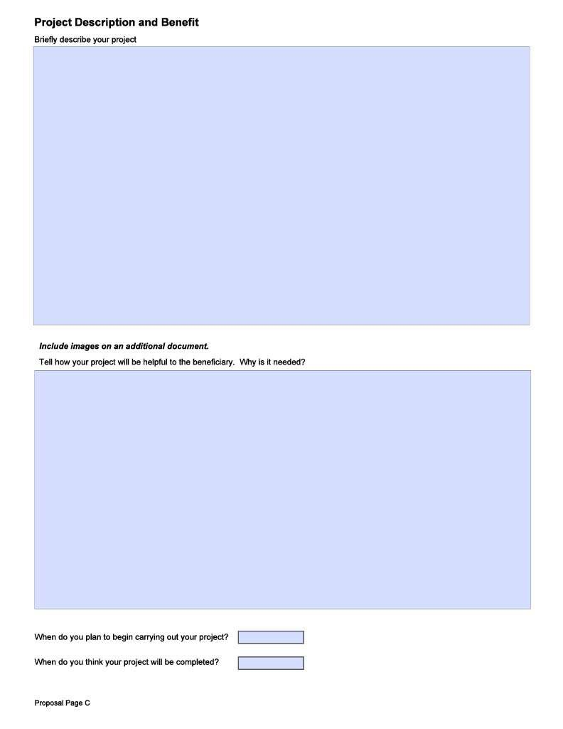
Proposal Page C
Project Description
Add Pictures, Drawings, Diagrams etc. (as separate document)
Describe Needs & Project Benefits
Start and End Dates

Slide 26
Photographs
Photos are a great way to document your project.
Proposal photos show conditions before the project was done.
Assign someone to take photos of the project in progress.
Take photos after the project is complete.
Captions are very helpful!

Slide 27
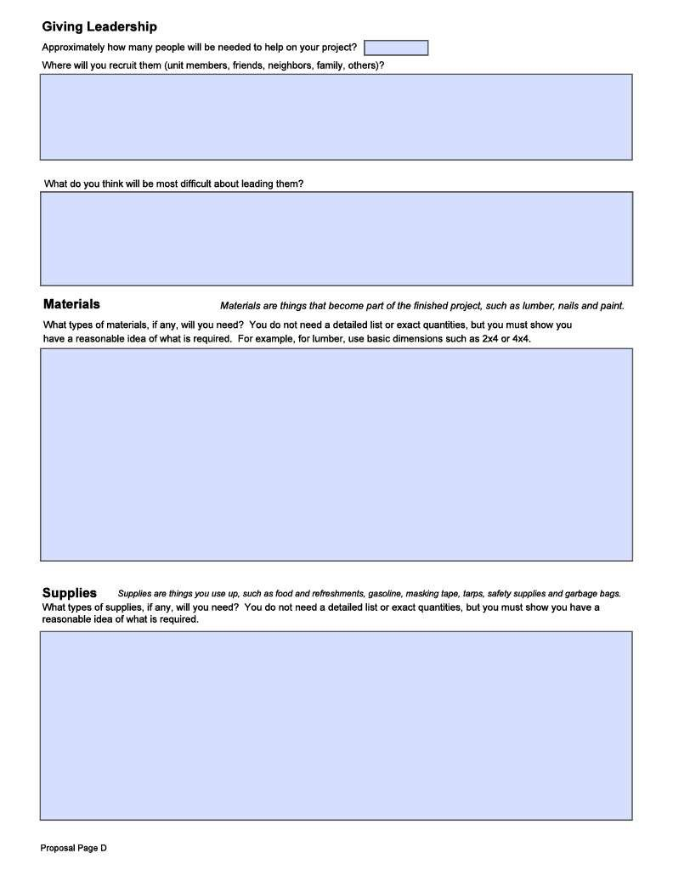
Proposal Page D
Giving Leadership – Work Crew and Challenges
Materials Needed
Supplies Needed

Slide 28
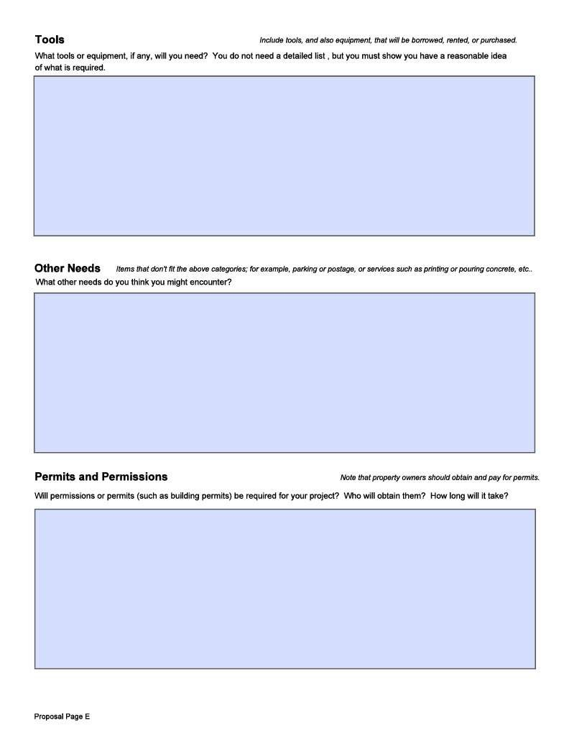
Proposal Page E
Tools Needed
Potential Other Needs
Permits & Permissions

Slide 29
Fundraising & Contributions
The project purpose may not be to raise funds (money).
Projects may collect donations (things) for a charitable purpose.
Fundraising is permitted to support your Eagle Project.
No approvals are required to raise less than $500.
There is no limit for fundraising or contributions from:
The beneficiary
The candidate’s family or relatives
The candidate’s unit or chartered organization
Parents or members of the candidate’s unit

Slide 30
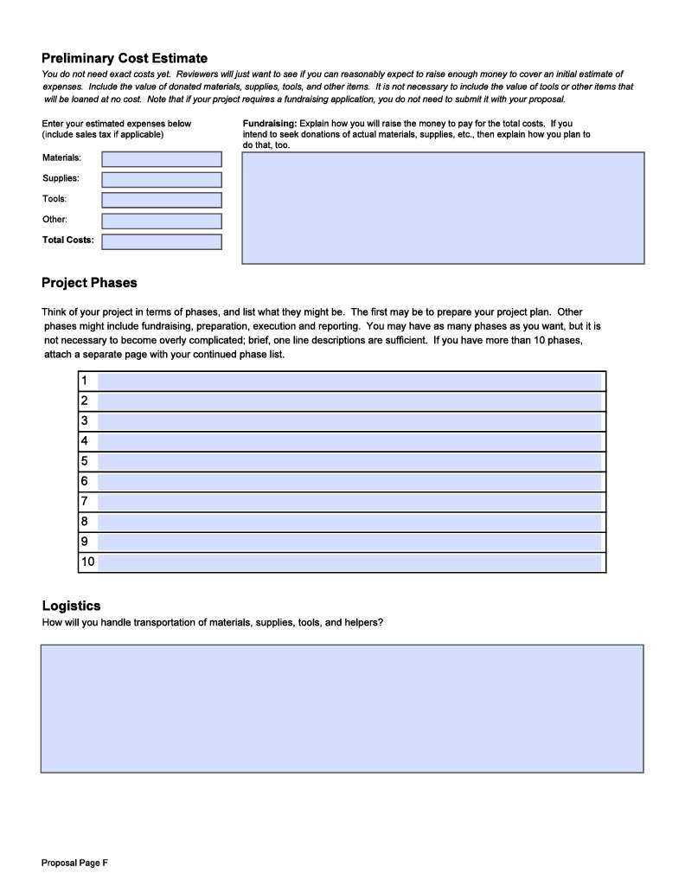
Proposal Page F
Prelim Cost Estimate (and Fundraising)
Project Phases (Include activities to prepare for the project)
Logistics (Transportation and coordination)

Slide 31
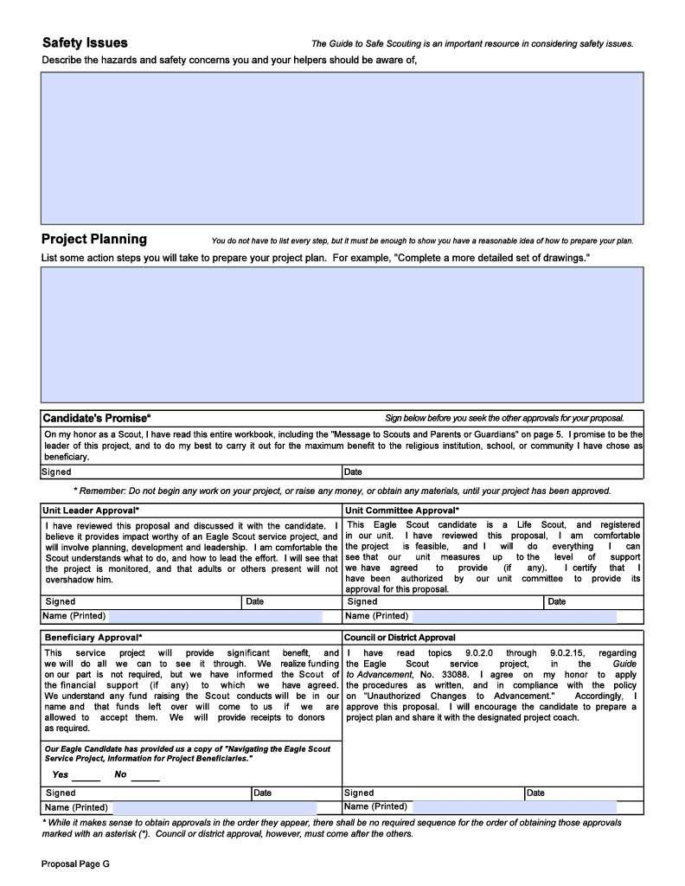
Proposal Page G
Safety Issues and mitigation
Additional Detailed Planning
Candidate’s Promise and Signature
Approval Signatures

Slide 32
Proposal Page G Candidate’s Promise
“On my honor as a Scout,
entire workbook, including the "Message to Scouts and Parents or Guardians" on page 5. I promise to be the leader of this project, and to do my best to carry it out for the maximum benefit to the religious institution, school, or community I have chosen as beneficiary.”
I have read this
Do not begin any work on your project, or raise
any money, or obtain any materials, until your
project proposal has been approved.

Slide 33
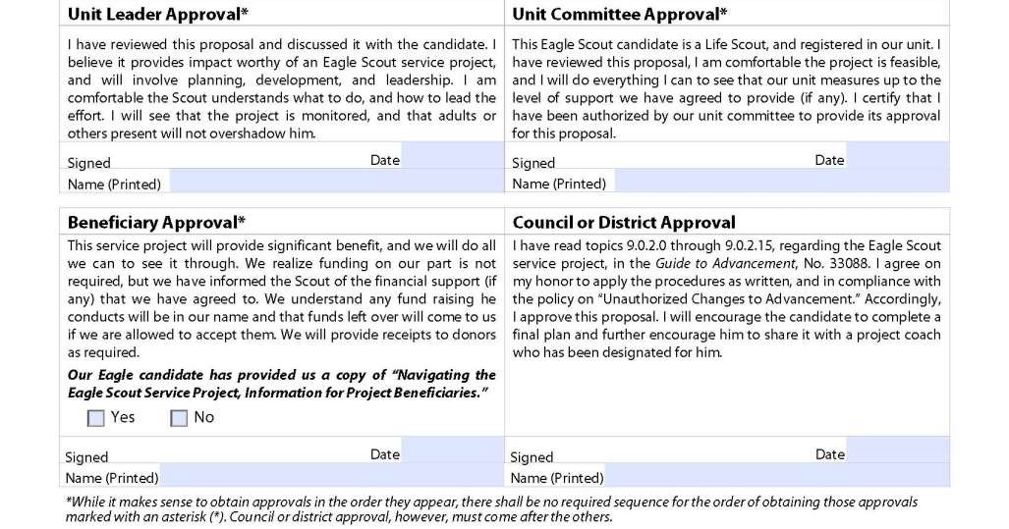
Proposal Page G Approvals
Last

Slide 34
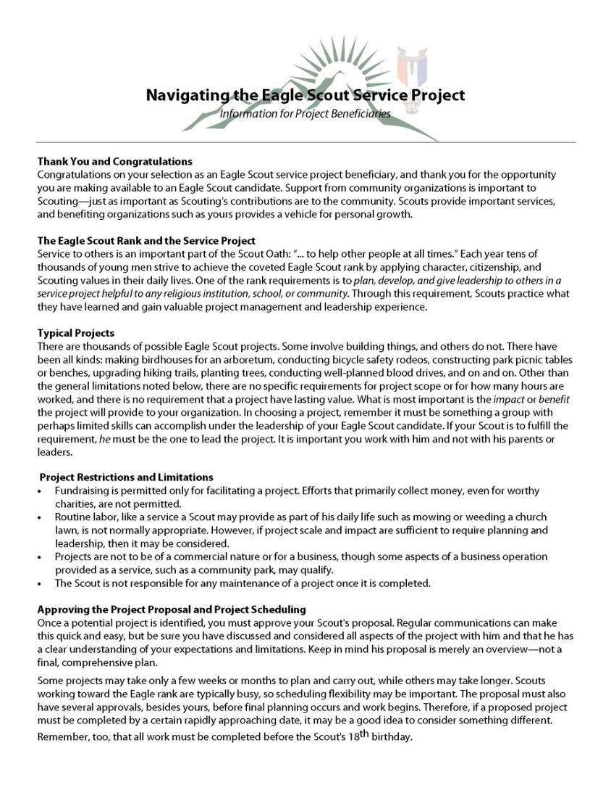
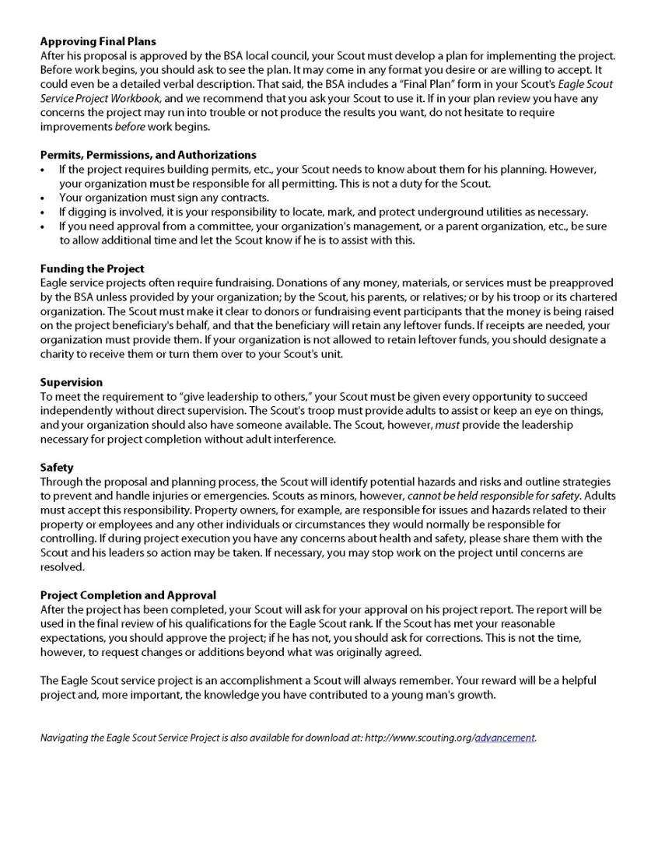
Information for Project Beneficiaries
Project Restrictions and Limitations
Approving Project Proposal and Scheduling
Approving the Project Plan
Supervision and Safety
Project Completion and Approval
30

Slide 35
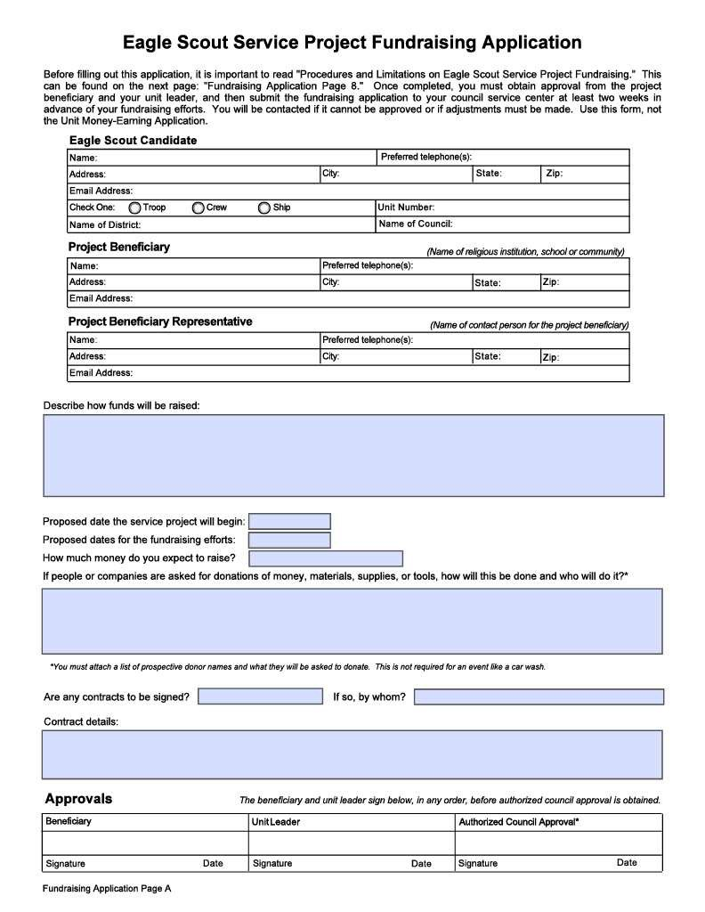
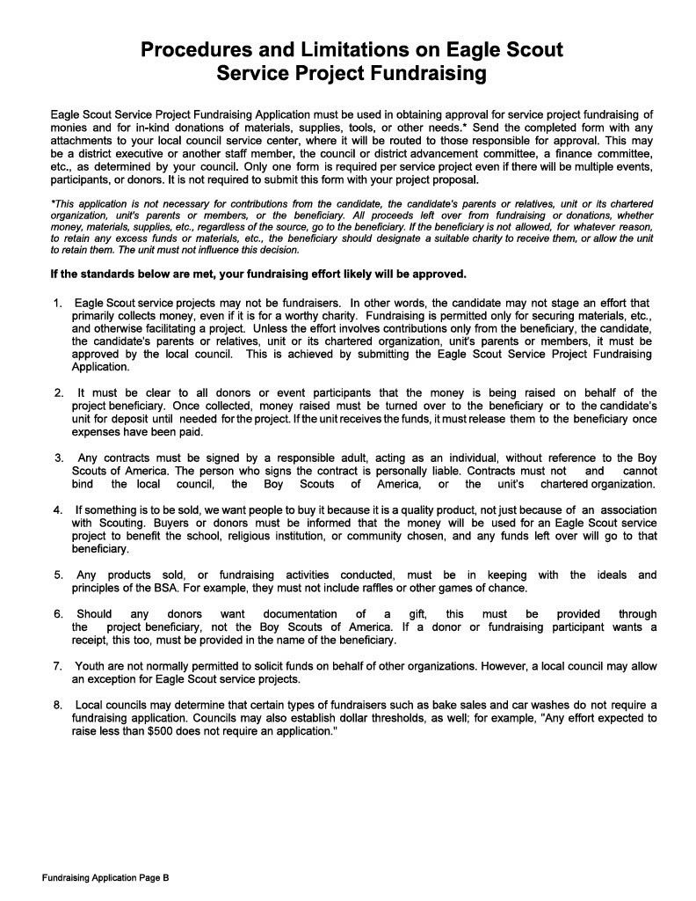
Fundraising Application Pages A & B
Form must be completed if more than $500 is to be raised from “outside” sources.
Donations of goods or materials do not require this form.

Slide 36
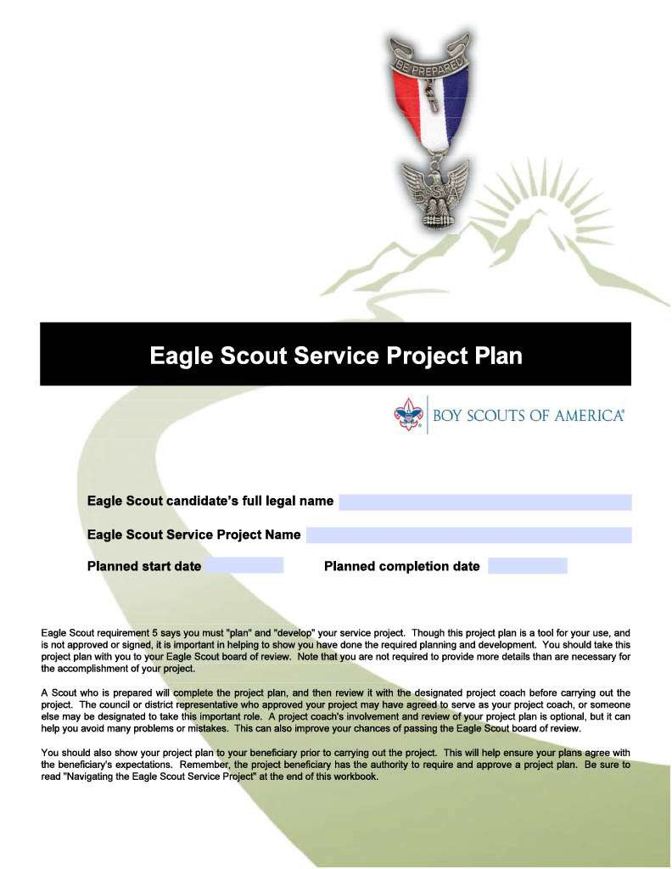
PROJECT PLAN

Slide 37
The Workbook States:
“A Scout who is prepared will complete the project plan, and then review it with the designated project coach before carrying out the project.”
“This can also improve your chances of passing the Eagle Scout board of review.”

Slide 38
Mike Tyson once said…
“Everyone has a plan until they get punched in the mouth…”
What does that mean?
In life, unexpected things happen. A good plan anticipates difficulties and has contingency options.

Slide 39
What is Planning?
5 P’s: Proper Planning Prevents Pitiful Performance.
What could go wrong? How will you make sure it doesn’t happen?
Who will do what – step by step.
Provide sufficient detail so that:
You and the beneficiary understand how and what things will be done.
You can explain it to everyone.
Your project will be successful.

Slide 40
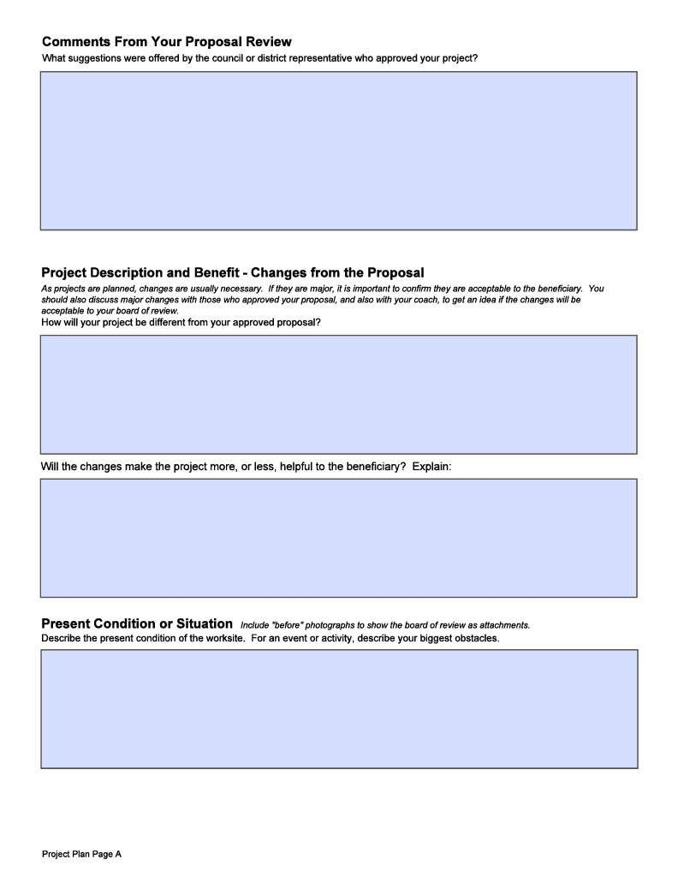
Project Plan Page A
Comments from your proposal review
Completed following Proposal Approval
Project Description and Benefit – Changes from the proposal
Explain impact of any changes
Present Conditions or Situation - What will be changed by the project?

Slide 41
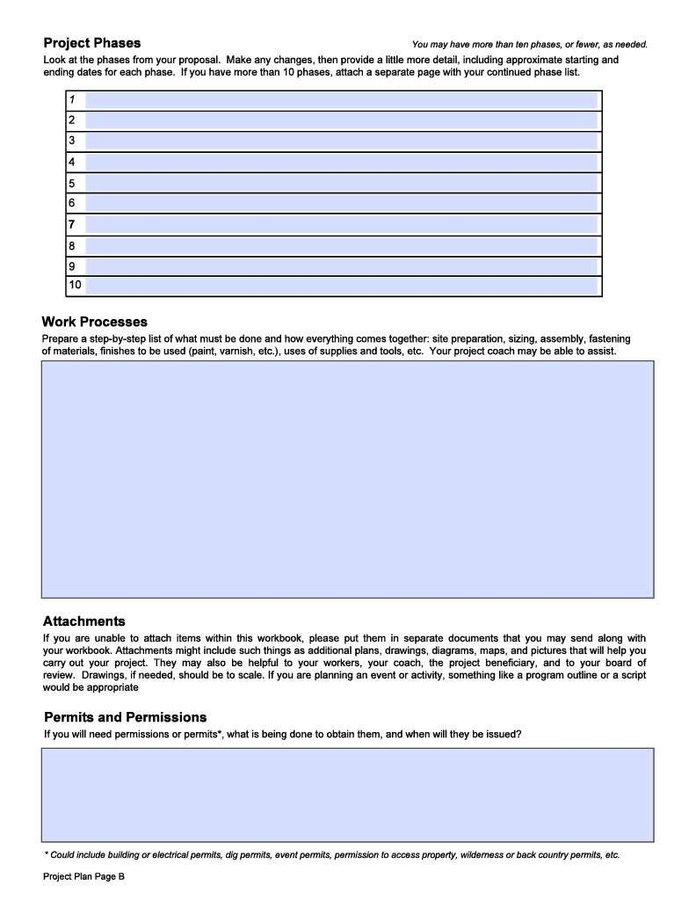
Project Plan Page B
Project Phases – Sequence details
Work Processes Step by Step
Attachments (Lists, diagrams, maps, drawings, photos, project
documents, etc.}
Permits and Permissions

Slide 42
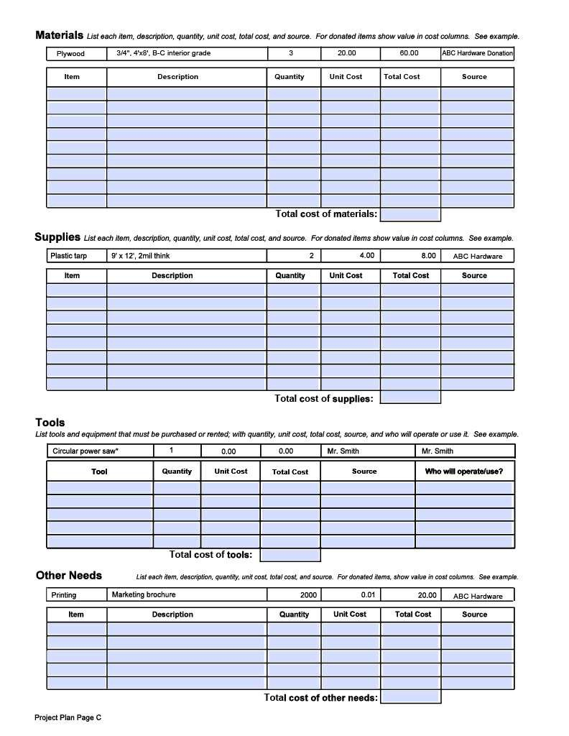
Project Plan Page C
Materials Itemized with costs and
provider
Supplies Itemized with costs and
provider
Tools Itemized with costs, provider & operator
Other Needs Items or conditions

Slide 43
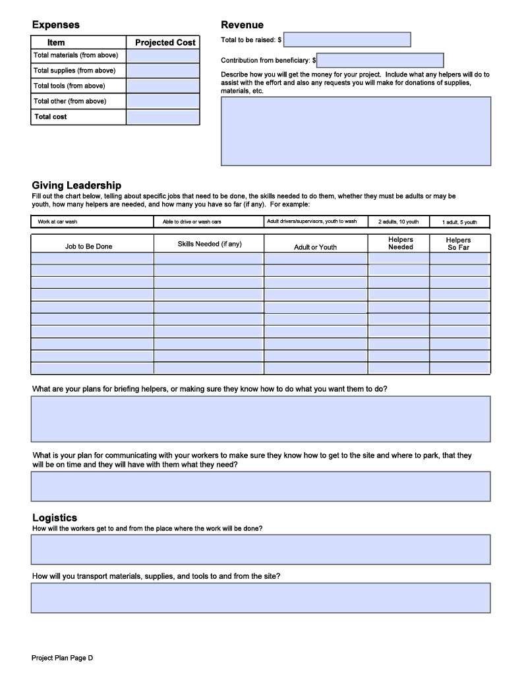
Project Plan Page D
Expenses & Revenue Totals by type
Giving Leadership
Staffing by task - Who will do what?
Describe your “Leadership Team”
Your “Training Plan”
Your “Communication Plan”
Logistics
Transporting workers
Transporting materials

Slide 44
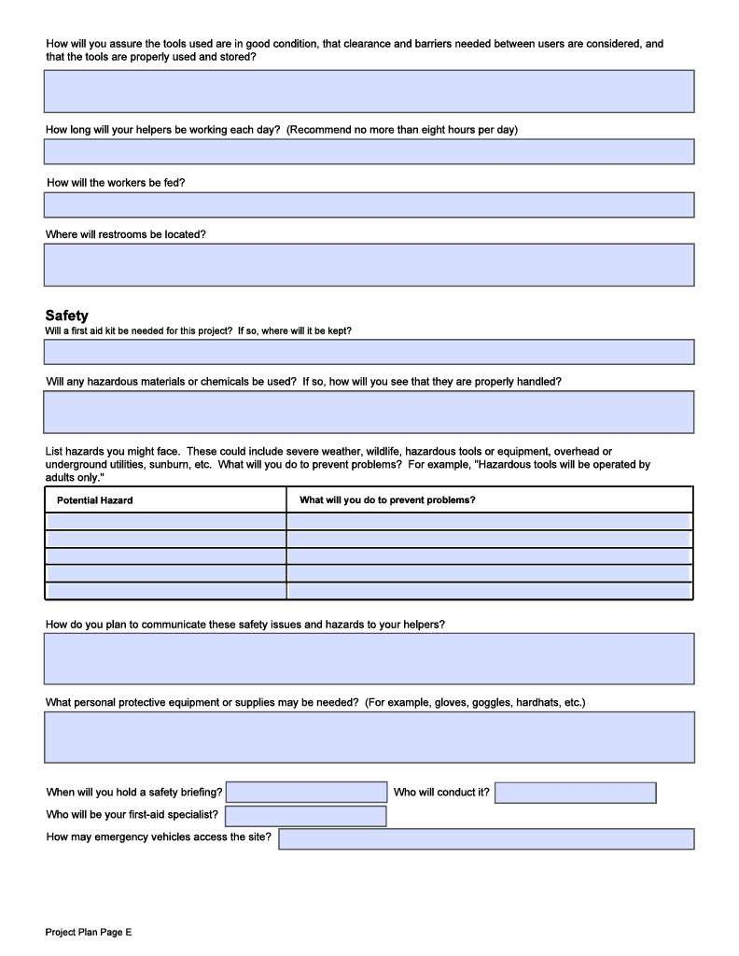
Project Plan Page E
Logistics
Tool use and safety
Work Schedules
Food and restrooms
Safety
Potential hazards and proposed mitigation
Safety communication
Safety equipment
Safety briefings
Emergency access
40

Slide 45
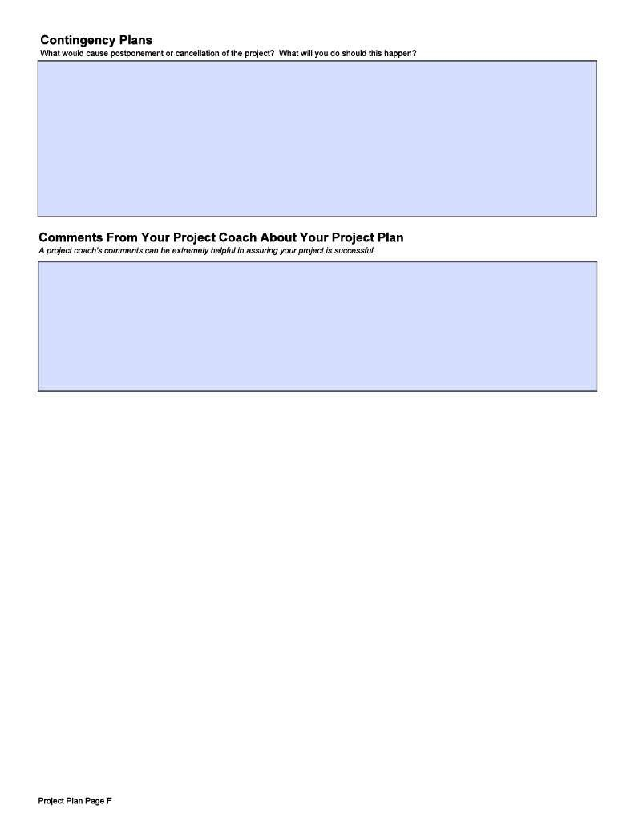
Project Plan Page E
Contingency Plans What if…
Review Comments From Your Coach

Slide 46
Beneficiary Review
The Workbook states:
“You should … show your project plan to your beneficiary prior to carrying out your project.”
“Remember, the project beneficiary has the authority to require and approve a project plan.”

Slide 47
Project Changes
Many projects require some changes from the approved Proposal.
Changes could include improvements.
If a major change is necessary, notify the Proposal approvers. Re-approval may be necessary.
43
GTA Para 9.0.2.7; page 65

Slide 48
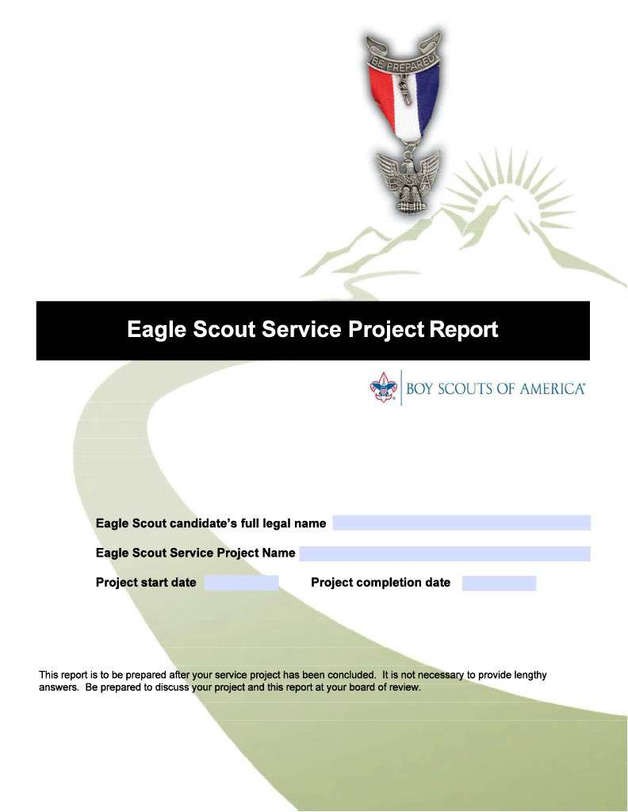
PROJECT REPORT

Slide 49
Project Leadership
The Eagle candidate must be the project leader.
Others must be involved so you can demonstrate leadership.
Don’t permit adults to highjack your project. They should direct their suggestions to you for consideration.

Slide 50
Completing The Project
Complete the Project Report ASAP – while your memory is fresh.
The Candidate and Beneficiary must agree that the work is complete.
The completion date will be entered on your Eagle Scout Rank Application (ESRA)

Slide 51
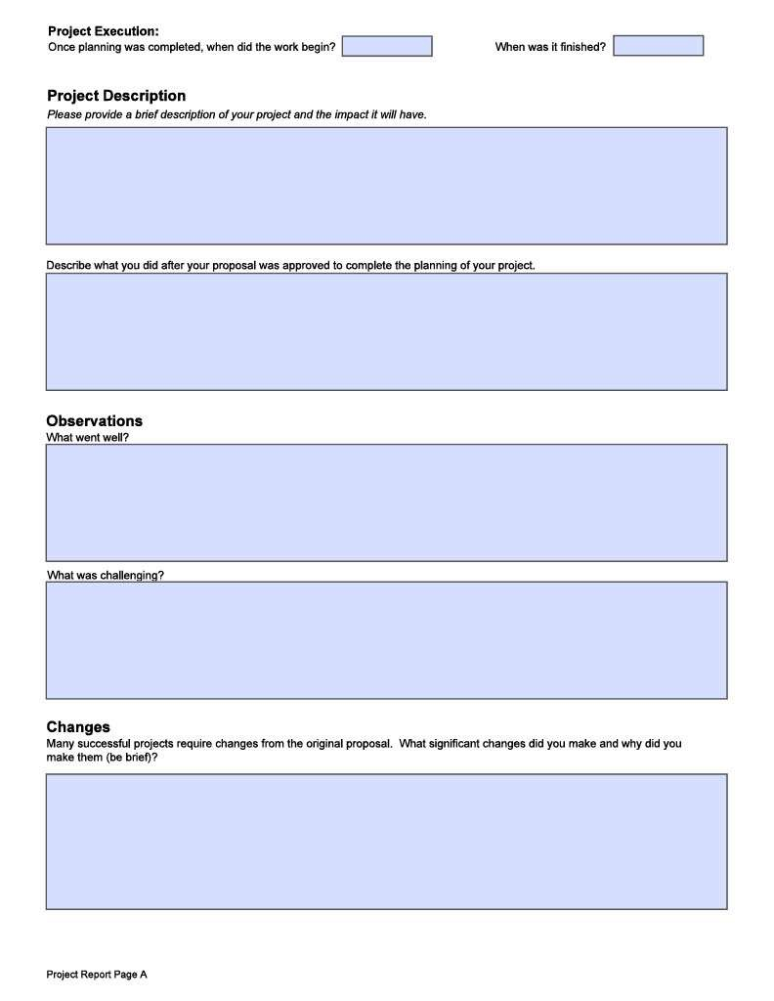
Project Report Page A
Project Execution
Project Description
What was actually done
Describe your planning process
Observations
What went well?
What challenges were encountered?
Changes
Positive, neutral, negative

Slide 52
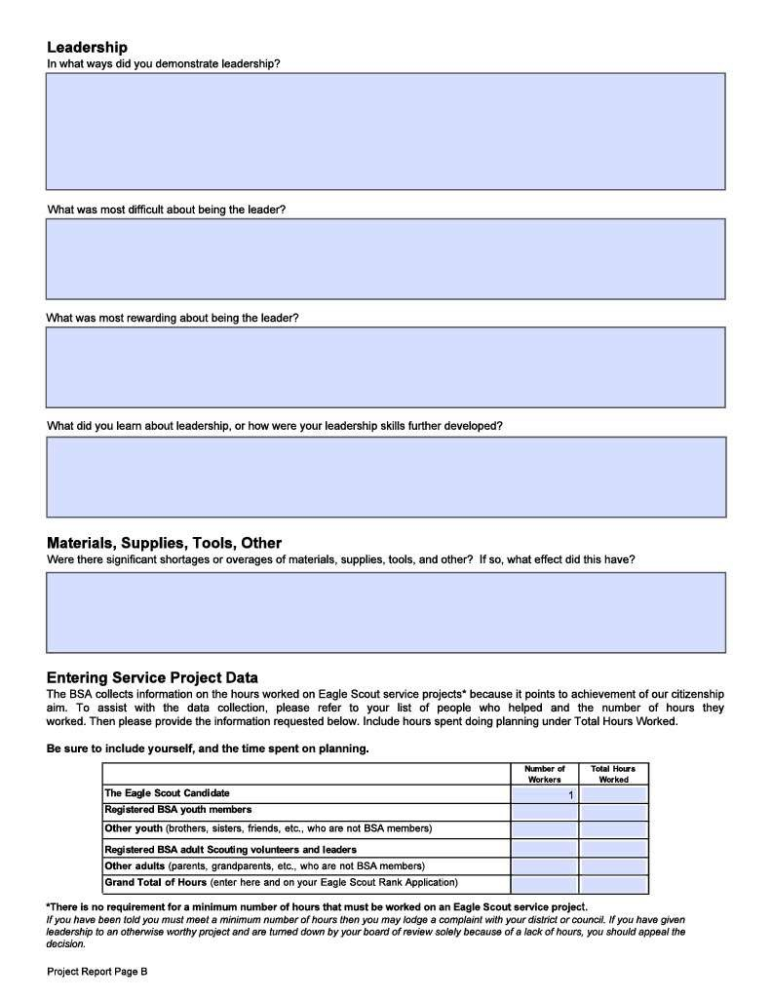
Project Report Page B
Leadership:
Demonsatrated?
What was: Most Difficult?
Most Rewarding?
What did you learn?
Materials, Supplies, &Tools
Too much? Too little?
Service Project Data:
Number of workers
Hours worked

Slide 53
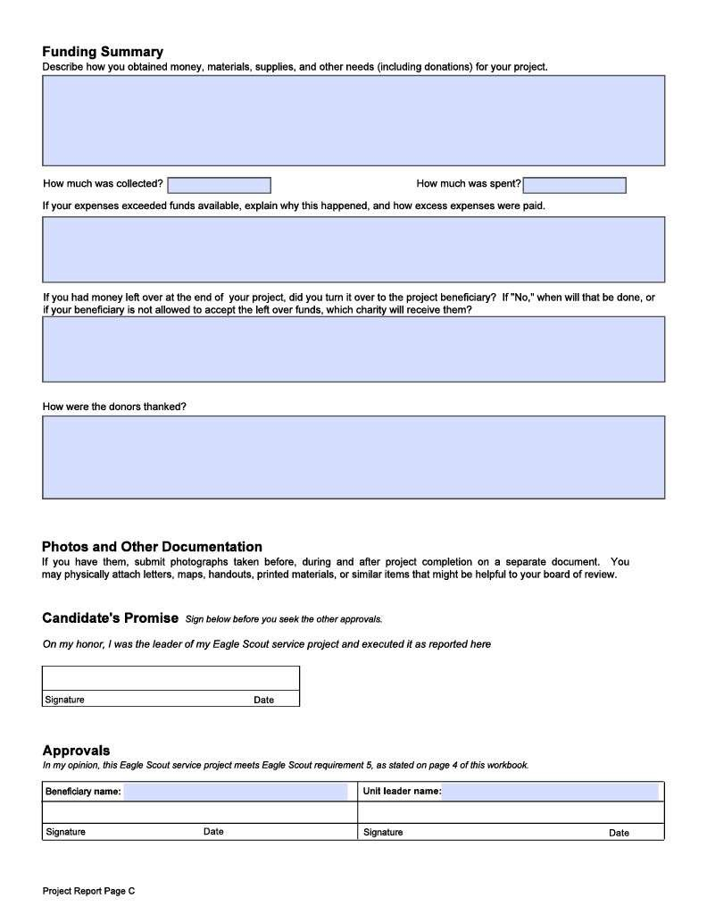
Project Report Page C
Funding
Funds and materials collected
Sufficient?
Excess?
Acknowledgments?
Attach Photos and Other Project Documents
Candidate’s Promise
Completion Approvals
Beneficiary
Unit Leader

Slide 54
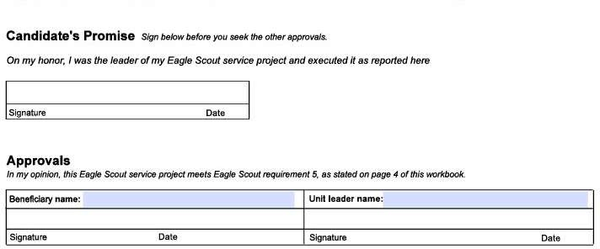
Project Report Page C
Scout
Sign and date before you seek other approvals.
Beneficiary
Unit Leader
50

Slide 55
Final Project Approval
Members of your Eagle Board of Review will decide if the project was completed properly.
Be prepared to discuss:
How you demonstrate leadership.
How you directed others to accomplish the work.
What benefits were achieved.
What changes were necessary and why.

Slide 56
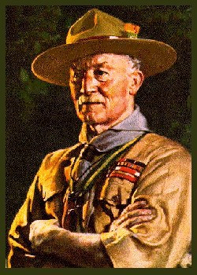
Questions?

Slide 58
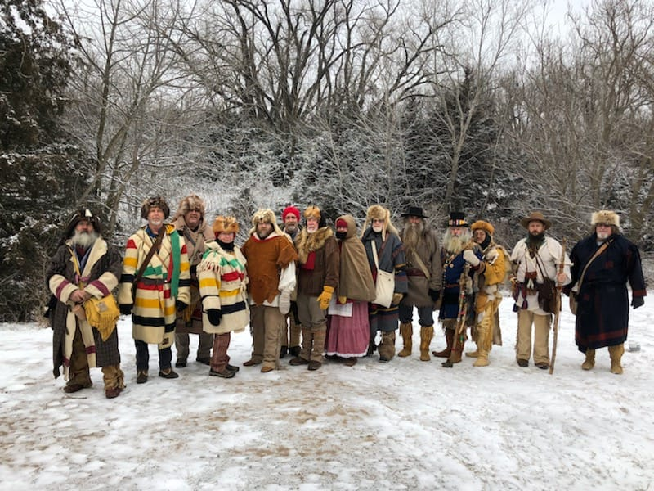
trappers rendezvous
Quivira Council

Slide 59
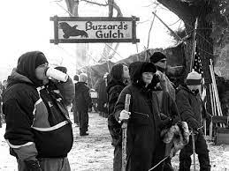

Slide 60
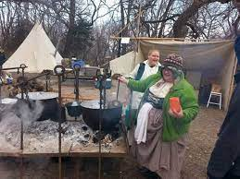

Slide 61
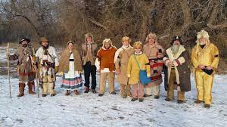

Slide 62
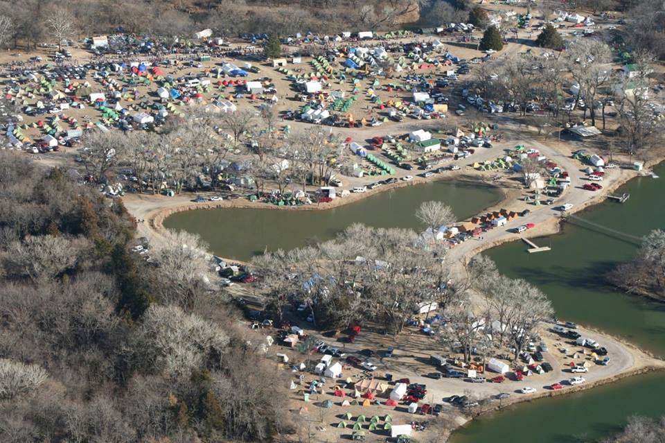

Slide 63
