Slide 1
Brief 2017 Recap and 2018 Planned & Proposed NOAA Surveys
Presentation to the Arctic Waterways Safety Committee Meeting
December 2017
Candace Nachman, HQ Arctic Liaison, Office of Policy, on behalf of all NOAA programs

Slide 2
2017 Survey Recap
Vessel Name | NOAA office | General Location | Dates | Purpose
USCG Cutter Healy | Oceanic and Atmospheric Research (OAR) | Bering and Chukchi Seas | Aug 26 – Sept 15 | Distributed Biological Observatory (DBO)
FV Alaska Knight & FV Vesteraalen | National Marine Fisheries Service (NMFS) | Northeastern Bering Sea | Early Aug – Early Sept | Loss of Sea Ice Project: Survey of bottom-dwelling fish, crabs & invertebrates
N/A | OAR | Bering Strait northward through the Chukchi Sea | July 10 – Oct 2 | Autonomous Surface Vehicle deployments (i.e., Saildrone project)

Slide 3
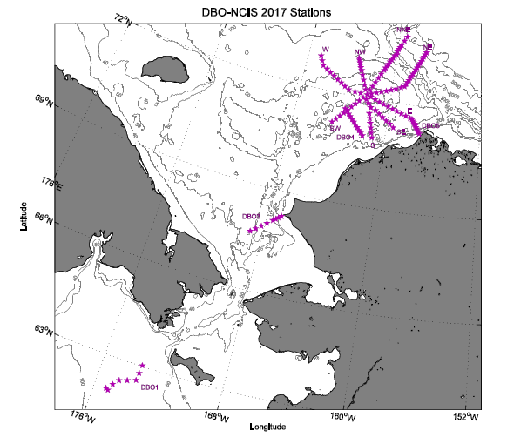
2017 DBO-NCIS (Northern Chukchi Integrated Study)
141 stations
CTD casts & water collection at all stations
Bottom grabs & core samples at ~half of the stations
Bird & marine mammal observations
Multibeam echosounder
Closest points of approach: 3 nm near Pt Hope and 5 nm near Barrow

Slide 4
NMFS Loss of Sea Ice Project
Utilized echosounders & research bottom trawl
Trends in abundance & distribution of fish, crabs & marine life to monitor effects of climate change & diminishing annual sea ice on food webs
Sampled 144 stations
1.5 nm in Norton Sound & 2.25 nm of St. Lawrence Island
In-season communication with Bering Sea communities
Norton Sound Economic Development Corporation staff member on-board
Open House Events
Hope to continue in odd years

Slide 5
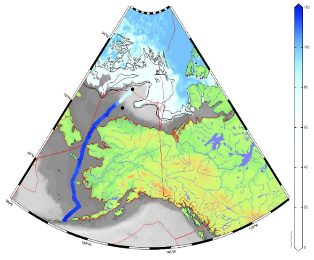
2017 OAR Chukchi Saildrone Project
Tested updated saildrone
Tested technology and successfully measured CO₂ concentrations from Dutch Harbor northward
Surveyed as far as 75N, as close to the ice edge as 7nm, and successfully transited Bering Strait (north and south). All firsts for unescorted, unmanned autonomous vehicles.
Data will help improve weather and climate forecasting and understanding of ocean acidification
Contact: heather.tabisola@noaa.gov
A map showing ice concentration (NSIDC MASAM-2) and the 0% ice edge (US NIC) for 13 August 2017. The ASV track, blue colors, indicating salinity (blue: 33S; white: 25 S). The ASV briefly crossed into international territory and came within about 7 nm of the ice edge. The NIC product helps us stay safe!
https://www.pmel.noaa.gov/itae/follow-saildrone-2017

Slide 6
Planned & Proposed 2018 Arctic Surveys
Vessel Name | NOAA office | General Location | Dates | Purpose
NOAA Ship Fairweather | National Ocean Service (NOS) | Pt Hope and vicinity | unknown | Hydrographic surveys
USCG Cutter Healy* | Oceanic and Atmospheric Research (OAR) | Bering and Chukchi Seas (continental shelf) | 28 days likely from early Aug to late Aug or early Sept | Distributed Biological Observatory (DBO)
Northwest Explorer | National Marine Fisheries Service (NMFS) | Northeastern Bering Sea (60N to 65N) | Aug 25 – Sept 20 | Loss of sea ice impacts
N/A | OAR | Bering Strait and Chukchi Sea | July through Sept | Autonomous Surface Vehicle deployments (i.e., Saildrone project)
*Details presented in DBO section of slides

Slide 7
NMFS Marine Mammal Lab 2018 Proposed Surveys
Vessel Name | NOAA office | General Location | Dates | Purpose
Yushin-Maru No. 2 | IWC lead | Central Bering Sea | Mid-July – Mid-Sept | IWC Pacific Ocean Whale & Ecosystem Survey
Unknown | OAR | Bering, Chukchi and Beaufort Seas | September | Arctic Long-Term Integrated Mooring Array (ALTIMA)
RV Oscar Dyson | NMFS | Bering Sea southern ice margins | Late March – Late April | Abundance & Health of Spotted & Ribbon Seals
N/A – Aerial surveys | NMFS | Chukchi and Beaufort Seas | Summer – Fall | Aerial Surveys of Arctic Marine Mammals (ASAMM)
N/A – Aerial surveys | NMFS (joint with Canada) | Beaufort Sea, Eastern Chukchi Sea | April – May 2019 | Seals & Polar Bears

Slide 8
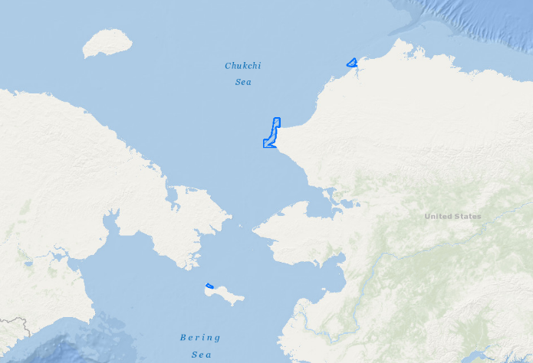
NOS Hydrographic Surveys
Multibeam echosounders & side-scan sonar to chart ocean bottom
Needed to ensure vessels can pass safely
Vessel passes very close to shoreline
2019
2018
2020

Slide 9
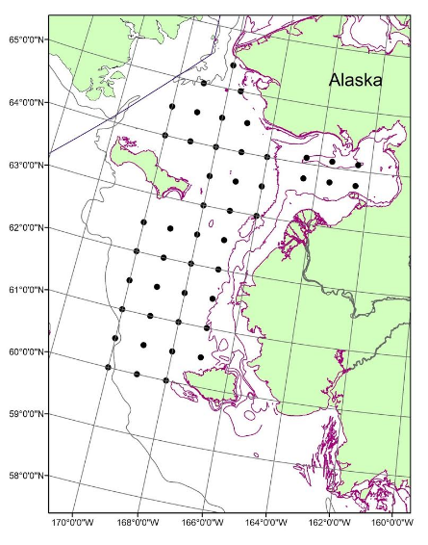
NMFS Impacts of Loss of Sea Ice Surveys
Bio/physical oceanography & fish samples using rope trawl
Pre-determined gridded stations ~30 nm apart
Operate 3 nm from shore to offshore
Late Aug – Late Sept
Annual surveys

Slide 10
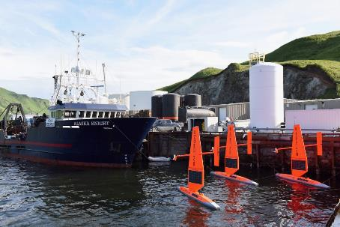
2018 OAR Saildrone Project
Two Projects in 2018
Bering Strait & Chukchi Sea
July through September 2018
Ocean Acidification
No active acoustics
Assess important questions about physical circulation, ice melt, ecosystems, and ocean acidification in the region
  Fisheries Survey
  Active acoustics
  Understand the fate of the age-0 Arctic cod on the Chukchi shelf
FOR INFORMATION
Notice of Operations (not yet updated for 2018)- https://www.pmel.noaa.gov/itae/mariner-and-public-notice-research-platforms
Saildrone Research Blog - https://www.pmel.noaa.gov/itae/follow-saildrone-2017
Email Updates – sign-up using https://goo.gl/forms/4fBQkg2GXp3obCn42
Contact: heather.tabisola@noaa.gov

Slide 11
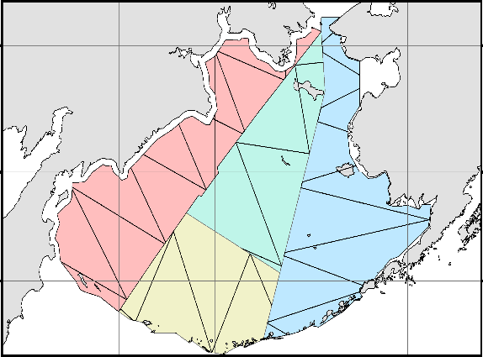
IWC Pacific Ocean Whale and Ecosystem Survey
Line transect survey, photo-id & biopsy sampling of whales
Come within 30 mi of shore
Ship uses echosounders
Mid-July – Mid-Sept
2018 or 2019
2018 or 2019
2017
Proposed Power Survey Areas for 2017-2019

Slide 12
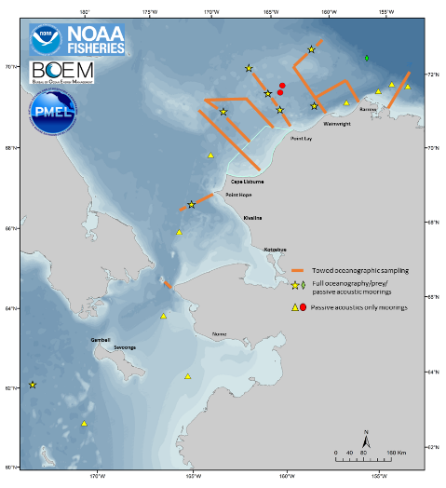
Arctic Long-Term Integrated Mooring Array (ALTIMA)
CTD tows
Plankton tows
Marine mammal surveys
Mooring deployment/recovery for long-term, year-round data record to relate changes in oceanography & prey availability to marine mammal occurrence
Sept 2018
One season of field work done and will continue in 2018 & 2019
Proposed ALTIMA cruise survey area and operations (figure may change)

Slide 13
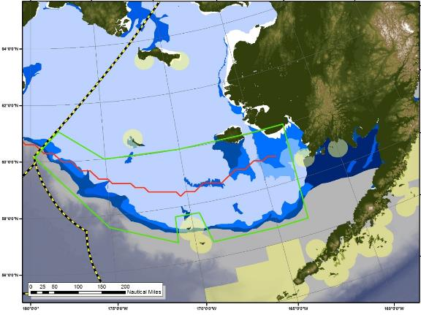
Abundance & Health of Spotted & Ribbon Seals
Launch researchers in small boats to sample, tag & satellite track seals
Improve estimates of haul-out timelines & understanding of seals’ dependence on sea ice for reproduction & molting
Ship uses echosounders
Late March – Late April 2018
Conducted similar projects in 2014 & 2016
Area of operations (green box). April sea ice concentration is shown in blue, red line is the median ice extent for April.

Slide 14
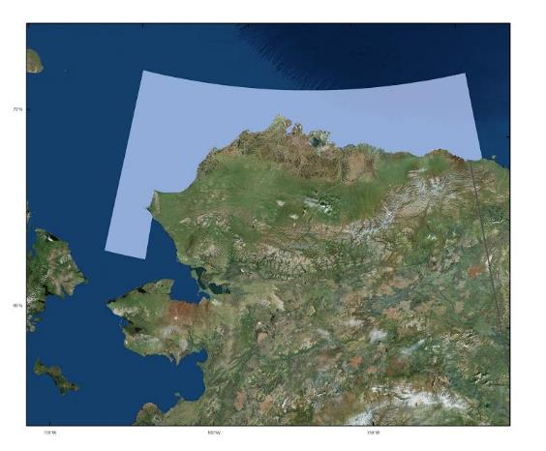
Aerial Surveys of Arctic Marine Mammals (ASAMM)
Aerial surveys of bowhead whales & other marine mammals in the Chukchi & Beaufort Seas
Survey has taken place annually since 1979
Summer – Fall 2018
The ASAMM aerial survey area is depicted by the light blue polygon extending from the Chukchi to Beaufort Seas
https://www.afsc.noaa.gov/NmmL/cetacean/bwasp/index.php

Slide 15
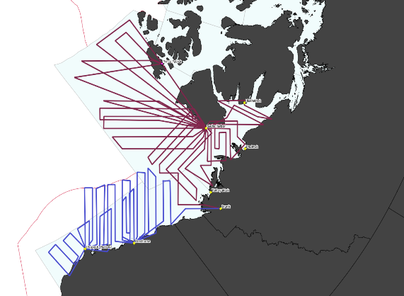
U.S.-Canada Joint Aerial Surveys for Seals & Polar Bears
Aerial photographic & thermal surveys of ice-associated seals & polar bears
Twin-engine aircraft operating at 1,000 ft
April – May 2019
One season of surveys already conducted
Example track lines for surveys of the Southern and Northern Beaufort Sea for bearded seals, ringed seals and polar bears. The blue (US) and violet (Canadian) survey tracks would be flown by separate aircraft. The thin curved red line indicates the US and Canadian exclusive economic zones, while the thin grey lines around areas of light blue shading indicate polar bear sub-population boundaries. Total track length shown exceeds 27,000 km.

Slide 16


Arctic Waterways Safety Committee Meeting
Open Public Meeting
Anchorage, Alaska, USA
December 5, 2017
2018 Pacific Arctic group (PAG) and the distributed biologiCal observatory (DBO) Cruises
Candace Nachman¹ and Jacqueline Grebmeier²
¹Arctic Liaison, NOAA Fisheries, Office of Policy, NOAA Headquarters,
Silver Spring, Maryland USA
²University of Maryland Center for Environmental Science, Chesapeake Biological Laboratory, Solomons, Maryland, USA
http://pag.arcticportal.org

Slide 17
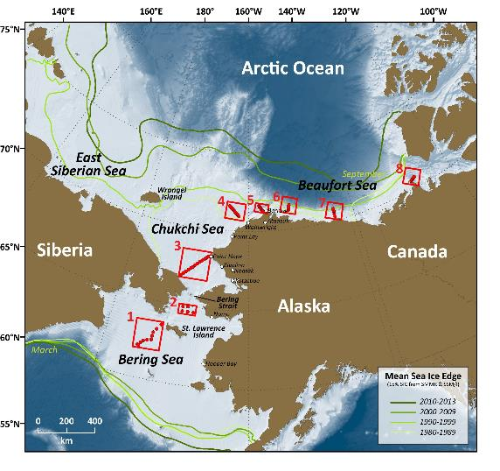








Linking Physics to Biology:
the Distributed Biological Observatory (DBO)
DBO sites (red boxes) are regional “hotspot” transect lines and stations located along a latitudinal gradient
DBO sites are considered to exhibit high productivity, biodiversity, and overall rates of change
DBO sites serve as a change detection array for the identification and consistent monitoring of biophysical responses
Sites occupied by national and international entities with shared data plan
[updated by Karen Frey from Grebmeier et al. 2010, EOS 91]
Notes:
Change MAP to 4 sites

Slide 18
2018 PAG and DBO Cruise Plan Table (11-27-17)

Slide 19
T/S Oshoro-Maru 2018 (ArCS project)
June 29–July 15, Dutch Harbor - Chukchi Sea - Dutch Harbor
Chief Scientist: Toru Hirawake hirawake@salmon.fish.hokudai.ac.jp
Objectives: (1) To reveal mechanism and processes of high primary production in the Northern Bering and Southern Chukchi Seas and impact on higher trophic levels. To investigate pollutant materials in biology and sediments.
https://www.arcs-pro.jp/en/project/collaborated/06.html

Slide 20

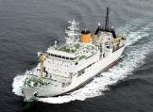
T/S Oshoro-Maru 2017
(ArCS project)
Oshoro-maru
CTD, DO, Salinity A. Ooki and H. Ueno
Optical properties and primary productivity T. Hirawake
Biogeochemistry of iodine and organic gases A. Ooki
Mooring recovery/re-deployment M. Sampei
Benthic Ecology M. Nakaoka
Ichtyoplankton Survey O. Yamamura
Marine mammal sighting survey Y. Mitani
Plankton A. Yamaguchi
Seabirds B. Nishizawa
Data will be shared two years later at https://ads.nipr.ac.jp/.
Preliminary report is available. Please contact to Dr. Atsushi Ooki (ooki@fish.hokudai.ac.jp).

Slide 21


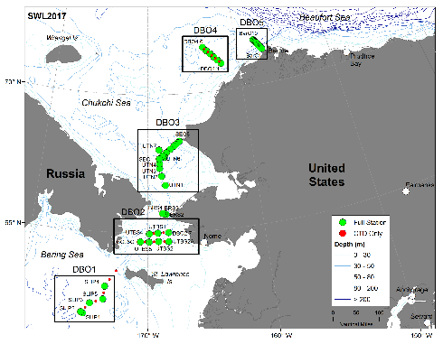





Canada’s Three Oceans (C30) and the DBO:
CCGS Sir Wilfrid Laurier, July 10-24, 2018
Focus: sampling along latitudinal transect lines developed as a “change detection array” for consistent monitoring of biophysical responses to changing environmental conditions
Date | Location | DBO Line | Distance from Shore | Time within 12 nm of shore
14-Jul | south St Lawrence Island | 1 | NA | NA
15-Jul | Chirikov Basin | 2 | NA | NA
17-Jul | SE Chukchi Sea | 3 | 5 nm | 2 hrs
19-Jul | NE Chukchi Sea off Wainwright | 4 | 30 nm | NA
20-Jul | Off Barrow | 5 | 5 nm | 2 hrs
DBO data collections
Contacts: Svein Vagle Svein.Vagle@dfo-mpo.gc.ca and
Jackie Grebmeier jgrebmei@umces.edu
Seawater temperature and salinity; velocity measurements
Nutrients, chlorophyll, carbon products, CDOM
Phytoplankton, zooplankton and macrobenthic abundance, biomass, community structure
Marine mammal and seabird surveys

Slide 22
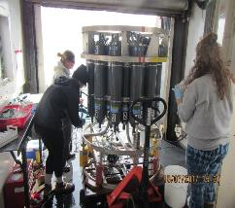
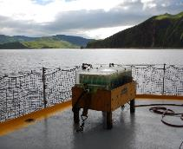
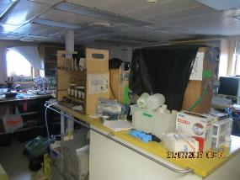
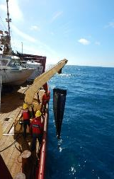
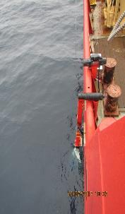
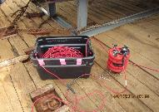

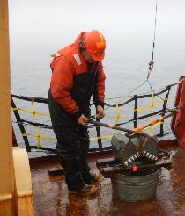
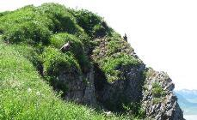
DBO Transect (July 14-July 22, 2017)
CTD/Rosette
Bongo nets
Incubation experiments
Laboratory filtrations
Science:
62 CTD stations. 45 of these with Rosette sampling
45 Bongo net hauls
42 deployments of 150 kHz ADCP
38 Benthic sampling stations with up to 5 vanVeen grabs at each station\
38 Benthic Video-camera recordings
20 stations where water was collected for methane and nitrous oxide analysis
12 stations were sampled for apparent optical properties
4 stations were used for primary productivity incubation experiments
Bird observations
Meteorological and position data from ship sensors
Over the side 150kHz ADCP
C-OPS
vanVeen grabs
Bird observations

Slide 23
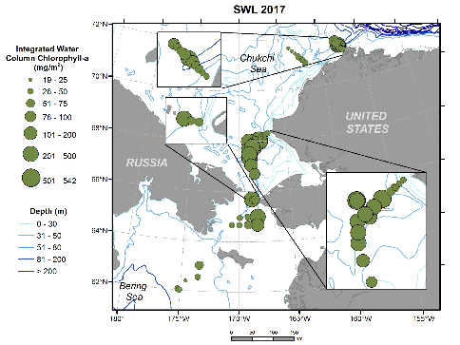
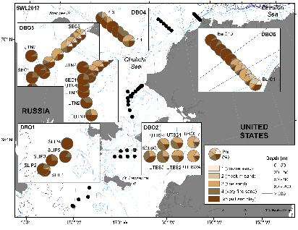
SWL17 Example data product: Sediment grain size for DBO1-5
Highest % total organic carbon content in silt & clay regions in lower current areas
High silt & clay in DBO1, offshore DBO3 sites, DBO4.4, and western half of DBO5
High TOC and silt/clay coincident with higher benthic biomass
Lowest silt & clay content in sandy area of DBO 2 (Chirikov Basin), eastern part of DBO3-DBO5 in Alaska Coastal water
Highest integrated water column chlorophyll a (chl a) in offshore waters of eastern Chirikov Basin, southern Chukchi Sea, and upper Barrow Canyon
Data indicate the importance for water column production in regions of high nutrient level and ultimately support pelagic and benthic prey for upper trophic marine mammal and seabirds
[Grebmeier and Cooper]

Slide 24


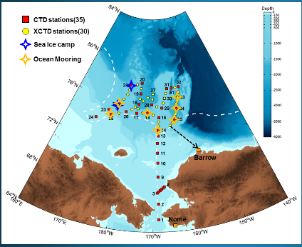
2018 KOPRI Arctic Cruise Plan
Ocean-Sea Ice-Atmosphere Integrated Observations (Chukchi/East Siberian Seas of Pacific Central Arctic Ocean)
Aims of the cruise:
- To identify key environmental parameters (physical and biogeochemcial) in rapid transition due to the sea-ice decrease in the Pacific Central Arctic Ocean (CAO) and predict environmental change patterns.
- To understand sea ice dynamics and sea ice ecosystem
Period: 2018. 8.6 - 8.25 (from Nome to Barrow) TBD
Chief Scientists: Sung-Ho Kang (shkang@kopri.re.kr)
Participating nations: TBD
2018 Arctic Survey Map (Tentative Plan of Work)
Northern Bering Sea to Southern Chukchi Sea (DBO 3)
Chukchi shelf
Chukchi Borderland to East Siberian Sea
2 Sea Ice stations

Slide 25



2018 Eco-/FOCI & DBO-NCIS (Northern Chukchi Sea Integrated Study)
(NOAA PMEL, UMCES, WHOI)
Est. Aug 1-24, 2018 (Dutch-Nome, Alaska)
Standard measurements and process studies (DBO 2,3,4,5) and EcoFOCI mooring array
Physical: CTD and ADCP, mooring retrieval and replacement
Chemical: nutrients, oxygen-18,
Chlorophyll-a, carbon components
Biological: Zooplankton abundance and biomass
Benthos: macrobenthos abundance, biomass and population structure
Sediment: organic carbon/nitrogen content, chl-a content, grain size, radioisotopes
Benthic oxygen uptake and nutrient exchange
Marine mammal and seabird surveys
moorings
Contact: Phyllis Stabeno/NOAA:
phyllis.stabeno@noaa.gov
DBO: Distributed Biological Observatory
Contact: Jackie Grebmeier/UMCES: jgrebmei@umces.edu

Slide 26

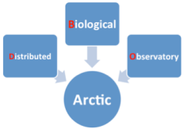
Thank you for your attention.
Questions and comments?
Financial support from the NOAA, NSF, and international partners within
the Pacific Arctic Group
http://www.arctic.noaa.gov/dbo/
http://pag.arcticportal.org/

