Slide 1
Aqua Cremation
Flameless Cremation
Green Cremation
Deon Strommer
Death Investigator, D-MORT Member, Mortician, Funeral Director, Cremationist, Business Owner, Embalmer

Slide 2
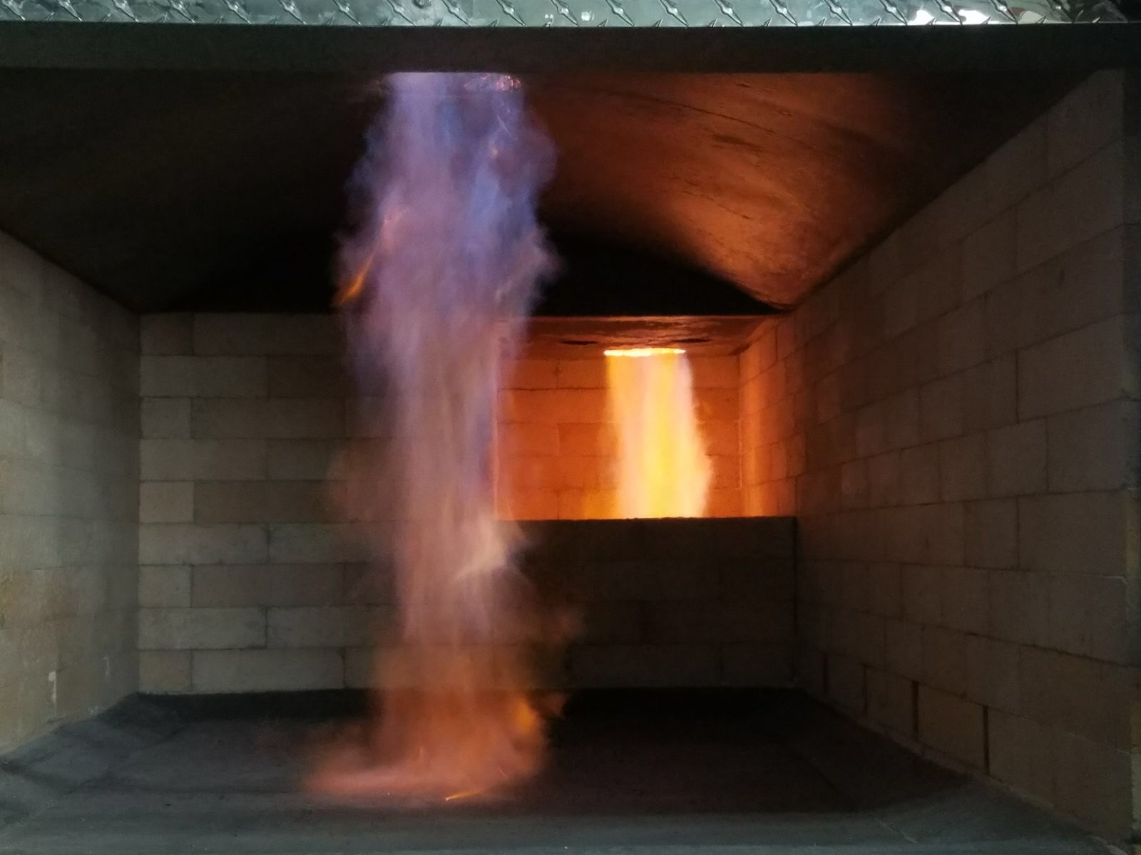
Essentials of Flame-Based Cremation

Slide 3
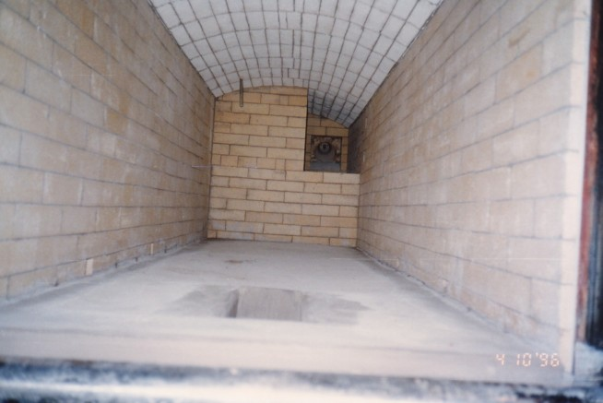
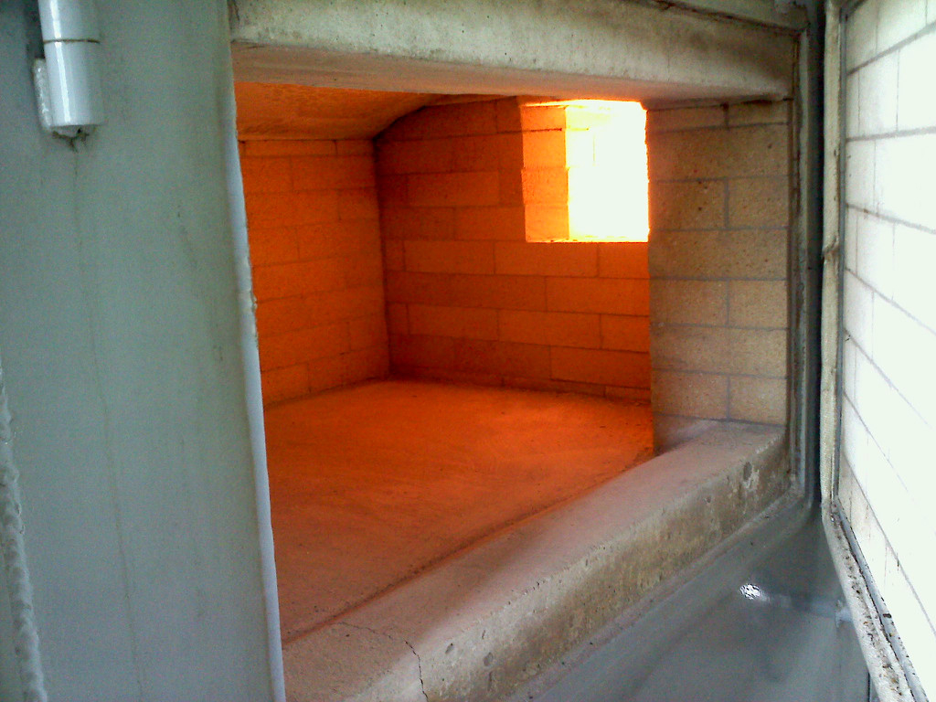
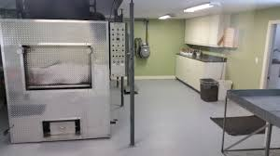
Uses natural gas and is heated to 1800 degrees Fahrenheit
Enough fuel is used to take a 500 mile road trip in your car.

Slide 4
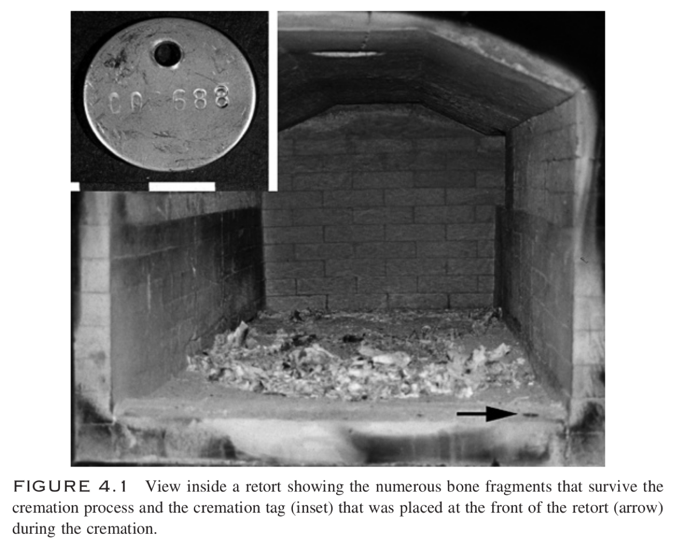
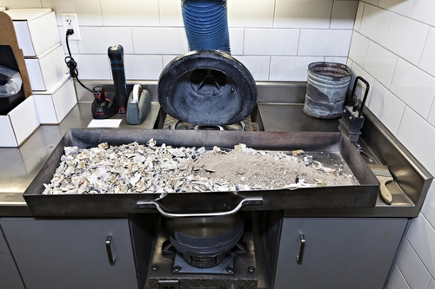

Slide 5
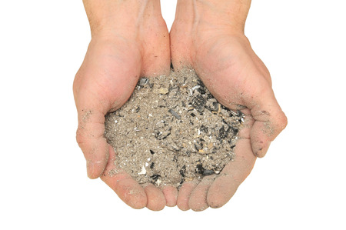

Slide 6
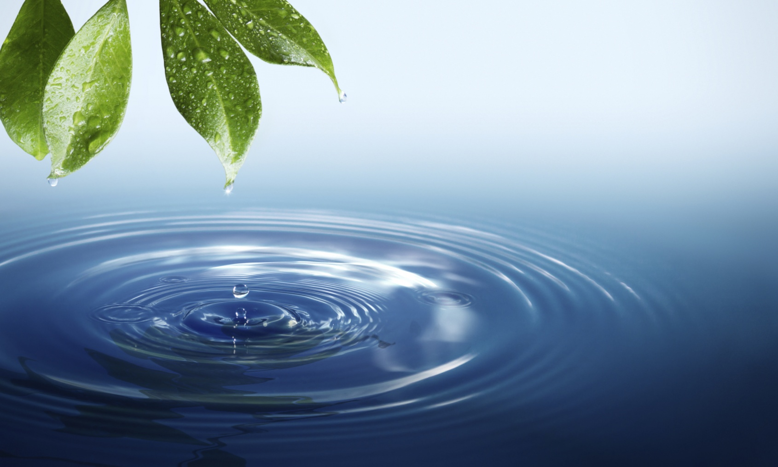
Water not Fire
A gentle and respectful process
No emissions of harmful greenhouse gasses or mercury
Over 90% energy savings when compared to flame-based cremation
1/10 the carbon footprint of flame-based cremation
20% more ash remains returned to the family

Slide 7

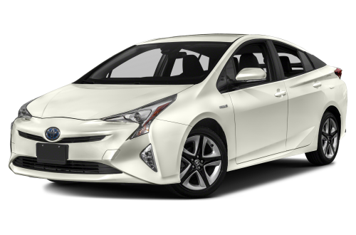
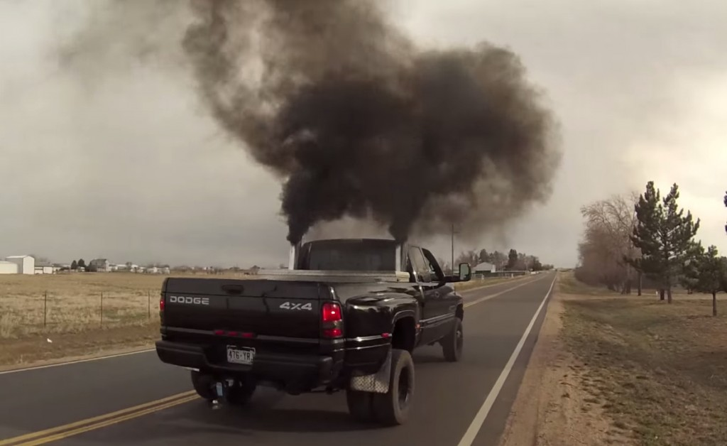
vs

Slide 8
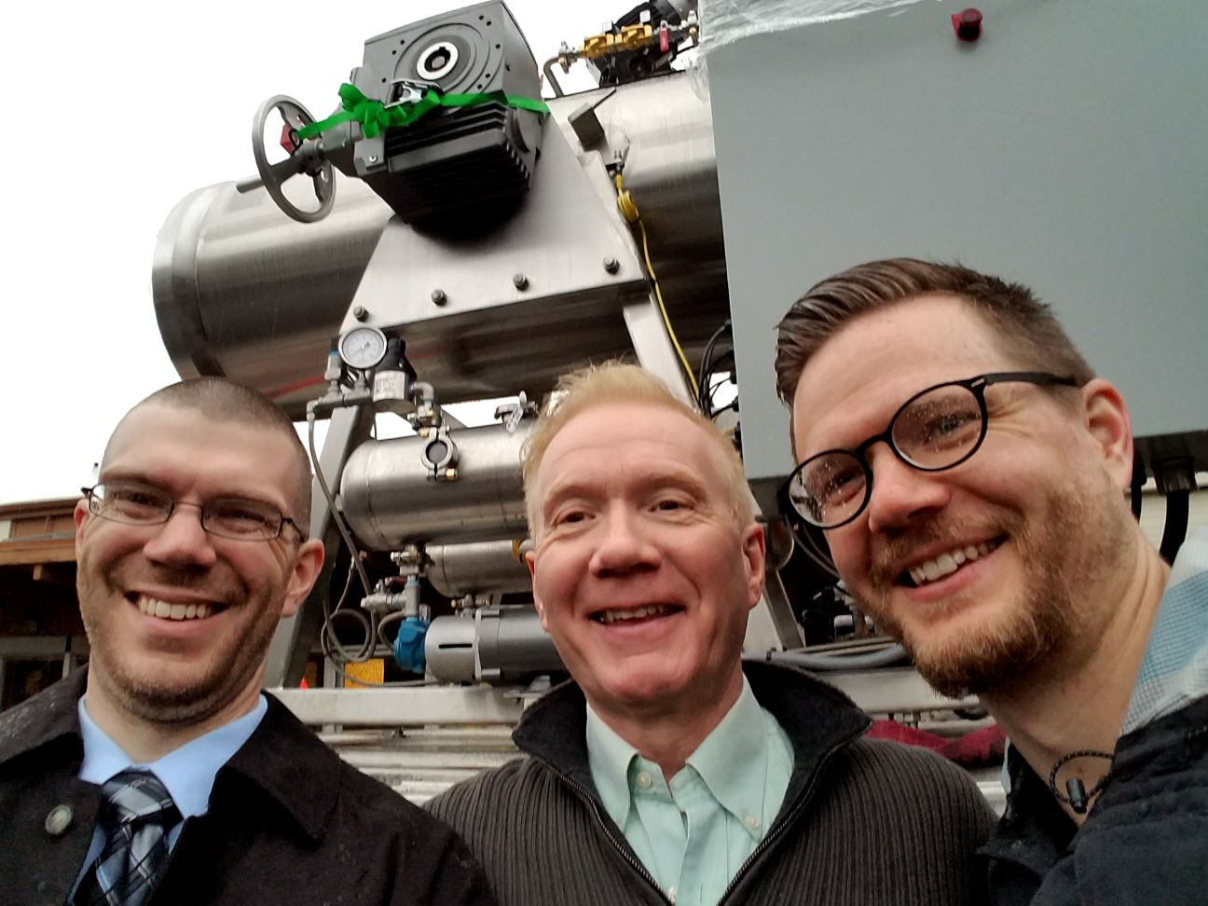
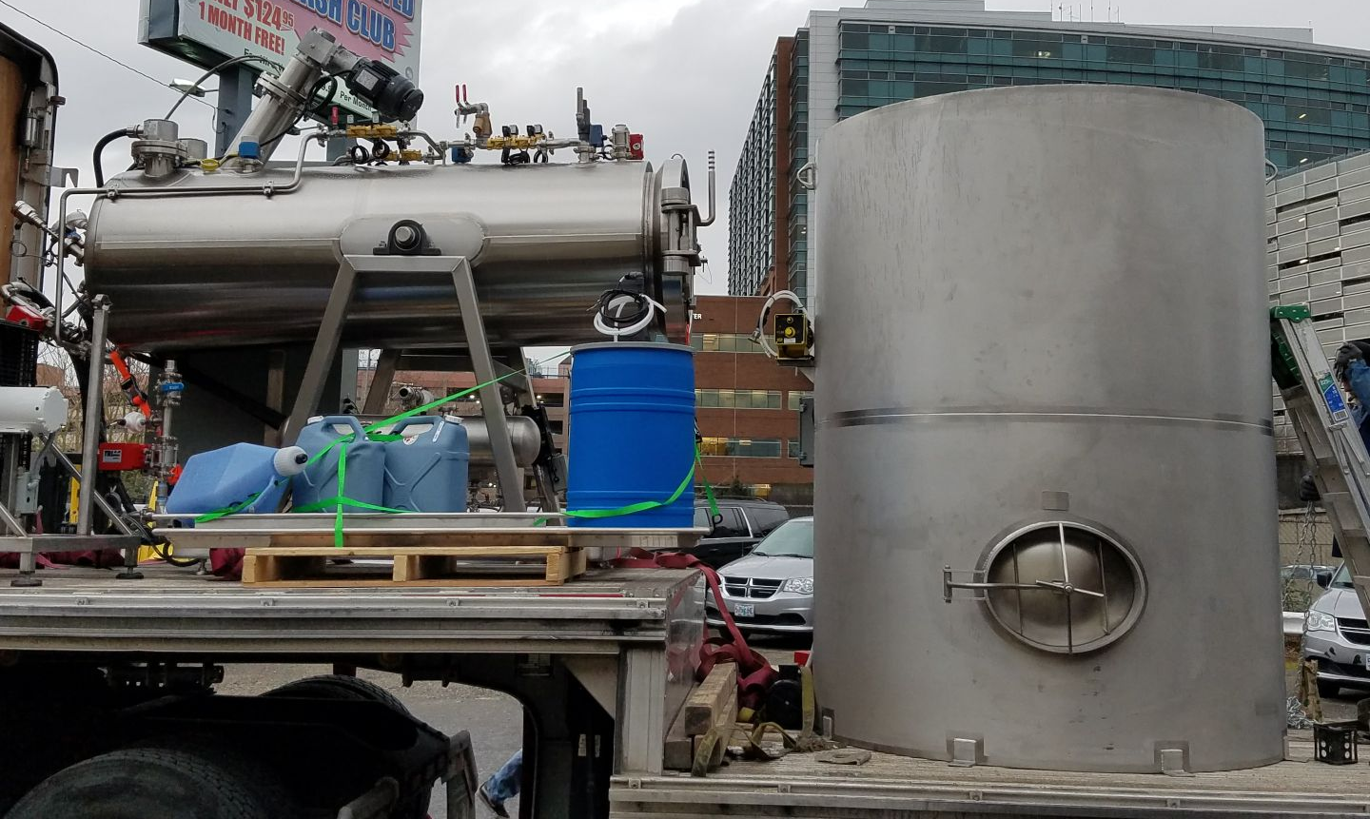
First high pressure machine on the West Coast arrives in Portland Oregon 2018

Slide 9
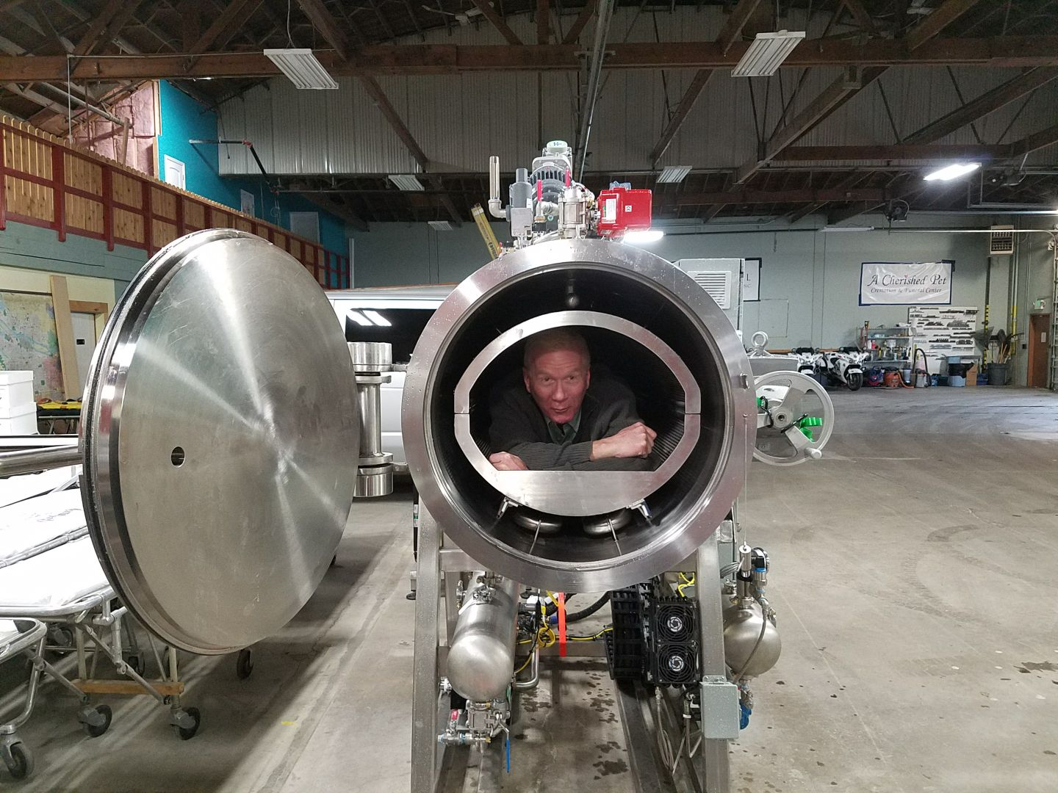

Slide 10
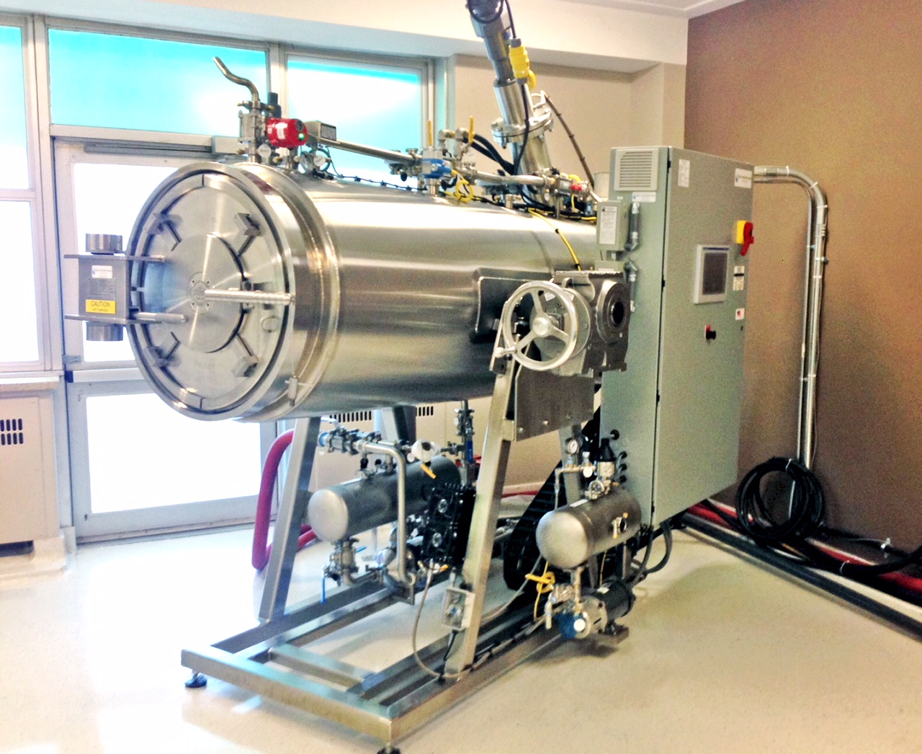
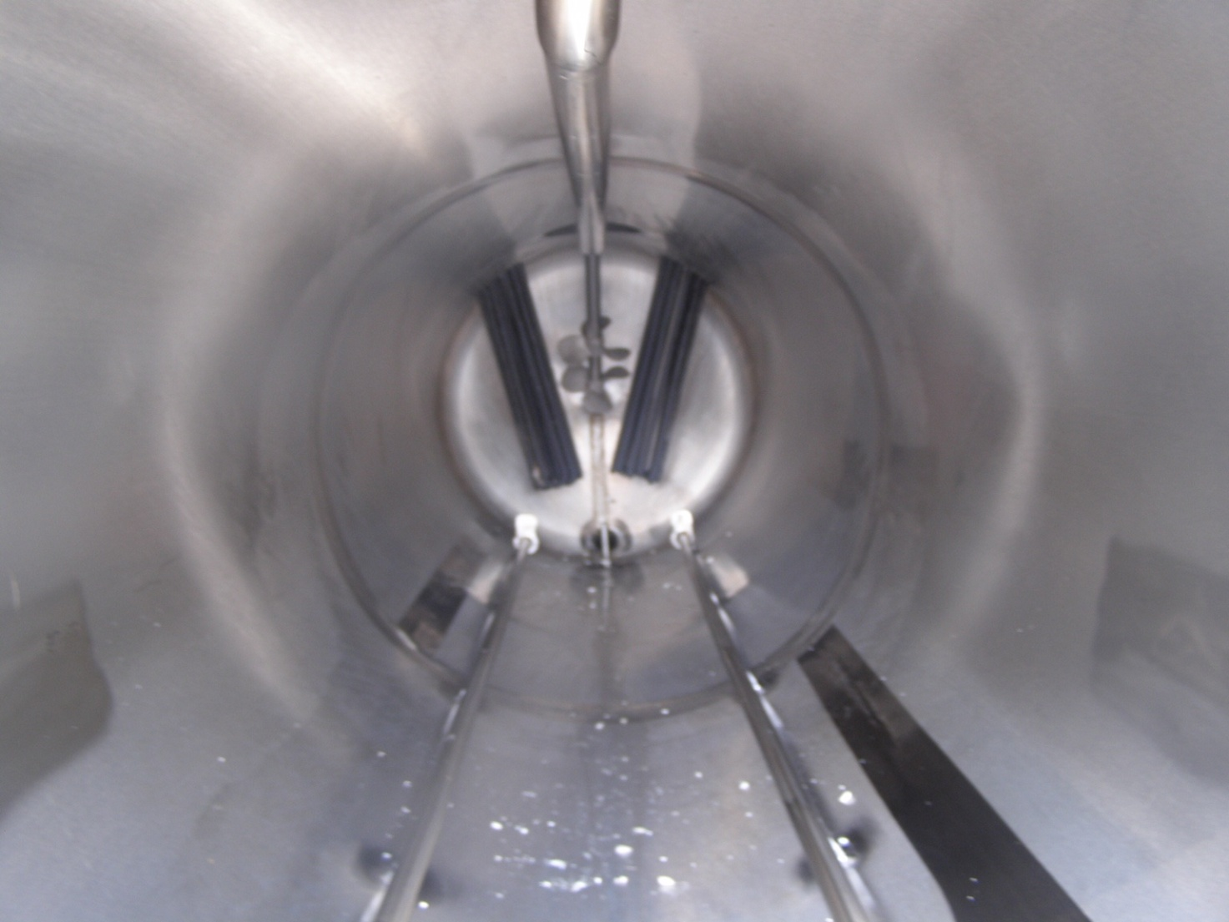

Slide 11
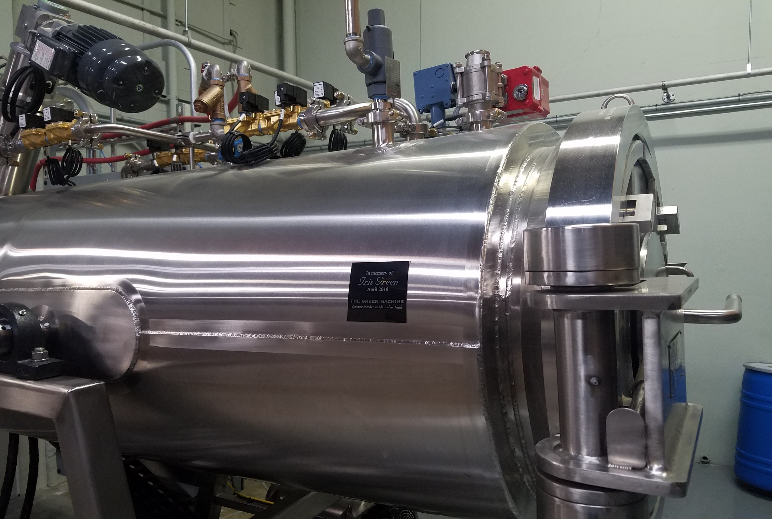

Slide 12
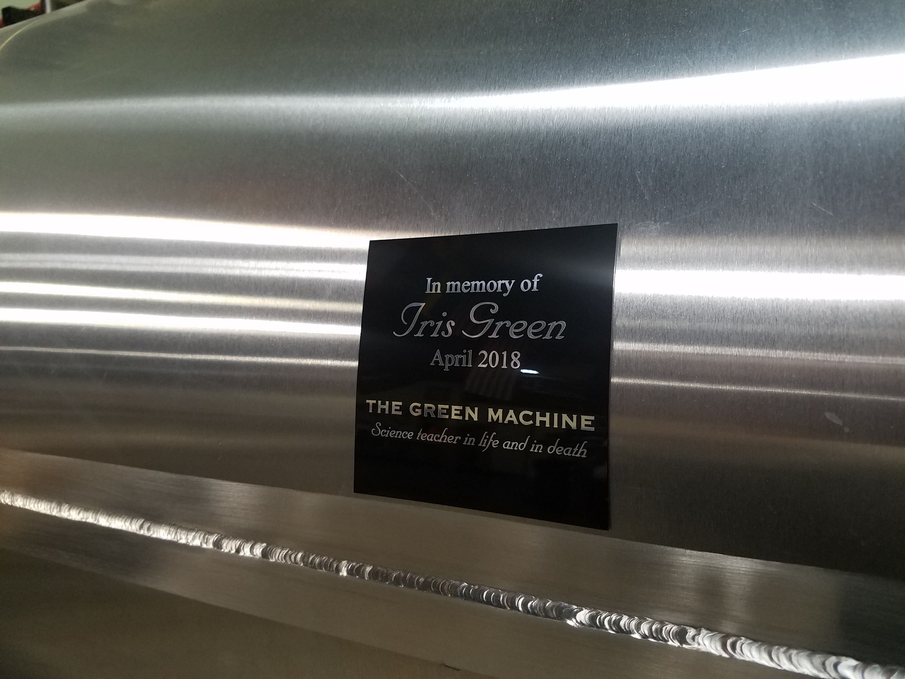


Slide 13
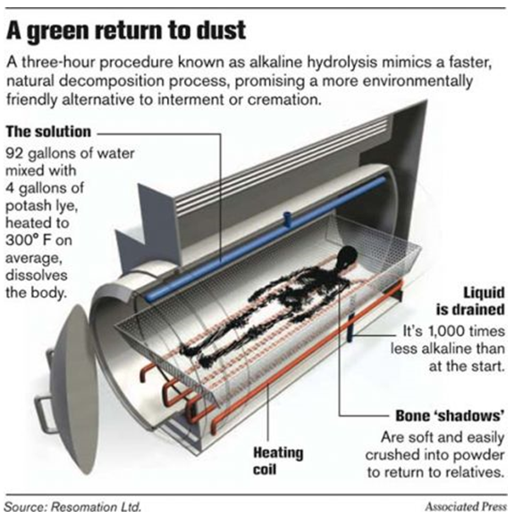
We call it cremation but it more closely resembles earth burial. However because there are ashes returned to the family, it’s been referred to as aqua cremation.

Slide 14
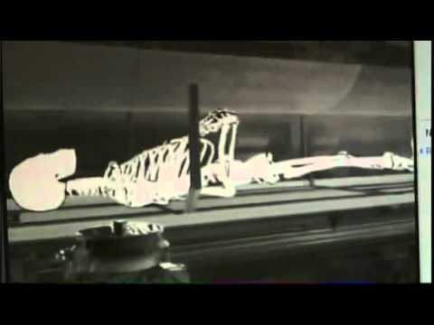

Slide 15
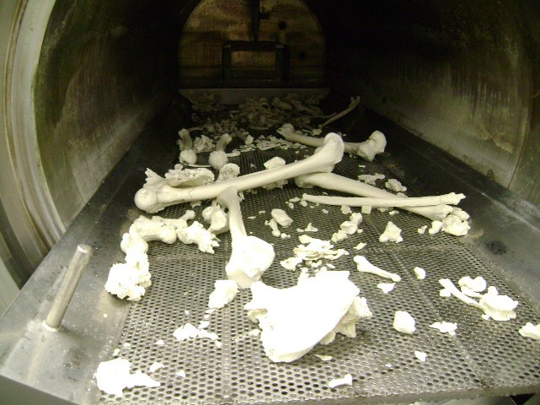

Slide 16
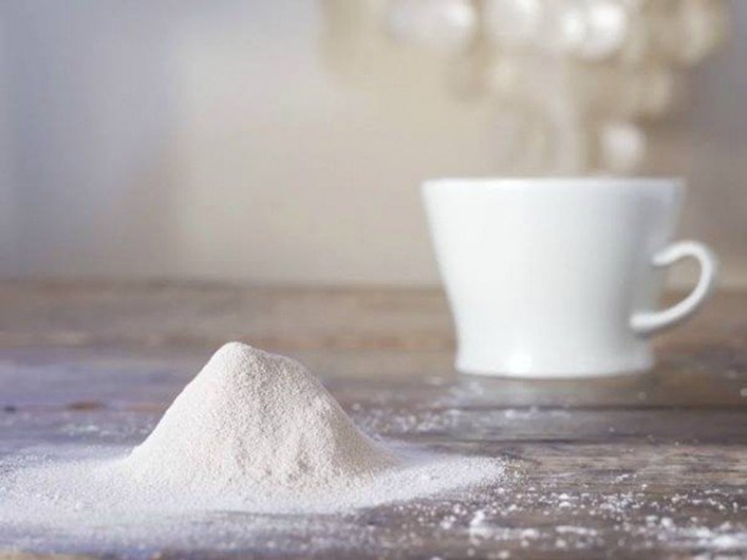
The whiteness of the ashes can be seen to compare to the whiteness of this teacup.

Slide 17


Slide 18
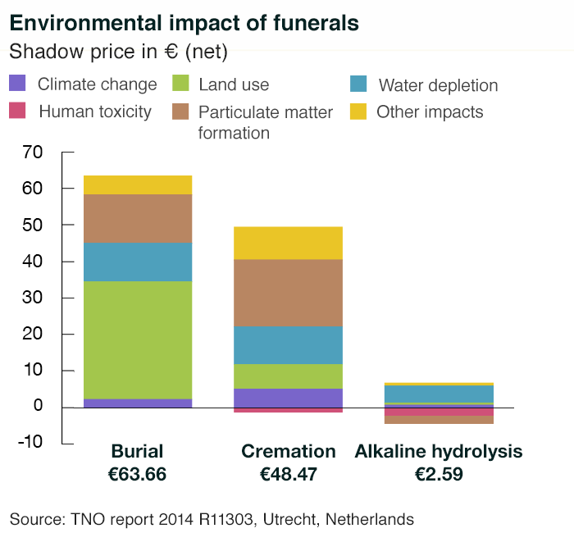
Elizabeth Keijzer

Slide 19
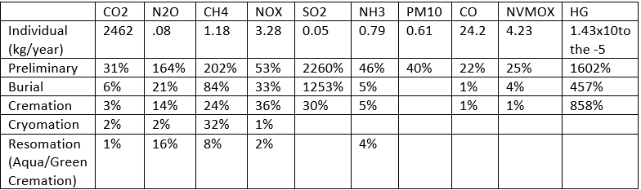
Campaigners say that in the US vaults for coffins use up more than 1.6m tons of concrete and 14,000 tons of steel every year.
As for cremation, it has been estimated that a typical cremation has a footprint equivalent to about 320kg (705lbs) of carbon dioxide.
Elizabeth Keijzer
Environmental impact of Funerals. Life cycle assessments of activities after life.

Slide 20
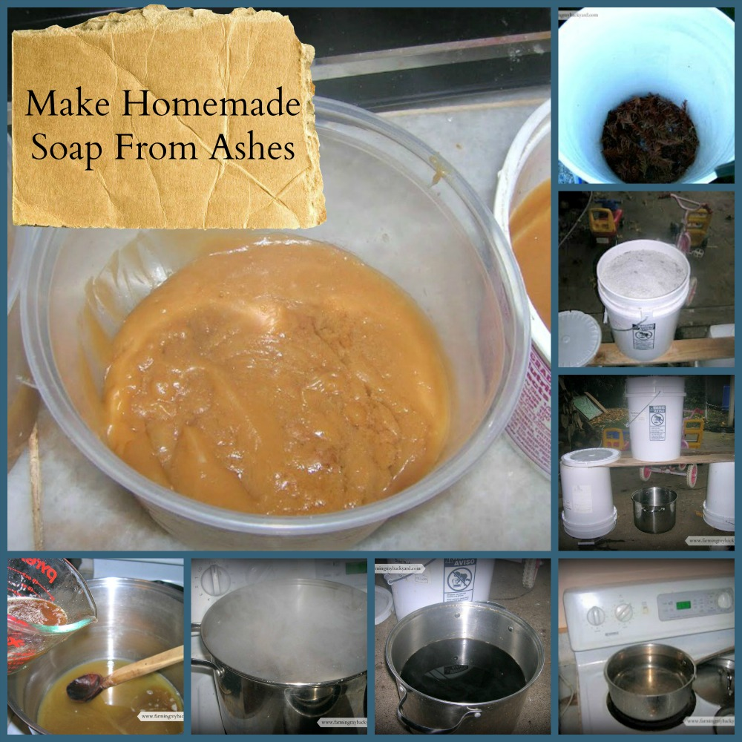
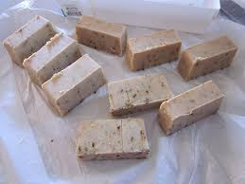
The pioneers used wood ash in their soaps. From wood ash comes sodium hydroxide (also known as caustic soda or caustic lye).

Slide 21
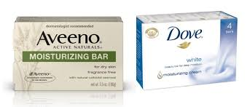

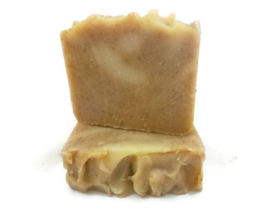
Potassium hydroxide is what gives soaps and cleansers its strength to cut through dirt and other grime.

Slide 22
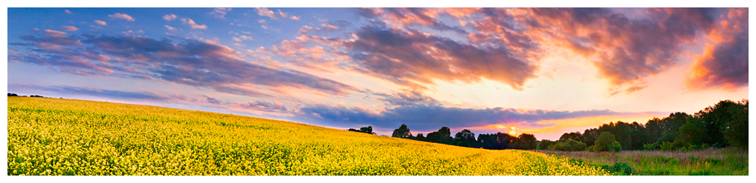
Water used in the process is called ‘effluent’. The remaining effluent is used to fertilize fields and crops. Thus fulfilling the life cycle.

