Slide 1
January CVFPB Meeting California Central Valley Flood Control Association Informational Briefing on January 2023 Storm Damage

Slide 2
City of Sacramento Erosion and Sloughing Sites Along SREL Dowstream of the American River

Slide 6
Reclamation District 1600 Sites

Slide 13
Reclamation District 108 Sites

Slide 20
Reclamation District 551 Sites

Slide 21
RD 551, Pearson District, erosion on Sacramento River, directly downstream of MA 9

Slide 22
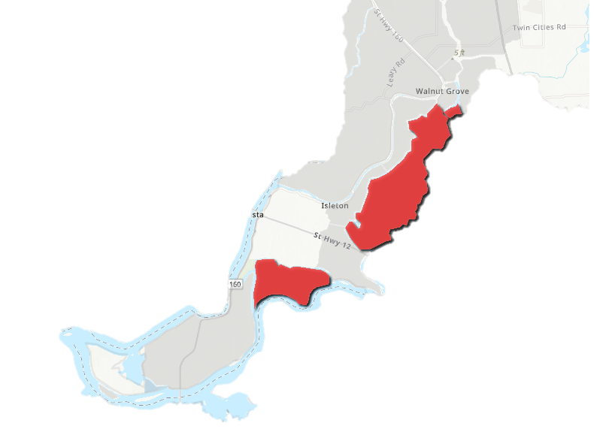
NORTH DELTA OVERVIEW
Mokelumne River at Benson’s Ferry peaked over Flood Stage
M O K E L U M N E
RD 2111
DEADHORSE ISLAND
Seepage, Slips, Emergency Rock Slope Protection
RD 563
TYLER ISLAND
Pre-positioned materials for Muscle Wall, Fallen Trees, Emergency Patrolling
RD 1601
TWITCHELL ISLAND
Seepage, Slumping, Levee Crown Road Damage, Wave Runup
Notes:
Cosumnes/Mokelumne was high (thankfully releases from Comanche were low)
San Joaquin River remained low, allowing flows to convey through the pinch point without catastrophic damage

Slide 23
DEADHORSE ISLAND
RD 2111
Rock Slope Protection,
Slumping, Seepage

Slide 24
TWITCHELL
ISLAND
RD 1601
Wave Run Up, Slumping that Damaged Levee Crown Road

Slide 25
TYLER
ISLAND
RD 563
Pre-Staged Material for Muscle Wall in Anticipation of High Water, Felled Trees, Seepage

