Slide 1
Essential Components
of
Mathematics Intervention

Slide 2
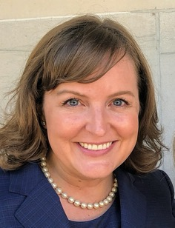
Sarah R. Powell, Ph.D.
Associate Professor
The University of Texas at Austin
www.sarahpowellphd.com
srpowell@utexas.edu
@sarahpowellphd

Slide 3
Introduce yourself.
Describe your role as an educator.
Describe the mathematics you support.
Share your Twitter handle!

Slide 4
MATH INTERVENTION
For students experiencing math difficulty
Tier 2
Tier 3
Secondary
With a school-identified disability
Persistent math difficulty
Targeted
Intensive
Special Education

Slide 5
DESIGN
Determine critical content
Identify evidence-based practices
Create the instructional platform

Slide 6
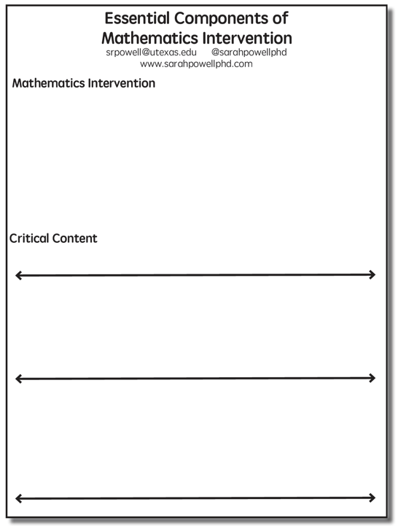

Slide 7
Determine critical content
Where student IS
Where student NEEDS TO BE
MATH INTERVENTION

Slide 8
Fluency

Slide 9
MATH INTERVENTION
Where student IS
Where student NEEDS TO BE
Fluently add and subtract within 5.
Add and subtract within 20, demonstrating fluency for addition and subtraction within 10.
Fluently add and subtract within 100 using strategies based on place value, properties of operations, and/or relationships.
Fluently multiply and divide within 100, using strategies such as the relationship between multiplication and division…
Fluently add and subtract multi-digit whole numbers using the standard algorithm.
Fluently multiply multi-digit whole numbers using the standard algorithm.
Fluently add, subtract, multiply, and divide multi-digit decimals using the standard algorithm.

Slide 10
Place Value

Slide 11
MATH INTERVENTION
Where student IS
Where student NEEDS TO BE
Compose and decompose numbers from 11 to 19 into ten ones and some further ones…
Understand that the two digits of a two-digit number represent amounts of tens and ones.
Understand that the three digits of a three-digit number represent amounts of hundreds, tens, and ones.
Use place value understanding to round whole numbers to the nearest 10 or 100.
Recognize that in a multi-digit number, a digit in one place represents ten times what it represents in the place to its right…
Recognize that in a multi-digit number, a digit in one place represents 10 times as much as it represents in the place to its right and 1/10 of what it represents in the place to its left.

Slide 12
Problem Solving

Slide 13
Interpret and compute quotients of fractions, and solve word problems involving division of fractions by fractions…
Solve word problems that call for addition of three whole numbers whose sum is less than or equal to 20…
Solve real-world and mathematical problems involving the four operations with rational numbers.
Use addition and subtraction within 100 to solve one- and two-step word problems…
Use multiplication and division within 100 to solve word problems…
Solve real-world and mathematical problems leading to two linear equations in two variables.
Solve addition and subtraction word problems, and add and subtract within 10…
Solve multi-step word problems posed with whole numbers and having whole-number answers using the four operations…
Solve word problems involving addition and subtraction of fractions referring to the same whole, including cases of unlike denominators…

Slide 14
Solve addition and subtraction word problems, and add and subtract within 10…
Solve word problems that call for addition of three whole numbers whose sum is less than or equal to 20…
Use addition and subtraction within 100 to solve one- and two-step word problems…
Use multiplication and division within 100 to solve word problems…
Solve multi-step word problems posed with whole numbers and having whole-number answers using the four operations…
Solve word problems involving addition and subtraction of fractions referring to the same whole, including cases of unlike denominators…
Interpret and compute quotients of fractions, and solve word problems involving division of fractions by fractions…
Solve real-world and mathematical problems involving the four operations with rational numbers.
Solve real-world and mathematical problems leading to two linear equations in two variables.

Slide 15
Where student IS
Where student NEEDS TO BE
Use addition and subtraction within 100 to solve one- and two-step word problems…
Use multiplication and division within 100 to solve word problems…
Solve multi-step word problems posed with whole numbers and having whole-number answers using the four operations…

Slide 16
Where student NEEDS TO BE
Where student IS
Explain why addition and subtraction strategies work, using place value and the properties of operations.
Understand that the two digits of a two-digit number represent amounts of tens and ones.
Use addition and subtraction within 100 to solve one- and two-step word problems…
Fluently add and subtract within 100 using strategies based on place value, properties of operations, and/or relationships.
Apply properties of operations as strategies to multiply and divide….
Fluently multiply and divide within 100, using strategies such as the relationship between multiplication and division…
Use multiplication and division within 100 to solve word problems…
Fluently add and subtract multi-digit whole numbers using the standard algorithm.
Find whole number quotients and remainders with up to four-digit dividends and one-digit divisors, using strategies based on place value, the properties of operations, and/or the relationship between multiplication and division.
Solve multi-step word problems posed with whole numbers and having whole-number answers using the four operations…
Understand that the three digits of a three-digit number represent amounts of hundreds, tens, and ones.
Fluently multiply multi-digit whole numbers using the standard algorithm.

Slide 17
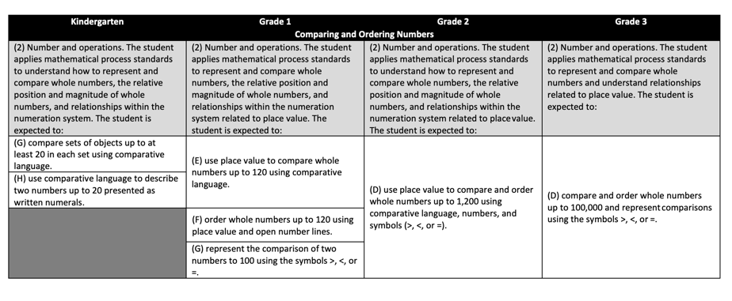
https://www.texasgateway.org/resource/vertical-alignment-charts-revised-mathematics-teks

Slide 18
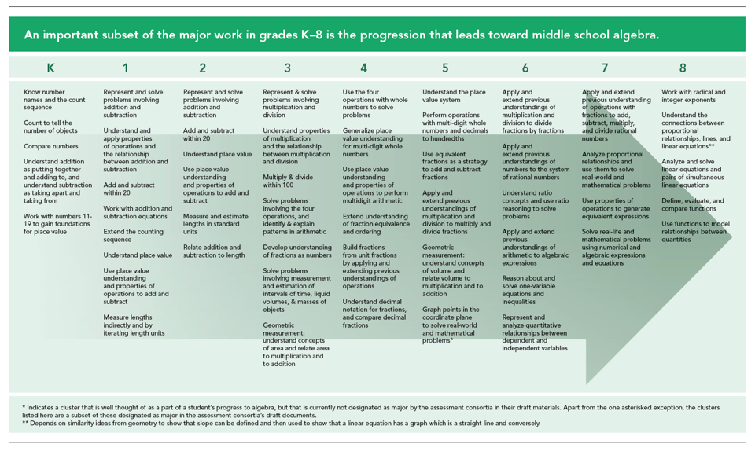
https://achievethecore.org/category/774/mathematics-focus-by-grade-level

Slide 19
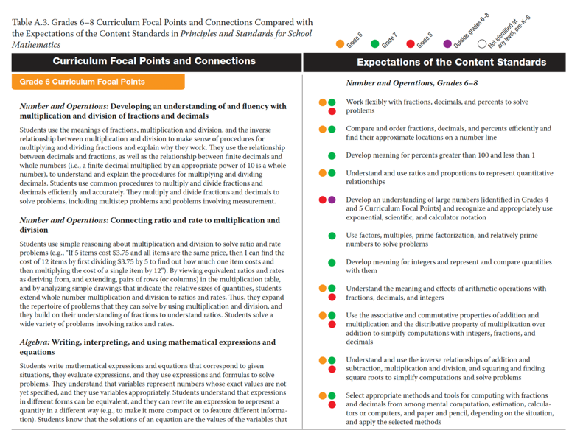
https://www.nctm.org/curriculumfocalpoints/

Slide 20
DESIGN
What is the critical content for your students?

Slide 21
DESIGN
Determine critical content
Identify evidence-based practices

Slide 22
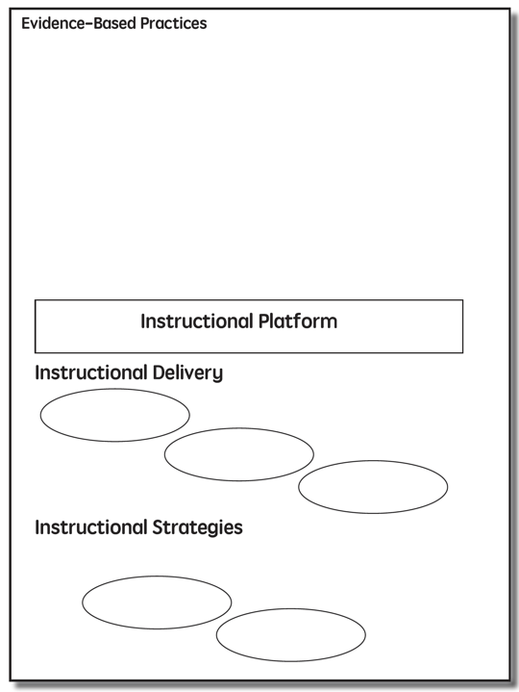

Slide 23
A practice that
has shown consistent and positive results
evidence-based practice

Slide 24
evidence-based practice
An intervention (i.e., packaged program) that
has shown consistent and positive results
evidence-based intervention

Slide 25
evidence-based practice
evidence-based intervention
evidence-based strategy
A method or strategy that has shown consistent and positive results

Slide 26
evidence-based practice
evidence-based intervention
evidence-based strategy
A method or strategy that has shown a positive result
promising practice

Slide 27
evidence-based practice
evidence-based intervention
evidence-based strategy
promising practice
no or negative evidence

Slide 28
Assessment data to show results
evidence-based practice
Improvement from before intervention
Improvement compared to no treatment students
Replication
evidence-based intervention
Multiple researchers
evidence-based strategy
Multiple students
Multiple times
promising practice
Setting and students similar to your own

Slide 29
DESIGN
Which evidence-based practices do you rely on for mathematics intervention?

Slide 30
DESIGN
Determine critical content
Identify evidence-based practices
Create the instructional platform

Slide 32
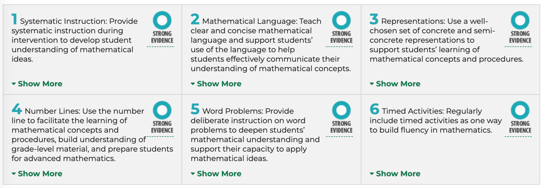
https://ies.ed.gov/ncee/wwc/PracticeGuides

Slide 33
Instructional Platform
INSTRUCTIONAL DELIVERY
Explicit instruction
Precise language
Multiple representations
INSTRUCTIONAL STRATEGIES
Fluency building
Problem solving instruction

Slide 34
DESIGN
Determine critical content
Identify evidence-based practices
Create the instructional platform
For your mathematics intervention:
(1) How will you determine critical content?
(2) How will you determine evidence-based practices?
(3) What do you plan to place into your instructional platform?

Slide 35
DESIGN
DELIVERY
Determine critical content
Identify evidence-based practices
Create the instructional platform

Slide 36
Instructional Platform
INSTRUCTIONAL DELIVERY
Explicit instruction
INSTRUCTIONAL STRATEGIES

Slide 37
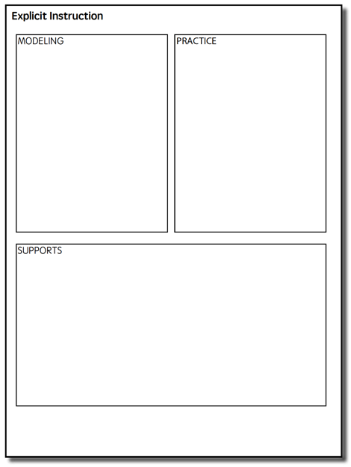

Slide 38
Explicit Instruction
MODELING
PRACTICE
Step-by-step explanation
Planned examples
Guided practice
Independent practice
SUPPORTS
Ask high-level and low-level questions
Eliciting frequent responses
Providing affirmative and corrective feedback
Notes:
For explicit instruction, we’ll rely on the model of explicit instruction from the National Center on Intensive Intervention. This model is a meaningful combination of modeling, practice, and supports.

Slide 39
MODELING
PRACTICE
Step-by-step explanation
Planned examples
Guided practice
Independent practice
SUPPORTS
Ask high-level and low-level questions
Eliciting frequent responses
Providing affirmative and corrective feedback
Modeling is a dialogue between the teacher and students.
In Modeling, a teacher introduces or reviews mathematical content.
Notes:
Let’s talk about Modeling. Modeling is a dialogue between the teacher and students. In Modeling, a teacher introduces or review mathematical content.

Slide 40
MODELING
PRACTICE
Step-by-step explanation
Planned examples
Guided practice
Independent practice
SUPPORTS
Ask high-level and low-level questions
Eliciting frequent responses
Providing affirmative and corrective feedback
Modeling includes a step-by-step explanation of how to do a mathematical problem.
A teacher may do 1 modeled problem or several.
Notes:
Let’s talk about Modeling. Modeling is a dialogue between the teacher and students. In Modeling, a teacher introduces or review mathematical content.

Slide 41
“Today, we are learning about division. This is important because sometimes you have to share objects or things with your friends.”

Slide 42
26
+ 79
“Let’s solve this problem. What’s the problem?
“26 plus 79.”
“To solve 26 plus 79, first decide about the operation. Should we add, subtract, multiply, or divide?”
“Add.”
“How did you know we want to add?”
“There’s a plus sign.”

Slide 43
26
+ 79
“The plus sign tells us we want to add. To add, let’s use the partial sums strategy. What strategy?”
“Partial sums.”
“With the partial sums strategy, we start adding in the greatest place value. What’s the greatest place value in this problem?”
“The tens.”
“So, let’s add the tens. What’s 20 plus 70?”
“90.”

Slide 44
26
+ 79
“20 plus 70 equals 90. Let’s write 90 right here below the equal line. What will we write?”
“90.”
“90 is the partial sum when you add the tens. What does 90 represent?”
“It’s the partial sum of adding 20 plus 70.”
“Now, let’s add the ones. What should we add?”
“6 plus 9.”

Slide 45
26
+ 79
“6 plus 9 equals what?”
“15.”
“Let’s write 15 below the 90. Where do we write the 15?”
“Below the 90.”
“15 is the partial sum when you add the ones. Now, let’s add the partial sums together. What will we add?”
“90 plus 15.”

Slide 46
26
+ 79
“What’s 90 plus 15?”
“105.”
“How did you add those numbers?”
“I added 90 plus 10 then added 5 more.”
“So, when you add 26 plus 79, the sum is 105. Who can share how we solved this problem?”
“We used the partial sums strategy. We added the tens then added the ones. Then we added the partial sums.”

Slide 47
MODELING
PRACTICE
Step-by-step explanation
Planned examples
Guided practice
Independent practice
SUPPORTS
Ask high-level and low-level questions
Eliciting frequent responses
Providing affirmative and corrective feedback
Modeling needs to include planned examples. These examples should be sequenced so easier skills lead to more difficult skills.
Planned examples in Modeling may also include worked examples – both correct and incorrect worked examples.
Notes:
Let’s talk about Modeling. Modeling is a dialogue between the teacher and students. In Modeling, a teacher introduces or review mathematical content.

Slide 48
MODELING
PRACTICE
Step-by-step explanation
Planned examples
Guided practice
Independent practice
SUPPORTS
Ask high-level and low-level questions
Eliciting frequent responses
Providing affirmative and corrective feedback
Sometimes, people refer to the modeling as “I Do.” I (Sarah) think that misrepresents modeling. What do you think?
Notes:
Let’s talk about Modeling. Modeling is a dialogue between the teacher and students. In Modeling, a teacher introduces or review mathematical content.

Slide 49
MODELING
PRACTICE
Step-by-step explanation
Planned examples
Guided practice
Independent practice
SUPPORTS
Ask high-level and low-level questions
Eliciting frequent responses
Providing affirmative and corrective feedback
Practice continues as a dialogue between the teacher and students.
During Practice, students have multiple opportunities to practice problems with varying levels of teacher support.
Notes:
Let’s talk about Modeling. Modeling is a dialogue between the teacher and students. In Modeling, a teacher introduces or review mathematical content.

Slide 50
MODELING
PRACTICE
Step-by-step explanation
Planned examples
Guided practice
Independent practice
SUPPORTS
Ask high-level and low-level questions
Eliciting frequent responses
Providing affirmative and corrective feedback
“Let’s work on a problem together.”
Guided practice is practice in which the teacher and students practice problems together.
Notes:
Let’s talk about Modeling. Modeling is a dialogue between the teacher and students. In Modeling, a teacher introduces or review mathematical content.

Slide 51
MODELING
PRACTICE
Step-by-step explanation
Planned examples
Guided practice
Independent practice
SUPPORTS
Ask high-level and low-level questions
Eliciting frequent responses
Providing affirmative and corrective feedback
“Now, you’ll practice a problem on your own. Don’t forget to use your attack strategy.”
Independent practice is practice in which the students practice independently with teacher support.
Notes:
Let’s talk about Modeling. Modeling is a dialogue between the teacher and students. In Modeling, a teacher introduces or review mathematical content.

Slide 52
MODELING
PRACTICE
Step-by-step explanation
Planned examples
Guided practice
Independent practice
SUPPORTS
Ask high-level and low-level questions
Eliciting frequent responses
Providing affirmative and corrective feedback
I (Sarah) believe that guided practice is essential as a scaffold for students. Would you say your students participate in enough guided practice?
Notes:
Let’s talk about Modeling. Modeling is a dialogue between the teacher and students. In Modeling, a teacher introduces or review mathematical content.

Slide 53
MODELING
PRACTICE
Step-by-step explanation
Planned examples
Guided practice
Independent practice
SUPPORTS
Ask high-level and low-level questions
Eliciting frequent responses
Providing affirmative and corrective feedback
These Supports should be used in both Modeling and Practice.
Notes:
Let’s talk about Modeling. Modeling is a dialogue between the teacher and students. In Modeling, a teacher introduces or review mathematical content.

Slide 54
MODELING
PRACTICE
Step-by-step explanation
Planned examples
Guided practice
Independent practice
SUPPORTS
Ask high-level and low-level questions
Eliciting frequent responses
Providing affirmative and corrective feedback
During Modeling and Practice, it is essential to engage students and check for understanding.
Ask a combination of high-level and low-level questions.
Notes:
Let’s talk about Modeling. Modeling is a dialogue between the teacher and students. In Modeling, a teacher introduces or review mathematical content.

Slide 55
MODELING
PRACTICE
Step-by-step explanation
Planned examples
Guided practice
Independent practice
SUPPORTS
Ask high-level and low-level questions
Eliciting frequent responses
Providing affirmative and corrective feedback
“What is 7 times 9?”
“63.”
Notes:
Let’s talk about Modeling. Modeling is a dialogue between the teacher and students. In Modeling, a teacher introduces or review mathematical content.

Slide 56
MODELING
PRACTICE
Step-by-step explanation
Planned examples
Guided practice
Independent practice
SUPPORTS
Ask high-level and low-level questions
Eliciting frequent responses
Providing affirmative and corrective feedback
“Why do you use zero pairs?”
“Because a positive 1 and a negative 1 equal 0. I use the zero pair to help me subtract.”
Notes:
Let’s talk about Modeling. Modeling is a dialogue between the teacher and students. In Modeling, a teacher introduces or review mathematical content.

Slide 57
MODELING
PRACTICE
Step-by-step explanation
Planned examples
Guided practice
Independent practice
SUPPORTS
Ask high-level and low-level questions
Eliciting frequent responses
Providing affirmative and corrective feedback
During Modeling and Practice, students should frequently respond. The frequent responses keeps student attention and keeps student learning active.
Notes:
Let’s talk about Modeling. Modeling is a dialogue between the teacher and students. In Modeling, a teacher introduces or review mathematical content.

Slide 58
MODELING
PRACTICE
Step-by-step explanation
Planned examples
Guided practice
Independent practice
SUPPORTS
Ask high-level and low-level questions
Eliciting frequent responses
Providing affirmative and corrective feedback
Oral
Written
With manipulatives
With drawings
With gestures
Notes:
Let’s talk about Modeling. Modeling is a dialogue between the teacher and students. In Modeling, a teacher introduces or review mathematical content.

Slide 59
MODELING
PRACTICE
Step-by-step explanation
Planned examples
Guided practice
Independent practice
SUPPORTS
Ask high-level and low-level questions
Eliciting frequent responses
Providing affirmative and corrective feedback
During Modeling and Practice, students should receive immediate feedback on their responses.
Students should receive affirmative and (when necessary) corrective feedback.
Notes:
Let’s talk about Modeling. Modeling is a dialogue between the teacher and students. In Modeling, a teacher introduces or review mathematical content.

Slide 60
MODELING
PRACTICE
Step-by-step explanation
Planned examples
Guided practice
Independent practice
SUPPORTS
Ask high-level and low-level questions
Eliciting frequent responses
Providing affirmative and corrective feedback
“Nice work using your word problem attack strategy.”
Notes:
Let’s talk about Modeling. Modeling is a dialogue between the teacher and students. In Modeling, a teacher introduces or review mathematical content.

Slide 61
MODELING
PRACTICE
Step-by-step explanation
Planned examples
Guided practice
Independent practice
SUPPORTS
Ask high-level and low-level questions
Eliciting frequent responses
Providing affirmative and corrective feedback
“Let’s look at that again. Tell me how you added in the hundreds column.”
Notes:
Let’s talk about Modeling. Modeling is a dialogue between the teacher and students. In Modeling, a teacher introduces or review mathematical content.

Slide 62
MODELING
PRACTICE
Step-by-step explanation
Planned examples
Guided practice
Independent practice
SUPPORTS
Ask high-level and low-level questions
Eliciting frequent responses
Providing affirmative and corrective feedback
Notes:
Let’s talk about Modeling. Modeling is a dialogue between the teacher and students. In Modeling, a teacher introduces or review mathematical content.

Slide 63
Modeling
Practice
Supports
Introduction of material
Review of material
Modeling
Practice
Modeling
Practice
Supports
Supports

Slide 64
MODELING
PRACTICE
Step-by-step explanation
Planned examples
Guided practice
Independent practice
SUPPORTS
Ask high-level and low-level questions
Eliciting frequent responses
Providing affirmative and corrective feedback
What’s your strength with modeling? What could you improve?
What’s your strength with practice? What would you improve?
Which
support is a strength? Provide an example.
Which
support could you improve? Why would this be important?

Slide 65
Explicit Instruction
MODELING
PRACTICE
Step-by-step explanation
Planned examples
Guided practice
Independent practice
SUPPORTS
Ask high-level and low-level questions
Eliciting frequent responses
Providing affirmative and corrective feedback
Notes:
For explicit instruction, we’ll rely on the model of explicit instruction from the National Center on Intensive Intervention. This model is a meaningful combination of modeling, practice, and supports.

Slide 66
Instructional Platform
INSTRUCTIONAL DELIVERY
Explicit instruction
Precise language
INSTRUCTIONAL STRATEGIES

Slide 67
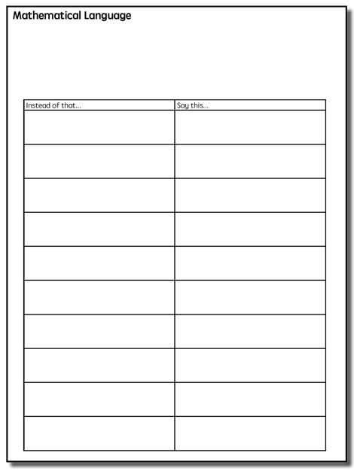

Slide 68
Powell, Bos, & Lin (2019)

Slide 69
Listening
Speaking
Reading
Writing
Vocabulary

Slide 70
1. Some math terms are shared with English but have different meanings
right
base
degree
Rubenstein & Thompson (2002)

Slide 71
1. Some math terms are shared with English but have different meanings
2. Some math words are shared with English with similar meanings
(but a more precise math meaning)
difference
even
Rubenstein & Thompson (2002)

Slide 72
1. Some math terms are shared with English but have different meanings
2. Some math words are shared with English with similar meanings
(but a more precise math meaning)
3. Some math terms are only used in math
numerator
trapezoid
parallelogram
Rubenstein & Thompson (2002)

Slide 73
1. Some math terms are shared with English but have different meanings
2. Some math words are shared with English with similar meanings
(but a more precise math meaning)
3. Some math terms are only used in math
4. Some math terms have more than one meaning
square
round
base
second
Rubenstein & Thompson (2002)

Slide 74
1. Some math terms are shared with English but have different meanings
2. Some math words are shared with English with similar meanings
(but a more precise math meaning)
3. Some math terms are only used in math
4. Some math terms have more than one meaning
5. Some math terms are similar to other content-area terms with different meanings
variable vs. variably cloudy
divide vs. Continental Divide
Rubenstein & Thompson (2002)

Slide 75
1. Some math terms are shared with English but have different meanings
2. Some math words are shared with English with similar meanings
(but a more precise math meaning)
3. Some math terms are only used in math
4. Some math terms have more than one meaning
5. Some math terms are similar to other content-area terms with different meanings
6. Some math terms are homographs
sum vs. some
eight vs. ate
base vs. bass
rows vs. rose
Rubenstein & Thompson (2002)

Slide 76
1. Some math terms are shared with English but have different meanings
2. Some math words are shared with English with similar meanings
(but a more precise math meaning)
3. Some math terms are only used in math
4. Some math terms have more than one meaning
5. Some math terms are similar to other content-area terms with different meanings
6. Some math terms are homographs
7. Some math terms are related but have distinct meanings
hundreds vs. hundredths
factor vs. multiple
numerators vs. denominator
Rubenstein & Thompson (2002)

Slide 77
1. Some math terms are shared with English but have different meanings
2. Some math words are shared with English with similar meanings
(but a more precise math meaning)
3. Some math terms are only used in math
4. Some math terms have more than one meaning
5. Some math terms are similar to other content-area terms with different meanings
6. Some math terms are homographs
7. Some math terms are related but have distinct meanings
8. An English math term may translate into another language with different meanings
mesa vs. tabla
Rubenstein & Thompson (2002)

Slide 78
1. Some math terms are shared with English but have different meanings
2. Some math words are shared with English with similar meanings
(but a more precise math meaning)
3. Some math terms are only used in math
4. Some math terms have more than one meaning
5. Some math terms are similar to other content-area terms with different meanings
6. Some math terms are homographs
7. Some math terms are related but have distinct meanings
8. An English math term may translate into another language with different meanings
9. English spelling and usage may have irregularities
four vs. forty
Rubenstein & Thompson (2002)

Slide 79
1. Some math terms are shared with English but have different meanings
2. Some math words are shared with English with similar meanings
(but a more precise math meaning)
3. Some math terms are only used in math
4. Some math terms have more than one meaning
5. Some math terms are similar to other content-area terms with different meanings
6. Some math terms are homographs
7. Some math terms are related but have distinct meanings
skip count vs. multiples
8. An English math term may translate into another language with different meanings
9. English spelling and usage may have irregularities
one-fourth vs. one quarter
10. Some math concepts are verbalized in more than one way

Slide 80
1. Some math terms are shared with English but have different meanings
2. Some math words are shared with English with similar meanings
(but a more precise math meaning)
3. Some math terms are only used in math
4. Some math terms have more than one meaning
5. Some math terms are similar to other content-area terms with different meanings
6. Some math terms are homographs
7. Some math terms are related but have distinct meanings
8. An English math term may translate into another language with different meanings
rhombus vs. diamond
9. English spelling and usage may have irregularities
10. Some math concepts are verbalized in more than one way
vertex vs. corner
11. Informal terms may be used for formal math terms

Slide 81
Use formal math language
Use terms precisely

Slide 82
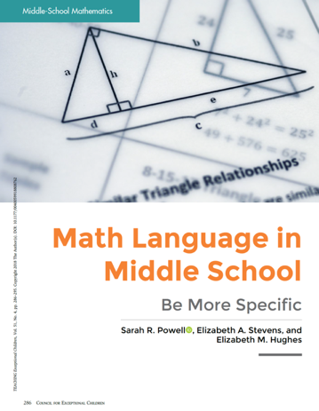

Slide 92
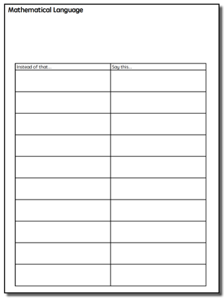
What are examples of,
“Instead of ___, Say ___?”

Slide 93
Use formal math language
Use terms precisely

Slide 94
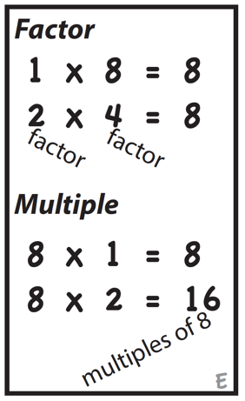
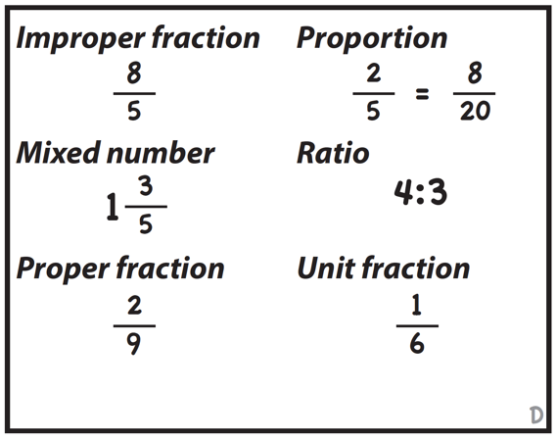

Slide 95
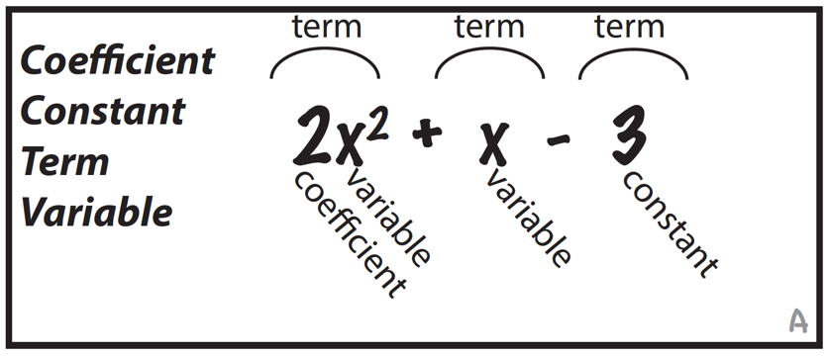
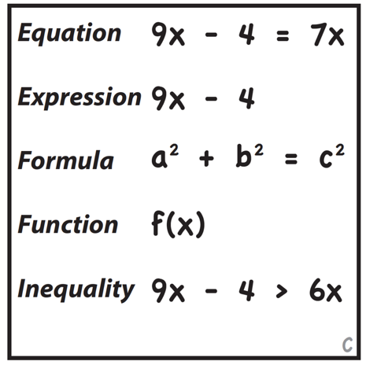

Slide 96
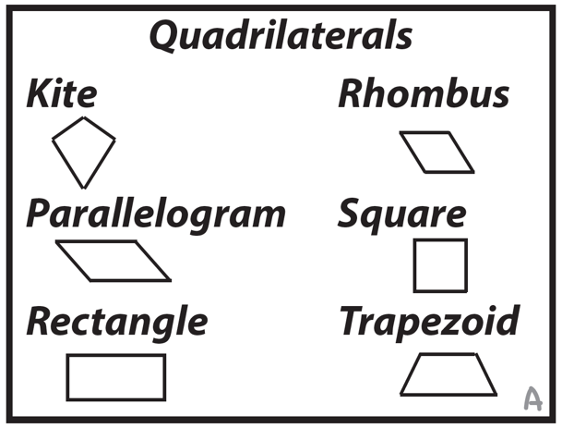

Slide 97
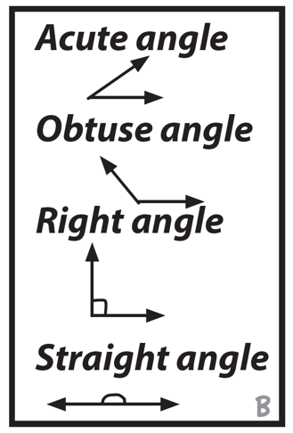
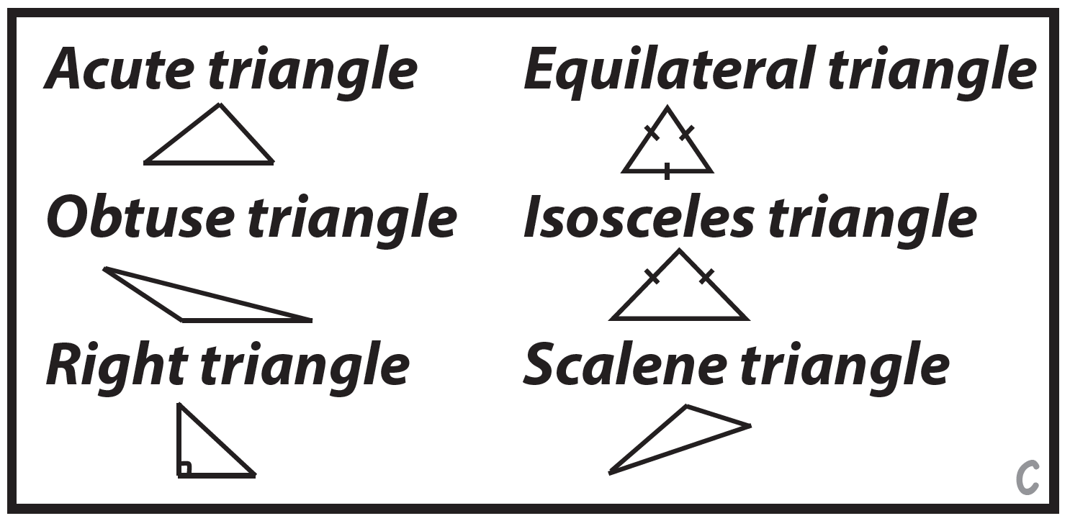

Slide 98
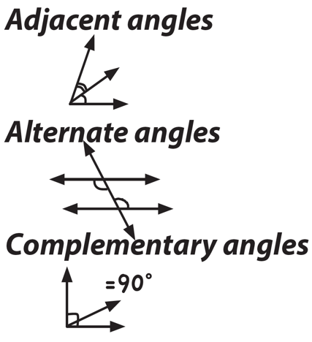
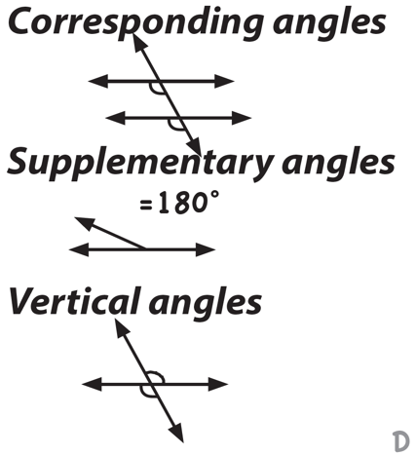
Rubenstein & Thompson (2002)

Slide 99
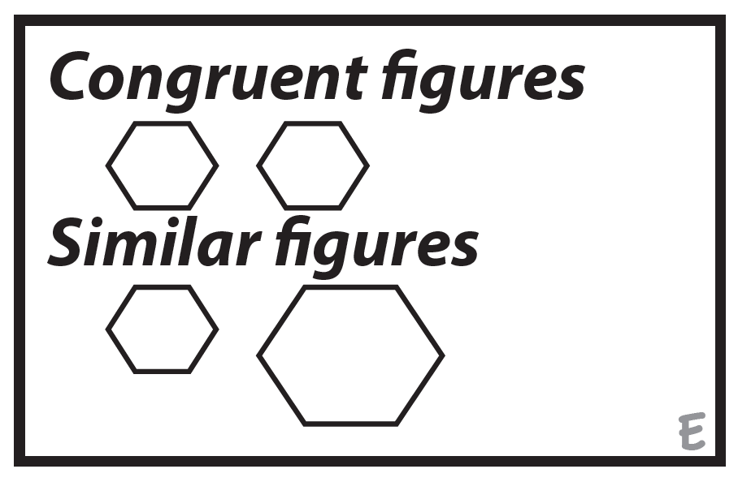
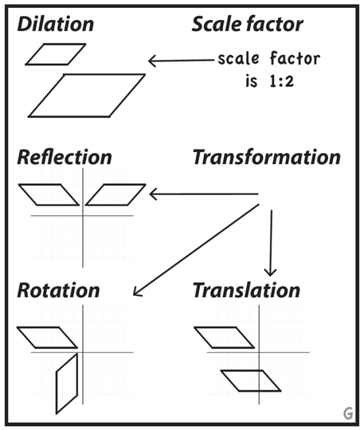
Rubenstein & Thompson (2002)

Slide 100
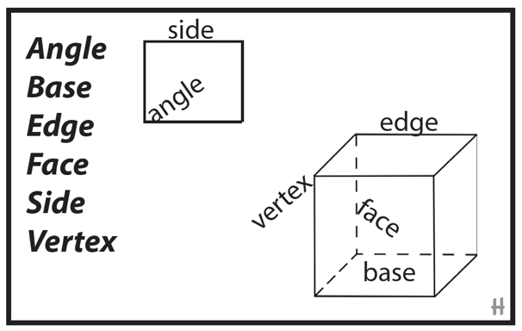
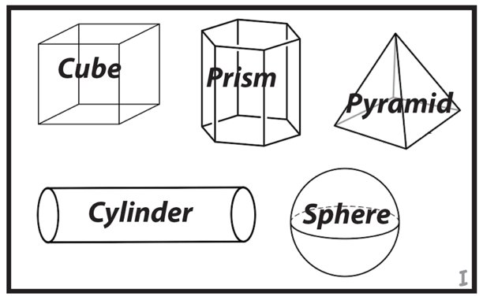
Rubenstein & Thompson (2002)

Slide 101
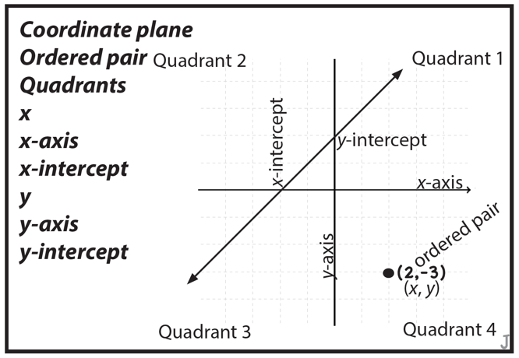
Rubenstein & Thompson (2002)

Slide 102
Which terms do your students not use precisely?

Slide 103
Use formal math language
Use terms precisely

Slide 104
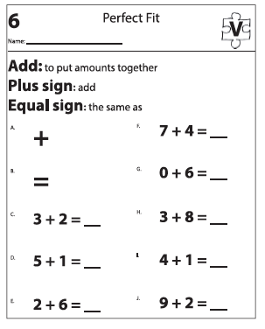
1. Use explicit instruction

Slide 105
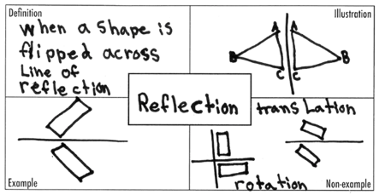
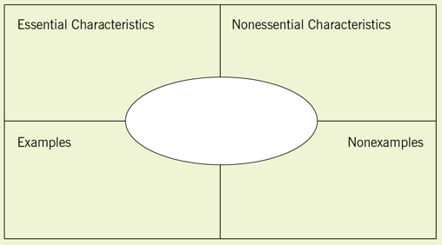
2. Use graphic organizers
Dunston & Tyminski (2013)

Slide 106
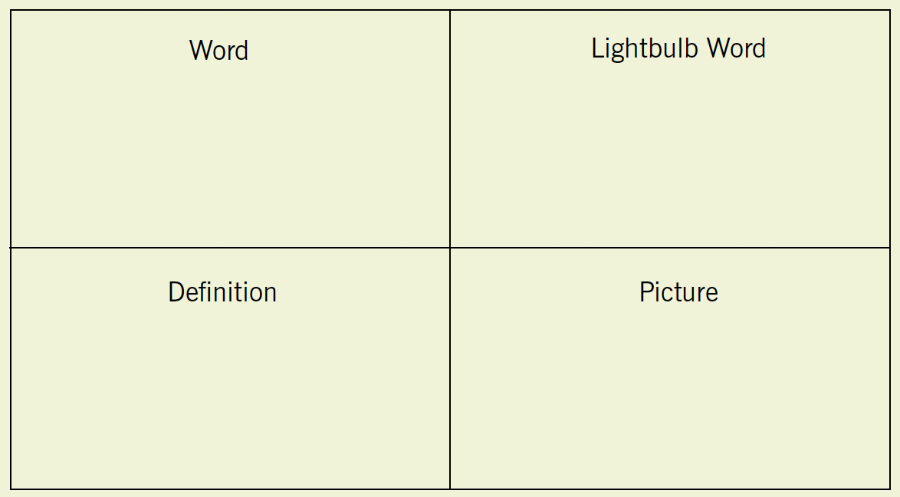
2. Use graphic organizers
Dunston & Tyminski (2013)

Slide 107
3. Have students create vocabulary cards

Slide 108
4. Have students create glossaries

Slide 109
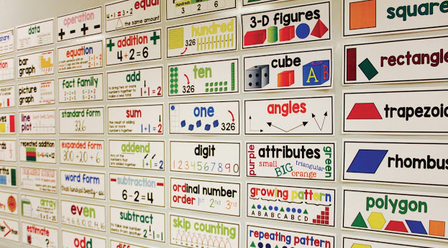
5. Create a word wall

Slide 110
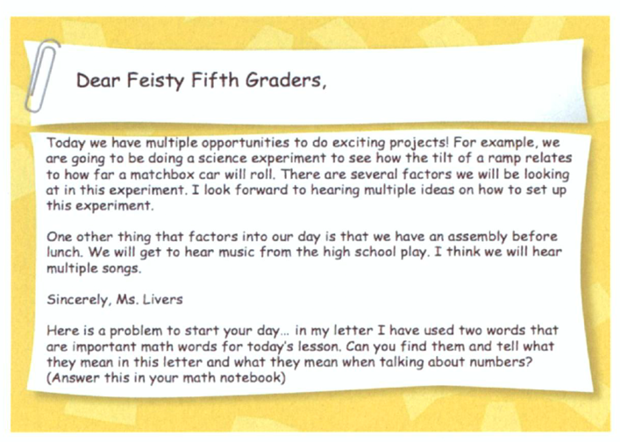
6. Preview vocabulary
Bay-Williams & Livers (2009)

Slide 111
7. Cluster vocabulary
Livers & Bay-Williams (2014)

Slide 112
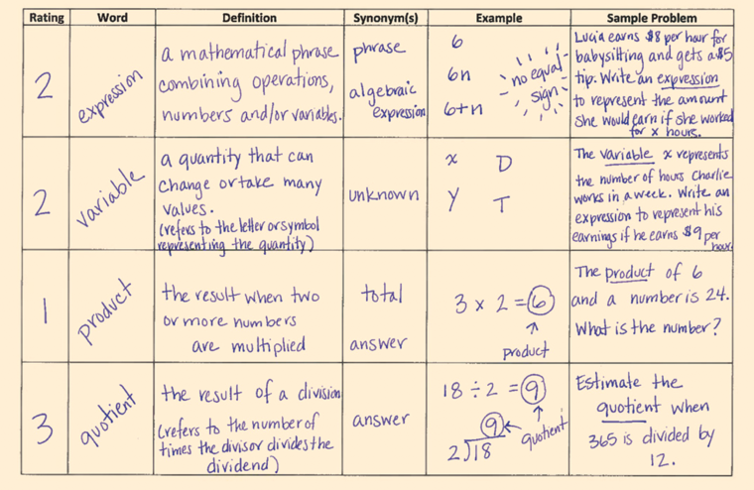
7. Cluster vocabulary
Marin (2018)

Slide 113
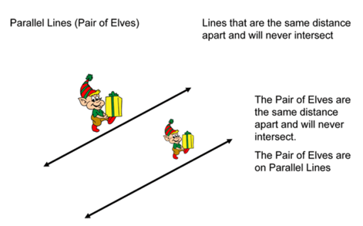
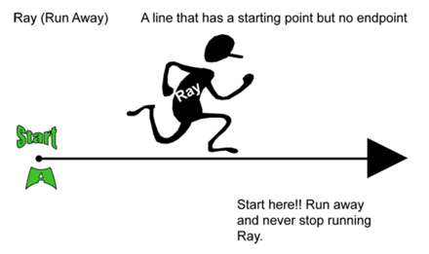
8. Use mnemonics
Riccomini et al. (2015)

Slide 114
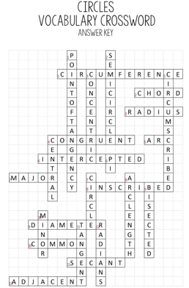
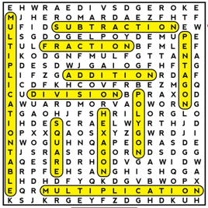
9. Do word games

Slide 115
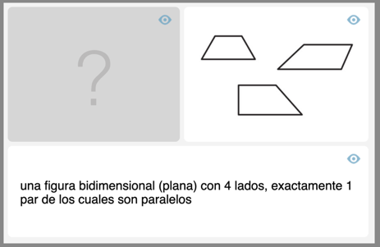
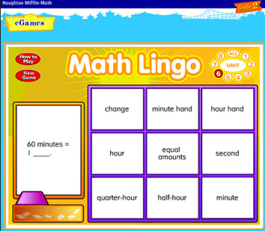
10. Use technology
Math Learning Center
Math Lingo

Slide 116
What are other ways to support learning mathematics vocabulary?

Slide 117
Instructional Platform
INSTRUCTIONAL DELIVERY
Explicit instruction
Precise language
Multiple representations
INSTRUCTIONAL STRATEGIES

Slide 118
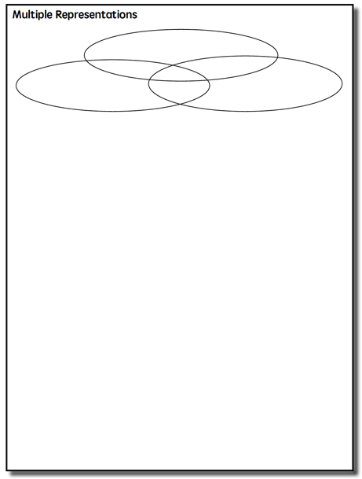

Slide 119
Multiple Representations
Abstract
Pictorial
Concrete

Slide 120
Abstract
Pictorial
Concrete
Three-dimensional objects

Slide 121
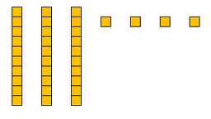
Abstract
Pictorial
Concrete
Two-dimensional images

Slide 122
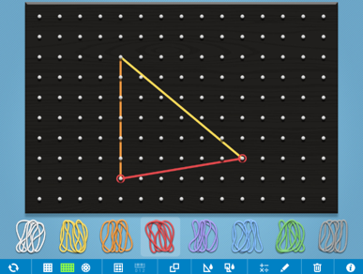
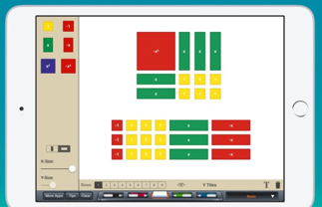
Abstract
Pictorial
Concrete
Two-dimensional images

Slide 123
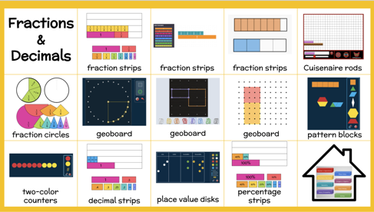
Abstract
Pictorial
Concrete
Two-dimensional images

Slide 124
Abstract
Pictorial
Concrete
Numerals and symbols and words
2 + 8 = 10
34 = 3 tens and 4 ones
x – 6 = 8
4,179
+ 569

Slide 125
If you are left handed:
What’s one of your favorite hands-on manipulatives?
If you are right handed:
What’s one of your favorite virtual manipulatives?

Slide 126
Instructional Platform
INSTRUCTIONAL DELIVERY
Explicit instruction
Precise language
Multiple representations
INSTRUCTIONAL STRATEGIES
Fluency building

Slide 127
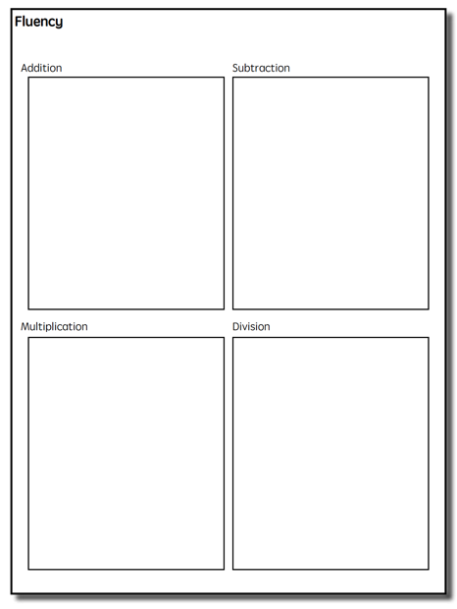

Slide 128
Building Fluency
Addition
Subtraction
Fluency is doing mathematics easily and accurately.
Fluency in mathematics makes mathematics easier.
Fluency provides less stress on working memory.
Fluency helps students build confidence with mathematics.
Multiplication
Division
Notes:
Now let’s talk about fluency.
Our conversation related to fluency will focus on addition, subtraction, multiplication, and division.
Fluency is doing mathematics easily and accurately. Note, we are not strictly talking about memorization when we talk about fluency.
Fluency in mathematics makes mathematics easier.
Fluency provides less stress on working memory.
Fluency helps students build confidence with mathematics.

Slide 129
Addition
Subtraction
With fluency, it is important to emphasize both conceptual learning and procedural learning.
Fluency is not strictly procedural!
Multiplication
Division
Notes:
With fluency, it’s important to emphasize both conceptual learning and procedural learning.
Fluency is not strictly procedural!

Slide 130
Addition
100 addition basic facts
Single-digit addends sum to a single- or double-digit number
5 (addend)
+ 4 (addend)
9 (sum)

Slide 131
Addition: Total (Part-Part-Whole, Combine)
Count one set, count another set, put sets together, count sum
2 + 3 = 5

Slide 132
Addition: Join (Change Increase)
Start with a set, add the other set, count sum
2 + 3 = 5

Slide 133
Total
Parts put together into a total
Karly saw 4 cardinals and 5 blue jays. How many birds did Karly see?
4 + 5 = ?

Slide 134
Change
An amount that increases or decreases
Premila had $4. Then they earned $3 for cleaning their room. How much money does Premila have now?
4 + 3 = ?

Slide 135
Total Versus Change (Join)
3 + 9 = __
If you have brown eyes:
What’s a Total story to show addition?
If you don’t have brown eyes:
What’s a Change/Join story to show addition?

Slide 136
Subtraction
100 subtraction basic facts
Subtrahend and difference are single-digit numbers and minuend is single- or double-digit number
16 (minuend)
– 8 (subtrahend)
8 (difference)

Slide 137
Subtraction: Separate (Change Decrease)
Start with a set, take away from that set, count difference
5 – 3 = 2

Slide 138
Subtraction: Difference (Compare)
Compare two sets, count difference
5 – 3 = 2

Slide 139
Change
An amount that increases or decreases
Bronwyn had 9 cookies. Then they ate 2 of the cookies. How many cookies does Bronwyn have now?
9 – 2 = ?

Slide 140
Difference
Greater and less amounts compared for a difference
Rachel has 9 apples. Jodie has 4 apples. How many more apples does Rachel have? (How many fewer does Jodie have?)
9 – 4 = ?

Slide 141
Change (Separate) versus Difference
9 – 5 = __
If you weren’t born in Texas:
What’s a Change/Separate story to show subtraction?
If you were born in Texas:
What’s a Difference story to show subtraction?

Slide 142
Multiplication
100 multiplication basic facts
Multiplication of single-digit factors results in a single- or double-digit product
2 (factor)
× 3 (factor)
6 (product)

Slide 143
Multiplication: Equal Groups
Show the groups, show the amount for each group, count product
3 × 2 = 6

Slide 144
Multiplication: Equal Groups
Show the groups, show the amount for each group, count product
3 × 2 = 6

Slide 145
Multiplication: Comparison
Show a set, then multiply the set
3 × 2 = 6

Slide 146
Equal Groups
Groups multiplied by number in each group for a product
Rhiannon has 2 boxes of crayons. There are 12 crayons in each box. How many crayons does Rhiannon have altogether?
2 × 6 = ?

Slide 147
Comparison
Set multiplied by a number of times for a product
Vivienne picked 6 apples. Jessica picked 2 times as many apples as Vivienne. How many apples did Jessica pick?
6 × 2 = ?

Slide 148
Equal Groups versus Comparison
2 × 5 = __
If you have glasses on:
What’s an Equal Groups story to show multiplication?
If you don’t have glasses on:
What’s a Comparison story to show multiplication?

Slide 149
Division
90 division basic facts
Divisor and quotient are single-digit numbers and dividend is single- or double-digit number
8 ÷ 4 = 2
(dividend) (divisor) (quotient)

Slide 150
Division: Equal Groups (Partitive Division)
Show the dividend, divide equally among divisor, count quotient
8 ÷ 2 = 4

Slide 151
Division: Equal Groups (Quotative Division)
Show the dividend, make groups of the divisor, count groups
8 ÷ 2 = 4

Slide 152
Equal Groups
Groups multiplied by number in each group for a product
Stefanie has 12 apples. She wants to share them equally among her 2 friends. How many apples will each friend receive?
2 × ? = 12
Nicole has 12 apples. She put them into bags containing 6 apples each. How many bags did Nicole use?
? × 6 = 12

Slide 153
Partitive versus Quotative
12 ÷ 4 = __
If you watched Friends:
What’s a Partitive story to show division?
If you watched Seinfeld:
What’s a Quotative story to show division?

Slide 154
Build fluency with math facts.
Addition: single-digit addends
Subtraction: single-digit subtrahend
Multiplication: single-digit factors
Division: single-digit divisor
Addition
Subtraction
Multiplication
Division
5
+ 8
9
– 4
6
× 7
56
÷ 8
Notes:
Students should develop fluency with math facts. Math facts include:
In addition, math facts have single-digit addends.
Click.
Like 5 plus 8. What’s another addition fact?
In subtraction, math facts have a single-digit subtrahend subtracted from a single- or double-digit minuend.
Click.
Like 9 minus 4. What’s another subtraction fact?
In multiplication, math facts have single-digit factors.
Click.
Like 6 times 7. What’s another multiplication fact?
And in division, math facts have a single-digit divisor with a single-or double-digit dividend.
Click.
56 divided by 8. What’s another division fact?

Slide 155
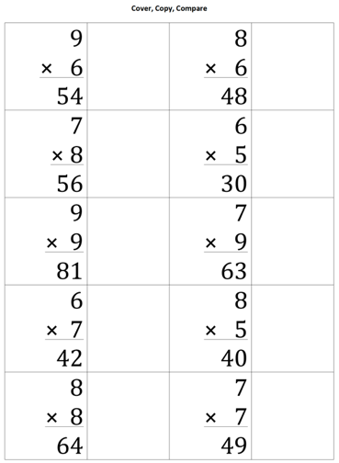
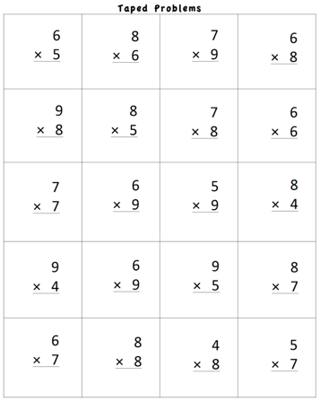
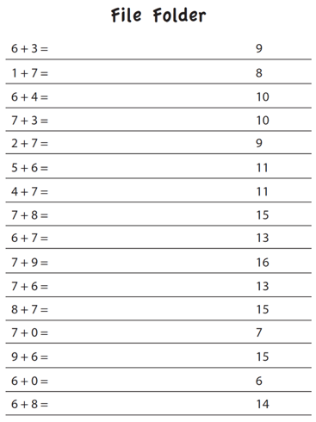

Slide 156
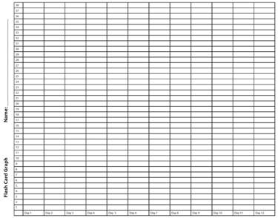
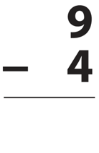
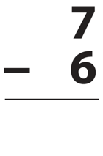

Slide 159
Addition
Subtraction
Multiplication
Division
What are other ways to practice fluency?
Notes:
To review, the fourth evidence-based strategy you should include in your instructional platform is to build fluency.
Fluency is doing mathematics easily and accurately.
With fluency, it’s important to emphasize both conceptual learning and procedural learning.
Fluency is not strictly procedural!

Slide 160
Addition
Subtraction
Build fluency with whole-number computation
Multiplication
Division
15
+ 28
1009
– 724
23
× 9
7250
÷ 15

Slide 161
Addition
Subtraction
Build fluency with rational-number computation
Multiplication
Division
1.4
+ 3.9
7.892
÷ 0.14
2
3
3
4
9
4
3
8
×
–

Slide 162
Addition
Subtraction
Build fluency with integer computation
Multiplication
Division
6
× -12
-135 ÷ 2 =
-14 – (-7) =
1.4
+ -3.9

Slide 163
Addition
Subtraction
Multiplication
Division
How will your support math language in your intervention?
How will you use multiple representations in your math intervention?
How will you build fluency in your intervention?
Notes:
To review, the fourth evidence-based strategy you should include in your instructional platform is to build fluency.
Fluency is doing mathematics easily and accurately.
With fluency, it’s important to emphasize both conceptual learning and procedural learning.
Fluency is not strictly procedural!

Slide 164
Instructional Platform
INSTRUCTIONAL DELIVERY
Explicit instruction
Precise language
Multiple representations
INSTRUCTIONAL STRATEGIES
Fluency building
Problem solving instruction

Slide 166
https://intensiveintervention.org/intensive-intervention-math-course

Slide 167
https://www.amazon.com/Teaching-Math-Middle-School-Students/dp/1598572741
https://www.inclusionintexas.org/apps/pages/index.jsp?uREC_ID=2155039&type=d&pREC_ID=2169859

Slide 168
Sarah R. Powell, Ph.D.
Associate Professor
The University of Texas at Austin
www.sarahpowellphd.com
srpowell@utexas.edu
@sarahpowellphd
119

