Slide 1
Parish Path Warden Report
8th April 2019

Slide 2
Strimming / Maintenance
Brookfield Farm Path
New Bridge
ST Resilience Project
2019-20 Plans

Slide 3
Strimming
WCC Strimming Programme
Reduced personal time
New strimmer/brushcutter purchased

Slide 4
Maintenance
General clearance
4 new stile stepovers
New waymarking
Fallen tree removals

Slide 5
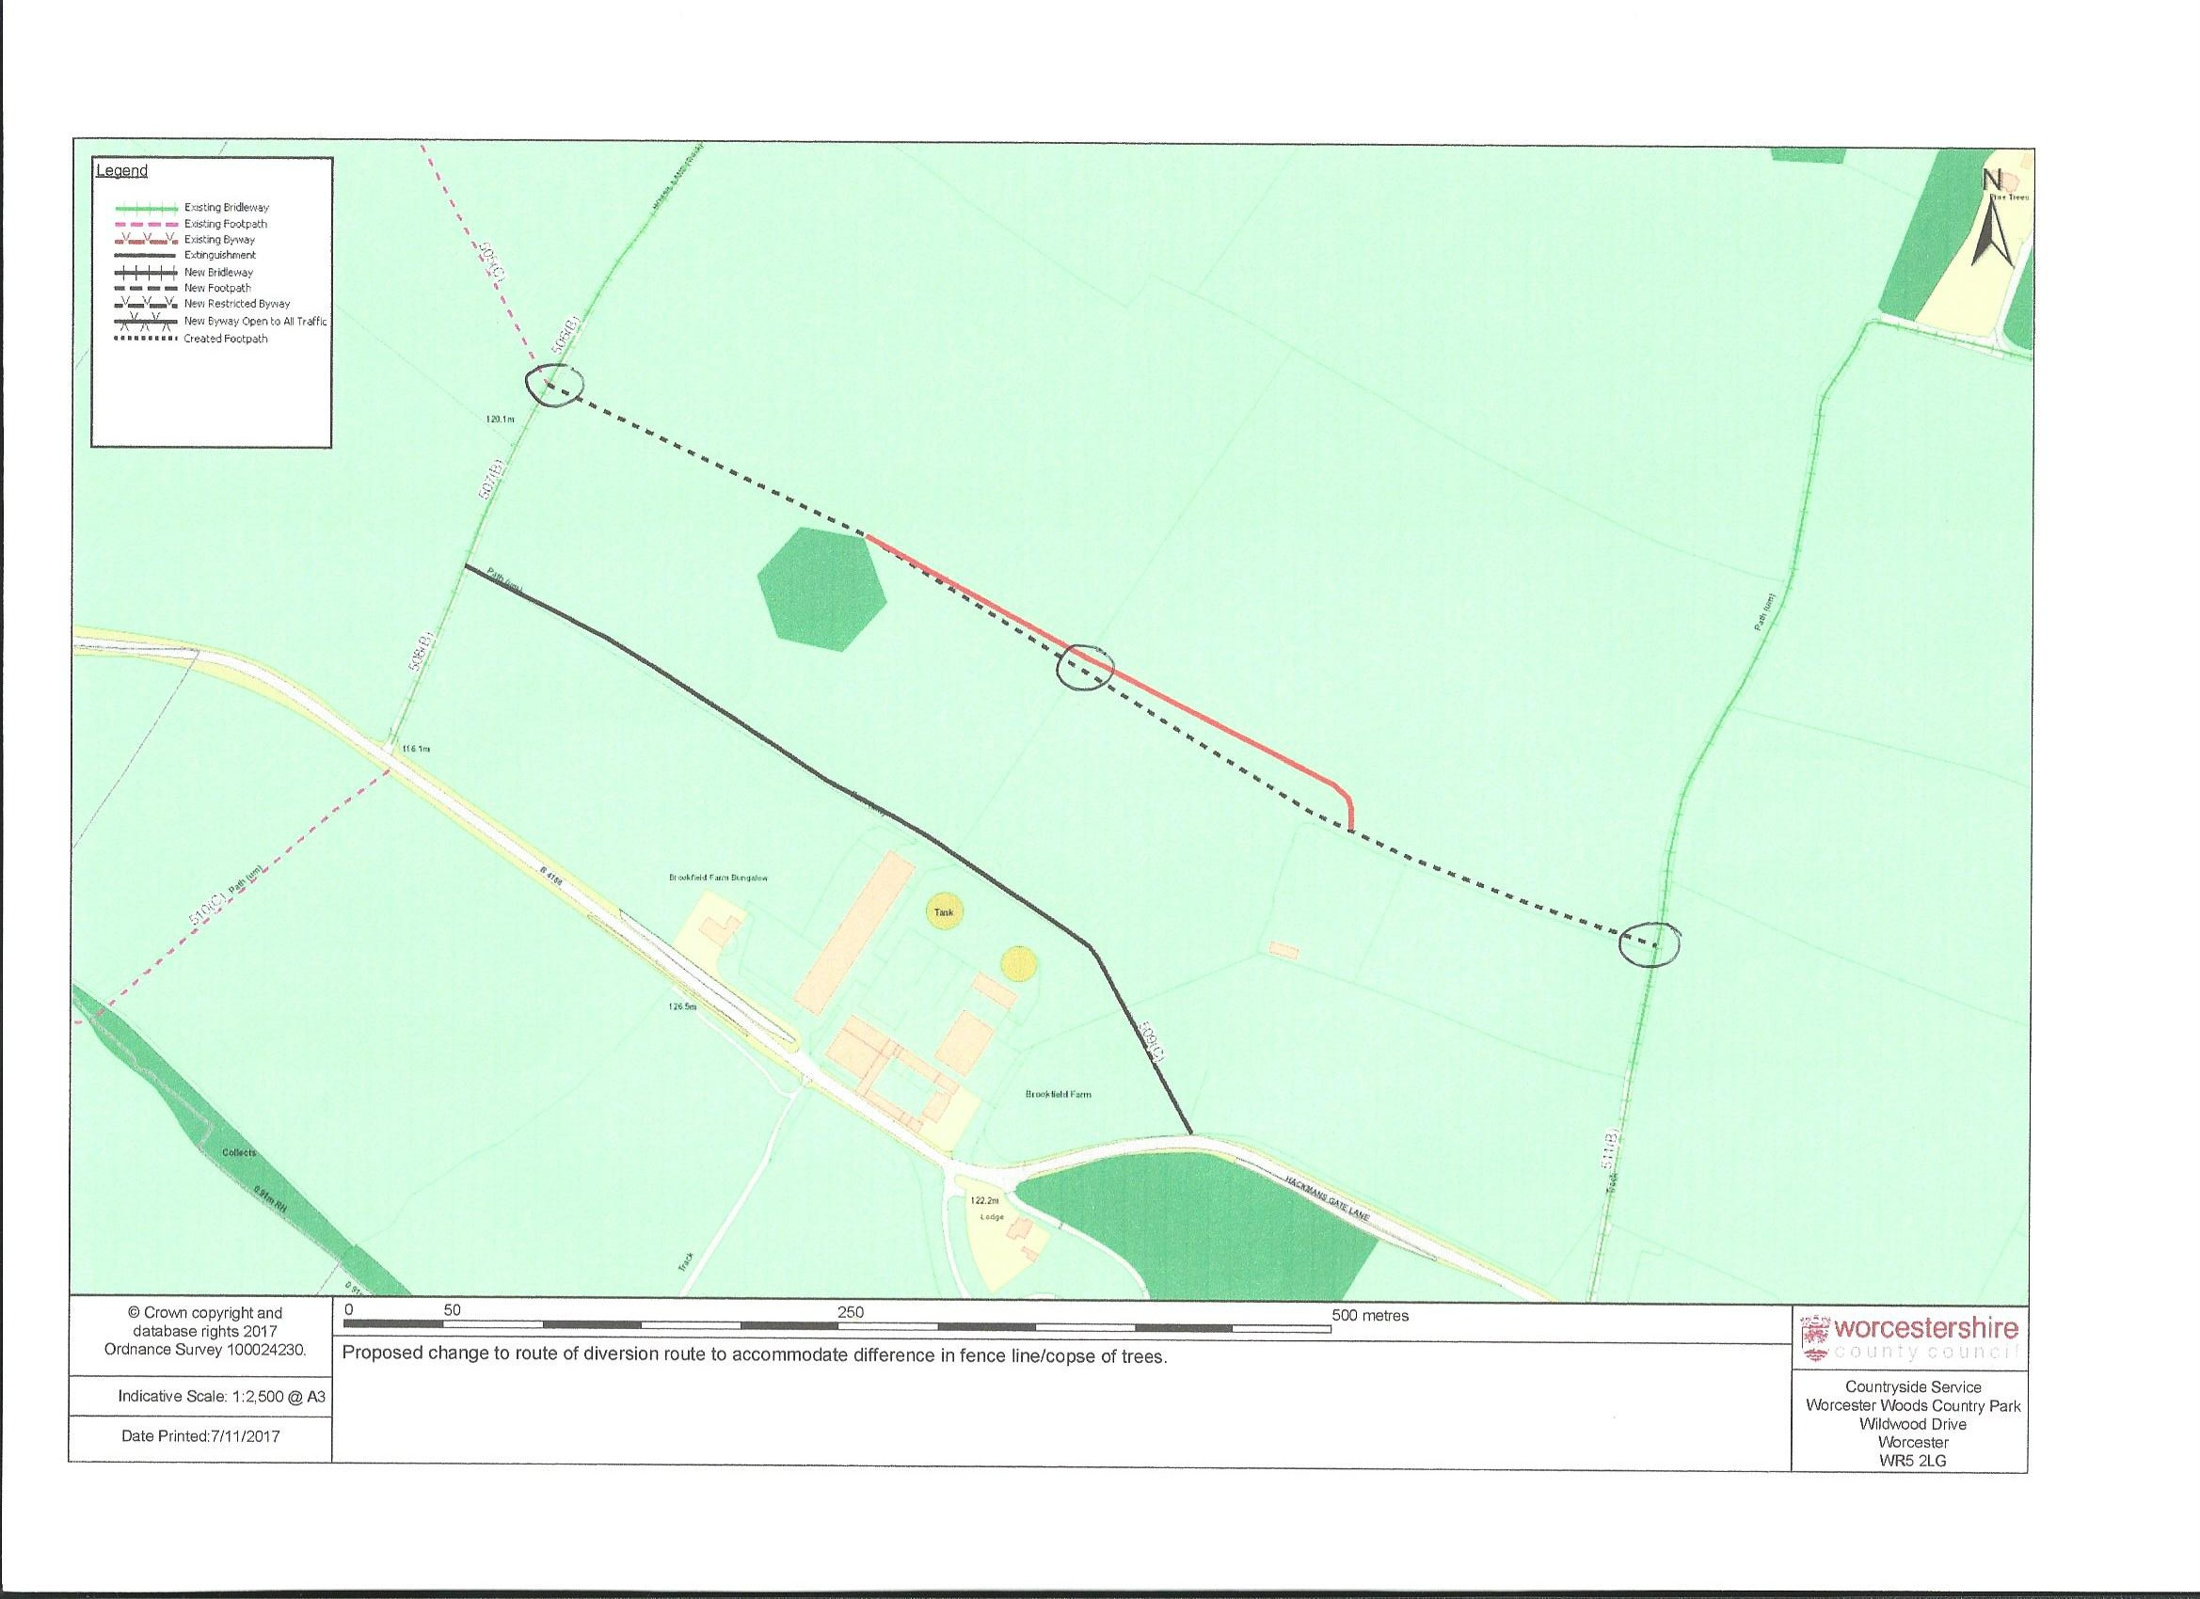
New Path – Brookfield Farm
Inaugural Walk 21st October 2018

Slide 6
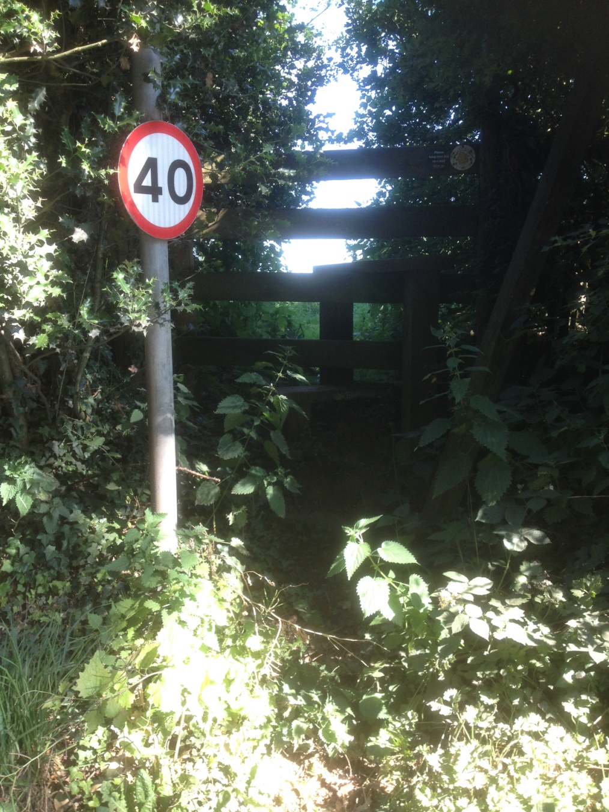
Old Path Stile

Slide 7
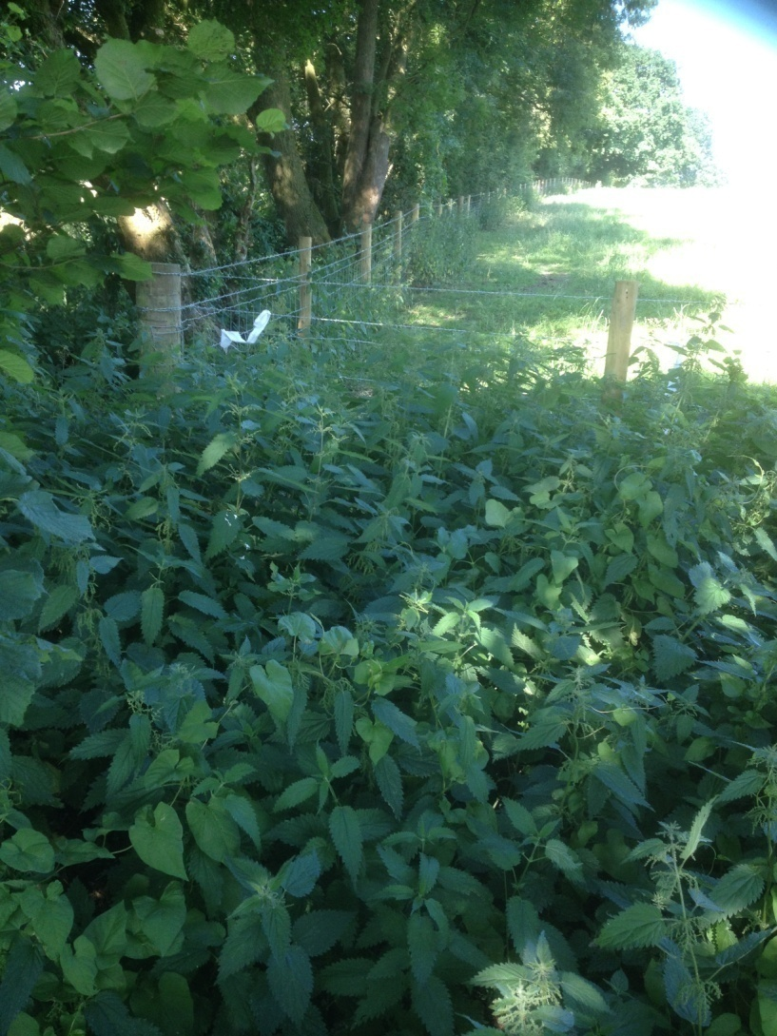
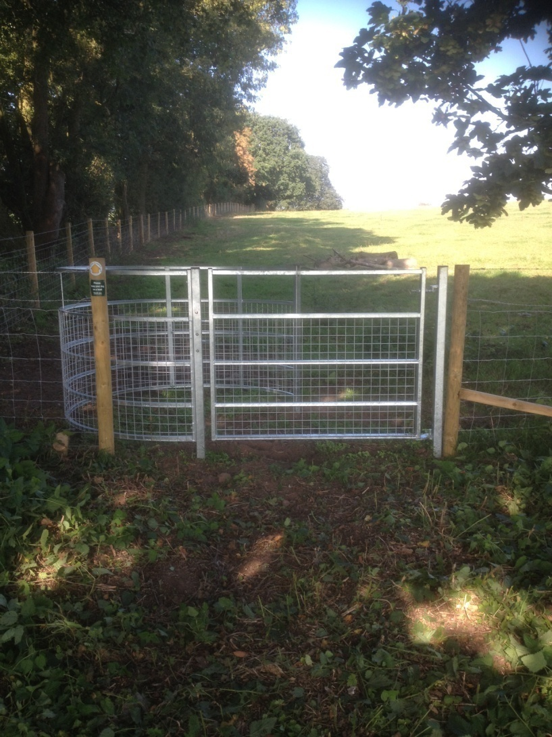
Lower Gate - nr Cricket Club

Slide 8
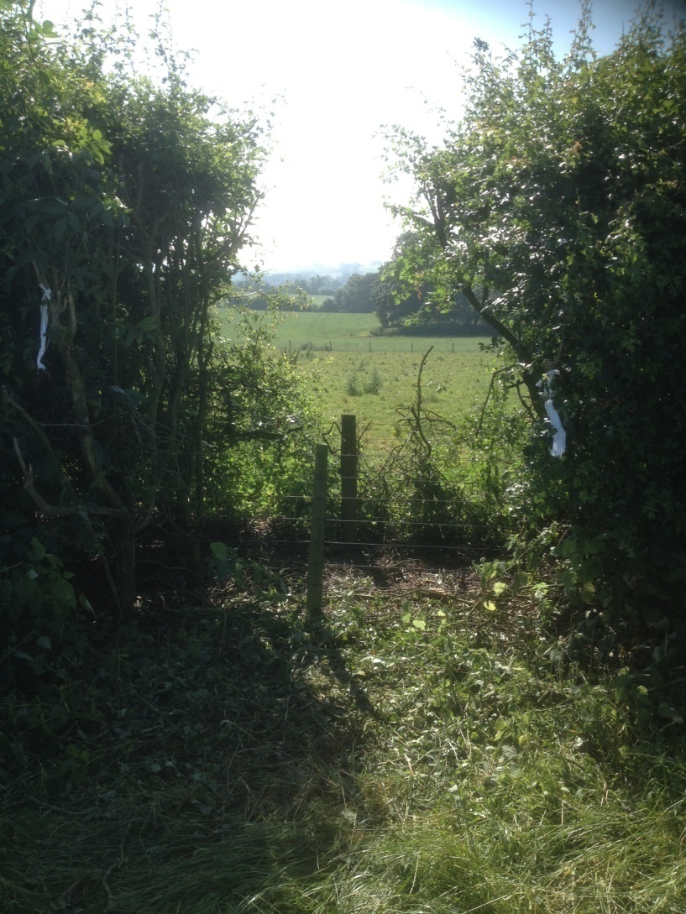
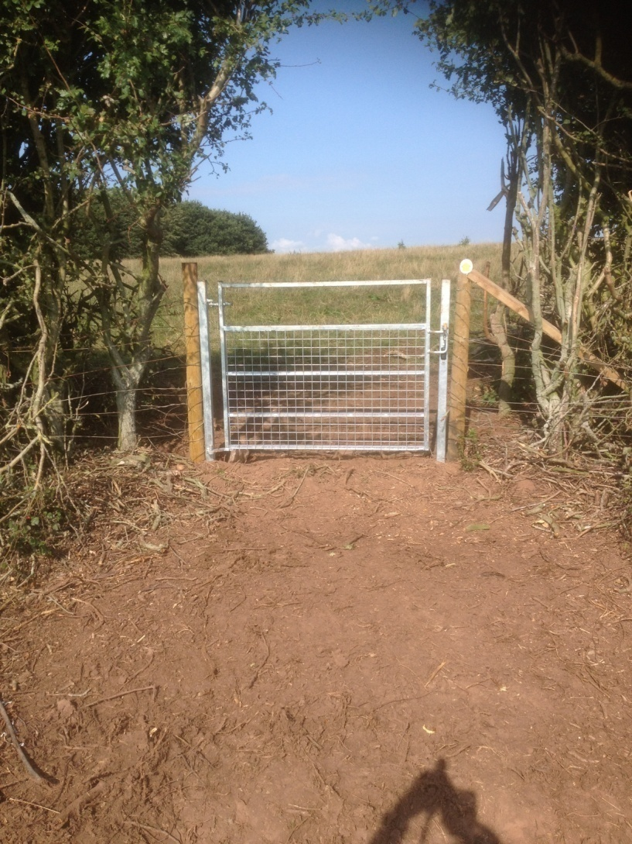
Central Hedge Gate

Slide 9
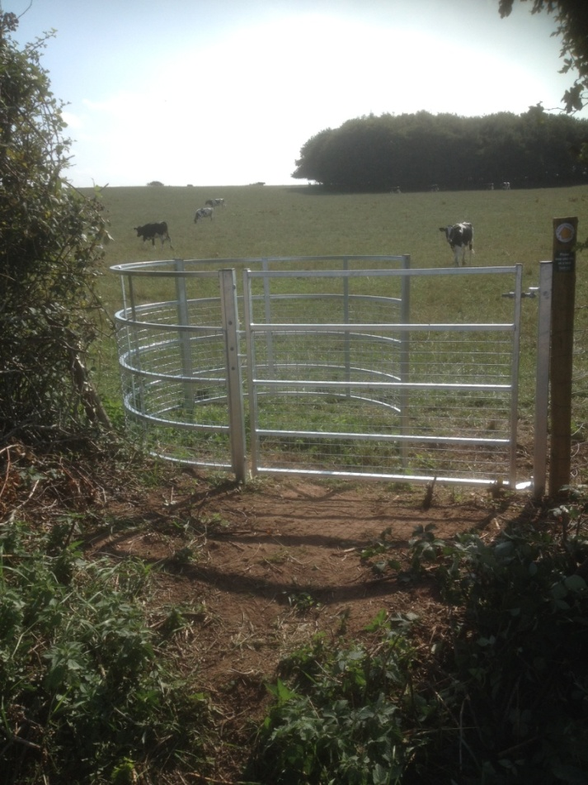
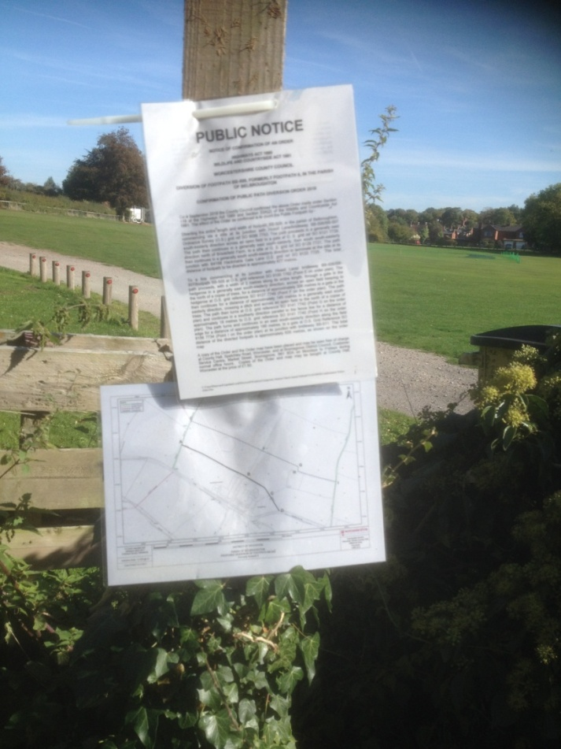
Public Notices
Higher Gate - Hossil Lane

Slide 10
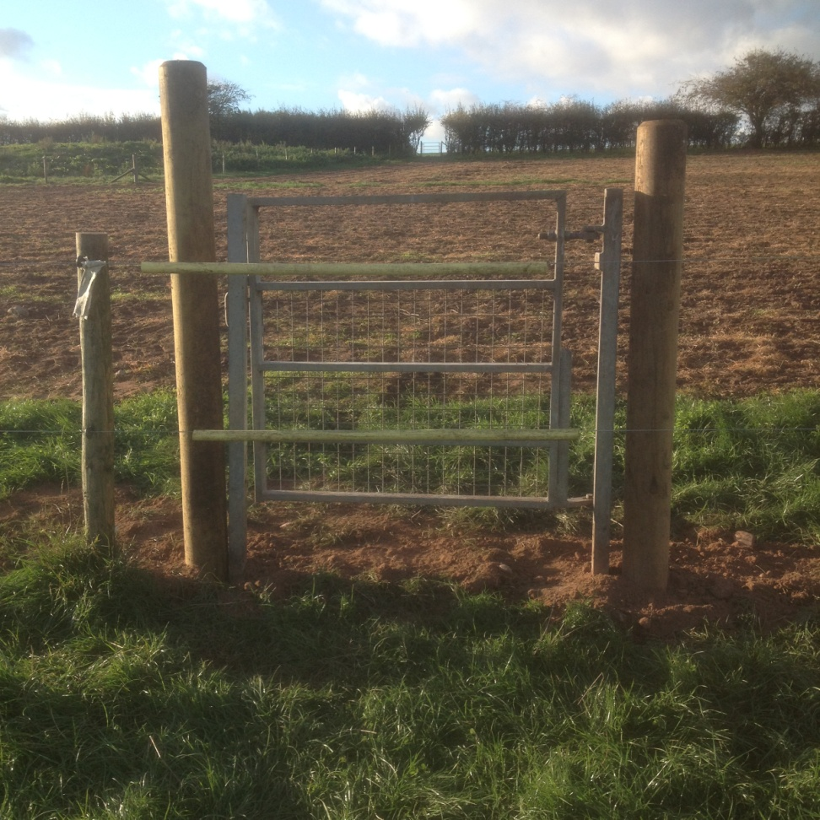
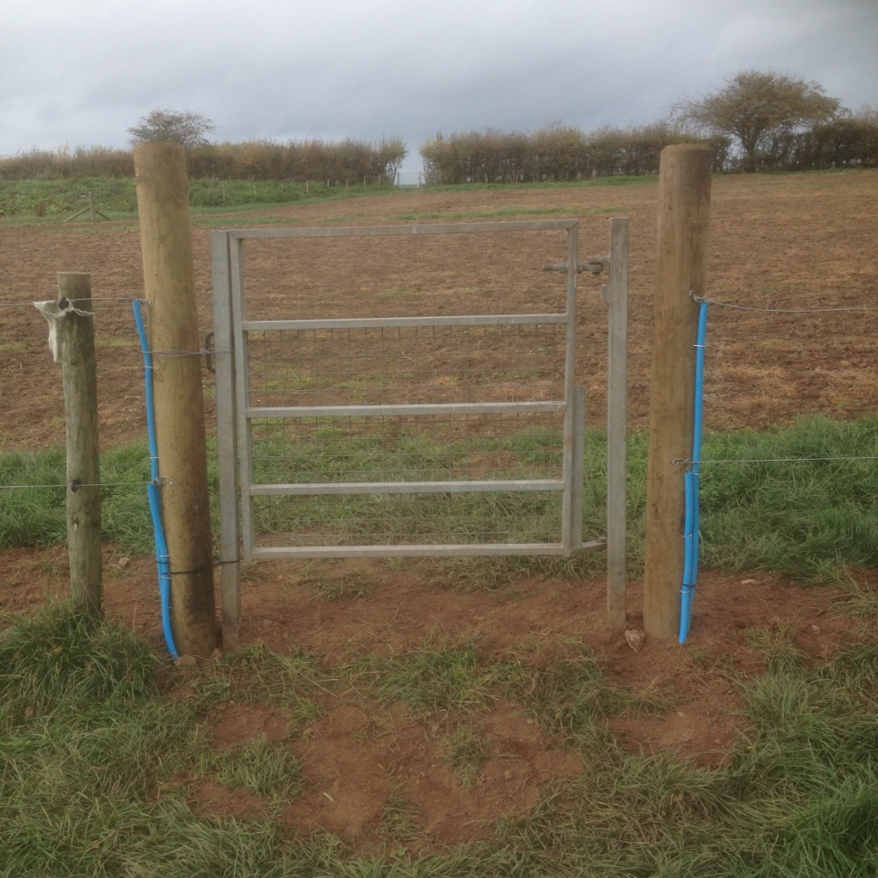
Electric Fence

Slide 11
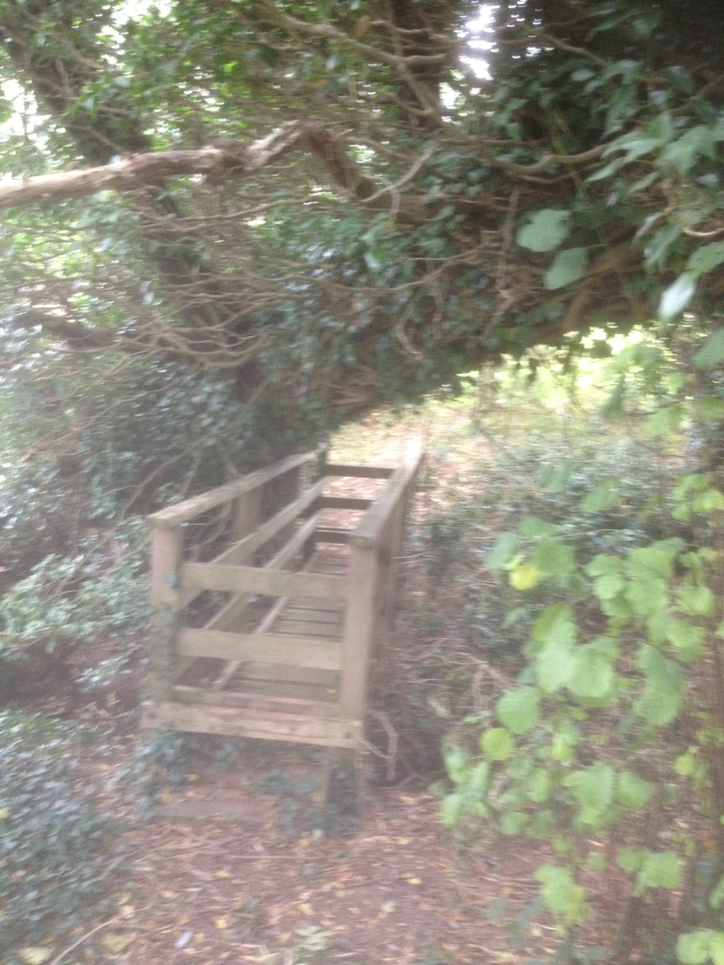
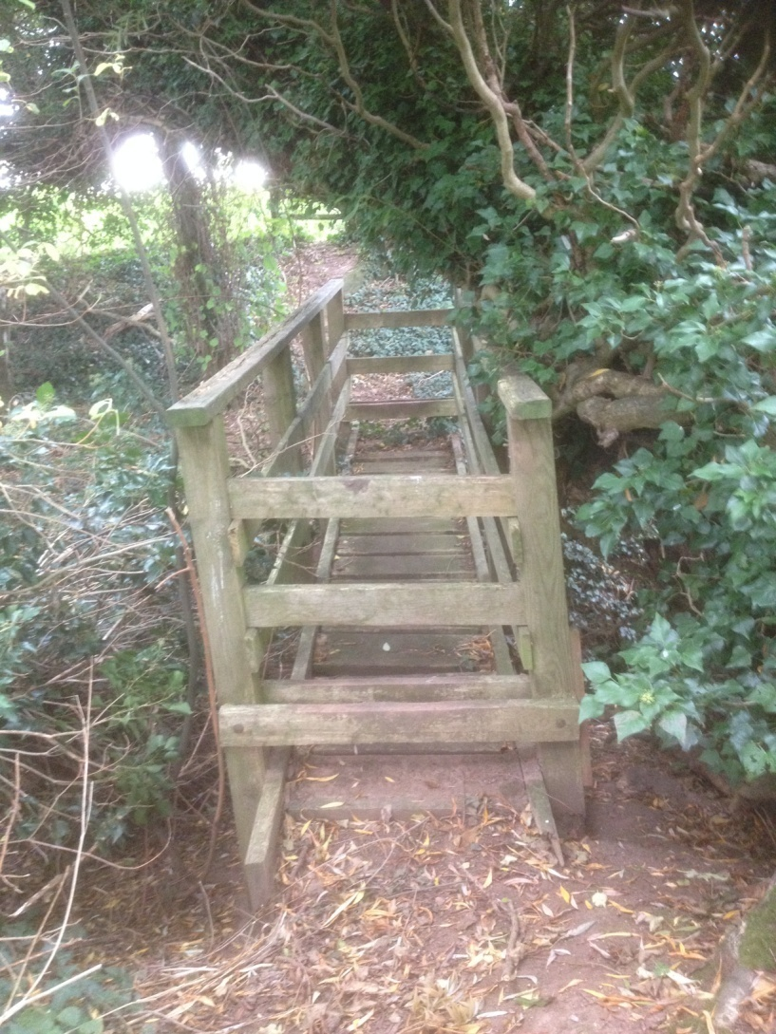
New Bridge
Hossil Lane to Drayton

Slide 12
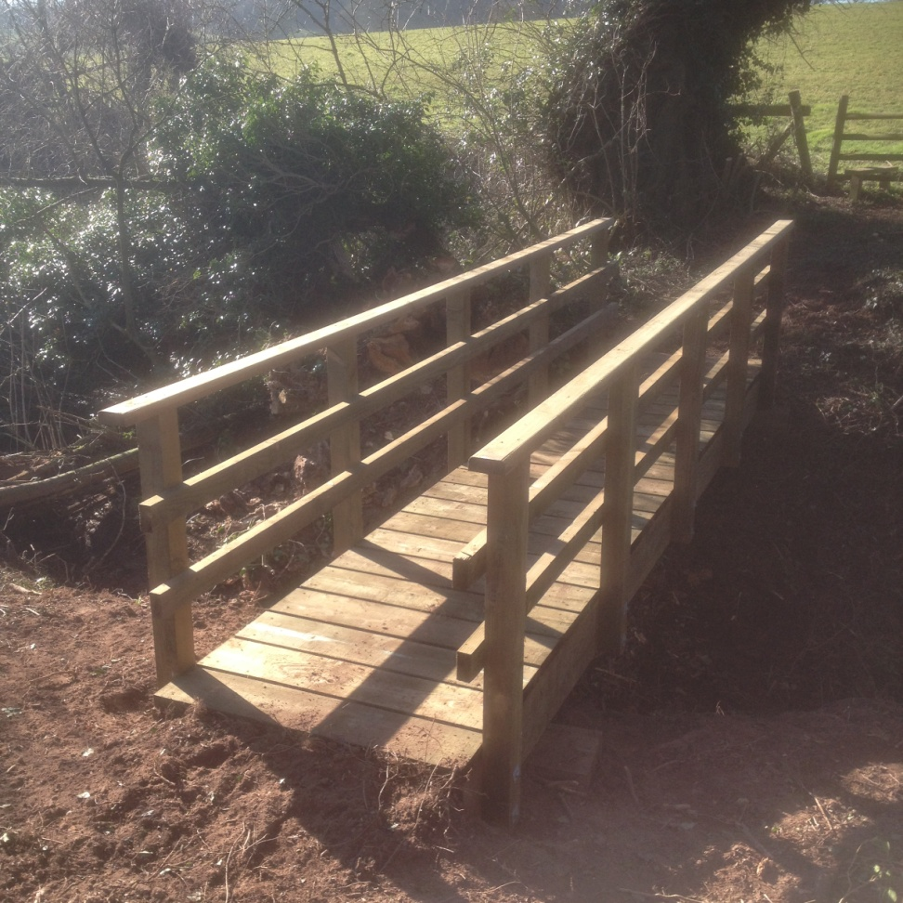
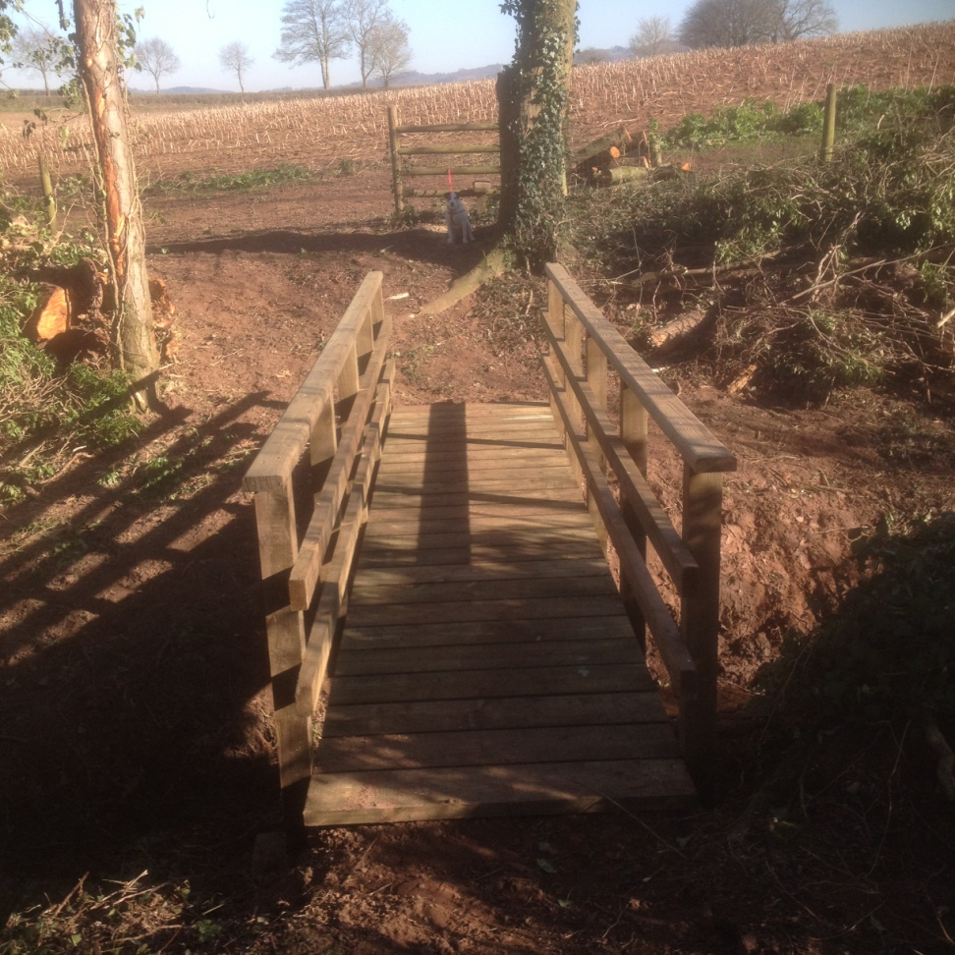

Slide 13
ST Resilience Project
No change/progress since last year
All paths have remained open
Awaiting surface re-instatement
Improvement / reparation work promised by Barhale

Slide 14
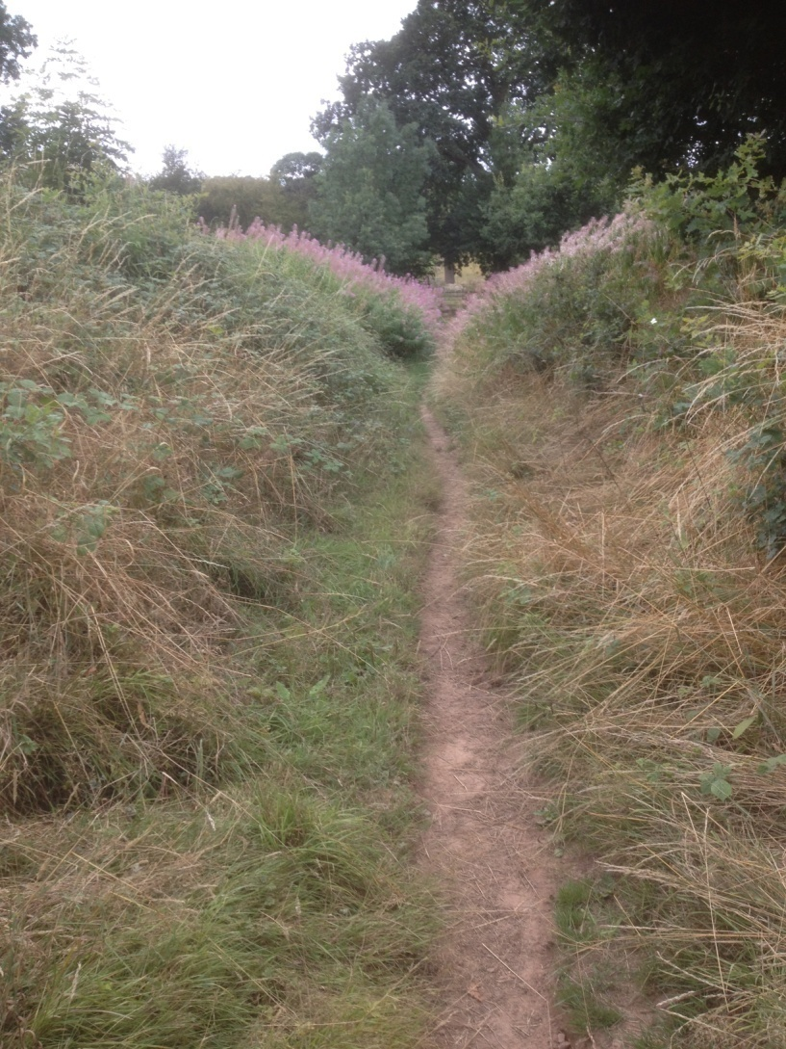
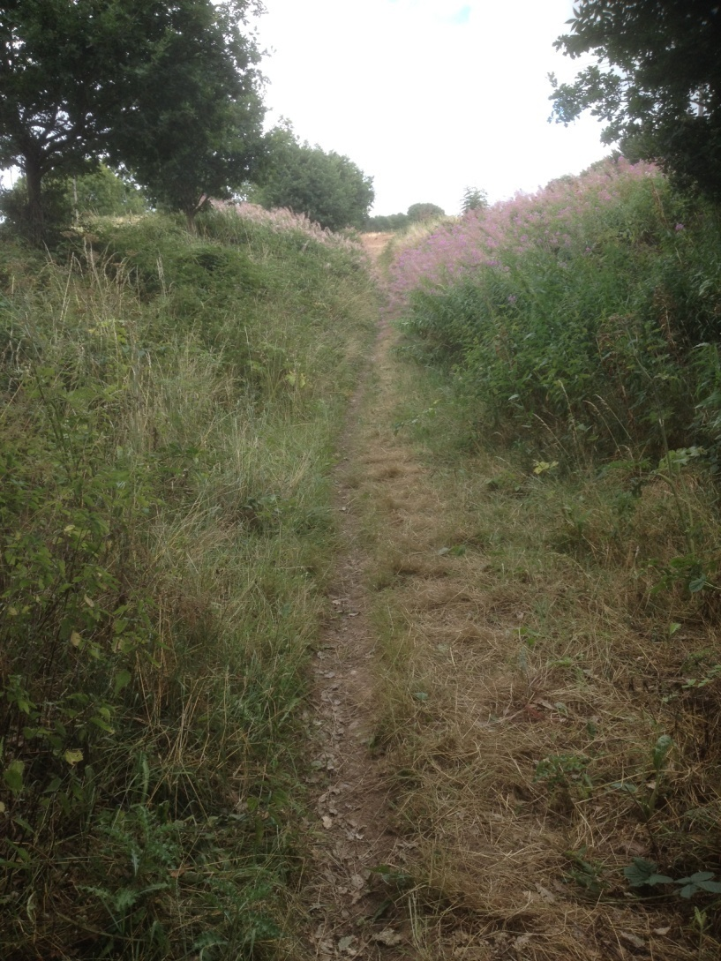
Gully below New Barn

Slide 15
2019 – 20 Plans
Continue WCC strimming programme
Continued general maintenance
Drainage work on Drayton path
Review possible surface works around Parish
Possible update to village walks booklets

Slide 16
Finally
Any problems or improvement suggestions
Lynne and Paul Hardcastle
01562 730511
07789 910653

