Slide 1

Capturing the Value of Carbon Intensity Reductions in Low Carbon Fuel Markets at Ethanol Plants and Corn Farms
Ron Alverson:
Corn Producer, Board of Directors Dakota Ethanol

Slide 2


Slide 3
Topics
Current and Prospective Low Carbon Fuel Markets
Current State of Fuel Carbon (GHG) Intensity Accounting/Modeling
Opportunities for Corn Ethanol to Reduce Carbon Intensity

Slide 4
Low Carbon Fuel Markets
U.S. EISA-RFS2 - 2007
California LCFS – 2007
British Columbia – 2008
European Union – 2008
United Kingdom
Oregon – Just starting now
Under consideration:
  Washington State
  11 Northeast and Mid-Atlantic States

Slide 5
California Low Carbon Fuel Standard (LCFS)
  Administered by the California Air Resource Board (CARB)
  Transportation Fuel Carbon Intensity (CI) must be reduced by 10% by 2020.
  Established a Carbon Trading Market that rewards Fuel Producers for Carbon Intensity reductions.
  LCFS Carbon Credits have traded for $20 to $127 per metric ton CO2 over the past 12 months.

Slide 6
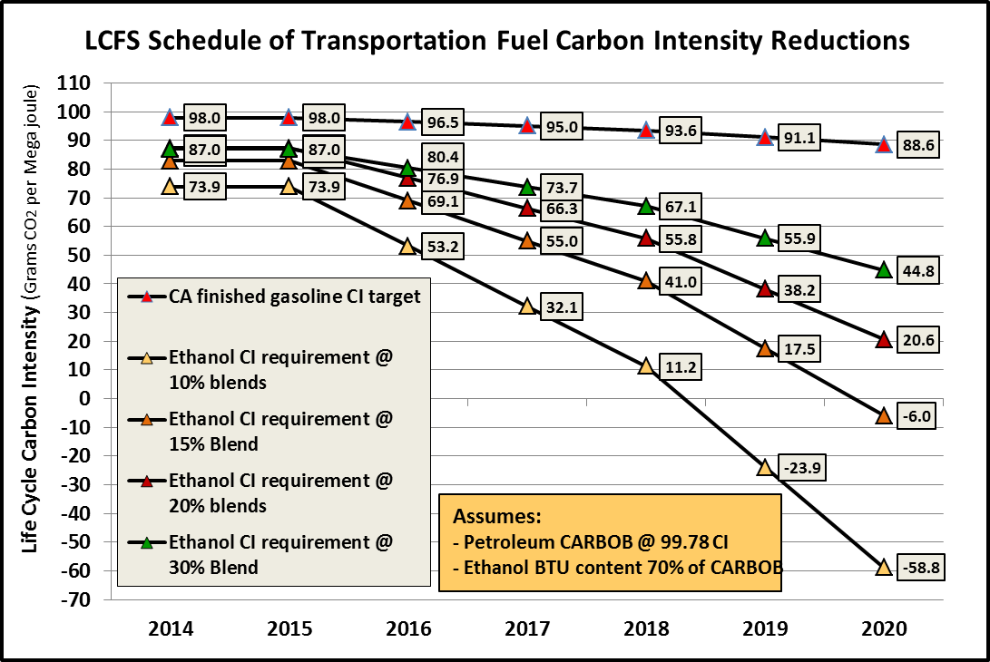
Where is the CA LCFS going to get enough Low Carbon Fuel to Meet this Schedule?
Higher Blends of Ethanol?

Slide 7
CARB has Capped CO2 Credits at $200 per Metric Ton

Slide 9
Low Carbon Fuels Used in California for LCFS Compliance
2011 - 2015 Statistics
Ethanol (All types) - 57%
Bio/Renewable Diesel - 37%
Natural Gas - 6%

Slide 10
Economic Incentives for CI Reductions
The Math
Carbon Intensity in the LCFS is the Grams of CO2 Equivalent Green House Gas Emissions from the Production of One Mega Joule of Fuel Energy.
There are 80.53 Megajoules of Energy in each gallon of Ethanol (76,330 btu/gallon divided by 947.82 btus/Megajoule)
Assuming $122/MT CO2 eq. (1,000,000 grams), the value of 1 gram is $.0098 per gram. ($122*80.53/1,000,000)
80 CI Ethanol in 2016 (99.78 CI standard) generates credits worth 20 cents per gallon @$122/MT. (20*80.53*122/1,000,000) for ethanol sold in CA.

Slide 11
Economic Incentives for CI Reductions
Using the GREET model……
Each 1,000 btu/gallon reduction in NG energy use during ethanol manufacturing reduces CI by .9 grams
Each .1 kWh/gallon reduction in electrical energy use during ethanol manufacturing reduces CI by 1.1 grams
Improvements in conversion (gallons/bu) do not have a significant impact on CI. Gains in gallons per bushel are offset by losses of co-product production credit.
Assuming $4 per mmbtu Nat Gas and $56/MT LCFS credits, the value of the LCFS credits is approximately equivalent to the value of the reduced energy use.

Slide 12
Corn Ethanol Carbon Intensity Accounting/Modeling – Argonne GREET Model

Slide 13
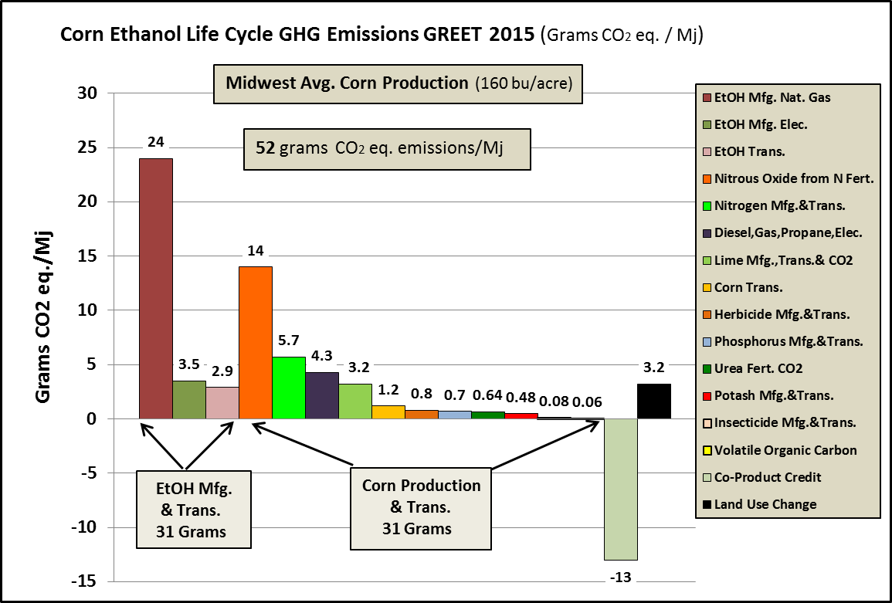

Slide 14
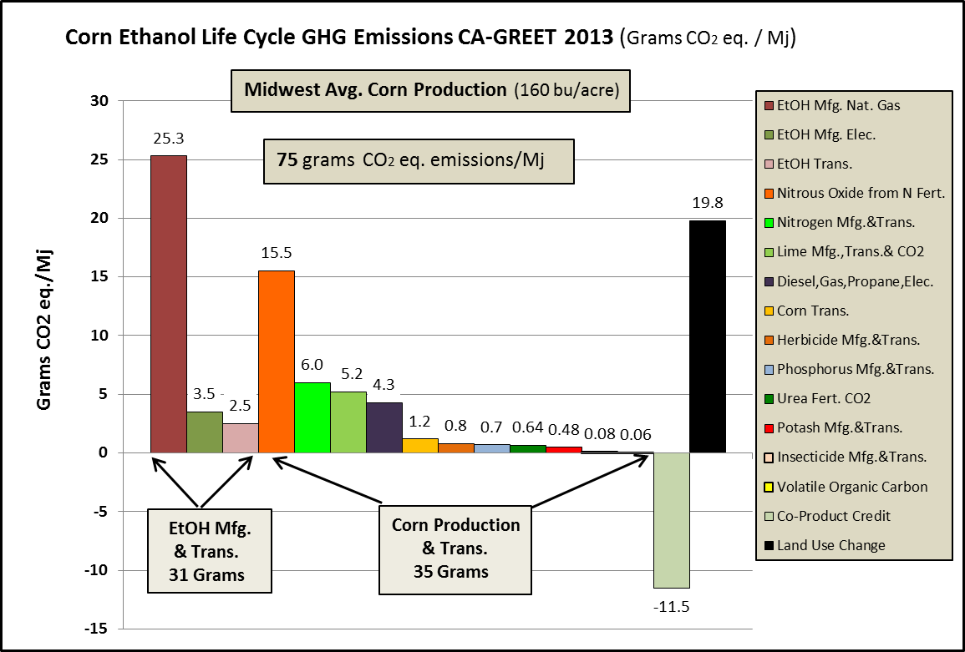

Slide 15
Opportunities to Reduce Corn Ethanol CI with Recent Science
Soil Carbon Accounting and Nitrous Oxide Accounting
  Soil Carbon accounting is not currently done by Argonne…….except in Land Use Change Calculations……..Modelers assume all biofuel crops have the same effect on soil carbon stocks!
  Nitrous Oxide modeling currently done uses old science…..Nitrogen Use Efficiency during Corn Production has greatly improved in the past two to three decades.

Slide 16
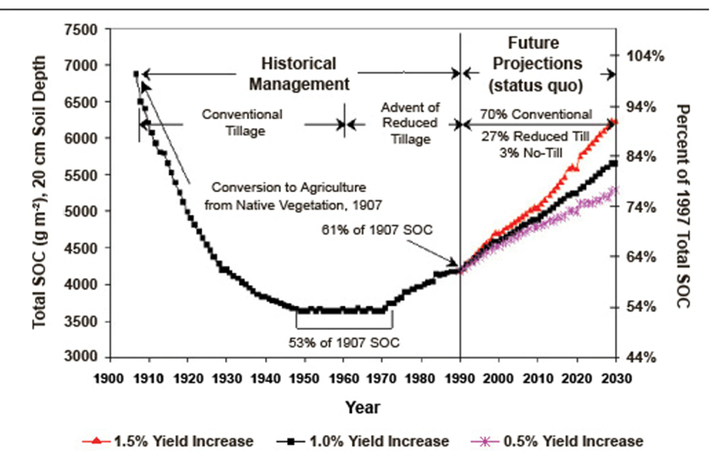
Source: Dr. Rattan Lal, Ohio State University Soil Science Dept.

Slide 17
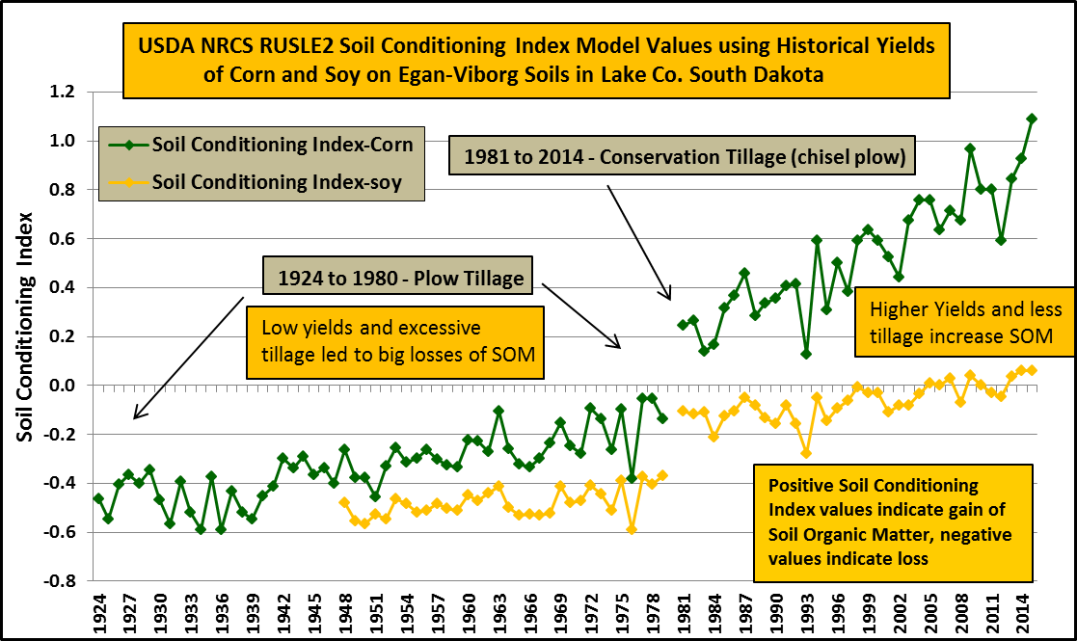

Slide 18
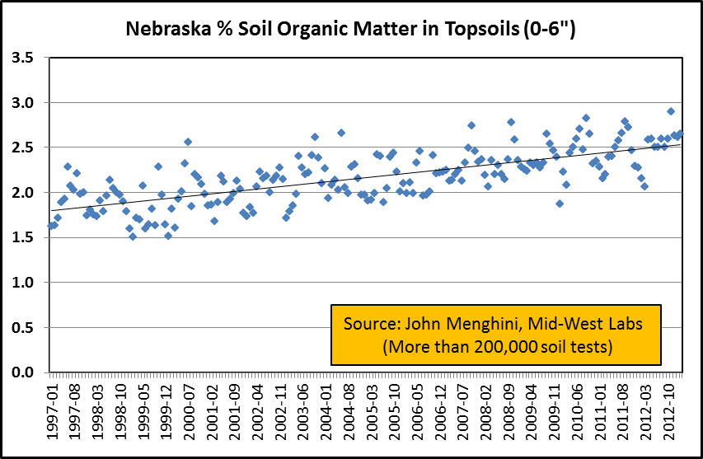

Slide 19
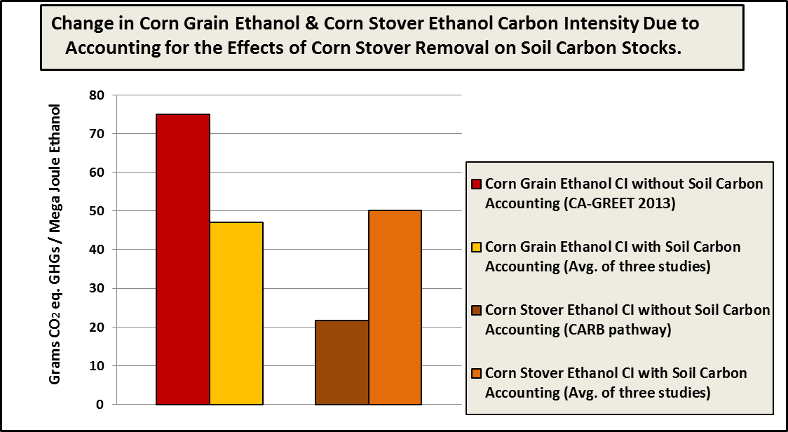
Summary of 3 Peer Reviewed Studies on the Effect of Retaining or Removing Stover on Soil Carbon Stocks,
and the Effect that Change in Soil Carbon Stocks has on Life Cycle GHG Emissions of Corn Grain
Ethanol and Corn Stover Cellulosic Ethanol produced from those fields

Slide 20
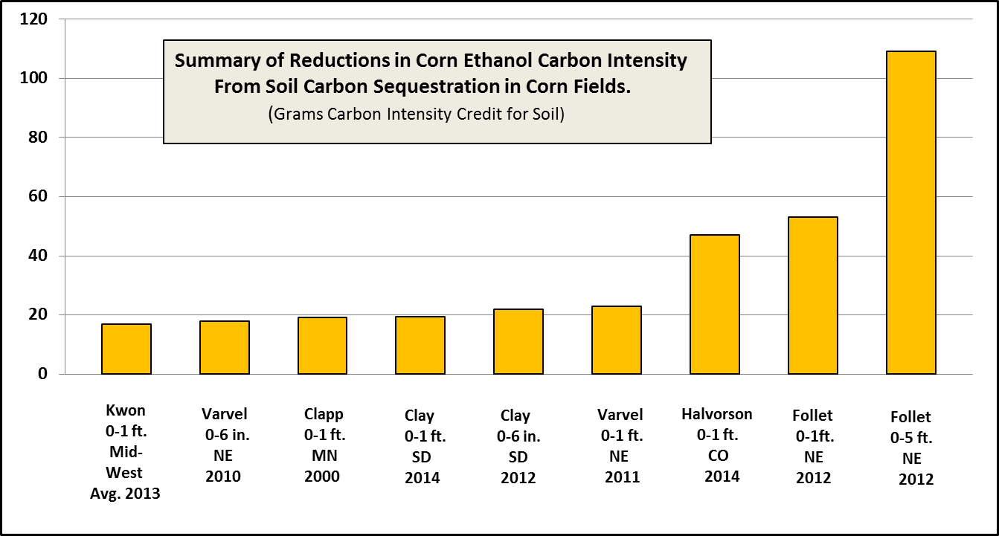
Nine Corn Soil Carbon studies average CI credit is more than 30 grams!
Bottom Line: Corn Ethanol is at a disadvantage in Low Carbon Markets because Argonne, CARB,
and the U.S. EPA do not consider/account for Corn’s effect on Soil Carbon Stocks !

Slide 21
Nitrous Oxide
Modeling / Accounting
CARB and Argonne’s GREET Model Assumes:
  1.325 % of Nitrogen Applied to Corn converts to Nitrous Oxide Gas, a powerful GHG (265X CO2).
  1.325% of the Nitrogen Content of Corn Stover also converts to Nitrous Oxide.
  30% of Applied Nitrogen is Leached from Corn Fields and 1% of that Leached N converts to Nitrous Oxide.
  All these assumptions are based on 1980 – 1990 data

Slide 22
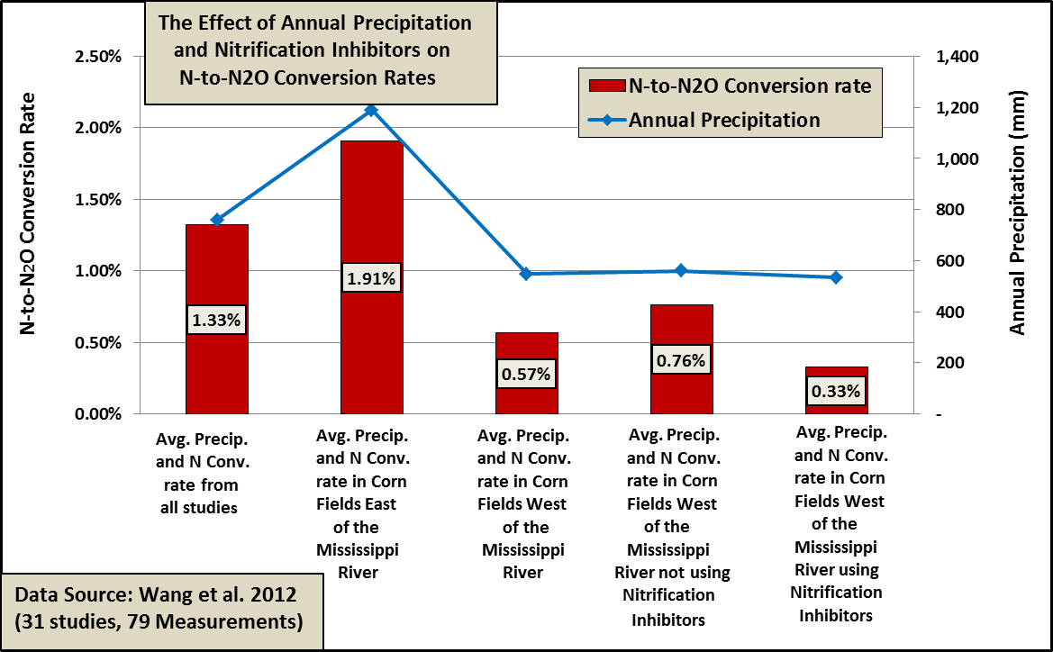
How did Argonne Determine the N to N2O Conversion Rate?

Slide 23
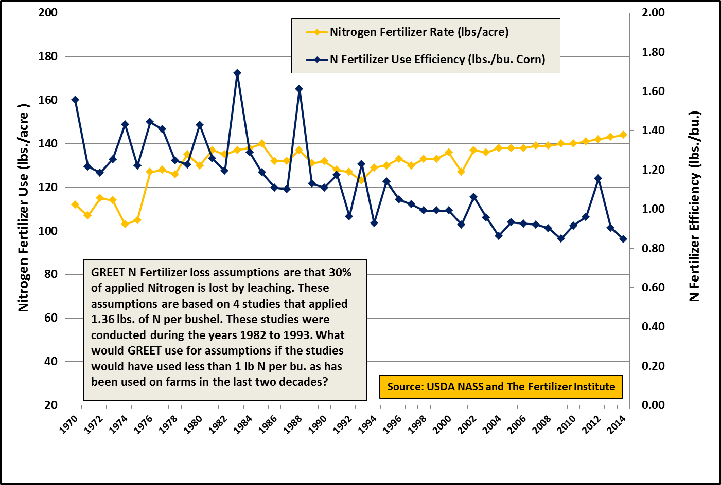
Historic Nitrogen Use and Efficiency on Corn

Slide 24
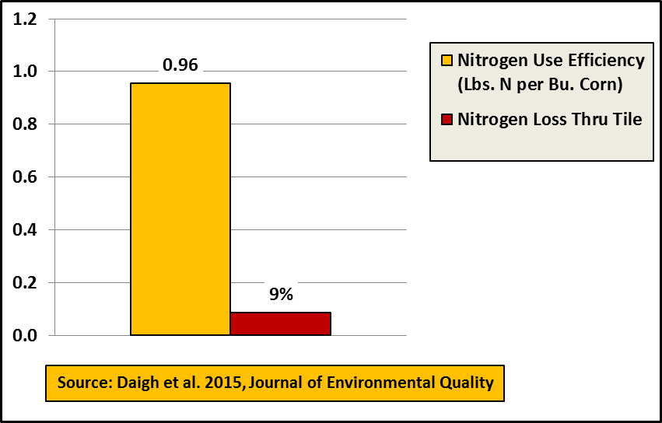
A Recent Four Year Study in Central Iowa on NUE and N Loss
(worse case scenario…high N rates, high rainfall, 100% pattern tiled)

Slide 25
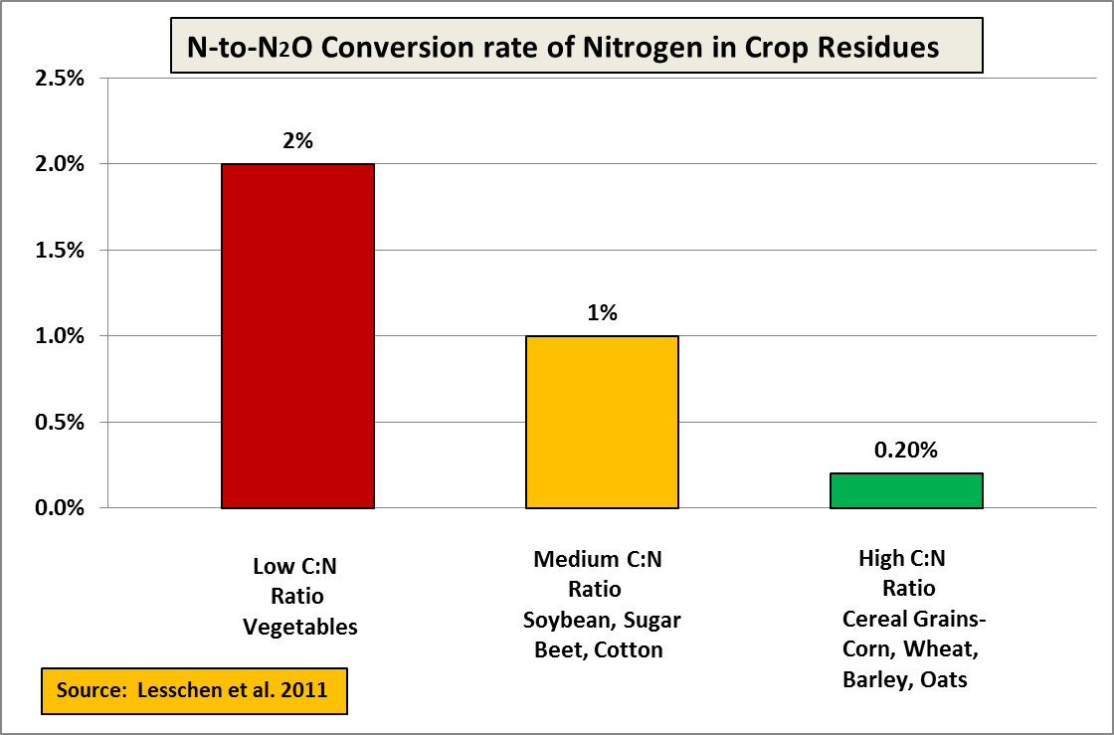
Nitrogen in Corn Stover has a low N-to-N2O conversion rate

Slide 26
Summary of Nitrous Oxide Emissions Reductions
Nitrogen fertilizer leaching losses used to be 30%......recent science indicates a 5% average corn belt wide loss
N-to-N2O conversion rates average 1.325%......a regional precipitation weighted corn belt average indicates .9%
N-to-N2O conversion rate of N in corn stover is far less than 1.325%.....science says .2%
Nitrous Oxide Emissions should be 7 grams CI, rather than the 14 g that is currently modeled in GREET

Slide 27
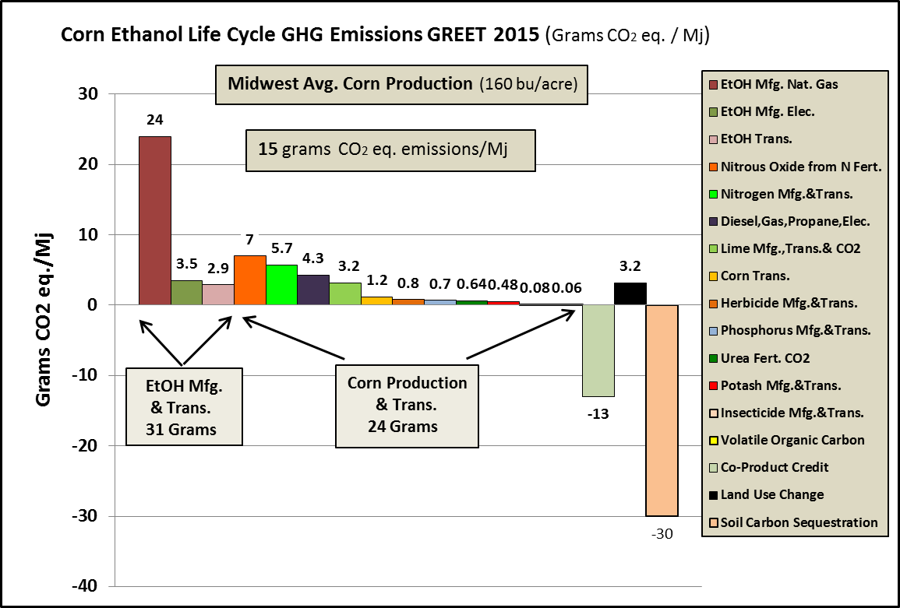
Corn Ethanol’s Carbon Intensity would be only 15 grams if the Modeling/Accounting was done using the latest science!

Slide 28
SUMMARY
Expanding Low Carbon Fuel Markets offer Opportunities for Ethanol Producers and Corn Producers
Incentives to reduce Carbon Intensity can be Large – up to $.5o per gallon!
Ethanol Plants and Corn Producers have dramatically Reduced Energy Use and GHG Emissions
GHG Modelers must update their accounting with the latest science that reflects the efficiency of modern Corn Production

