Slide 1
NEW YORK STATE HIGH SCHOOL
GIRLS FLAG FOOTBALL OFFICIALS' INTERPRETATION
(updated 3-3-24)

Slide 2
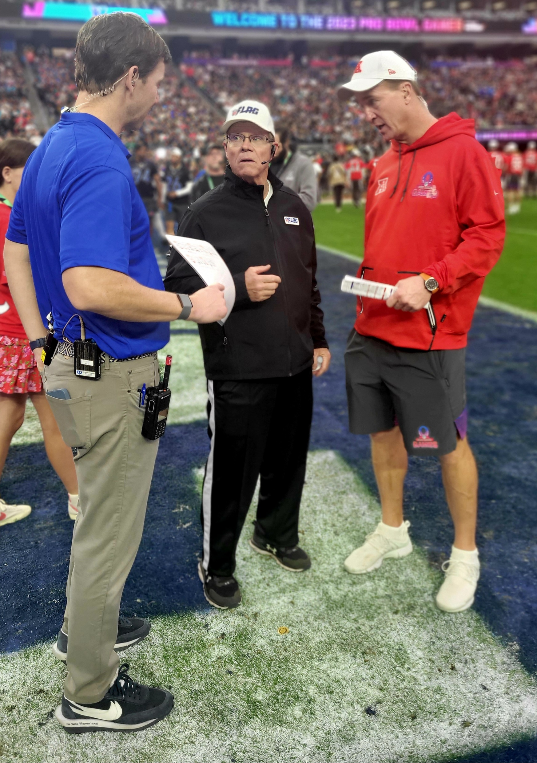
INTRODUCTION
Tom LaNeve-NFL FLAG Director of Officiating
tlaneve@rcxexperiences.com
Involved with NFL FLAG for over 25 years
Coached 5 Teams to Nationals including Girls 14U 3 times
Assisted NFL, NFL Europe and NFL China in football development projects including Officials training and certifications
Collaborated with Bill Lemmonier on ‘Fundamentals of Youth Officiating’ for USA Football/ Master Trainer USA Football
Created ‘Pro Bowl Games’, NCAA based NAIA & NJCAA rulebooks
2

Slide 3
NYSPHSAA Girls Flag Football Rules
(updated 3-3-24)
IMPORTANT - The NYSPHSAA Girls Flag Football Rules are a modified adaptation of the NFHS Football and NFL Flag rules.
As a general guideline, unless otherwise specified in the rules or interpretations provided by the NYSPHSAA, the officials should revert to NFHS Football rules.
Where there is a difference between a NYSPHSAA GFF rule and an NFL Flag rule, the NYSPHSAA GFF rule supersedes the NFL Flag rule.
Thank you to NFL Flag for sharing their content and resources.
3

Slide 4
2024 NYSPHSAA GFF Rule Changes
Each player must wear "pop" flag belts at the waistline with two flags.
During the first 23 minutes of each half (Running Clock Period), the clock will be stopped for the following:
A score – Touchdown, or Safety (clock will start on next snap following a safety)
Extra Point (untimed down) (clock will start on next snap following a PAT)
Change of Possession (clock will start on next snap following a COP)
Penalty Administration (clock will start on RFP or next snap depending on previous play)
Team Time-Out (clock will start on next snap following a Team TO)
Referee’s Time-Out (clock starts at his/her discretion)
Each team is entitled to 2 charged timeouts per half. (they do not carry over)
The receiving team may advance the ball if the punt is caught by the receiving team.
4

Slide 5
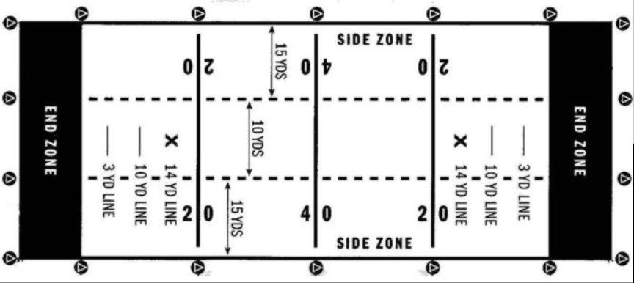
Dimensions / Line to gain
Field Size 40 yds by 100 yds (including each EZ)
Start @ 20 – 4 downs – 1st down @ 40&20 Coaches box to the 20’s
5

Slide 6
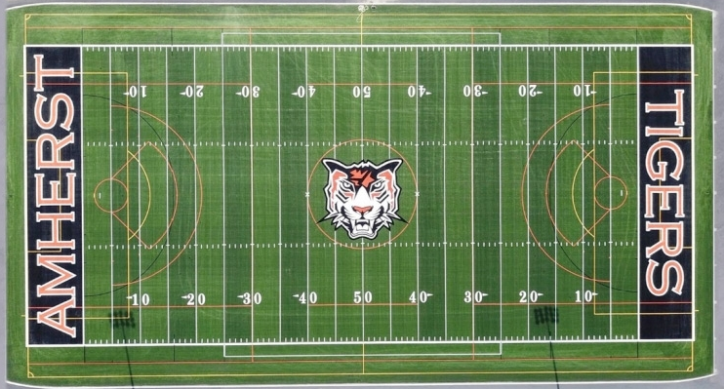
Flag Field imposed over standard football field
G
TEAM BOX
G
2 0
4 0
2 0
END ZONE
END ZONE
2 0
4 0
2 0
G
TEAM BOX
G
6

Slide 7
Timing
Games are 50 minutes / Two 25-minute halves
Amended running clock until the last 2 minutes of each half
“NFHS timing” during last to minutes of each half
3-minute intermission if overtime is required
Referee will stop the clock with 2 minutes left in each half to give a 2-minute warning.
BJ should announce time left after each play thereafter
Halftime is 5 minutes long
Each time ball is spotted, team has 25 seconds to snap the ball
Each team has (2) charged timeouts per half (1 timeout per period in Overtime)
Officials may stop the clock at their discretion
In the event of an injury, the clock will stop and then restart when the injured player is removed from the field
Anytime during or prior to the game the playing time may be shortened by mutual agreement between the coaches and referee
7

Slide 8
Timing
During first 23 minutes of each half the clock will stop for the following:
Team time-out (start on next snap)
Penalty and administration (start on ready for play)
Referee's Time-out - starts at his/her discretion
Any Change of Possession, including:
Score (touchdown&PAT or safety) (start on next snap)
PAT is an untimed down
Touchback (start on next snap)
Team attempting to conserve time illegally
During final 2 minutes of each half the clock will stop and not start until the next snap for the following:
Incomplete Pass
Out-of-Bounds
Team time-out
Fair Catch
Penalty and administration (on snap or ready for play depending on previous ball status)
Referee's Time-out - (on snap or ready for play depending on previous ball status)
Any Change of Possession, including:
Score (touchdown&PAT or safety)
PAT is an untimed down
Touchback
Team attempting to conserve time illegally (on snap or ready for play depending offending team)
First Down Clock will stop and restart at the ‘Ready for Play’ for 1st downs unless play ends OOB.
8

Slide 9
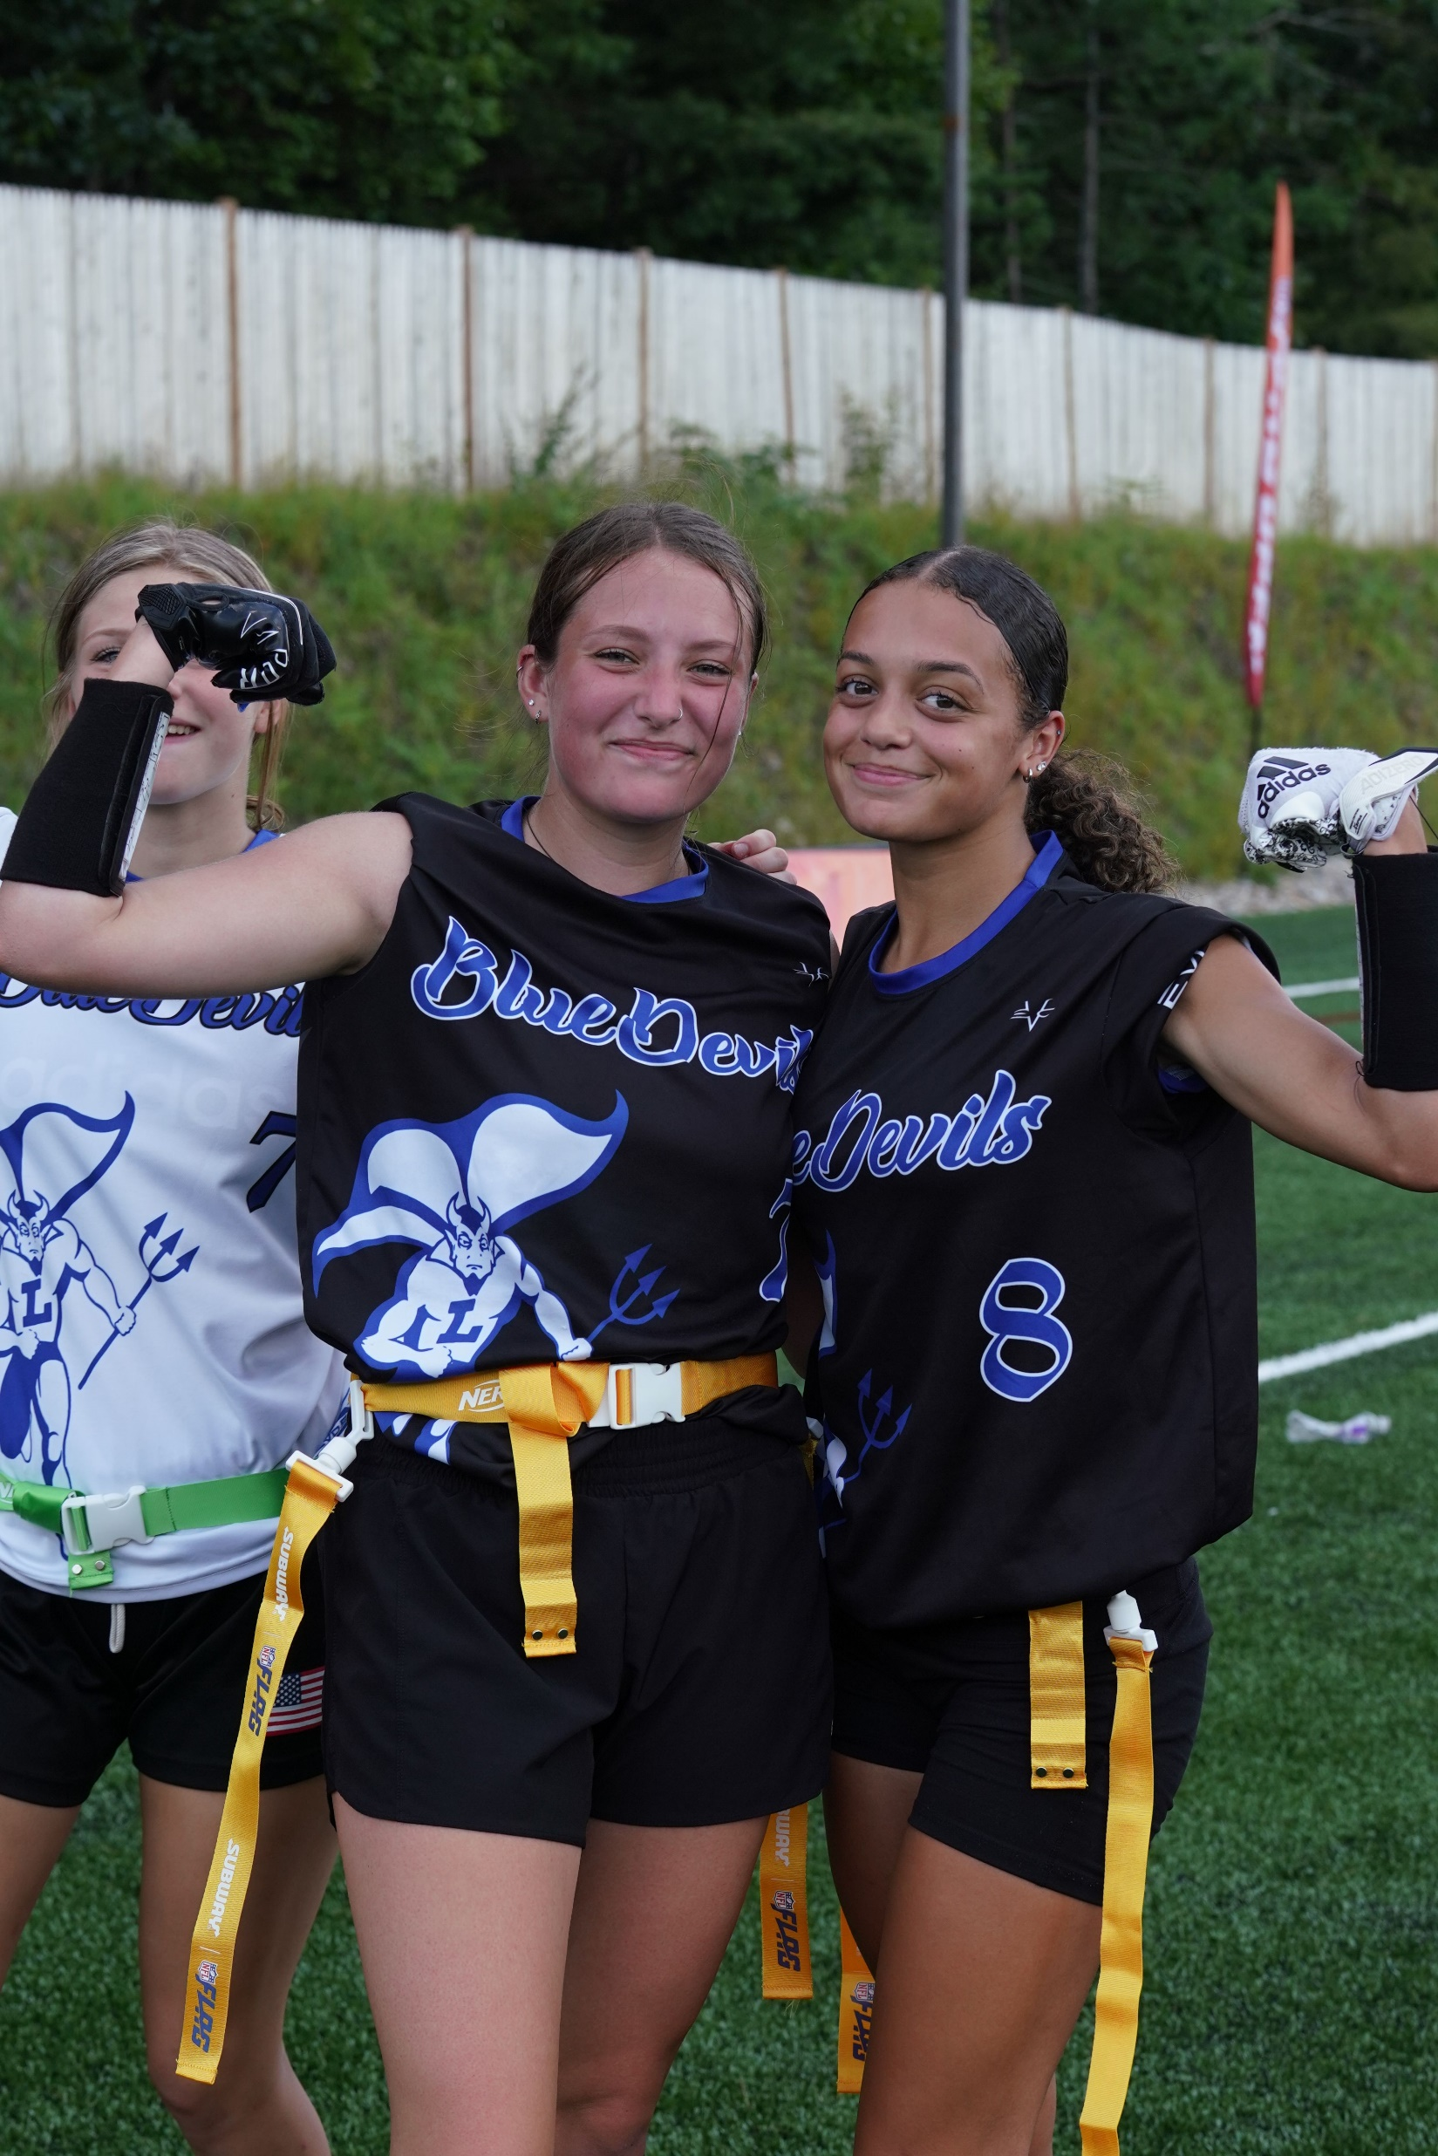
Scoring
Touchdown: 6 points
Extra point options:
1 point from the 3
2 points from the 10
3 points from the 20
PATs cannot be returned by the defense
Overtime winner: Final Score Overtime is during playoffs only
In overtime, the ball remains live if the defense intercepts a pass or fumble
Equipment:
Game to played by 2 Teams of 7 players (5 players minimum)
Each player to wear issued flag belt and 2 flags with flags positioned
on each hip with no excess belt exposed at the connection point
Players must wear shorts or pants with no pockets
Hair shall be controlled so it does not interfere with the flag belt
Jerseys are to be tucked in and/or not over the flags obstructing the defender
All players must wear a mouthpiece. Gear check Pre-Game and dead ball during game play
Soft headgear is permitted
The offense is responsible for the ball
The ball shall be pebble-grained leather or rubber covered and shall be one size smaller than a NFHS varsity football sized ball
9

Slide 10
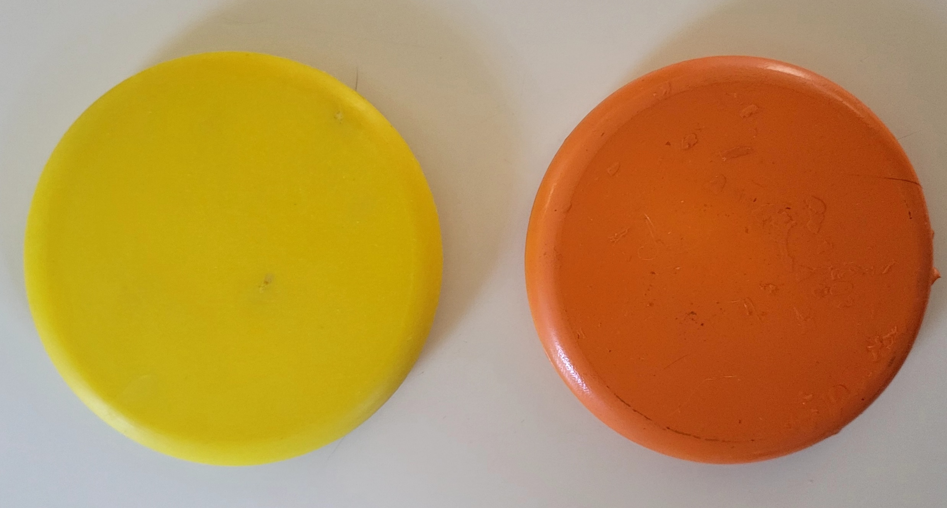
Game Rules
Center is only player required to be on the line of scrimmage
4 players must be within 1 yard of the LOS and no more than 15 yards from the ball
Center may have 1 or both knees on the ground at the snap
Player who receives the snap must be at least 2 yards from the LOS
Passing
Passes allowed behind the LOS and anyone is eligible to touch or receive a pass
Illegal Forward Pass if:
passer’s entire lead foot is on or beyond the LOS,
intentionally thrown to the ground or out of bounds to avoid a sack
more than 1 forward pass per down
Ball can be advanced across the LOS, thrown or run back behind the LOS, and passed forward
It is an Early Flag Pull foul (5 yards) if eligible receiver is deflagged prior to touching a legal forward pass
Screen blocking allowed when stationary anywhere or moving behind the LOS provided player has arms/hands inside their framework (Shoulders/hips/knees)
Defense can rush at all times from 1 yard off LOS. Defenders should NOT initiate contact with blockers
Referee sets the pucks for the neutral zone
10

Slide 11
Receiving
Possession with one foot or body part other than the hand contacting the ground 1st in bounds.
If the defender’s contact takes the receiver out of bounds, in Officials judgment, ruled complete.
Ball may be tipped / batted forward by a player while in the air who has not touched the ground yet.
Running
Behind the Line of Scrimmage, handoffs can be made in any direction. Beyond the Line of Scrimmage, handoffs can only be backward.
A runner may pass backward including after crossing the LOS into the backfield. A backward pass or fumble that hits the ground between the goal lines is dead at that spot.
If fumble occurs before the runner reaches the end zone, the offense retains possession, and the ball is spotted where possession was lost. This includes into the end zone from field of play.
Diving with the ball is NOT permitted. Kill the play and mark where ball at the spot when the runner left the ground. Penalty can be enforced for Illegal contact if warranted.
When flag belt is taken from the runner by the defender, the play is dead at that spot.
If flag belt falls off the runner inadvertently, defenders must tag the runner from shoulders to knees.
11

Slide 12
Kicking Game
Prior to the ‘Ready for Play” on 4th down offensive Team must declare Punt or Play.
Teams may elect to Punt on any down. Team must declare Punt.
Referee will make that announcement and if Punt is declared, the ball must be punted.
Exceptions: If timeout is called by either team/ the period ends/ a foul occurs/ inadvertent whistle
All players must keep hand down.
After receiving the snap, the punter must punt the ball immediately in a continuous motion.
Neither team may enter the neutral zone until the ball is punted. NO RUSH on punts.
The receiving team may advance the ball if the punt is caught by the receiving team.
Fair catches are permitted and if the ball contacts the ground, player or caught, it is dead at that spot.
Dead Ball
BALL / not where the player is when flag was pulled
Ball hits the ground.
Flag is pulled or player is tagged after belt has fallen off.
Player contact on the ground (except for putting a hand down).
Dual possession.
Muffed punt.
The ball will always be spotted in the middle of the field.
12

Slide 13
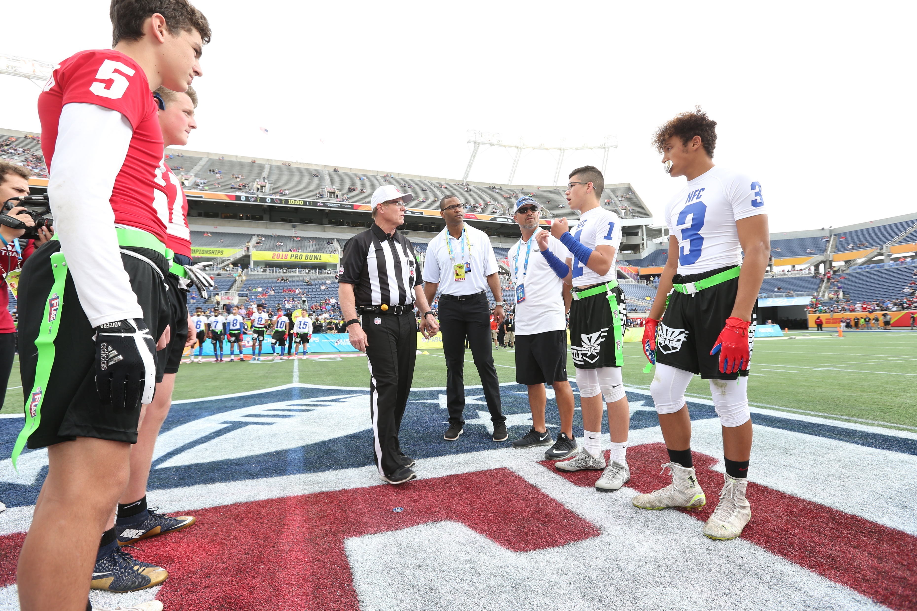
Overtime: Playoffs Only
Coach and captains will meet for rules review
Captains will remain for the coin toss
Winner to determine offense, defense or which end of field OT to play in.
Possession to start at the 20 yard-line
Each team gets 4 downs to score
Play to a winner
1 timeout per Team per period
13

Slide 14
Questions
14

Slide 15
Officiating Philosophies
Always box in the play. When in doubt take a position wider and deeper.
Signal and verify the down with other officials. Check the down box for accuracy.
Communicate the clock status as necessary, especially under 2 minute.
Be familiar with the concept of player, zone, ball.
Use preventative officiating when possible and avoid game interrupter calls.
Make the call when it involves player safety.
15

Slide 16
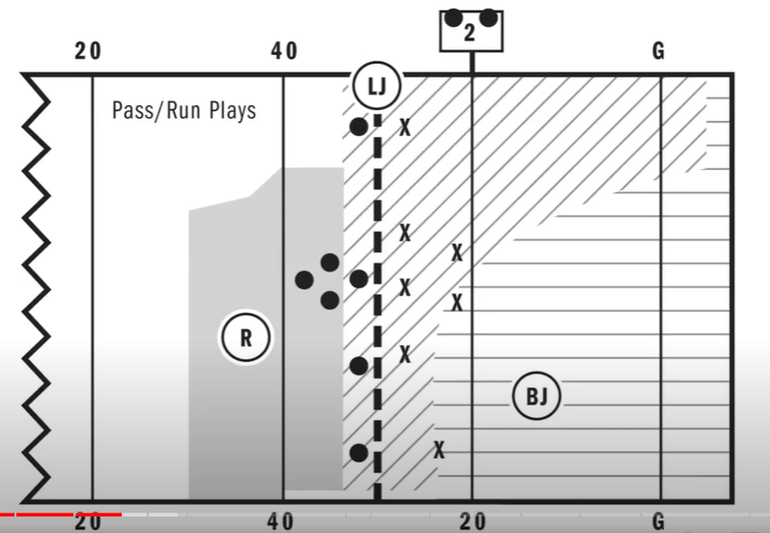
16

Slide 17
Pre-Snap Referee:
Set the ball spotters to create the neutral zone
Announce down/distance/ LTG, mark the ball ‘Ready for Play’ by blowing it in with signal
‘Ready for Play’ procedure should not prevent a Team from snapping the ball quickly
Start the timing of the play clock (R is responsible for play clock)
Initial position should be approximately 7 yards wide and 7 yards deep from the deepest offensive back and on the opposite side of the field as the Line Judge and same side as the Back Judge
Positioning should be able to see the center, players near the center and backs in your sightlines. Alert to false starts and illegal shifts
Communicate when play clock gets to 10 seconds with signal and chop out 5,4,3,2,1
verbal count is optional
17

Slide 18
Pre-Snap Line Judge:
Upon conclusion of the previous play, mark forward progress spot with downfield foot and signal next down. Upon giving the R the spot, communicate down and distance to the down box
Take initial position between the neutral zone on the boundary opposite the R and BJ. Widen position as players press the boundary in their pre-snap alignment
Sightlines: neutral zone, players on both sides of the LOS. Be alert for players entering and exiting (be aware of substitutes)
Alerts: encroachment, false starts, illegal snaps, illegal formations, illegal shifts, illegal motions. Take responsibility for players in motion
18

Slide 19
Pre-Snap Back Judge:
Upon conclusion of the previous play, if necessary, mark the forward progress spot and pass on to the LJ for the next LOS
Initial position is opposite boundary of the LJ at least 20 yards downfield and 5 yards deeper than the deepest defender.
Initial position is ON the boundary NOT 5 yards on the field of play.
Wider is better and can press the play as it dictates following your reads
Be alert for players entering and exiting (be aware of substitutes)
Communicate the clock status when needed
19

Slide 20
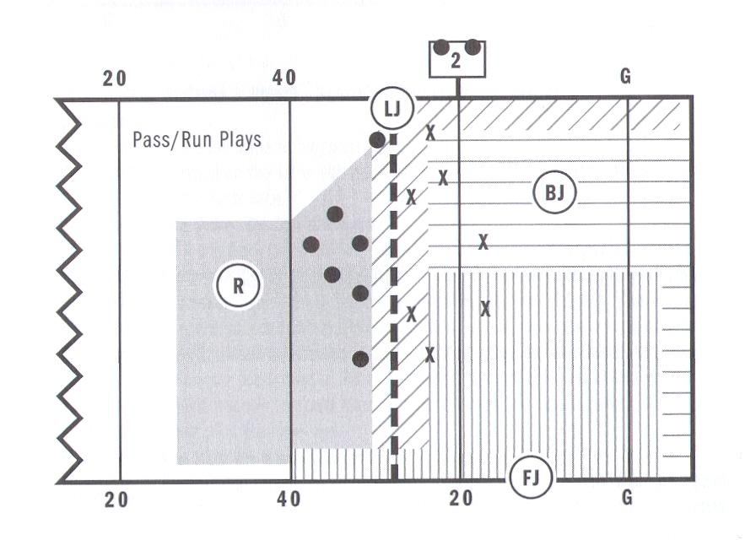
4 Person Mechanic
20

Slide 21
4-Person: Field Judge
Assumes 3-person BJ position keys
4-Person: Back Judge
Initial position is opposite of the FJ on LJ side of the field, at least 25 yards downfield and 5 yards deeper than the deepest defender.
Take a position approx.15 yards off the boundary
21

Slide 22
Questions
22

Slide 23
Reading and understanding initial keys:
Referee:
QB, players and blockers in the backfield.
Dead ball equipment enforcement.
Line Judge:
Snapper, all players lined up on their respective LOS and receivers on your boundary.
Dead ball equipment enforcement
Back Judge:
Receivers on your boundary and field side of the snapper.
Dead ball equipment enforcement
4-Person Crew:
Field Judge:
Receivers on your boundary and field side of the snapper.
Dead ball equipment enforcement
Back Judge:
Receivers to both boundaries.
Dead ball equipment enforcement
23

Slide 24
Passing and Running Plays Referee:
Be ready to rule on snap if it strikes the ground. After the snap, observe action behind the neutral zone with your eyes on the QB and blockers around the QB/ runner
Mark forward progress if play ends behind the LOS
Assist the BJ with runners going out of bounds on your boundary
Once ball is advanced beyond the LOS, remain near the neutral zone to rule on plays from trailing position behind the ball. Once the ball is dead, be ready to retrieve the pucks.
Remain wider and deeper than the QB, aware of potential backward passes to another passer. If pass is not thrown immediately, you’re responsible for ruling on all passes behind the LOS. If in doubt, the pass is backward
When forward pass is thrown announce “Ball is Away” with eyes on the passer until no threat of a foul
Primarily responsible for roughing the passer and intentional grounding
Press the LOS with the passer to rule on the legality of the pass. If in doubt, the pass is legal
24

Slide 25
Passing and Running Plays Line Judge:
Post snap, hold your position for 1 count to observe initial charge of the line players to rule on contact created by either team.
Run read: Hold at the neutral zone and observe blockers and defenders around the ball.
If pass is thrown immediately rule on the direction.
Pass read: Move downfield 3-5 yards with your eyes on the middle of the field and receivers pressing your boundary
Once the forward pass is thrown work to a position between the receiver and defender, keeping ‘outside in’ look of the play
As the runner crosses the LOS, stay parallel with the runner to rule on all backward passes beyond the LOS. Mark forward progress past the neutral zone and be responsible for your sideline from end line to end line
25

Slide 26
Passing and Running Plays Back Judge 3-Person:
After the snap, hold your position for a 1 count to observe movement of initial keys
Run read: Observe blockers around runner and retreat to boundary as the ball presses your sideline
Pass Read: Retreat as receivers establish patterns. Don’t allow players to get behind you. Once the pass is thrown, work to get in position between the receiver and the defender
Passing and Running Plays Back Judge 4-Person
After the snap, hold your position for a 1 count to observe movement of initial keys
Run read: Observe blockers around runner and retreat as the ball presses your position
Pass Read: Retreat as receivers establish patterns. Don’t allow players to get behind you. Once the pass is thrown work to get in position
Field Judge:
Field Judge: Position, coverage and responsibilities are the same as back judge 3-person on other scrimmage plays
26

Slide 27
3rd and 4th Down Line to Gain coverage 3-person
Referee: Position, coverage and responsibilities are the same as other scrimmage plays
Line Judge: Pre-snap position and keys remain the same. If the ball is snapped 10 yards or less from the line-to-gain move quickly to LTG. Hold there to rule of 1st down or forward progress short. Travel as the runner travels beyond the LTG to dead ball.
Back Judge: Position, coverage and responsibilities are the same as other scrimmage plays
3rd and 4th Down Line to Gain coverage 4-person
Referee: Position, coverage and responsibilities are the same as other scrimmage plays
Line Judge: Pre-snap position and keys remain the same. If the ball is snapped 10 yards or less from the line-to-gain move quickly to LTG. Hold there to rule of 1st down or forward progress short. Travel as the runner travels beyond the LTG to dead ball.
Field Judge: Position, coverage and responsibilities are the same as other scrimmage plays
Back Judge: Position, coverage and responsibilities are the same as other scrimmage plays
27

Slide 28
3rd and 4th Down Line to Gain coverage 3-Person
28

Slide 29
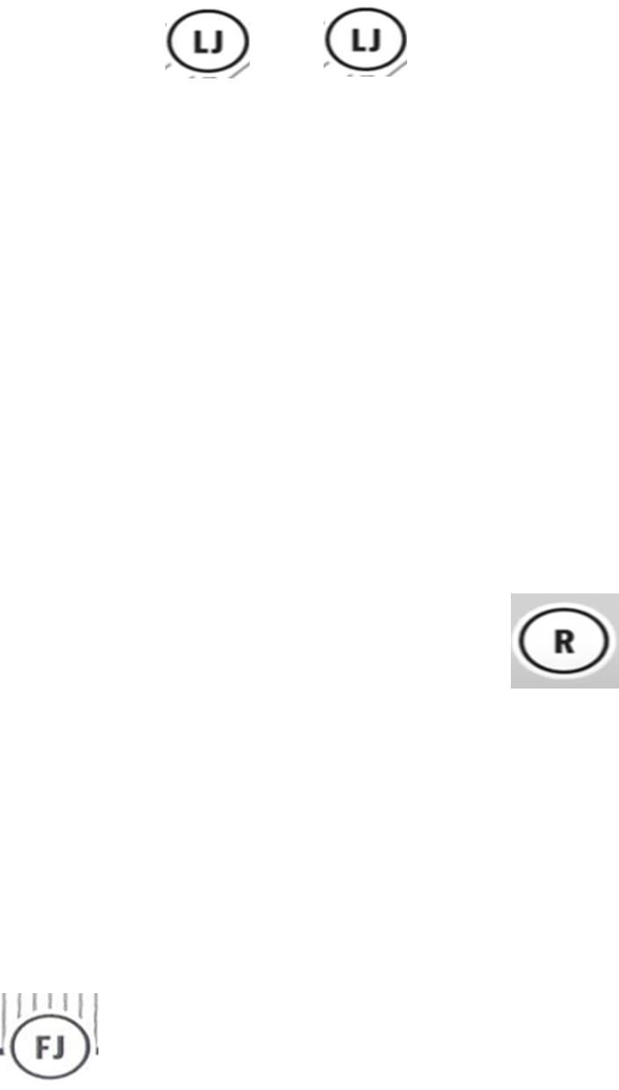
3rd and 4th Down Line to Gain coverage 4-Person
29

Slide 30
Goal Line and PAT Conversion coverage: 3-Person
Referee: Pre-snap position, keys and coverage responsibilities are the same
Line Judge: Pre-snap position and keys remain the same. If the ball is snapped on the 10 yard-line or inside move to the goal line immediately to rule on plays from there.
Back Judge: Pre-snap position remains the same. If the ball is snapped on the 10 yard-line or in position on the end line and off the boundary. Hold position until dead ball or change of possession.
Goal Line and PAT Conversion coverage: 4-Person
Referee: Pre-snap position, keys and coverage responsibilities are the same
Line Judge: Pre-snap position and keys remain the same. If the ball is snapped on the 10 yard-line or inside move to the goal line immediately to rule on plays from there.
Field Judge: Hold the goal line and off the boundary
Back Judge: Pre-snap position remains the same. If the ball is snapped on the 10 yard-line or in position on the end line in the middle of the field. Hold position until dead ball or change of possession.
30

Slide 31
Goal Line and PAT Conversion 3-Person
31

Slide 32
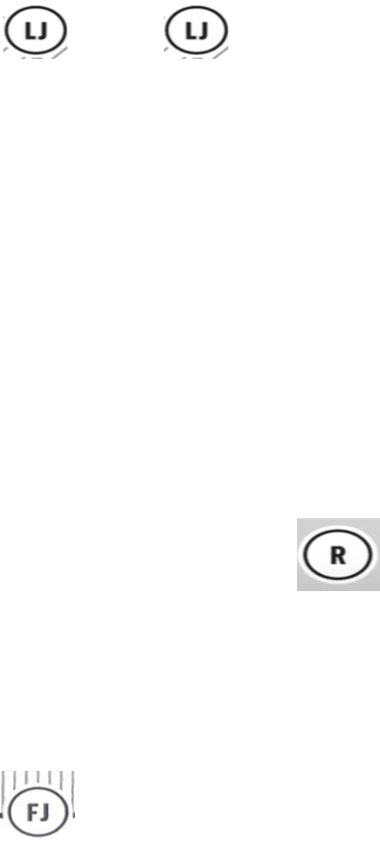
Goal Line and PAT Conversion 4-Person
32

Slide 33
Punt Plays Referee:
Prior to 4th down plays ask the team captain or coach do they want to punt or play. Communicate the decision, mark and signal the ball ‘Ready for Play’.
Notify all players to stay out of the neutral zone until the ball is punted
Initial position and keys remain the same
Watch for the snap hitting the ground and the punter kicking the ball
Once the punt hits the ground the ball is dead
33

Slide 34
Punt Plays Line Judge:
Initial position and keys remain the same
Post snap hold your position to rule on the play from there eyes on neutral zone infraction before the kick
Rule on if the kick crosses the LOS
If kick is short mark the spot with bean bag where the kick touches the ground
Assist with the spot if the ball goes out of bounds
Kick in the air move downfield and observe blockers and runner maintaining your boundary
Once the punt hits the ground the ball is dead
34

Slide 35
Punt Plays Back Judge:
Initial position the same but move at least 3-5 yards behind the deepest receiver
If that is on or inside the 10 move to the goal line
After the snap keep your angle with the receiver. Once the ball is caught mark the kick end spot with bean bag. Observe blockers and responsible for the goal line to rule on touch backs and balls hitting the ground
Balls out of bounds on the ground or in flight mark the spot
Once the punt hits the ground the ball is dead
35

Slide 36
Questions
36

Slide 37
Approach to Penalty Enforcement
Be professional and courteous at all times
Know the rules and penalty enforcement
Take into account the age and skill level.
Be proactive in communication with coaches and players
Enforce the rules with eye on player safety
Make the call when it involves player safety
Avoid ‘By the Book’ or game interrupter calls
Have a defined penalty announcement progression in place
What? Who? Result. Verbal and by signal
37

Slide 38
Penalties
A runner shall not charge into nor contact an opponent in their path or attempt to run between 2 opponents Stay in front of rough play don’t chase it
Flag guarding is the attempt by the ball-carrier to obstruct the defender access to the flags by stiff arming, dropping the hand, arm, shoulder or head or intentionally covering the flags with the football or jersey. It is Illegal to pull flags off a player who doesn’t have possession
Roughing the passer by the defense is an automatic first down
Illegal forward pass committed by the offense is loss of down
Illegal equipment is a 10-yard penalty.
All USC and personal fouls are 10 yards
Disqualification
Flagrant unsportsmanlike conduct: Fighting, leaving the box to enter the field during fight, intentionally contacting an official
Flagrant personal foul: tackling a ballcarrier, fighting an opponent, leaving the sideline to participate while the play is live (Nonplayer)
38

Slide 39
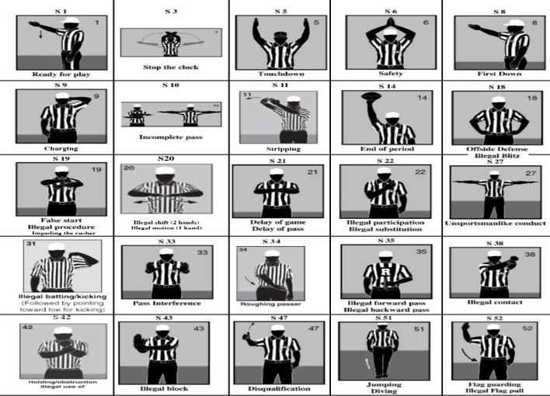
Signal Chart
39

Slide 40
THANK YOU!

