Slide 1
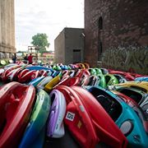

Saturday July 25th packet pickup
And
Sunday July 26th race
Participant instructions

Slide 2
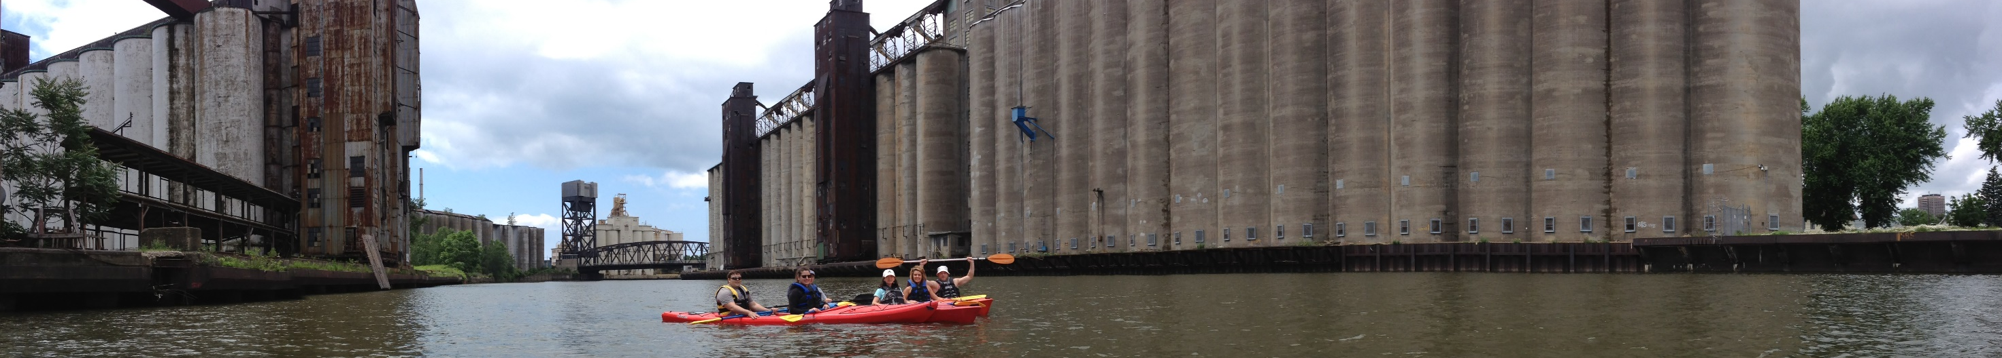












July 25th, 2020
Packet pickup, kayak drop-off, and course preview
Proceeds go to :
On Saturday, July 25th 2020 DUENDE AT Silo City, 92 Childs St, Buffalo, NY, will be open to all race participants. Packet Pickup Hours are: 12PM-5PM. Parking is available on site. During these hours you will be required to drop off your kayak and pick up your race packet which includes your race bib, kayak number and bike top bar number. All of these numbers will correspond in order to keep proper security procedures regarding the safety of all bikes and kayaks. There is no overnight bike storage. Kayaks will be kept overnight with live 24 hour security. Dropping off kayaks the day before will allow for a smooth transition on race day. If you rented a kayak it will be there already for you with a PFD and paddle.
Every racer will receive a goodie bag with a custom race shirt, medal and various goodies. A big thank you to all of our sponsors participating.

Slide 3
July 28th, 2019
Race day instructions
On Sunday, July 26th, 2020 we look forward to seeing you at Silo City. Start times will vary depending on your skill level, team and watercraft. Be sure to remember your race numbers as they will be your ticket to the event. Start times will be emailed on Monday, July 20th and will range from 7AM-11PM. Participants will be going out in waves of 30 – 35 racers. The first leg of the event is the paddle were you will start by being helped into your vessel and lined up for a whistle start. Please be sure to wear your PFD or you will not be able to participate. Once you finish the paddle you will have to portage your vessel and transition to where your bike will be waiting (your bib number must match your bike to leave the area and helmets are required) you will then leave Silo City for the 16 mile ride around the outer harbor and South Park. You will then return to the same transition area where you will drop off your bike and complete the run around the Silo City property. Water, and bananas will be provided throughout Silo City property. Please come prepared with a water bottle on your bike as there is only 1 water station throughout the bike portion of the race. After completing the run you can stay and enjoy and after party at Duende at Silo City. Also, the public is encouraged to join us for the event so please bring your friends and family.

Slide 4
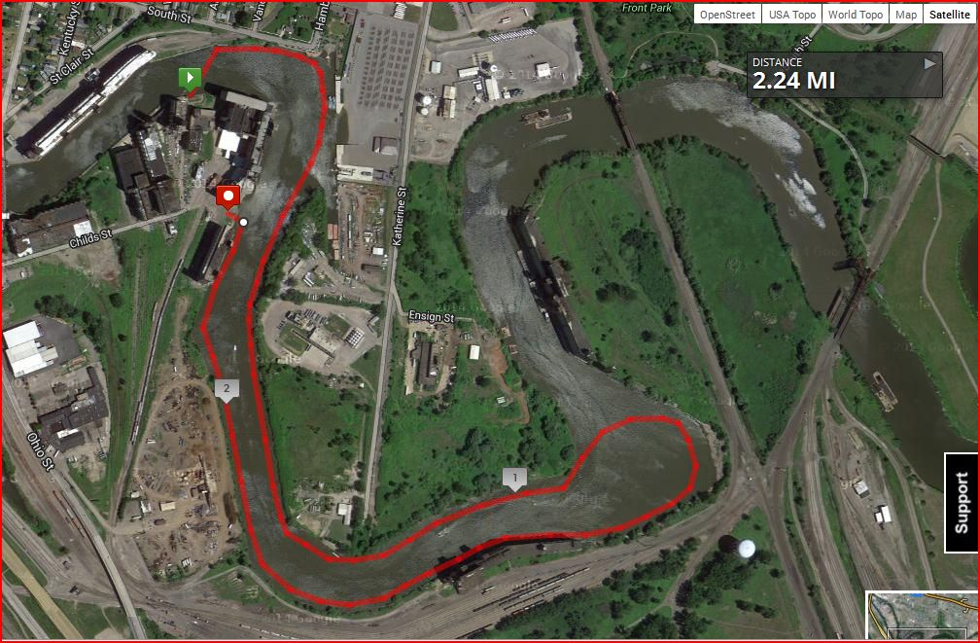
Beginner Paddle map

Slide 5
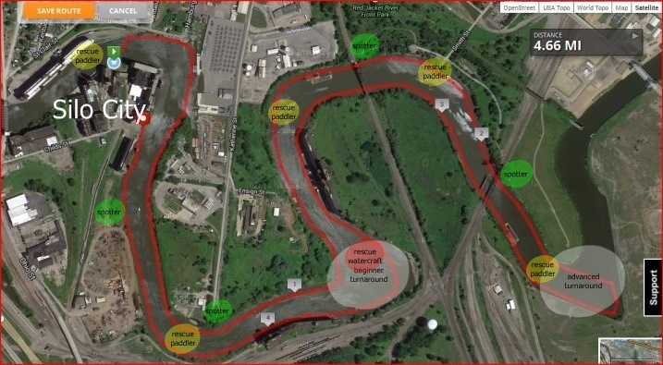
Advanced Paddle map

Slide 6
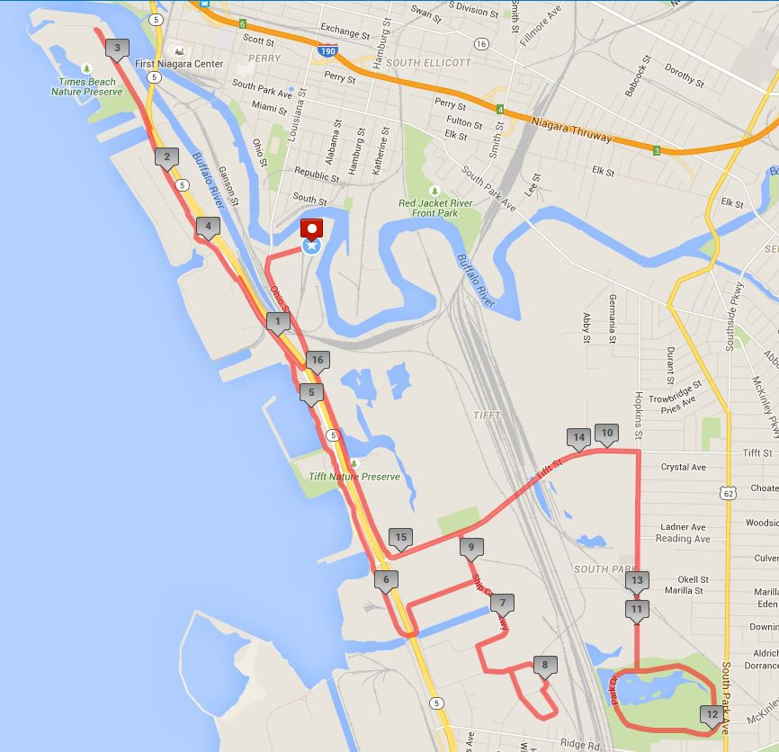
Bike map

Slide 7
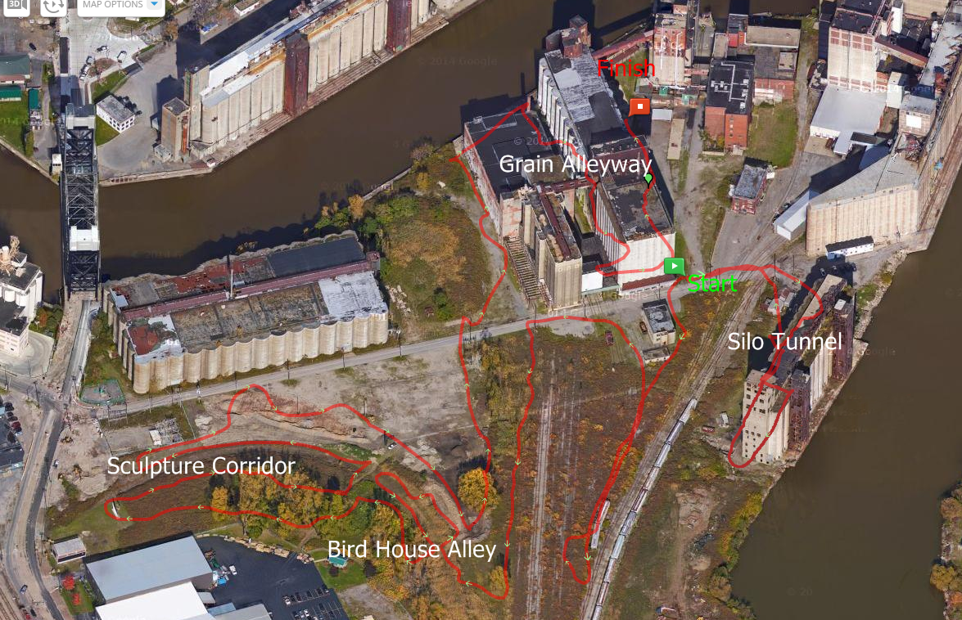
Run map

Slide 8
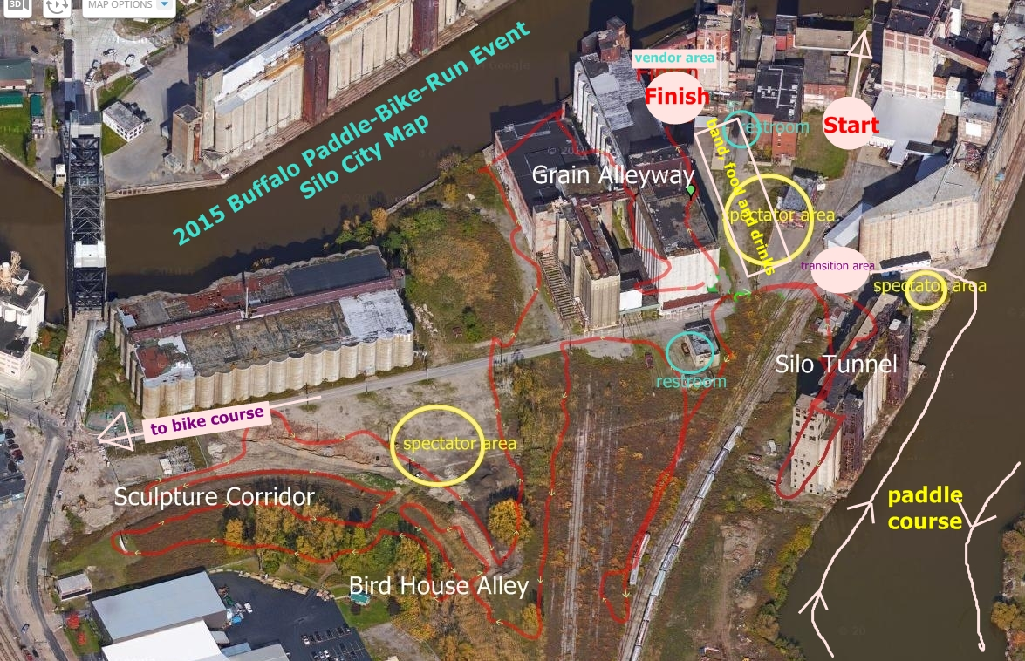
Map of silo city, spectator areas, restrooms and festivities

Slide 9
Contact
Nancy Maisano
Lisa Donovan
Race Director’s
Buffalo Paddle-Bike-Run
716-998-0949
716-803-2302
nancy@buffalopaddlebikerun.com
We appreciate that you’ve decided to join us for the first event of this kind - Buffalo Paddle-Bike-Run. Please call or email if you have any further questions.
http://www.bflopaddlebikerun.com

