Slide 1
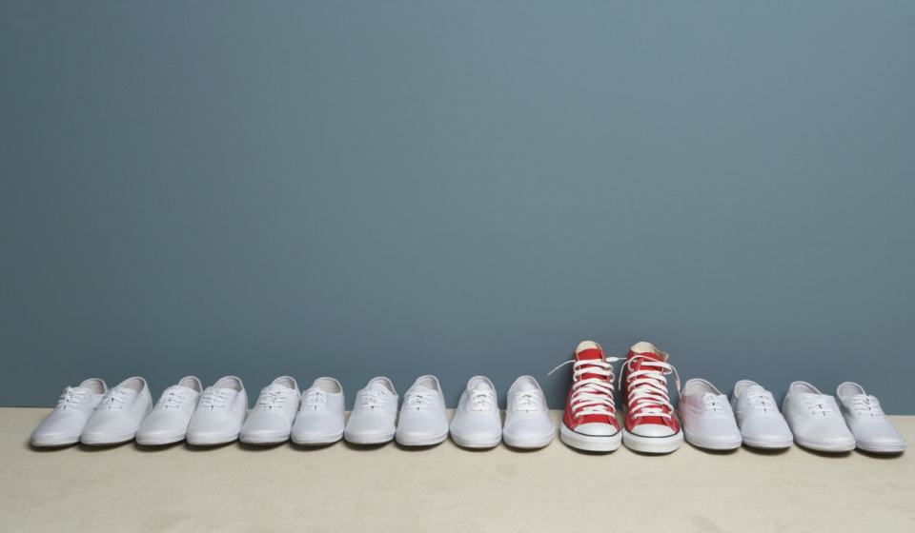
The Link Group
Hello Research, Meet Personality.
UNC BUSI 406
February 2020
Notes:
Introduce selves – how long have you been at TLG, education/degrees, what type of research you do (qual/quant, industry focus)

Slide 2
Today’s Agenda
Who is TLG?
What is market research?
Examples of what we do
Notes:
Today we’ll briefly tell you about ourselves, what market research is and how it plays in to the bigger picture of marketing, and then talk through some case studies to bring this to life. Feel free to ask questions throughout – this can be more of a casual conversation than a formal presentation.

Slide 3
Who is TLG?
Smarter research, better service.

Slide 4
Who are we?
Founded in 1994 by Tom Pfeil and Brad Camrud (both came from Procter & Gamble)
Strategic partner of large companies with research needs (our clients are primarily Fortune 500)
85 employees; 2/3 in Durham, 1/3 in Atlanta
$32.5MM revenue last fiscal year; 400-500 custom research projects completed annually
Steady organic growth is our motto; 99.1% of revenue is repeat business,
super low annual employee turnover (2.8%)
4
Notes:
Tom & Brad met at P&G and decided to start TLG because they thought they could do better than the MR agencies they had worked with. Think of us as “consulting light” – we are consultants for our clients, using the customer’s voice to help them make decisions. We do primary research, which means each project is custom-designed to answer our client’s specific questions. We’ve been around almost 25 years, and although we’re a small company, of about 80 employees, we’ve been in the Top 50 for quite a while.. Almost all of our clients are very big. Voted one of the best places to work! The numbers show we’re doing it right – clients come back for more, and employees don’t leave (unique in this day in age!).

Slide 5
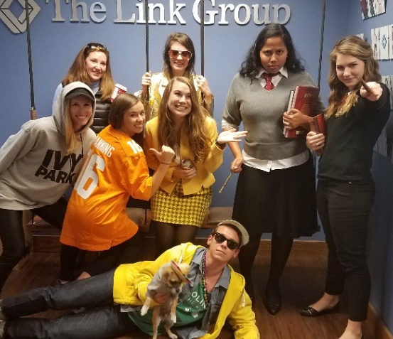
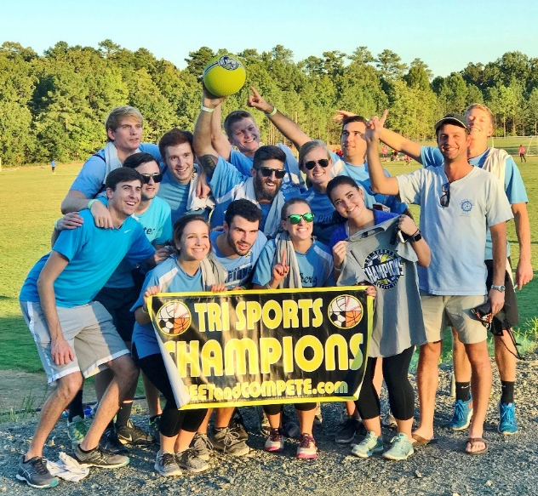
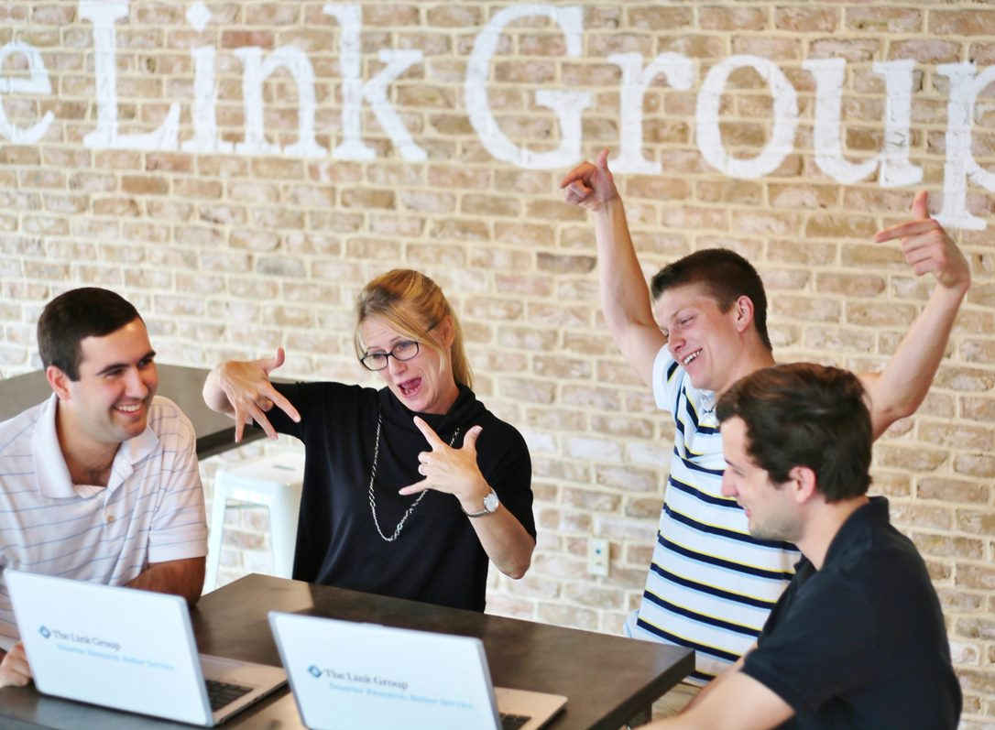
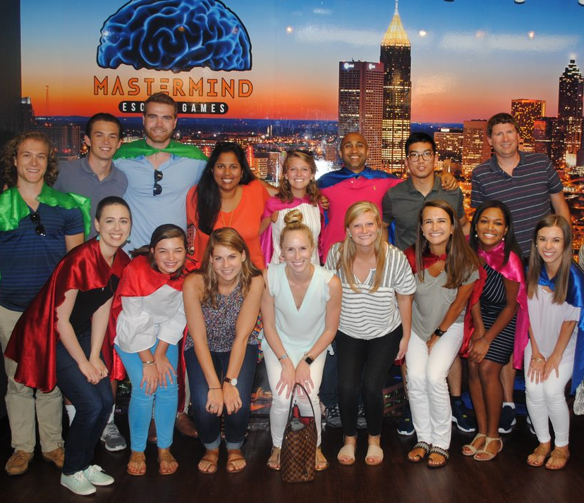
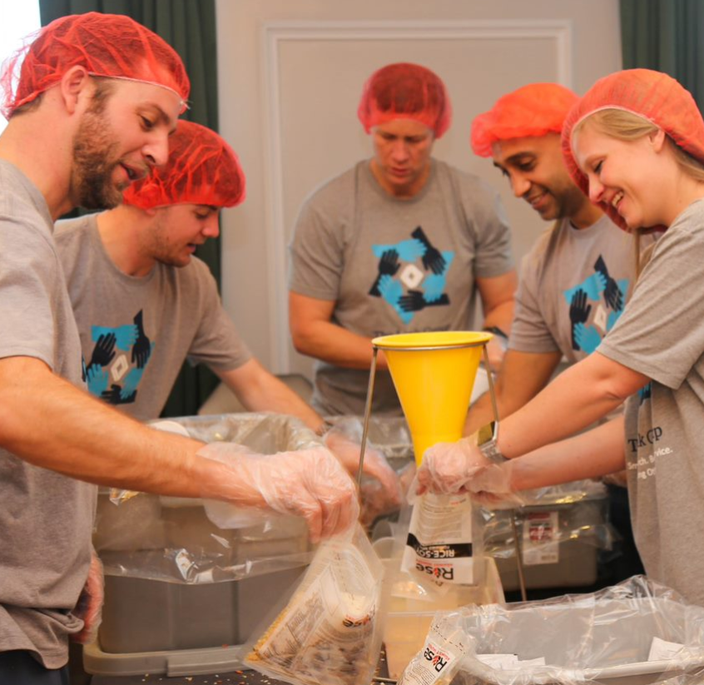
Our culture is a key component of our success.
Notes:
We are a group of smart, sociable people who genuinely enjoy working with each other.
TLG is full of hard workers. The students we hire often skip offers from big name firms to work in a close-knit group of smart, fun people. Personality is huge for us. We are friends more than coworkers. Kickball league, spontaneous happy hours, hang out outside of work, events (casino night, flapper party, engagement parties, weddings, etc.), spirit week.

Slide 6
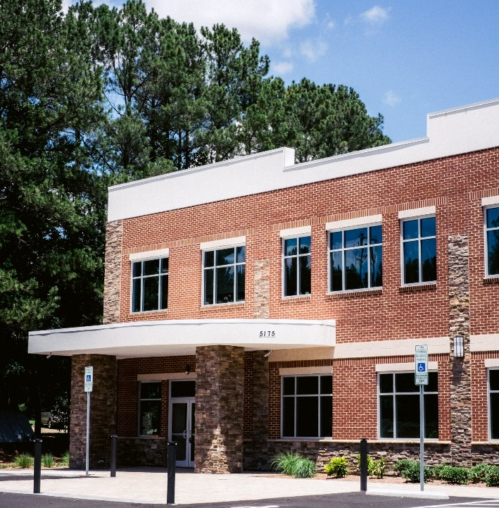
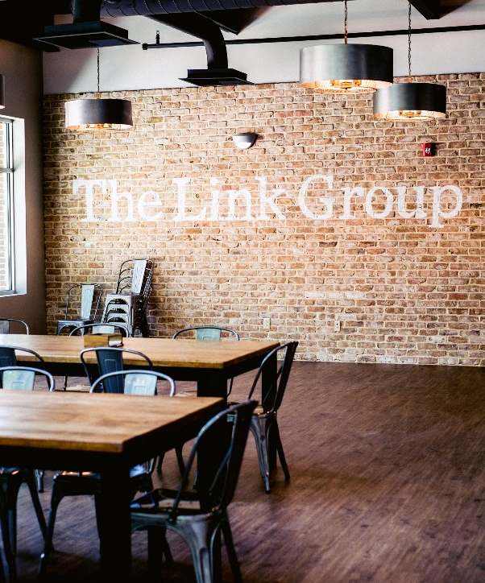
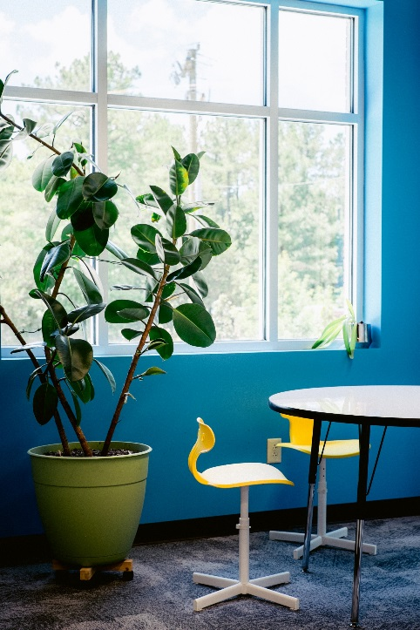
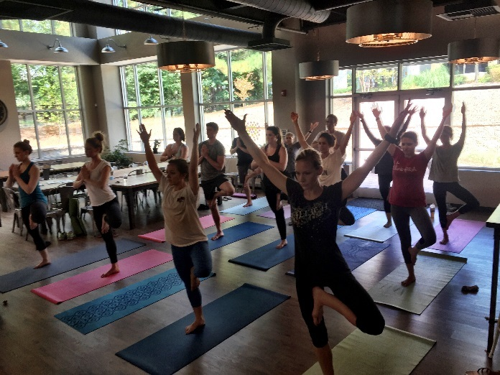
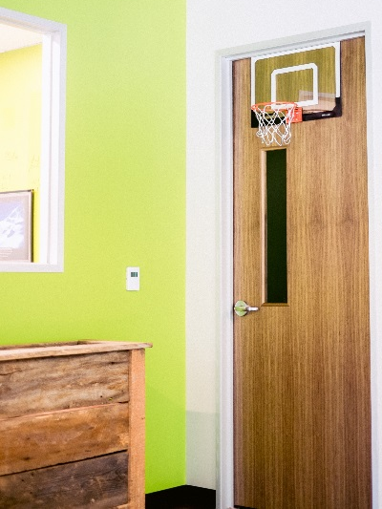
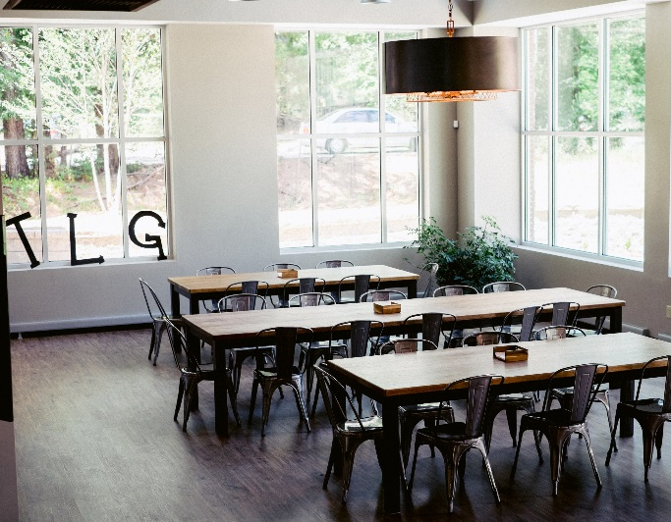
The new Durham office
Notes:
We have two offices with one more on the way. One in Atlanta, and one in south Durham, near Southpoint Mall and we’re working on opening one in Sarasota, FL. We built it new and it’s won awards for how its design is environmentally friendly. Casual office environment – dogs allowed, shoes optional. Yoga on Tuesdays. Get your own office after 6 months of training.

Slide 7
What do we do?
“market research consulting”
Our clients have questions about how they should best market to their customers, and they come to us for help.
“Where in the marketplace are there unmet needs and opportunities for a new product?”
“What are the attitudes and behaviors of parents who shop for their kid’s shoes?”
“What is the patient experience on Product X, a diabetes medication?”
“We have 3 prototypes for a new product. Which one is going to be the most appealing for consumers?”
Notes:
What we do is essentially consulting, but with research. Our clients come to us with a question that relates to how they should market to their customers, and we do research to deliver the answers. It may be very broad (“attitudes and behaviors of parents shopping for kids shoes”) or very specific (“3 prototypes – which is most appealing”). It can happen any time in the product life cycle, so before a product’s even created (“unmet needs and opportunities”) or once a product’s already out and they want to see how it’s doing (“patient experience”).

Slide 8
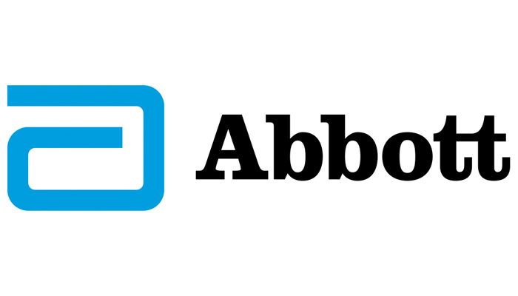
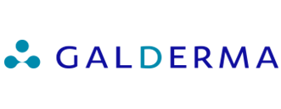
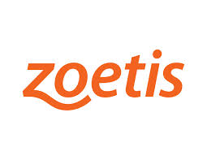
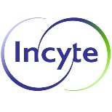
Some of our clients…
Healthcare | Retail | CPG | Other
80%
of our business is healthcare
Notes:
80% animates in

Slide 9
Where do we do this research?
by the numbers…
35+
The Americas | Europe |  | Asia
All US Markets Brazil Canada Colombia Mexico Venezuela Africa South Africa | Austria Belgium Czech Republic Denmark Finland France Germany Greece Ireland | Italy Netherlands Norway Poland Portugal Russia Spain Sweden Switzerland UK | Australia China India Indonesia Japan Malaysia New Zealand Saudi Arabia Singapore South Korea Russia Taiwan
countries we have conducted research in over the past decade
1/3
of all of our research contains a global component
Linkers travel 25% of the time on average

Slide 10
What is market research?
Got questions? We’ll find answers.
Notes:
So, you’re probably thinking – “This sounds great! But I’m still not quite sure I understand what market research is.”

Slide 11
market research:
Objectively gathering, recording, and analyzing qualitative and quantitative data in order to identify and define marketing opportunities and solutions.
goal:
To understand how the marketing mix impacts customer behavior.
11
Notes:
So, you may be thinking: “this sounds cool, but I’m still not really sure what we’re talking about.” Here’s the plain and simple: market research is gathering information from people, analyzing it all together to understand trends and what it all really means, and then telling our clients how they can use that information to better market to their customers. Objective = no bias. “Marketing mix” = product, place, price, promotions.

Slide 12
Why invest in market research?
Market research can help companies understand and predict consumer behavior so they can make better decisions about what to market or sell, to whom, at what price, and through what channel or route.
12
Notes:
Throw it out to the audience.

Slide 13
Marketing and Creative Agency
Marketing Research (also known as consumer insights)
Human Resources
Legal
Business Decision
Sales
Operations
Product Development
Finance
Notes:
Research is an aid to judgment for business decisions. Marketing research represents the voice of the customer. However, the voice of the customer is only one piece of the puzzle.

Slide 14
Marketing Research covers a wide spectrum.
New Product Development
Marketing Communications
Customer Satisfaction
Ideation
Concept screening
Concept evaluation
Choice modeling
Product tests
Pricing and demand forecasts
Packaging research
Brand equity studies
Brand positioning development & evaluation
Advertising development & testing
Awareness, brand and image tracking
Satisfaction & loyalty driver studies
Satisfaction tracking
Attrition studies
“Shoppability” studies
Strategic Research
Attitude and usage studies
Market segmentation research
Market opportunity mapping
Purchase process studies
Notes:
Don’t need to explain everything – just the buckets and maybe point out some of the key ones we do a lot.

Slide 15
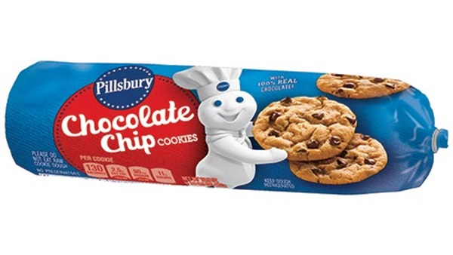
So, why do primary research?
Primary research
Secondary research
Tailored to needs
Data speaks to objectives
Takes time to conduct
More expensive
Faster
Cheaper
Covers broader topics
Data sometimes conflicts
Lots of data to sift through
Notes:
There are pros and cons to each. Secondary research is research that’s already available – like research you can find using Google. Primary research is conducted from scratch, to address a company’s specific business questions.

Slide 16
So, why hire an outside research agency?
Objectivity and Open-Mindedness
Good research takes time
Professional Expertise and Skills
Getting the full story
Notes:
Ask this to the class. See what they come up with.

Slide 17
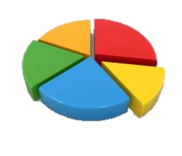
Qualitative vs. quantitative research
qualitative
quantitative
not statistical
broad, deep
“how? why?”
numbers, statistics
precise, specific
“how many?”
focus groups
1:1 interview
ethnography
surveys
observations
“M&Ms are my favorite candy because they are sweet without being TOO sweet, and because they remind me of happy childhood memories.”
21% of candy consumers ages 18 to 39 choose M&Ms (any variety) as their favorite candy.
Notes:
There are two main types of research

Slide 18
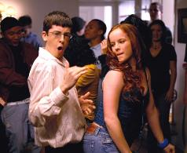
Let’s dive a bit deeper into qualitative research
A company wants to understand consumer perceptions of their brand relative to the competition. Here, we’ll show you instead of tell.
Pick a brand, any brand.
Now, imagine that brand walks into a party.
What do they look like (age, gender, etc.)?
What are they wearing?
What are they drinking?
Do people want to hang out with them?
This is called a projective technique – we use this in research!

Slide 19
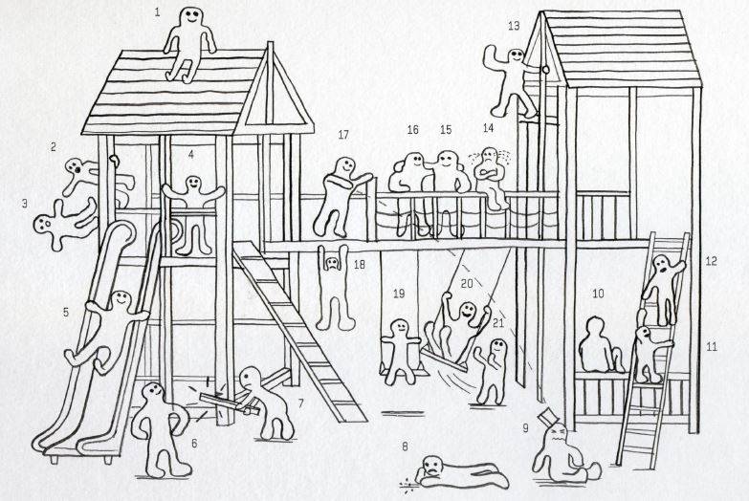
So, let’s say UNC wants to better understand the undergraduate student experience.
They might hire us to conduct a research project, and we might interview students like you about this. Here, we’ll show you instead of tell.
Notes:
So, let’s say UNC is our client and they want to better understanding the undergraduate student experience so they can improve it. We might interview students like yourself. Let’s do a little exercise. Here you see a bunch of figures on a playground.
Which one of these figures best represents your first day at Carolina? For what reasons?
Which one best represents you during finals week? For what reasons?
Which one best represents a you in your dorm? For what reasons?

Slide 20
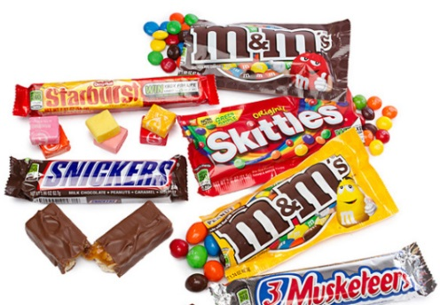
Quantitative research has rules and sophisticated techniques
To be confident in our data, we must “follow the rules.”
There are validated techniques to get beyond stated attitudes and behaviors.
“What is your favorite type of candy?”
[OPEN END RESPONSE]
VS.
“When shopping for a car, how important is… Color? A Sunroof? 4WD?
[STATED IMPORTANCE, 5-POINT SCALE]
VS.
“What is your favorite type of candy?”
[CHOOSE ONE]
Option 1 | Option 2 | Option 3 | None of these
Blue | Black | White
Sunroof | No Sunroof | Sunroof
2WD | 4WD | 4WD
Notes:
Quantitative research has “rules” to follow… i.e. best practices and industry standards. And this type of research takes precision and attention to detail.
For example, if we are asking about favorite candy, did we ask in an open ended way? Did we give them choices? Did we allow them to say none? There are many details to think about – the order in which we present information and ask questions, the scales we use, etc.
But just as projective techniques show creative ways you can phrase questions in qualitative research, there are also many cool techniques that can be used in quant surveys. For example: choice based exercises – conjoint

Slide 21
Ethnographic Research
Seeing respondents in their “natural habitat.”
reel life documentaries
in-home interviews
in-store intercepts & observations
Notes:
Sometimes phone and in-person interviews aren’t enough. In order to get a full picture of the marketplace and needs, you need to examine respondent behavior in natural environments. Explain what each of these things are and why we might use them.
A great example of recent ethnography: watching consumers wash and wax their vehicles, to understand pain points in the process.

Slide 22
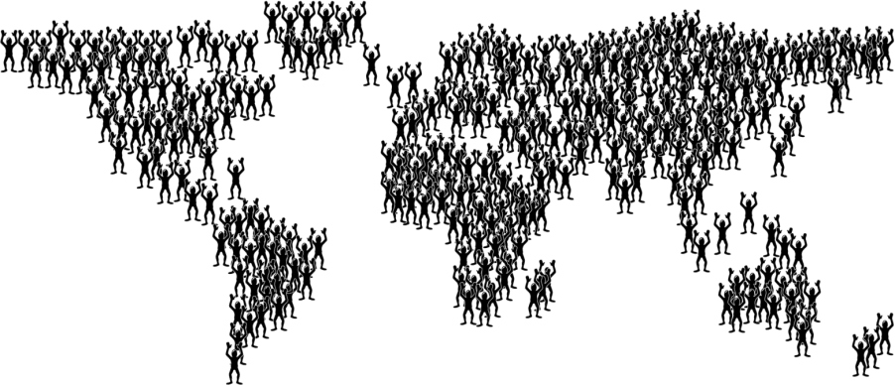
There are three key players in market research.
Clients
Suppliers
Respondents
Notes:
We are the “supplier.”

Slide 23
Here’s how a typical project goes down.
Step 1:
Research Purpose
Step 2:
Research Objectives
Clients
Step 3:
Design Research
Step 4:
Collect Data / Execute
Step 5:
Analyze Data
Step 6:
Report Results
Suppliers
Notes:
Explain what goes into “designing research” and “collecting data.” Our reports are typically PowerPoints (like this one!).
The way TLG manages this is usually with a 2-3 person team – a lead, a support, and possibly a strategist if it’s a complex project. The lead and support take the project from beginning to end, so as an APM, you’re involved in ALL aspects of the project.

Slide 24
Let’s give this a try.
background
Client is a major retail pharmacy. In their large scale customer satisfaction survey, they saw that satisfaction with the drive-thru pharmacy was significantly lower than satisfaction with the in-store pharmacy.
Understand the reasons for lower satisfaction with the drive-thru pharmacy
Identify opportunities to increase drive-thru satisfaction
objectives
research design?
Qualitative research among customers
(mini-groups)
[INTERNAL]
Concept development
Quantitative concept testing among customers
(online survey)
Notes:
Share background and objectives with class. Allow class to brainstorm research design – who would they target? What methodology? What questions?
Then share research that was actually conducted by this client (large number of mini-groups to hear about drive-thru experience from wide range of customers; then from that client team created several concept descriptions around potential improvements, new features/offerings, etc.; those concepts were then tested quantitatively among large number of pharmacy customers.

Slide 25
At the end of the project, we deliver a research report in PowerPoint to our clients as the end deliverable.
Qualitative Report
Quantitative Report

Slide 26
Some Examples
Case Studies

Slide 27
Case study: Healthcare advertisement concept testing
Objective:
Explore patient reactions to various creative concepts for a healthcare brand’s television commercials.
Methodology:
Qual IDIs: In-person in-depth interviews at two focus group facilities (Phoenix, Atlanta)
Talking to: Patients with Type 2 Diabetes and various co-morbidities (High Cholesterol, Hypertension, etc.)
In the interview: Showed “storyboards;” captured initial reactions and deep dives on each; compared options to determine overall preference.
Output:
A clear understanding of which concept(s) elicit the most perceptual and/or behavioral change in favor of the brand.

Slide 28
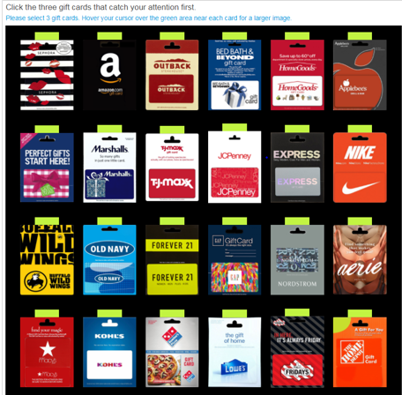
Case study: Clothing brand gift card design evaluation
Objective:
Identify how well potential gift card designs perform on key metrics, including eye-catching, fit with the brand, and customer preference.
Methodology:
Quant survey: Nationwide online survey
Target: n=600 gift card purchasers (must have purchased a specialty clothing retailer or department store gift card in past 12 months) who have at least heard of the target brand.
In the survey: Showed a mock “gift card wall” and head-to-head comparisons of the gift cards within each brand; captured reactions and preference.
Output:
A clear understanding of which gift card(s) are most attention-grabbing in order to inform future design decisions.

Slide 29
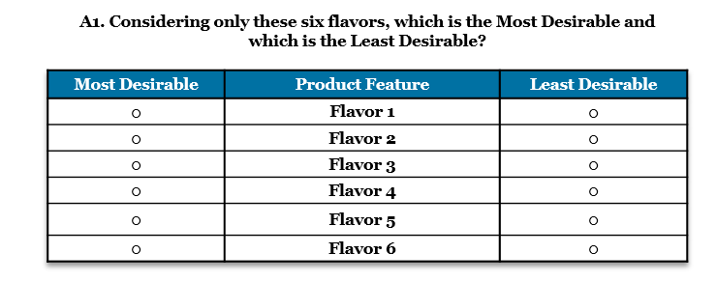
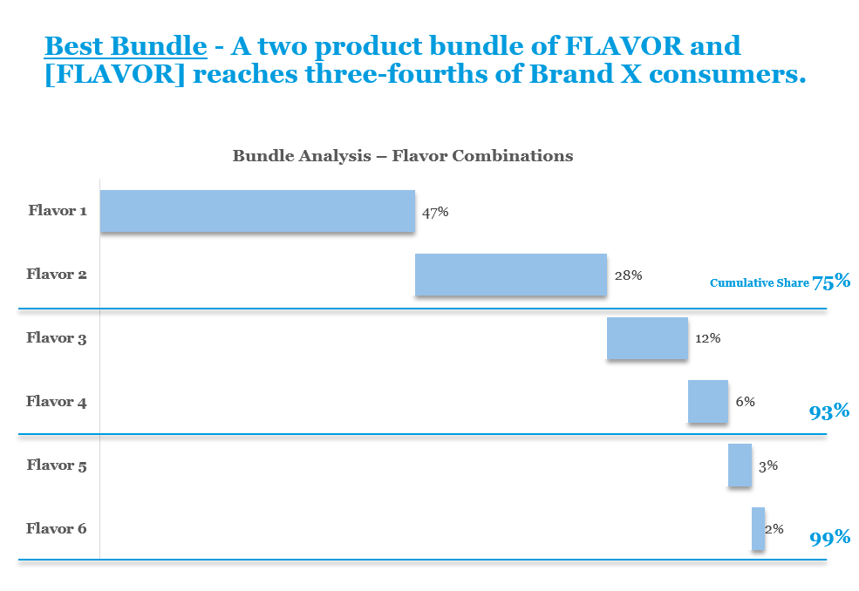
Case study: Nutritional beverage flavor evaluation
Objective:
Choice-Based Survey Example:
Identify the most desirable flavors and flavor combinations that will maximize volume across key target consumers of nutritional beverage brand
Methodology:
Quant survey: Nationwide online survey
Target: n=700 nutritional drink consumers
In the survey: Included a “choice-based” series of questions (called Max-Diff methodology), showing them sub-sets of 40 potential flavors, asking their most/least desired flavor in each sub-set
Output:
A clear understanding of the most desired flavors, that the bundle of flavors that optimizes total reach. This data was put into a Simulator for the client.

Slide 30
Questions?

Slide 31
Andrew Borum
Vice President
aborum@tlg.com
Elizabeth Berry
Associate Project Manager
elizabeth@tlg.com

