Slide 1


Ensuring FA Students Register for Courses in Their Program Using Registration Restriction Rules
Karen Statler Sonya Atkinson
Financial Aid Curriculum

Slide 2
SMEs-Our Role
Training
Support Tier II Help Desk
Create Documentation
Customized Consulting through the use of ellucian Best Practices
Monitor Patch Releases

Slide 3
Our Goal
To demonstrate how colleges can use registration rules to ensure financial aid recipients receive aid for only the courses required in their program

Slide 4
Assumptions
The College has implemented Degree Audit
Early registration
  Students have applied for Financial Aid by this date
  Financial Aid is being processed for upcoming year by this date
Student can be given an override or waiver to register
Registration rules will be reviewed as program requirements change
College is using Eligible Program Rules in Autopackager AND Transmittals

Slide 5
Assumptions
Cross application communication is open between FA and Registrar and/or Curriculum
Person(s) responsible for creating rules has working knowledge of academic program requirements
Pending FA for this purpose is SA.ACTION.CATEGORY of ‘A’

Slide 6
Points to Ponder
Are there restrictions for General Education courses that need to be created?
Are there restrictions for courses not eligible for FA (like some certificate programs)?
Have the sections for upcoming academic term been built?
How will you deal with students who change their major after registering?
If you have other Registration restrictions you must incorporate logic to account for all rules
It is important to consider the time necessary to successfully implement and test rules before using this process in your PRODUCTION account

Slide 7
Our Sample College
One of our medium sized schools
FA staff consisted of 3 full time professionals
3500 enrollees, 50% received FA
Using Web Registration
Spends approximately 2 weeks reviewing student registrations

Slide 8
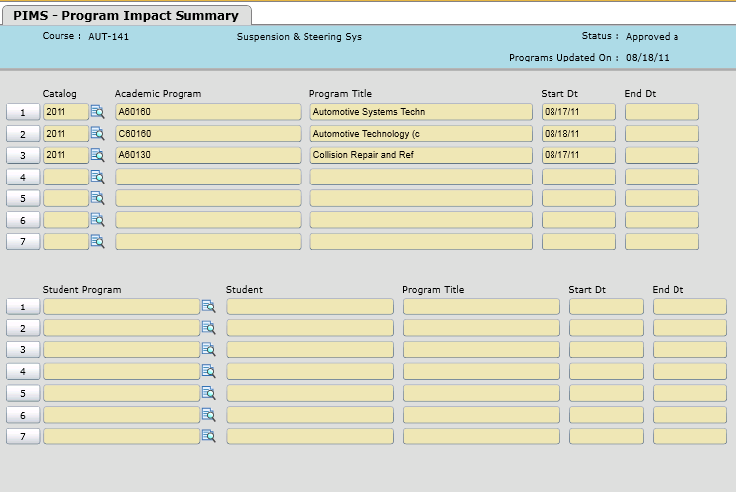
Step 1
Access PIMS and enter the course. This form will show what programs have this course as a requirement. This is what you can see in the example below.

Slide 9
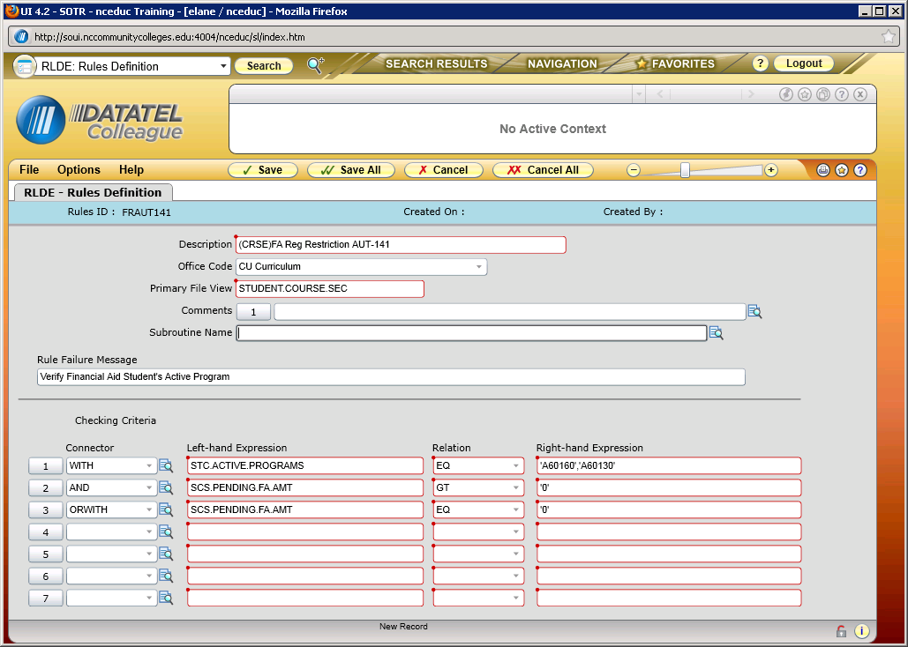
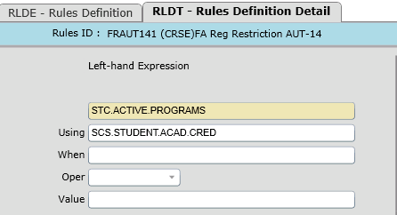
Step 2
Create registration restriction rule for each course. There are two examples provided. It is important to ensure the proper pointer is used with STC.ACTIVE.PROGRAMS.

Slide 10

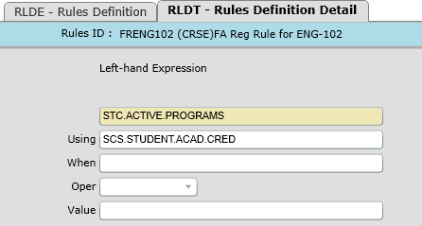
Step 2
SECOND EXAMPLE

Slide 11
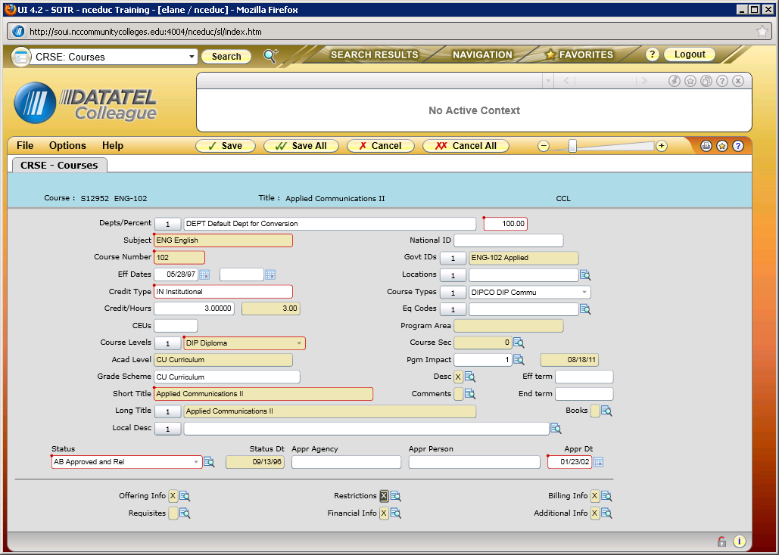
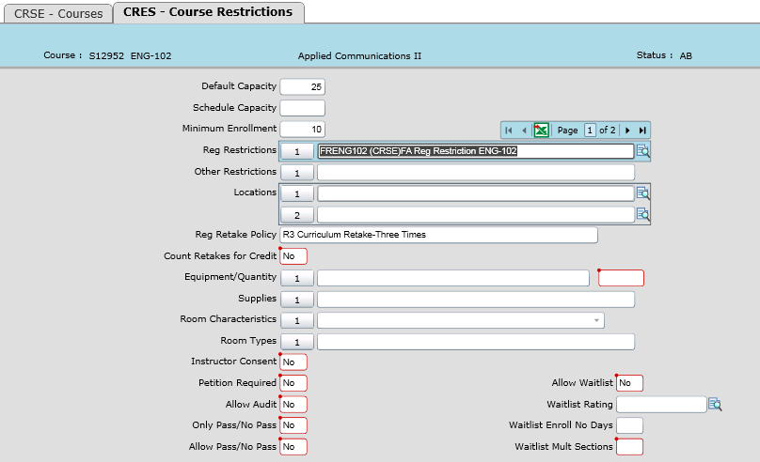
Step 3
Attach the registration rule to the appropriate course as shown.

Slide 12
Step 4:TESTING
We identified students with aid and without aid
We verified their program of study
We registered the students

Slide 13
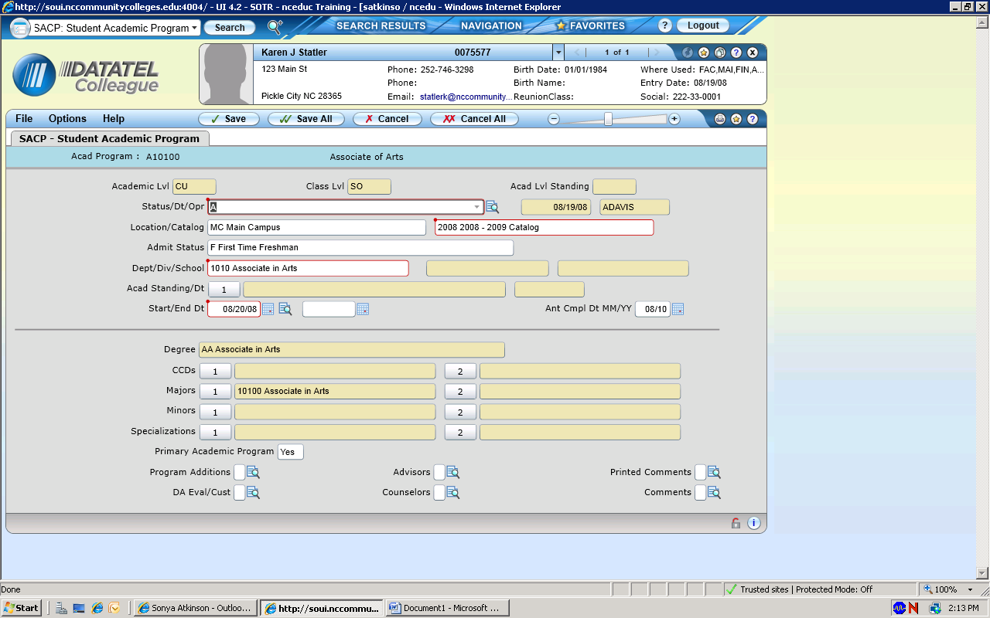
Example #1
Student does not have ACCEPTED FA on AIDE

Slide 14
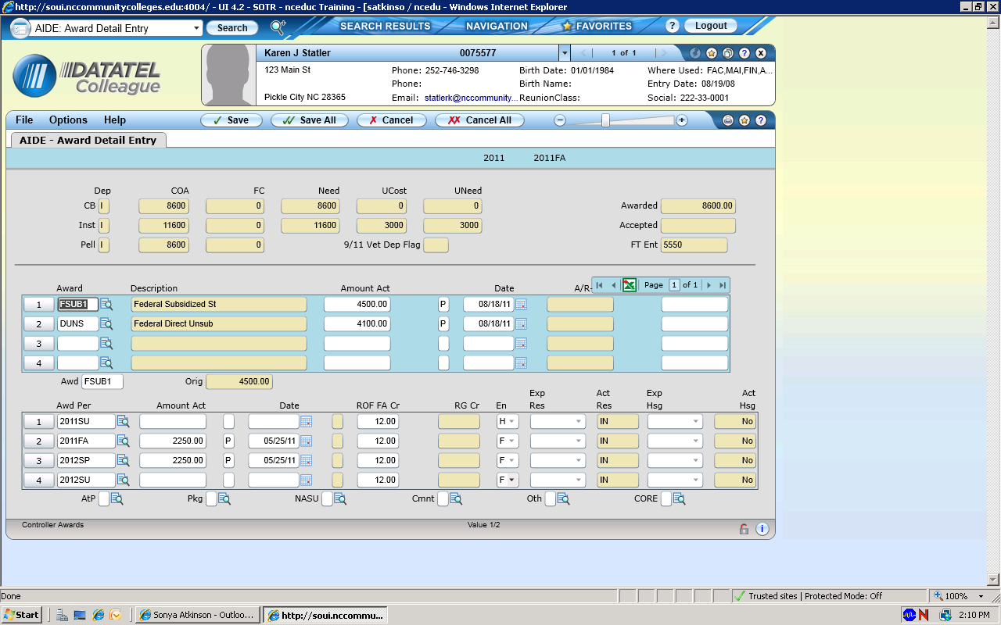
Example #1
Student does not have ACCEPTED FA on AIDE

Slide 15
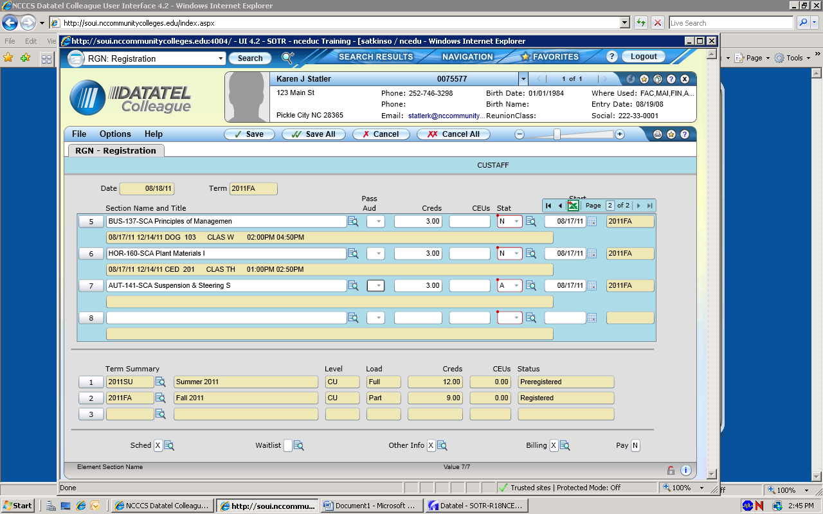
Example #1
Student does not have ACCEPTED FA on AIDE

Slide 16
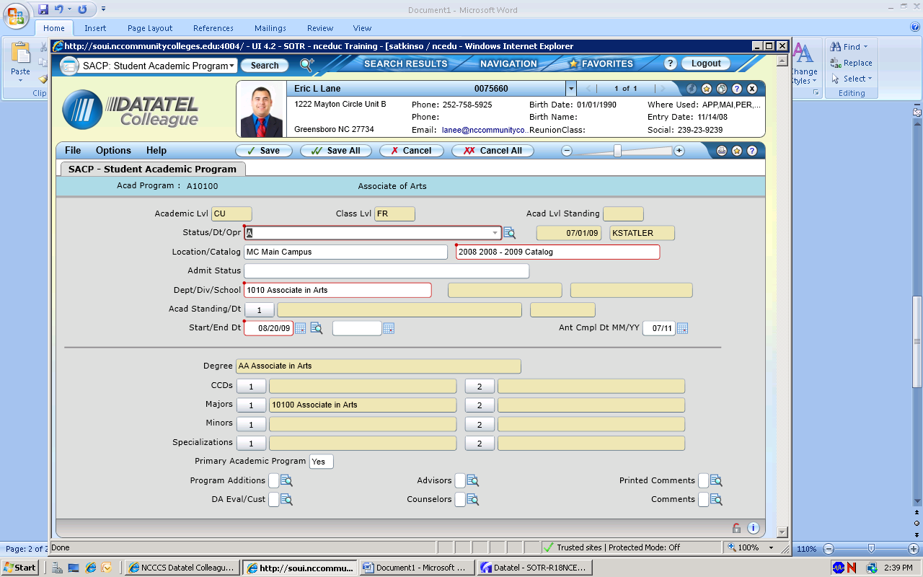
Example #2
Student has ACCEPTED FA on AIDE

Slide 17
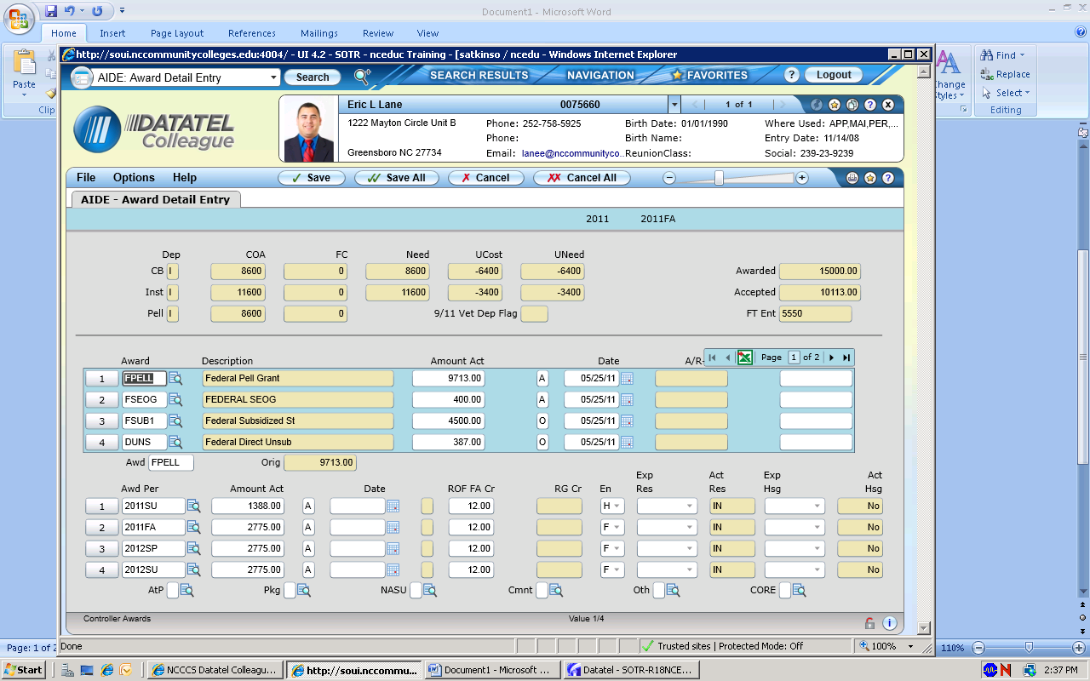
Example #2
Student does have ACCEPTED FA on AIDE

Slide 18
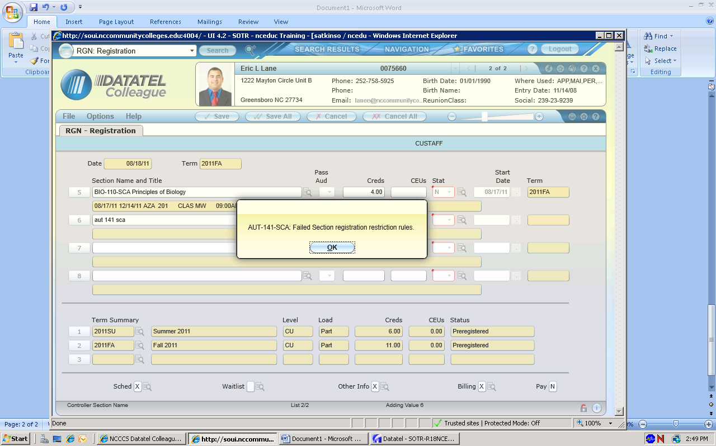
Example #2
Student does have ACCEPTED FA on AIDE

Slide 19
Questions

Slide 20

Contact Information
Sonya Atkinson
atkinsons@nccommunitycolleges.edu
Karen Statler
staterk@nccommunitycolleges.edu

