Slide 1
Attendance Supervisor Session
Bo Magnusson
Cumberland County Schools
Attendance Supervisor

Slide 2
Our Team
Bo Magnusson
Attendance Supervisor
Director of Emergency Management & Security
Threat Assessment Task Force
Supervisor of Safe Schools Counselors
Discipline Hearing Authority Chairman
Faith Abston
SIS & Attendance Administrative Assistant & Bookkeeper
Lead Attendance Clerk
Patricia Overstreet
SIS Administrator
Testing Coordinator
Cumberland County Schools - Around 7,100 Students in 12 schools

Slide 3
Student Attendance
Strategies Utilized to Ensure and Increase Student Attendance

Slide 4
Getting Everyone Involved
School
Family
Community

Slide 5
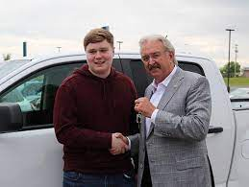
Community Partnerships & Relationships
Dave Kirk Car Giveaway(19 years)
Juvenile Court Officers
General Sessions Court Judge
DCS Case Managers & Supervisors

Slide 6
District Interventions
Attendance Audits
District Attendance Team
Twice Every Grading Period
EIS “Absent Student” Data Report
Excused and Unexcused
School Outreach and Follow-up
Centralized Google Folder
Shared Drive With Procedures and Policies
Consistent Documents Across the District

Slide 7
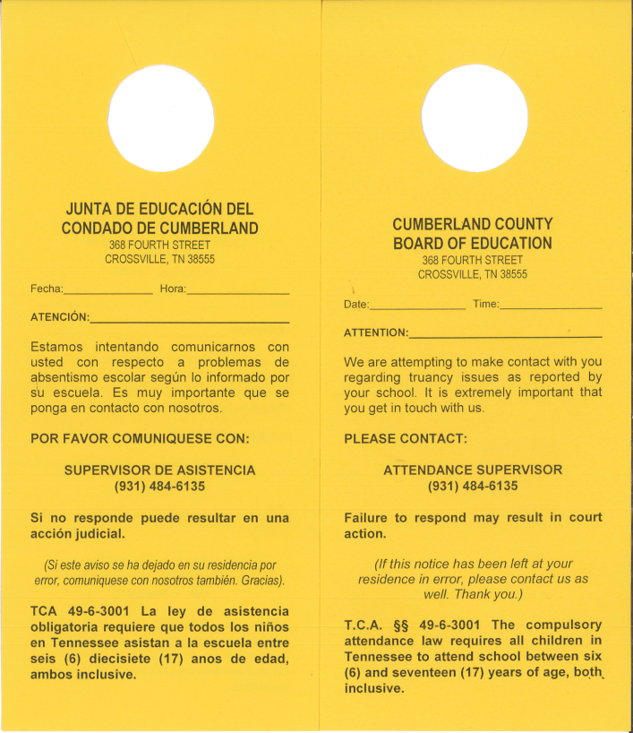
District Interventions
Home Visits
School Requests
Door Knockers
Juvenile Court Officers

Slide 8
School Interventions
SIS Package
Communication
Robocalls
Family Weekly Attendance Emails
Encourage use of Family Access to check attendance and if notes have been turned in by the student
Tier Process

Slide 9
Tier Interventions
Tier 1
Meeting with student and school attendance representative at 3 unexcused
Reviews absences and notes
Tier 2
Meeting with student, parent/guardian, school attendance representative at 4 unexcused
Signed attendance contract

Slide 10
Tier Interventions
Tier 3
Truancy Court with student, parent, Juvenile Service Officers, and District Attendance Supervisor at 5 unexcused
Informal agreement is signed
Tier 4
Juvenile Court Citation to appear before the General Session Judge if student continues to miss school

Slide 11
Thanks!
Any questions?
You can find me at magnussonb@ccschools.k12tn.net

