Slide 1
Mobile Lockout-Tagout Training System Overview

Slide 2
Lockout Tagout Mobile Training System
Issue: Employees had raised concerns with the Lockout Tagout skill sets of our employees that do not perform them often. We needed a better hands-on training system in addition to our policy review and OJT opportunities.
Purpose: Increase the knowledge and skill set of our employees in regards to executing a safe Lockout Tagout of our equipment and systems; both mechanical and electrical.
Solution: A mobile Lockout Tagout board was created to meet the following criteria:
Train new employees on the proper execution of a lockout tagout procedure before being placed in the workplace locking out live equipment with limited or inconsistent OJT training.
Periodic refresher training and knowledge checks of existing employees on the proper execution of a Lockout Tagout procedure and the proper PPE needed.

Slide 3
Lockout Tagout Mobile Training System
What is the goal with using the LOTO Training Board?
Developing competent skill sets within our Lockout Tagout Program that can be periodically tested and improved upon if or when performance gaps are identified.
What types of lockouts can be completed on the board?
Line Breaks (LEO and LEO Permit)
Double Block & Bleed
Pump Isolations
Chest Isolations (Confined Space Entry)
Electrical Circuit Isolations (Arc Flash Potential and PPE)

Slide 4
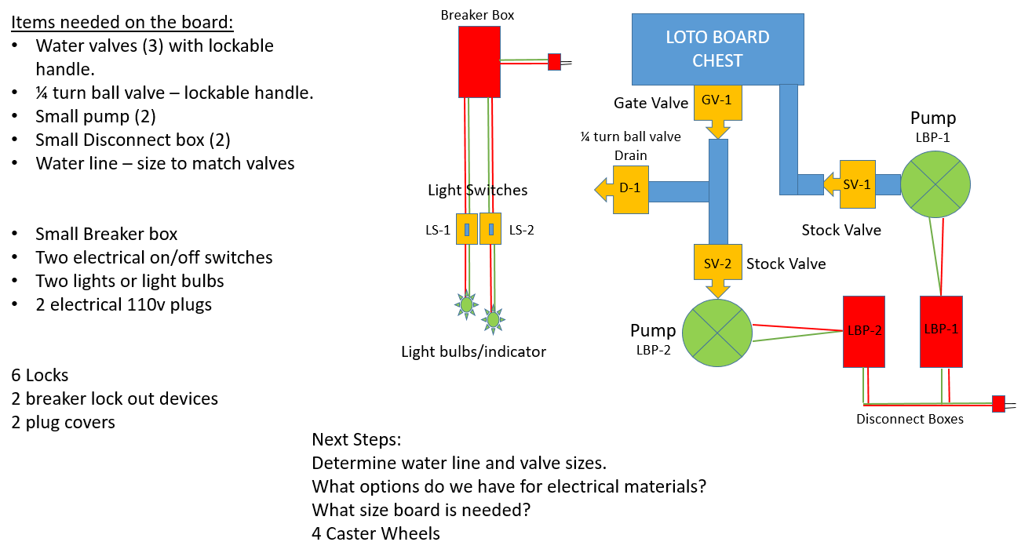
Lockout Tagout Mobile Training System
Originally this started out as an idea in my head that I put on paper and brought to my M&E Team. It evolved into what you will see on the following slides.

Slide 5
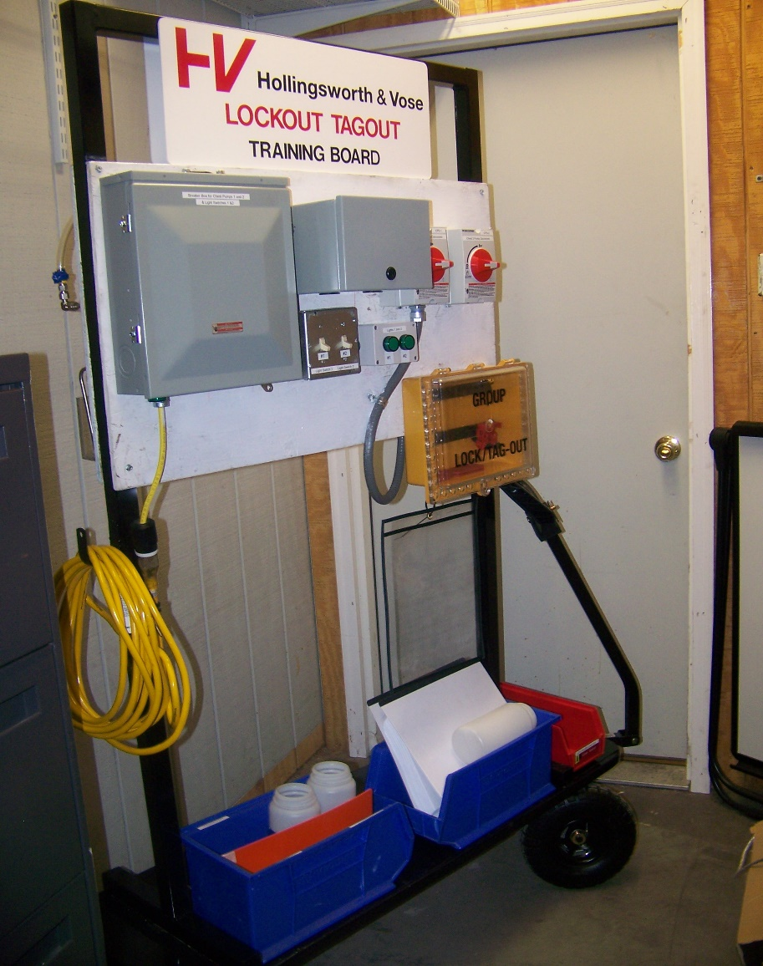
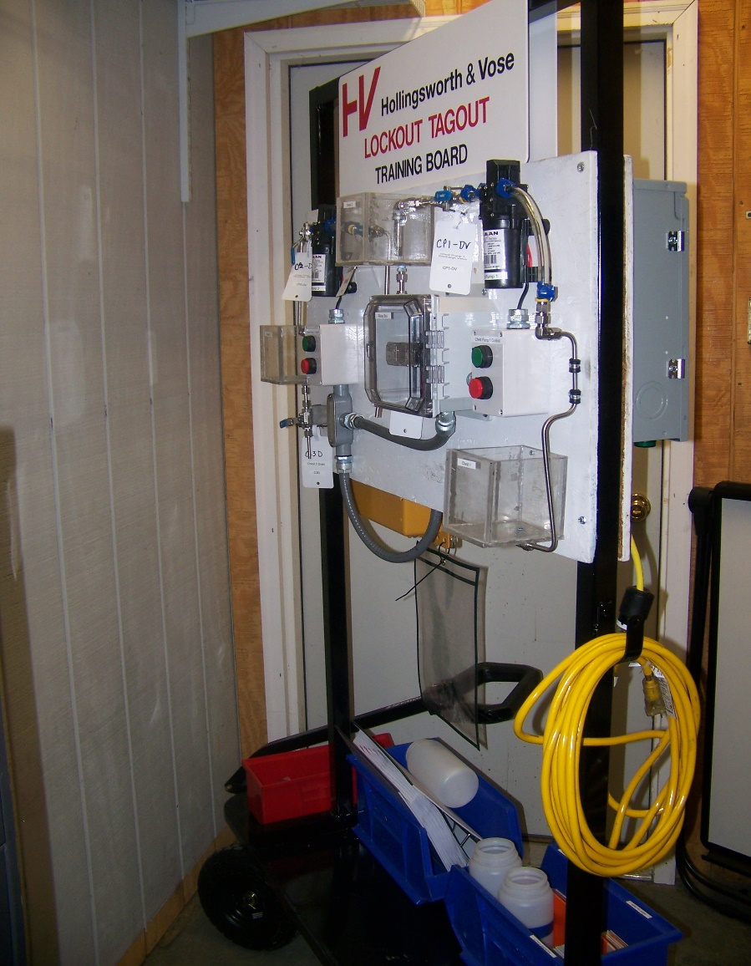
Lockout Tagout Mobile Training System
Electrical Lockout Training
Mechanical Lockout Training

Slide 6
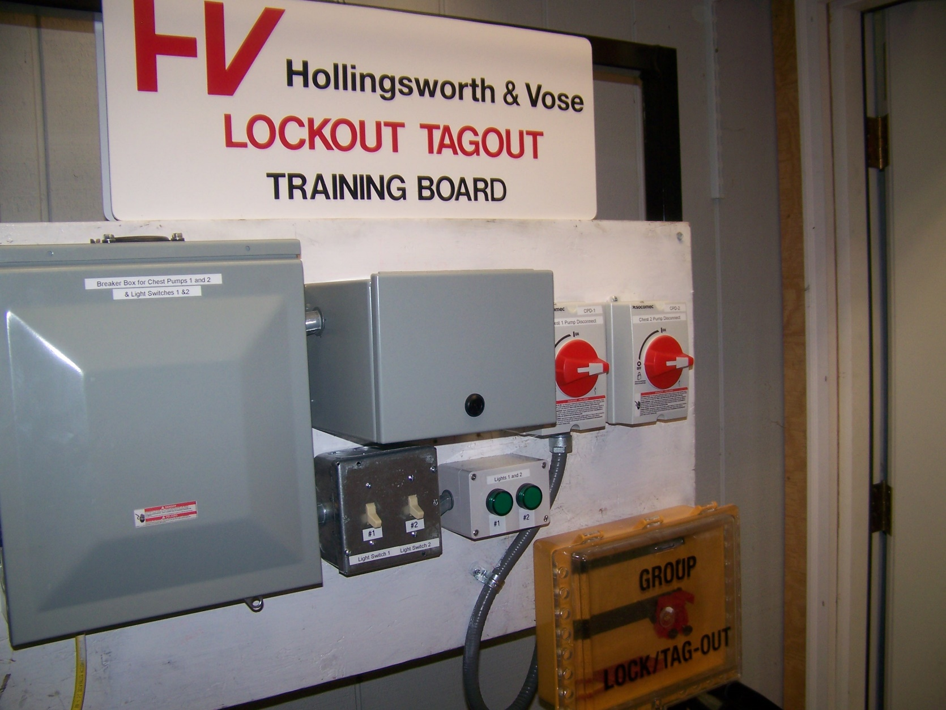
Lockout Tagout Mobile Training System

Slide 7
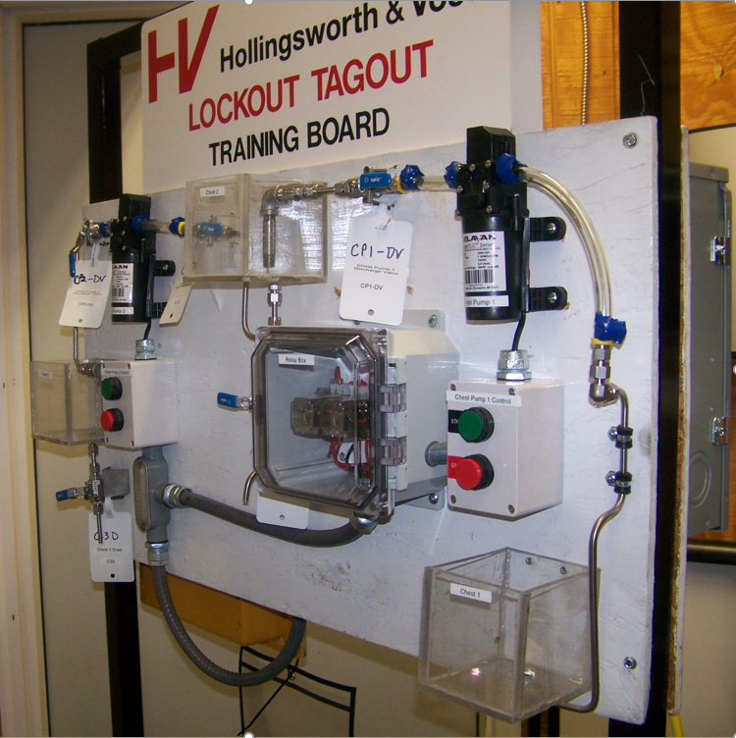
Lockout Tagout Mobile Training System

Slide 8
Lockout Tagout Mobile Training System
Some of the items covered during the training: (in no particular order)
Our LOTO Procedure review. How to read the document and understand the intent of the layout, like adding pictures and completing the annual inspections requirement.
Following PPE guidelines for a proper safe lockout of our equipment.
Review of the auditing process and the expectations in place.
Reinforcing the importance of communication to all involved.
How and when a lockbox is used.
When additional permits might need to be used. (LEO, Hot Work or PRCS)
The proper unlocking of the equipment and the order in which that happens.
Safe practices and procedures when “throwing” electrical disconnects.

Slide 9
Lockout Tagout Mobile Training System
Other potential training discussion opportunities:
Reinforcing Confined Space Safety, Permit Requirements, Completions and use of our On-Site Rescue Equipment
Arc Flash Safety:
Boundary and Safe Distance Requirements
The Arc Flash Categories and PPE needed for each
“Prevention By Design” – Designing Safety Systems into our new installs
Many of our steam and older piping systems cannot be Double Blocked and Bled because it wasn’t designed that way when it was installed.
Proper Labeling of our equipment
Clear and Concise labeling makes it easier for everyone to identify the correct equipment.

