Slide 1
Data Mining
Beyond the Basics
Lisa Berry
Alcoa City Schools

Slide 2
Old Dog, New Tricks?
Data Mining – Beyond the Basics
Notes:
Recently needed to compare Lunch Codes and Passwords – quickly did a Data Mining Report
Planned this presentation while learning new tricks from the Skyward feature I use most often.
Had me when I saw Data Mining.
Full disclosure – since we started on Skyward the canned reports are much better

Slide 3
Data Mining – Beyond the Basics
Let’s Share

Slide 4
Training Resources
Data Mining – Beyond the Basics
Just enough, Just in time, just for me

Slide 5
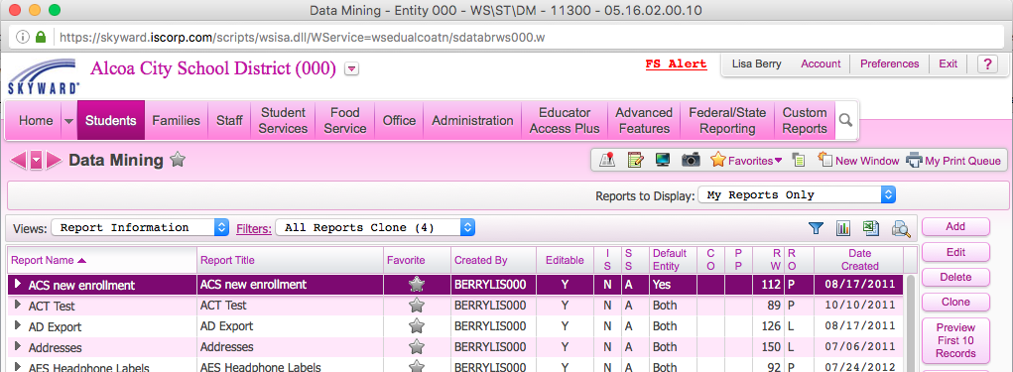
Data Mining – Beyond the Basics

Slide 6
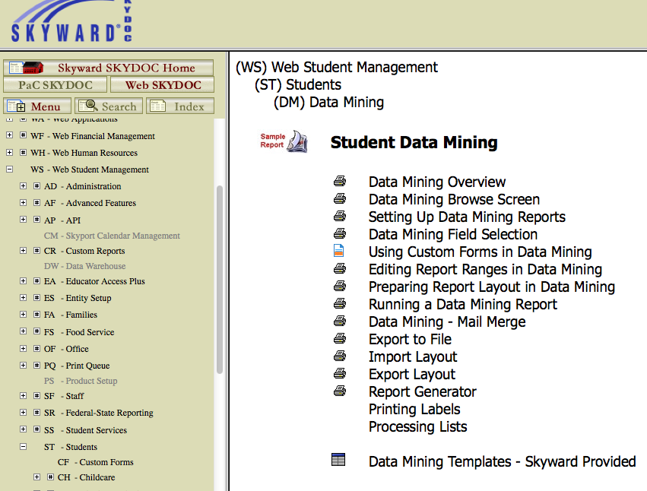
Data Mining – Beyond the Basics
Notes:
Original Documentation – not deep, but often will get you started or remind you of something you had not done in a while.

Slide 7
Data Mining – Beyond the Basics
Notes:
Original Documentation – not deep, but often will get you started or remind you of something you had not done in a while.

Slide 8
Data Mining – Beyond the Basics

Slide 9
Data Mining – Beyond the Basics

Slide 10
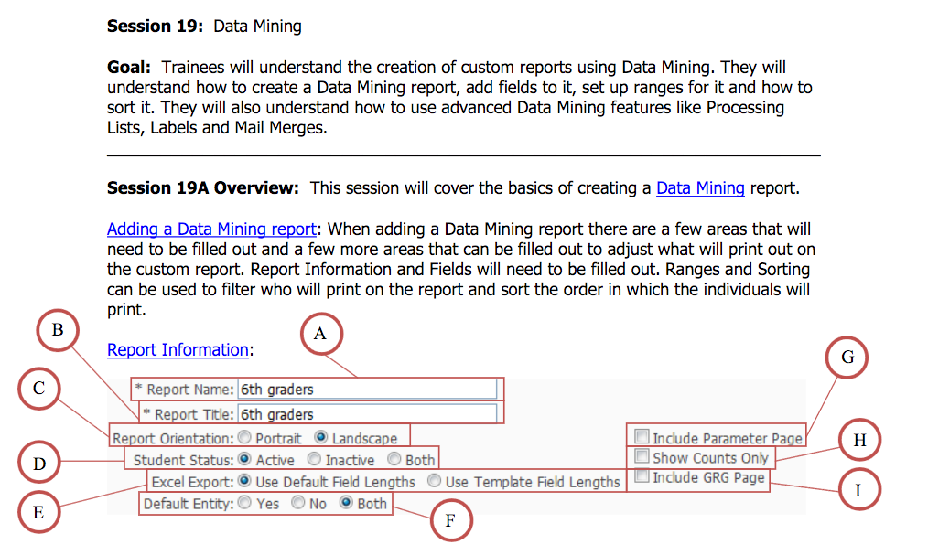
Data Mining – Beyond the Basics
Notes:
Pre-Training Agenda.

Slide 11
Data Mining – Beyond the Basics

Slide 12
Data Mining – Beyond the Basics
Notes:
Not many templates there yet, but is an interesting area to monitor.

Slide 13
Data Mining – Beyond the Basics
Other Resources
PDC
Other Resources
Data Mining Tutorials
Brilliant Gems From Data Mining
Notes:
Data Mining Tutorials – pptx
From Attendance Conference
Puts all data mining tutorials
Can be found on TNSUG Website
Brilliant Gems From Data Mining
Presentation from iCon 2015 – with Jennifer Dossett – plug – presentation tomorrow on using data mining to streamline transportation reporting

Slide 14
Data Mining – Beyond the Basics

Slide 15
Data Mining – Beyond the Basics

Slide 16
Data Mining – Beyond the Basics

Slide 17
Contact Information
Data Mining – Beyond the Basics
Lisa Berry
Alcoa City Schools
lberry@alcoaschools.net
Notes:
Planned this presentation while learning new tricks from the Skyward feature I use most often.
Had me when I saw Data Mining.

