Slide 1
Blended
Using Disruptive Innovation to Improve Schools
Michael B. Horn | mhorn@christenseninstitute.org | Twitter: @michaelbhorn
Notes:
Disruption in brief through circles – make clear 2 types of innovation (1 that improves products in the circle, 1 outside)
Online learning as disruption
What’s exciting about it → Potential
Improving
Blended learning
Tell blended learning as disruptive vs. sustaining story through sailboat shorthand
Team structures to innovate
Somewhere how it fits in with project-based learning – in staffing.

Slide 2
The growth of online learning

Slide 3
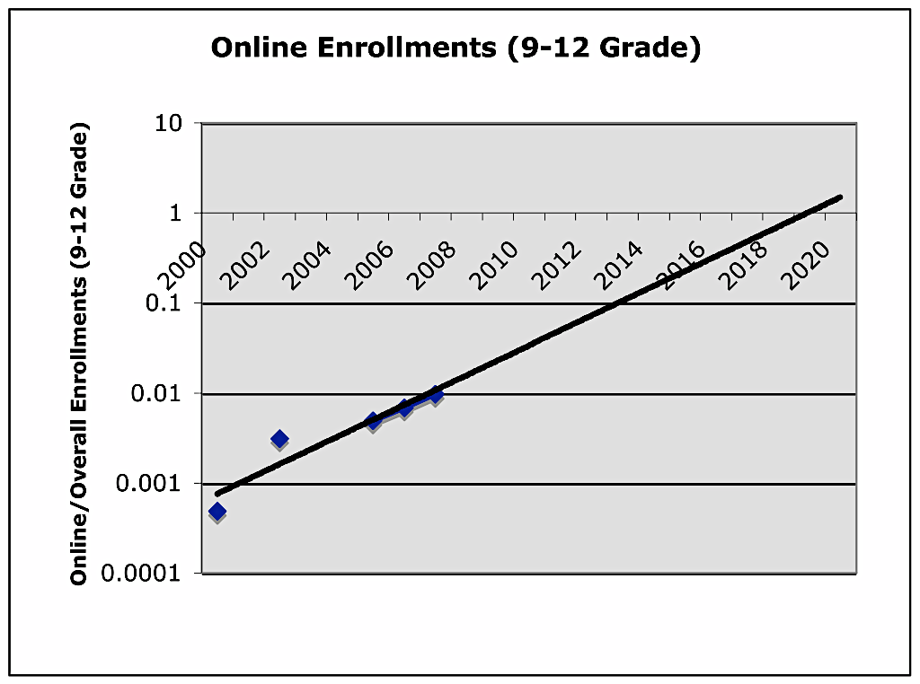
Online learning is gaining adoption
Substitution calculation indicates online learning is growing disruptively
50% of all high school courses online by 2019

Slide 4


The rise of K-12 blended learning
Definition of blended learning
A formal education program in which a student learns at least in part through online learning, with some element of student control over time, place, path and/or pace
at least in part in a supervised brick-and-mortar location away from home (such as school).
100010001111010101000
The modalities along each student’s learning path within a course or subject are connected to provide an integrated learning experience.
100010001111010101000

Slide 5
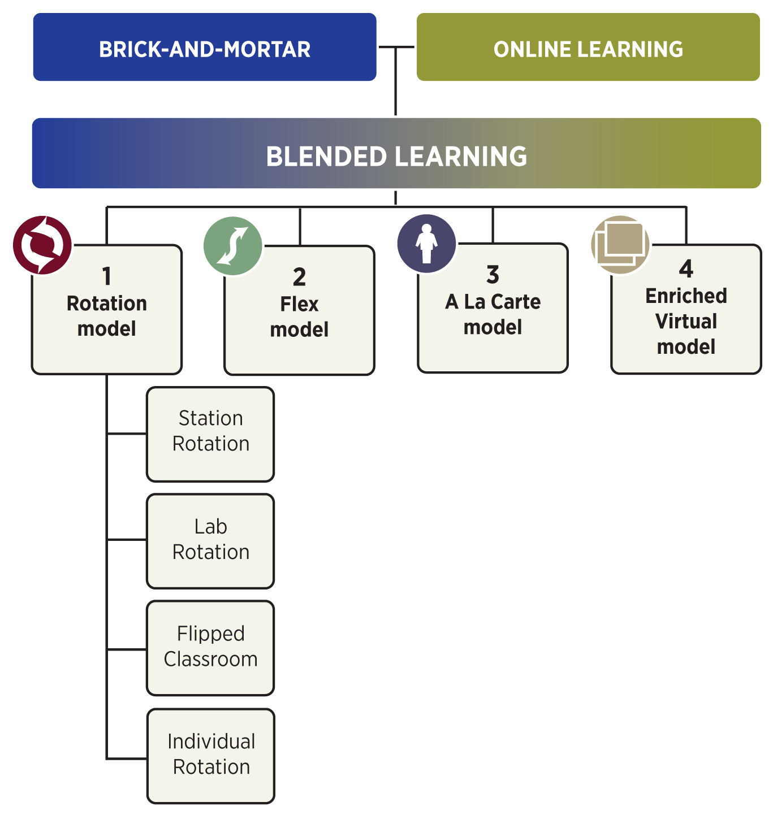
Emerging blended-learning models

Slide 6
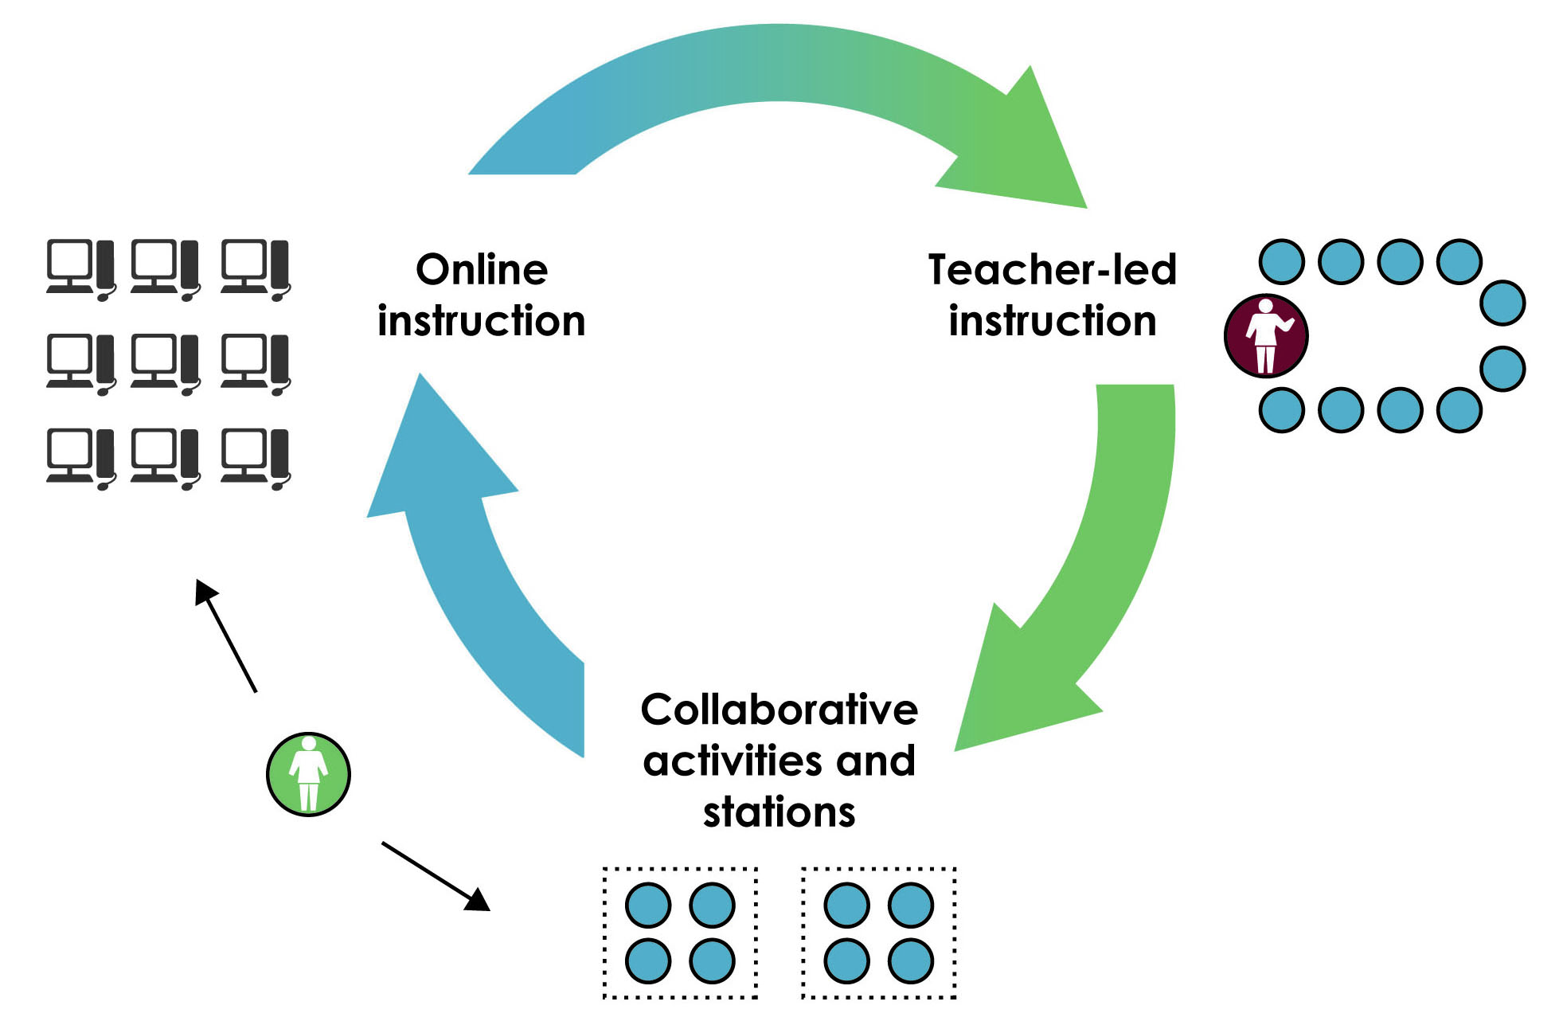
Station Rotation Model

Slide 7
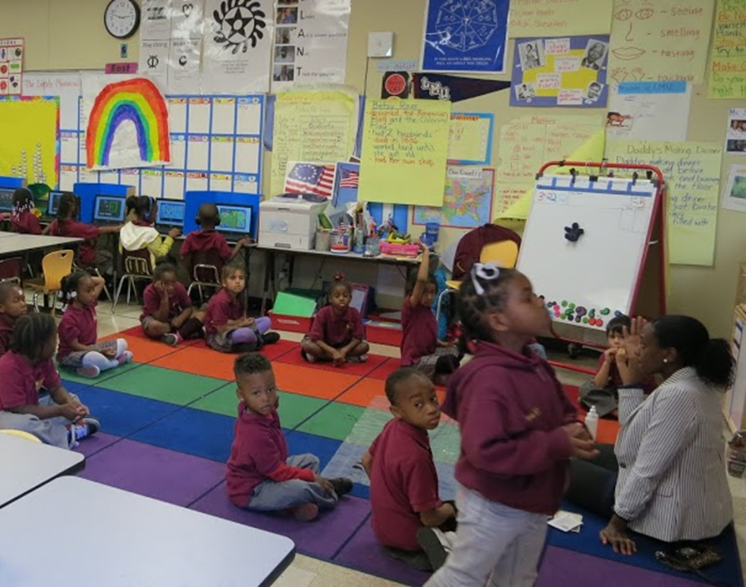
Station Rotation Model

Slide 8

Station Rotation Model

Slide 9
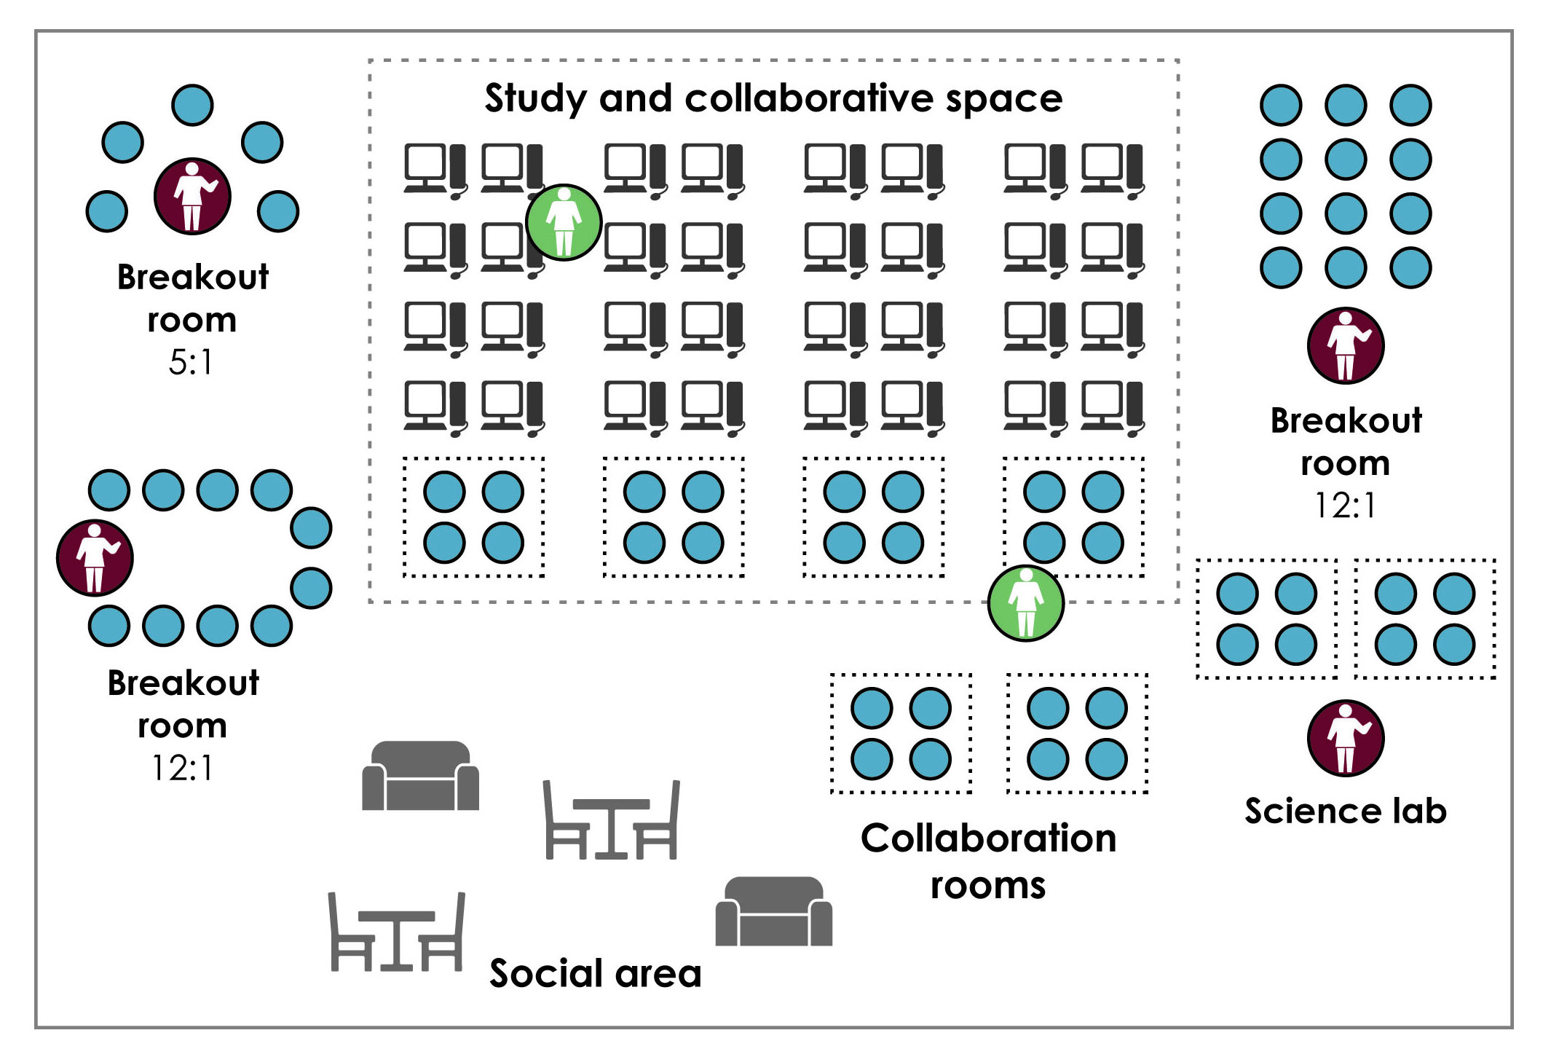
Flex Model

Slide 10
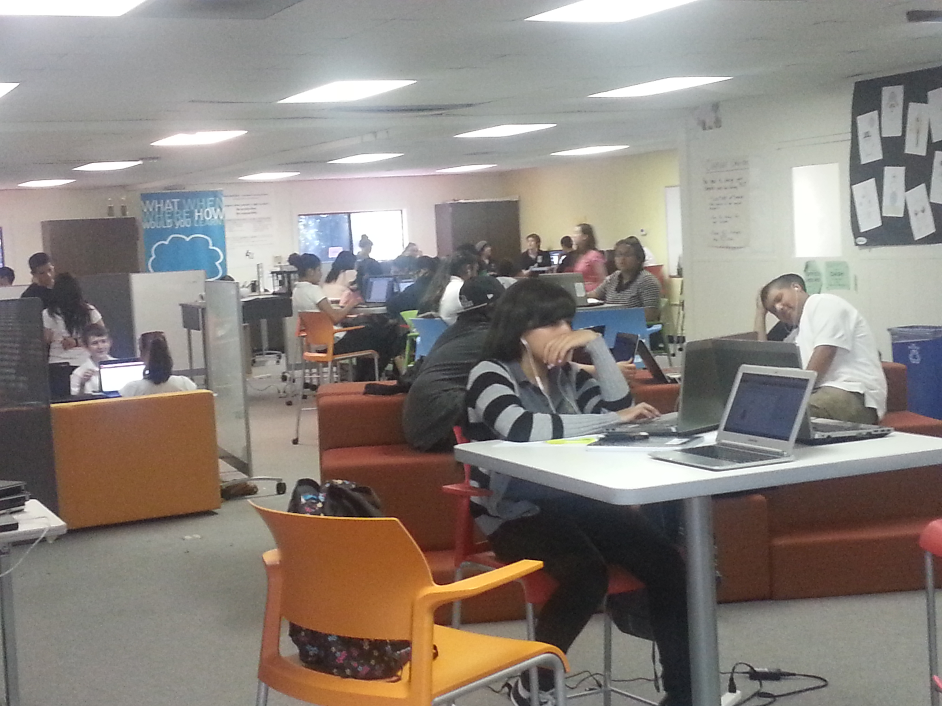
Summit Public Schools

Slide 11
Why should we care about online learning?

Slide 12
Student-centered learning =
Personalized learning
+
Competency-based learning

Slide 13
3 elements driving its adoption

Slide 14

Driving adoption
Personalization

Slide 15

Driving adoption
Personalization
Access and Equity

Slide 16


Driving adoption
Personalization
Cost Control
Access and Equity

Slide 17
How do we seize its potential?

Slide 18
Implementing blended learning
Choose a SMART rallying cry

Slide 19
Choose a rallying cry
Solve problems, achieve goals, seize opportunities
Core problems
Provide high school teachers more time to give individual feedback on writing assignments
Boost academic reading results
Nonconsumption problems
Lack specific subject-matter teachers
Help students recover units & credits to stay on track for on-time graduation
Our goal is to raise school math performance by 10 percentage points by the end of the 2014-15 school year.

Slide 20
Implementing blended learning
Organize the team
Choose a SMART rallying cry

Slide 21
Implementing blended learning
Design the student experience
Organize the team
Choose a SMART rallying cry

Slide 22
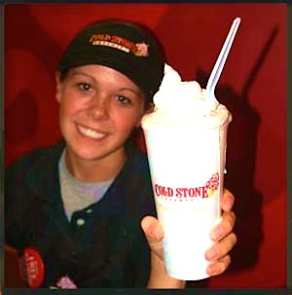
What motivates people?
Student jobs to be done:
Experience success & make progress
Have fun with friends

Slide 23
Three levels in the architecture of a Job
What and how must we integrate to provide these experiences?
What are the experiences we need to provide
to get the job done perfectly?
What’s the job to be done?
(Each job has functional, emotional & social dimensions)

Slide 24
Summit Public Schools
How to help students achieve lifelong success?
Cognitive Skills
Content Knowledge
Experiences
Habits of
Success
Source: Summit Public Schools
Notes:
- Individual playlists through Activate
- 16 hrs/week of Personalized Learning Time (possible insertion of graphic from p. 153 on this slide & then on to next slide for more things they integrated) – show picture of Summit
Comprehensive scope & sequence through graduation that is transparent
Summit Reads
Project-based learning time (maybe show schedule from p. 154?)
8 weeks per year of Expeditions
Internal mentorship program
45 minutes/week of community time

Slide 25
8 experiences Summit provides students
Student agency
Individual mastery
Access to actionable data and rapid feedback
Transparency in learning goals
Sustained periods of quiet, solitary reading time
Meaningful work experience
Mentoring experiences
Positive group experiences

Slide 26
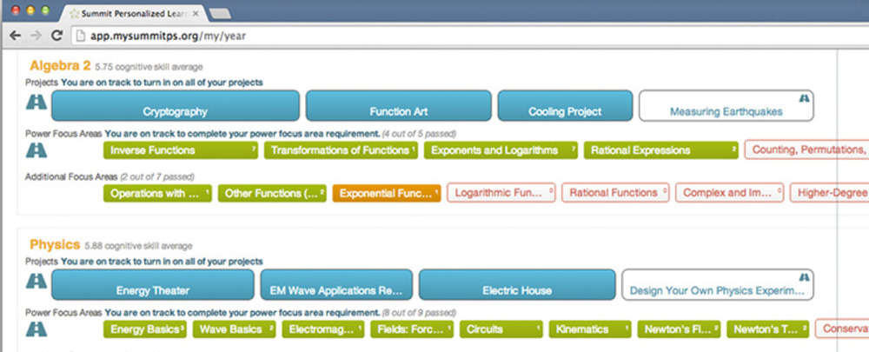
What & how to integrate
Individual playlists through Activate
Source: Summit Public Schools

Slide 27
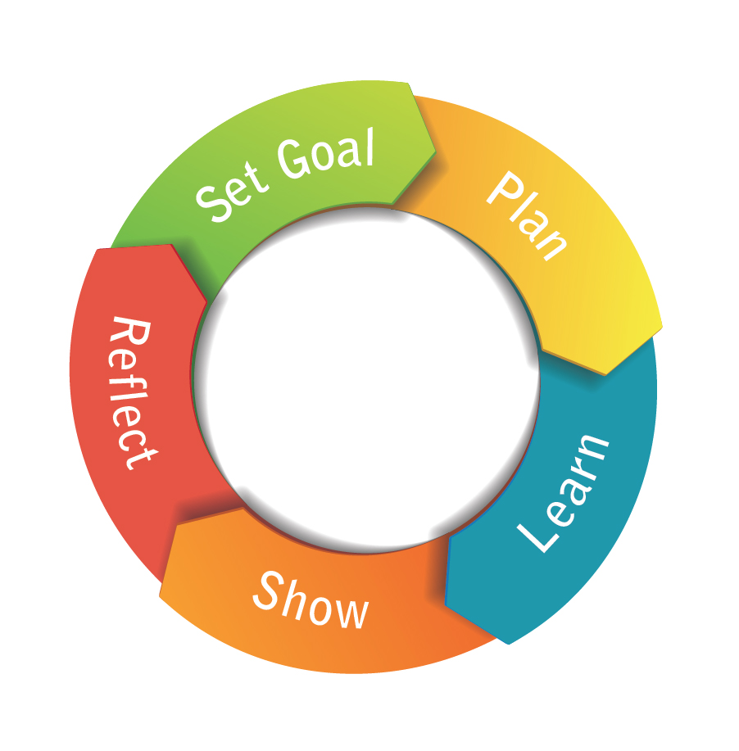
What & how to integrate
16 hours/week of Personalized Learning Time with self-directed learning cycle
Source: Summit Public Schools

Slide 28
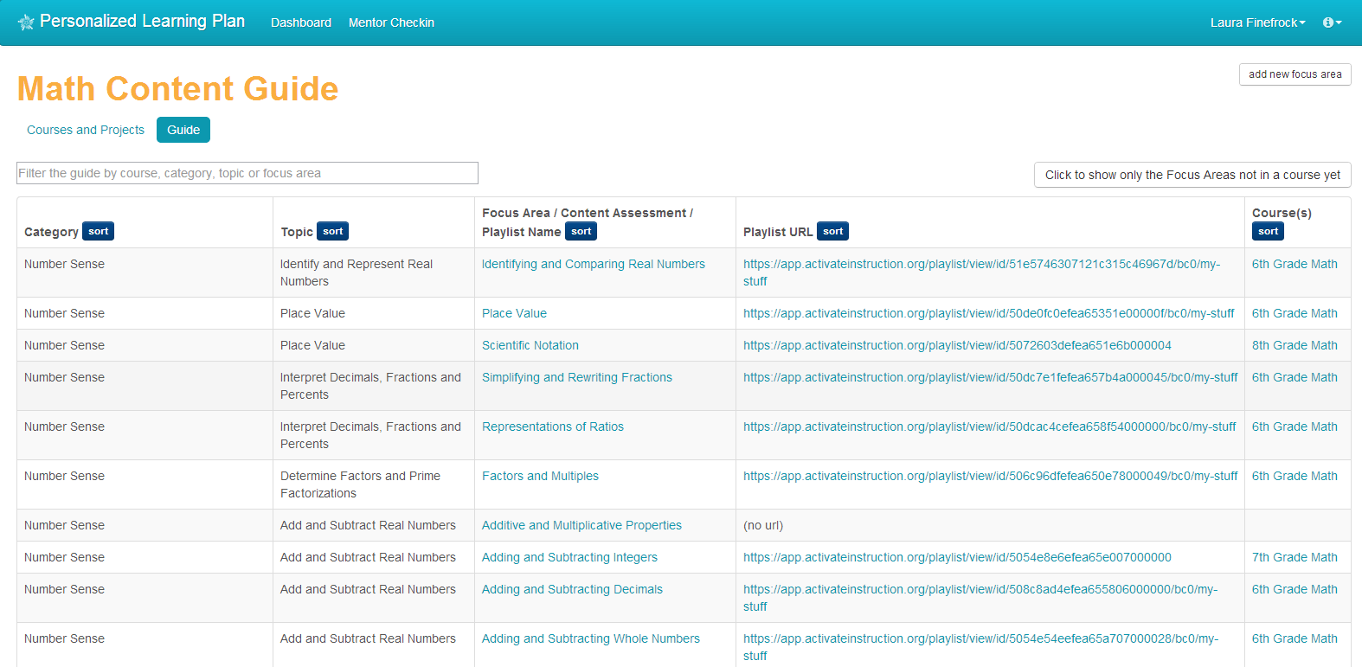
What & how to integrate
Comprehensive scope & sequence through graduation that is transparent
Source: Summit Public Schools

Slide 29
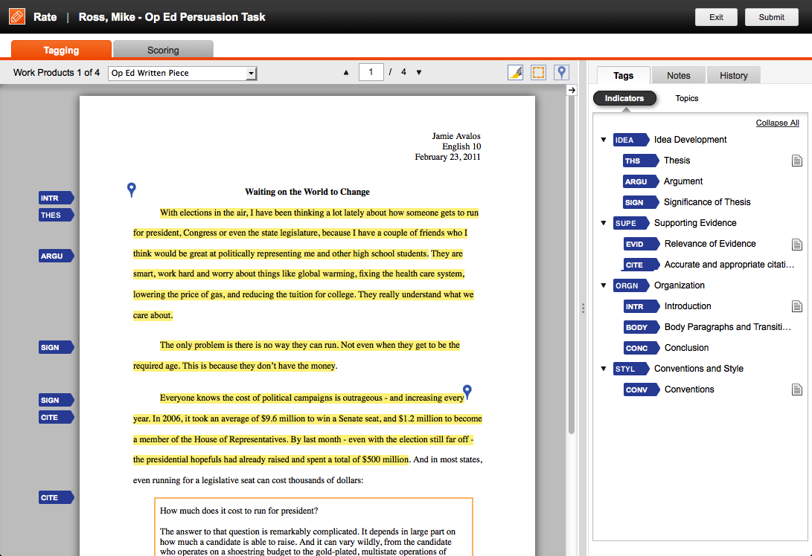
What & how to integrate
With transparent, rich, rapid feedback
Source: Summit Public Schools

Slide 30
A day in the life of a Summit student
Time for projects & mentors
7:30 | Begin to arrive; work on personalized learning plan
8:25 | Schools start with project time (math & science)
10:20 | Break
10:35 | Personalized Learning Time
11:35 | PE or sustained reading time (using Curriculet)
12:35 | Lunch & recess outside
1:20 | Project time (English & history)
3:15 | School ends; can stay & work on personalized learning plan
Note: | On Fridays, the student spends most of the day on her personalized learning plan & has a one-on-one check-in with her mentor.

Slide 31
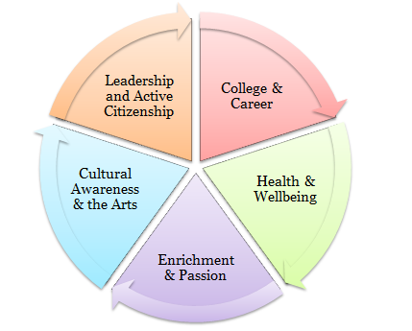
What & how to integrate
8 weeks per year of expeditions
Source: Summit Public Schools

Slide 32
Implementing blended learning
Design the teaching experience
Design the student experience
Organize the team
Choose a SMART rallying cry

Slide 33

What’s the best use of face-to-face time?
T
Mentor
Facilitator
Tutor
Evaluator
Counselor

Slide 34
Integrating motivators into blended designs
Some of the tactics from the field
Extend reach of great teachers
Specialization
Team teaching
Awards for achievement
Grant authority

Slide 35
Implementing blended learning
Content
Technology
Facilities
Design the teaching experience
Design the student experience
Organize the team
Choose a SMART rallying cry

Slide 36
12 considerations when picking software
Existing inventory
Full-time or supplemental—how many hours?
Price
Student experience
Adaptability or assignability
Data
Efficacy
Flexibility
Compatibility
Alignment
Provisioning
Single Sign-on

Slide 37
Implementing blended learning
Content
Technology
Facilities
Design the teaching experience
Design the student experience
Organize the team
Choose a SMART rallying cry

Slide 38

What’s the best use of brick-and-mortar space?
T
Safe
Clean
Inspiring
Available
Flexible

Slide 39
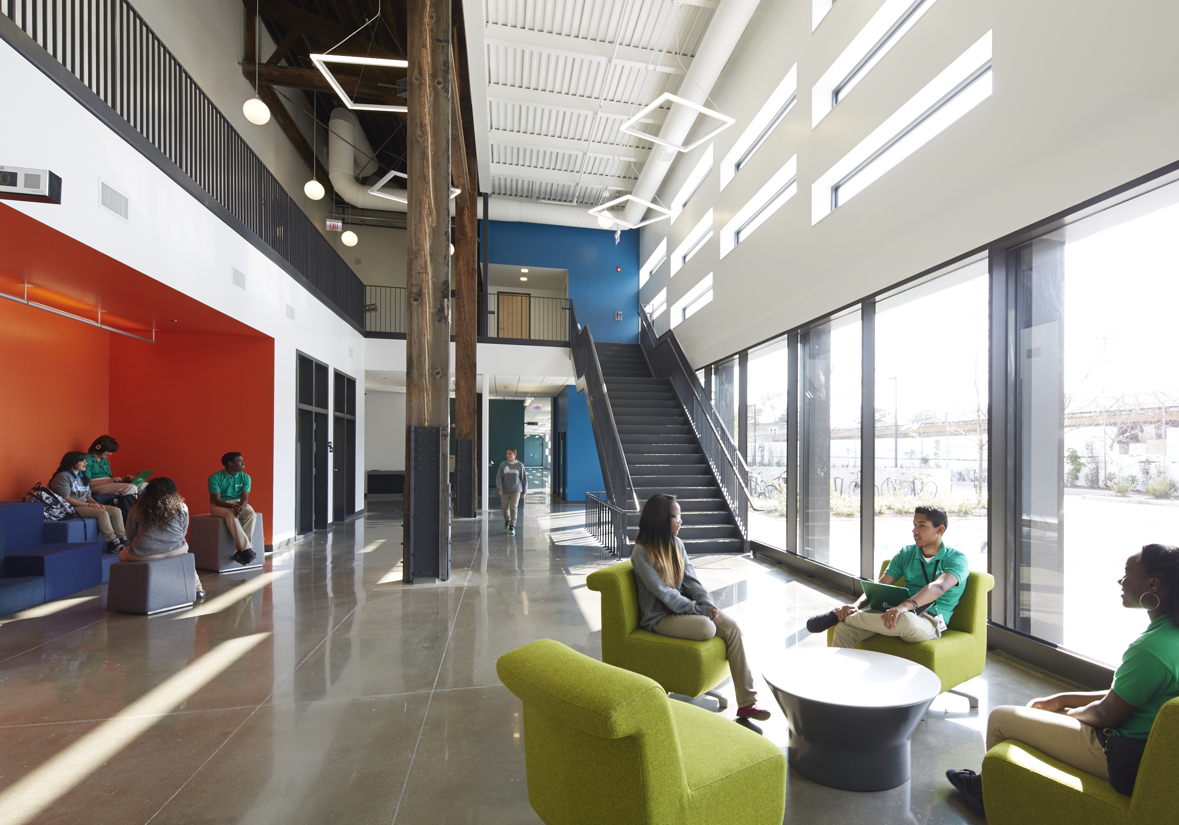
Intrinsic Schools
Source: Steve Hall, Hedrich Blessing (Wheeler Kearns Architects)

Slide 40
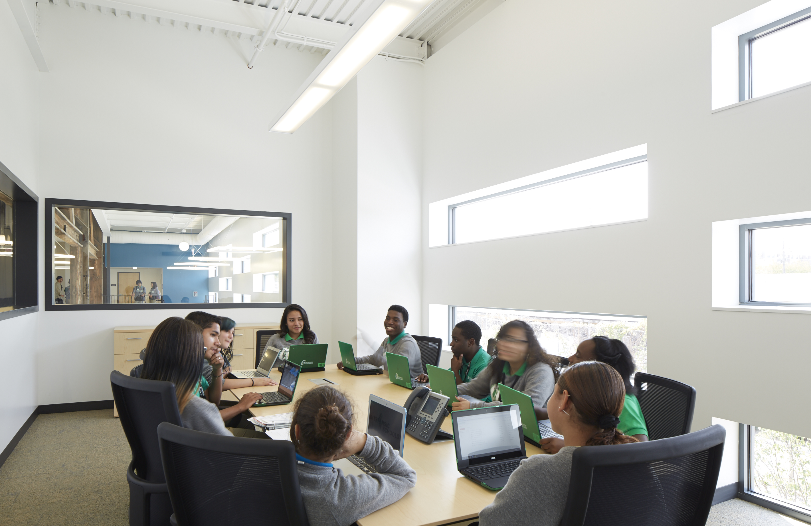
Intrinsic Schools
Source: Steve Hall, Hedrich Blessing (Wheeler Kearns Architects)

Slide 41
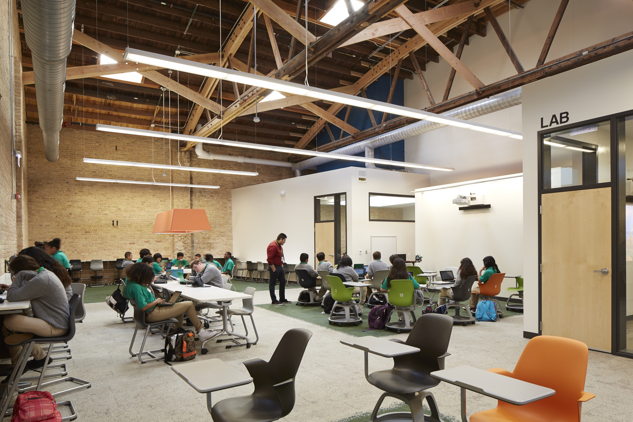
Intrinsic Schools
Source: Steve Hall, Hedrich Blessing (Wheeler Kearns Architects)

Slide 42
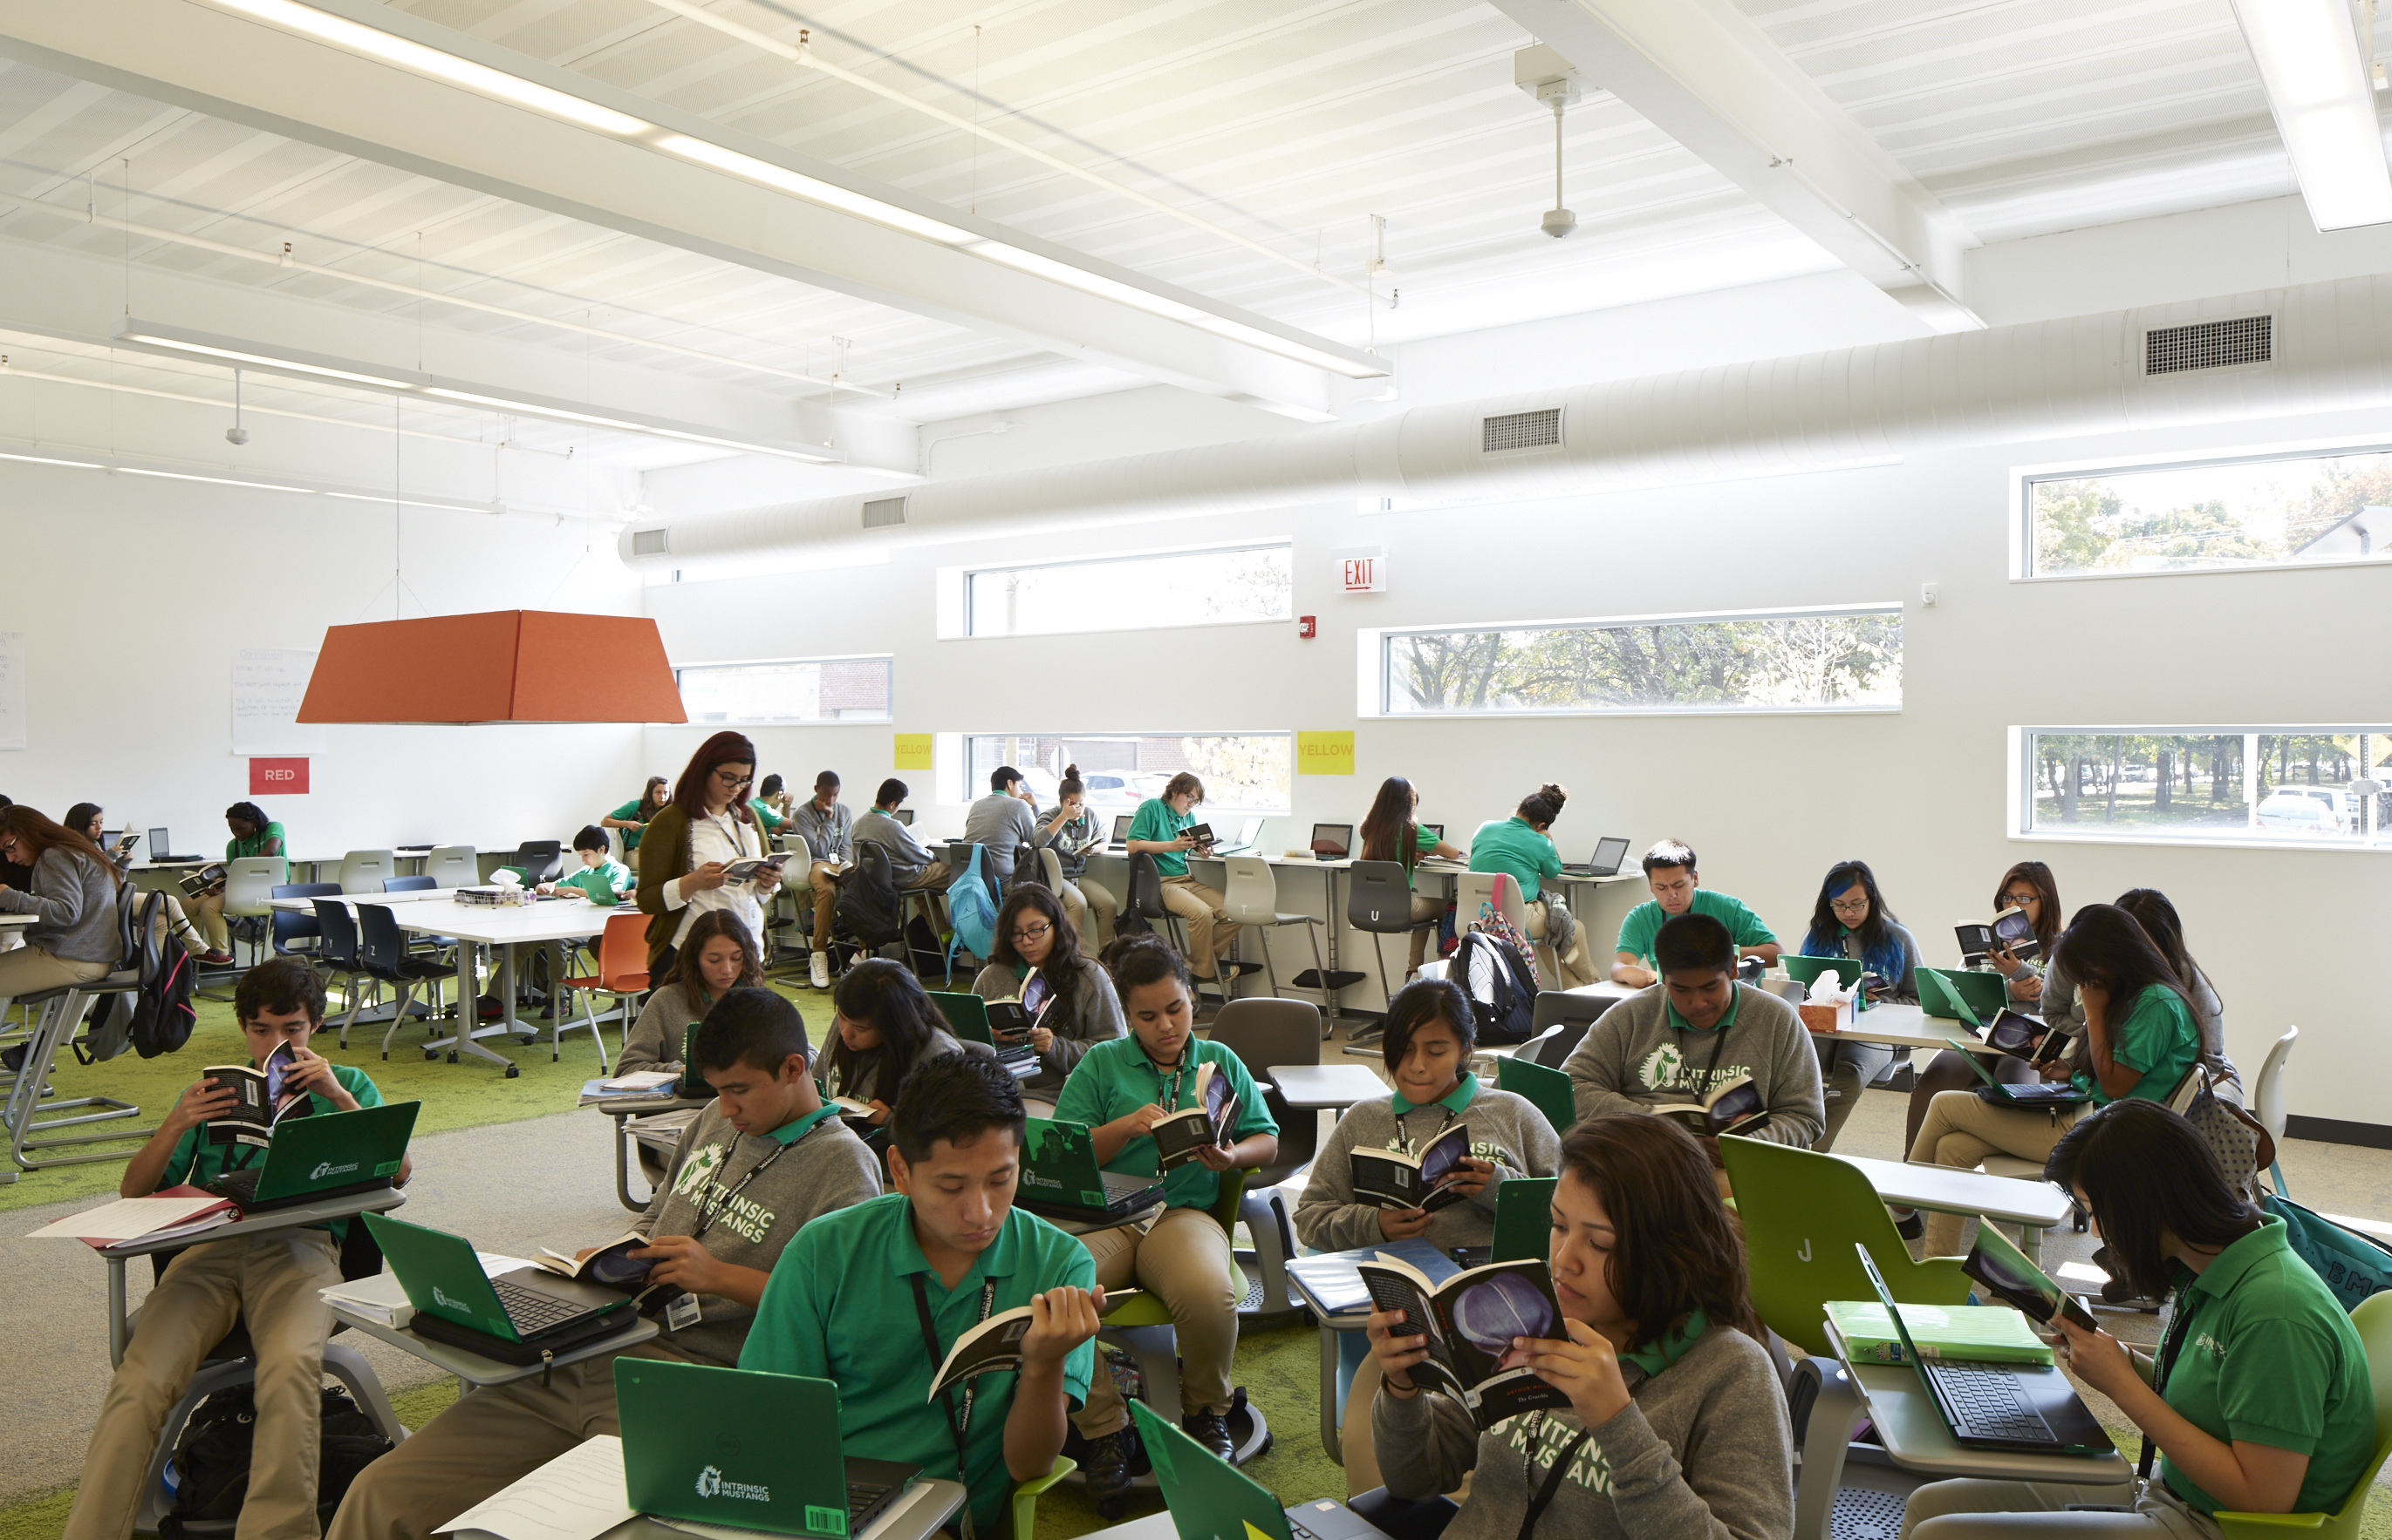
Intrinsic Schools
Source: Steve Hall, Hedrich Blessing (Wheeler Kearns Architects)

Slide 43
Test and learn
Adjust!
Identify and prioritize assumptions
Adjust!
Shape the culture
Choose the model(s)
Content
Technology
Facilities
Design the teaching experience
Design the student experience
Organize the team
Choose a SMART rallying cry

Slide 44
Blended
Using Disruptive Innovation to Improve Schools
Michael B. Horn
mhorn@christenseninstitute.org
Twitter: @michaelbhorn

