Slide 1
Tennessee Department of Education 2021 Updates
Lisa Coons, Chief Academic Officer, TDOE September 2021

Slide 3


Special Recognition
Thank you to Governor Bill Lee, state legislators, districts,
schools, teachers, partners, families and communities for
being proactive in making education a priority in Tennessee.
Tennessee has led the nation and already put strategic measures in motion to combat predicted negative impacts resulting from the COVID-19 pandemic.
Together, educators and families have made tremendous efforts to support children and keep on pace. While it will take time to see the full payoffs of these efforts, Tennesseans have demonstrated their commitment to accelerating student achievement.
Now is the time for all Tennesseans to keep focused on doing what it takes to support our students and set them on a path to success.

Slide 4
TCAP Results Demonstrate Urgent Need
Districts and schools across Tennessee worked incredibly hard during the pandemic to provide
services to our students.
Both schools and families demonstrated a shared commitment to finding out how our students
are performing by achieving a 95% student participation rate on the statewide Spring 2021 TCAP.
Disruptions to education as a result of the pandemic have led to expected declines in academic proficiency
in the state, across all subjects and grade bands. These declines were mitigated as a direct result of
the hard work of our educators and families.
While declines in proficiency were expected, families, school systems, and the public need access to
information that will help drive strategic decision-making to support accelerating student achievement
in the years to come.
Tennessee is well-prepared and will continue
to focus on doing what’s best for our kids.

Slide 5



State Framework for Response
The Tennessee Department of Education will operate with a forward-looking, proactive, and optimistic lens, based on what is possible for students. The state response is firmly rooted in our strategic plan for education, Best for All.
ACADEMICS
A strong focus on early literacy and math, with additional learning time delivered
through high-dosage
tutoring and summer programming.
STUDENT READINESS
Providing students with the pathways and supports they
need through innovative
high schools and access to
advanced courses and non-academic supports.
EDUCATORS
Eliminate teacher vacancies
and support strong
professional growth and
learning through Grow Your
Own programs and opportunities.

Slide 6
TCAP Administration Successes
SPRING 2019
FALL
2019
FALL
2020
SPRING
2021
  Smooth full TCAP administration.
  Smooth online administration
  of high school End of Course (EOC) and science exams.
  Successful
  paper-based EOC administration with new assessment vendor.
  Successful
  high school EOC administration, despite COVID challenges.
  Spring 2020 testing was suspended for
  all grades.
  Successful full TCAP administration.
  Strong 95% statewide student participation rate due to testing flexibilities and the efforts of schools and districts.

Slide 7
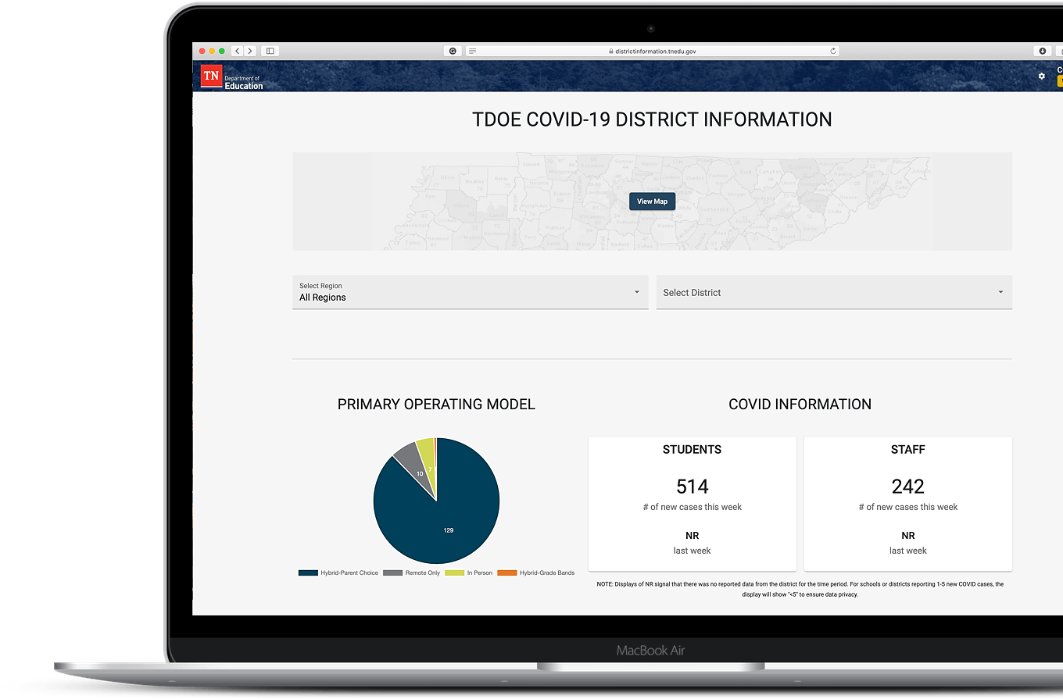
Context for 2020-21 Spring TCAP
The models “In person”, “Hybrid”, and “Remote” represent the primary district operating models for the 2020-21 school year, as reported to the Tennessee Department of Education via
the COVID-19 District Information Dashboard.
Not all districts had proportionate representation
of student groups participating in assessments.
These analyses do not include the results of
TCAP-Alt assessments (for students with the
most significant learning disabilities.)

Slide 8

Efforts to Maximize Student
Participation in TCAP
Offered flexibility in test administration as a result of the disruptions due to COVID-19
  Expanded available use of off-site testing locations
  Increased flexibility for local testing schedules
  Provided guidance to support a larger number of assessment proctors
  Enhanced guidance on Medical Exemptions for COVID-impacted students
Dramatically increased choice within expanded test administration windows
  Expanded TCAP window options, with three times more calendar days to work with than any prior year
  Provided for student make-ups across testing windows, for greater flexibility and access
  Allowed extensions and provided additional testing options for all state tests, including WIDA and ACT
Maintained robust customer service, including guides and resources to support districts
  Supported maximizing participation through toolkits and checklists documents
  Provided peer support and highlighted profiles of real-time district solutions
  Developed sample communications and social media tools
  Hosted daily webinars, office hours, weekly updates, virtual trainings to support districts
Worked with many districts to set and meet clear participation rate goals
  Increased communications with parents
  Set clear goals and tactics, customized by school and community
  Co-created ways to incorporate positivity, joy, and celebrations surrounding testing activities

Slide 9

Student Participation
95%
100% of DISTRICTS
MET THE 80%
“hold harmless” target
State TCAP
PARTICIPATION RATE
*Breakdown of data in Appendix

Slide 10

COMBINED PROFICIENCY
OVERVIEW: ALL STUDENTS, GRADES & SUBJECTS
KEY TAKE-AWAYS
2020-21 TCAP data shows decreases in students scoring Mastered and On Track and increases in students scoring Approaching and Below.
While this year’s results track with state projections, Tennessee prevented the severe proficiency drops that some states have experienced due to the pandemic due to the extraordinary efforts of our school systems and families.
Students whose scores were most negatively impacted were economically disadvantaged students, urban/suburban students, English learners, and students of color.
Proactive State Solutions:
2021 Special Legislative Session legislation; Strategic investments in summer programming; Reading 360 initiative; TN ALL Corps; Innovative High Schools; Student Support Grants; Grow Your Own; Family Resources
NO
TESTING
SPRING
2020
SOURCE: Tennessee Department of Education, 2021

Slide 11
COMBINED PROFICIENCY
RESULTS BY STUDENT GROUP
ASIAN
BLACK or AFRICAN AMERICAN
ECONOMICALLY
DISADVANTAGED
ENGLISH
LEARNERS
HISPANIC
STUDENTS
WITH DISABILITIES
WHITE
Declining proficiency rates over the past five years have been a challenge across most
student groups. Because children across the state experienced the pandemic differently,
learning supports should be tailored and targeted to individual student needs.

Slide 12
2020-21 PROFICENCY BY OPERATING MODEL
Students learning in person were more likely to score On Track or Mastered.
Tennessee districts did exceptional work to keep school buildings open; however, even students attending in person
may have missed classroom learning time due to quarantine, demonstrating the widespread impact of the pandemic.
ELEMENTARY
MIDDLE
HIGH
SOURCE: Tennessee Department of Education, 2021

Slide 13

ELA
ALL STUDENTS OVERVIEW
KEY TAKE-AWAYS
3 in 10 Tennessee students are meeting grade level expectations
in English Language Arts (ELA).
Overall proficiency in ELA dropped
5 points from 2019.
Proactive State Solutions:
Summer Programming; TN Literacy Success Act and Reading360; TN ALL Corps; personalized reading supports with district networks
SOURCE: Tennessee Department of Education, 2021

Slide 14
ELA
OVERVIEW
KEY TAKE-AWAYS
ELEMENTARY
MIDDLE
HIGH
In ELA, 2nd & 3rd grades scores show large increases in students scoring Below.
  The rate of 2nd graders scoring Below increased 68%
  The rate of 3rd graders scoring Below increased 47%
Students scoring Below
in 2nd and 3rd grades are
typically those who are not
able to read proficiently.
The largest categorical drops
in ELA across each test were
in writing and conventions
of writing.
SOURCE: Tennessee Department of Education, 2021

Slide 15


ELA
RESULTS BY INCOME
ECONOMICALLY DISADVANTAGED
ALL OTHER
STUDENTS
KEY TAKE-AWAYS
1 in 7
economically disadvantaged students
is meeting grade level expectations in English Language Arts.
SOURCE: Tennessee Department of Education, 2021

Slide 16


MATH
ALL STUDENTS OVERVIEW
KEY TAKE-AWAYS
1 in 4 Tennessee students
is meeting grade level expectations in math.
Consistent with national trends, math saw the sharpest declines of any subject area besides science, as projected. Overall proficiency dropped 12 points from 2019.
The greatest drops across subject areas were understanding and using mathematical notation
to describe quantitative relationships and situations.
Proactive State Solutions:
Investments in math adoption and instructional resources; TN ALL Corps tutoring supports; personalized online math and reading supports for students.
SOURCE: Tennessee Department of Education, 2021

Slide 17
MATH
OVERVIEW
KEY TAKE-AWAYS
Overall 3rd grade proficiency declined from 44% in 2019 to 31% in 2021. Overall 4th grade proficiency declined from 46% in 2019 to 34% in 2021.
In middle school, districts on average saw the number of students in the Below category increase by 50%. Students in remote instruction saw proficiency rates decrease at twice the rate of students in person.
There was general stability in Approaching, but significant
increases in the percent of
students scoring Below.
ELEMENTARY
MIDDLE
HIGH
SOURCE: Tennessee Department of Education, 2021

Slide 18


MATH
RESULTS BY INCOME
ECONOMICALLY DISADVANTAGED
NON-ECONOMICALLY DISADVANTAGED
KEY TAKE-AWAYS
1 in 10
economically disadvantaged students
is meeting grade level
expectations in math.
SOURCE: Tennessee Department of Education, 2021

Slide 19
How to Use the Data
This data provides a state-level overview of student performance. Every district is different,
and trends may vary at the local level. Any interpretation of state level data should reflect a consideration for variations in local context, district participation rates, as well as other assessment data and performance indicators that will be available.*
The expected declines noted as a result of disruptions caused by the pandemic should create a sense of urgency in every district and school to consider the academic interventions necessary to support students. This data can be used to help communities reflect on strategic investments in student achievement and support necessary revisions to a district’s needs assessment for the purposes of planning federal recovery (ESSER) funding.
School systems, teachers, and families should use this and other relevant student data to develop individualized plans for every student who may require additional support to reach grade-level proficiency, or to maintain the rate of acceleration she or he would otherwise have had.
* The TDOE utilizes longitudinal, state-level data from a state level because of our strong participation rate. For some districts,
these types of longitudinal comparisons may not be appropriate, given a larger difference in participation year-to-year.

Slide 20
Academic Projections
& Recovery
Original projections of the academic impact were provided in fall of 2020.* Those projections are generally reflected in the current data.
20-21 TCAP data show sharp declines in math, but typically, math proficiency results fall-- and climb-- faster than ELA.**
The effects of falling behind are most pronounced in the youngest grades, especially in ELA.***
Economically disadvantaged students feel the effects of learning loss more acutely.****
Recovery and acceleration will take time,
but collaborative, proactive solutions are already underway.
* Tennessee Releases Data Showing Significant Learning Loss Among K-12 Students
**Collaborative-Brief_Covid19-Slide-APR20.pdf (nwea.org); The Effects of Summer Vacation on Achievement Test Scores: A Narrative and Meta-Analytic Review on JSTOR
***The Potential Impact of COVID‐19 on Student Learning and How Schools Can Respond - Wyse - 2020 - Educational Measurement: Issues and Practice - Wiley Online Library)
****Introduction (harvard.edu)
SOURCE: Tennessee Department of Education, 2021

Slide 21




Priority Areas of Concern Statewide
SUMMARY
Early Elementary Reading/ELA is an area of concern, especially in those grades that do not have assessments or where public data is not shared. Significant declines are likely in kindergarten, 1st and 2nd grade reading, which creates more urgency in providing these students with additional literacy supports to ensure they are on-track to reading proficiently by 3rd grade.
While math overall is a concern, middle school math is especially problematic. In 2020-21, fewer students demonstrated readiness for Algebra I (in addition to fewer students taking the Algebra I assessment), and these declines will potentially create long-term challenges with other high school courses that require a strong foundation in Algebra as well as ACT performance (therefore scholarship eligibility and post-secondary readiness).
Widening achievement gaps between student groups are clear, exacerbating a historical gap
that has not significantly closed even as the state had seen performance increases.
Specifically, economically disadvantaged students saw significant declines in proficiency,
which has traditionally been more difficult to recover from. Students with Disabilities and
English learners also reflected increased challenges as a result of the pandemic disruptions.

Slide 22
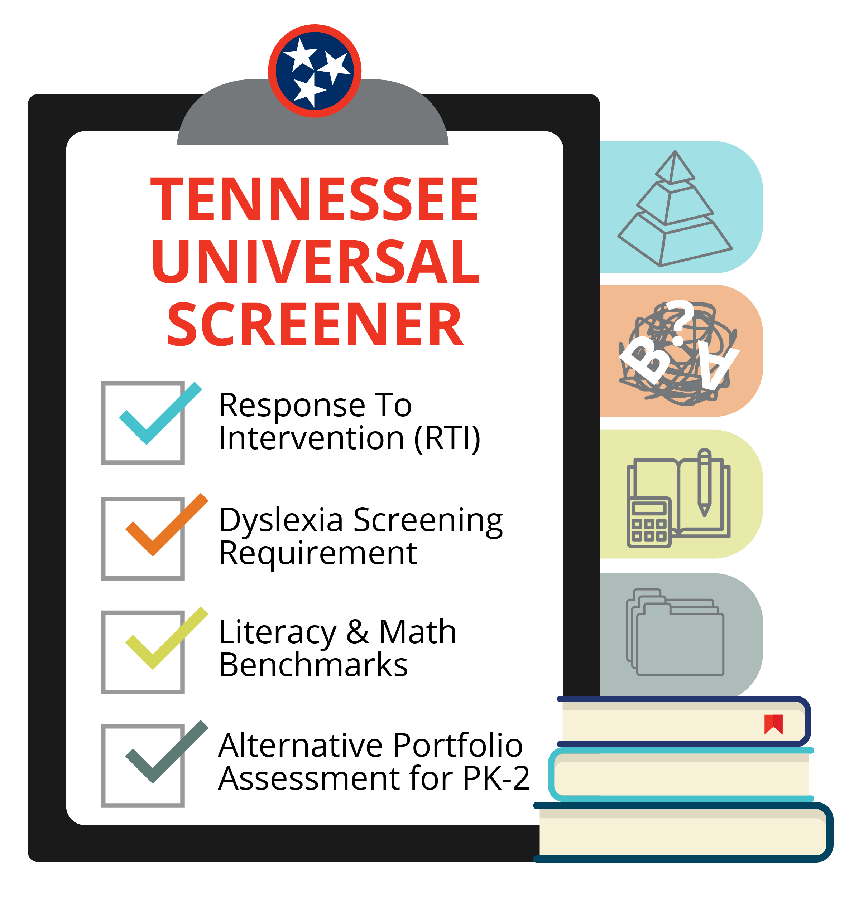
What to Do about the Data
Provide instruction using grade-level-appropriate content, rather than repeating material from the end of the prior grade. Build-in the pre-requisite skills and knowledge as is needed to understand the content of the school year.
Measure learning regularly and provide feedback to students often. It is important that teachers have the tools and information
to best meet the needs of their students, and the state has provided
a free universal reading screener and other free diagnostic assessments to support teachers and districts.
Use time and resources for high-impact supports for students most
in need, such as high-dosage/low-ratio tutoring or extra time outside of regular class.
Understand that the recovery period from the pandemic and prior declines in academic achievement is likely to take 3 – 5 years,
and districts should maximize federal relief spending
on student academic acceleration.
TENNESSEE UNIVERSAL READING SCREENER

Slide 23
Historic Federal Funds for K-12 Education
Tennessee public schools will receive over $4.5 BILLION in federal relief funding for use between spring 2020 & fall 2024.
Over $150M in Coronavirus Relief Funds (CRF), including PPE
Over $45M in competitive federal grants
for literacy, CCTE, and mental health resources
Over $126M in GEER (Governor’s discretionary relief funding)
Over $385M in ESSER (SEA discretionary relief funding)
...in addition to over $3.58 billion passed directly to LEAs

Slide 24

ENGAGING FAMILIES: TCAP FAMILY PORTAL
TCAP Family Portal is a free, online resource to help families and students understand their TCAP results. Specifically, the portal provides families with access to:
Test history features to track
progress over time
TCAP scale scores and performance
levels by subject
Parent guides and resources
Individualized recommendations
for improvements
Families can access this resource by registering at familyreport.tnedu.gov.

Slide 25




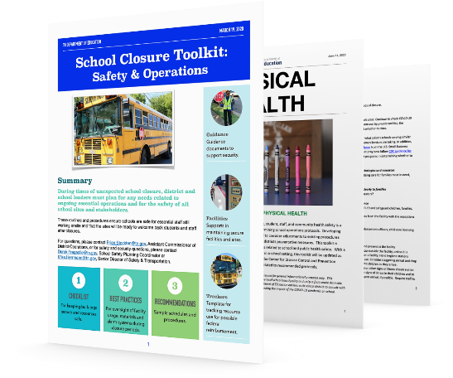

2020-21 TDOE Pandemic Response & Actions
Crisis management
& response
Weekly communication
with district leaders
School closure and reopening guidance documents
Statewide investments, resources & partnerships
+
200+
+
+
MANY
MORE
PARTNERSHIP
TEACHING
TENNESSEE

Slide 26





Continuum of Student Supports
Students require access to a continuum of supports. These includes core instruction, additional time, skill-specific support, and connections between grade levels to connect missed learning. Each serves a unique and different purpose, but all are part of a comprehensive, effective academic program.
TIER 1: Core Instruction
Daily grade level instruction grounded in high-quality instructional materials (HQIM) with supports and access points for all all learners.
TN ALL Corps Tutoring
High-dosage, low ratio tutoring that creates high-impact learning experiences, focuses on re-teaching missed or unlearned content, and connects missed learning to grade level content.
Response to Instruction and Intervention (RTI²)
Structured intervention time (Tier II or Tier III) to provide additional skills-specific instruction and ensure students practice skills that allow them to access their core/Tier I instruction.
Summer Programs Designed to provide additional instruction in grade level lessons, grounded in HQIM that allows students more time and practice in smaller group settings.

Slide 27
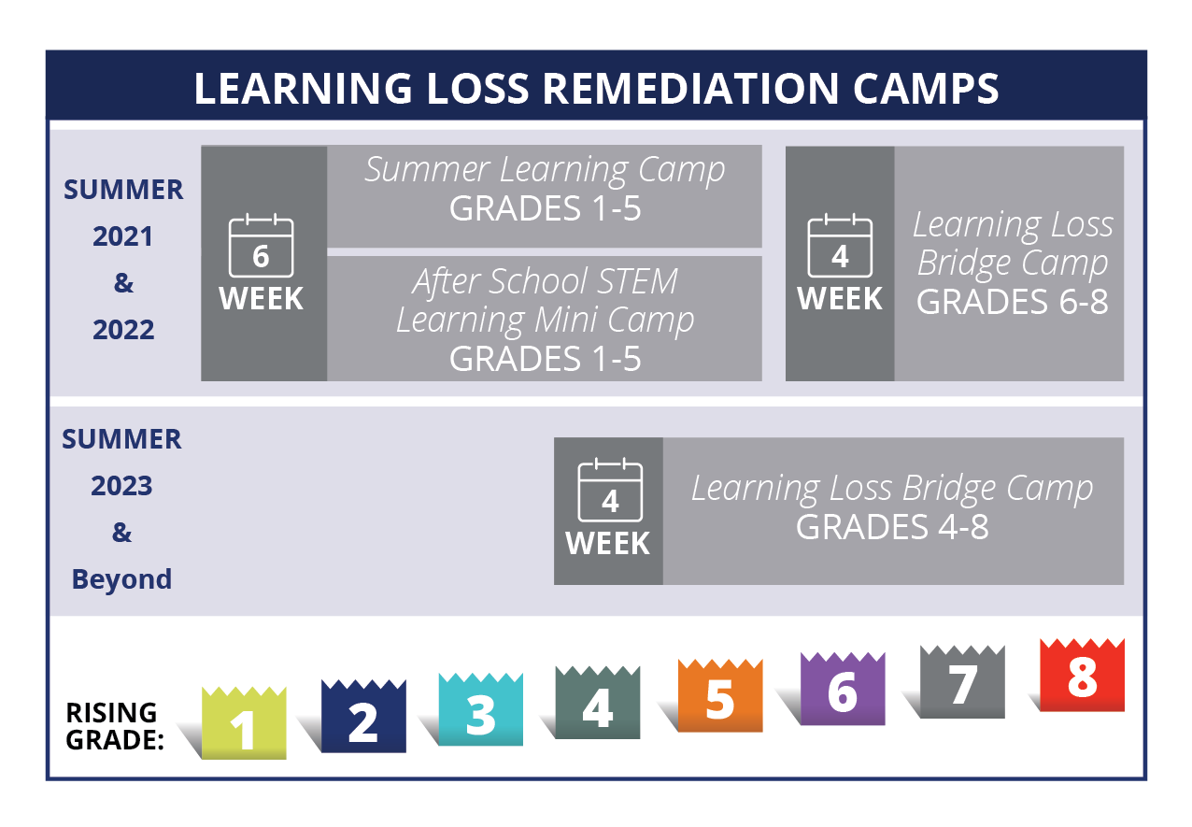
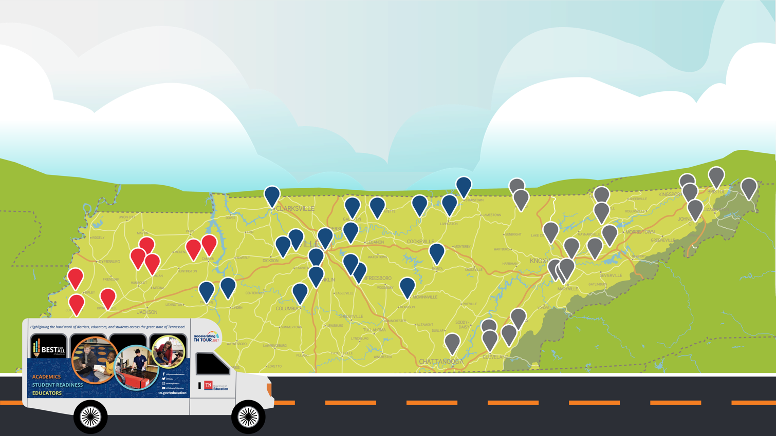
Summer Programming Actions
During the special session, the Tennessee General Assembly passed the Tennessee Learning Loss Remediation and Student Acceleration Act, which set forward a path for students to receive additional instructional time and supports through summer programming opportunities beginning in summer 2021.
During the Accelerating TN 2021 Tour, Commissioner Schwinn, department staff, state and local elected officials, and community partners connected directly with students, educators, and stakeholders this summer to learn more about how schools are accelerating student achievement and where additional supports and resources could be helpful.
2,600
43
SUMMER LEARNING SCHOOL VISITS
50
DISTRICTS
TOTAL
MILES
ROUND
TABLES
EARLY READING
TRAININGS
15
2

Slide 28
State ESSER Plan: Investments Aligned to Data
ACADEMICS: All TN students will have access to ​a high-quality education…
by learning to read and ​reading to learn with high-quality materials. ​
$120.7M for the Literacy Success Act & Reading360
$170.5M for the TN ALL Corps & summer programming*
$35M to support the 2022-23 math adoption
$32M for teaching & learning online resources & improvements for LEAs
STUDENT READINESS: TN schools will be equipped ​to serve the academic and
non-academic needs of ​all students… by developing robust career pathway
opportunities and connecting students to real-time support. ​
$32.6M for Innovative High Schools & Advanced Courses
$17.8M for Mental Health & Family Resource Centers
$56.5M for K-12 open-source readiness coursework & statewide professional development
EDUCATORS: TN will set a new path for the ​education profession…
by becoming a teacher for free.
$21M in programs to support the educator pipeline, including department’s
Grow Your Own program
Received approval on
ARP ESSER State Plan
from U.S. Ed on 7/15/21

Slide 29



ACADEMICS
Investing to Address the Data
Strategy: TDOE will invest more than $358M in academic supports focusing on early elementary reading, middle school math, closing achievement gaps, and supporting students not on grade level.
Focus: TDOE is focused on literacy and early reading and high-dosage, low-ratio tutoring as the most research-driven ways to support students who need more individualized supports to reach grade level mastery.
To address early literacy and the needs of students not yet on grade level, strategies include providing resources to teachers and parents, professional development to school systems, targeted instruction for students, and strong partnerships with families and communities
across the state.
Programs and supports include:
Reading 360 supports for our youngest readers
TN ALL Corps tutoring resources for K – 12th grade students
Best for All Central website for all students, families and educators

Slide 30
Thank you!
Lisa.coons@tn.gov

