Slide 1
Navagraha
Significance & Symbolism

Slide 2
Jyotisha or Jyothishastra (or Jyotish from Sanskrit jyótis- "light, heavenly body")
Traditional Hindu system of ASTROLOGY and ASTRONOMY. Also known as Indian astrology or more recently Vedic astrology.
Jyotiṣa is one of the Vedāṅga, the six auxiliary disciplines used to support Vedic rituals. Early jyotiṣa was concerned with the preparation of a calendar to fix the date of sacrificial rituals.
Astrology remains an important facet in the lives of many Hindus. Astrological concepts are pervasive in the organization of the Hindu calendar and holidays as well as in many areas of life, such as in making decisions about marriage, starting a new business or job, moving into a new home, etc.

Slide 3
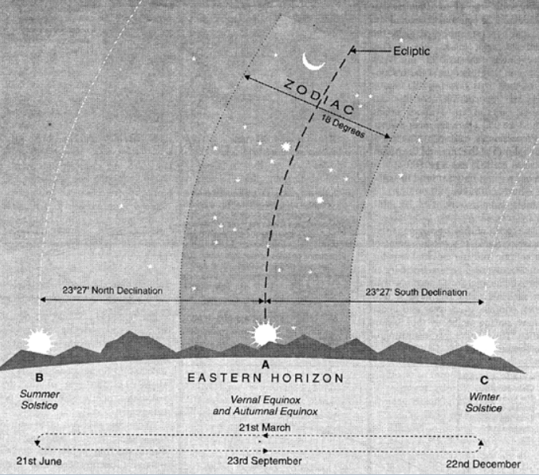
Introduction
Zodiac: The earth takes one year to complete its rotation around the Sun - from the earth, it appears that the Sun moves around the earth. The great circle on the celestial sphere representing the apparent annual path of the sun relative to the stars is called Ecliptic. An imaginary belt of 18 degree width with ecliptic in its center is known as the zodiac. Many groups of stars occupy this imaginary belt. Vedic astrology recognizes 27 such groups of stars called nakshatras.
Zodiac

Slide 4
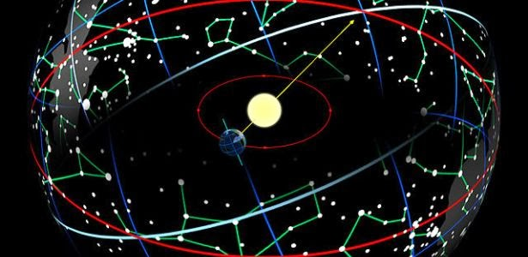
Nakshatras
The 27 nakshatras identified in Jyothisha – Ashvinī, Bharanī, Kṛttikā, Rohinī, Mrigashīra, Ārdrā, Punarvasu, Pushya, Ashlesha, Maghā, Pūrva Phalgunī (Pubbha), Uttara Phalgunī (Uttara), Hasta, Chitrā, Svātī, Vishākhā, Anurādhā, Jyeshtha, Mūla, Pūrva Ashādhā, Uttara Ashādhā, Shravana, Dhanistha, Shatabhisha, Pūrva Bhādrapadā, Uttara Bhādrapadā, Revatī

Slide 5
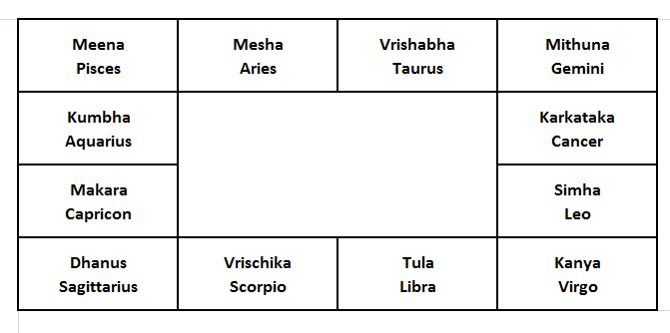
Raashi Chakra
The Twelve Raashis or Zodiacal Signs

Slide 6
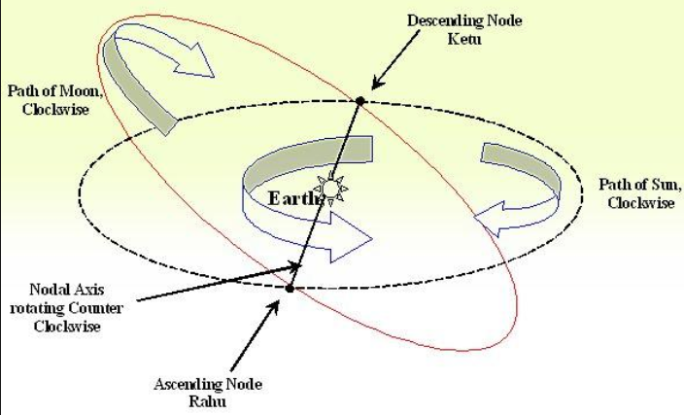
NAVAGRAHA
Planets and Celestial Bodies:
Sun (SURYA), Moon (CHANDRA), Mars (MANGALA), Mercury (BUDHA), Jupiter (GURU), Venus (SHUKRA),
Saturn (SHANI)
Ascending Moon (RAHU) and Descending Moon (KETU)

Slide 7
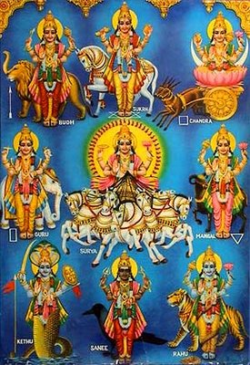
NAVAGRAHA
Nava - nine
Graha – house or influencer
The word “Graha” is also linked to planets in the solar system. But, the Navagrahas that Hindus worship are all not planets.
The nine grahas (or influencers) are believed to affect human lives and behavior.
Each Graha is associated with a specific energy quality, which is described in an allegorical form through its scriptural and astrological references.

Slide 8
SUN - Surya/Aditya
Son of Kashyapa and Aditi.
Lord of: Simha Rashi
Abhimani Devatas: Rudra and Agni
He is the lord of one’s own self.
His blessings grant good health and wisdom.
Symbolized by:
Color: Red Metal: Gold
Gemstone: Ruby Dhanya/Grain: Wheat

Slide 9
MOON – Chandra/Soma
Parents: Sage Atri and Anasuya
Lord of : Kataka Rashi
Abhimani Devatas: Aap & Gowri
He is the lord of vegetation and mind. He represents beauty and affection.
His blessings are needed for good relationships and beauty which are quite natural to his feminine nature.
Symbolized by:
Color: White Metal: White
Gemstone: Pearl Dhanya/Grain: Rice

Slide 10
MARS - Mangala/Angaraka/Kuja
He is Bhouma, the son of Bhoo devi.
Abhimani Devatas: Bhoomi and Kshetrapala (or Skanda)
Lord of: Mesha and Vrischika Raashi
He is a warrior hero who worships Shanmuka. Brilliantly robust in stature, he is dear to the warriors and farmers
He blesses his devotees for their heroic and agricultural (work) enrichment.
Symbolized by:
Color: Red Metal: Copper
Gemstone: Coral Dhanya/Grain: Toor Dal
(Pigeon Peas)

Slide 11
MERCURY – Budha/Soumya
Budha is also known as Soumya, is born to Chandra and Tara.
Lord of Mithuna and Kanya Rashi
Abhimani Devatas: Vishnu & Maha Vishnu
He is fair, masculine, modest yet he brilliant and sharp. He is devoted to Lakshmi Narayana.
His blessings favor wisdom, as well as scholarly and intellectual pursuits.
Symbolized by:
Color: Green Metal: Bronze
Gemstone: Emerald Dhanya/Grain: Whole Moong
(Green Gram)

Slide 12
JUPITER - Guru/Brihaspati
Son of sage Angirasa and Shraddha.
Lord of Dhanus and Meena Rashi
Abhimani Devatas: Brahma and Indra.
Deva guru or Brihaspati, is the mentor of Gods. He is also Vachaspati, lord of speech. He is pure, pious and is unparalleled in his wisdom. Tara is his consort.
His blessings yield good results in intellectual and spiritual pursuits. 'Guru Bala', the approval of Guru is indispensable for scholarship or erudition.
Symbolized by:
Color: Creamy White/ Yellow Metal: Gold
Gemstone: Yellow Sapphire Dhanya/Grain: Bengal Gram

Slide 13
VENUS - Shukra
Shukracharya, also called Bhargava or Ushanas is the mentor of the demons or Asuras..
Abhimaani Devatas: Indra, Indrani and Maruts.
Lord of Tula and Vrishabha Rashis.
His tendencies are Rajasik and his association is mostly with materialistic Asuras. He is charismatic despite his damaged right eye. His attributes include knowledge in general and fine arts in particular.
Pleasure and prosperity devotedly follow those who are blessed by him. (His presence is for about 20 years – good things happen in life during this period called Shukra Dasa)
Symbolized by:
Color: White Metal: Silver
Gemstone: Diamond Dhanya/Grain: White Beans

Slide 14
SATURN - Shani
Shani is the son of Surya and Chaya.
Lord of Makara and Kumbha Rashi.
Abhimani Devatas: Yama and Prajapati.
He is considered the most powerful among the Navagrahas, and commands formidable respect. His complexion is dark as are his preferences.
His blessings help to manage adversity or major changes and cultivates discipline.
Symbolized by:
Color: Black, Blue Metal: Iron
Gemstone: Sapphire Dhanya/Grain: Sesame Seeds

Slide 15
ASCENDING MOON - Rahu
Rahu, son of the demon Simhika is represented with a serpent body and human head.
Rules no Rashi
Abhimani Devatas: Sarpa & Nirrati
His complexion is jet black and his preferences too are similar. He has a furious disposition and hates Surya and Chandra. Unlike other Grahas, his movement is anti clockwise. His influence brings chaos.
His blessings compels one to radically change – to improve future and make the outer self a better reflection of inner potentials.
Symbolized by:
Color: Black Metal: Silver
Gemstone: Hessonite Dhanya/Grain: Whole Urad (Whole Black Gram)

Slide 16
DESCENDING MOON - Ketu
Ketu is considered as the counterpart of Rahu. He has a serpent head and human body.
Rules no Rashi
Abhimaani Devatas: Brahma and Chitragupta.
Like Rahu, Ketu too is furious and his movements are anti clockwise. Ketu’s influence can be inauspicious and can cause extremely tough life circumstances.
His blessings bestows power discrimination and gyana or spiritual knowledge (knowledge of self)
Symbolized by:
Color: Multi-colored Metal: Silver
Gemstone: Cat’s Eye Chrysoberyl Dhanya/Grain: Horse Gram

Slide 17
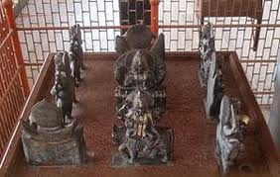
NAVAGRAHA - IDOLS
After Brahma, Vishnu and Shiva, the Navagrahas are considered to be most important as far as Hindu rituals are concerned. Temples of Navagrahas along with their consorts are rare in India. But Shiva temples in South India have Navagraha idols placed in their premises.
Navagraha idols are placed in designated spots with Surya or Sun in the center. Each graha is also assigned a particular direction.

Slide 18
Placement Directions
Graha | Direction
Surya (Sun) | East
Chandra (Moon) | North West
Mangala (Mars) | South
Budha (Mercury) | North
Guru (Jupiter) | North East
Shukra (Venus) | South East
Shani (Saturn) | West
Rahu (Ascending Moon) | South west
Ketu (Descending Moon) | --

Slide 19
NAVADHANYA- Nine Grains
Nine grains used to invoke Navagrahas in poojas
Surya – Whole Wheat
Chandra - Rice
Mangala – Pigeon Peas
Budha – Green Gram
Guru – Bengal Gram
Shukra – White Beans
Shani – Sesame Seeds
Rahu – Black Gram
Ketu – Horse Gram
Picture above shows nine grains and colored fabric used in poojas. Note: Each grain is identified by its Sanskrit name.

Slide 20
NAVARATNA – Nine Gems
The navaratnas linked to the navagrahas are worn together or separately (as jewelry)for the good graces of the grahas affecting an individual’s nakshatra or raashi. The gems are set in the metal associated with the graha for best results.
Surya - Ruby (Maanikya)
Chandra - Pearl (Mukta)
Mangala - Coral (Pravala)
Budha - Emerald (Markata)
Guru - Yellow Saphire (Pushyaraga)
Shukra - Diamond (Vajra)
Shani – Sapphire (Neela)
Rahu – Hessonite (Gomedhika)
Ketu – Cat’s Eye (Vaidurya)

