Slide 1


HAWAII SECTION
WELCOME
to the 13th Annual
ASCE Hawaii Section Scholarship
Golf Tournament
in honor of Steve Fong
August 28th, 2015

Slide 2
HAWAII SECTION
ASCE Hawaii Section and CCPI
would like to recognize and thank
the following companies for their generosity and sponsorship
towards the
ASCE Hawaii Section Scholarship
Golf Tournament
in Honor of Steve Fong...
MAHALO!

Slide 3



HAWAII SECTION
Platinum Corporate Tee Sponsors
Much mahalo for your support!

Slide 4






HAWAII SECTION
Platinum Corporate Tee Sponsors
Much mahalo for your support!

Slide 5






HAWAII SECTION
Platinum Corporate Tee Sponsors
Much mahalo for your support!

Slide 6






HAWAII SECTION
Gold Corporate Tee Sponsors
Much mahalo for your support!

Slide 7





HAWAII SECTION
Team Sponsors
Much mahalo for your support!

Slide 8






HAWAII SECTION
Team Sponsors
Much mahalo for your support!

Slide 9



HAWAII SECTION
Team Sponsors
Much mahalo for your support!

Slide 10




HAWAII SECTION
Tee Sponsors
Much mahalo for your support!

Slide 11
HAWAII SECTION
Much thanks to the numerous volunteers and
University of Hawaii
College of Engineering Students
for all their assistance with today’s tournament!
Volunteers
Much mahalo for your support!

Slide 12
HAWAII SECTION
Tournament Co-Chairs
Emi Kiyoi Kristin Namoca
Tournament Committee
Ron Iwamoto Lori Fong
Wayne Kawano Jon Young
Glenn Miyasato Brian Enomoto
Tony Sproat Kimo Scott
Steve Yoshida
Tournament Committee
Much mahalo for your support!

Slide 13
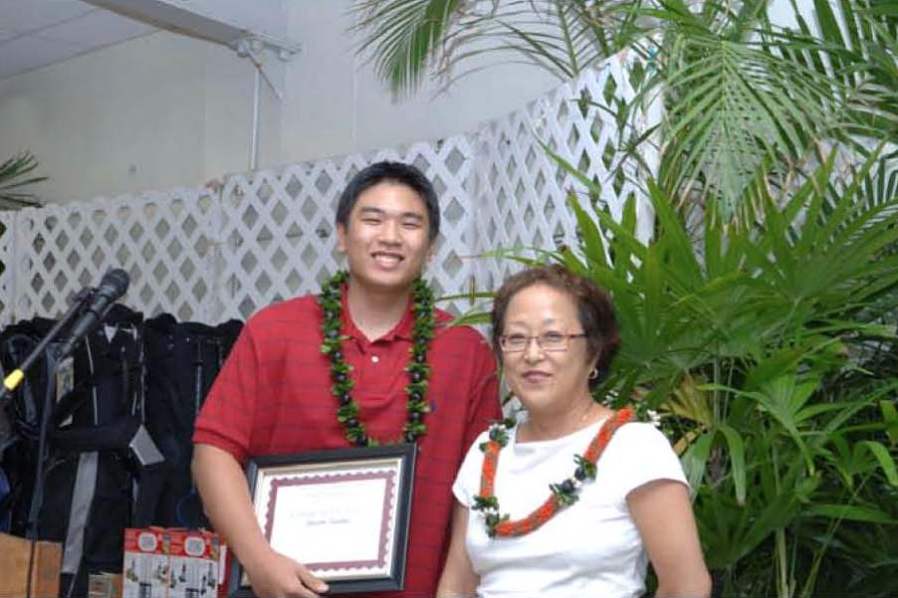
HAWAII SECTION
2003 – Bryan Lum
2004 - Bessie Tran
2005 - Brian Campbell
2006 - Mason Suga
2007 - Jayson Tasaka
2008 - Ting-Cheng Wen
2009 – Kristin Au
2010 – University of Hawaii ASCE Student Chapter
2011 – University of Hawaii ASCE Student Chapter
2012 – University of Hawaii ASCE Student Chapter
2013 – University of Hawaii ASCE Student Chapter
2014 – University of Hawaii ASCE Student Chapter
2007 Recipient - Jayson Tasaka with Yvonne Fong
Past Scholarship Recipients

Slide 14
HAWAII SECTION
ASCE Hawaii Section
2015-2016 Executive Committee
      President Glenn Miyasato
      President-Elect Ben Rasa
      Vice-President Tim Goshi
      Secretary Lara Karamatsu
      Treasurer Eric Arakawa
      Immediate Past President Brian Enomoto
      YMF President Puna Kaneakua
Hawaii Section Executive Committee

