Slide 1
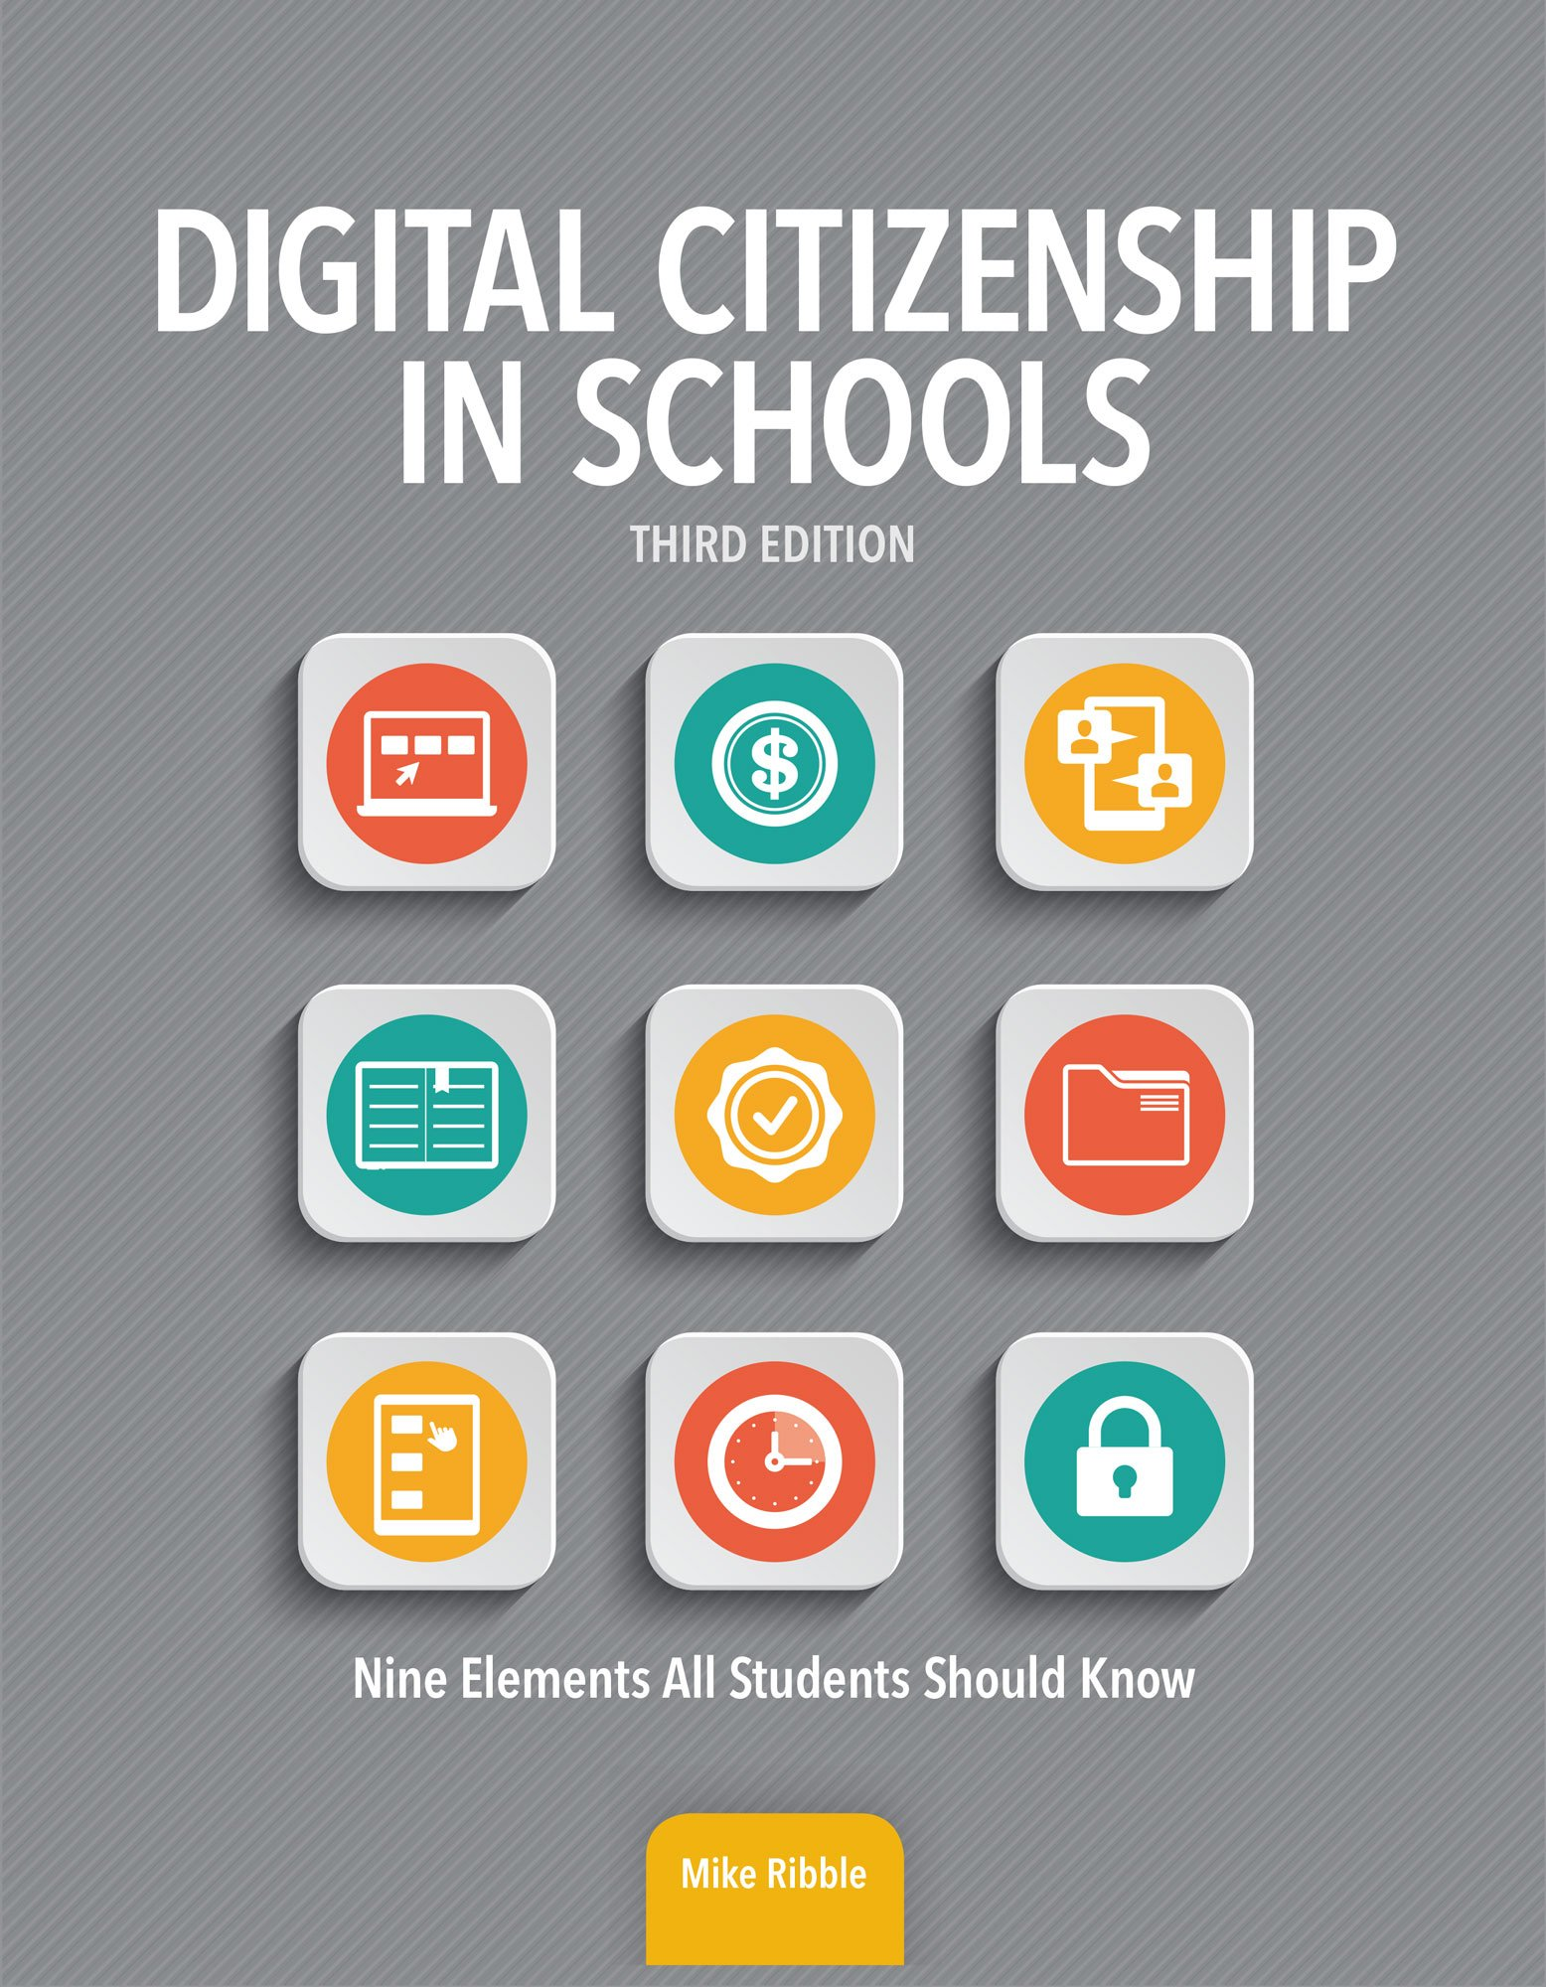

Digital Citizenship – Fear the Unknown
Dr. Mike Ribble - Director of Technology, Manhattan-Ogden Schools and author of the books Digital Citizenship in Schools and Raising a Digital Child

Slide 2
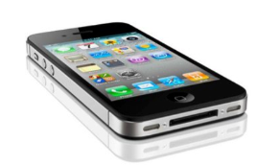
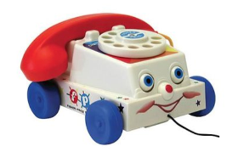
Phones that students have when they are six
Phone I had when I was six

Slide 3


Slide 4






Slide 5
Parents, If Your Kids Have Any of These 10 Dangerous Apps, It’s Time to Hit “Delete”
Sex educator Megan Maas has the scoop on 10 apps that can be very dangerous for your kids, and what you need to know about them.
Constant Social Media Presence May Jeopardize Teens' Mental Health
Adolescents could be more vulnerable than adults, expert says
By Alan Mozes
HealthDay Reporter
Online Pressures Make Kids Deeply Unhappy: Effects Of Social Media On Children
By Ted Ranosa, Tech Times | January 9, 9:47 AM
Samantha Allen
11.09.15 5:10 PM ET
Colorado’s Sexting Nightmare
Colorado teenagers might face child pornography charges for sending each other nude photos.
Don't leave your kid alone with your iPad — 7-year-old spends over $5K playing Jurassic World
By Lulu Chang — January 1, 2016
Tweens, Teens, and Screens: What Our New Research Uncovers
By taking a "census" of kids' media use, Common Sense's new study quantifies screen use, identifies unique types of users, and uncovers patterns that could spark improvements in content, access, and learning.
Michael Robb Director of Research | Dad of two 11/2/2015 Categories: Screen Time
Director of Research | Dad of two

Slide 6
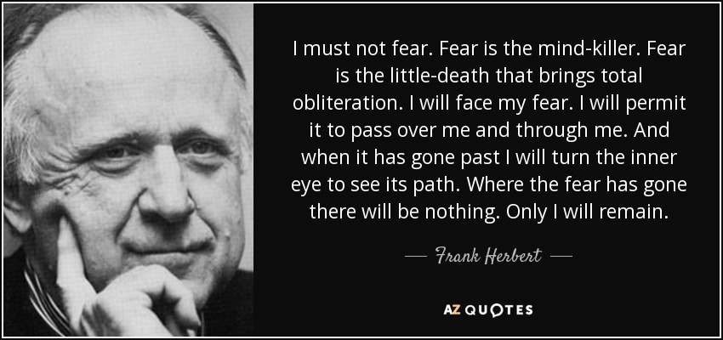

Slide 7

What Do You Hope for Your Children/ Students?

Slide 8
Teaching with Tech: How Can Teachers Embrace Technology Tools
Research Editorial Team 21 March 2015
STEM School Breaks the Norm with Flipped Classroom Model
15+ Ways of Teaching Every Student to Code (Even Without a Computer)
Collaborative Learning: Why Transforming Classrooms Into Collaboration Rooms Can Make A Big Difference
To make learning truly futuristic in India and prepare a future ready workforce, we need to give students a collaborative learning environment.
Technology as a Tool to Support Instruction
By Lynne Schrum
Study: Emerging Technology Has Positive Impact in Classroom
A recent study highlights educators' feelings of goodwill toward technological innovation.
By Ryan Lytle July 14, 2011, at 9:00 a.m.
7 Benefits Οf Technology Integration Ιn Τhe Education Sphere

Slide 9
What is Digital Citizenship?
Why Not Just Citizenship?

Slide 10





Slide 11

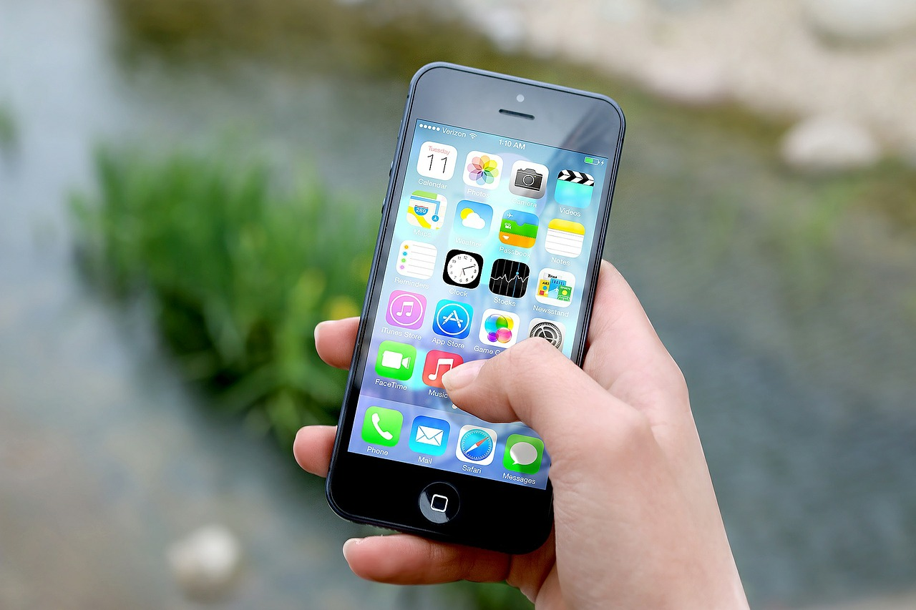



Slide 12
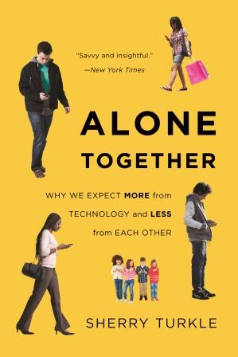
Quotes from Sherry Turkle’s Book – Alone Together
Drawn by the illusion of companionship without the demands of intimacy, we conduct “risk free” affairs on Second Life and confuse the scattershot postings on a Facebook wall with authentic communication.
Technology promises to let us do anything from anywhere with anyone. But it also drains us as we try to do everything everywhere. … In a surprising twist, relentless connection leads to a new solitude.

Slide 13

“Frankenstein Syndrome – One creates a machine for a particular and limited purpose. But once the machine is built, we discover – sometimes to our horror, … that it has ideas of its own.”
Postman on the erosion between childhood and adulthood with the expansion of technology:
First, it requires no instruction to understand its form
Second, it does not make complex demands on either mind or behavior
Third, it does not segregate its audience

Slide 14

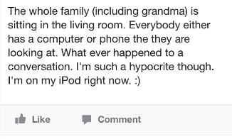
Facebook Post from My 13 Year-Old Niece

Slide 15
Use the STEP Process
Stop – Take a Breath
THINK – True, Helpful, Inspire confidence, Necessary, Kind
Empathize – Reflect on others
Post – If you have met the criteria above

Slide 16
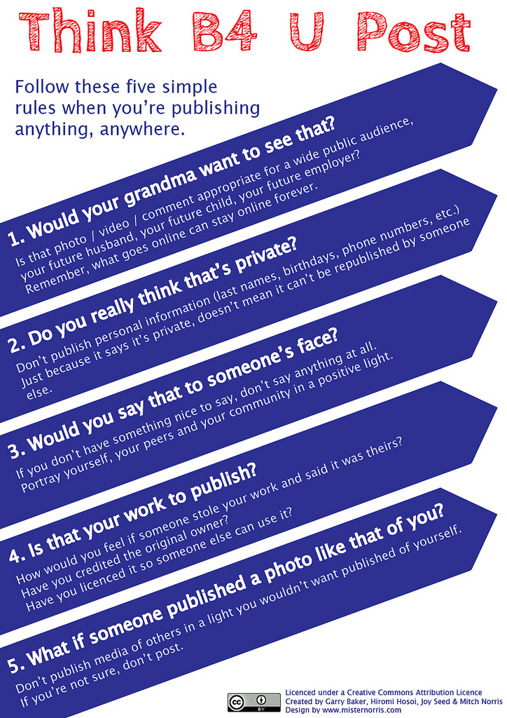

Slide 17
Universality of the Golden Rule
Confucius:
Aristotle:
Judaism:
Hinduism:
Islam:
Buddhism:
Christianity:
What you do not want done to yourself, do not do unto others.
We should behave to others as we wish others to behave to us.
What you dislike for yourself, do not do to anyone.
Do nothing to thy neighbor which thou wouldst not have him do to thee thereafter.
No one of you is a believer unless he loves for his brother what he loves for himself.
Hurt not others with that which pains thyself.
Do unto others as you would have them do unto you.

Slide 18
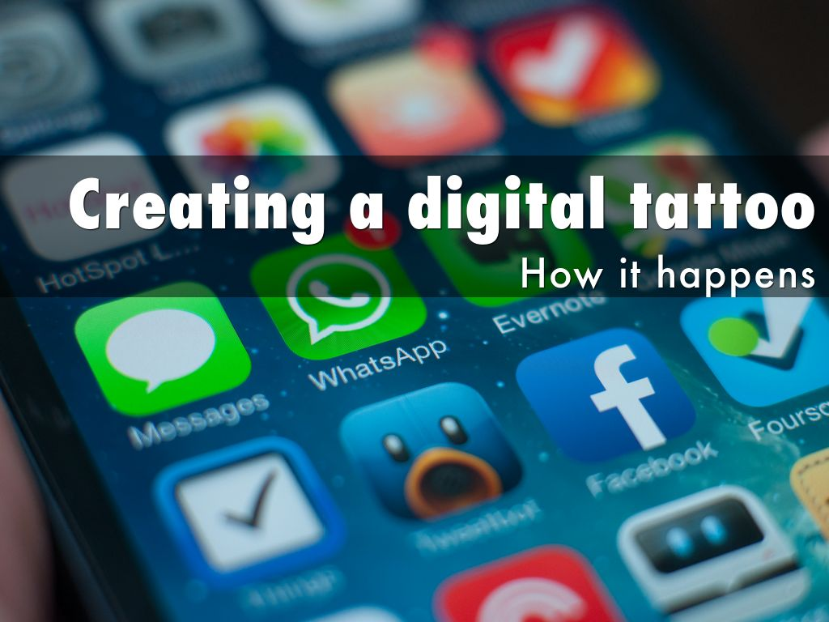
Photo by Jan Persiel - Creative Commons Attribution-ShareAlike License https://www.flickr.com/photos/65497194@N00
Created with Haiku Deck

Slide 19
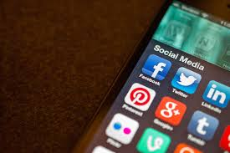






What Social Media Do Students Use?

Slide 20

http://www.lolomgbook.com/
1st Question – “Why are you online?, What is the reason to have a Twitter or Facebook account?”
2nd Question – “Is now the right time?”
3rd Question – “Where is your line between public and private?”

Slide 21

When Is The Right Time?
Can my child stay home alone, by themselves, for a few hours?
2. Can my child confidently speak to a stranger in public? Specifically: can my child civilly divert the interest of, and break verbal contact with, a stranger who speaks to them in public?
3. Does my child pass the Self Worth Test?
Begin by asking the person – in this case your child - to think of and
name three things they love to do and do very well.
From Peter Andrada
http://www.westcodesoft.com/2012/11/27/kids-can-also-be-taught-programming/

Slide 22
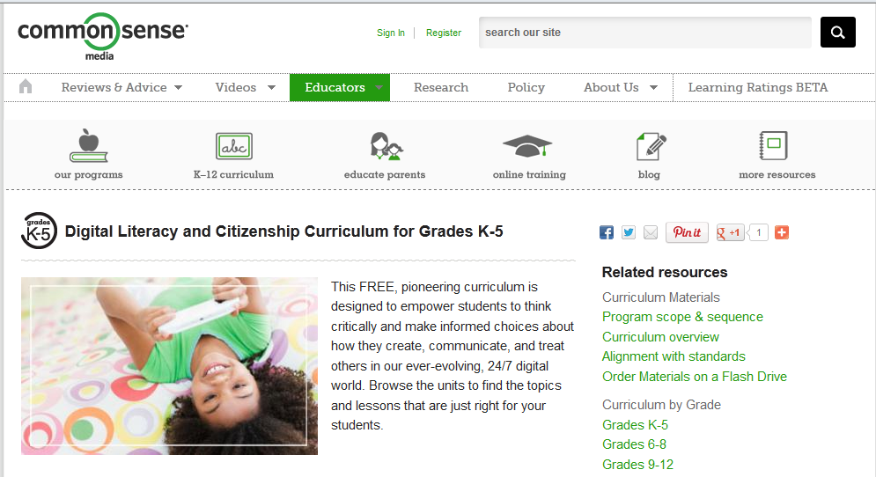

http://www.commonsensemedia.org/educators/curriculum/

Slide 24
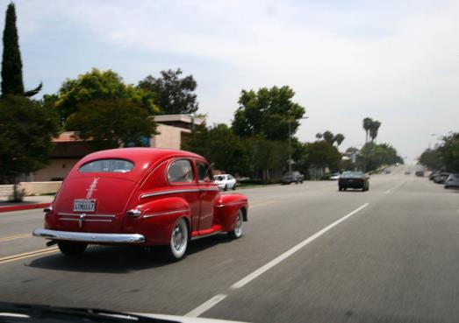
When looking at a Digital Citizenship Program it looks like a Driver’s Education course.
There are rules of the road (Acceptable Use Polices, laws, unwritten rules).
Users need to understand not just the rules but how the machinery operates.
We have to enforce the rules!
Image from www.fontplay.com

Slide 25

Parents must be involved. Are you including them in the discussion? How can they be partners in this process?
Image from http://www.ikeepsafe.org/wpcontent/uploads/2011/01/BAPResearchImage.png

Slide 26
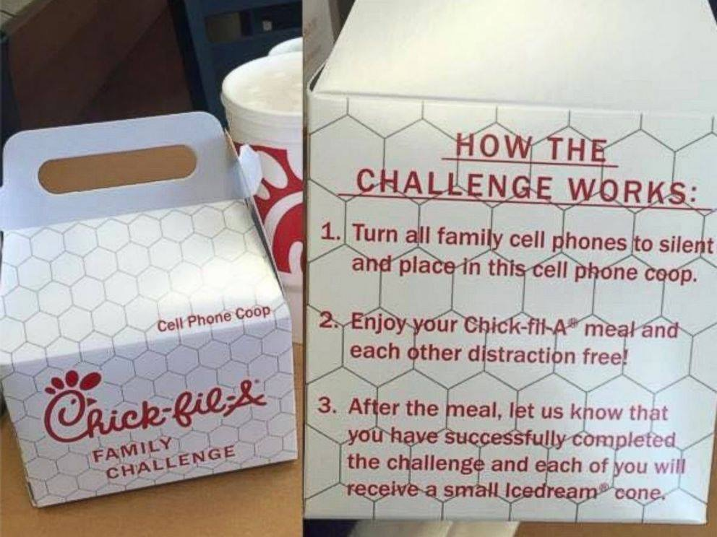

Slide 27
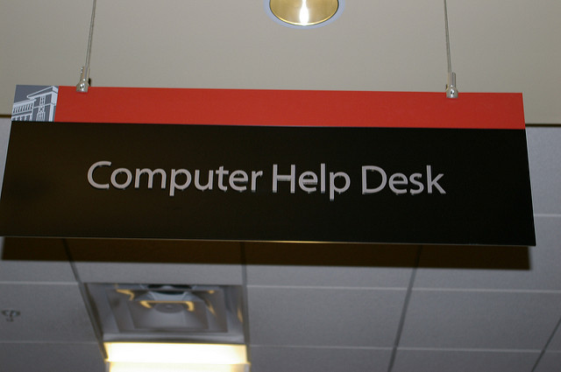
What is your Wish for Your Students?
My Hope is that they will be Safe, Savvy and Social when using these tools.

Slide 28

How Do You Eat an Elephant?
One Bite At a Time!!

Slide 29
Teach the children so it will not be necessary to teach the adults.
- Abraham Lincoln
If you think in terms of a year, plant a seed; if in terms of ten years, plant trees; if in terms of 100 years, teach the people
-Confucius

Slide 30
Thank You for the Opportunity
If you have questions directly for me please use either my website – www.digitalcitizenship.net (Contact Us) or Twitter @digcitizen

Slide 31
Abernethy, M. (February 3, 2014) Teen to face jury in facebook cyberbullying case.
From Times-News.
A Platform for Good (2014) Now is the perfect time to clean-up your digital
footprint. From
http://www.aplatformforgood.org/pages/clean-up-your-digital-footprint.
Retrieved on April 15, 2014.
Cable Impacts-formerly Cable in the Classroom (2014) Digital citizenship definition.
From http://www.ciconline.org/DigitalCitizenship. Retrieved on June 10,
2013.
Common Sense Media (2013) Digital citizenship curriculum videos. From
http://www.commonsensemedia.org/videos Retrieved on multiple dates.
Curran, M. (May 2014) iconstitution Retrieved from http://www.youtube.com/watch?v=sdFipCB1VQo&feature=youtu.be&app=d
esktop on May 30, 2014
Duggan, M. & Smith, A. (2013) Social media update 2013. From
http://www.pewinternet.org/2013/12/30/social-media-update-2013/.
Retrieved on January 10, 2014.
Ellis, R. (March 2, 2014) Teen charged with cyberbullying after posting ned photo of
15-year-old girl from CNN.com Retrieved on March 30, 2014
Haesler, D. (2012) Driving down social media way. From http://danhaesler.com/2012/10/02/driving-down-social-media-way/.
Retrieved on October 20, 2013.
Ivester, M. (2012) lol..omg. CreateSpace

Slide 32
Gautam, H. (October 2013) Social media explained as if it was donut. From
http://www.bloggodown.com/wp-content/uploads/2013/10/social-media
-explained-using-donuts.jpg. Retrieved on October 15, 2013.
Kleiner, Perkins, Caufield & Byers (May 2014) Screen minutes across countries
Retrieved from http://www.kpcb.com/internet-trends on May 30, 2014
Lodge, J. (November 11, 2013) Driven to distraction: bringing your own device to
school could hinder learning. From The Conversation. Retrieved on
November 15, 2013.
Ohler, J. (May 2014) jasonohler.com Retrieved from http://www.jasonOhler.com on
June 4, 2014
Singer, N. (November 9, 2013) They loved your g.p.a. then they saw your tweets.
From New York Times. Retrieved on November 10, 2013.
Sole, E. (November 2013) Women’s boston marathon bombing costume: What it says
about everyone From Shine. Retrieved on November 20, 2013.
Sole, E. (March 2014) Daughter’s facebook brag costs her family $80,000. From Shine.
Retrieved on April 1, 2014.
Tucker, R. (November 1, 2013) Selfies with a splash of serious safety issues. Retrieved
on November 2, 2013.
User Experiences Works (October 2011) A magazine is an ipad that does not work
Retrieved from http://www.youtube.com/watch?v=aXV-yaFmQNk on
September 10, 2013
Wallace, K. (October 16, 2013) Parents beware of bullying on sites you’ve never seen
from CNN.com Retrieved on October 18, 2013.
WeAreTeachers (2013) 10 smart ways to help kids be kind on social media. From
http://www.weareteachers.com/homepage. Retrieved on October 21, 2013.

