Slide 1
TDOE IT Updates
Steven Sanders, Director

Slide 2
2019-2020 IT Updates
Agenda
Student Information System (SIS) Contracts
Orion – Single Sign On (SSO)
TNShare – TDOE Information Sharing
Tennessee Education Data System (TEDS)
Assessment Updates

Slide 3
Student Information System Contracts
SIS Contract Topics
State Approved Contracts
Hosting
Participating Agreement (PA)
Task Order (TO)
Frequently Asked Questions

Slide 4
Student Information System Contracts
Why new contracts?
Max contract length met for previous contracts – 5 years
More rigorous technical requirements
Includes current state requirements for security and controls
Includes the new technologies needed for future systems
Clarifies roles and responsibilities

Slide 5
Student Information System Contracts
TDOE worked with our state procurement office to certify and contract with five SIS vendors for state reporting:
Edupoint Educational Services
Follett Schools Solutions
Infinite Campus, Inc.
PowerSchool Group LLC
Skyward, Inc.

Slide 6
Student Information System Contracts
Moving forward, all districts must use one of the state approved contracts:
Each district can choose state-hosting or vendor hosting
Both environments are secure and have proper controls in place.
State-hosting will be covered by the state and therefore free to districts.
If currently self-hosted, the district can be grandfathered in to remain self-hosted.

Slide 7
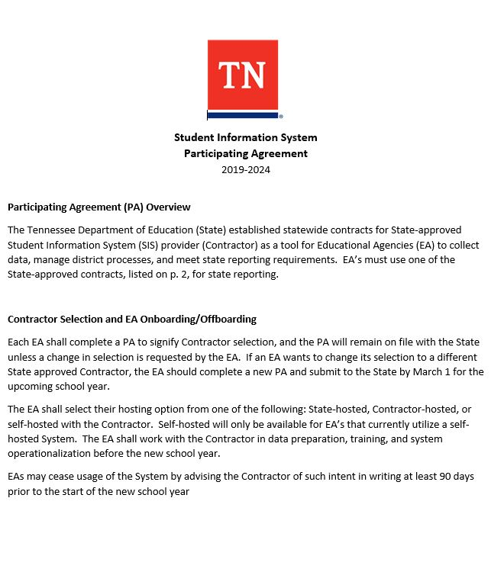
Student Information System Contracts
Participating Agreement (PA)
The PA is the form that districts complete to signify which SIS vendor and hosting option they will use.
PA is valid until a new one is submitted.

Slide 8
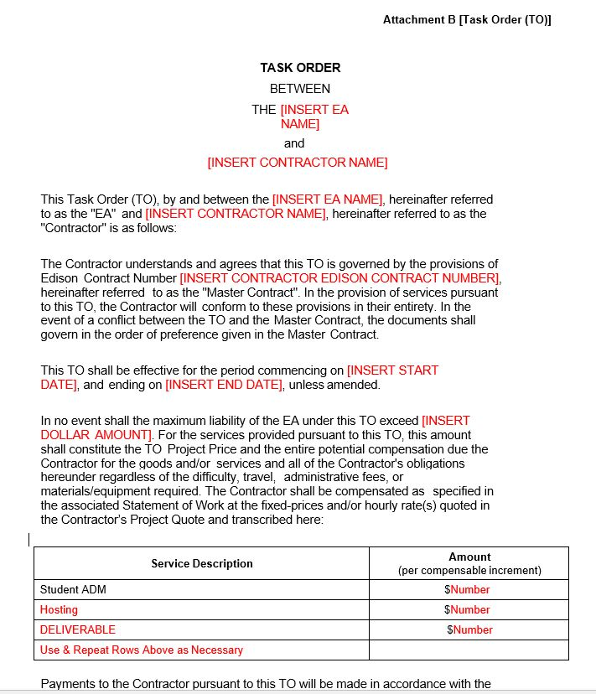
Student Information System Contracts
Task Order (TO)
The TO is the form that districts and vendors complete to specify and commit services.
Base-functionality
Related features

Slide 9
Student Information System Contracts
SIS Frequently Ask Questions
Q: What is the contract period for the new SIS contracts?
A: July 1, 2019 – June 30, 2024

Slide 10
Student Information System Contracts
SIS Frequently Ask Questions
Q: Are districts/Education Agencies (EAs) required to purchase their SIS for state reporting through one of the state-approved contracts?
A: Yes, for compliance with state reporting and to ensure all EAs are receiving the expected level of service, all EAs must purchase their SIS through one of the approved contracts.

Slide 11
Student Information System Contracts
SIS Frequently Ask Questions
Q: Can EAs choose if they want their SIS application to be State-hosted or vendor-hosted?
A: Yes, EAs can choose if they prefer State-hosted or vendor-hosted for their SIS solution and will need to mark this selection on the PA; however, vendor hosting will result in hosting charges from the SIS vendor.
Q: Can an EA self-host their SIS software?
A: If an EA is currently self-hosted, it may remain self-hosted. If the EA is not currently using a self-hosted model, self-hosting will not be an option.

Slide 12
Student Information System Contracts
SIS Frequently Ask Questions
Q: Can an EA change SIS contractors from one year to the next?
A: Yes. A district may change their current SIS vendor by completing a new PA and submitting to the State by March 1, preceding the new school year. The EA must also notify its current SIS vendor at least 90 days before the start of the new school year and work with both vendors on the transition plan.

Slide 13
Student Information System Contracts
SIS Frequently Ask Questions
Q: Can a vendor offer better pricing to a district than the price listed in the contract?
A: Yes, the ADM prices in the contract are maximum prices and the State encourages EAs to compare all features/functionality and to obtain specific best-pricing quotes if the EA is considering to move to a new SIS package.

Slide 14
Student Information System Contracts
SIS Frequently Ask Questions
Q: Can an EA add additional features and functionality that are not included in the base functionality of a product?
A: Per the terms of the contract, if an EA requires or wants additional functionality outside of the State contracts’ base functionality, an agreement can be reached between the EA and the Contractor by means of a Task Order, Statement of Work, or separate agreement.

Slide 15
Student Information System Contracts
More Questions?
We will be in the TDOE customer service room this morning for any specific questions.
District may also submit any questions to district.technology@tn.gov

Slide 16
Orion – Single Sign On (SSO)
Orion Topics
Platform changes last year
Recent platform stability
SSO usage
Provisioning
New features
Legacy EIS login page

Slide 17
Orion – Single Sign On (SSO)
Application History
Last year, application and platform change
Third party integration issues are resolved
Stable and robust for several months
Currently, about 5,000 users each morning
Load tested 40k concurrent users

Slide 18
Orion – Single Sign On (SSO)
Staff Provisioning Updates
Daily updates from EIS staff data
Spreadsheet updates for anyone not in EIS
After system testing and vendor certification, updates will be processed through EDFI 3.1 data

Slide 19
Orion – Single Sign On (SSO)
New Management Features
The SSO User Report is available for users that have an EIS Production security role of DST_AA.
The Login Detected column was recently added to the SSO User Report. This can be used to confirm that staff members have successfully logged into Orion.

Slide 20
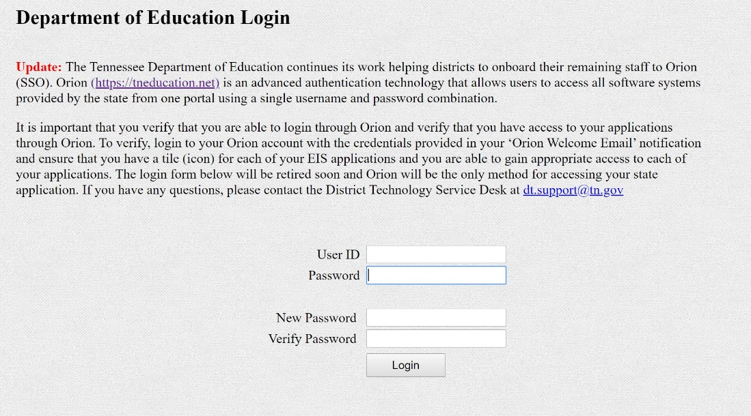
Orion – Single Sign On (SSO)
Department of Education Login or Legacy Login will be retired this year.
Make sure that all staff are using Orion.

Slide 21
TNShare
TNShare
TNShare is the Department of Education’s file sharing platform.
Director of Schools, Technology Directors, EIS Supervisors, and District Testing Coordinators have had access for the last 18 months.
We have now rolled TNShare out to all district staff.

Slide 22
TNShare
TNShare is built on Office 365 SharePoint and accessed through Orion.
Security roles are granted based upon staff classifications sent in by the SIS.
TNShare will start with limited features and additional features will be added over time.
For now, it will be a read-only file distribution system.

Slide 23
TNShare
Current user roles in TNShare
Director: all superintendents
District Administration: all district admins in a district
Principal: all principals in district
Teacher: all teachers in a district
District User: all users in a district

Slide 24
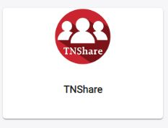
TNShare
Log into Orion and click on the TNShare tile

Slide 25
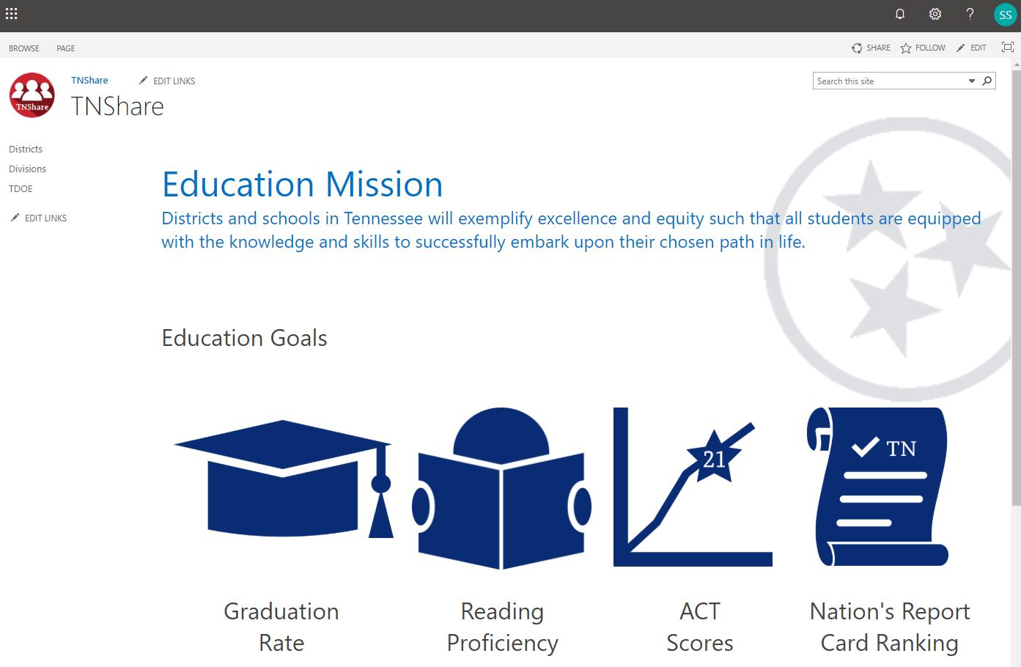
TNShare

Slide 26
Tennessee Education Data System (TEDS)
TEDS Topics
Development update
Testing timeline
Production timeline

Slide 27
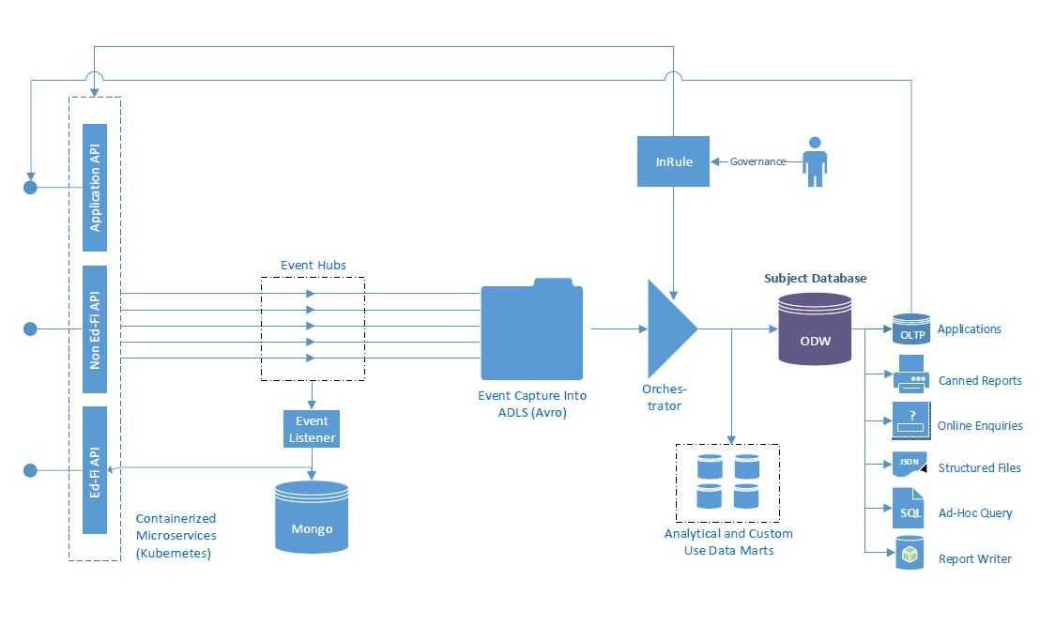
Tennessee Education Data System (TEDS)
Development is going well
Architecture design is finalized

Slide 28
Tennessee Education Data System (TEDS)
TEDS Testing
We are currently testing data flows with the SIS vendors
The data from SIS will follow the TN EDFI 3.1 model
SIS vendors will go through a certification process

Slide 29
Tennessee Education Data System (TEDS)
TEDS Testing
Development and testing continues for the error reporting portal
It is important for districts to provide complete data for staff and students – this data will be used by the EduID system for creating the records

Slide 30
Tennessee Education Data System (TEDS)
TEDS Timeline
2019-2020 – Alpha testing with SIS vendors
2020-2021 – Beta testing with districts
2021-2022 – Parallel running with EIS
2022-2023 – TEDS moves to production, Retire EIS

Slide 31
Tennessee Education Data System (TEDS)
Thank you!
steven.sanders@tn.gov
district.technology@tn.gov

